Slide 1
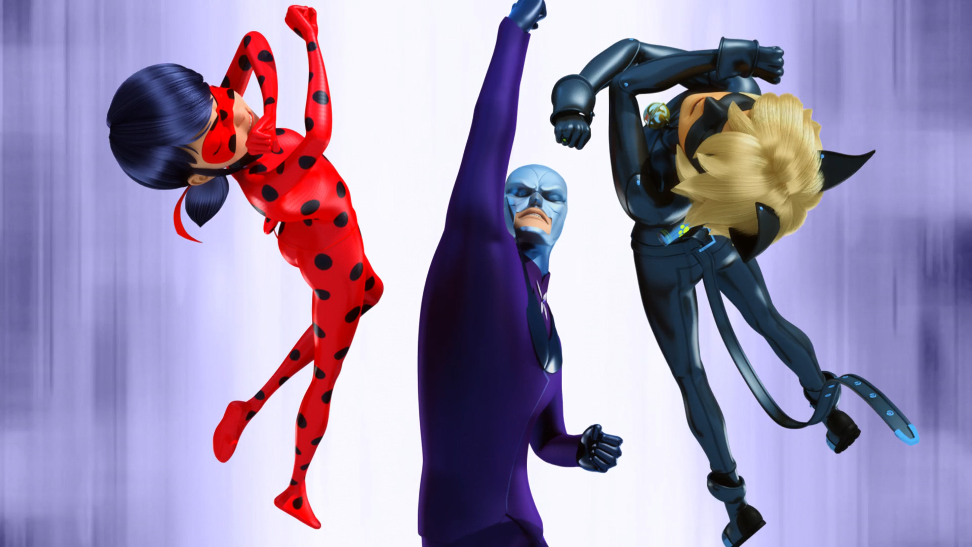
MIRACULOUS LADYBUG: HEROS DAY 2. PART 2

Slide 2
VOCABULARY
catalyst - 催化剂 - kætᵊlɪst
coward - 懦夫 - kaʊəd
despair - 绝望 - dɪˈspeə
detour - 绕道 - diːtɔː
knave - 流氓 - neɪv
peacock - 孔雀 - piːkɒk
revolution - 革命 - rɛvəˈluːʃᵊn
survive - 生存 - səˈvaɪv

Slide 3
1. 懦夫
2. 孔雀
3. səˈvaɪv

Slide 4
1. 懦夫 - coward
2. 孔雀 - peacock
3. səˈvaɪv - survive

Slide 5
HEROS DAY 2. PART 2
Cat Noir: Any miraculous ideas, M'lady?
Ladybug: Besides running and surviving you mean?
Nora: Parisians, we can be heroes just for one day!
Gina: Are you okay?
Marlena: It's awesome seeing you guys again!
Gina: Parisians are all on your side.

Slide 6
Cat Noir: People are amazing!
Ladybug: That's precisely why you should never give up hope, kitty!
Scarlet Moth: They're more resistant than
I expected.
Catalyst: But we still have the last phase of our plan.
Ladybug: Take care of the ice cream man, Cat Noir!

Slide 7
Catalyst: The time has come! You are about to triumph at last.
Ladybug: It's not too late. You can fight for good, with us.
Scarlet Moth: No!
Ladybug: You're such a coward, Hawk Moth!
Cat Noir: But there's no hiding this time!
Hawk Moth: No!
Catalyst: No! Argh! Ah!

Slide 8
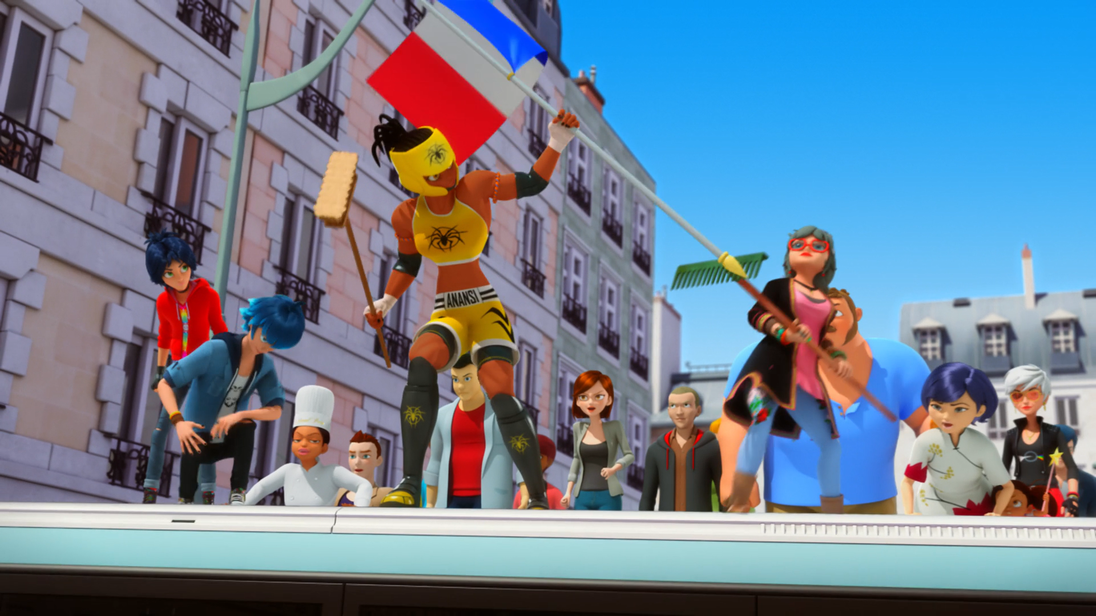

Parisians, we can be ______ just for one day!
rich
students
heroes

Slide 9
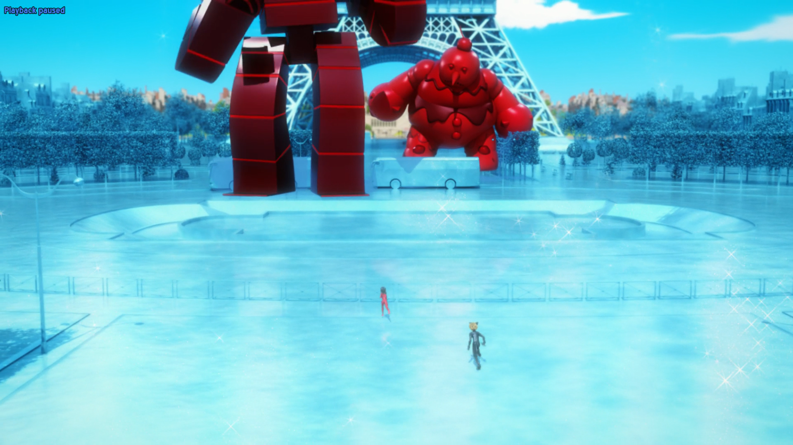
With pleasure! All this fighting has made me ______.
hungry
sexy
tired

Slide 10
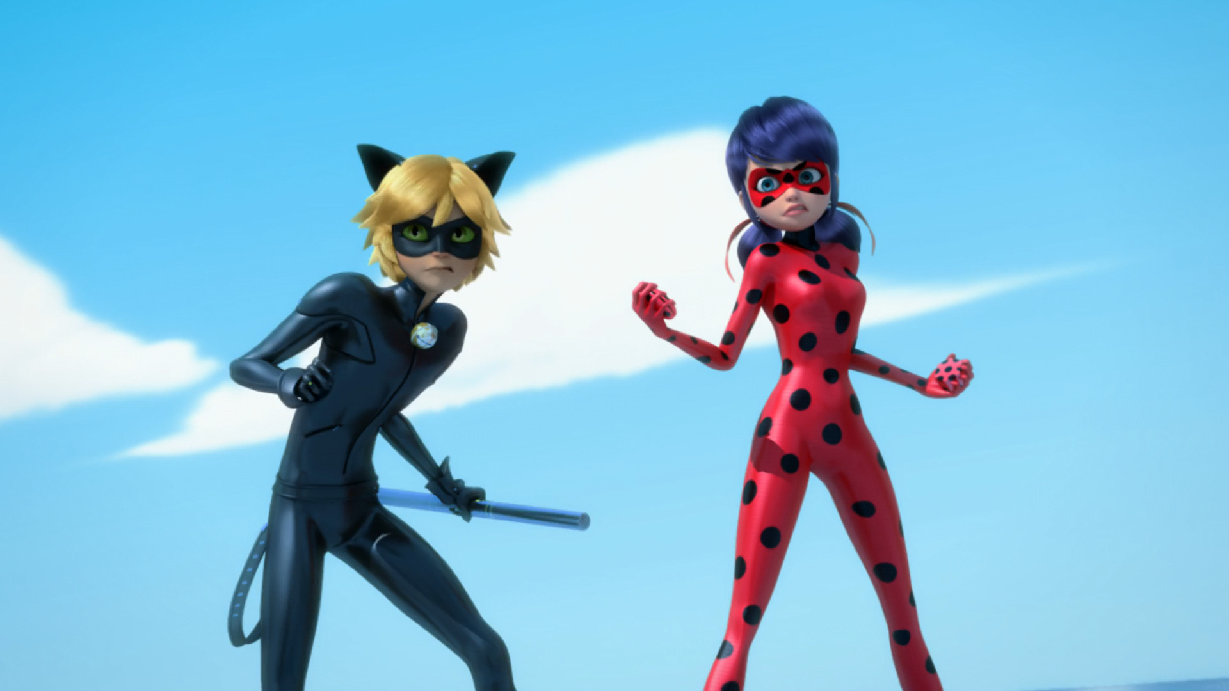
You're such a ______, Hawk Moth!
pig
coward
idiot

Slide 11
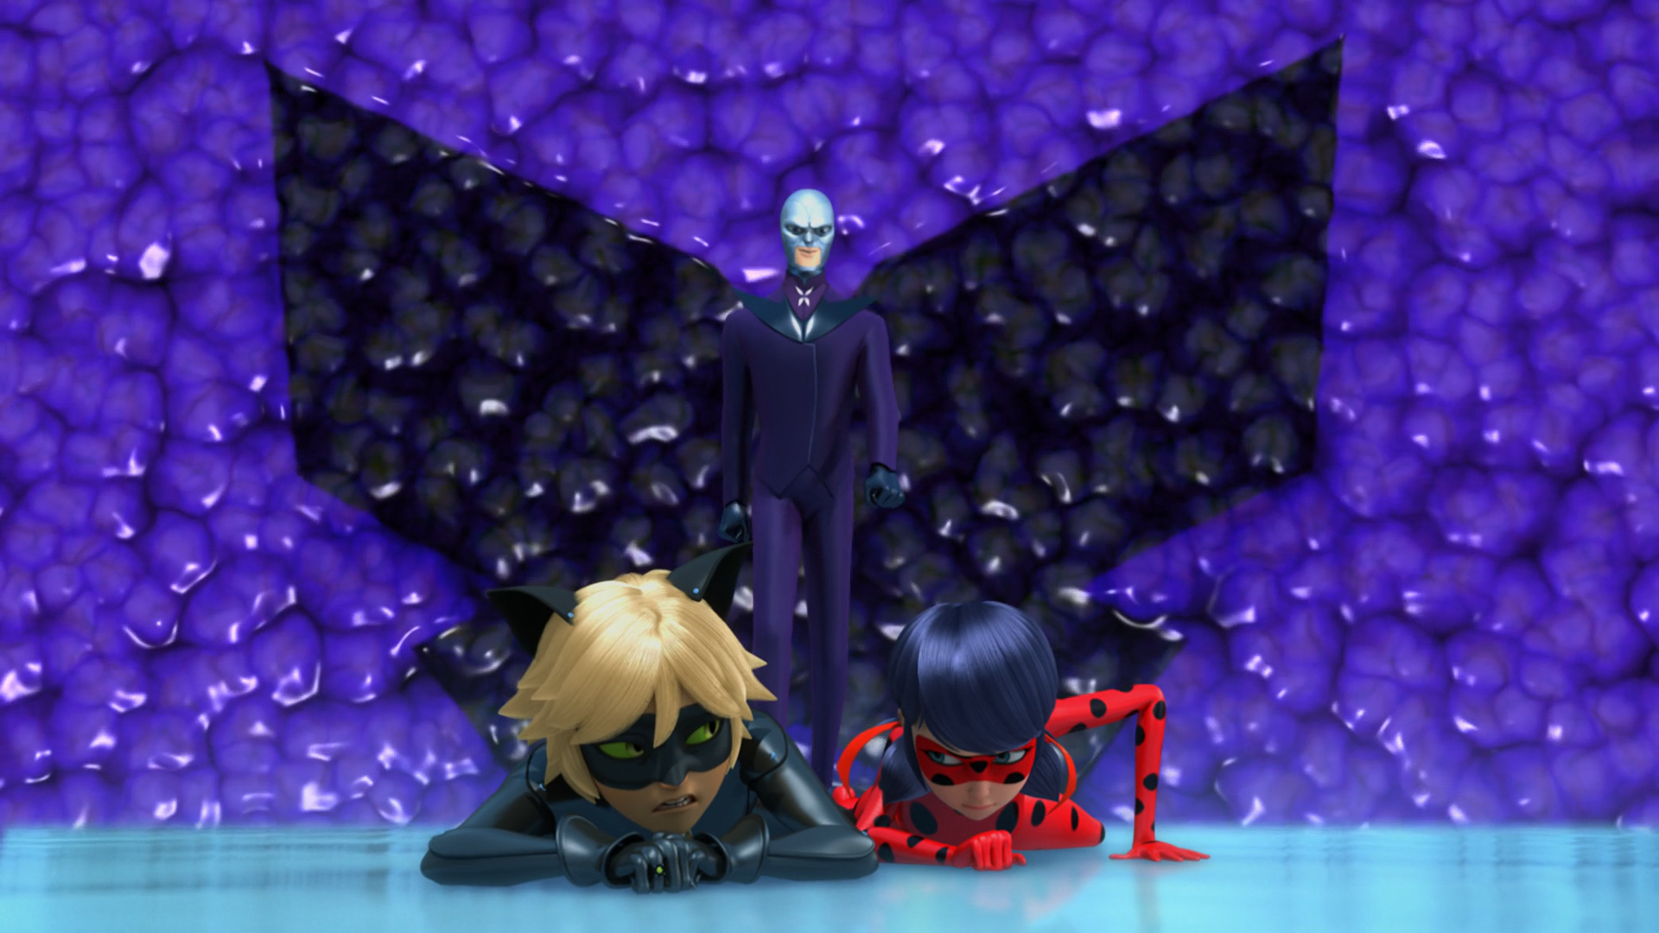
You can't even stay ______ after you've used your powers.
superheroes
transformed
still

Slide 12
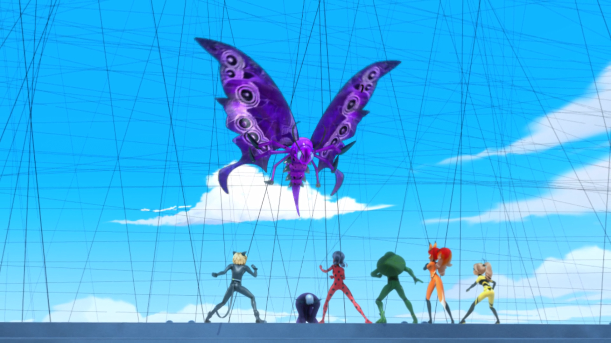
What is that ______!
insect
butterfly
monster

Slide 13
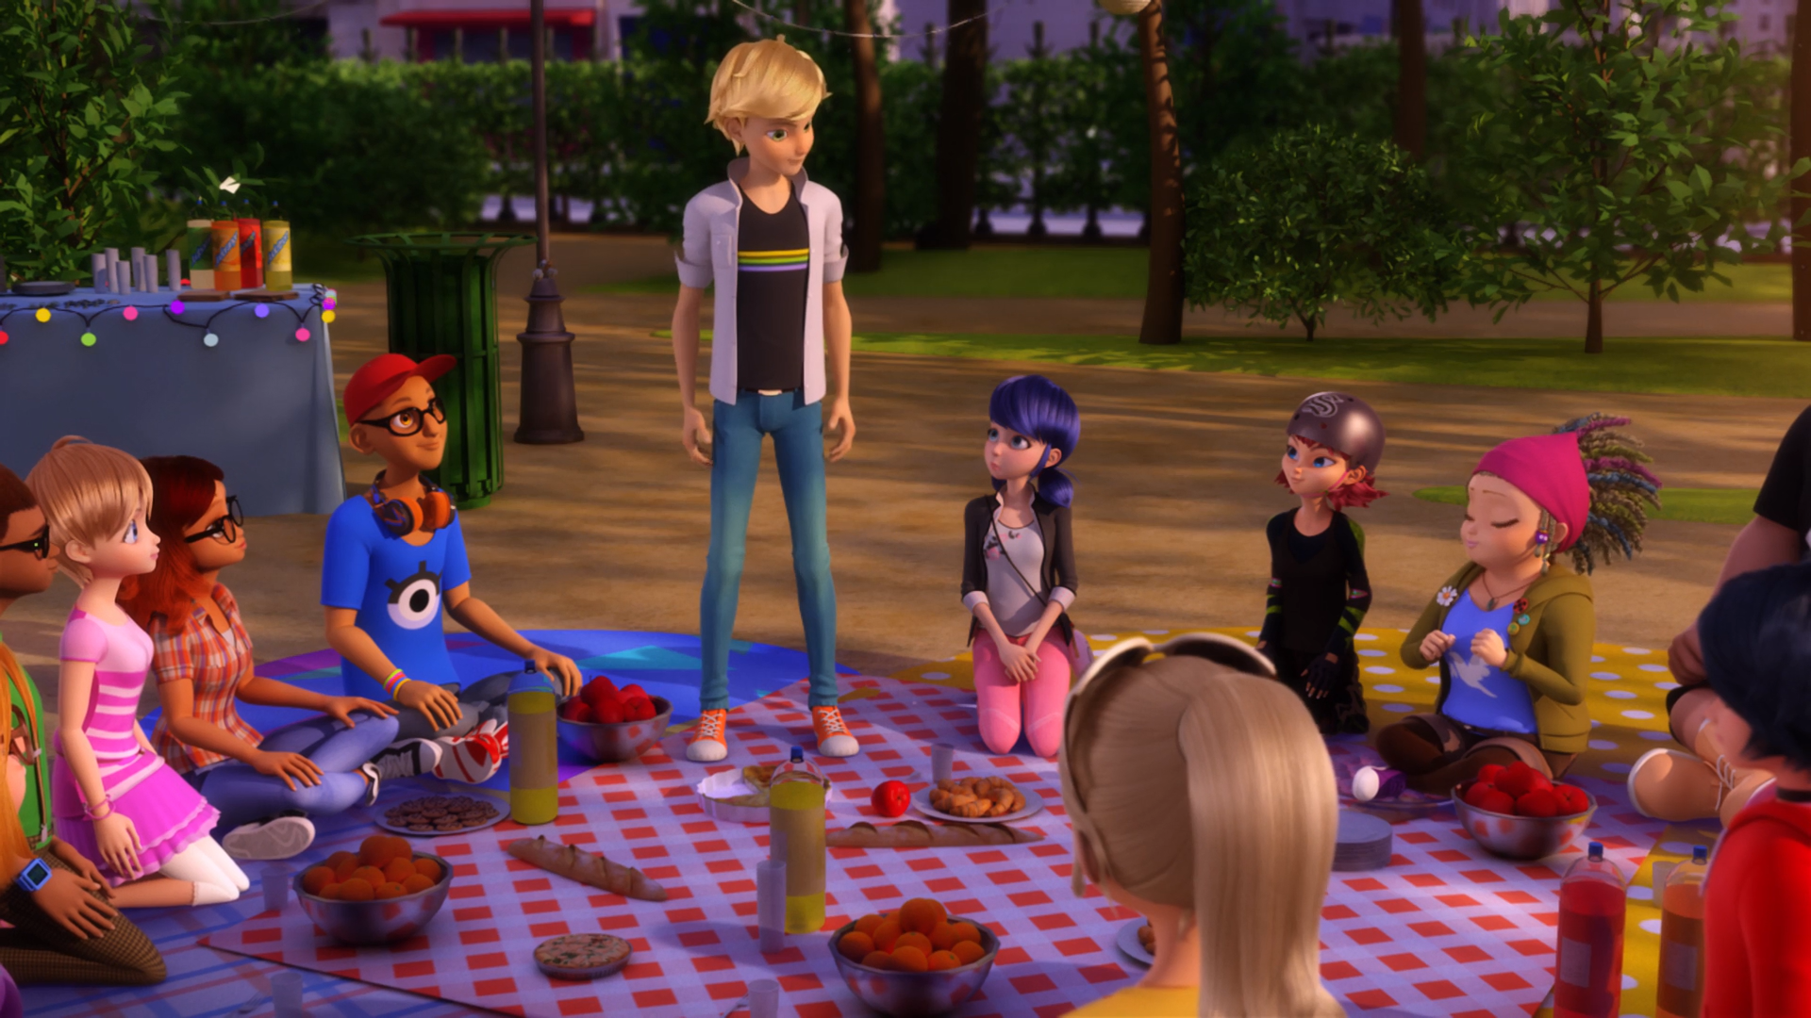
You helped me get to the movies so that I could see my ______.
mother
grandma
dog

Slide 14
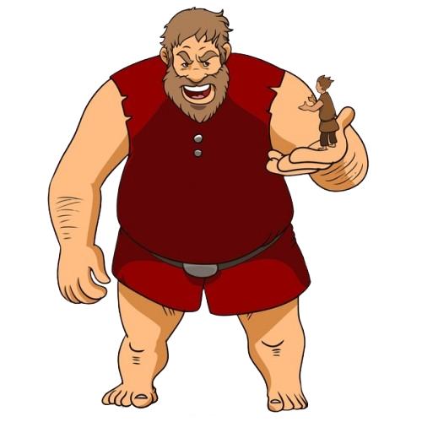
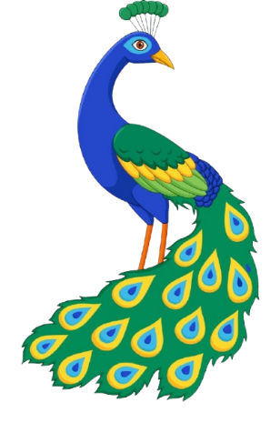
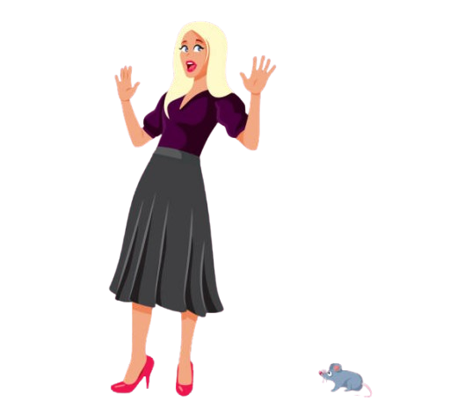

Matching Exercise
peacock | detour | giant | cowardly

Slide 15
Matching Exercise
giant | peacock | cowardly | detour

Slide 16
TRUE OR FALSE
1. The giant baby plays with a car.
2. Cat Noir breaks Hawk Moth's cane.
3. A giant bird blows away the heroes.
4. Using the Peacock Miraculous is dangerous.
5. The students have a barbecue.

Slide 17
TRUE OR FALSE
1. The giant baby plays with a car. | TRUE
2. Cat Noir breaks Hawk Moth's cane. | TRUE
3. A giant bird blows away the heroes. | FALSE
4. Using the Peacock Miraculous is dangerous. | TRUE
5. The students have a barbecue. | FALSE

