Slide 1
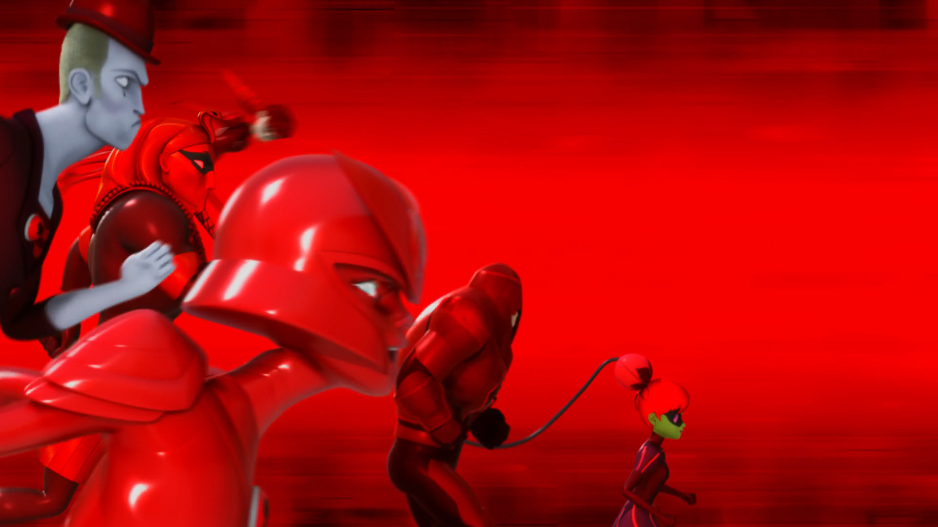
MIRACULOUS LADYBUG: HEROS DAY 2. PART 1

Slide 2
VOCABULARY
bemused - 困惑 - bɪˈmjuːzd
cane - 手杖 - keɪn
delightful - 令人愉快的 - dɪˈlaɪtfᵊl
lousy - 糟糕的 - laʊzi
objective - 客观的 - əbˈʤɛktɪv
pendant - 吊坠 - pɛndᵊnt
scarlet - 猩红色的 - skɑːlət
victim - 受害者 - vɪktɪm

Slide 3
1. bɪˈmjuːzd
2. 猩红色的
3. 受害者

Slide 4
1. bɪˈmjuːzd - bemused
2. 猩红色的 - scarlet
3. 受害者 - victim

Slide 5
HEROS DAY 2. PART 1
Cat Noir: Penny for your thoughts, M'lady?
Ladybug: It's like he's been preparing for this for a long time. But we...we're not prepared for this.
Cat Noir: Yes, we are! We've already fought them all and we won! And there are five of us this time!

Slide 6
André: Audrey, my darling. Where's our Chloé?
Audrey: Out playing superheroes again probably.
André: Chloé shouldn't be playing the superheroine!
Audrey: It's unacceptable! Utterly unacceptable!
Butler Jean: She will have to be punished.

Slide 7
Rena Rouge: You are not cut out to be a hero! Let go of me, you weakling!
Carapace: Shh. Easy.
Queen Bee: You don't have to worry about me, Ladybug! I'll never let my emotions get the better of me!
Scarlet Moth: You should never say... "never".
Style Queen & Malediktator: Chloé!
Queen Bee: Daddy? Mommy?!

Slide 8
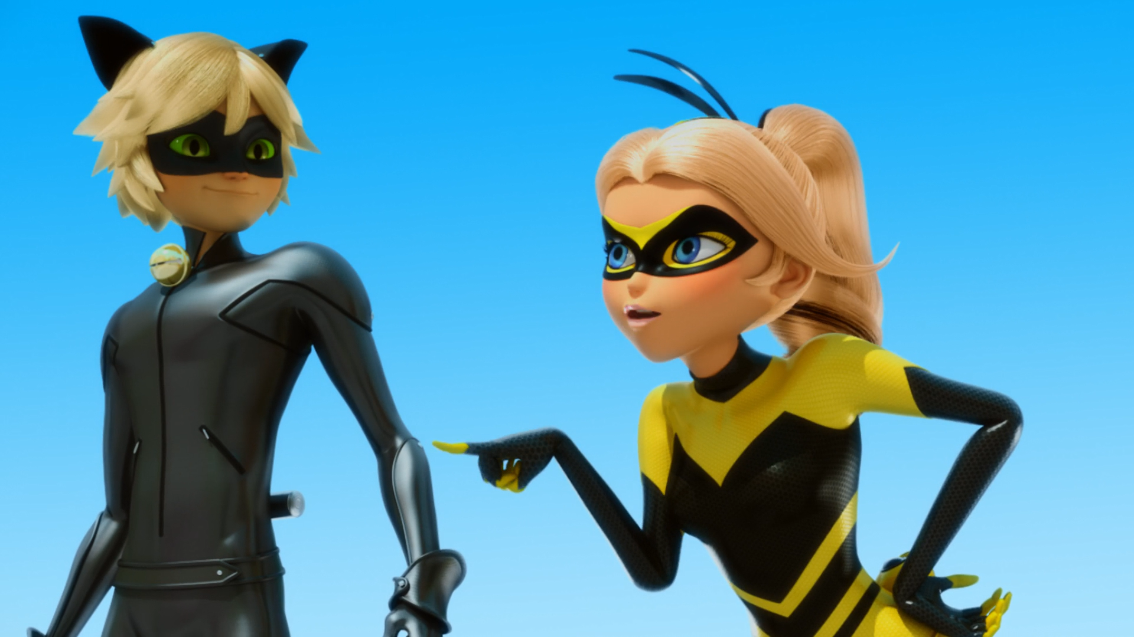

You're going to wish you never wore that utterly ridiculous ______.
hat
ootd
costume

Slide 9
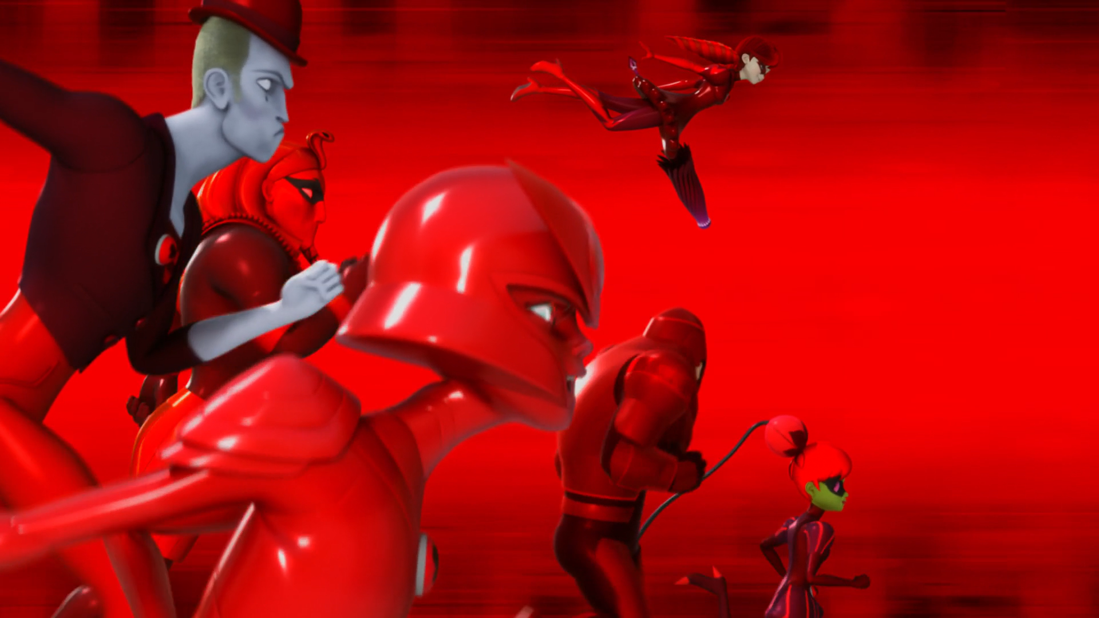
The ______ army is on its way.
scarlet
red
pink

Slide 10
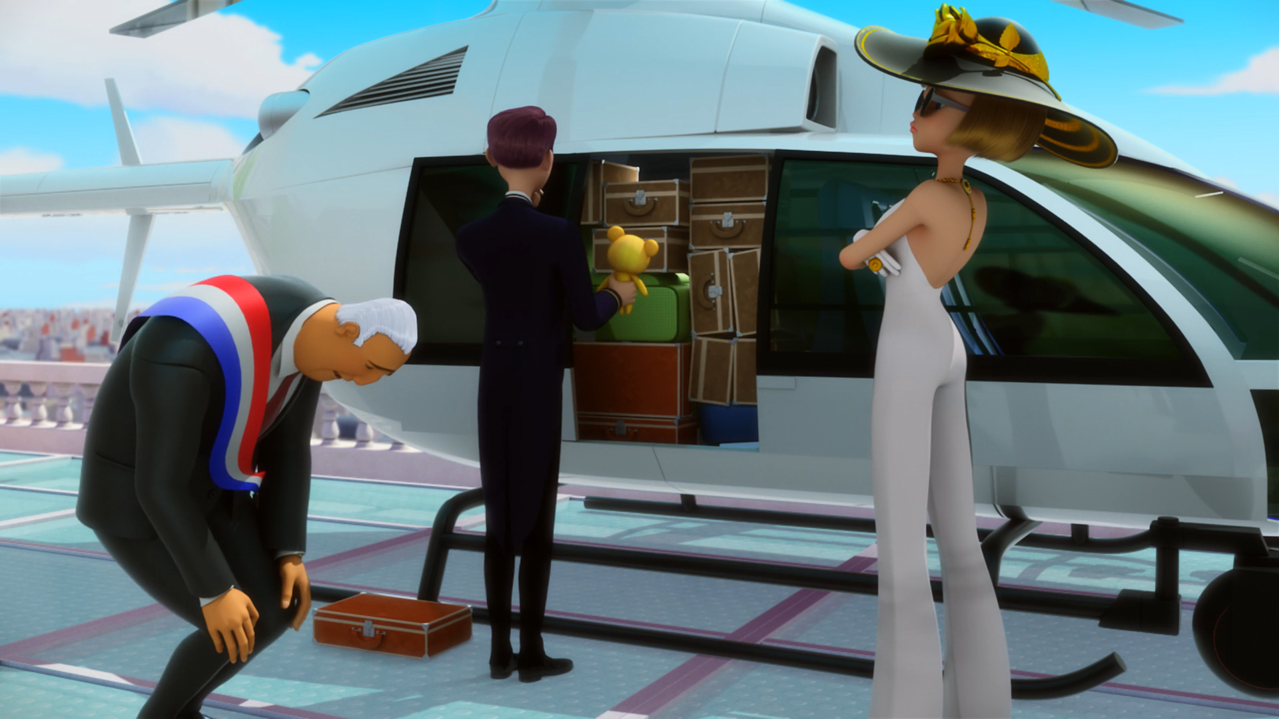
I will supervise Paris' defence... from my ______!
airplane
helicopter
drone

Slide 11
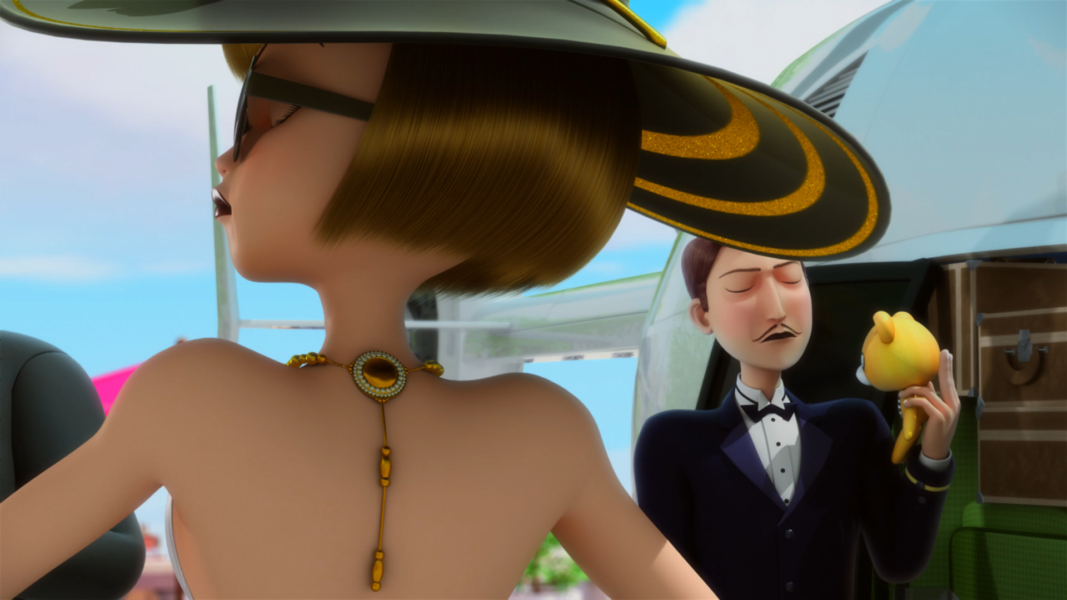
______ will have to be punished.
Mama
Mademoiselle
Mia

Slide 12
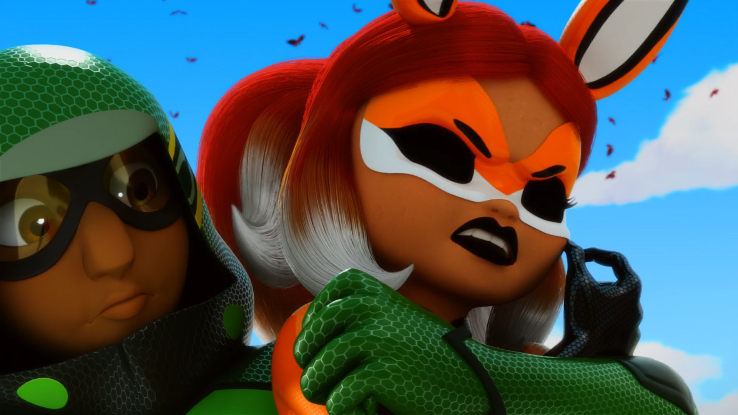
Let go of me, you ______!
idiot
gay
weakling

Slide 13
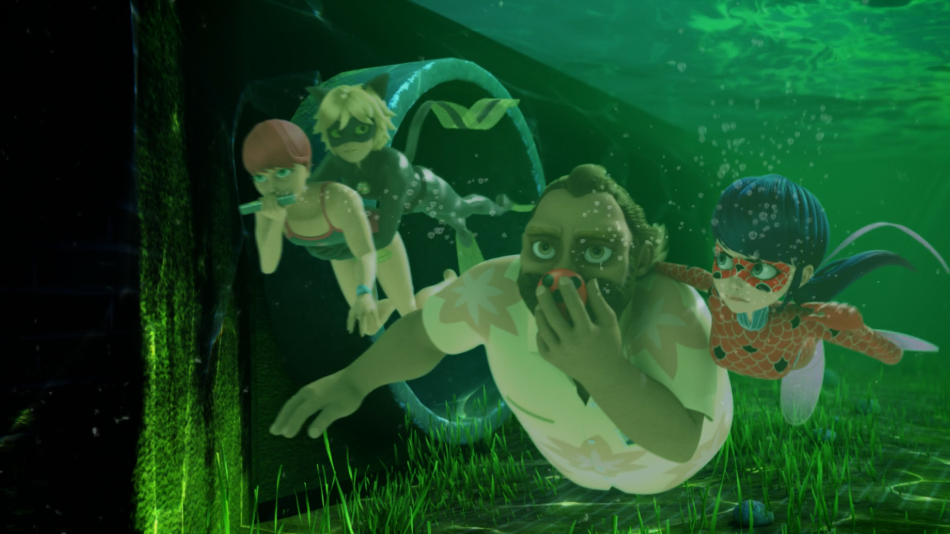
He's using his ______ to
re-akumatize his victims.
cane
walking stick
kwami

Slide 14



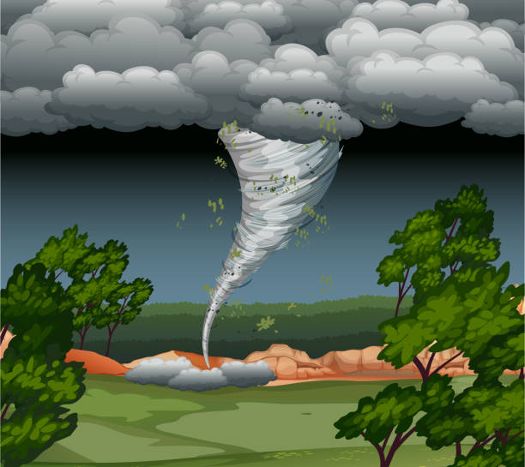
Matching Exercise
sword | cyclone | macaroon | cane

Slide 15
Matching Exercise
cane | macaroon | sword | cyclone

Slide 16
TRUE OR FALSE
1. Queen Bee love's Scarlet Moth's costume.
2. Audrey is trying to leave Paris in a helicopter.
3. Cat Noir & Ladybug escape down the sewers.
4. Tikki eats cheese.
5. Aquabug catches a fish.

Slide 17
TRUE OR FALSE
1. Queen Bee love's Scarlet Moth's costume. | FALSE
2. Audrey is trying to leave Paris in a helicopter. | TRUE
3. Cat Noir & Ladybug escape down the sewers. | TRUE
4. Tikki eats cheese. | FALSE
5. Aquabug catches a fish. | TRUE

