Slide 1
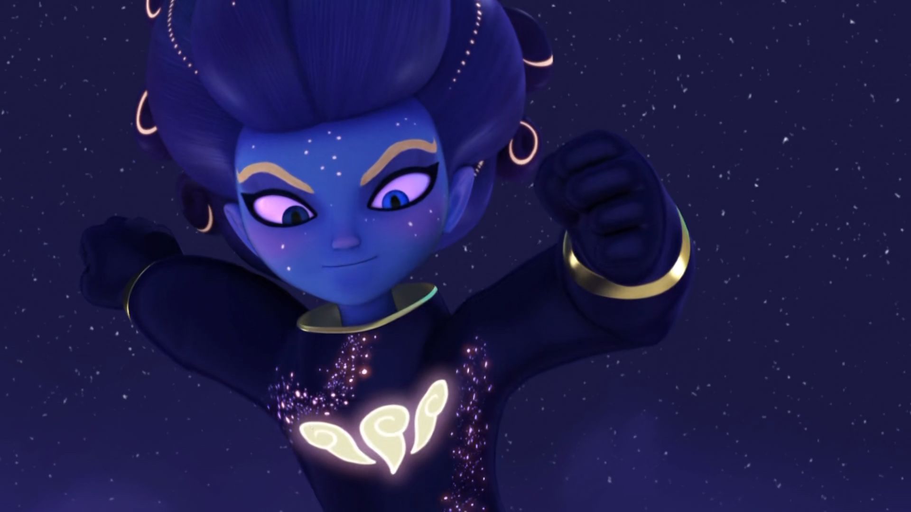
MIRACULOUS LADYBUG: SANDBOY. PART 2

Slide 2
VOCABULARY
daydream - 白日梦 - deɪˌdriːm
downfall - 垮台 - daʊnfɔːl
fault - 错误 - fɔːlt
power - 力量 - paʊə
purpose - 目的 - pɜːpəs
scare - 恐惧 - skeə
slave - 奴隶 - sleɪv
weird - 奇怪 - wɪəd

Slide 3
1. 错误
2. 恐惧
3. wɪəd

Slide 4
1. 错误 - fault
2. 恐惧 - scare
3. wɪəd - weird

Slide 5
SANDBOY. PART 2
Marinette: Adrien?
Nightmare Adrien: I'm in love with a girl and her name is Chloé!
Marinette: What kind of a nightmare is this? He must be bringing nightmares to life.
Nightmare Adrien: One day, Chloé and I will have a house together and we'll have a hamster named Marinette.

Slide 6
Hawk Moth: A-ha! It's me who's going to find you, little kwamis! And I will make you my slaves, just like Nooroo!
Fluff: His will is so powerful!
Barkk: We must cut off all communication! Hawk Moth is trying to track us down!
Wayzz: Hey, wait. The reason we can't speak to Nooroo is because he's powering Hawk Moth right now.

Slide 7
Plagg: Thank you Adrien!
Adrien: Plagg! Something wrong?
Plagg: No… Just… Thanks for letting me do whatever I want. Almost all the time.
Adrien: I know what it's like to have your freedom restricted, Plagg. You don't need to pretend to be a sock.
Plagg: You're the best Cat Noir I've ever had, Adrien!

Slide 8
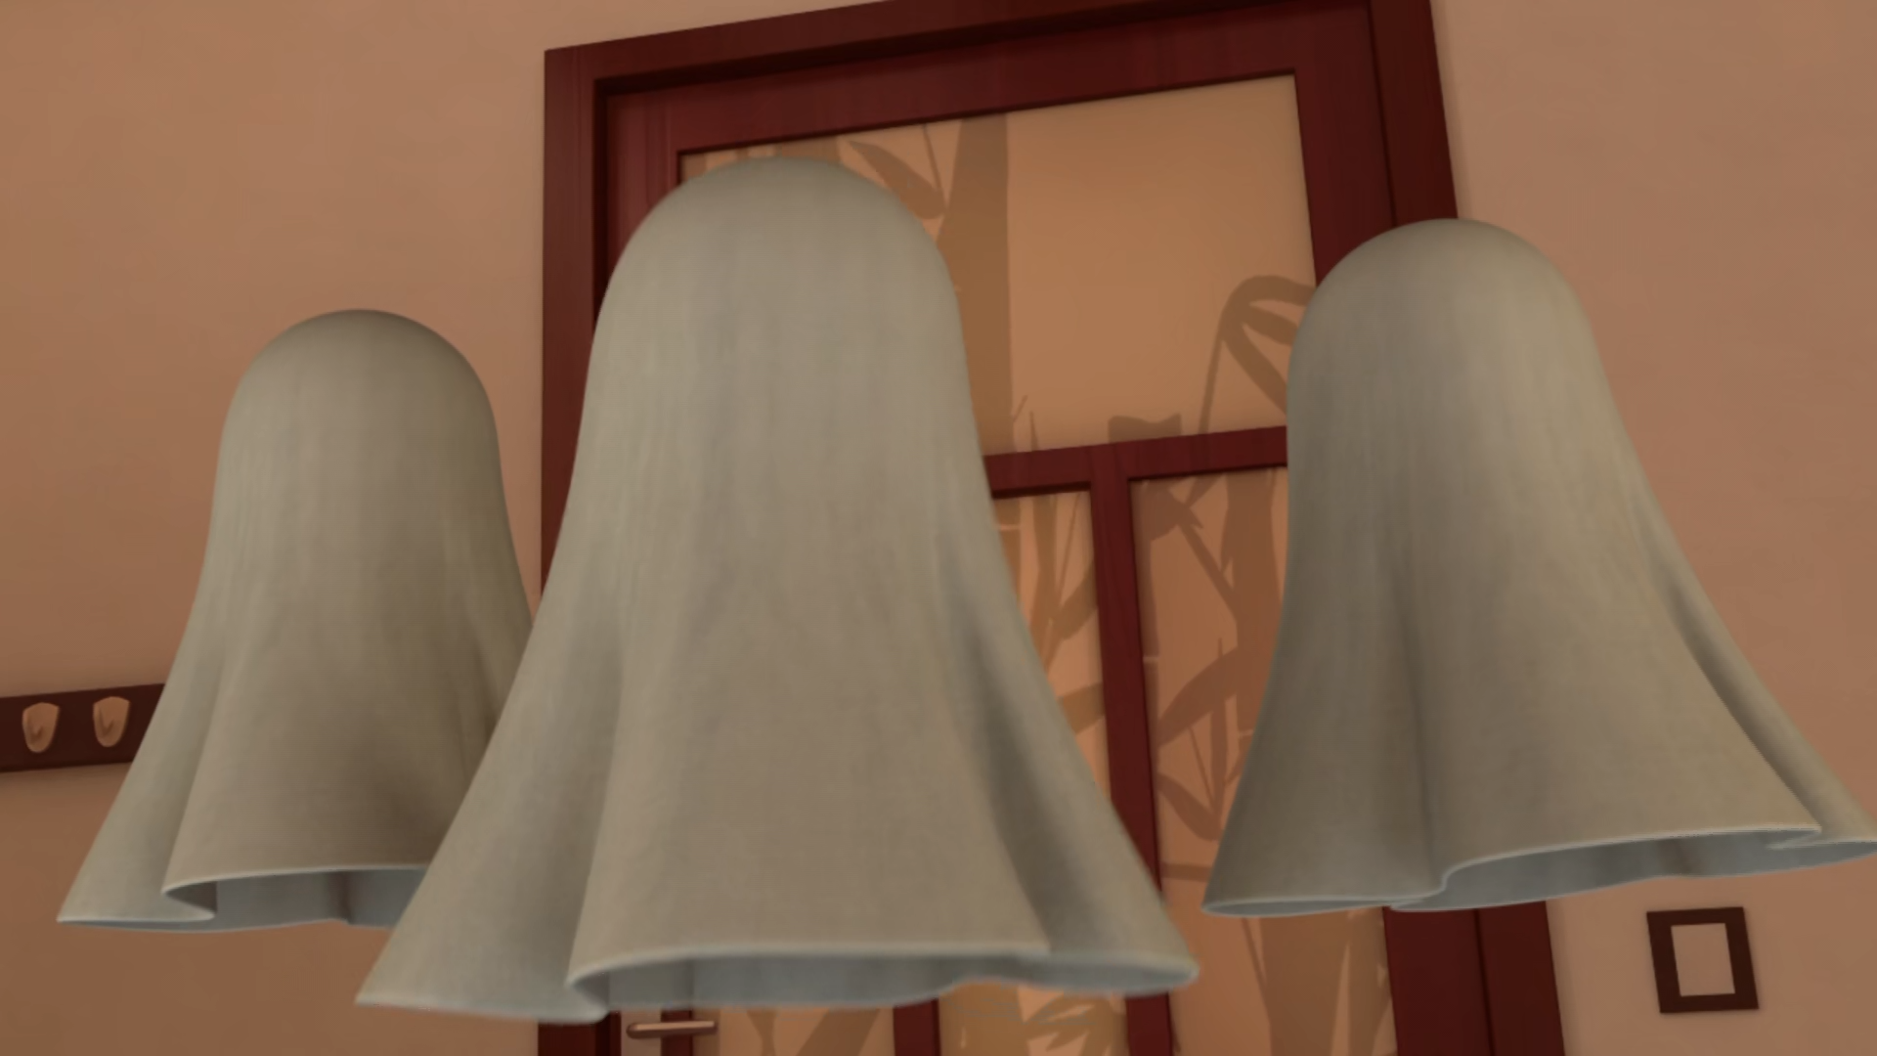
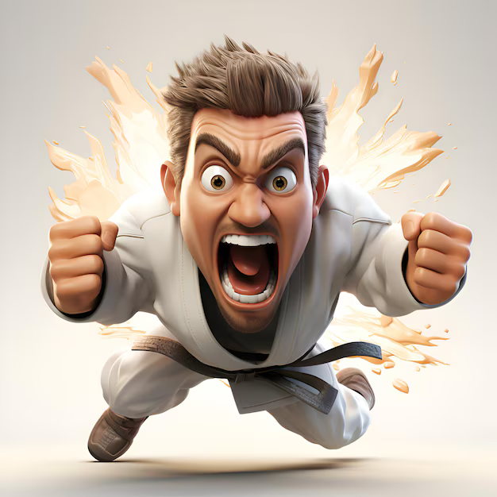
Fu! We are the ______ of The Order of The Guardians of The Miraculous.
spirits
demons
ghosts

Slide 9
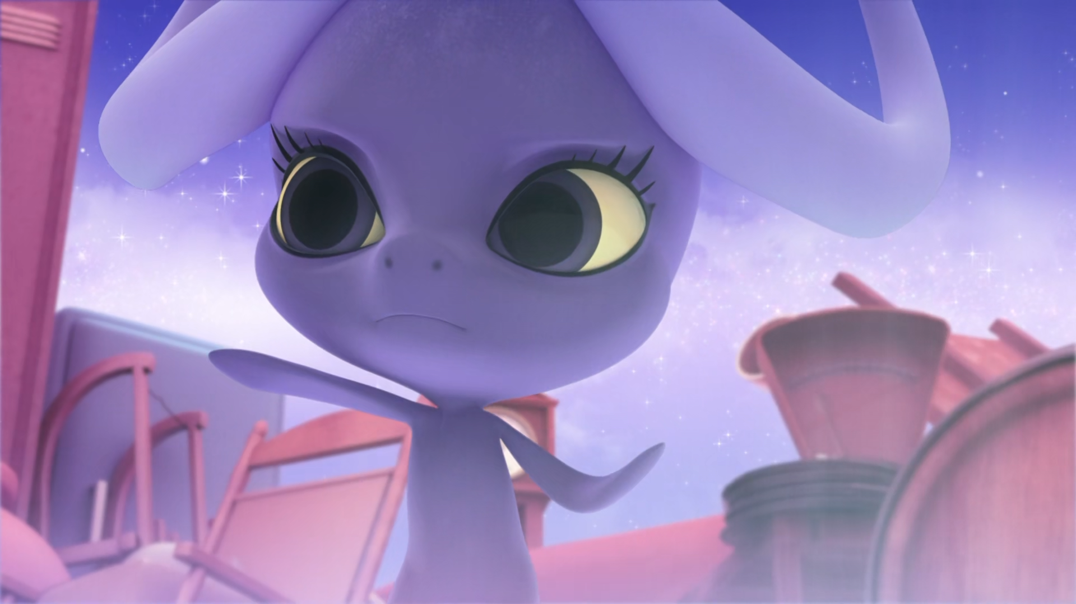
Keep ______! We must try to find out where he's hiding!
singing
chanting
texting

Slide 10
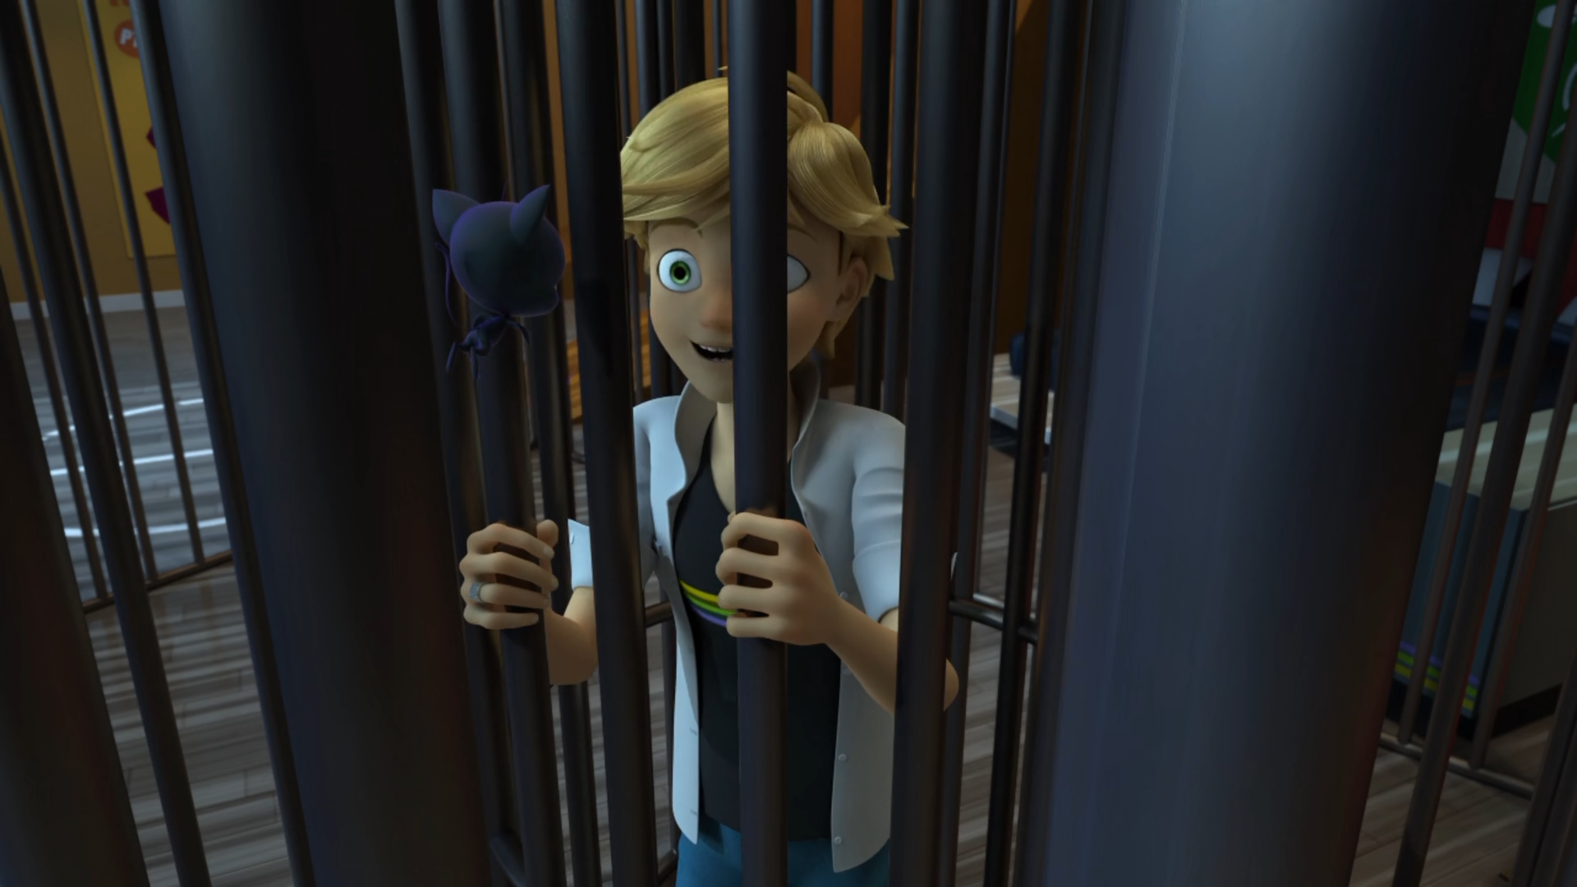
I'm so relieved you're not a ______, but you better have a good excuse.
shoe
sock
scarf

Slide 11
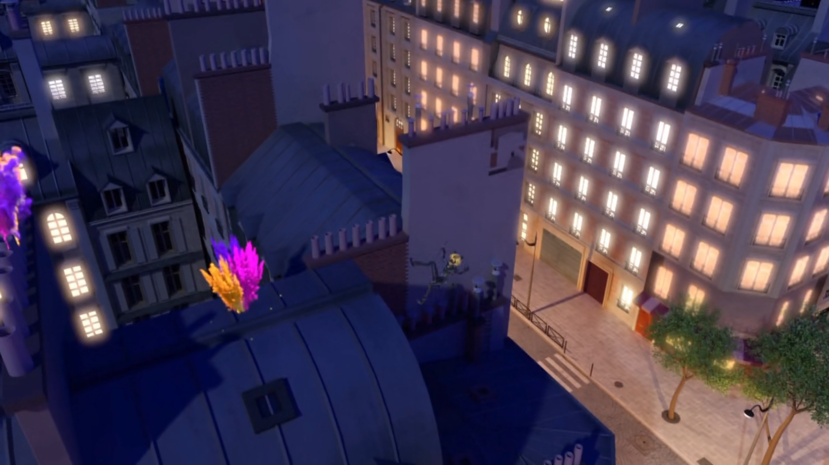
And his evil ______ is blowing everywhere.
grandma
sand
glitter

Slide 12
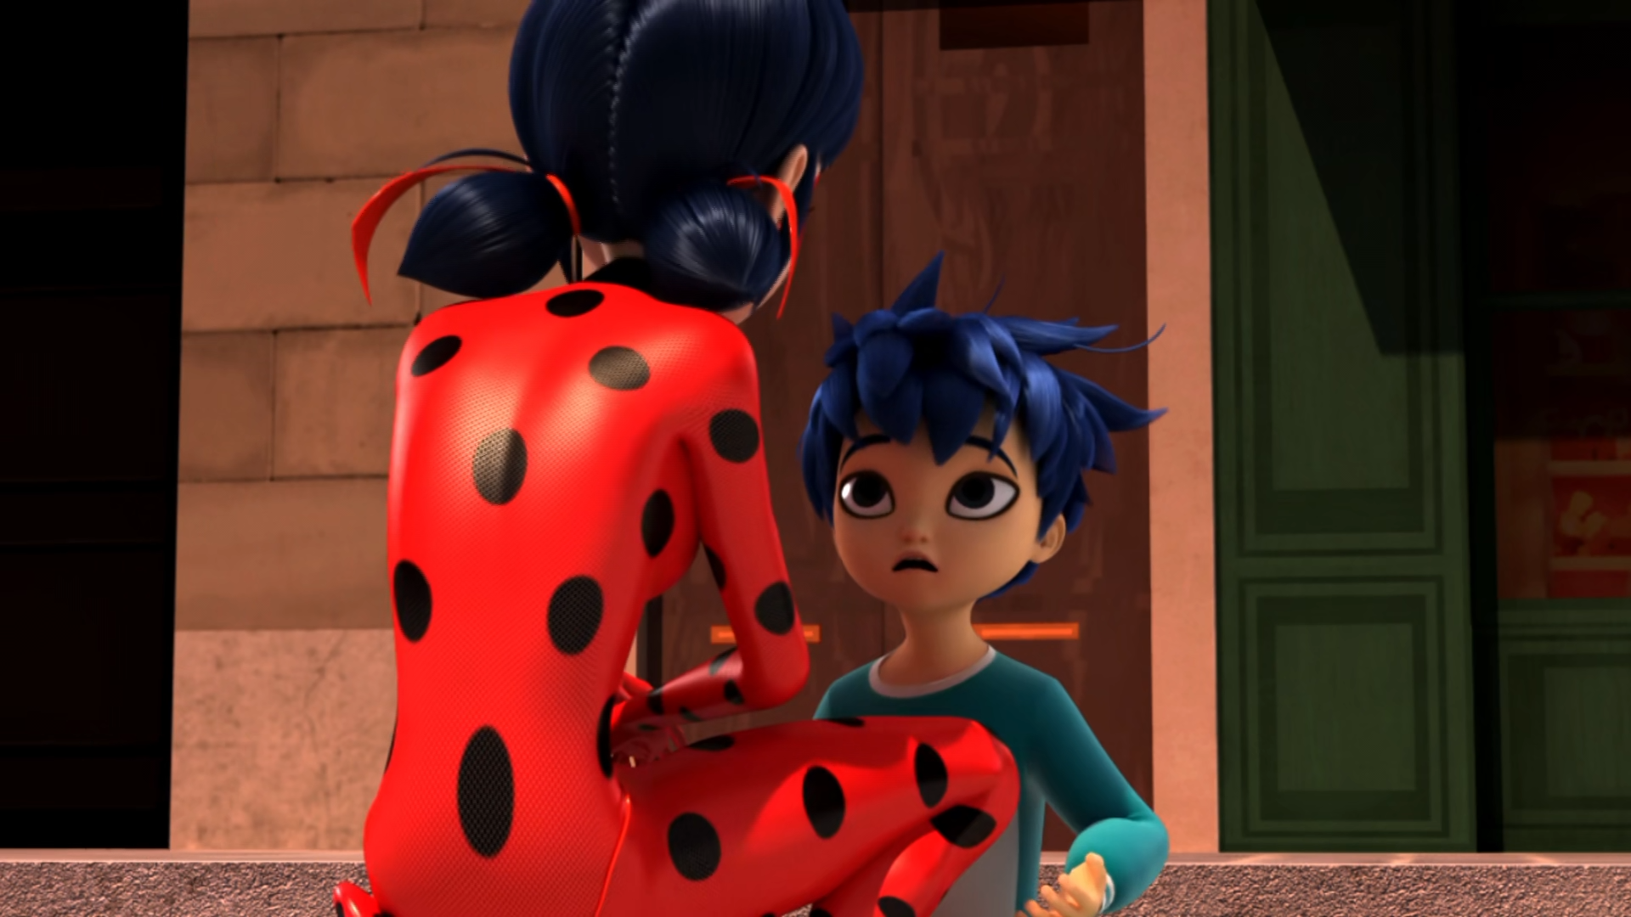
Oh, Ladybug. I watched a movie on TV. It was kinda ______.
funny
cool
scary

Slide 13
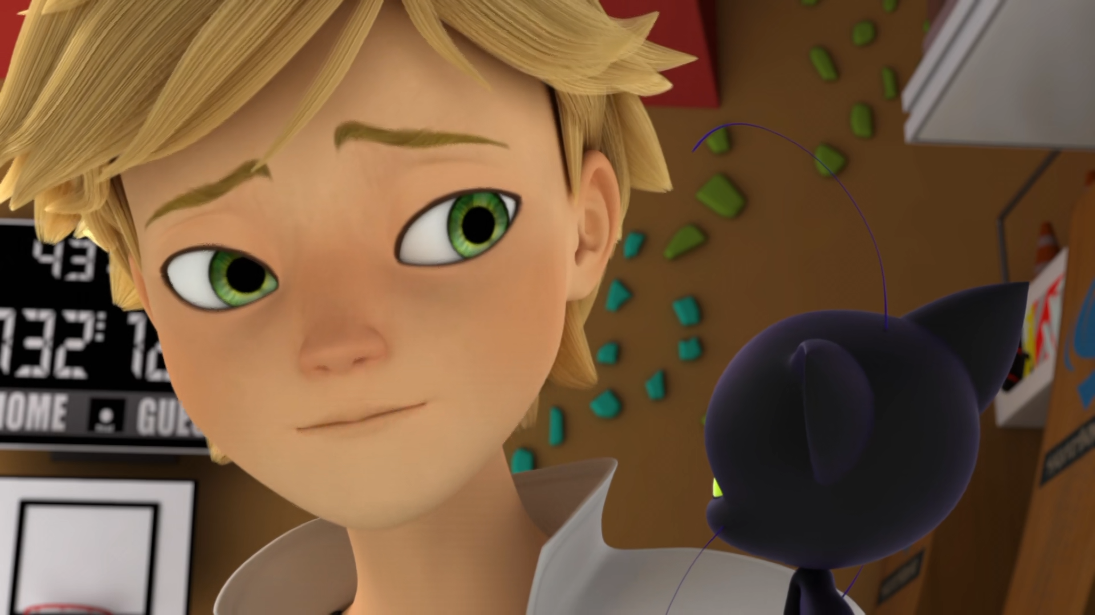
I know what it's like to have your freedom ______, Plagg.
restricted
taken away
removed

Slide 14
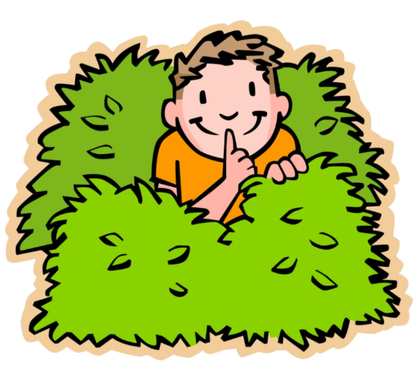
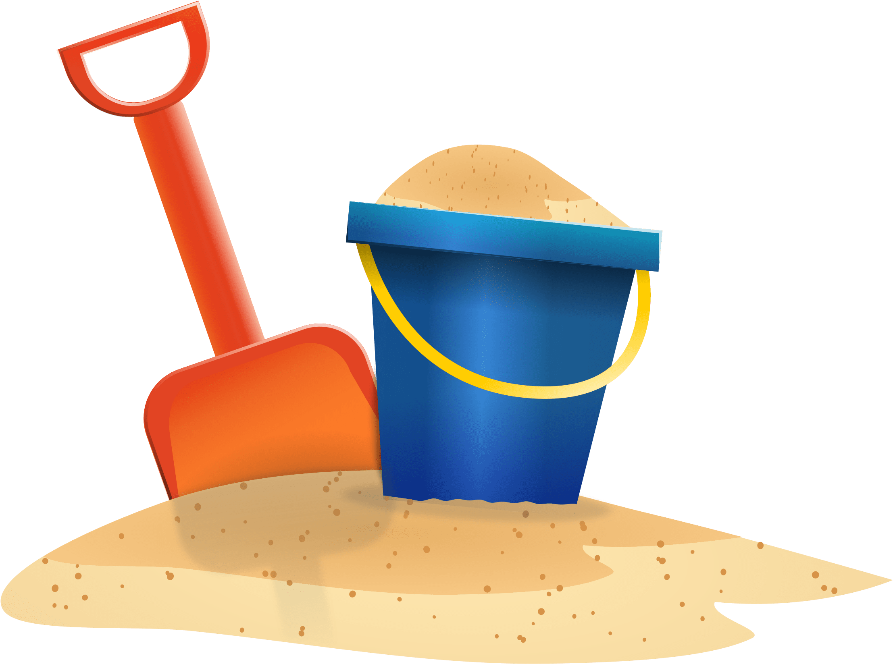

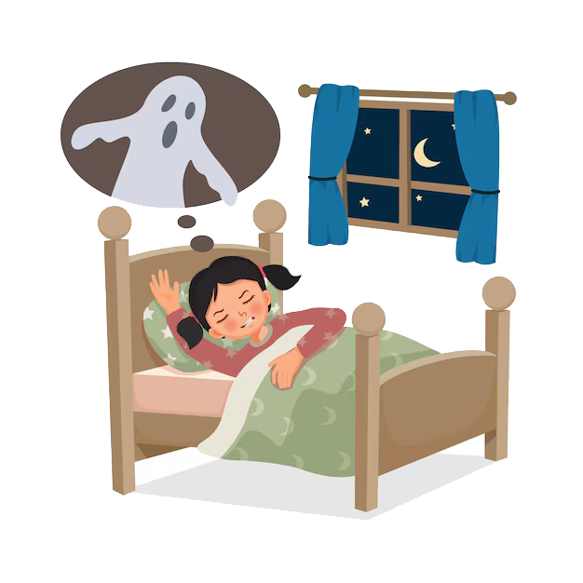
Matching Exercise
magic | nightmare | sand | hide

Slide 15
Matching Exercise
hide | sand | magic | nightmare

Slide 16
TRUE OR FALSE
1. The Guardians lost two Miraculous.
2. The kwamis are somewhere in the Seine river.
3. Sandboy rides a pillow.
4. Plagg's nightmare is dairy-free cheese.
5. Nightmare Marinette has a giant hammer.

Slide 17
TRUE OR FALSE
1. The Guardians lost two Miraculous. | FALSE
2. The kwamis are somewhere in the Seine river. | TRUE
3. Sandboy rides a pillow. | TRUE
4. Plagg's nightmare is dairy-free cheese. | TRUE
5. Nightmare Marinette has a giant hammer. | FALSE

Slide 18
IELTS Speaking Exam. Tourism. Part 2
Describe a city you would like to visit for tourism. You should say:
which city it is
what it's known for
and what you would like to see or do there

