Slide 1
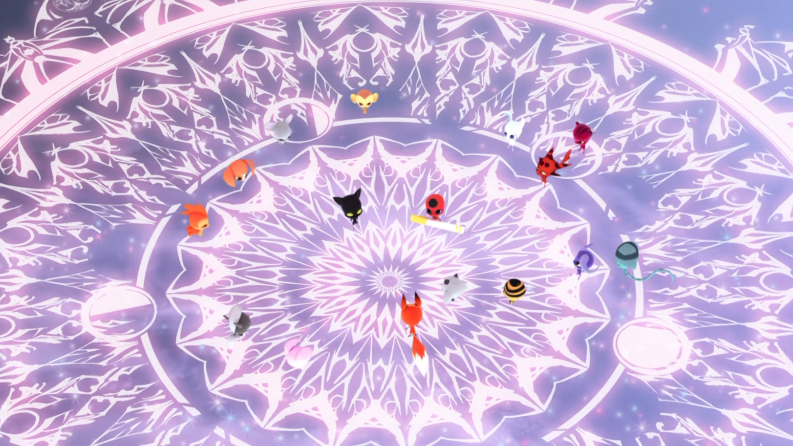
MIRACULOUS LADYBUG: SANDBOY. PART 1

Slide 2
VOCABULARY
approve - 赞同 - əˈpruːv
cruel - 残忍 - kruːəl
grossed out - 恶心 - ɡrəʊst aʊt
guard - 守卫 - ɡɑːd
opportunity - 机会 - ɒpəˈʧuːnəti
rules - 规则 - ruːlz
sneak out - 偷偷溜走 - sniːk aʊt
specific - 具体 - spəˈsɪfɪk

Slide 3
1. 残忍
2. ɡrəʊst aʊt
3. 规则

Slide 4
1. 残忍 - cruel
2. ɡrəʊst aʊt - grossed out
3. 规则 - rules

Slide 5
SANDBOY. PART 1
Tikki: So you're okay with it? You'll let me go?
Marinette: Yes, I trust you Tikki.
Tikki: Oh, thank you, Marinette! You don't have to worry, I won't let you down. Sweet dreams!
Plagg: I am exhausted. I'm off to bed.
Adrien: Uh… good night Plagg!

Slide 6
Nathalie: Good night, sir.
Gabriel: Where do you think you're going, Nooroo?
Nooroo: I just wanted to go out… just for a little while.
Gabriel: No, you know the rules. You're not allowed to be more than a few feet away from me and no communicating with anyone besides me.

Slide 7
Plagg: Hey, Sugarcube!
Tikki: Ugh. I've already told not to call me that. Do you ever hear me calling you
"Stinky Sock"?
Plagg: No, but you should! That would be delightful, Sugarcube! So, what lies did you tell your owner in order to sneak out tonight?
Tikki: Actually, I just told her the honest truth.

Slide 8
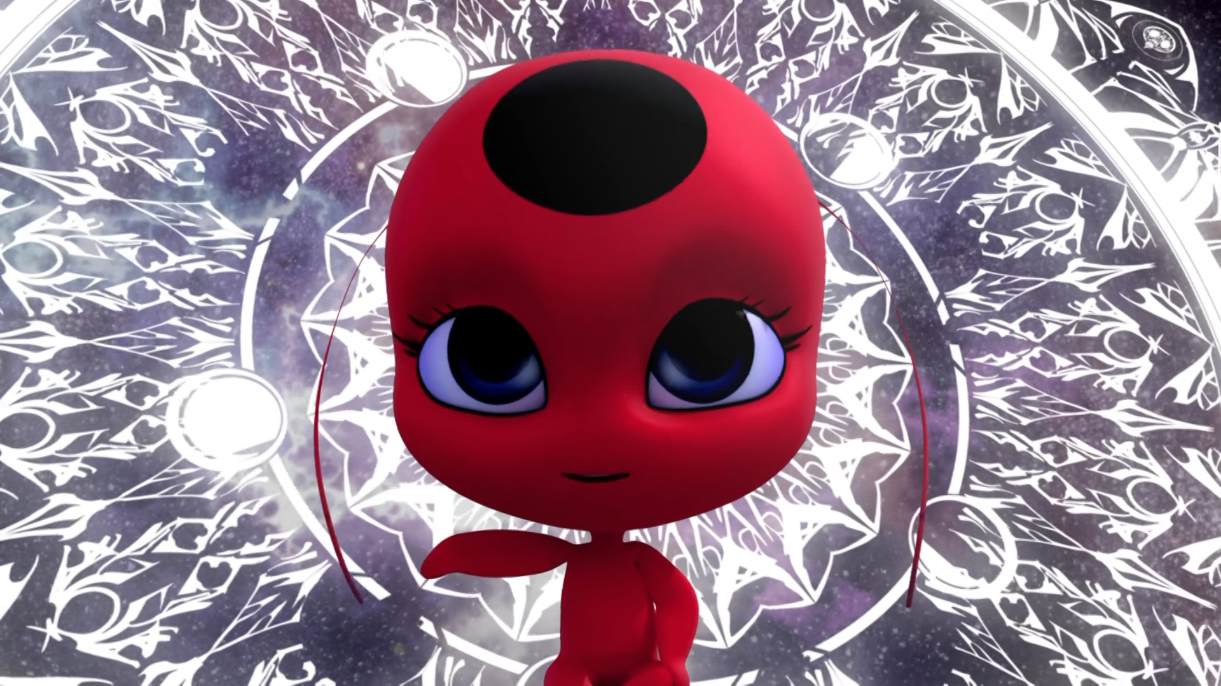
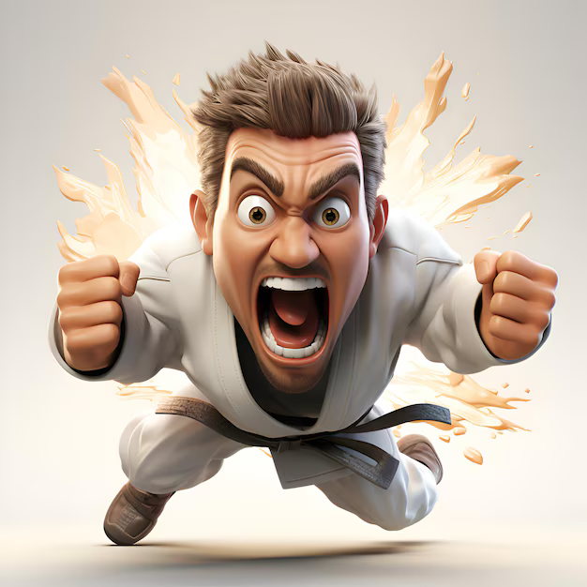
Kwamis are able to communicate on their cycle, or ______.
funerals
weddings
birthdays

Slide 9
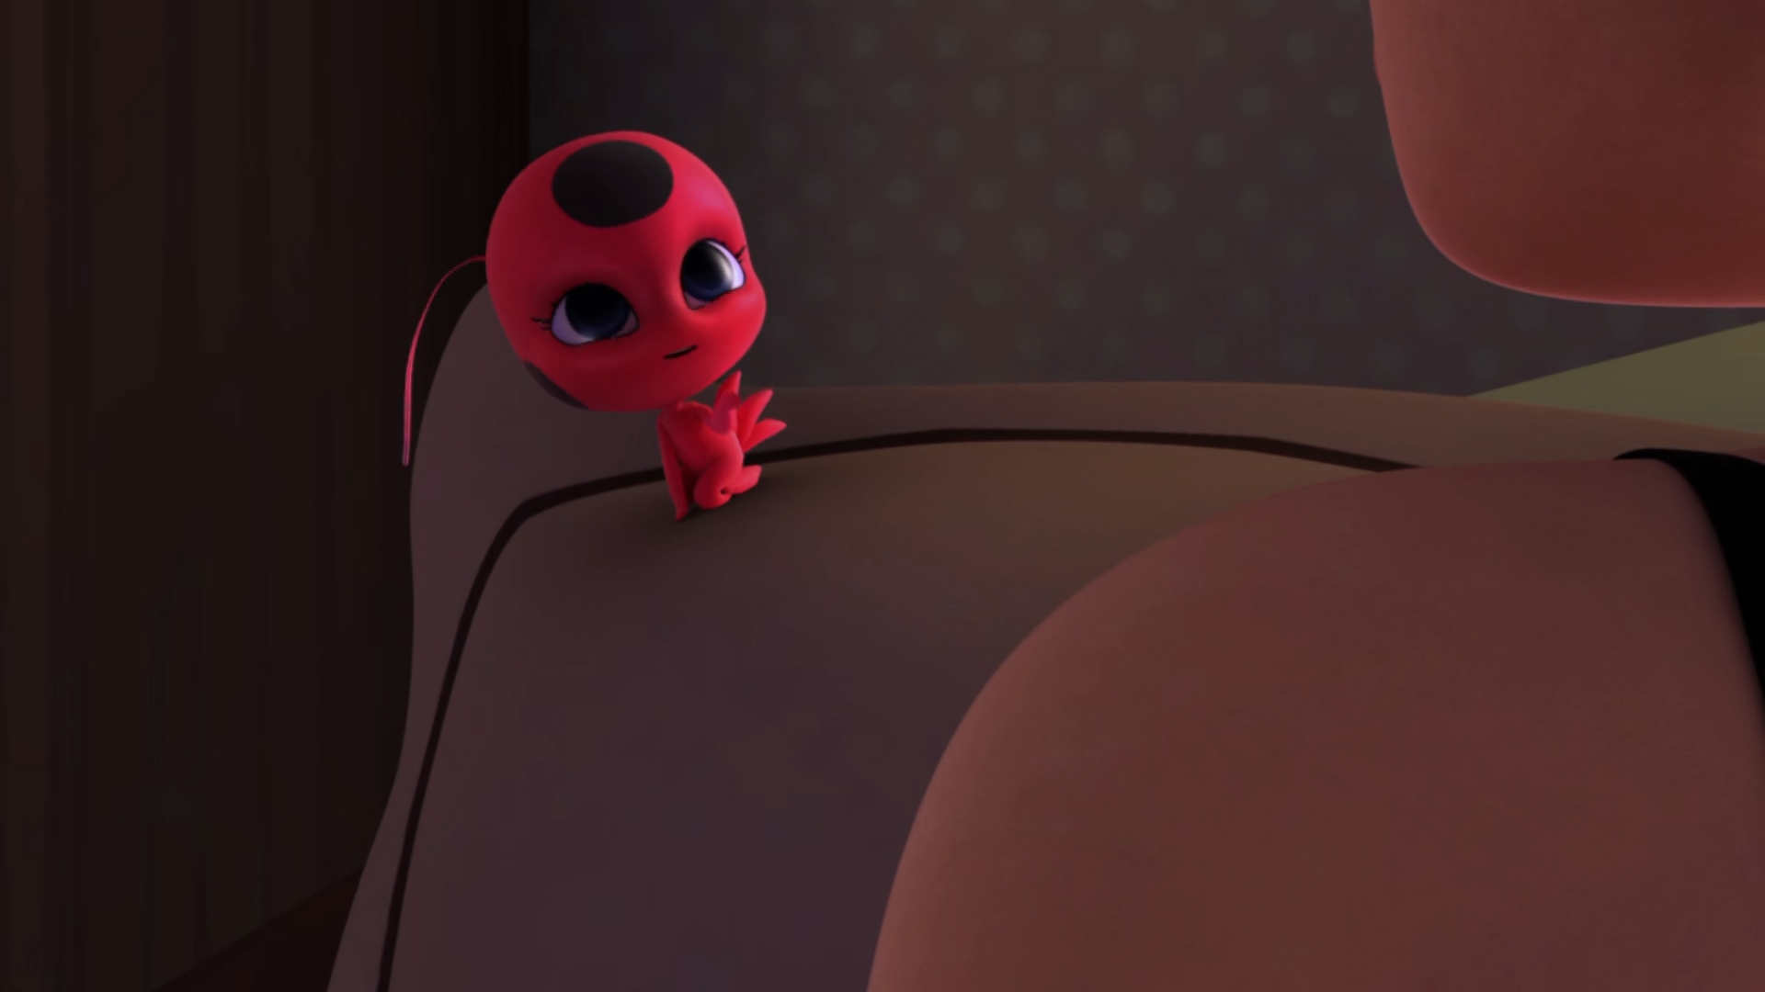
The kwamis must gather in a ______ box at a specific time.
magic
secret
miraculous

Slide 10
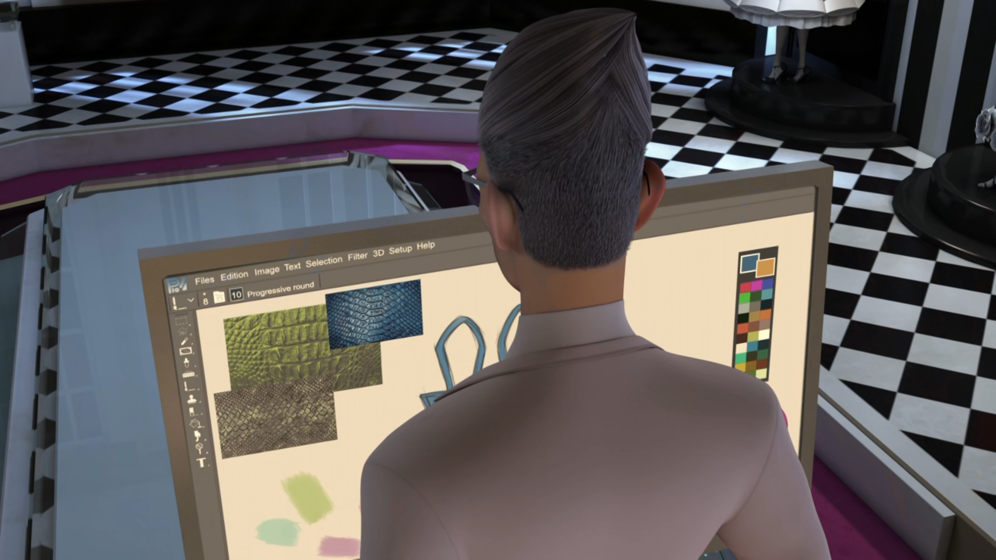
You're not allowed to be more than a few ______ away from me.
metres
feet
miles

Slide 11
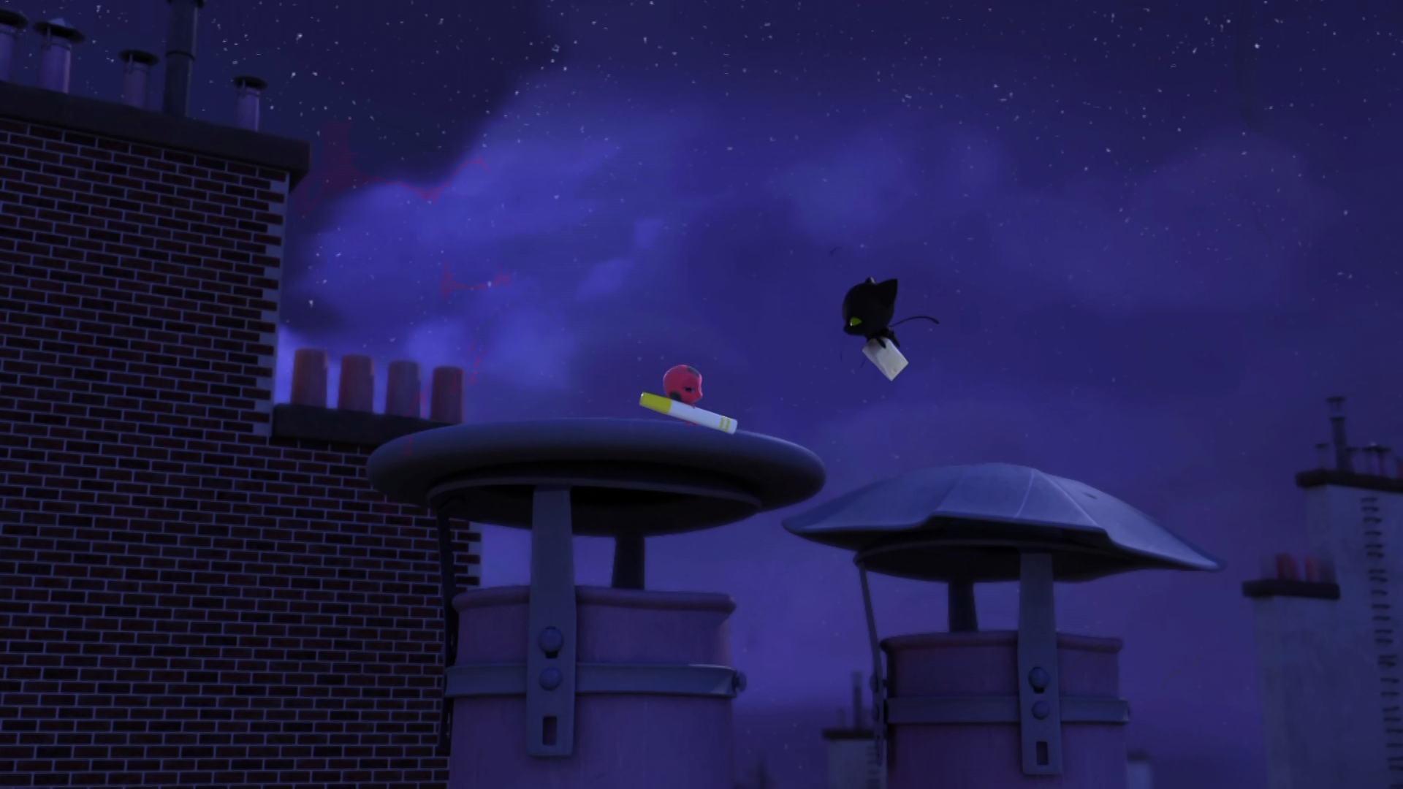
Hey, ______!
Sexy
Sugarcube
Sweetheart

Slide 12
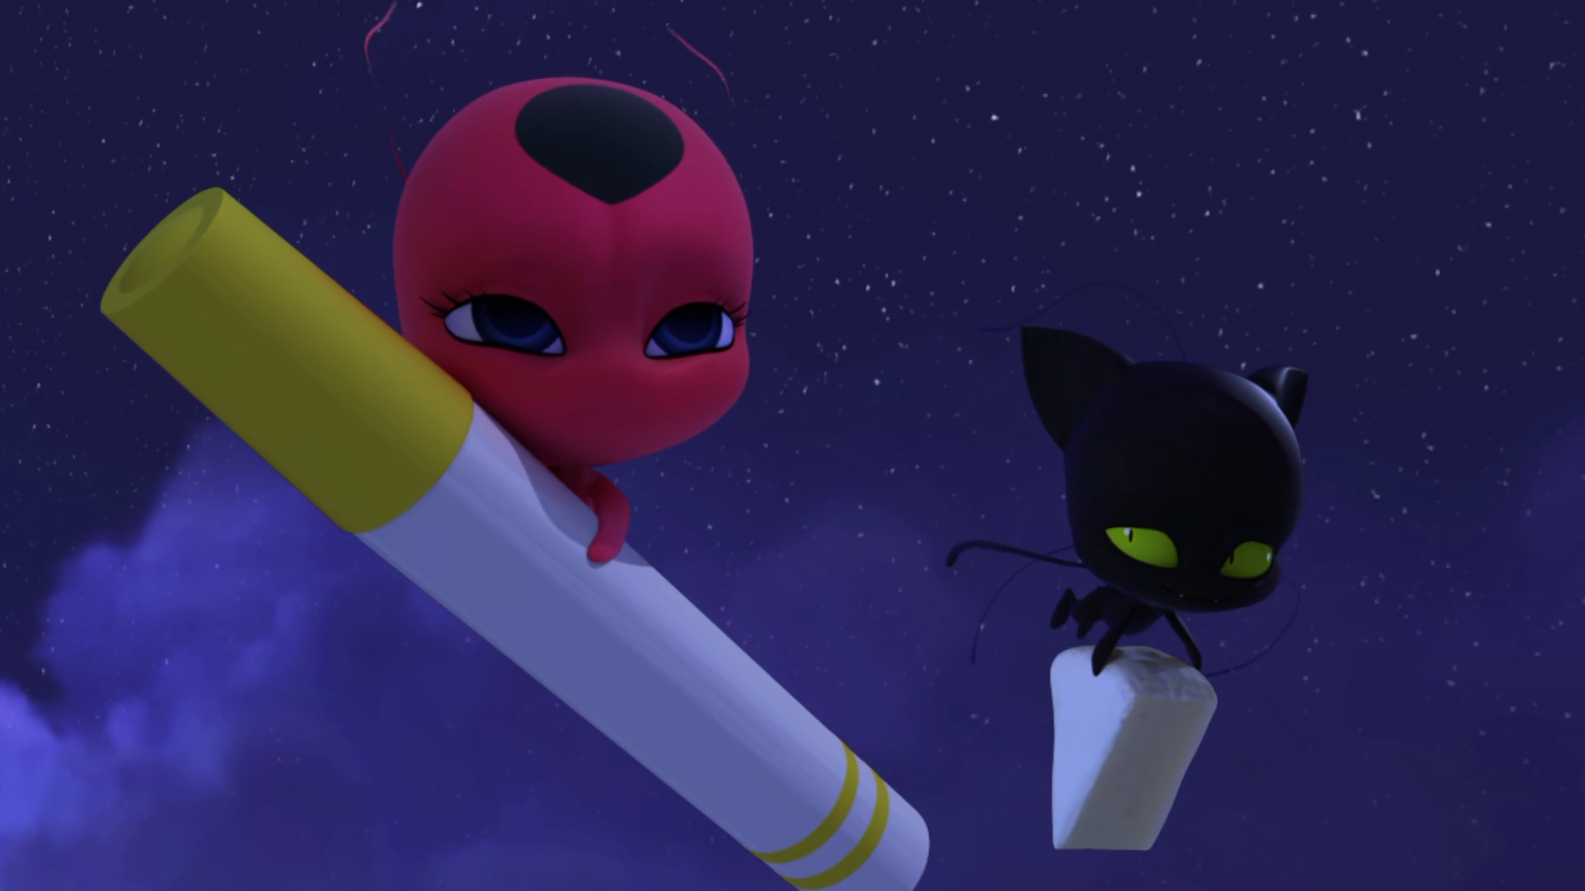
So, what lies did you tell your ______ in order to sneak out tonight?
master
teacher
owner

Slide 13
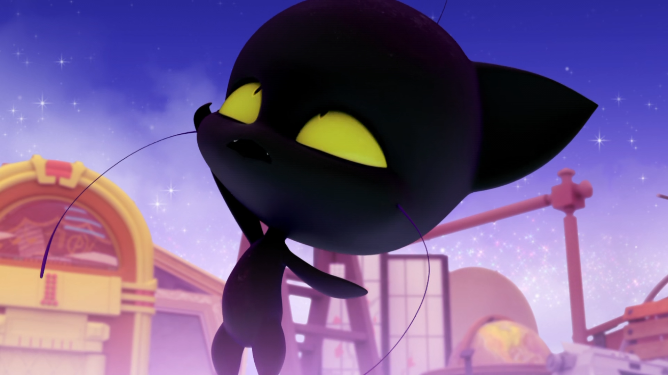
To feed a poor, starving ______.
kitten
Plagg
puppy

Slide 14
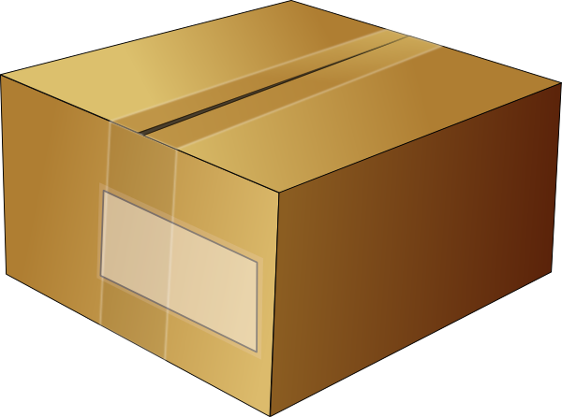
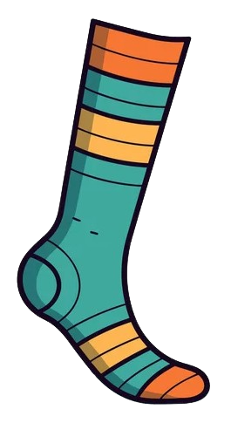
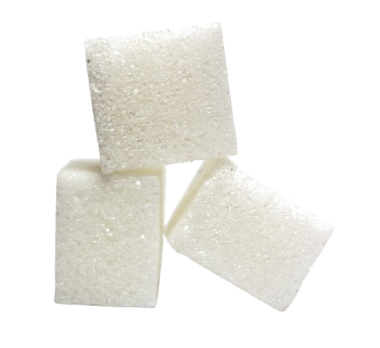
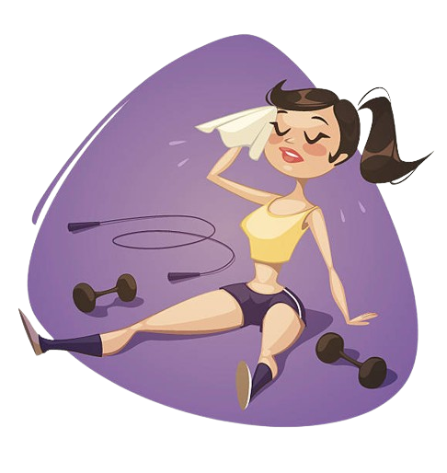
Matching Exercise
sock | sugar cube | exhausted | box

Slide 15
Matching Exercise
box | sock | sugar cube | exhausted

Slide 16
TRUE OR FALSE
1. It's Nooroo's birthday.
2. Plagg is going to stand guard.
3. Plagg's pet name for Tikki is sugar cube.
4. Tikki eats cheese.
5. Plagg starts crying.

Slide 17
TRUE OR FALSE
1. It's Nooroo's birthday. | TRUE
2. Plagg is going to stand guard. | FALSE
3. Plagg's pet name for Tikki is sugar cube. | TRUE
4. Tikki eats cheese. | FALSE
5. Plagg starts crying. | TRUE

Slide 18
IELTS Speaking Exam. Tourism. Part 1
What kind of places do you like to visit when you travel?
How important is tourism to the economy of your country?
What is the most memorable trip you've ever taken?

