Slide 1
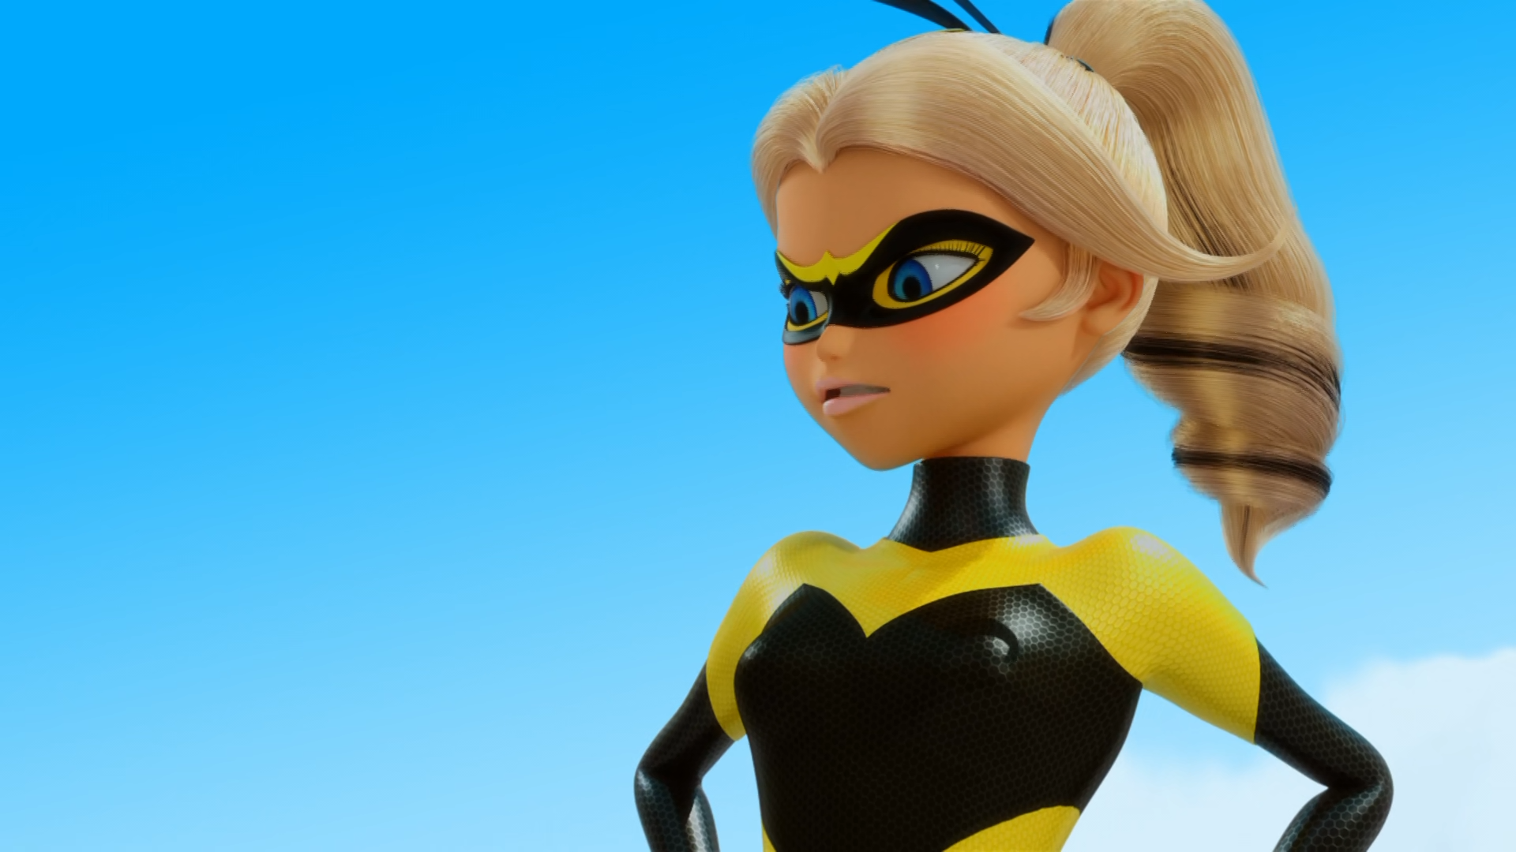
MIRACULOUS LADYBUG: QUEEN'S BATTLE 2. PART 2

Slide 2
VOCABULARY
claws - 爪子 - klɔːz
exceptional - 非凡的 - ɪkˈsɛpʃᵊnᵊl
heinous - 令人发指的 - heɪnəs
impress - 令人印象深刻的 - ɪmˈprɛs
ironic - 讽刺的 - aɪˈrɒnɪk
paralyze - 麻痹的 - pærᵊlaɪz
pompous - 自大的 - pɒmpəs

Slide 3
1. ɪkˈsɛpʃᵊnᵊl
2. 令人印象深刻的
3. aɪˈrɒnɪk

Slide 4
1. ɪkˈsɛpʃᵊnᵊl - exceptional
2. 令人印象深刻的 - impress
3. aɪˈrɒnɪk - ironic

Slide 5
QUEEN'S BATTLE 2. PART 2
Cat Noir: Your Lucky Charm has a great sense of humour - at least you won't drown.
Ladybug: "Drown"! That's the idea: wasps don't like water! We may have to get a little dirty, Cat Noir.
Cat Noir: That's ironic, we just took a bath.
Ladybug: Just follow me.

Slide 6
Audrey: Chloé just clearly demonstrated that there is nothing exceptional about her.
Cat Noir: I know that you did the things you did to impress your mother.
Ladybug: Anyone can make mistakes, even a superhero. What matters is how you fix them. I personally made one by losing that Miraculous. Don't make the mistake of not giving it back. Act like a hero.

Slide 7
Marinette: I think you're wrong. A huge part of your life is here in Paris, too!
Audrey: Chlorene? Uh… Chloé?
Chloé: Why don't you love me, Mom?
Audrey: But… Uh… Of course I l-l-love you.
Marinette: You're also wrong about your daughter not being exceptional. In fact, Chloé is exceptionally mean. She's the worst person I've ever met.

Slide 8
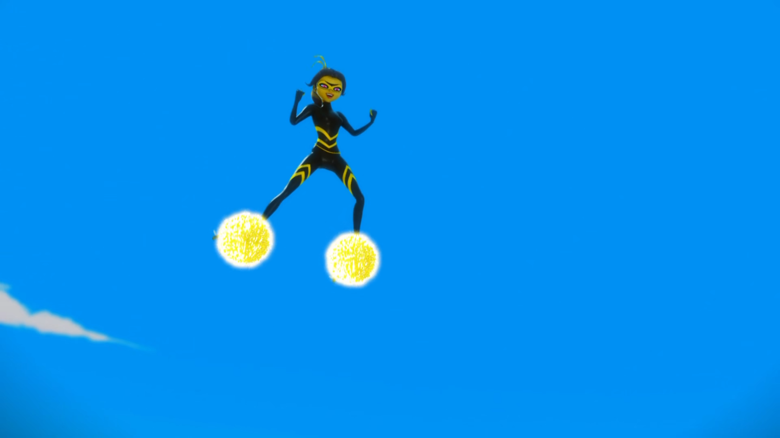

A ladybug doesn't stand a chance against the queen of ______!
bees
venom
wasps

Slide 9
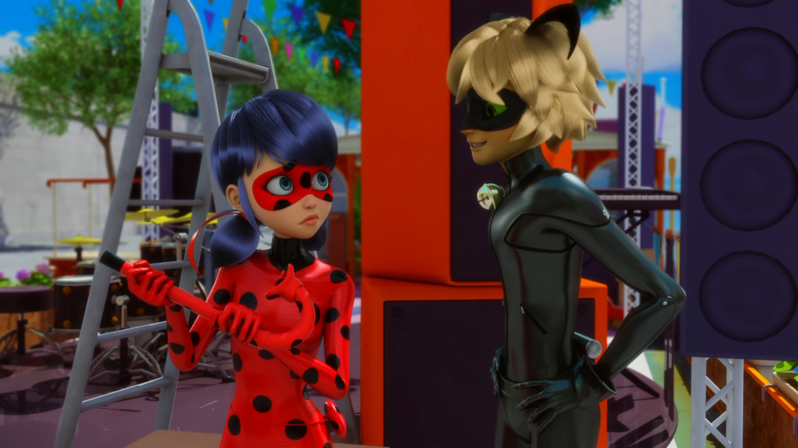
Your Lucky Charm has a great sense of ______ - at least you won't drown.
humour
glamour
honour

Slide 10
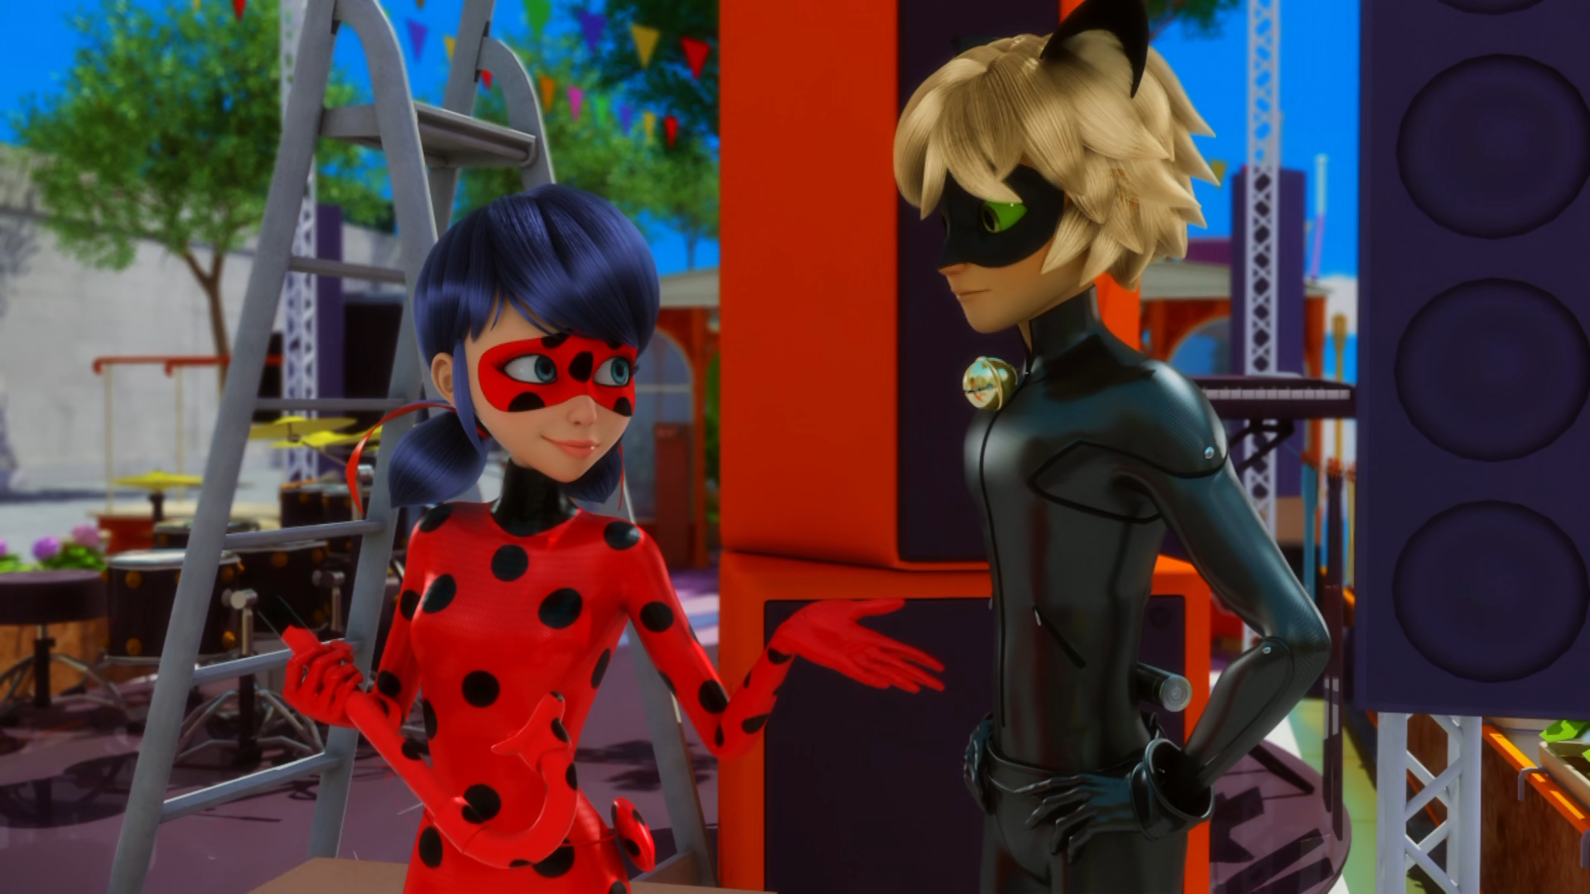
We may have to get a little ______, Cat Noir.
funky
dirty
sexy

Slide 11
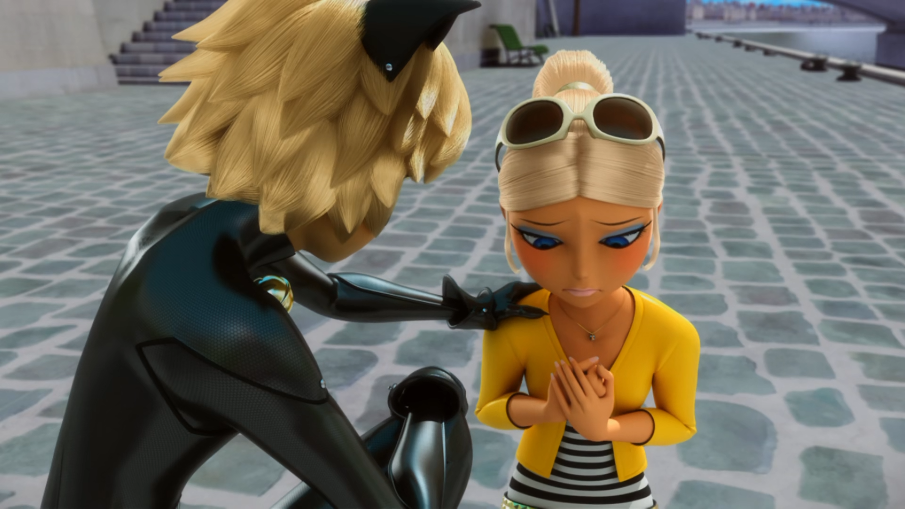
I know that you did the things you did to impress your ______.
grandma
mother
father

Slide 12
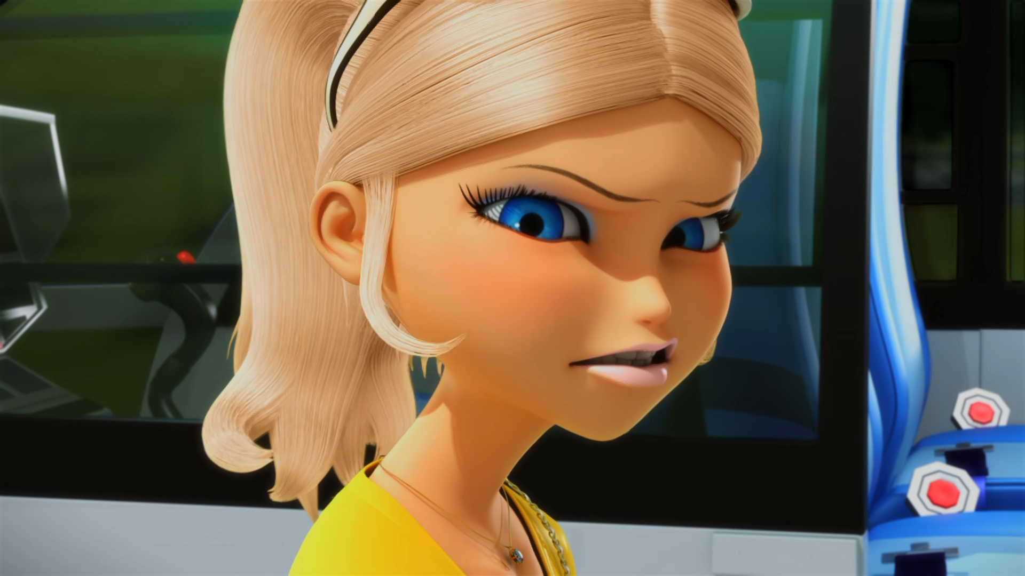
Chloé is exceptionally mean. She's the worst ______ I've ever met.
girl
bitch
person

Slide 13
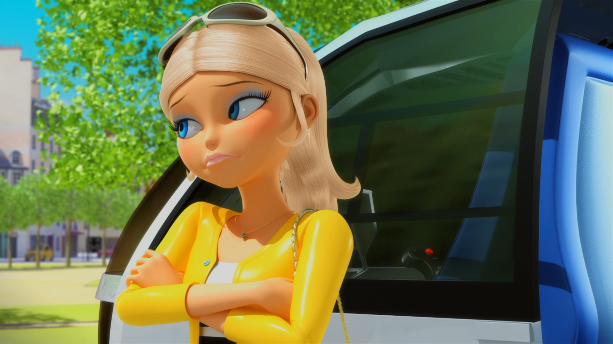
Well, I don't have one single friend in school except for ______.
Sabrina
Rose
Alya

Slide 14
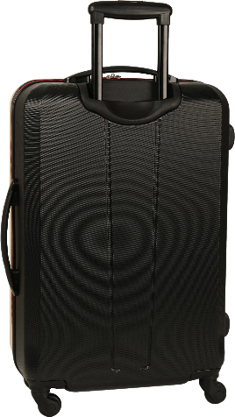
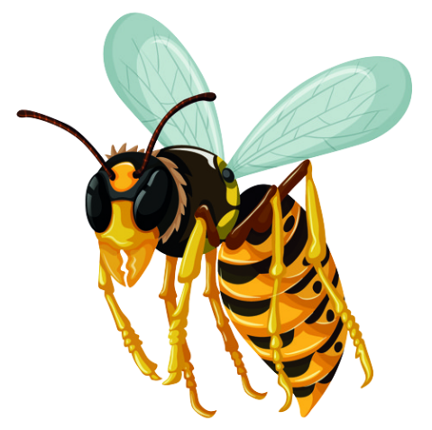
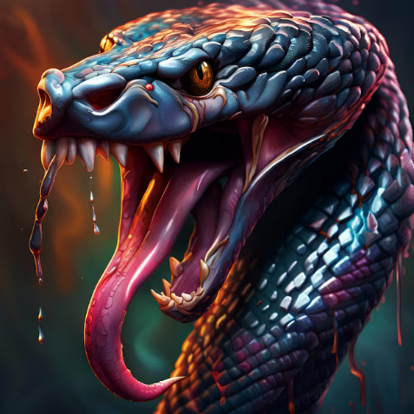

Matching Exercise
wasp | luggage | drown | venom

Slide 15
Matching Exercise
luggage | wasp | venom | drown

Slide 16
TRUE OR FALSE
1. Wasps don't like water.
2. Chloé gives back the Miraculous.
3. Marinette is going to New York.
4. Audrey doesn't love Chloé.
5. Chloé and her mom are alike.

Slide 17
TRUE OR FALSE
1. Wasps don't like water. | TRUE
2. Chloé gives back the Miraculous. | TRUE
3. Marinette is going to New York. | FALSE
4. Audrey doesn't love Chloé. | FALSE
5. Chloé and her mom are alike. | TRUE

Slide 18
IELTS Speaking Exam. Clothes. Part 2
Describe your favourite clothes shop. You should say:
the name of the shop
where it is
what kind of clothes it sells
why you like shopping there

