Slide 1
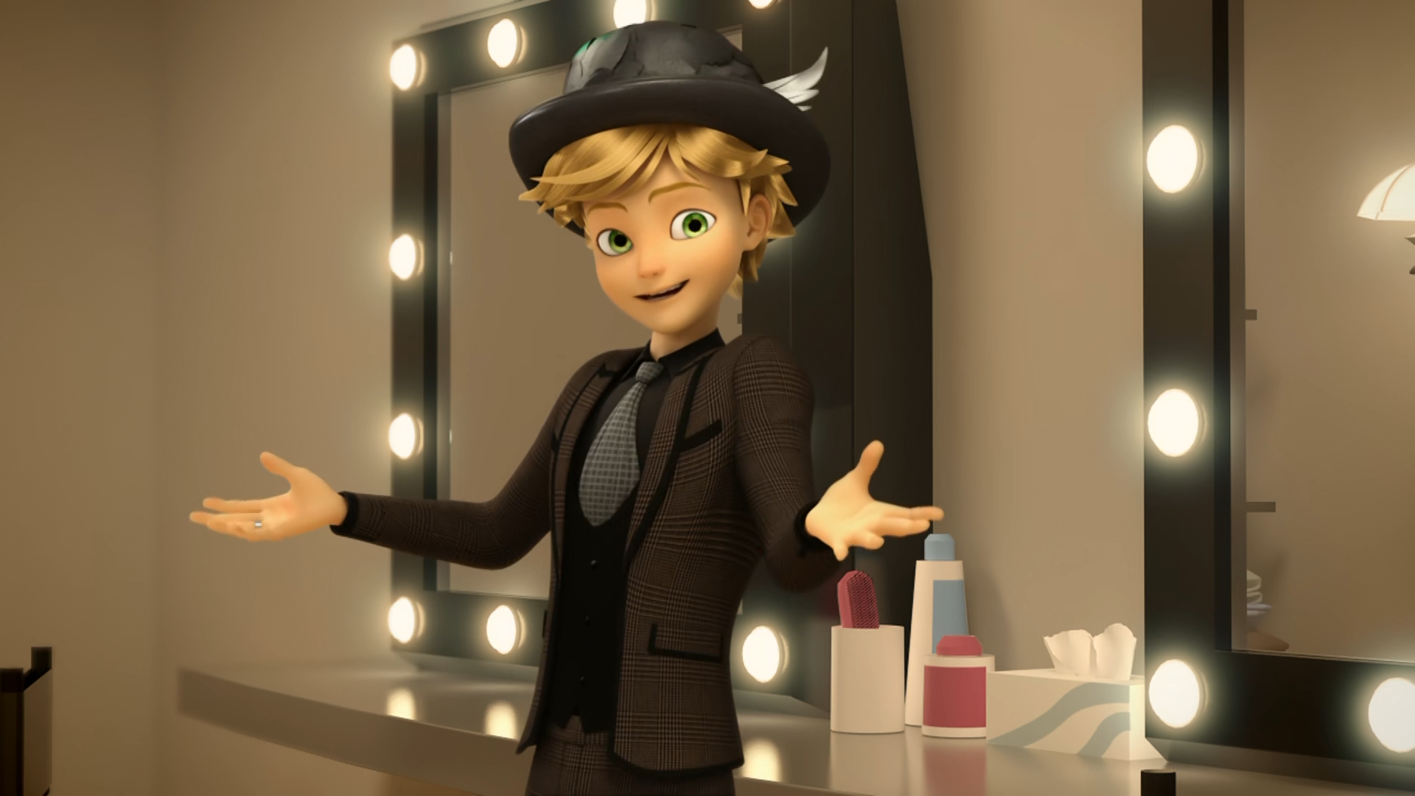
MIRACULOUS LADYBUG: QUEEN'S BATTLE. PART 1

Slide 2
VOCABULARY
allergy - 过敏 - æləʤi
catwalk - 时装表演 - kætwɔːk
harsh - 严酷 - hɑːʃ
prestigious - 声望高 - preˈstɪʤəs
sensational - 耸人听闻 - sɛnˈseɪʃənəl
synthetic - 合成 - sɪnˈθɛtɪk
trend - 趋势 - trɛnd
yo-yo - 溜溜球 - jəʊ.jəʊ

Slide 3
1. kætwɔːk
2. 趋势
3. 溜溜球

Slide 4
1. kætwɔːk - catwalk
2. 趋势 - trend
3. 溜溜球 - yo-yo

Slide 5
QUEEN'S BATTLE. PART 1
Marinette: Oh, no! It's Audrey Bourgeois!
Tikki: Who?
Marinette: Only the harshest fashion critic in the entire world. I didn't know she was coming!
Audrey: What is this carpet? Is it fabric? Why isn't the red carpet made out of marble like I said! You're fired!

Slide 6
Chloé: She's very happy to see me. By the way, Mom, I have a little something for you. Audrey: Clara… Uh… Chloé, what is this?
Chloé: Um… it's a gift?
Audrey: Ugh, this wrapping paper is ridiculous, utterly ridiculous. You're fired.
André: Darling, please! You can't fire Chloé. She's your daughter!

Slide 7
Style Queen: Where is that ungrateful Gabriel Agreste? I demand that he kneels before me!
Adrien: My father isn't here!
Style Queen: Well, then, if fashion-disaster daddy isn't here, I'll just have to settle for Agreste Junior! You're fired!
Marinette: Adrien!
Plagg: Uh-oh! We've got a problem!

Slide 8
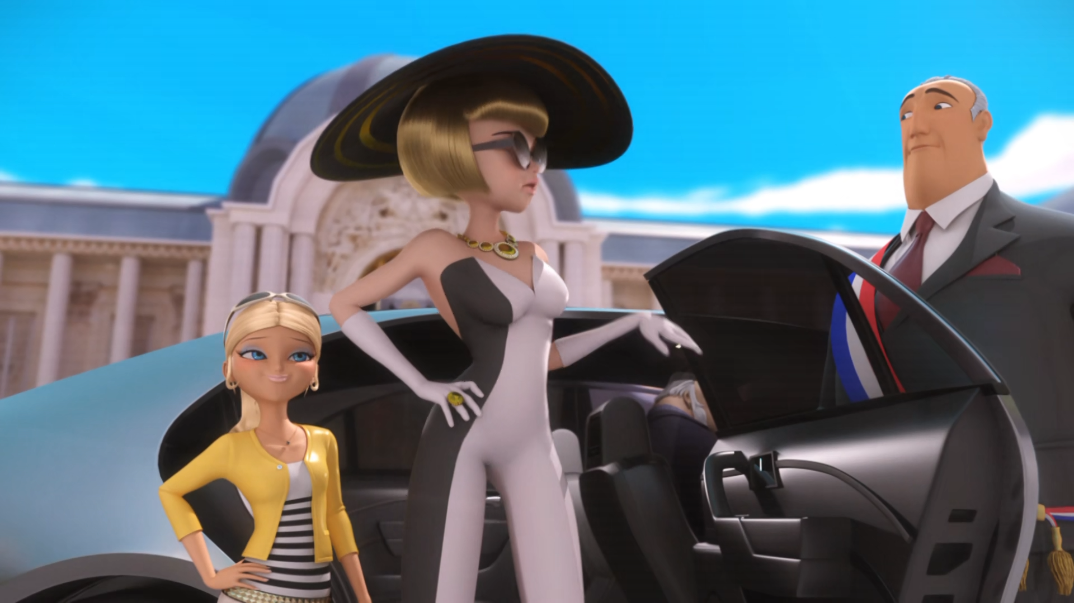

André, be a dear and ______ the chauffeur.
kill
sack
fire

Slide 9
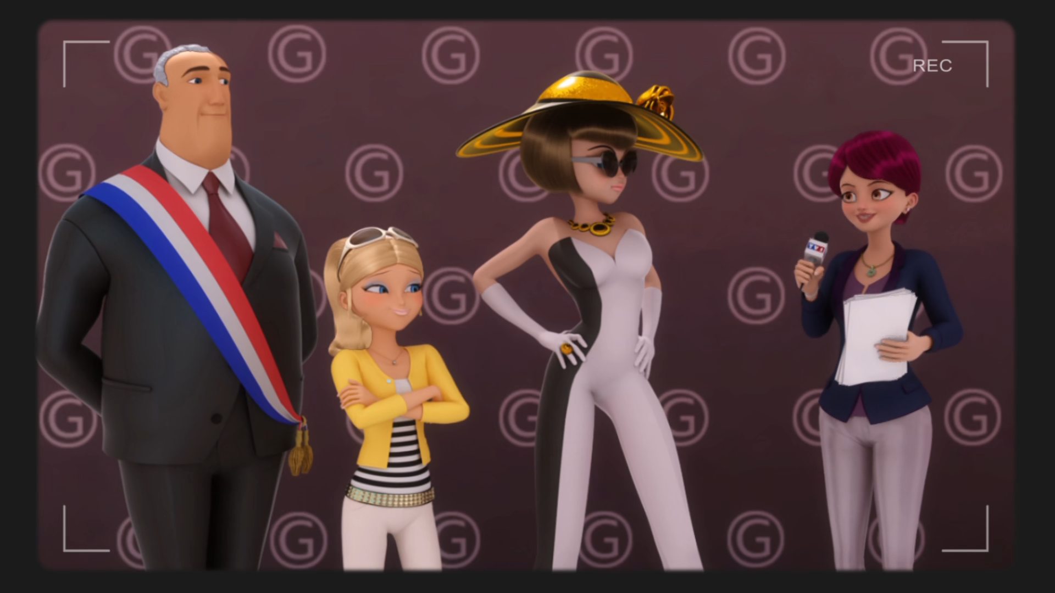
You spend a lot of time in ______.
It must be nice to be with your family.
New York
Dalian
the toilet

Slide 10
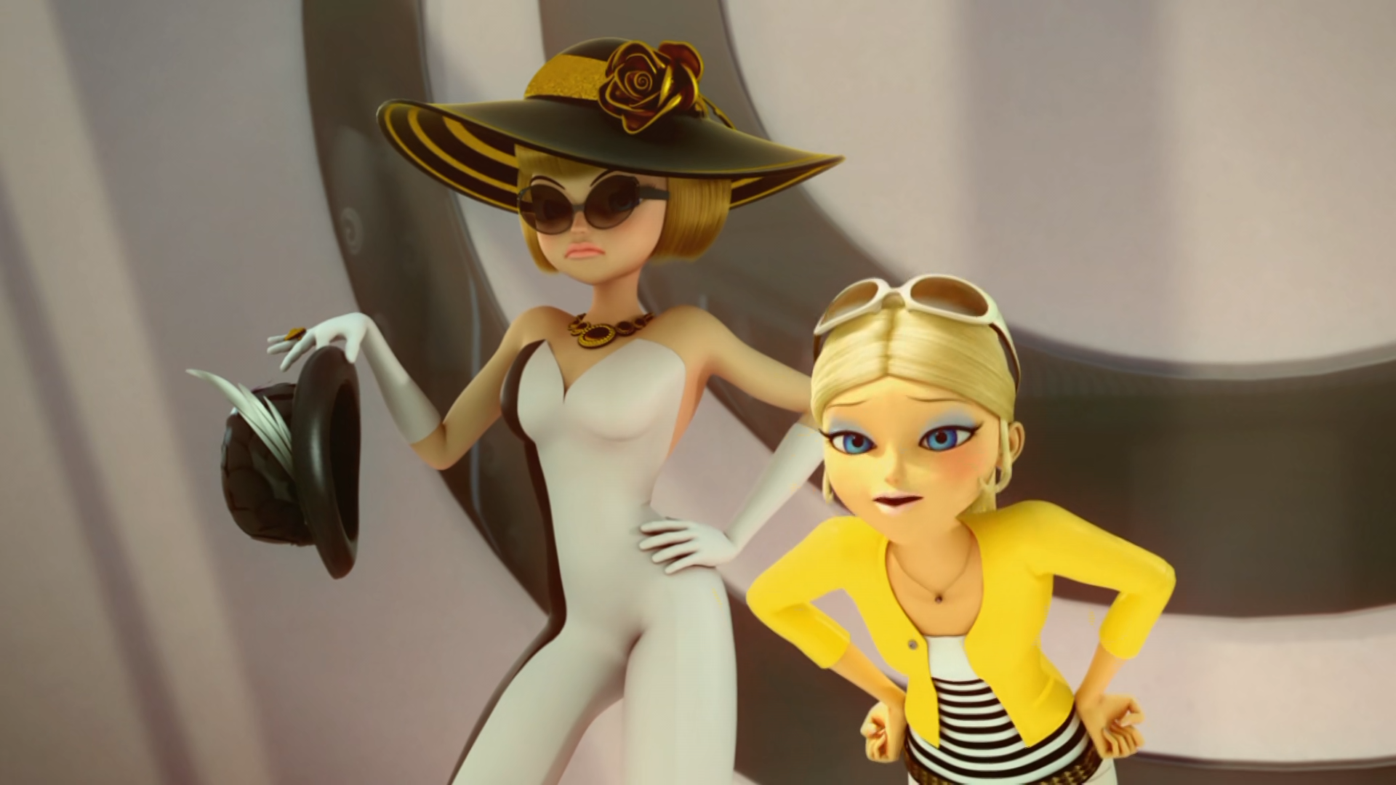
This is Marinette Dupain Cheng, the loser! And this is a ______ she made.
beret
hat
cap

Slide 11
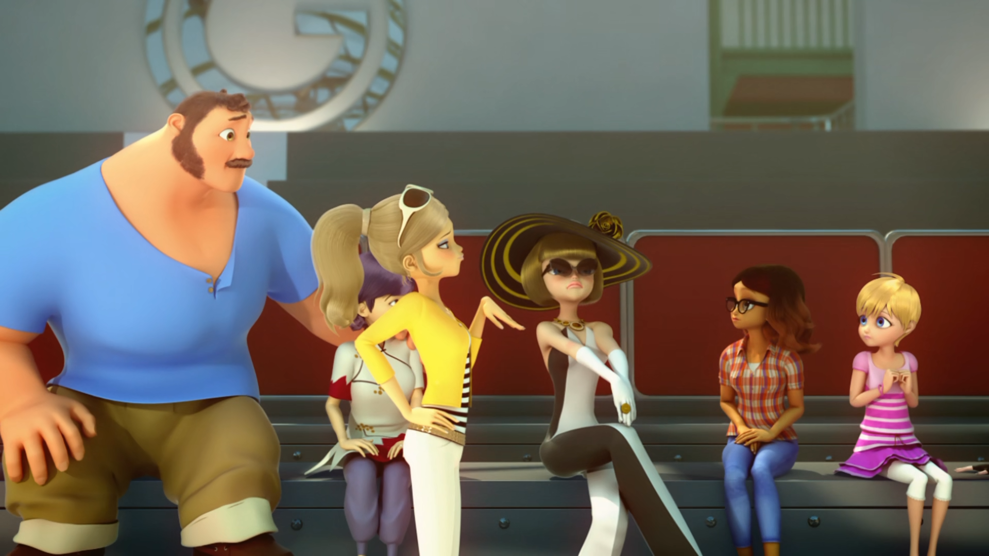
I have to share the front row with this group of low-lives? ______!
absurd
ridiculous
disgusting

Slide 12
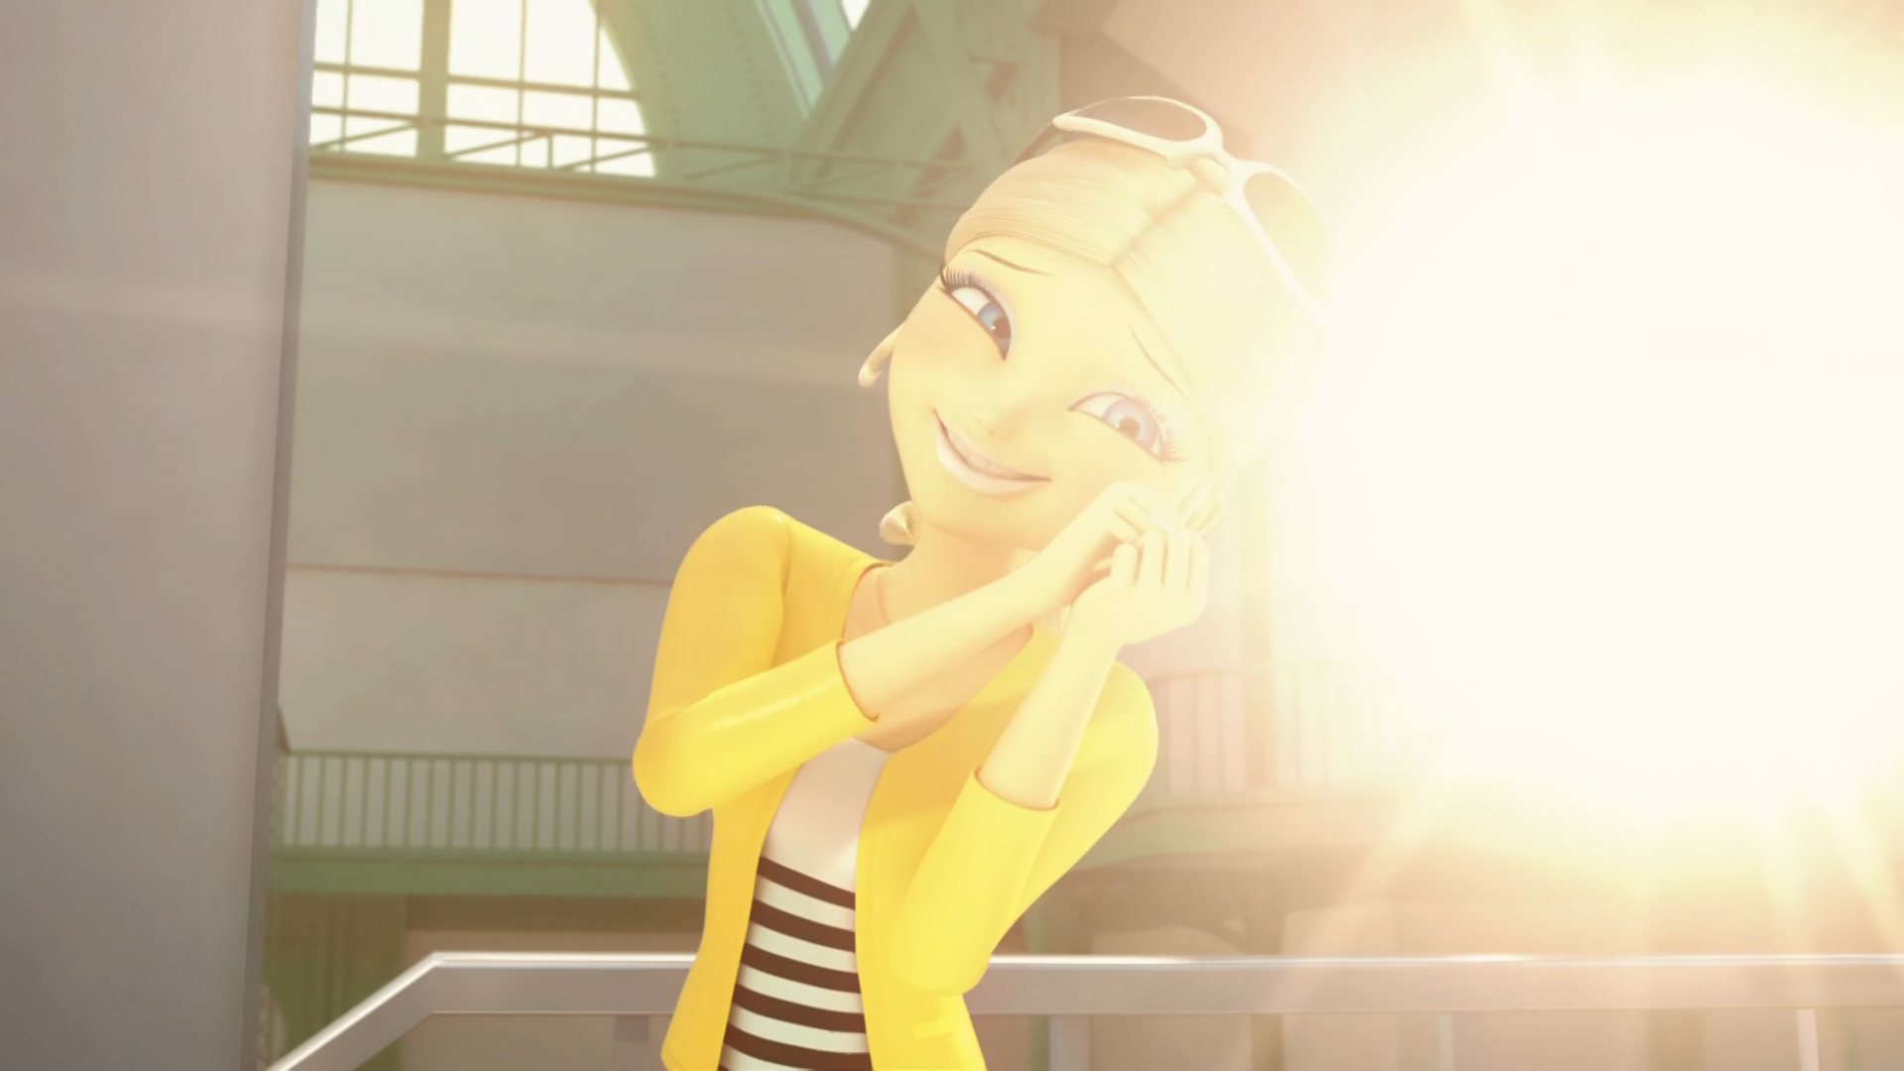
Uh... besides, don't you need an ______?
sidekick
daughter
assistant

Slide 13
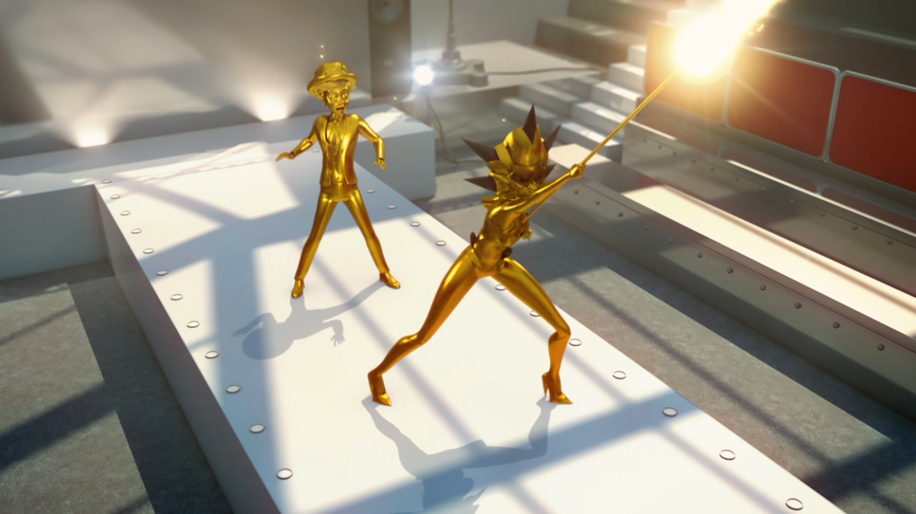
You're a couple of ______ too small to beat me, Ladybug.
sizes
kilos
dresses

Slide 14
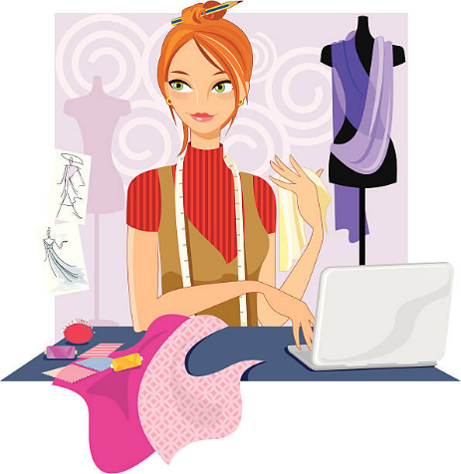
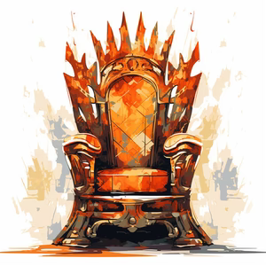
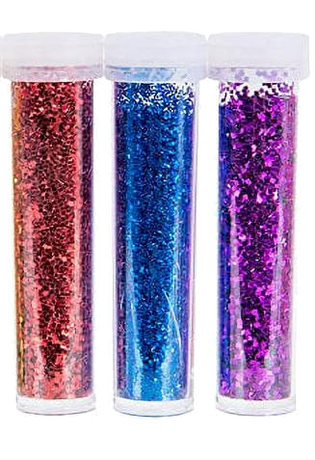

Matching Exercise
chauffeur | glitter | throne | designer

Slide 15
Matching Exercise
designer | throne | glitter | chauffeur

Slide 16
TRUE OR FALSE
1. Marinette's hat has real pigeon feathers.
2. The red carpet is made out of marble.
3. This year's trend is glitter.
4. Nathalie is fired.
5. Chloé's mom is a bitch.

Slide 17
TRUE OR FALSE
1. Marinette's hat has real pigeon feathers. | FALSE
2. The red carpet is made out of marble. | FALSE
3. This year's trend is glitter. | TRUE
4. Nathalie is fired. | FALSE
5. Chloé's mom is a bitch. | TRUE

Slide 18
IELTS Speaking Exam. Shopping. Part 1
What do you usually buy when you go shopping?
Do you prefer shopping in-store or online?
How do you decide what to buy when you go shopping?

