Slide 1

MIRACULOUS LADYBUG: FROZER. PART 2

Slide 2
VOCABULARY
feline - 猫科动物 - fiːlaɪn
form - 形式 - fɔːm
hesitation - 犹豫 - hɛzɪˈteɪʃᵊn
lesson - 教训 - lɛsᵊn
shining - 闪亮 - ʃaɪnɪŋ
sparkle - 闪耀 - spɑːkl
statute - 雕像 - stæʧuːt
trophy - 奖杯 - trəʊfi

Slide 3
1. 教训
2. spɑːkl
3. 雕像

Slide 4
1. 教训 - lɛsᵊn
2. spɑːkl - sparkle
3. 雕像 - statute

Slide 5
FROZER. PART 2
Philippe: See how a few lessons from me could come in handy? Please, Adrien Agreste. Just put your name on this form and your fans will come running. And my ice rink will be saved!
André: None of these young people want to sign up, Philippe. You can't force them now, can you?

Slide 6
Tikki: Why are you so sad?
Marinette: I like Luka. He's really nice, but do you think he's just like Adrien? Just a friend?
Adrien: Marinette? Are you okay?
Marinette: Yeah, I'm fine!
Plagg: You're supposed to be in love with Ladybug, and now you ditch Kagami to go after Marinette?

Slide 7
Ladyice: I get it, but we should really focus on saving Paris right now.
Icecat: We don't always have to do everything together, after all. It's not like we're a couple.
Ladyice: Cat Noir, don't get all pouty on me! Icecat: This way.
Ladyice: I need to set a trap, but what could
I use as bait?

Slide 8
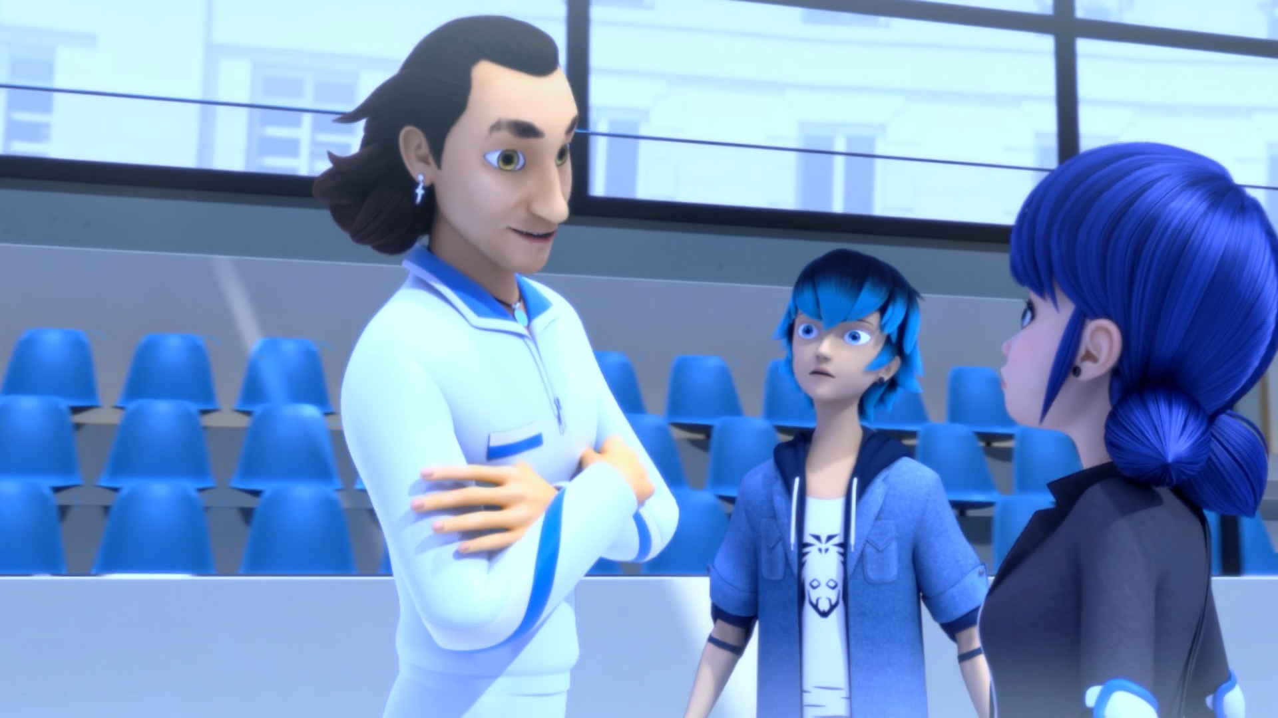

I'll give you a week's worth of lessons for ______.
$100
coffee
free

Slide 9
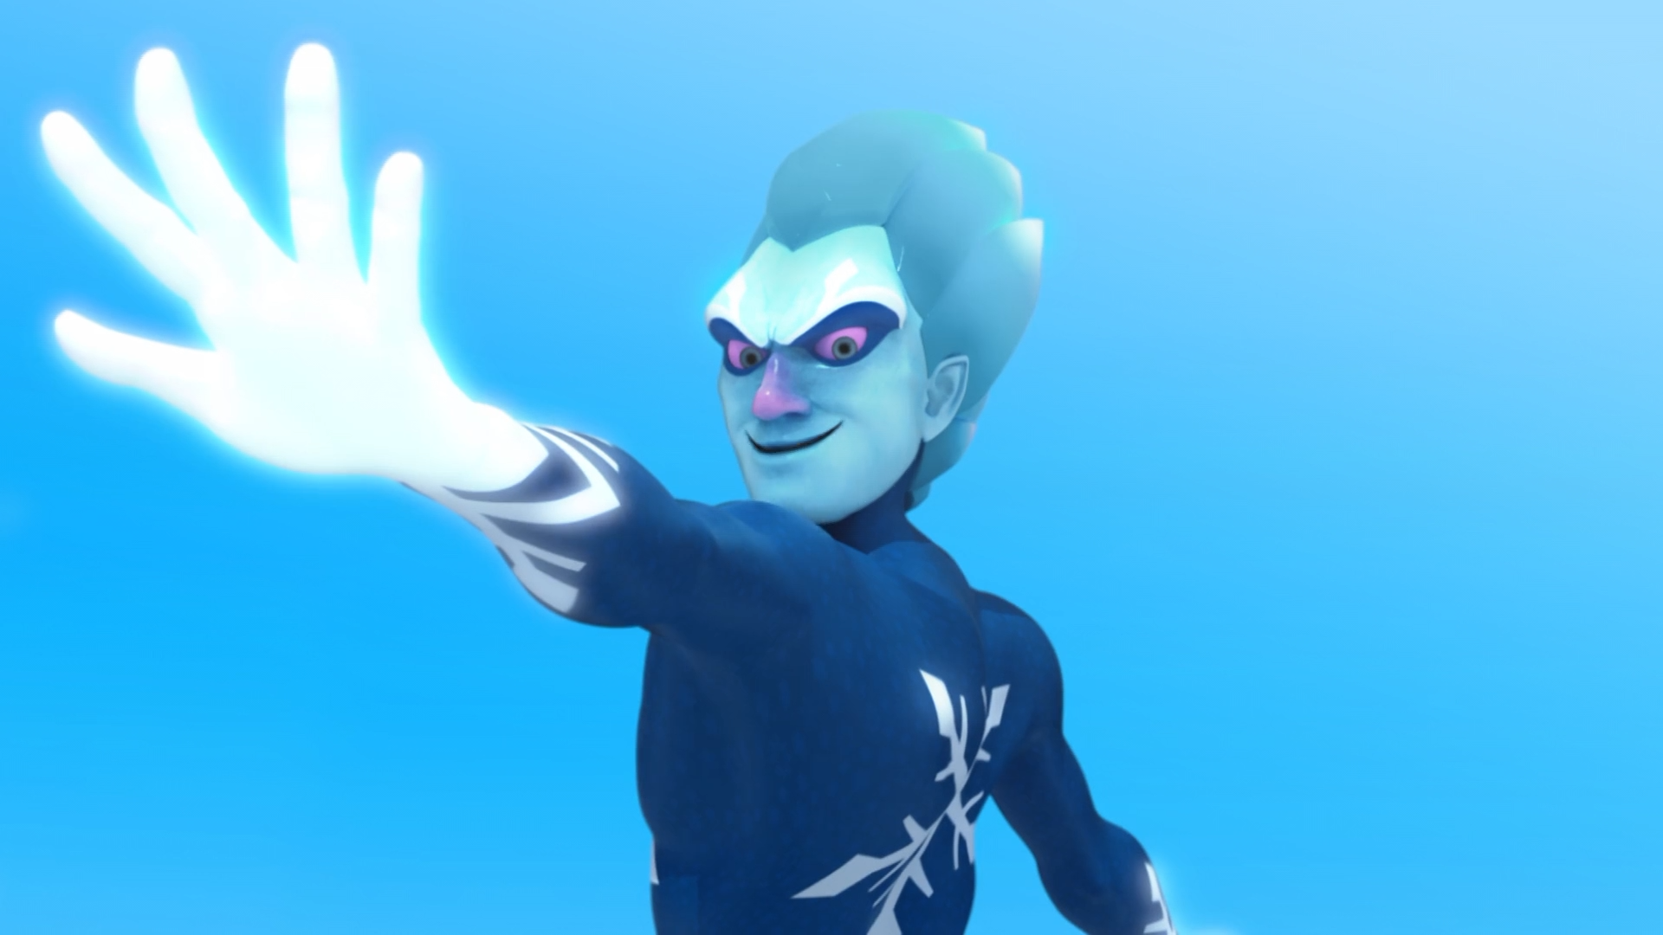
Your ______ statues will sparkle like trophies upon my kingdom of ice!
frozen
ice
snow

Slide 10

He's too fast! I'm positive the akuma's in his ______!
feet
skates
pants

Slide 11
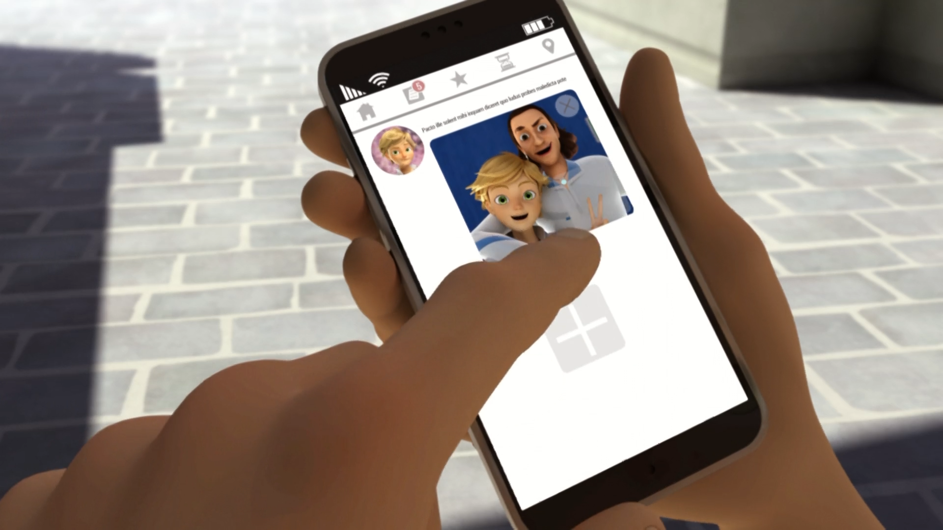
This is Philippe at the ice rink.
He makes ______ so much fun.
dating
skating
mating

Slide 12
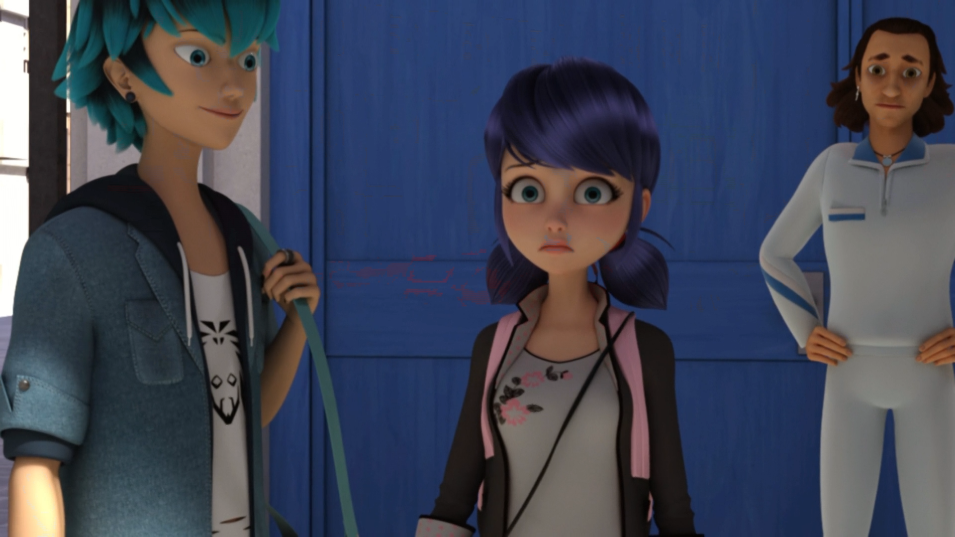
You wanna take the ______ together, Marinette?
train
bus
subway

Slide 13
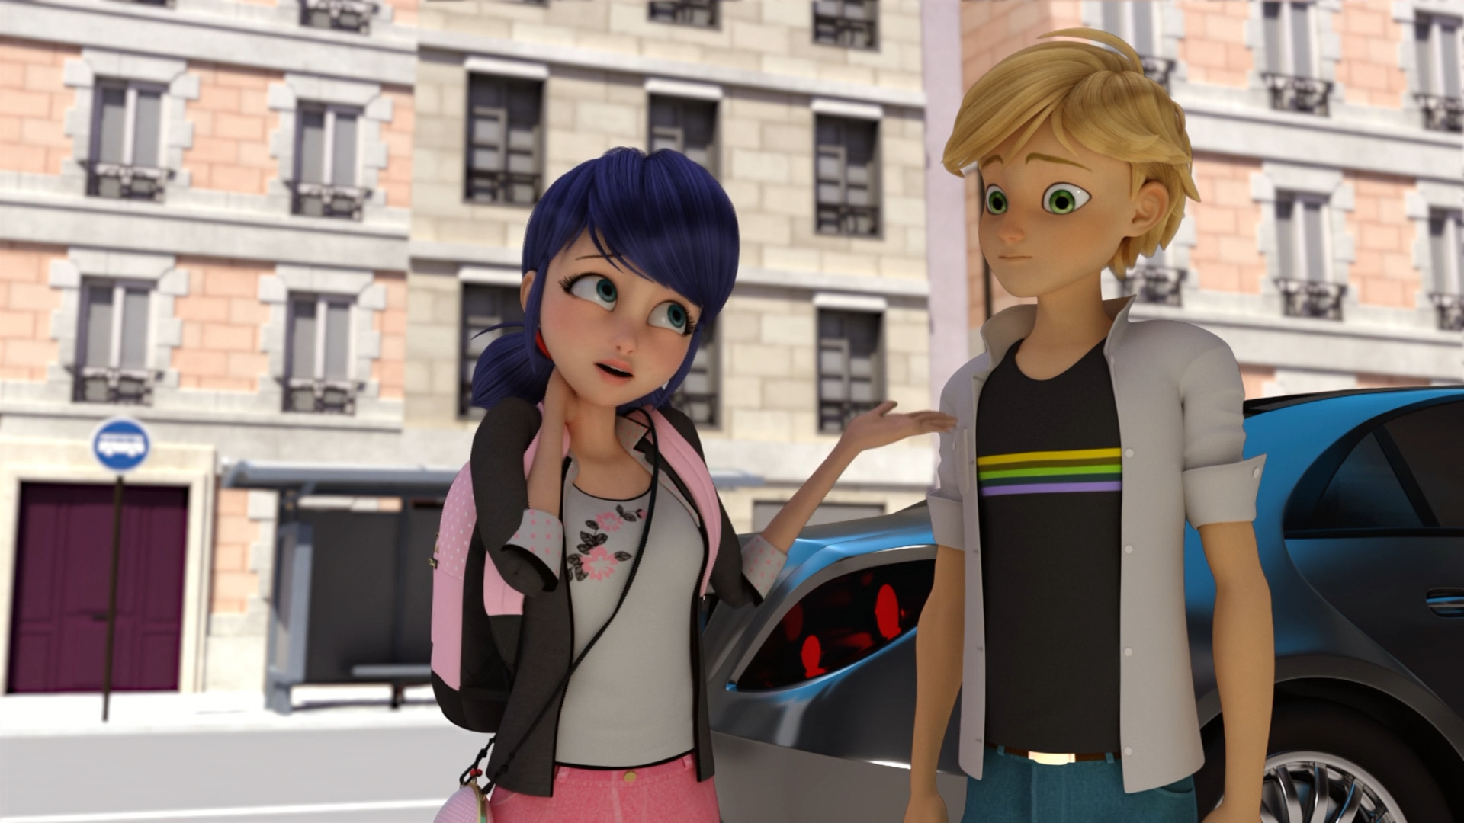
Oh, no! course not! Cause we should take the whole ______.
gang
class
group

Slide 14



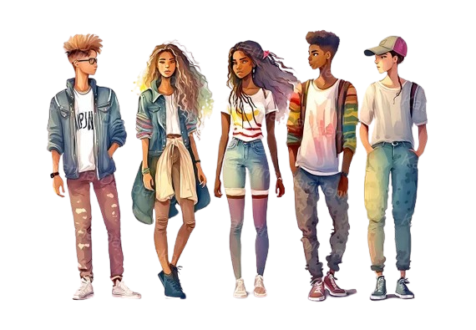
Matching Exercise
candle | gang | kingdom | skate

Slide 15
Matching Exercise
skate | kingdom | candle | gang

Slide 16
TRUE OR FALSE
1. Philippe offers Marinette free skating lessons.
2. Marinette takes Luka's hand.
3. Frozer's akuma is in his skates.
4. Kagami makes a social media post.
5. Marinette tells Adrien that she loves him.

Slide 17
TRUE OR FALSE
1. Philippe offers Marinette free skating lessons. | TRUE
2. Marinette takes Luka's hand. | FALSE
3. Frozer's akuma is in his skates. | TRUE
4. Kagami makes a social media post. | FALSE
5. Marinette tells Adrien that she loves him. | FALSE

Slide 18
IELTS Speaking Exam. Jobs. Part 2
Describe your ideal job. You should say:
what this job is
what qualifications or skills are needed for this job
what you would do in this job
and explain why this would be your ideal job

