Slide 1
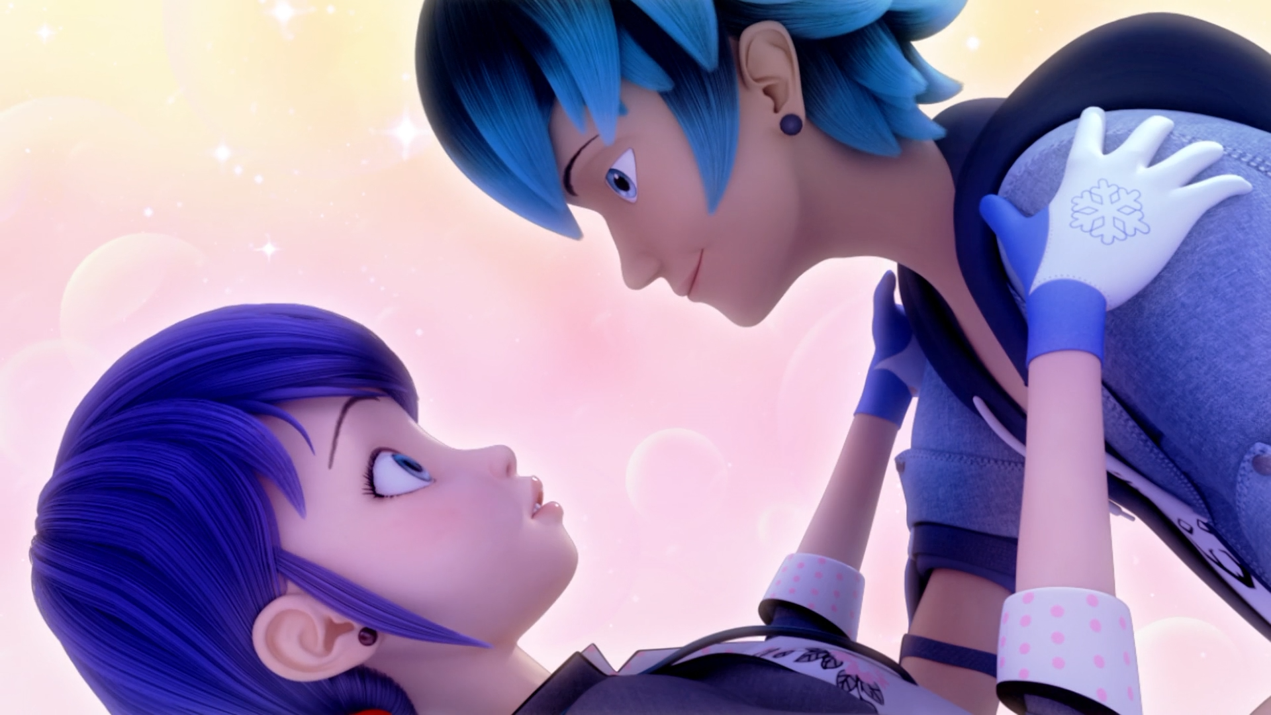
MIRACULOUS LADYBUG: FROZER. PART 1

Slide 2
VOCABULARY
awkward - 尴尬 - ɔːkwəd
concert - 音乐会 - kɒnsət
fencing - 击剑 - fɛnsɪŋ
ice rink - 溜冰场 - aɪs rɪŋk
imagine - 想象 - ɪˈmæʤɪn
mysterious - 神秘 - mɪˈstɪəriəs
predictable - 可预测 - prɪˈdɪktəbᵊl
sparkling - 闪闪发光 - spɑːklɪŋ

Slide 3
1. 音乐会
2. ɪˈmæʤɪn
3. 神秘

Slide 4
1. 音乐会 - concert
2. ɪˈmæʤɪn - imagine
3. 神秘 - mysterious

Slide 5
FROZER. PART 1
Ladybug: Cat Noir! I can't accept this rose from you. I told you already. I'm in love with someone else.
Cat Noir: I know, M'lady. But if he weren't here, would things be different between us?
Ladybug: Well, you know, I can't even begin to imagine him not being here. I'm sorry, Cat Noir.

Slide 6
Mylène: There's everything between you, actually.
Marinette: I always jumble my words around him. So how could I even manage going out on a date? I think we're actually just meant to be friends. Whenever I talk to him as a friend, I hardly stammer at all. That's a sign right there. Right?
Juleka: Um...

Slide 7
Adrien: It was really cool of you to bring Luka, Marinette.
Marinette: Of course. That's what friends are for.
Adrien: I don't know what to do about Kagami. Should I offer to hold her hand?
Marinette: You have to let her fall.
Adrien: Huh?

Slide 8
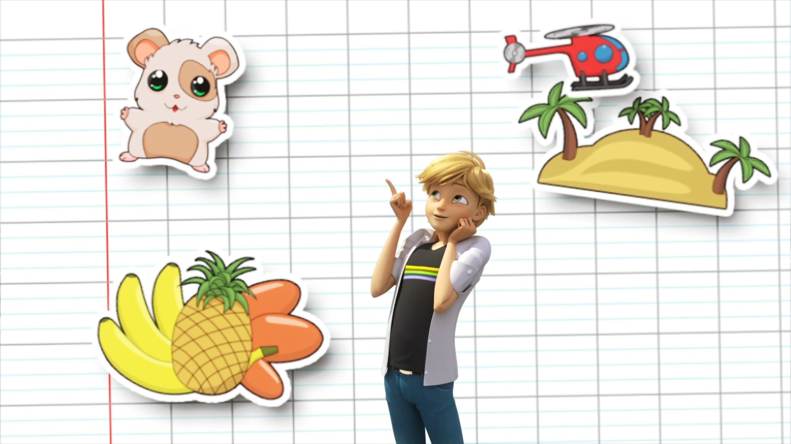

We will live off nothing but ______, and we will have a little pet hamster.
food
KFC
fruits

Slide 9
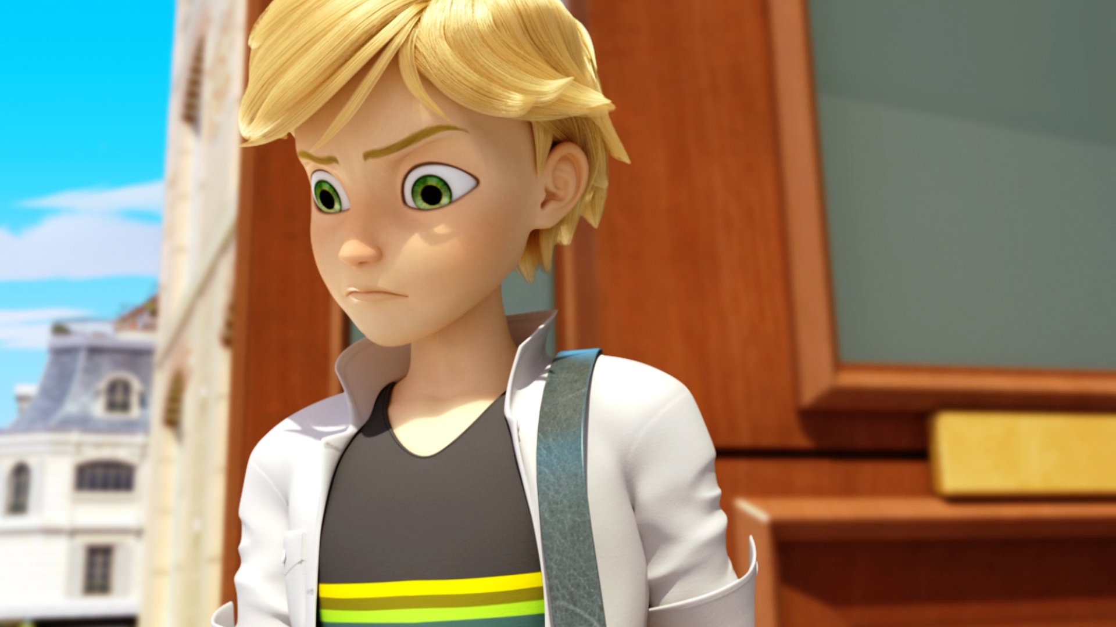
I must not have the right ______, that's all.
technique
temperament
talent

Slide 10
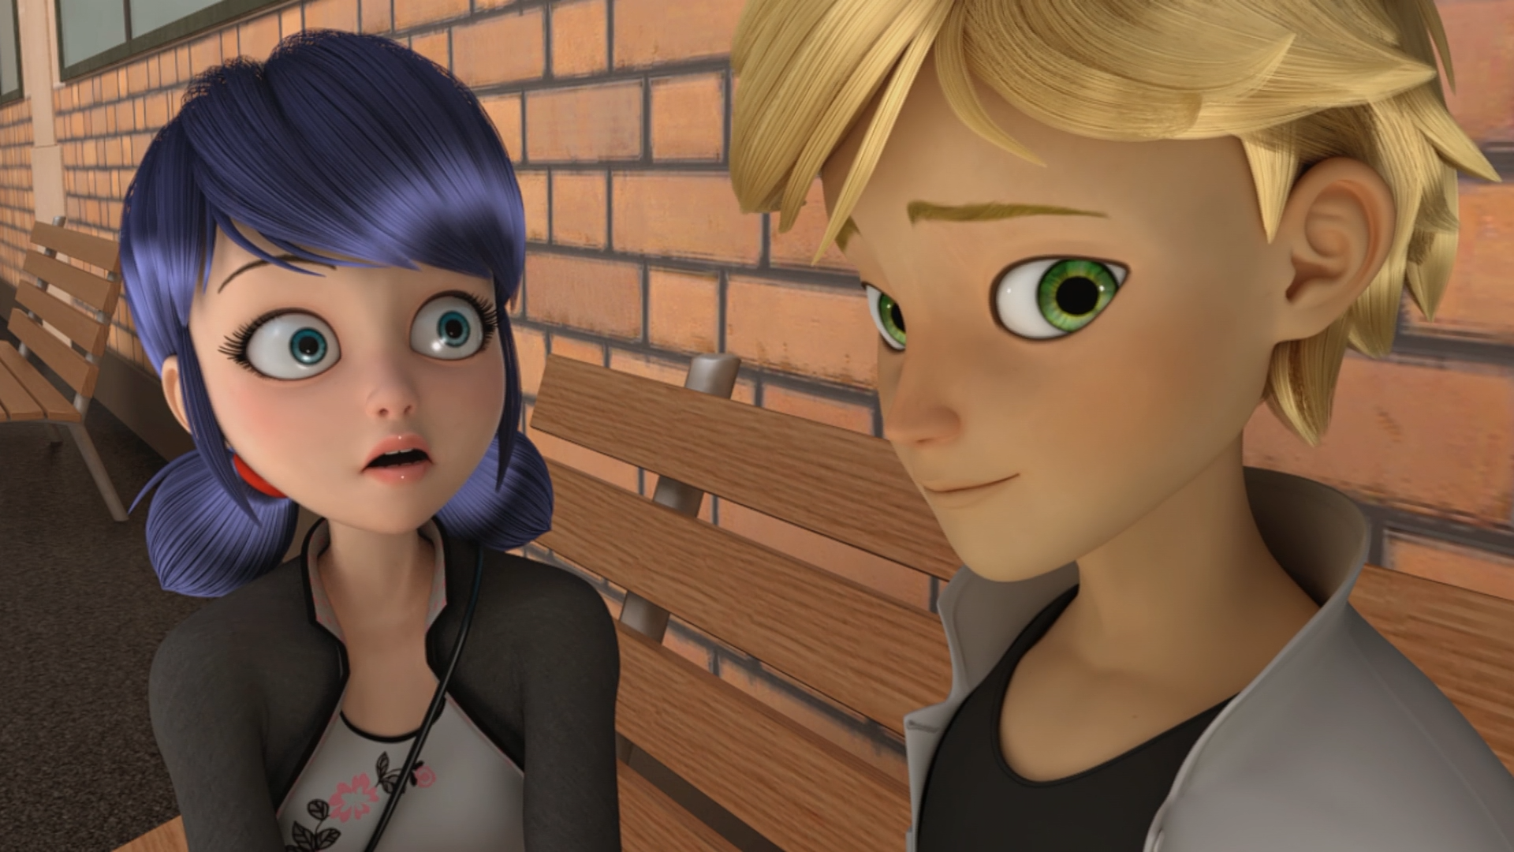
We've just been ______, you know. Until recently.
married
friends
enemies

Slide 11
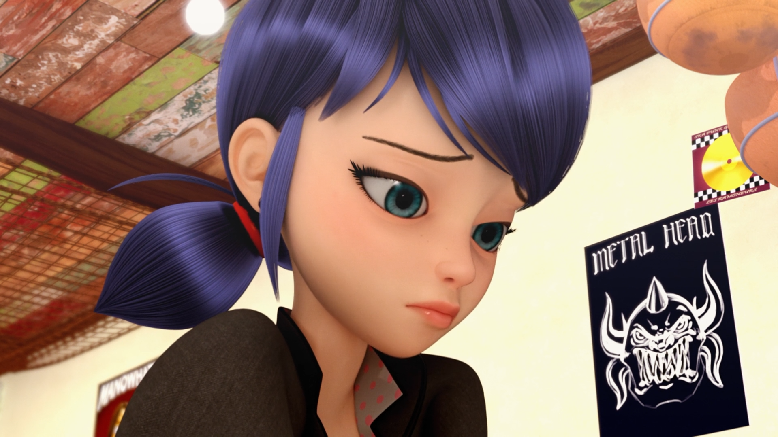
I always ______ my words around him.
jumble
stumble
mumble

Slide 12
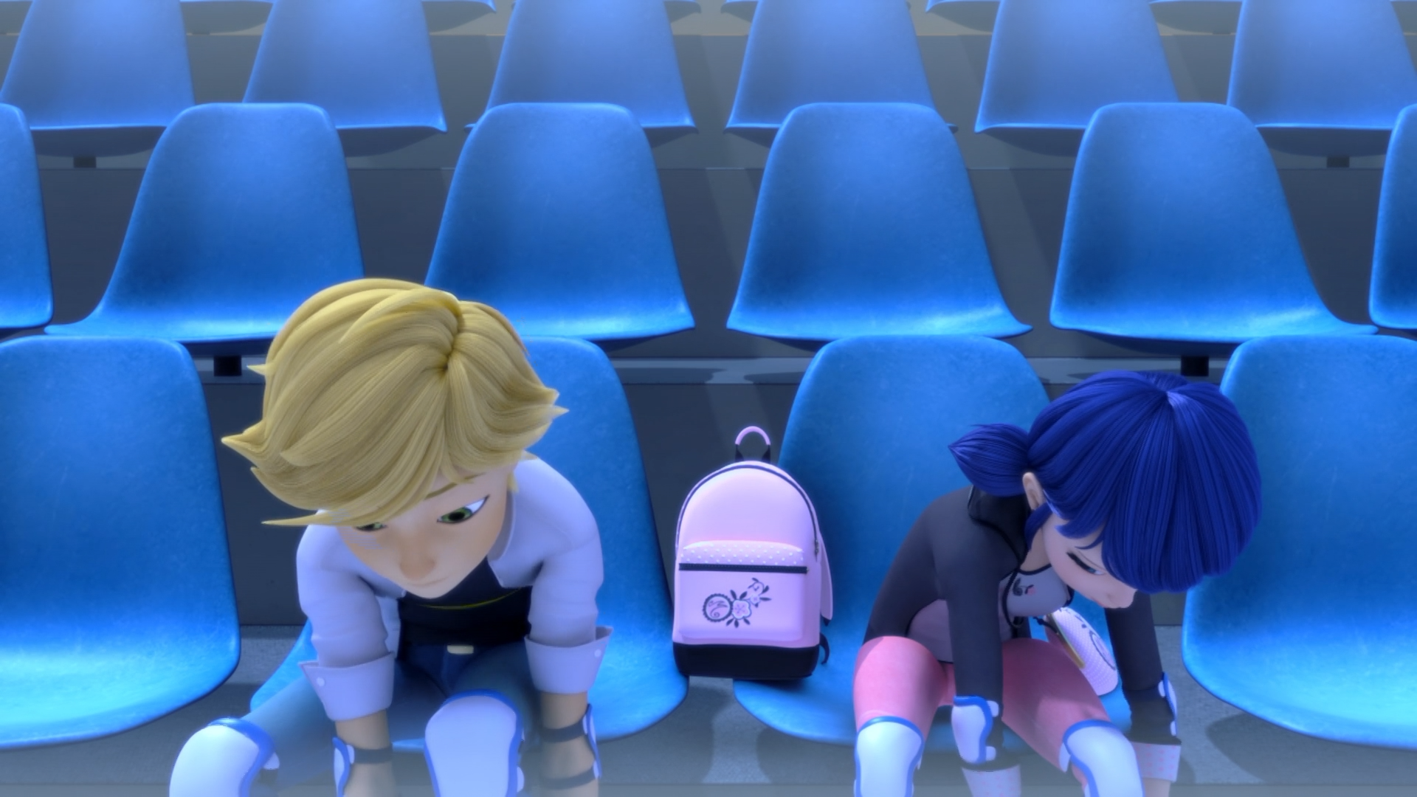
I don't know what to do about ______.
Origami
Tsunami
Kagami

Slide 13
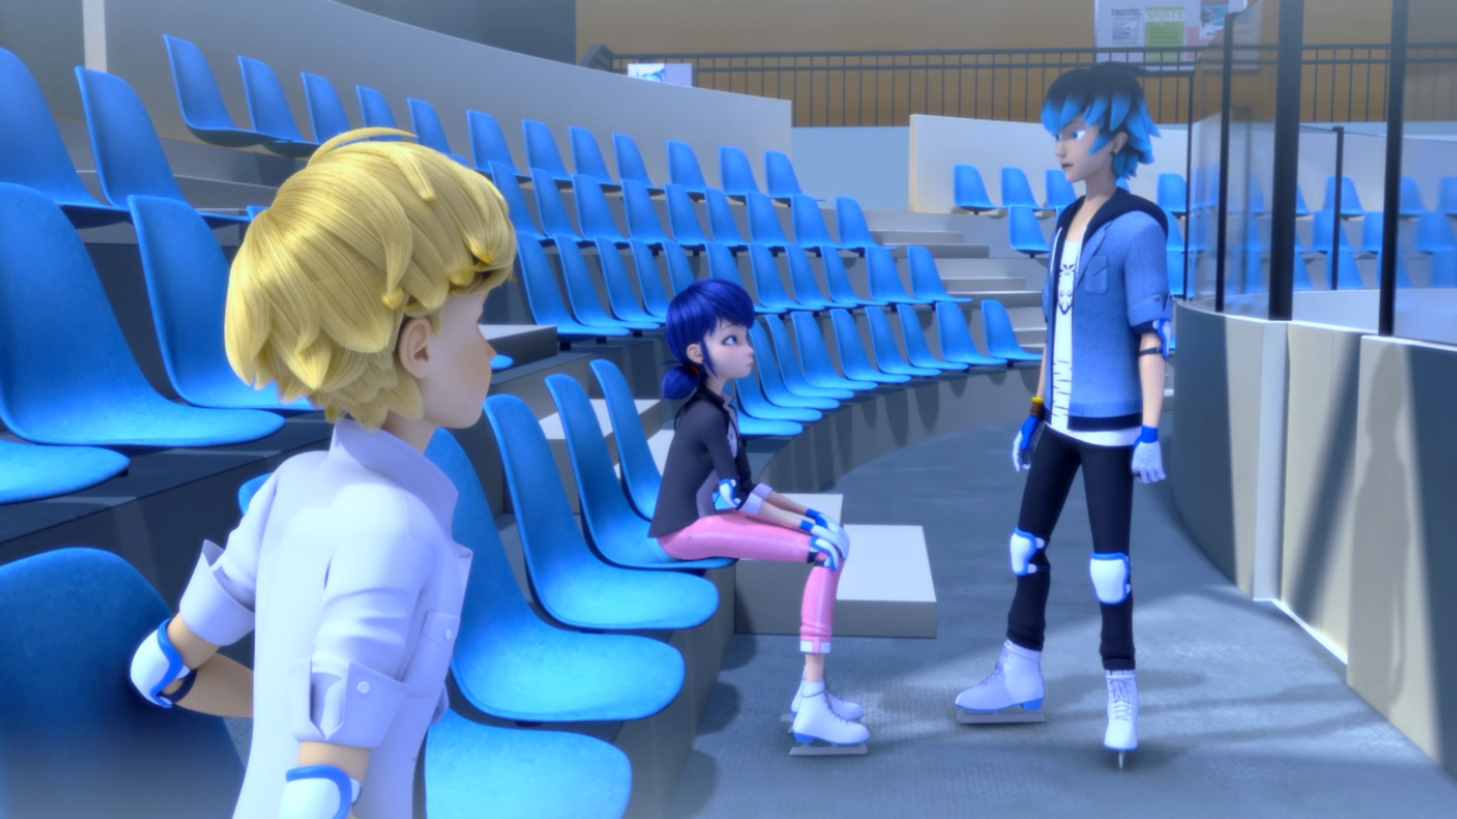
Try to be natural. Go with the flow and listen to the ______.
rhythm
music
teacher

Slide 14


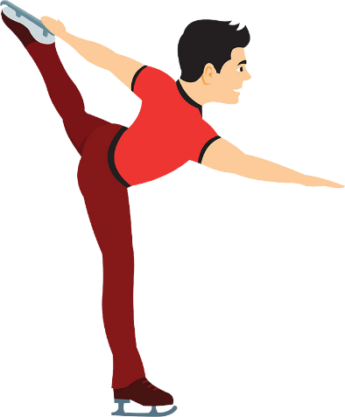

Matching Exercise
helmet | target | laces | figure skating

Slide 15
Matching Exercise
target | laces | figure skating | helmet

Slide 16
TRUE OR FALSE
1. Marinette accepts Cat Noir's rose.
2. Adrien has feelings for Kagami.
3. Adrien goes fencing with Kagami.
4. Chloé's father wants to turn the ice rink into a cafe.
5. Luka is going to write a song for Alya.

Slide 17
TRUE OR FALSE
1. Marinette accepts Cat Noir's rose. | FALSE
2. Adrien has feelings for Kagami. | TRUE
3. Adrien goes fencing with Kagami. | FALSE
4. Chloé's father wants to turn the ice rink into a gym. | TRUE
5. Luka is going to write a song for Alya. | FALSE

Slide 18
IELTS Speaking Exam. Jobs. Part 1
What job or career would you like to have in the future?
Do you think it's better to work for yourself or for someone else?
Would you prefer a job that pays well or a job that you enjoy?

