Slide 1
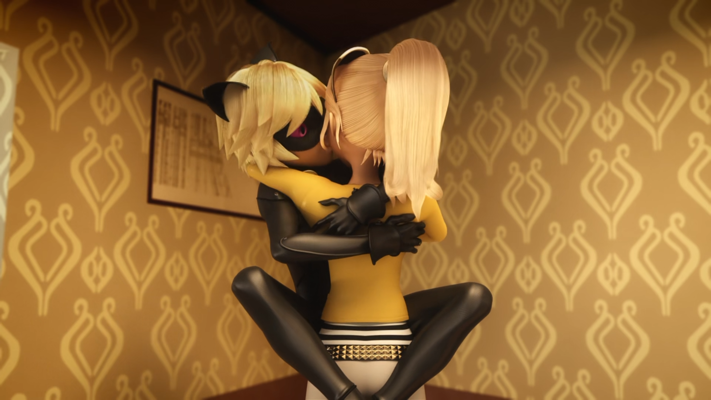
MIRACULOUS LADYBUG: ZOMBIZOU. PART 2

Slide 2
VOCABULARY
ankle - 脚踝 - æŋkᵊl
autograph - 签名 - ɔːtəɡrɑːf
citizens - 公民 - sɪtɪzᵊnz
compliment - 称赞 - kɒmplɪmənt
evacuate - 撤离 - ɪˈvækjueɪt
invade - 入侵 - ɪnˈveɪd
technical - 技术 - tɛknɪkᵊl
triumph - 胜利 - traɪəmf

Slide 3
1. 脚踝
2. 签名
3. tɛknɪkᵊl

Slide 4
1. 脚踝 - ankle
2. 签名 - autograph
3. tɛknɪkᵊl - technical

Slide 5
ZOMBIZOU. PART 2
Nadja: Yet again, it seems citizens of Paris are in great danger. Since this morning, a strange disease is spreading.
Cat Noir: Hey guys, I'm all for our French greetings, but let's hold off on the kisses for now, huh?
Ladybug: I'm glad you're here, Cat Noir. Check this out.

Slide 6
Zombizou: I took care of your father, Chloé. Show yourself!
Alix: Chloé! Huh! Always Chloé! You only think about yourself!
Alya: I don't know why we don't just give them what they want.
Nino: Yeah! Good idea!
Chloé: Is it my fault if I'm better than all of you?

Slide 7
Cat Noir: Stay together and follow me!
Ladybug: Nino! The vending machine! Quick! Everybody, inside the elevator!
Alya: Faster, faster!
Ladybug: Alya!
Nino: Oh...no!
Cat Noir: There's nothing we can do for her. Come on!

Slide 8
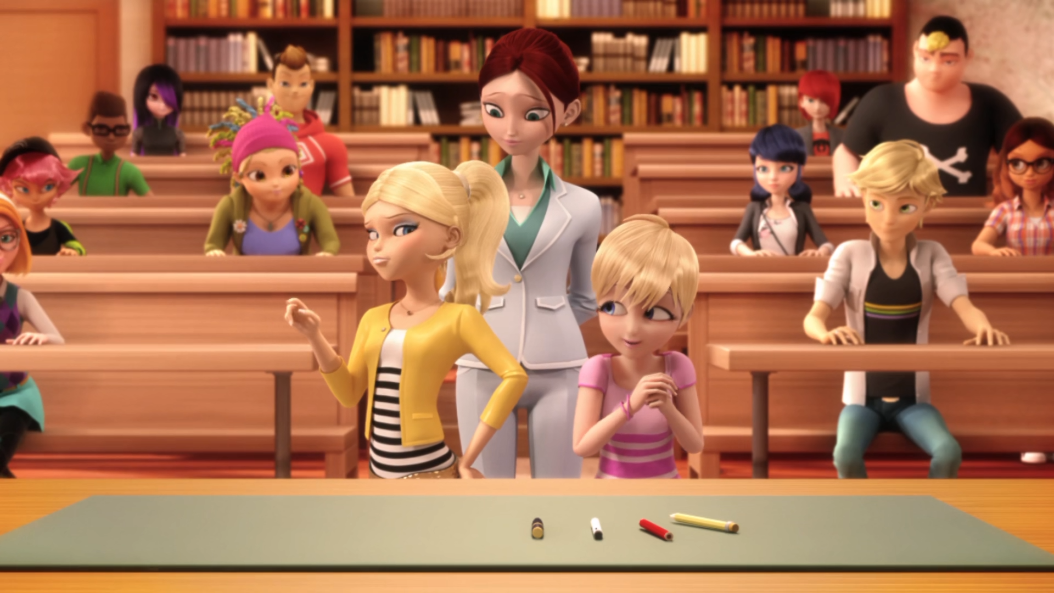

Yeah, well, today, ______, you seem less annoying.
Sabrina
Mylene
Rose

Slide 9
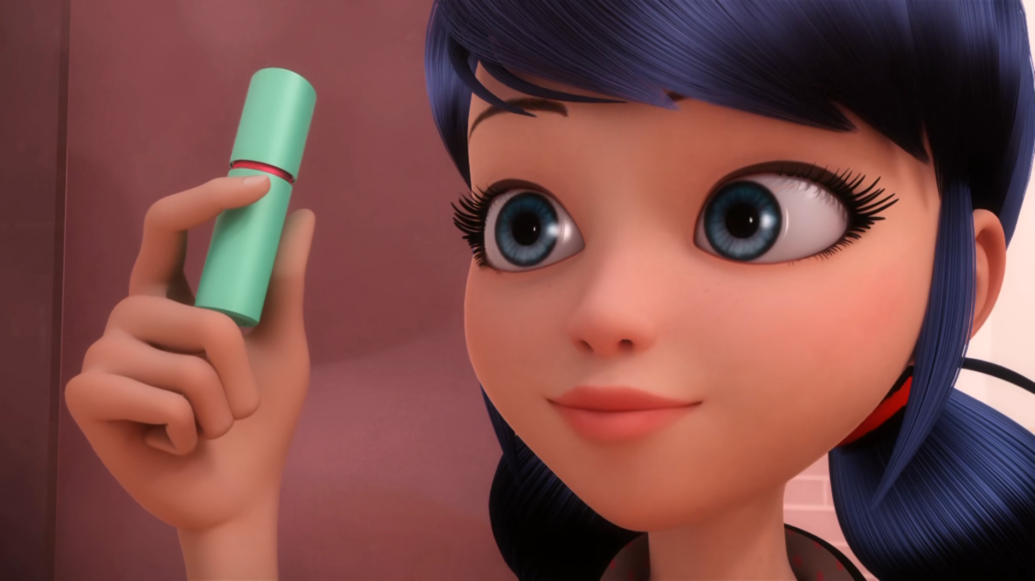
I also added this ______ of lip balm Miss Bustier's favourite color!
tube
box
tub

Slide 10
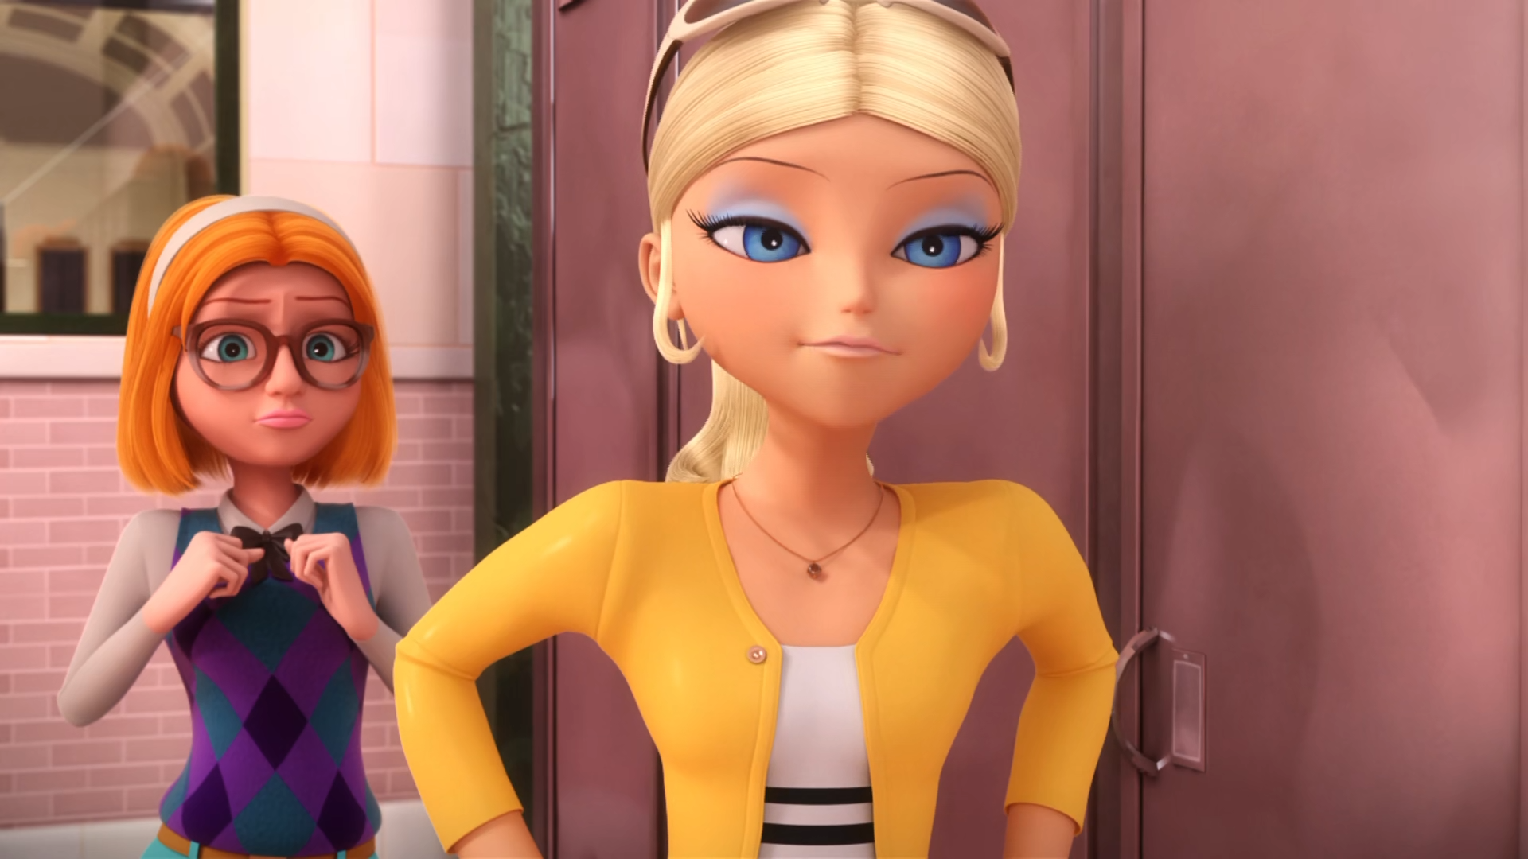
Uh, of course I have a ______!
brain
heart
boyfriend

Slide 11
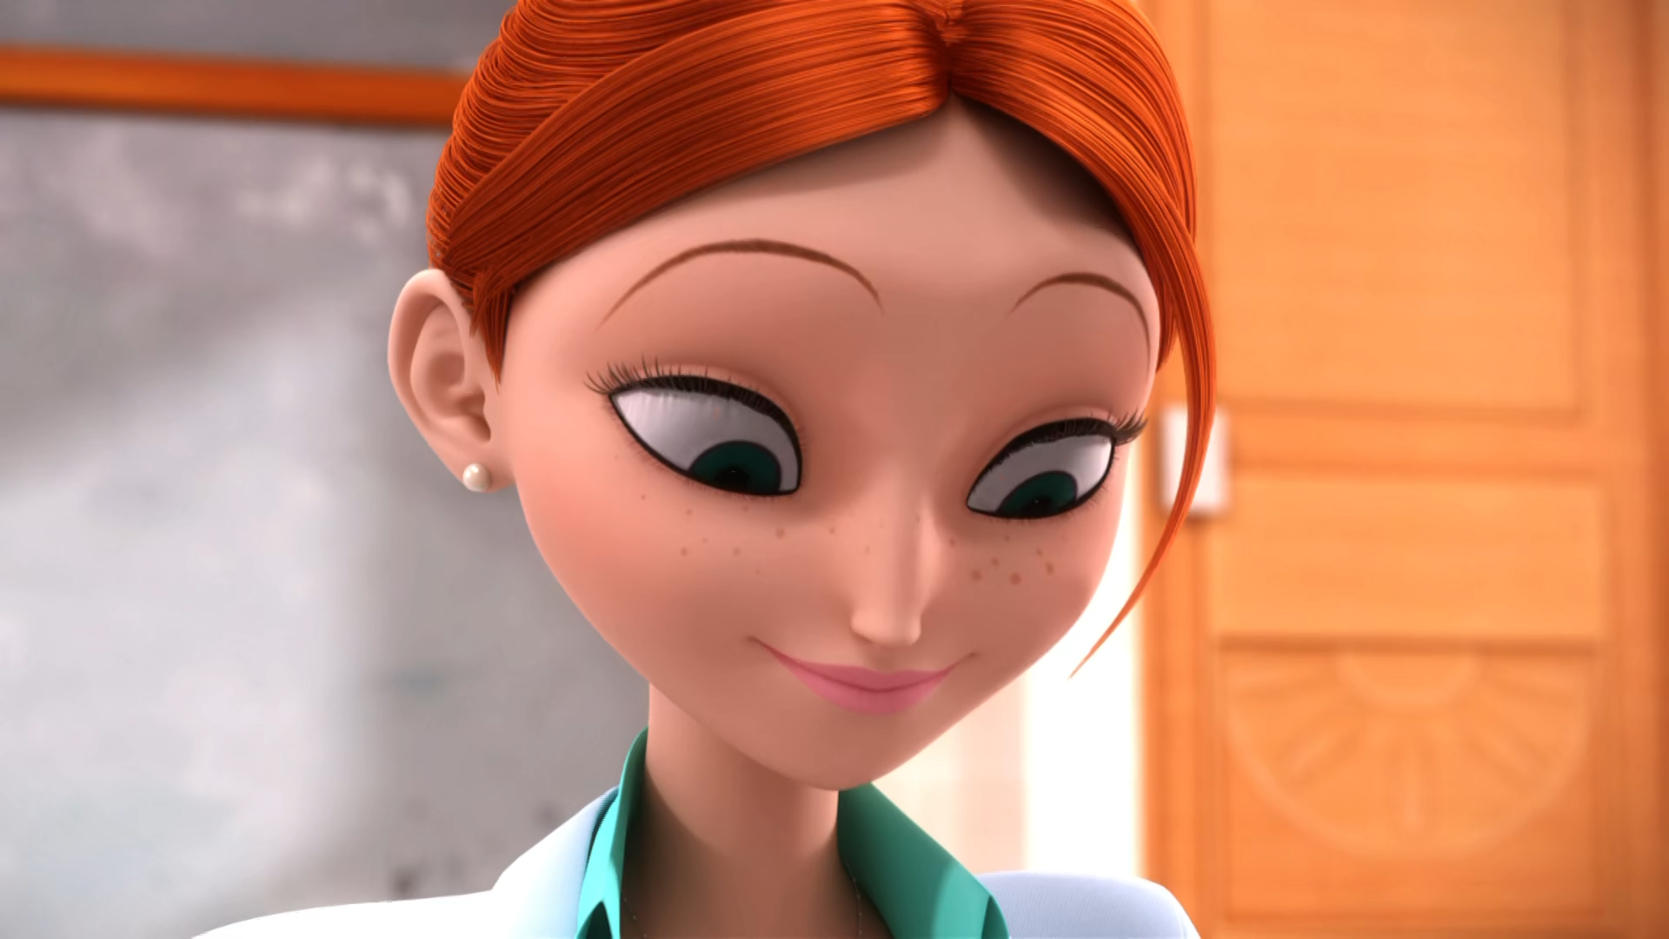
It'll be my new ______ bag!
make-up
cosmetics
lip-balm

Slide 12
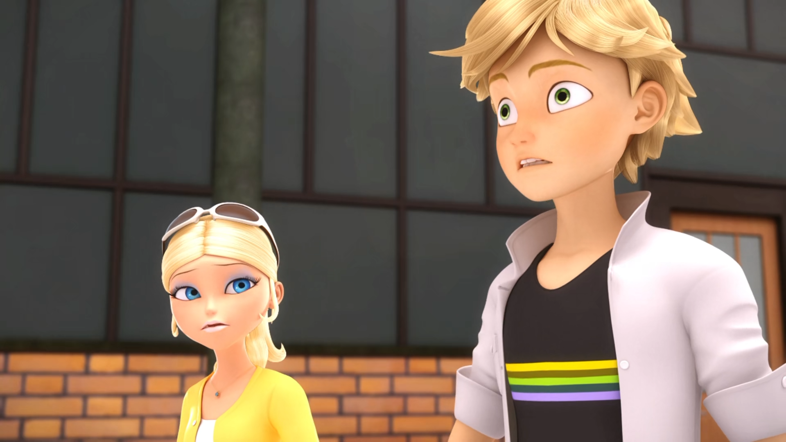
They're ______! Don't let yourselves get kissed!
dangerous
outrageous
contagious

Slide 13
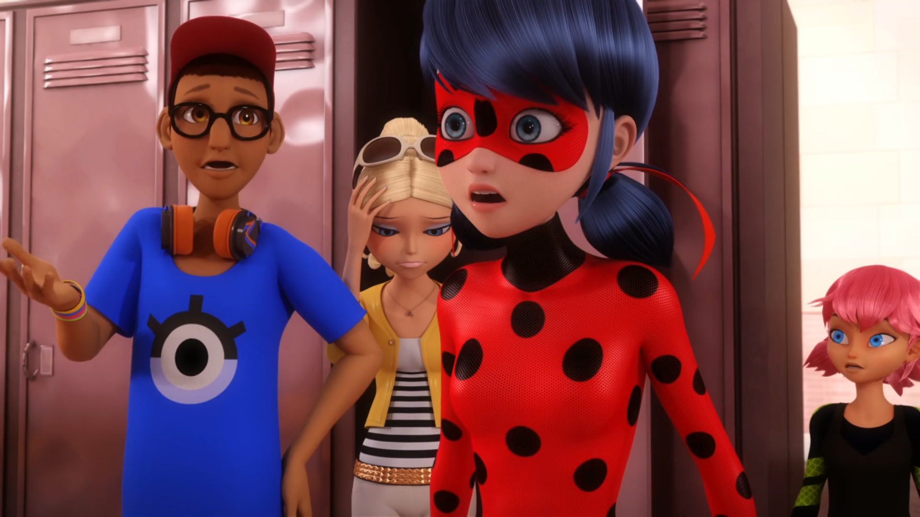
Adrien? He still hasn't come out of his ______.
locker
room
car

Slide 14

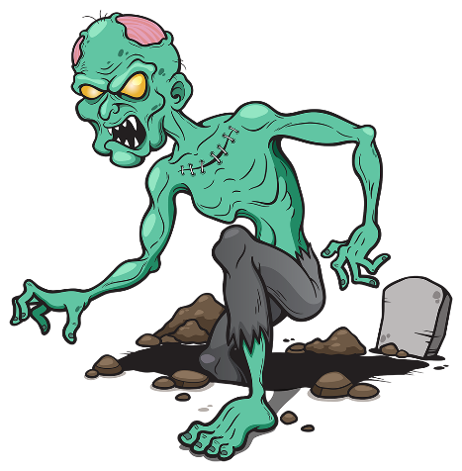
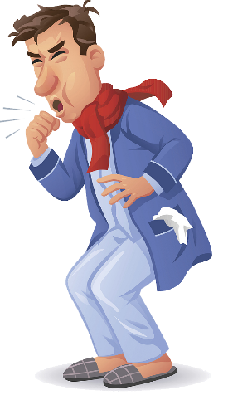
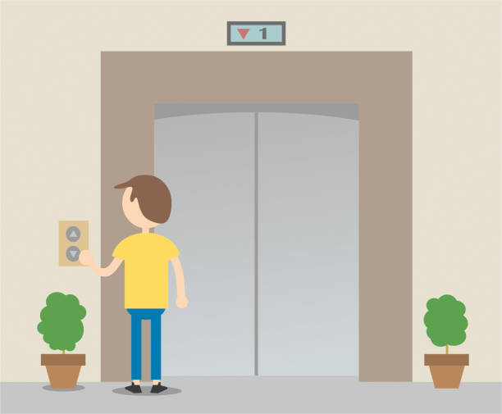
Matching Exercise
disease | elevator | neighbours | zombie

Slide 15
Matching Exercise
neighbours | zombie | disease | elevator

Slide 16
TRUE OR FALSE
1. Cat Noir doesn't know how to drive.
2. Chloé twisted her ankle.
3. Cat Noir drives to the Eiffel Tower.
4. Zombies jump Alya when she opens the elevator.
5. Chloé forgot her teacher's birthday.

Slide 17
TRUE OR FALSE
1. Cat Noir doesn't know how to drive. | FALSE
2. Chloé twisted her ankle. | TRUE
3. Cat Noir drives to the Eiffel Tower. | TRUE
4. Zombies jump Alya when she opens the elevator. | TRUE
5. Marinette forgot her teacher's birthday. | FALSE

Slide 18
IELTS Speaking Exam. Social Media. Part 2
Describe your favourite social media platform. You should say:
what it is
how often you use it
what features you like
why it is your favourite.

