Slide 1
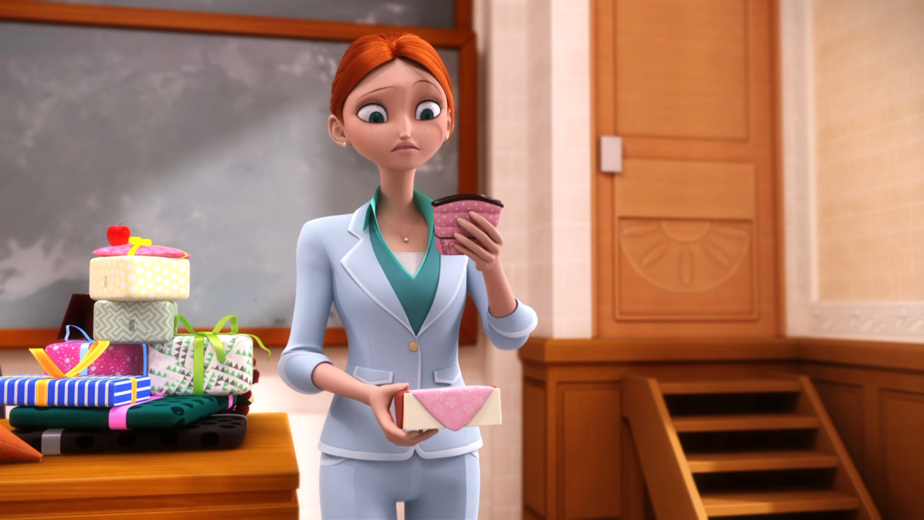
MIRACULOUS LADYBUG: ZOMBIZOU. PART 1

Slide 2
VOCABULARY
compassion - 同情心 - kəmˈpæʃᵊn
contagious - 传染性 - kənˈteɪʤəs
injustice - 不公正 - ɪnˈʤʌstɪs
lake - 湖泊 - leɪk
ploy - 诡计 - plɔɪ
rely - 依赖 - rɪˈlaɪ
smooch - 亲吻 - smuːtʃ
surface - 表面 - ˈsɜːfɪs

Slide 3
1. 湖泊
2. 依赖
3. smuːtʃ

Slide 4
1. 湖泊 - lake
2. 依赖 - rely
3. smuːtʃ - smooch

Slide 5
ZOMBIZOU. PART 1
Rose: Morning, Chloé! Your hair is really pretty today!
Chloé: What do you mean, "today"? My hair is always pretty. Yeah, well, today, Rose, you seem less...annoying.
Rose: Oh!. Isn't it great to start the day by sharing a few kind words with each other?

Slide 6
Zombizou: I have got some great news for you, students! From now on, everyone's going to hug and kiss and feel the love! Even you, Chloé.
Chloé: Me? Ah! Yuck! Ew!
Sabrina: Oh! What is that thing?
Ladybug: Please, Miss! You've gotta snap out of it!

Slide 7
Nino: Ladybug!
Ladybug: Are you all okay?
Alya: Looks like it.
Nino: Uh... Adrien? He still hasn't come out of his locker.
Ladybug: Adrien?
Adrien: Kissy-boo...
Alya: Oh, man. He must've gotten kissed on the stairs when he was saving Chloé.

Slide 8
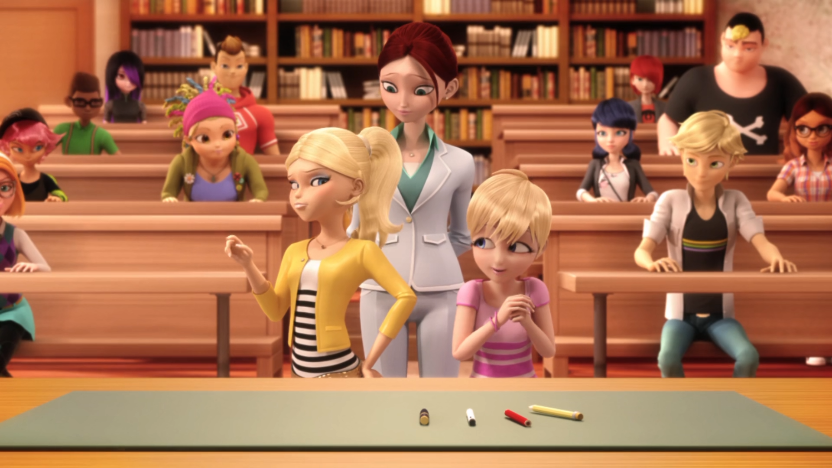

Yeah, well, today, ______, you seem less annoying.
Sabrina
Mylene
Rose

Slide 9
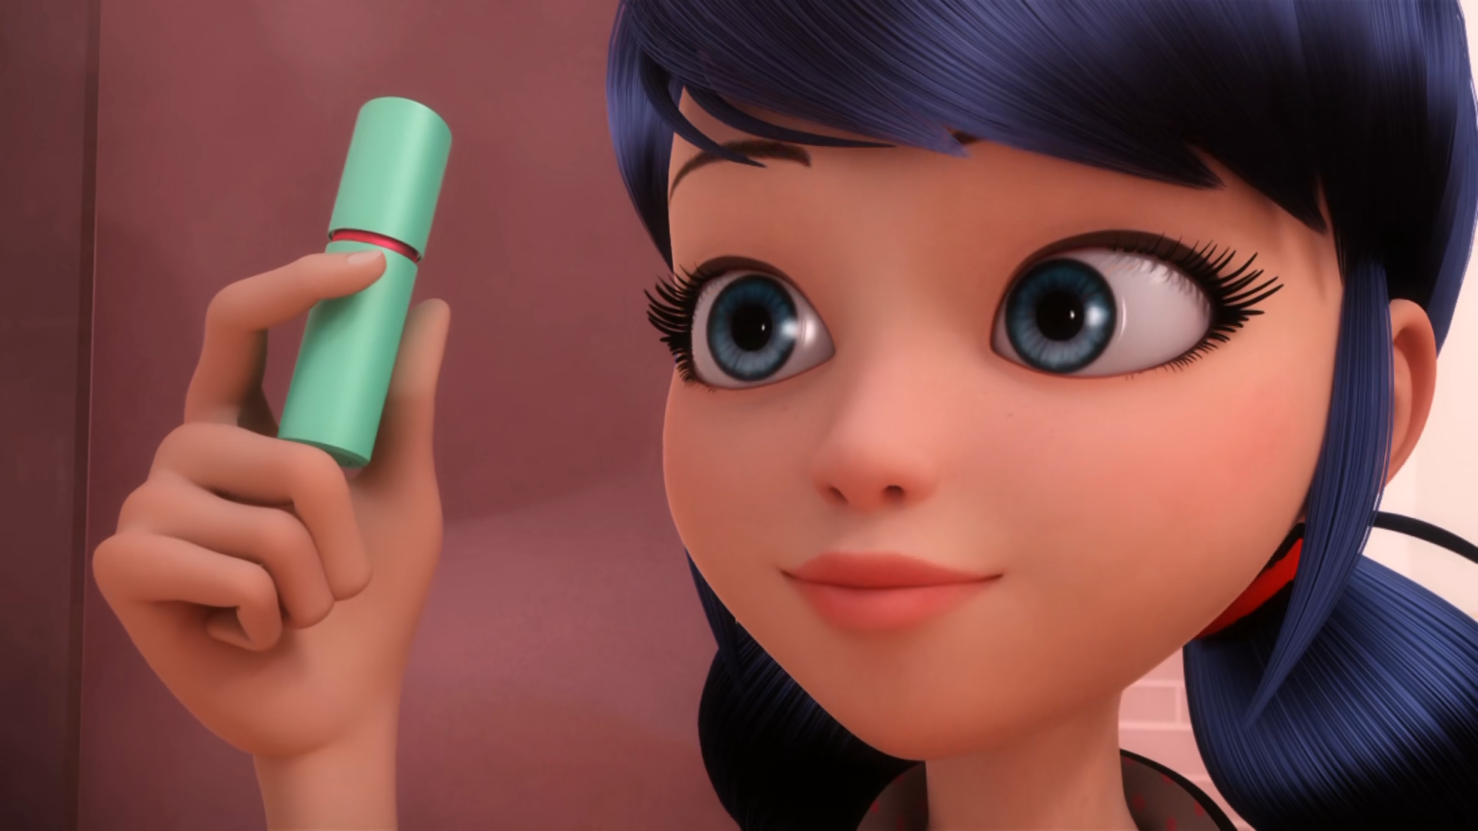
I also added this ______ of lip balm Miss Bustier's favourite color!
tube
box
tub

Slide 10
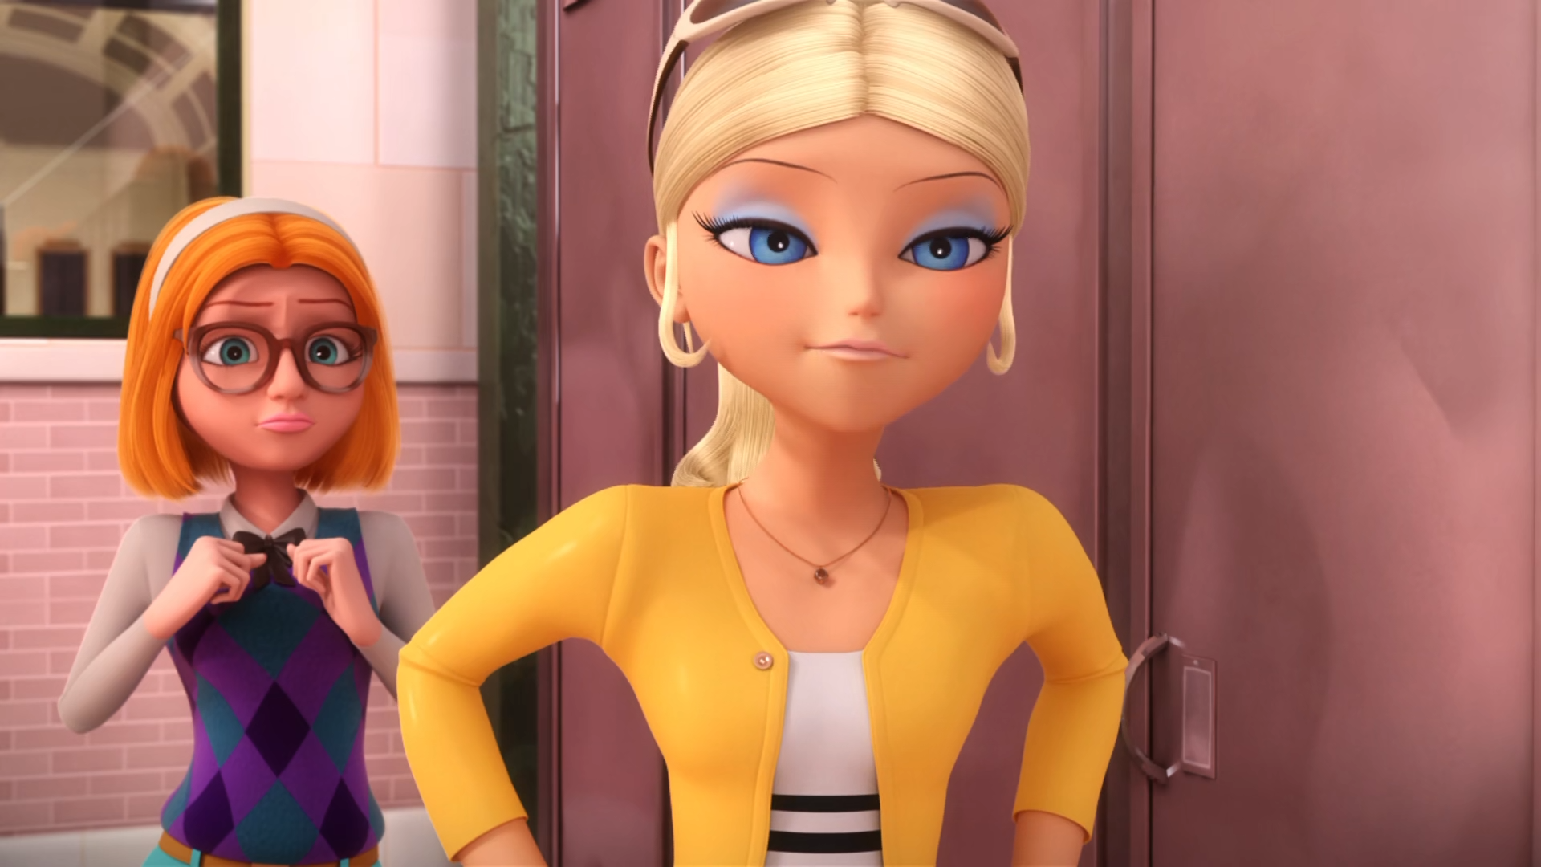
Uh, of course I have a ______!
brain
heart
boyfriend

Slide 11
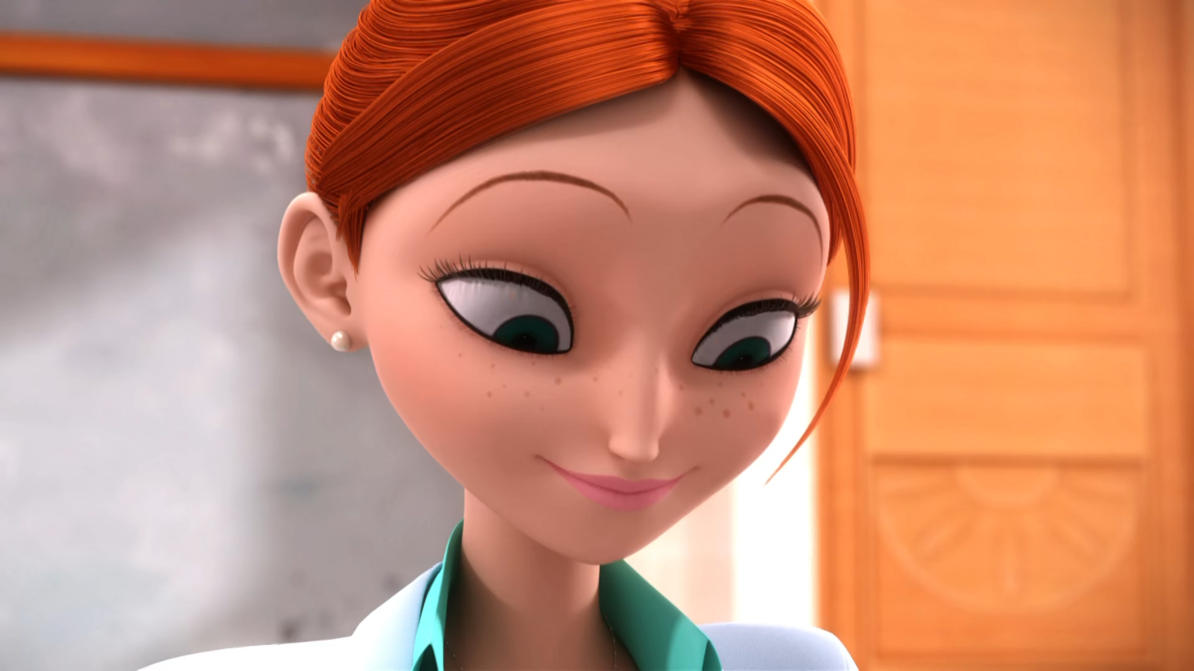
It'll be my new ______ bag!
make-up
cosmetics
lip-balm

Slide 12
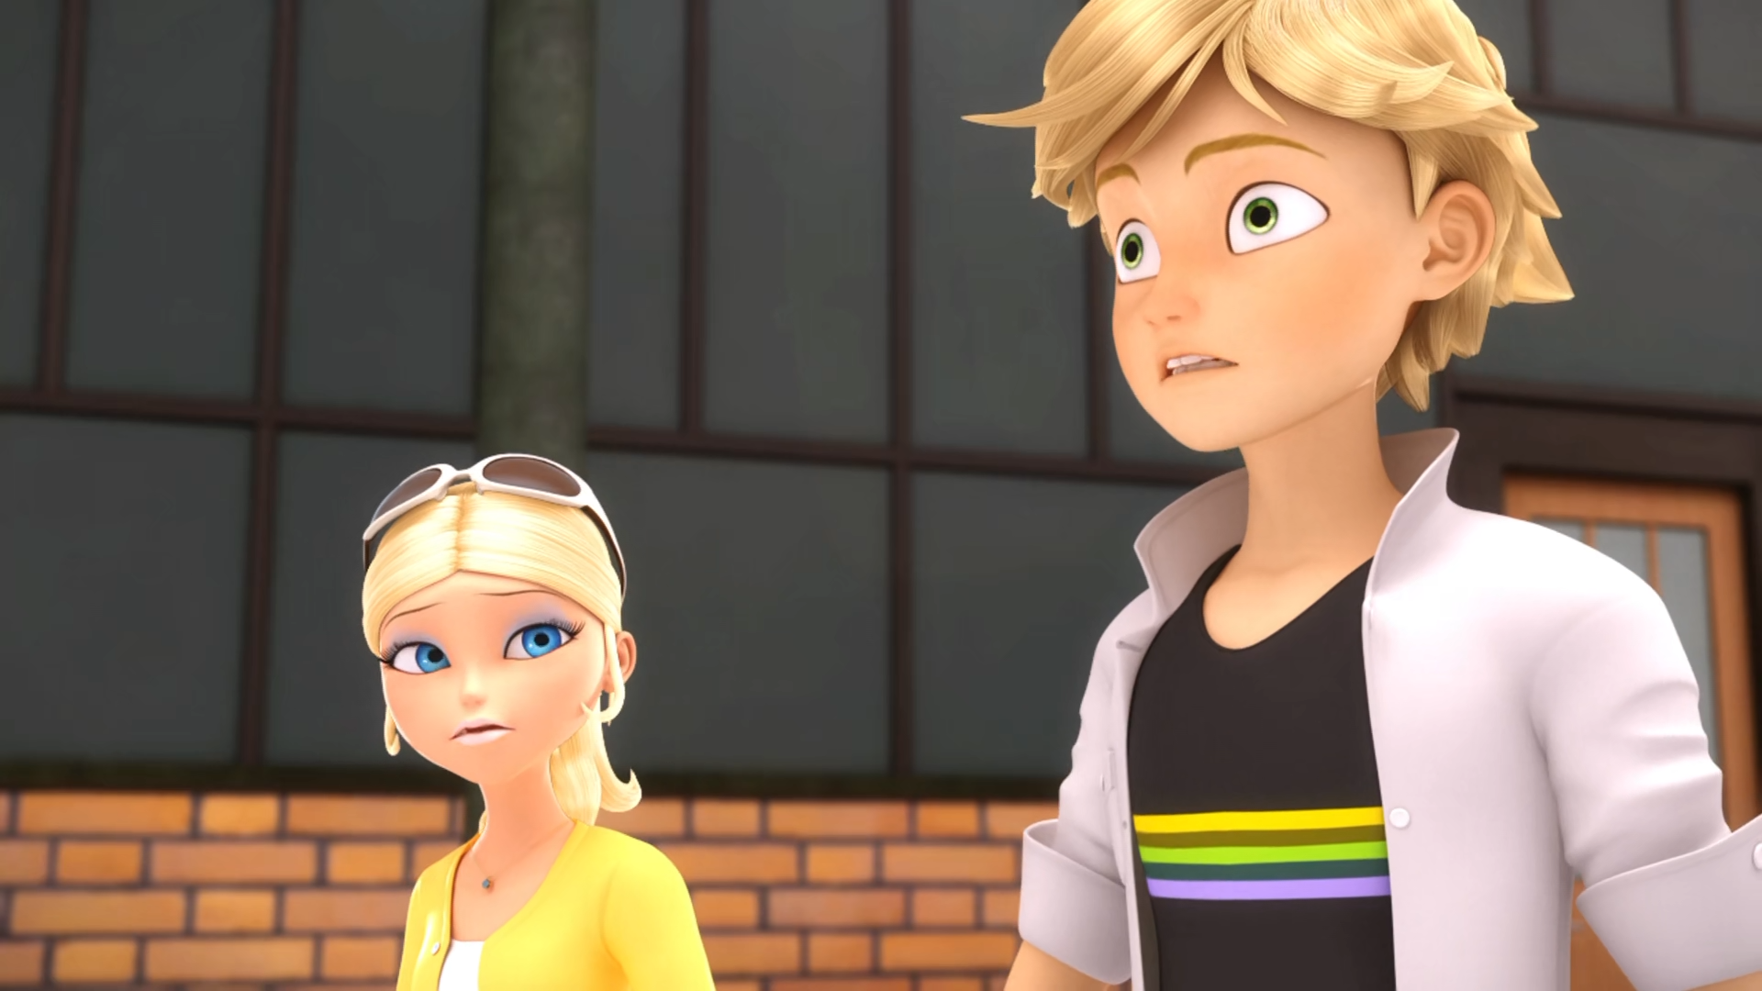
They're ______! Don't let yourselves get kissed!
dangerous
outrageous
contagious

Slide 13
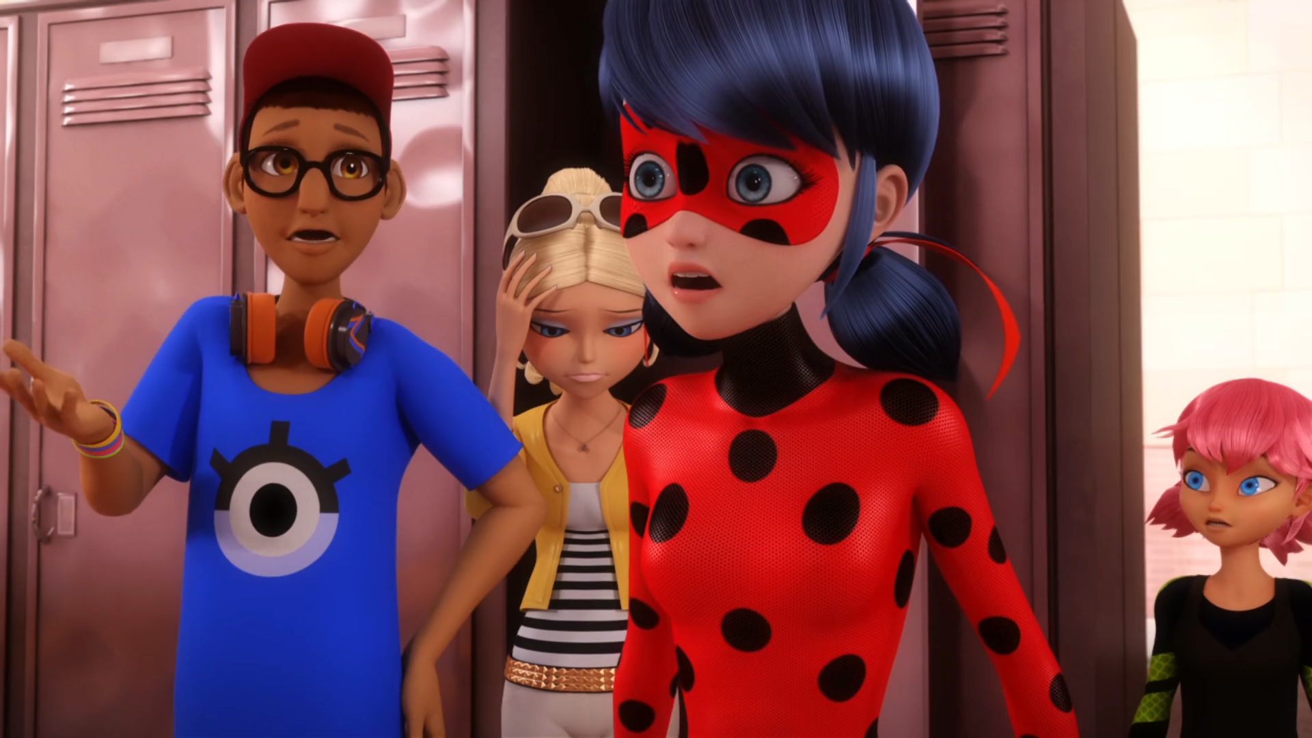
Adrien? He still hasn't come out of his ______.
locker
room
car

Slide 14
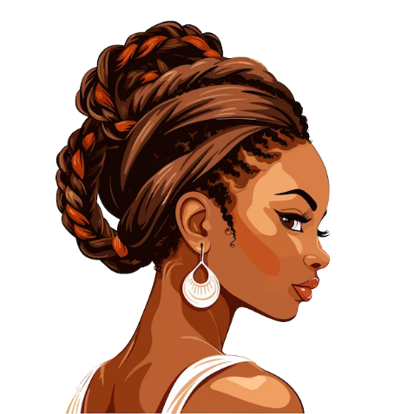
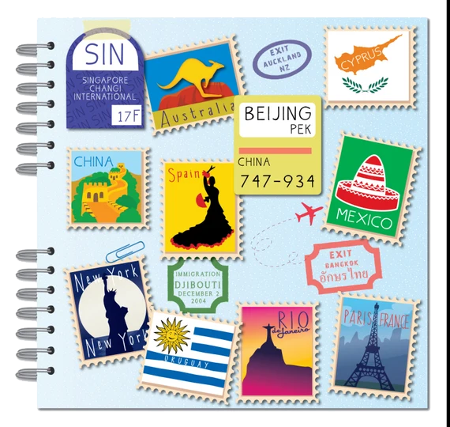

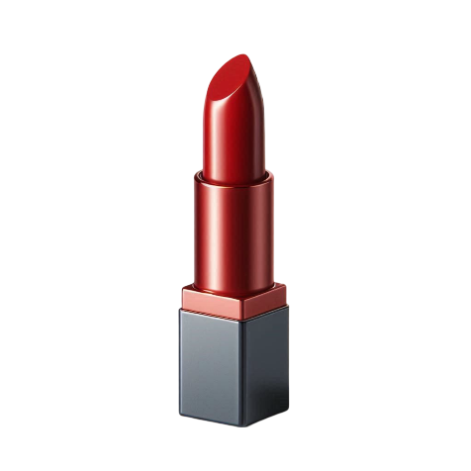
Matching Exercise
tube | lip balm | braids | scrapbook

Slide 15
Matching Exercise
lip balm | braids | scrapbook | tube

Slide 16
TRUE OR FALSE
1. It's the teacher's birthday.
2. Rose made a diary.
3. Chloé doesn't like birthdays.
4. Sabrina kisses Mylene.
5. Marinette throws Adrien into a locker.

Slide 17
TRUE OR FALSE
1. It's the teacher's birthday. | TRUE
2. Rose made a diary. | FALSE
3. Chloé doesn't like birthdays. | TRUE
4. Sabrina kisses Mylene. | TRUE
5. Marinette throws Adrien into a locker. | FALSE

Slide 18
IELTS Speaking Exam. Social Media. Part 1
Which social media platforms do you use the most?
What do you like about using social media?
How has social media changed the way we communicate?

