Slide 1
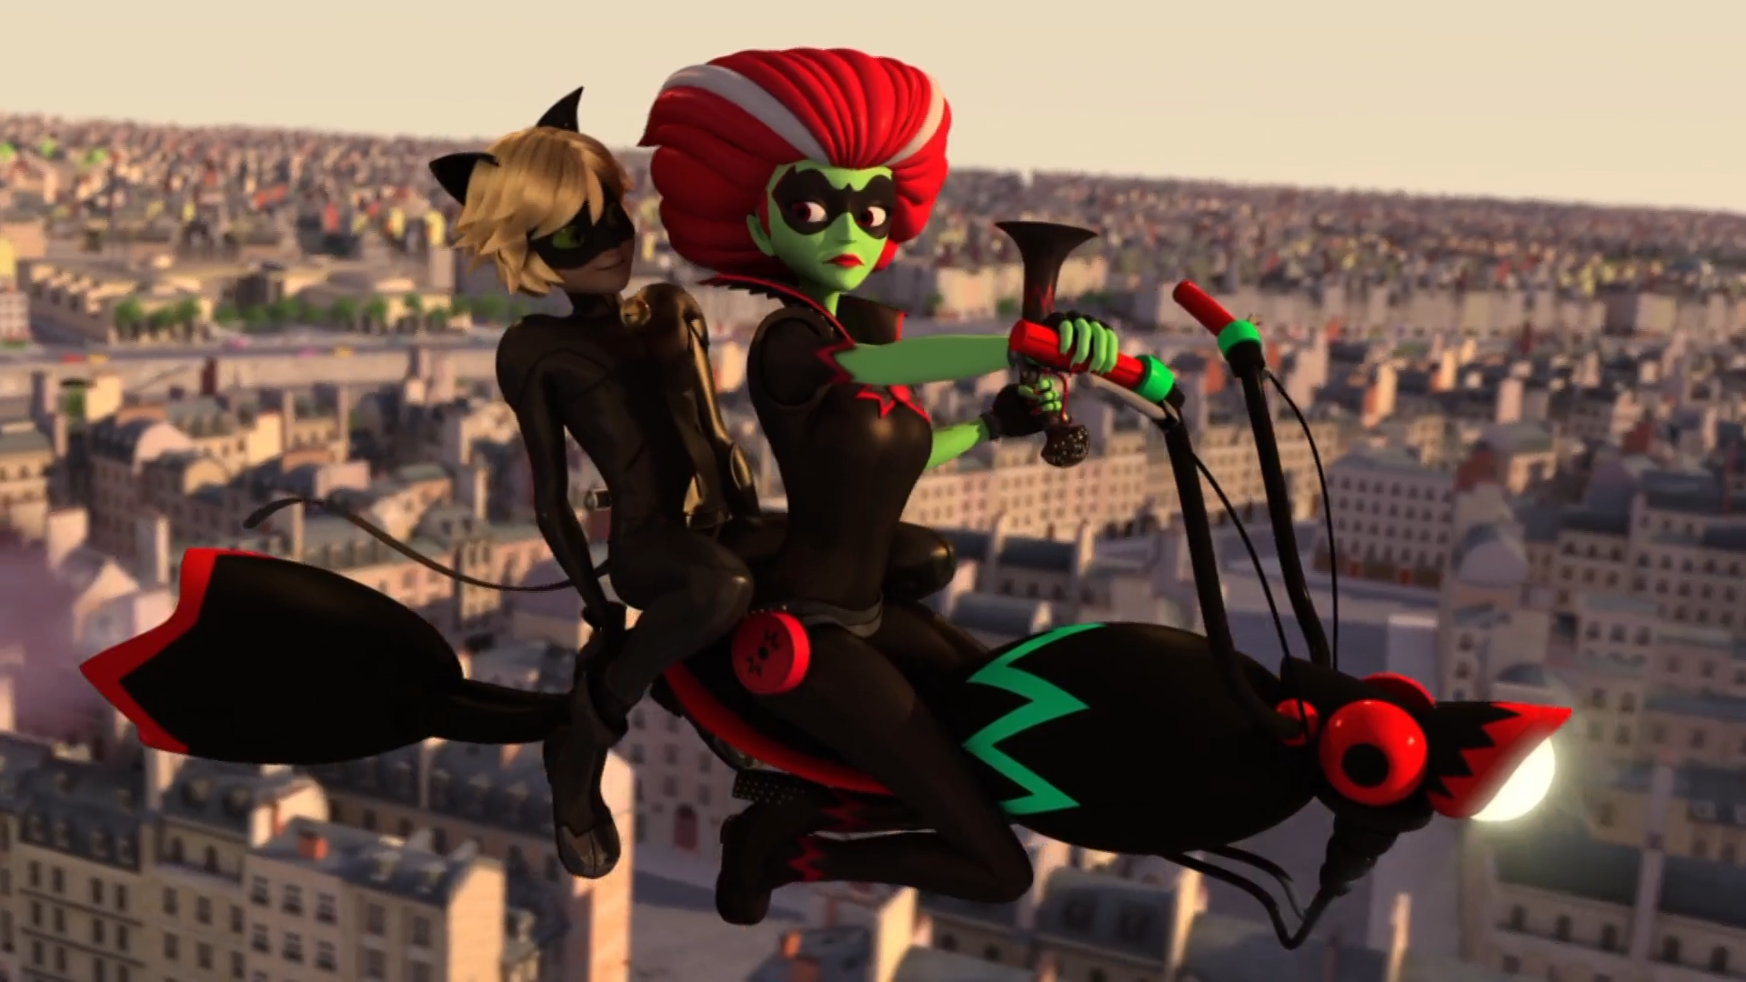
MIRACULOUS LADYBUG: BEFANA. PART 2

Slide 2
VOCABULARY
compulsive - 强迫性的 - kəmˈpʌlsɪv
convince - 说服的 - kənˈvɪns
dodge - 躲避的 - dɒʤ
nasty - 令人讨厌的 - nɑːsti
noble - 高尚的 - nəʊbᵊl
pesky - 令人讨厌的 - pɛski
precious - 珍贵的 - prɛʃəs
rude - 粗鲁的 - ruːd

Slide 3
1. dɒʤ
2. 令人讨厌的
3. 粗鲁的

Slide 4
1. dɒʤ - dodge
2. 令人讨厌的 - nasty
3. 粗鲁的 - rude

Slide 5
BEFANA. PART 2
Cat Noir: Hey, I never knew grandmas could be so nasty.
Befana: You would look wonderful in white, my pretty kitty.
Cat Noir: Eh, not convinced. I'm much more into black - makes my eyes stand out, don't you think?
Befana: Take care of this pesky pussycat!

Slide 6
Befana: The time has come to teach you a lesson.
Alya: Marinette is not a liar!
Befana: Someone has to teach you table manners!
Marinette: Alya! No, Kim!
Befana: That's what you get for stealing candy, you bunch of ill-mannered kids!

Slide 7
Marinette: Do you realize? He made it specially for me, with his own hands.
Tikki: Yeah, well, it's kind of a weird gift if you ask me.
Marinette: But that doesn't mean they're not both precious to me. The most important thing about a present, Tikki, is the person who's giving it.

Slide 8
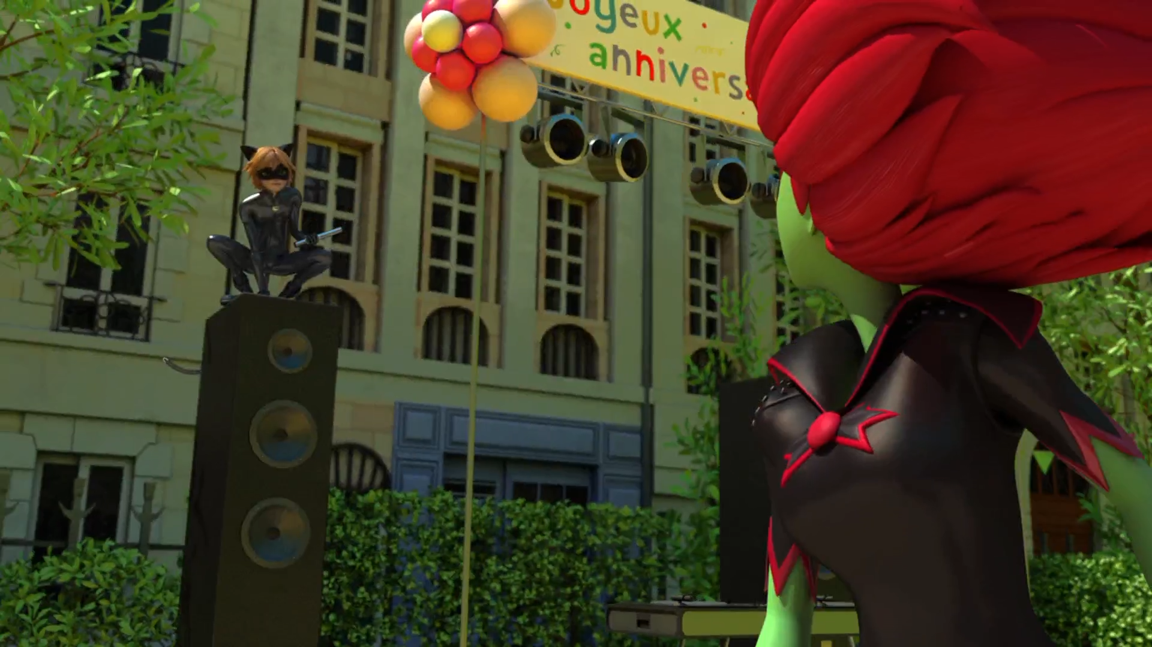

Hey, I never knew grandmas could be so ______.
old
mean
nasty

Slide 9
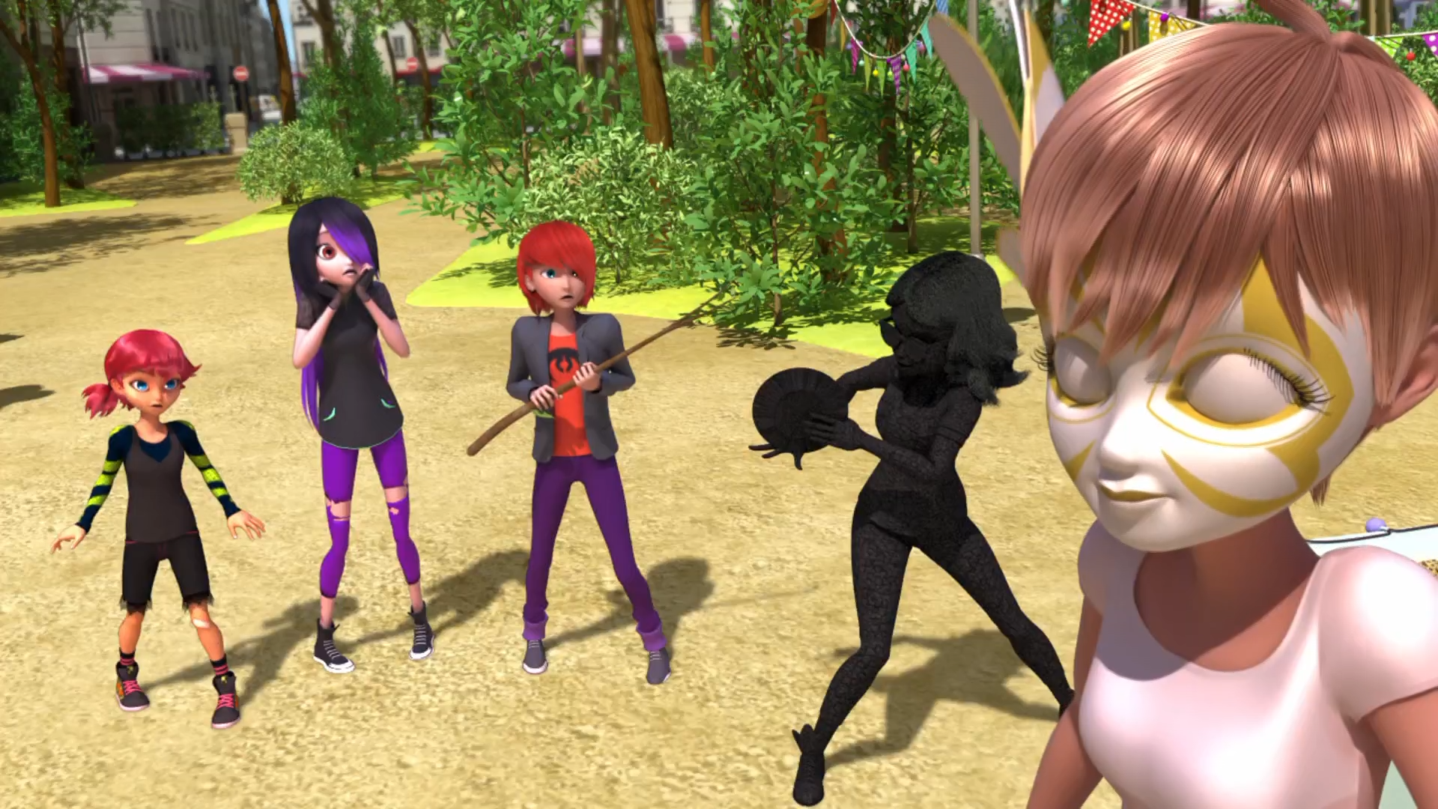
Okay. I shall make you a ______.
fairy
pig
boy

Slide 10
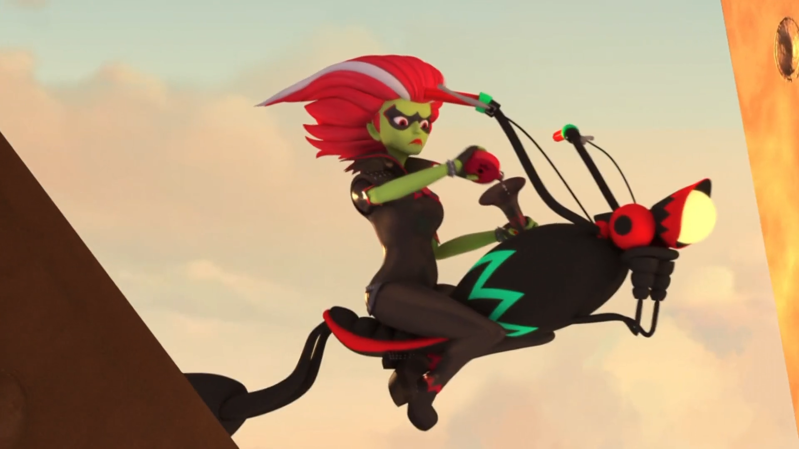
The candy ______. The akuma must be in there.
purse
bag
wallet

Slide 11
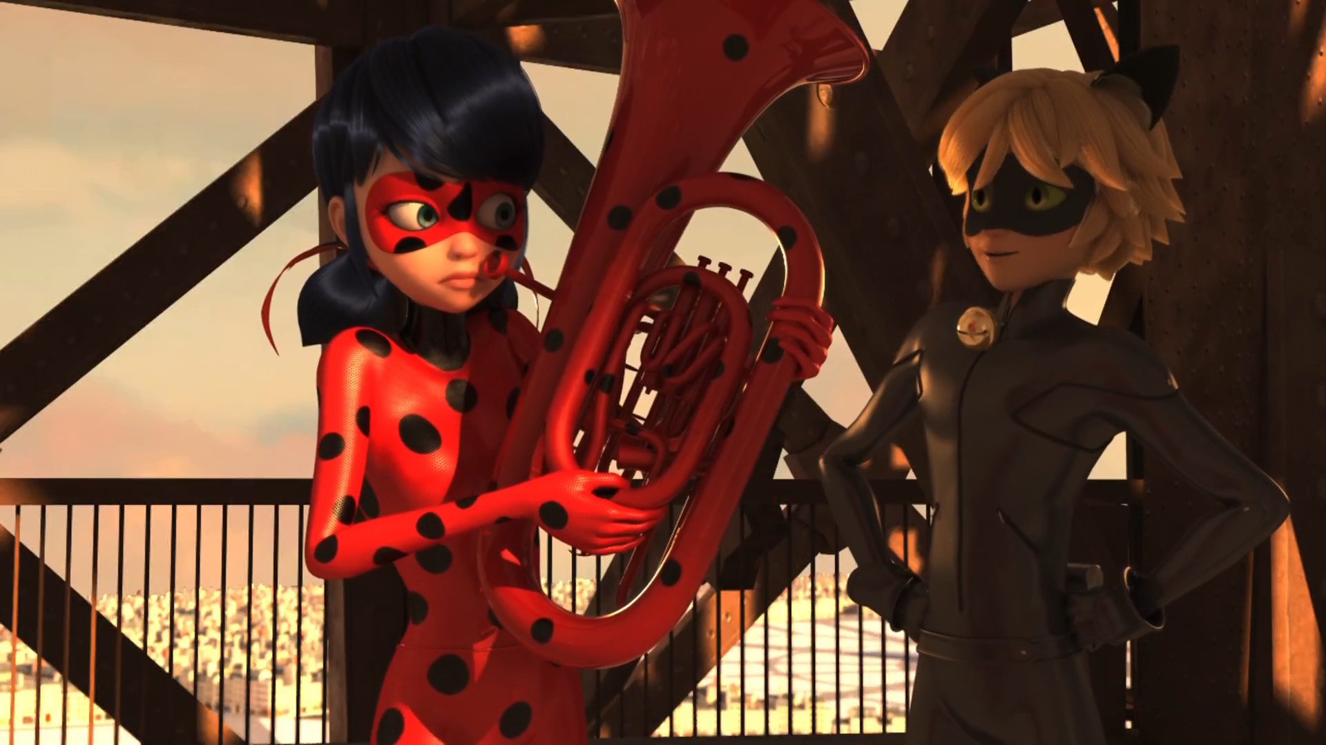
You didn't tell me you played the ______.
trumpet
tuba
trombone

Slide 12
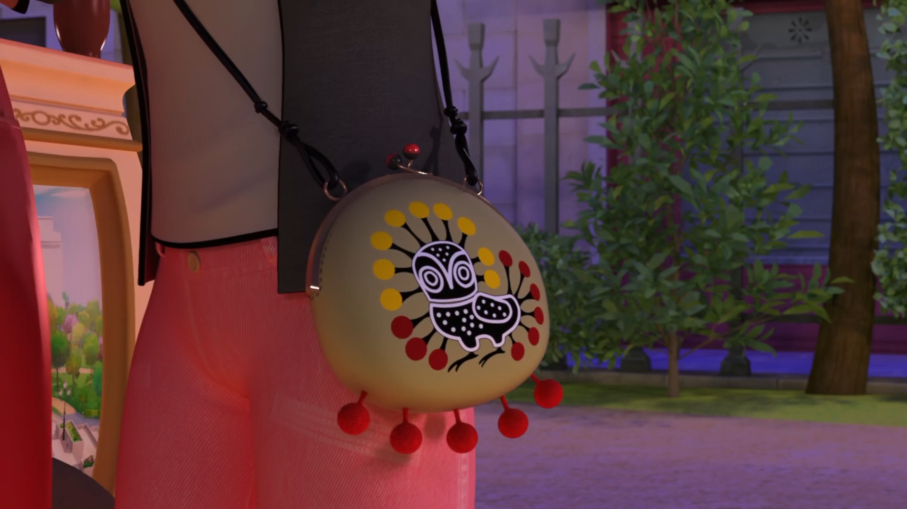
I've been ______ ever since the last time you came to visit.
drawing
painting
sewing

Slide 13
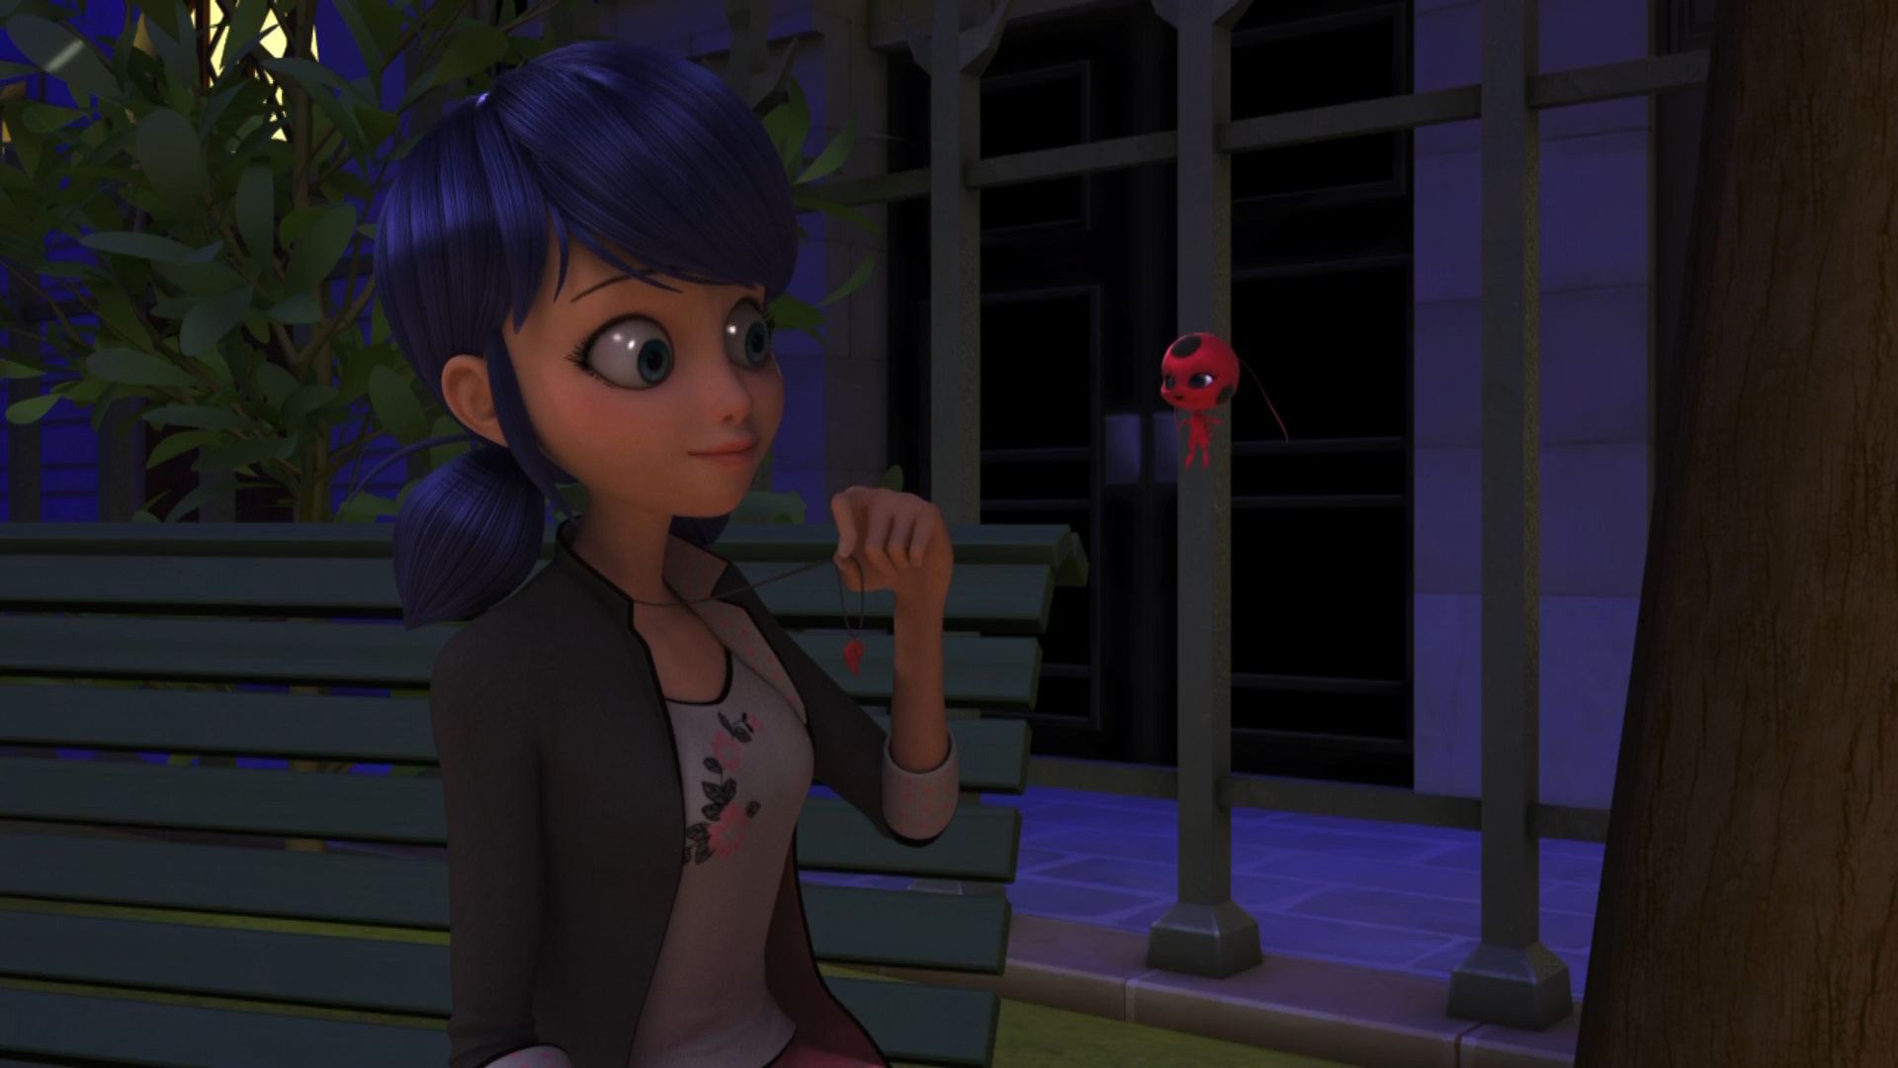
The most important thing about a present is the ______ who's giving it!
person
boy
girl

Slide 14
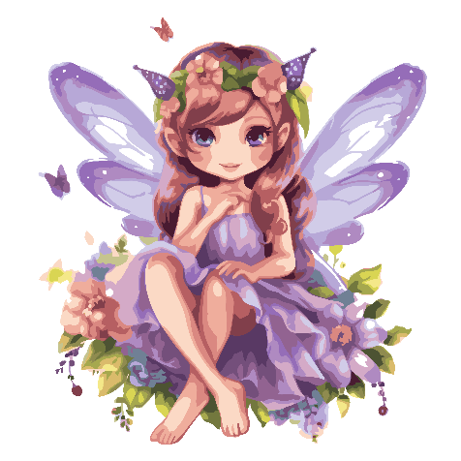

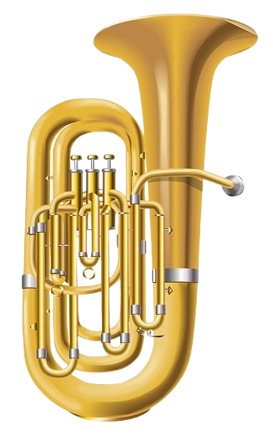

Matching Exercise
broom | fairy | fire hydrant | tuba

Slide 15
Matching Exercise
fairy | fire hydrant | tuba | broom

Slide 16
TRUE OR FALSE
1. Alya is turned into coal.
2. Rose is turned into a fairy.
3. It's Cat Noir's birthday.
4. Marinette plays the tuba.
5. Adrien makes Marinette a lucky charm.

Slide 17
TRUE OR FALSE
1. Alya is turned into coal. | TRUE
2. Rose is turned into a fairy. | TRUE
3. It's Cat Noir's birthday. | FALSE
4. Marinette plays the tuba. | FALSE
5. Adrien makes Marinette a lucky charm. | TRUE

