Slide 1
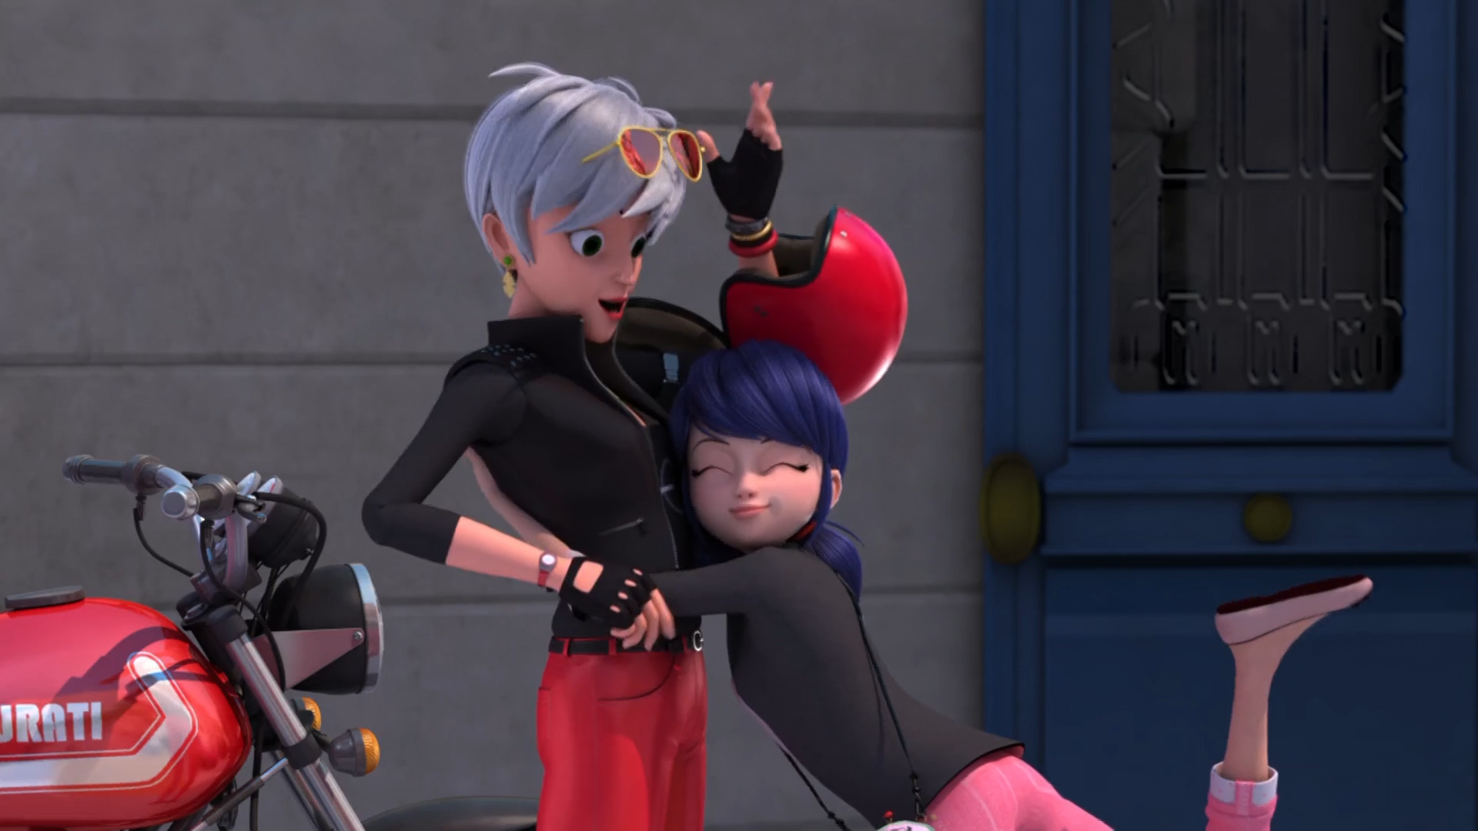
MIRACULOUS LADYBUG: BEFANA. PART 1

Slide 2
VOCABULARY
buffet - 自助餐 - bʌfɪt
chase - 追逐 - ʧeɪs
conclusion - 结论 - kənˈkluːʒᵊn
knitted - 针织 - nɪtɪd
punish - 惩罚 - pʌnɪʃ
resin - 树脂 - rɛzɪn
reward - 奖励 - rɪˈwɔːd
spoil - 掠夺 - spɔːɪl
symbol - 符号 - sɪmbᵊl

Slide 3
1. 结论
2. 惩罚
3. rɛzɪn

Slide 4
1. 结论 - conclusion
2. 惩罚 - punish
3. rɛzɪn - resin

Slide 5
BEFANA. PART 1
Tikki: We take a hair from our Miraculous holder and join it to the hairs of all the former Miraculous holders.
Marinette: I-I really love your gift. It's just that Alya should already have called me by now. We're supposed to be taking her little sister to the "dentist" at four o'clock today.

Slide 6
Marinette: Grandma?!
Tom: Mom?
Sabine: Gina?
Gina: Marinetta! You're so tall for your age! Did you get my letter from Patagonia?
Marinette: Yes! And the ones from Australia, Bali, and Estonia, too! Did you really get chased by a bear?!

Slide 7
Gina: Happy birthday, my little fairy! My friend knitted it especially for your tenth birthday!
Tom: Uh, she's fourteen.
Gina: My. How time flies.
Marinette: No! No, it's awesome! I can make this work. It's perfect, grandma. Thank you.
Gina: Your Nonna has also brought you your favourite candy!

Slide 8
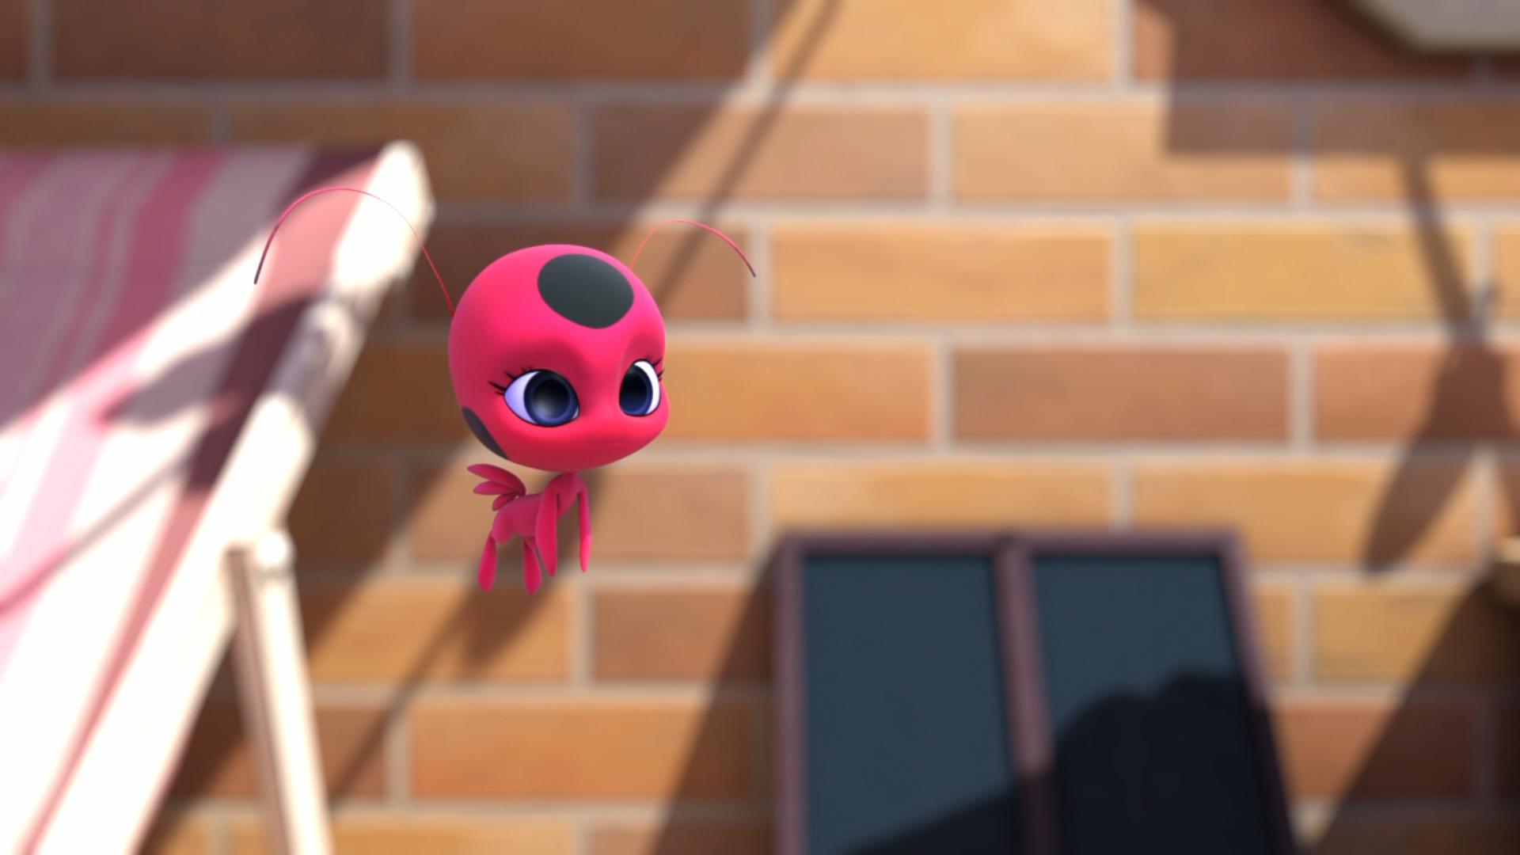

Do you always celebrate your birthday by going to the ______?
doctor
toilet
dentist

Slide 9
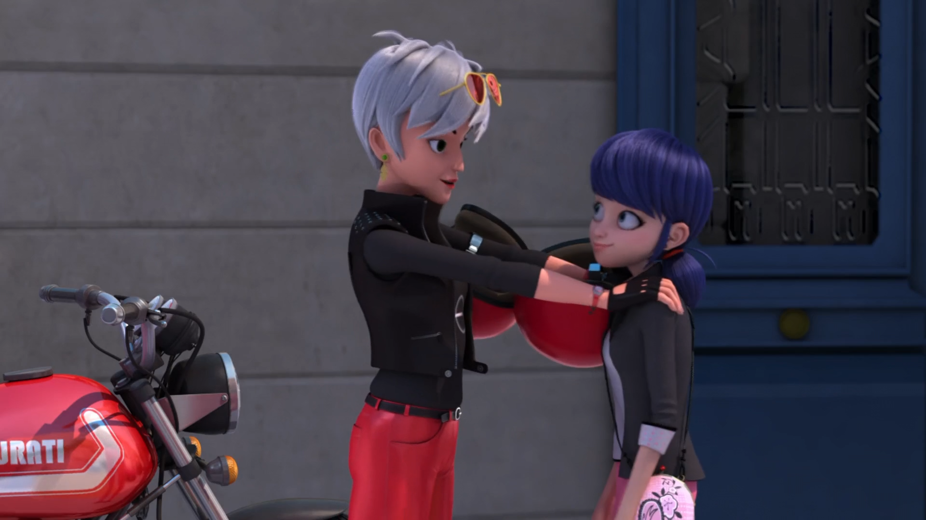
Marinetta! You're so ______ for
your age!
tall
small
big

Slide 10
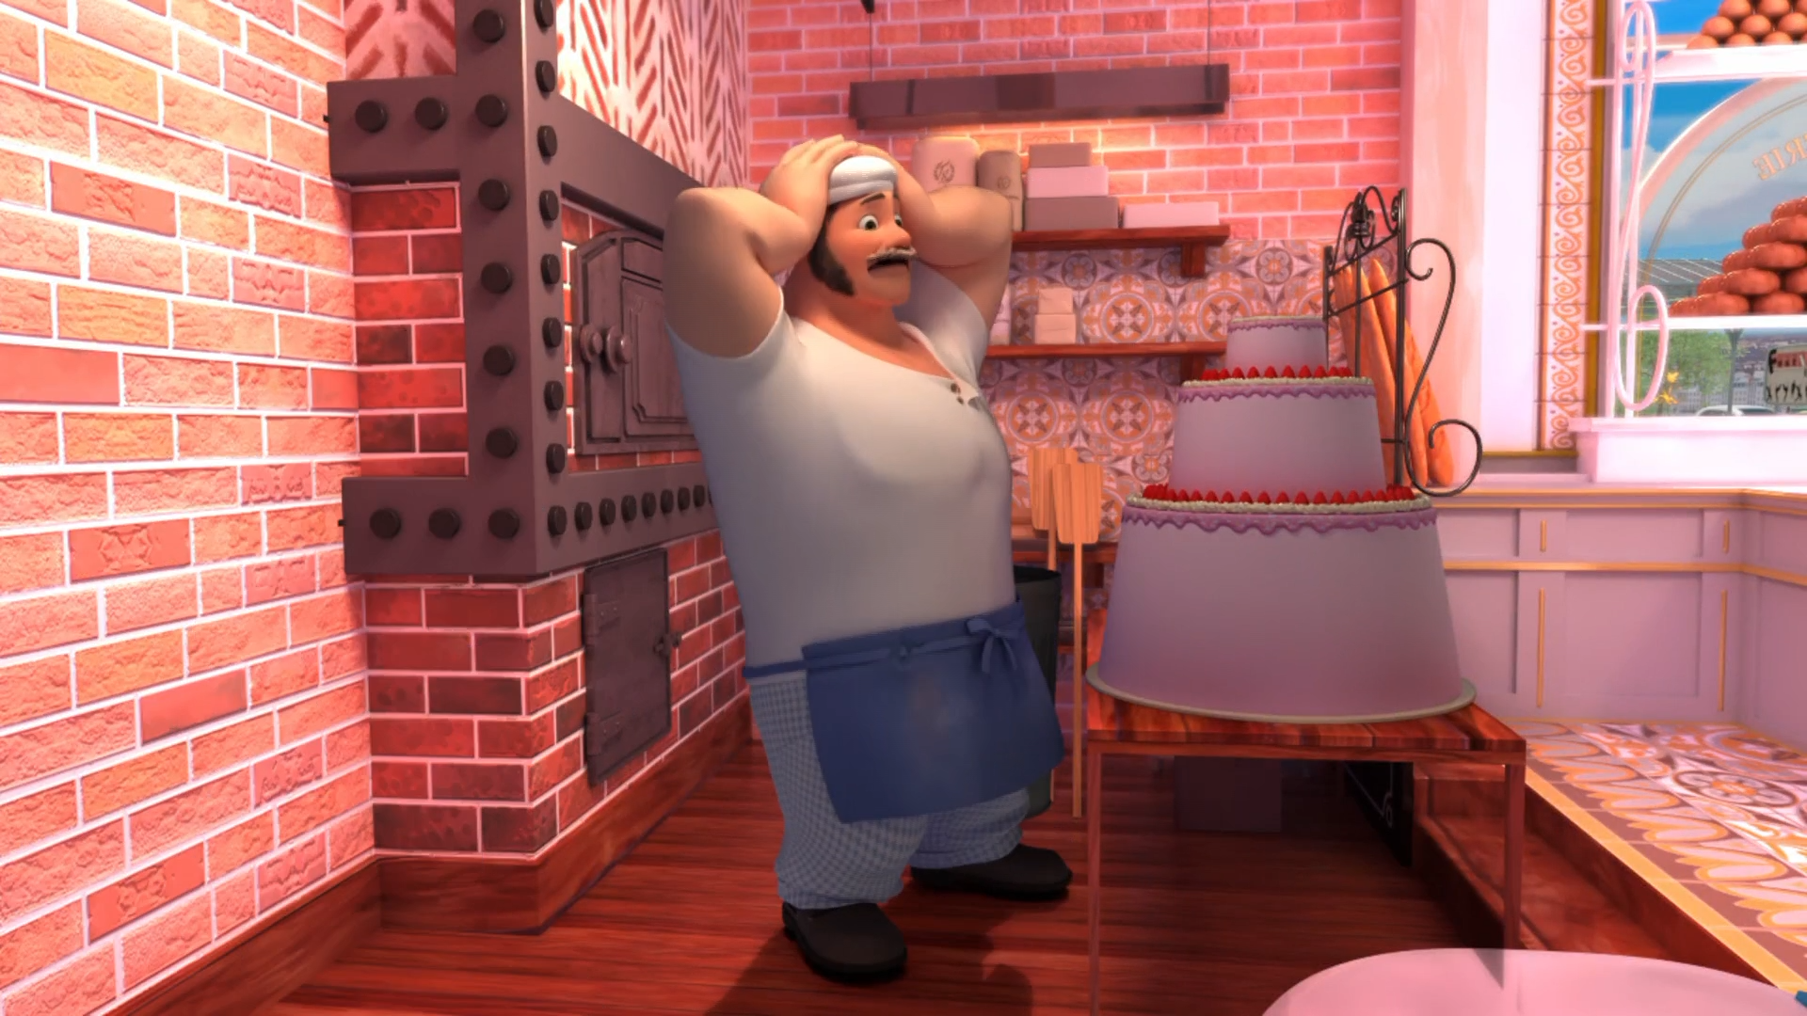
Marinette can't see the ______!
motorcycle
cake
dentist

Slide 11
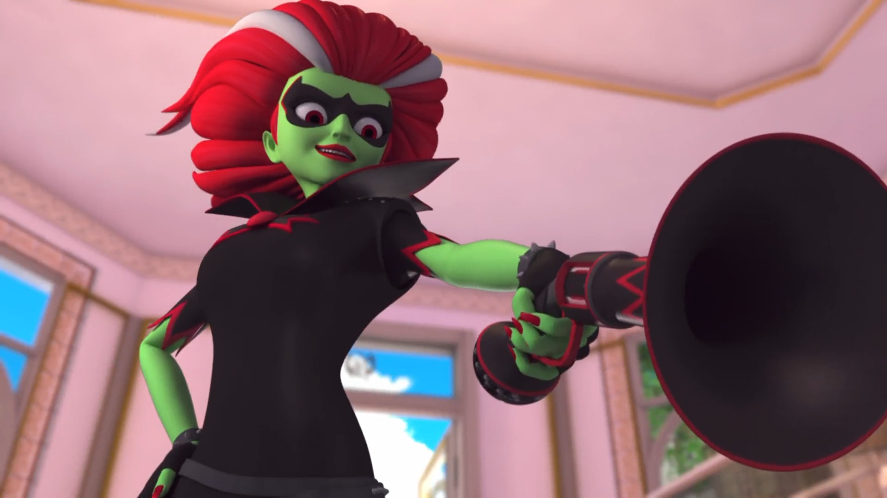
Do you know what naughty boys get? ______!
oil
coal
mud

Slide 12
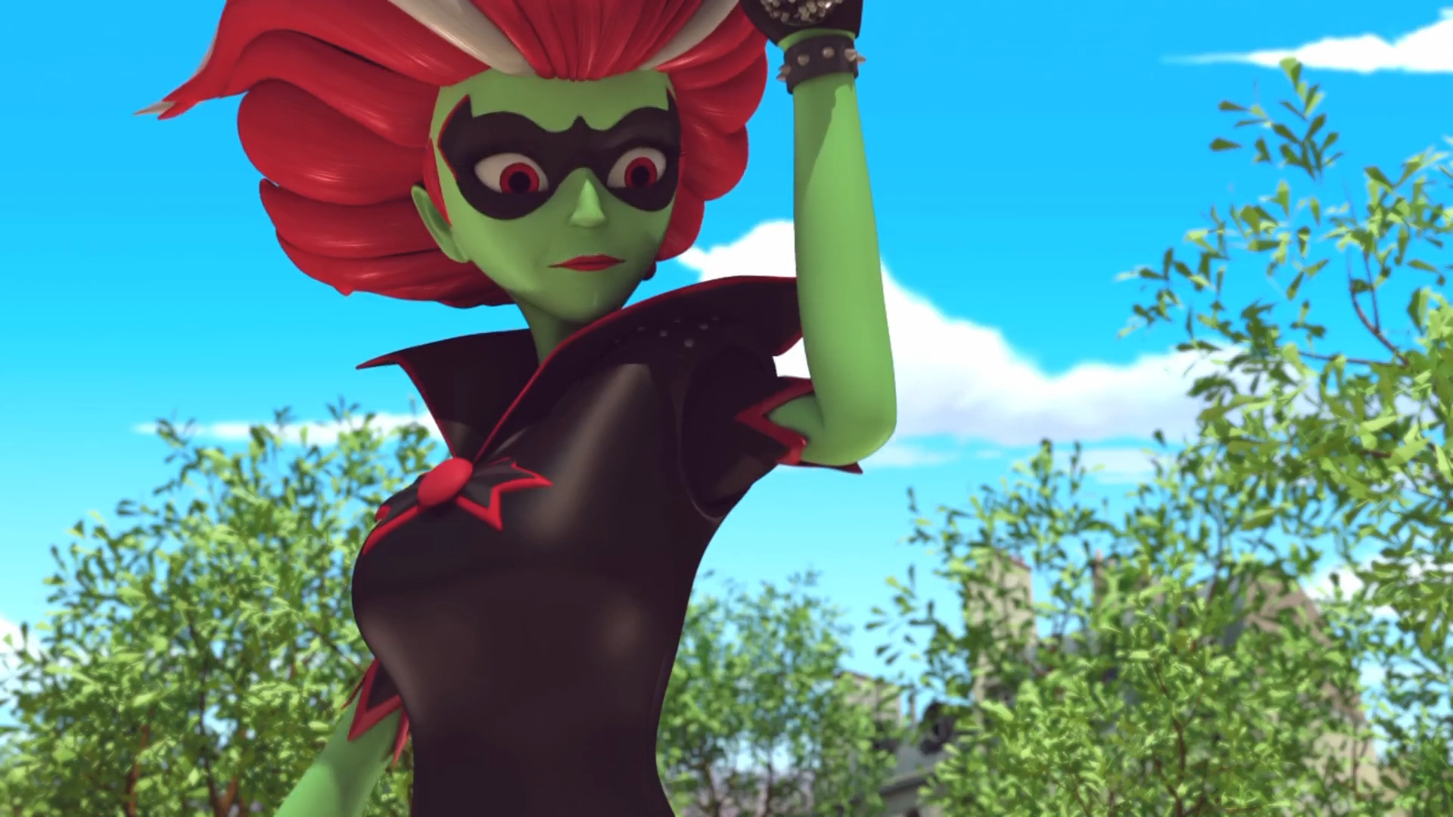
I'm not your ______ anymore.
grandpa
dog
grandma

Slide 13
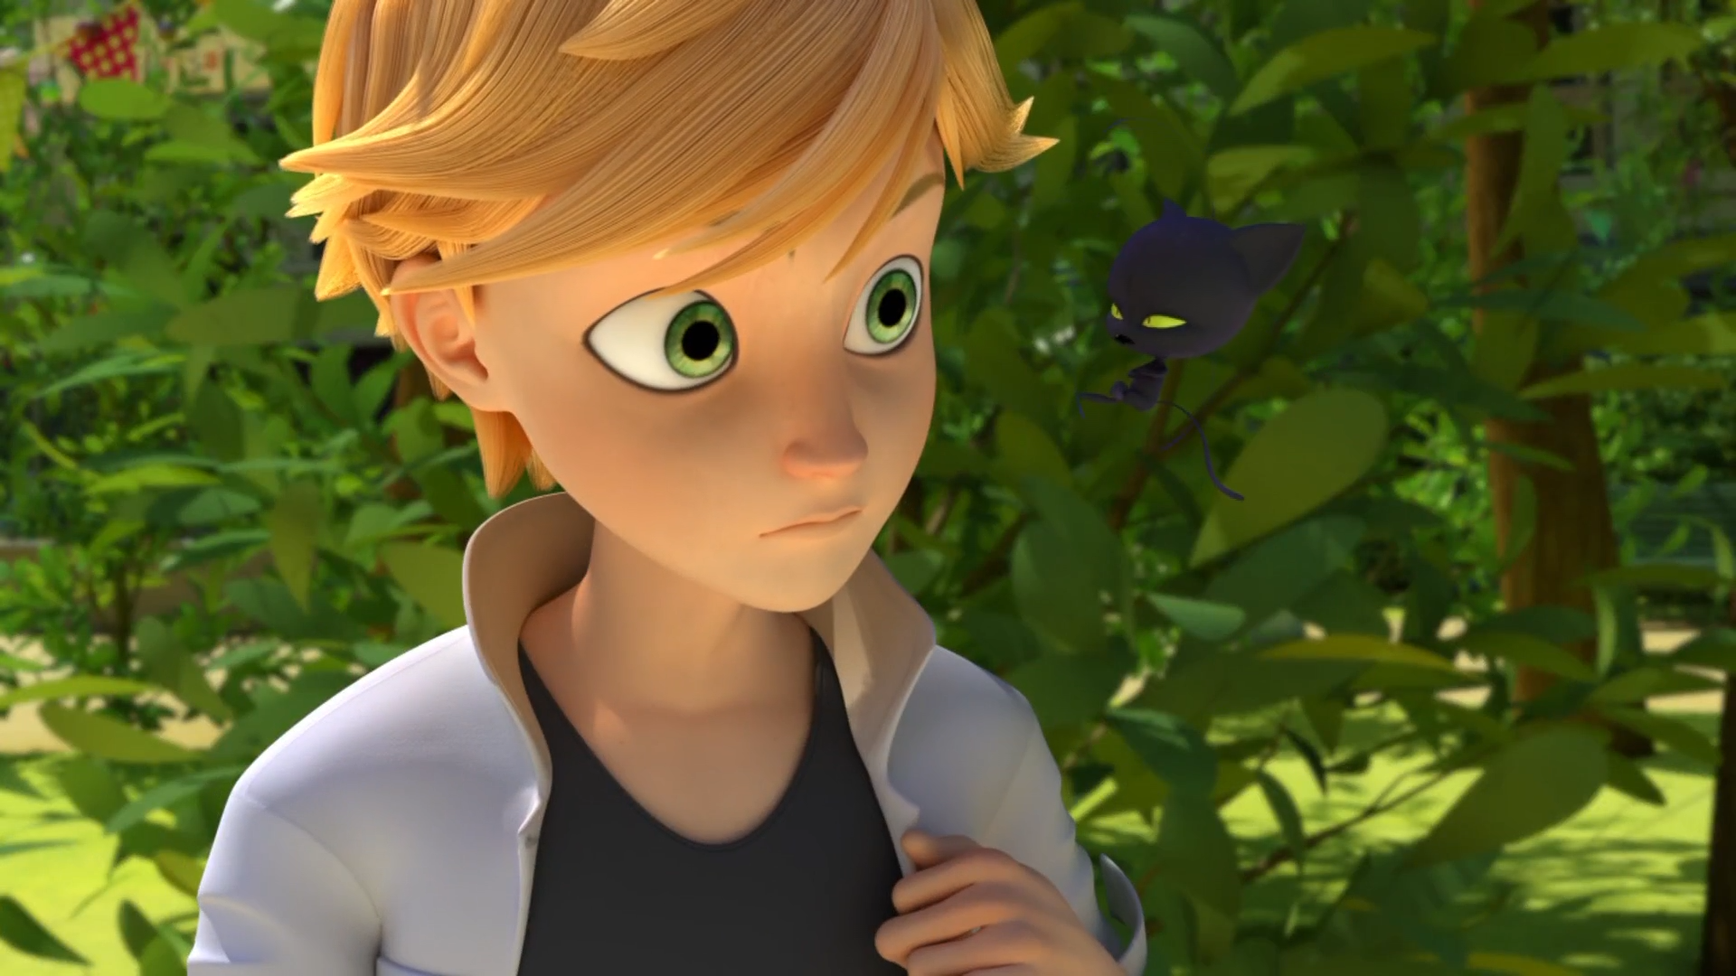
We didn't even get in on the ______!
buffet
food
candy

Slide 14


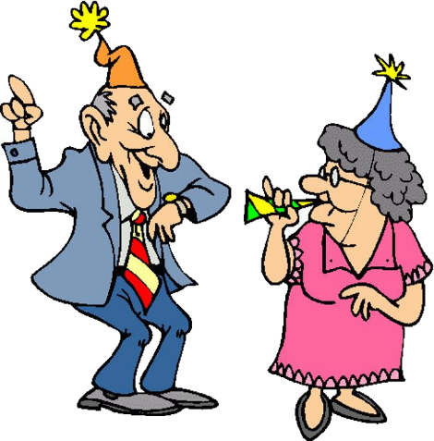

Matching Exercise
party | travel | bear | pump

Slide 15
Matching Exercise
travel | bear | pump | party

Slide 16
TRUE OR FALSE
1. Tikki's gift is made from hair.
2. Marinette's grandma is Tom's mom.
3. Marinette is 15 years old.
4. Marinette and Gina go to the zoo.
5. Befana shoots Sabine.

Slide 17
TRUE OR FALSE
1. Tikki's gift is made from hair. | TRUE
2. Marinette's grandma is Tom's mom. | TRUE
3. Marinette is 15 years old. | FALSE
4. Marinette and Gina go to the zoo. | TRUE
5. Befana shoots Sabine. | FALSE

