Slide 1
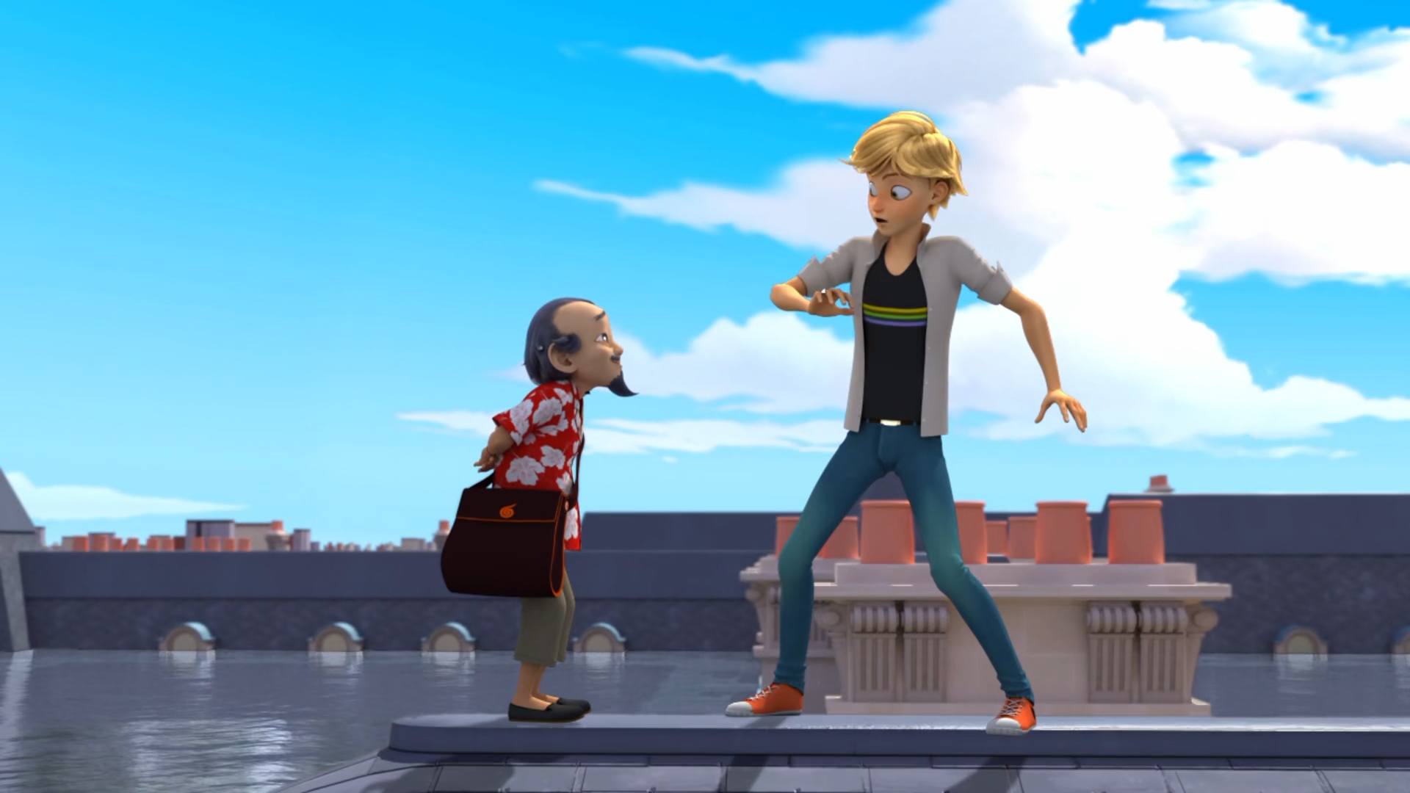
MIRACULOUS LADYBUG: SYREN. PART 2

Slide 2
VOCABULARY
blend - 混合 - blɛnd
corresponds - 对应 - ˌkɒrɪˈspɒndz
merman - 人鱼 - mɜːmæn
nibble - 啃 - nɪbᵊl
obtain - 获得 - əbˈteɪn
pour - 倒 - pɔː
recipe - 配方 - rɛsɪpi
reconsider - 重新考虑 - ˌriːkənˈsɪdə

Slide 3
1. 获得
2. pɔː
3. 配方

Slide 4
1. 获得 - obtain
2. pɔː - pour
3. 配方 - recipe

Slide 5
SYREN. PART 2
Kim: I love what you've done with the pool! It's awesome!
Syren: This is the pool where the old me tried to pour her heart out to you so many times.
Kim: But, uh...I've never seen a Syren at the pool. Ondine?!
Syren: It only needs a kiss, and you'll become just like me!

Slide 6
Kim: Your new outfits are so cool!
Aqua Ladybug: Oh, um, thanks! But tell me, what happened to your friend that got her so worked up?
Kim: We were playing a game of secrets, and
I think she was trying to tell me that I'm the boy she likes. But, I was a doofus and didn't realize.

Slide 7
Master Fu: Hello, I'm Mr. Chan. Adrien's Chinese tutor could not come today. I'll be replacing him.
Nathalie: Adrien, here's Mr. Chan. He'll be your substitute teacher for today.
Master Fu: Hello, Adrien. I think you and
I should have a little talk.
Plagg: Adrien, meet Master Fu, the last Guardian of the Miraculous.

Slide 8
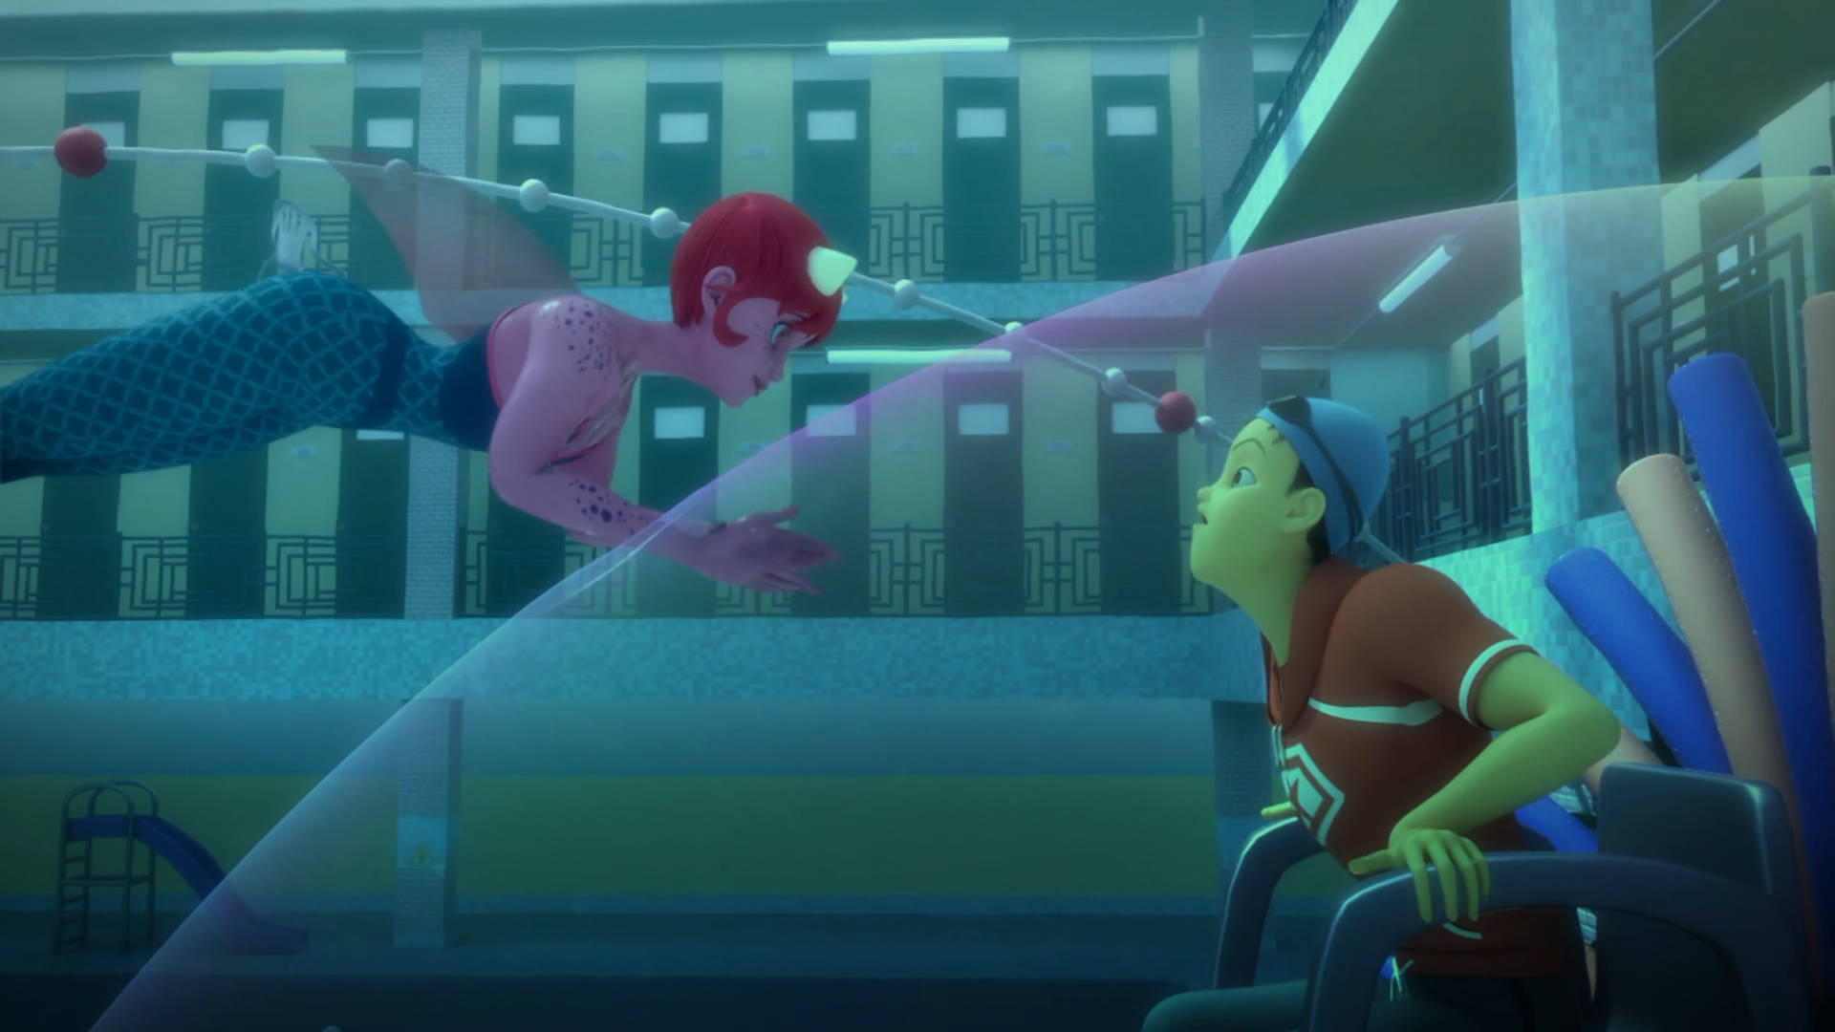

I'm your Syren now. And you could be my ______.
king
bitch
merman

Slide 9
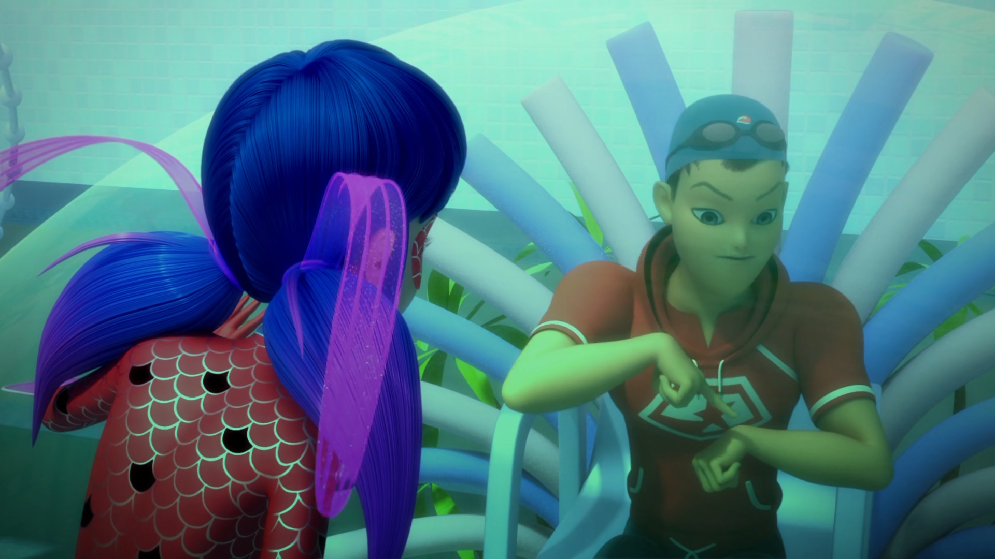
You write down a secret and put it inside the bracelet's ______.
capsule
box
chain

Slide 10
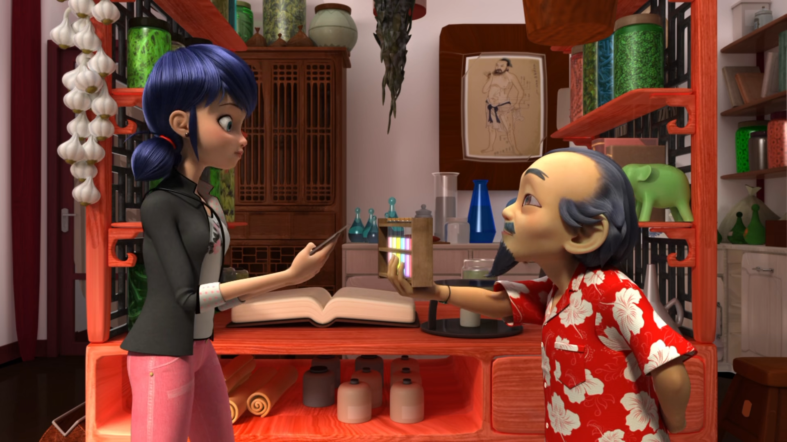
You should keep these ______ with you at all times, just in case.
bottles
vials
test tube

Slide 11
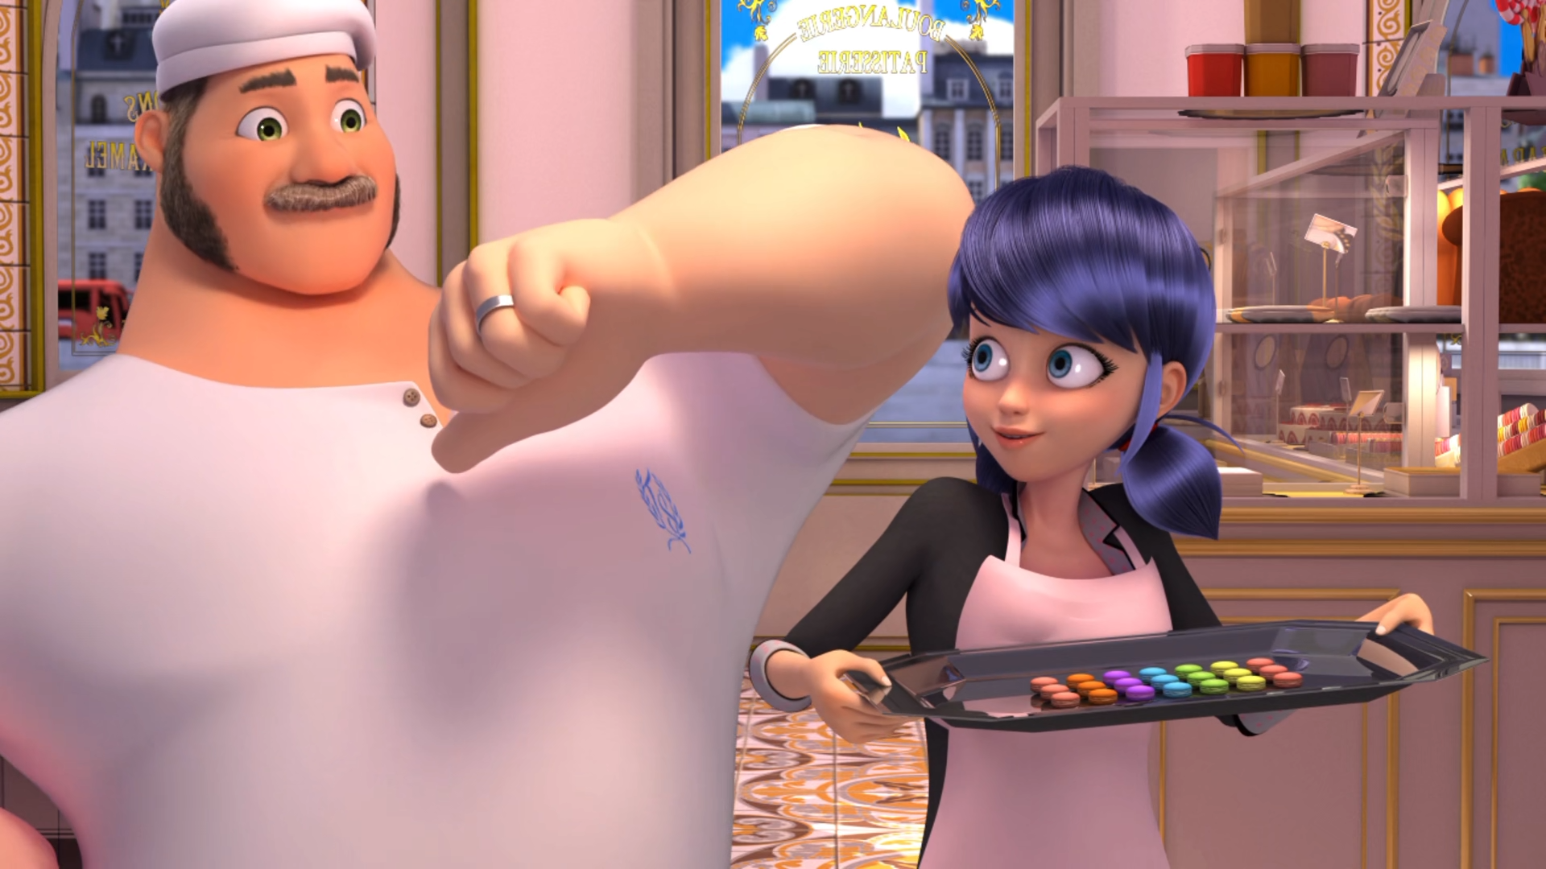
My daughter ______ them! They're bound to be great!
made
baked
cooked

Slide 12
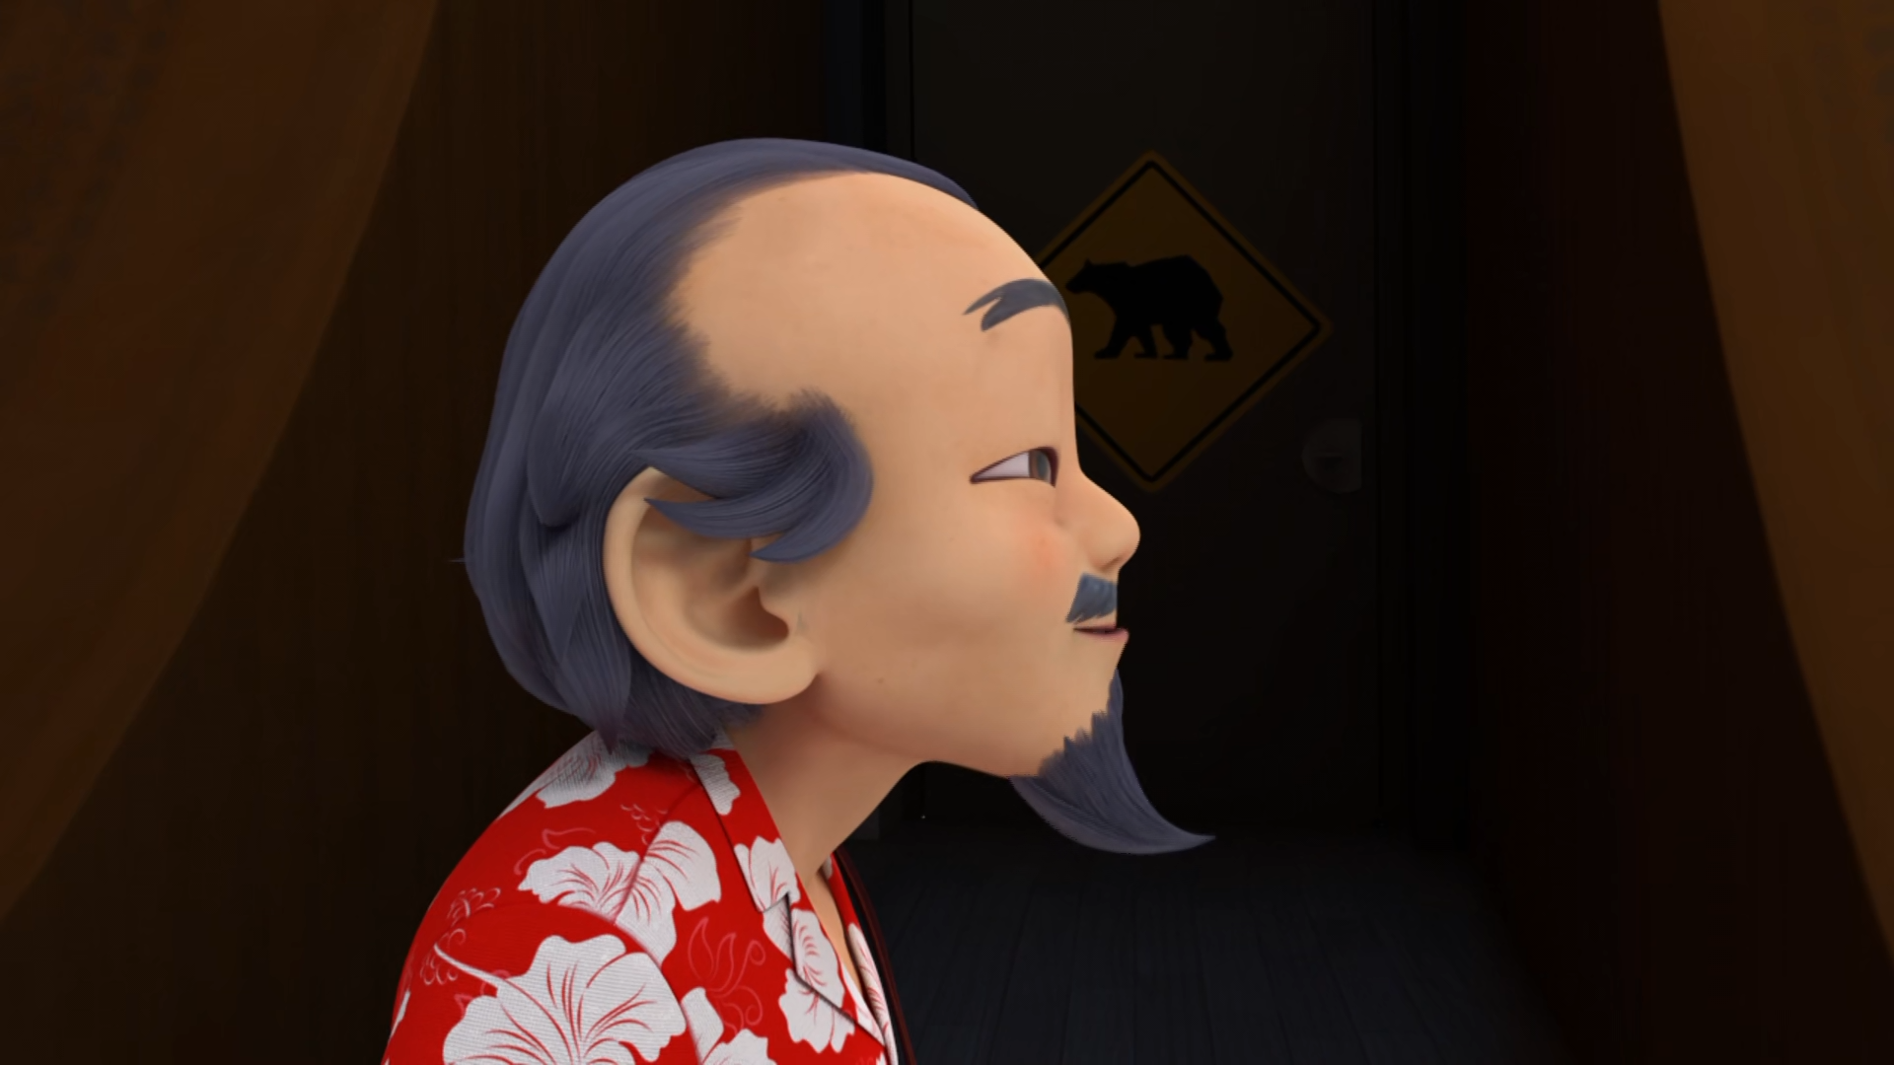
Adrien, here's Mr. Chan. He'll be your ______ teacher for today.
replacement
special
substitute

Slide 13
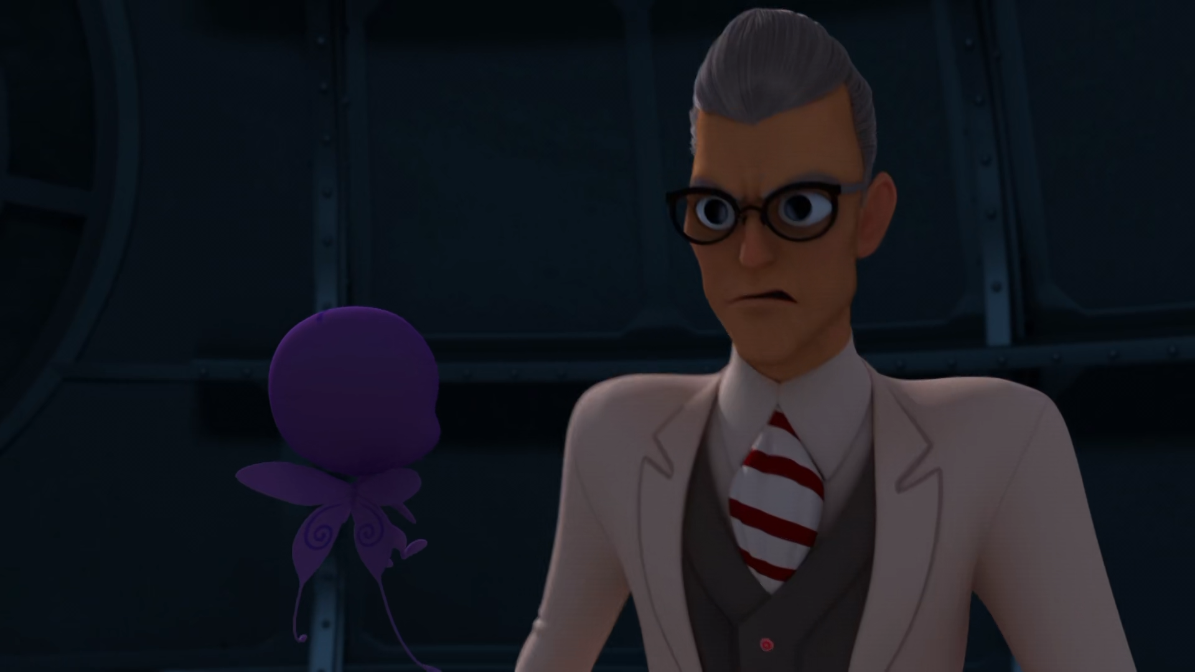
Don't treat me like ______! Ladybug and Cat Noir have new powers.
an idiot
a fool
a plank

Slide 14



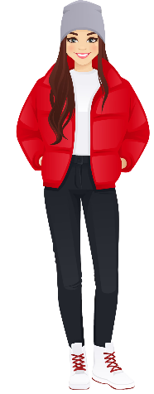
Matching Exercise
capsule | popcorn | outfit | bracelet

Slide 15
Matching Exercise
popcorn | bracelet | capsule | outfit

Slide 16
TRUE OR FALSE
1. Ondine and Kim played a game of secrets.
2. A secret is written down and put in a safe.
3. Ladybug and Cat Noire trap Syren in a car.
4. Tom bakes macaroons.
5. Master Fu is Marinette's teacher.

Slide 17
TRUE OR FALSE
1. Ondine and Kim played a game of secrets. | TRUE
2. A secret is written down and put in a safe. | FALSE
3. Ladybug and Cat Noire trap Syren in a car. | TRUE
4. Tom bakes macaroons. | FALSE
5. Master Fu is Marinette's teacher. | FALSE

Slide 18
IELTS Speaking Exam. Where You Live. Part 2
Describe your hometown. You should say:
where it is located
what it is known for
what you like most about it

