Slide 1
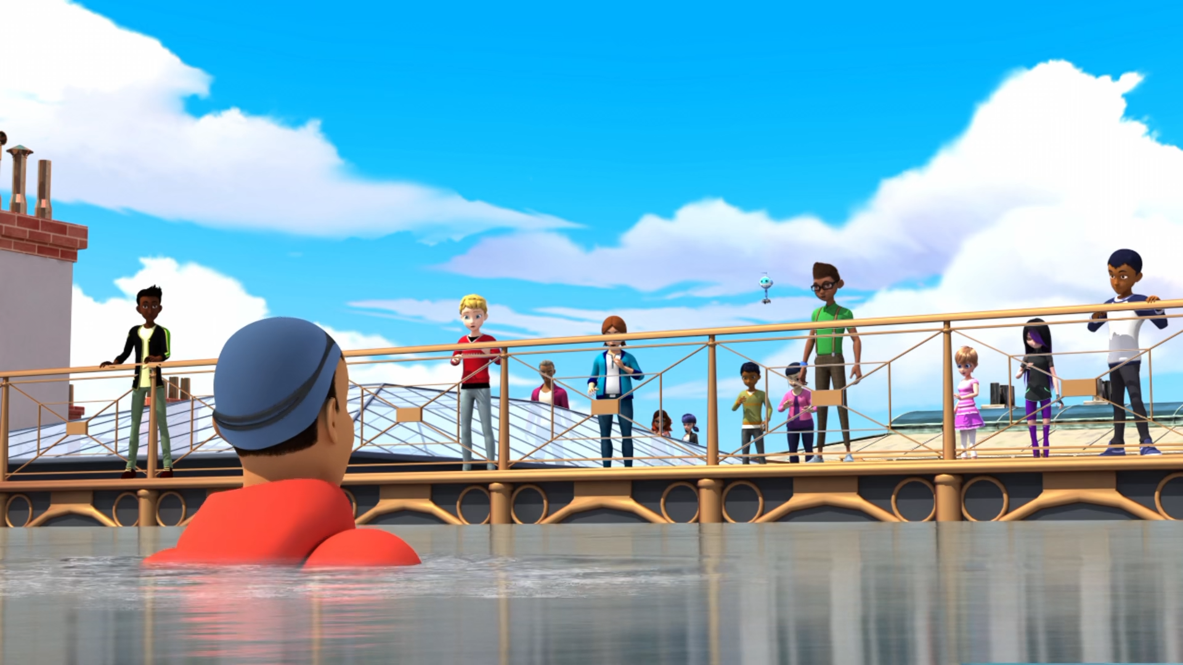
MIRACULOUS LADYBUG: SYREN. PART 1

Slide 2
VOCABULARY
blend - 混合 - blɛnd
boil - 煮沸 - bɔɪl
cousin - 表弟 - kʌzᵊn
facility - 设施 - fəˈsɪləti
modify - 修改 - mɒdɪfaɪ
sorrow - 悲伤 - sɒrəʊ
swayed - 摇摆 - sweɪd
trailers - 预告片 - treɪləz
zoo - 动物园 - zuː

Slide 3
1. bɔɪl
2. 表弟
3. 动物园

Slide 4
1. bɔɪl - boil
2. 表弟 - cousin
3. 动物园 - zoo

Slide 5
SYREN. PART 1
Kim: Is Chloé here?
Max: Chloé watching Mecha Monkey vs. Cyber Shark 3? I think your swimming cap's on too tight, Kim.
Alya: Ah, let me guess, Marinette hasn't arrived yet?
Max: True to form. We'll save you both a seat.

Slide 6
Master Fu: So, what's on your mind, Marinette?
Marinette: Master Fu, Cat Noir is asking more and more questions. He's tired of being left in the dark.
Master Fu: Tell me, Marinette; do you put the noodles in the water before the water boils?
Marinette: Uh, no.

Slide 7
Kim: Huh! This is amazing! I can breathe underwater, just like a fish.
Syren: I knew you'd love it, and I've got lots of other surprises for you, you'll see.
Kim: Hey!
Syren: My prince!
Hawk Moth: Ladybug, you won't be able to win this time. Ladybugs can't breathe underwater.

Slide 8
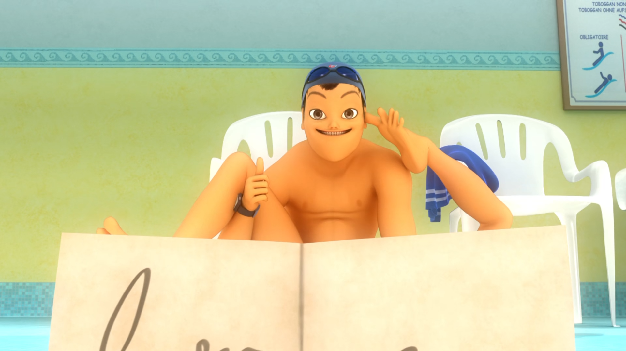

I can stick my big toe inside my ______?
butt
mouth
ear

Slide 9
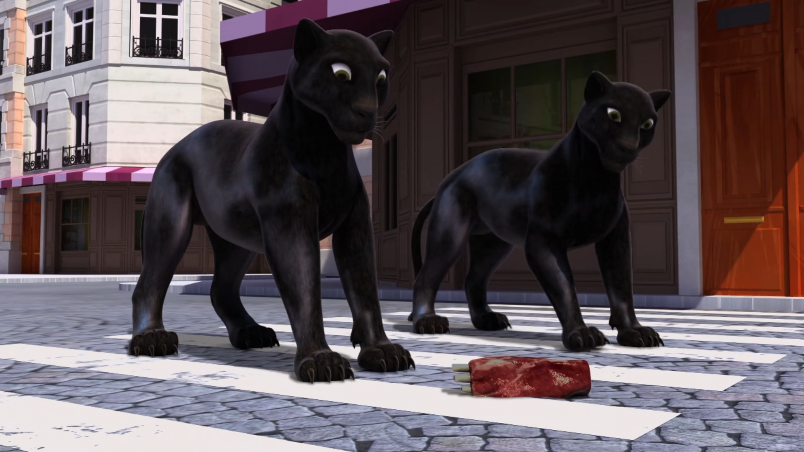
How about some tasty ______, instead?
chops
meat
pig

Slide 10
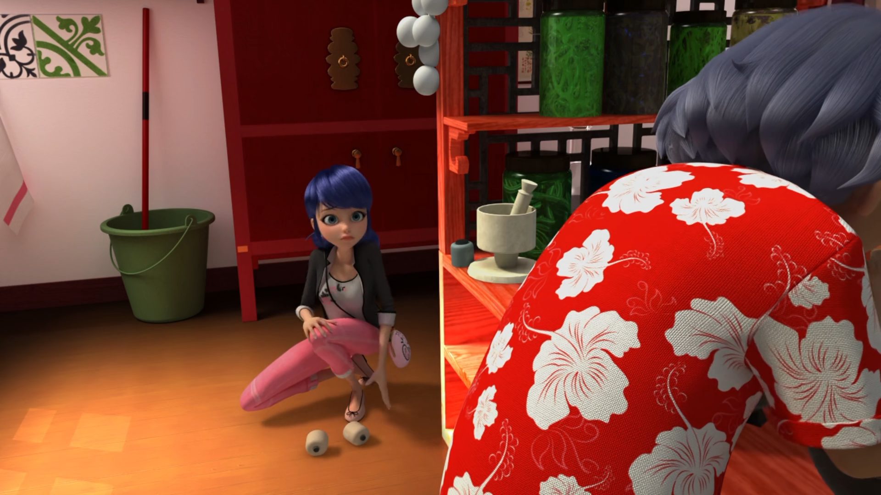
He's tired of being left in the ______!
toilet
dark
supermarket

Slide 11
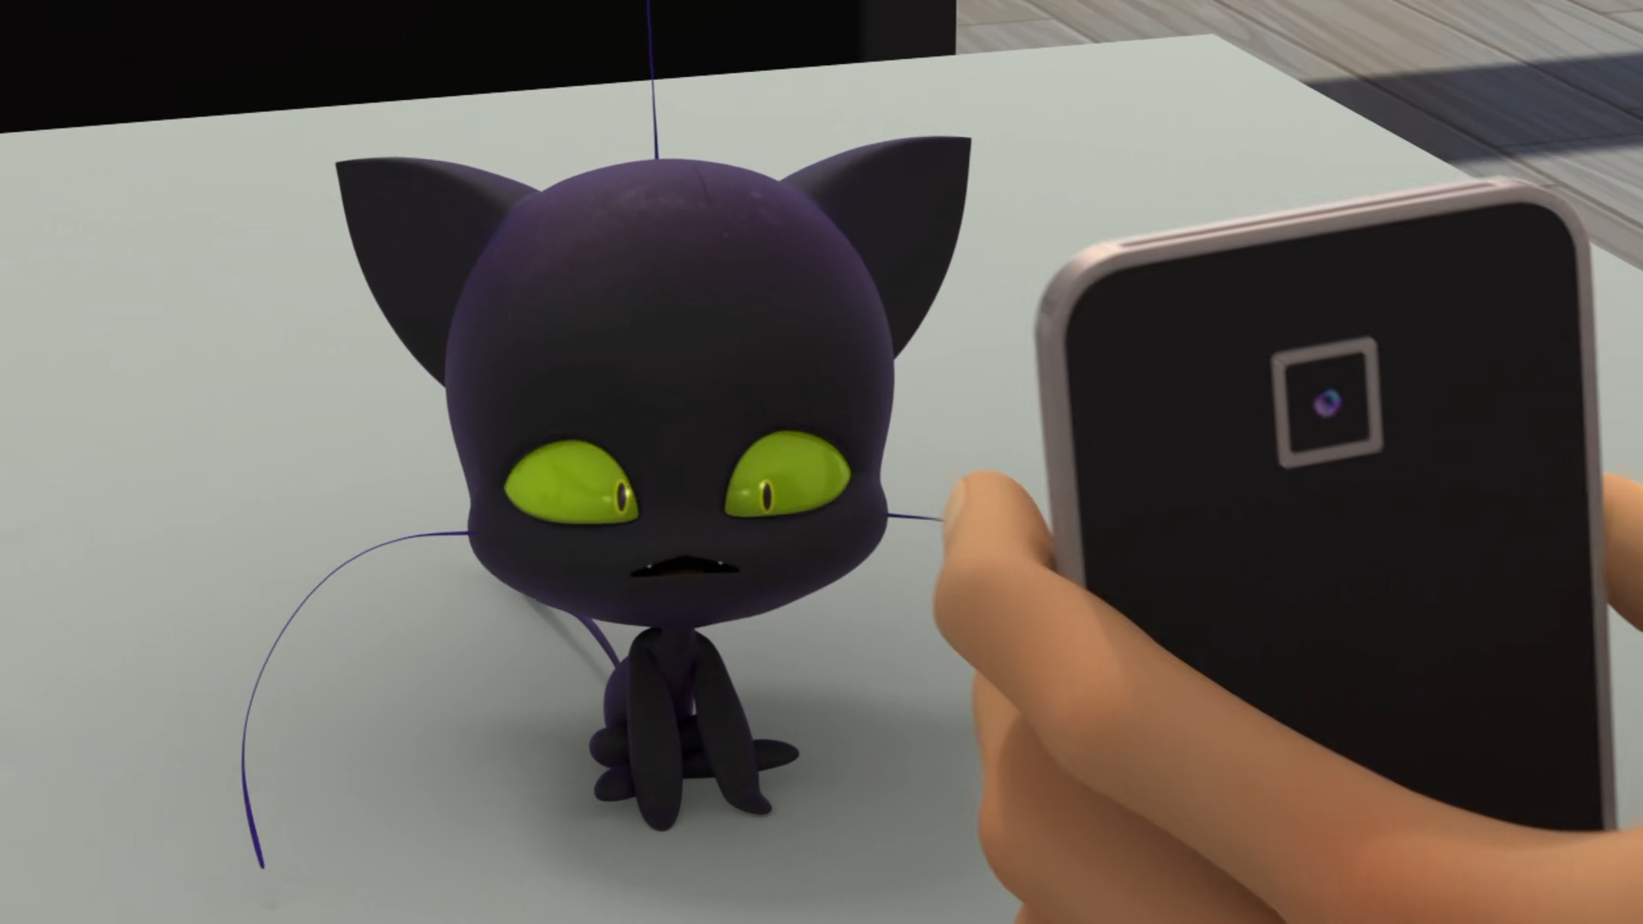
Yes... and do you know why its rind is ______?
red
orange
green

Slide 12
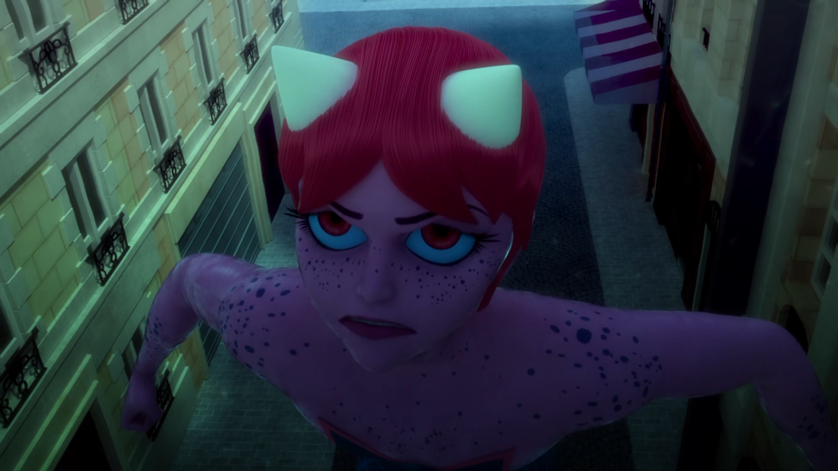
My ______!
fish
grandma
prince

Slide 13
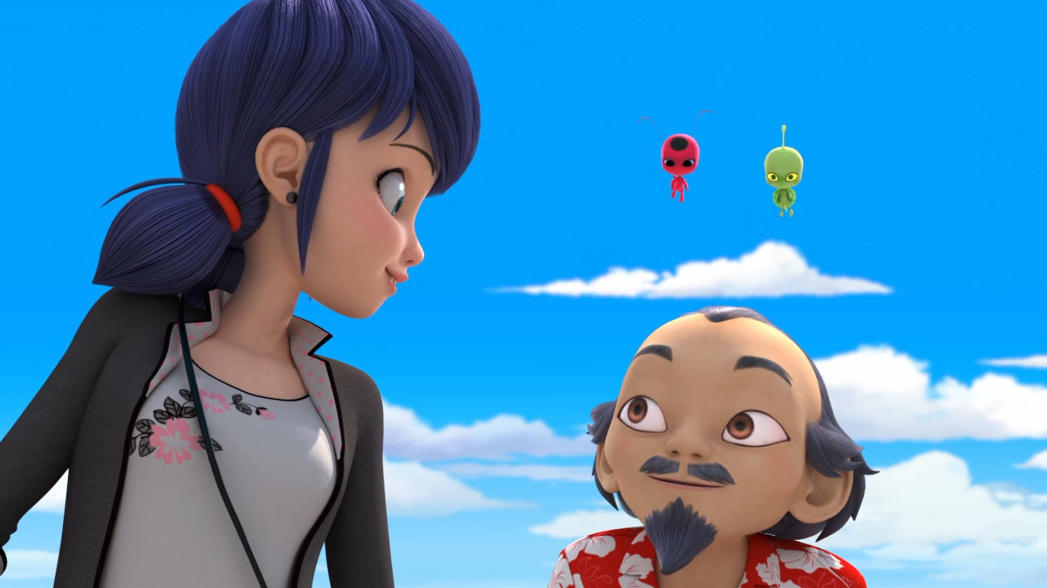
I think you have just found the magic ______, Marinette!
ingredient
spell
book

Slide 14
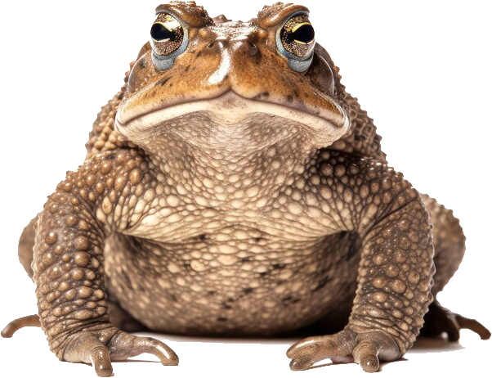
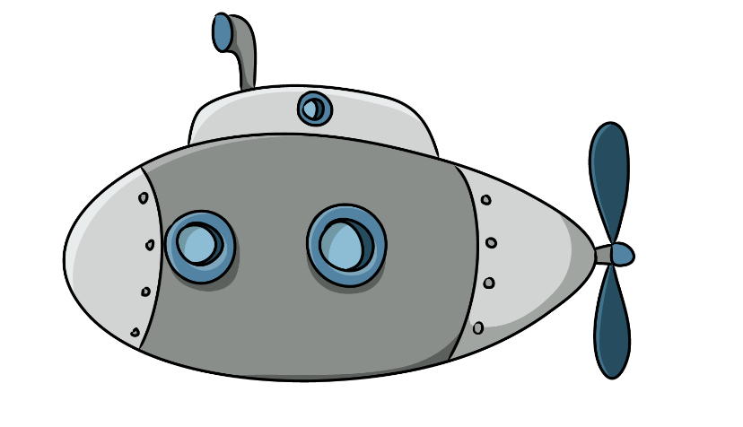
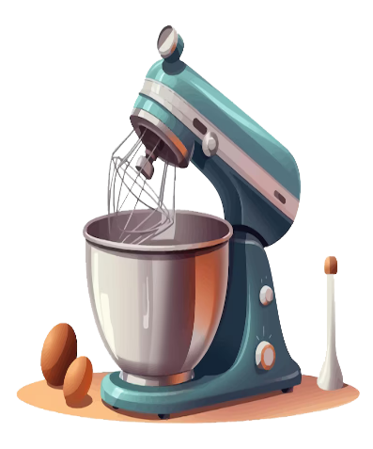

Matching Exercise
submarine | mix | cap | frog

Slide 15
Matching Exercise
frog | submarine | mix | cap

Slide 16
TRUE OR FALSE
1. Cat Noir is being chased by big cats.
2. Master Fu is making noodles.
3. Plagg likes the smell of socks.
4. Kim can't breathe underwater.
5. Ladybugs can breathe underwater.

Slide 17
TRUE OR FALSE
1. Cat Noir is being chased by big cats. | TRUE
2. Master Fu is making noodles. | FALSE
3. Plagg likes the smell of socks. | TRUE
4. Kim can't breathe underwater. | FALSE
5. Ladybugs can breathe underwater. | FALSE

Slide 18
IELTS Speaking Exam. Where You Live. Part 1
Do you live alone or with others?
What's the most convenient thing about where you live?
Is there anything you would like to change about your current living situation?

