Slide 1
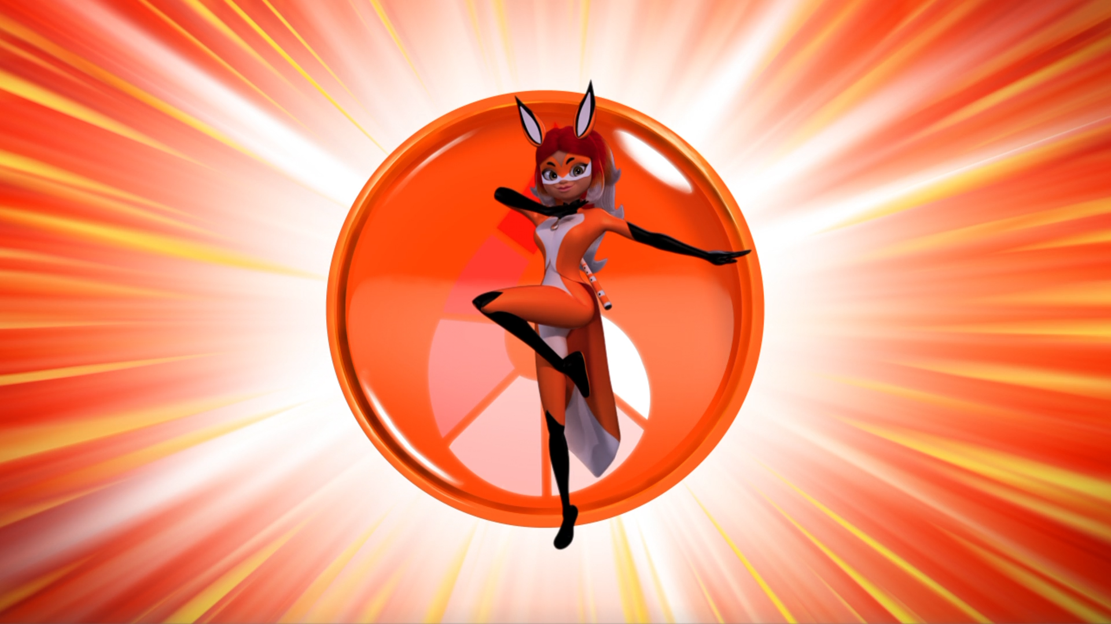
MIRACULOUS LADYBUG: SOPOTIS. PART 2

Slide 2
VOCABULARY
ally - 盟友 - ælaɪ
alongside - 并肩 - əˌlɒŋˈsaɪd
hint - 暗示 - hɪnt
insane - 疯狂 - ɪnˈseɪn
kitty - 猫咪 - kɪti
renegotiate - 重新谈判 - riːnɪˈɡəʊʃieɪt
retreat - 撤退 - rɪˈtriːt
sneaky - 鬼鬼祟祟 - sniːki

Slide 3
1. 暗示
2. ɪnˈseɪn
3. 猫咪

Slide 4
1. 暗示 - hint
2. ɪnˈseɪn - insane
3. 猫咪 - kitty

Slide 5
SOPOTIS. PART 2
Ladybug: Alya, here is the Miraculous of the fox, which grants the power of illusion.
Alya: What is that thing?
Trixx: I am not a thing. My name is Trixx, and I'm your kwami!
Alya: My kwami? I know! You're what gives superheroes their superpowers, right?
Ladybug: She's an expert.

Slide 6
Cat Noir: Your friend seems pretty good.
Ladybug: I surround myself with only the best!
Cat Noir: Welcome to our team! If you need any cool superhero tips, you know where to come.
Rena Rouge: Really? You're gonna give me Ladybug's phone number?
Cat Noir: I have a feeling working with you is gonna be a lot of fun!

Slide 7
Rena Rouge: My necklace is flashing. Um, that means I'm gonna change back soon,
right?
Cat Noir: Yeah. But it's okay if I see who you are. I can keep a secret.
Rena Rouge: Naughty kitty! You know very well that our identities must remain secret.
Cat Noir: Good job. You're a fast learner.

Slide 8
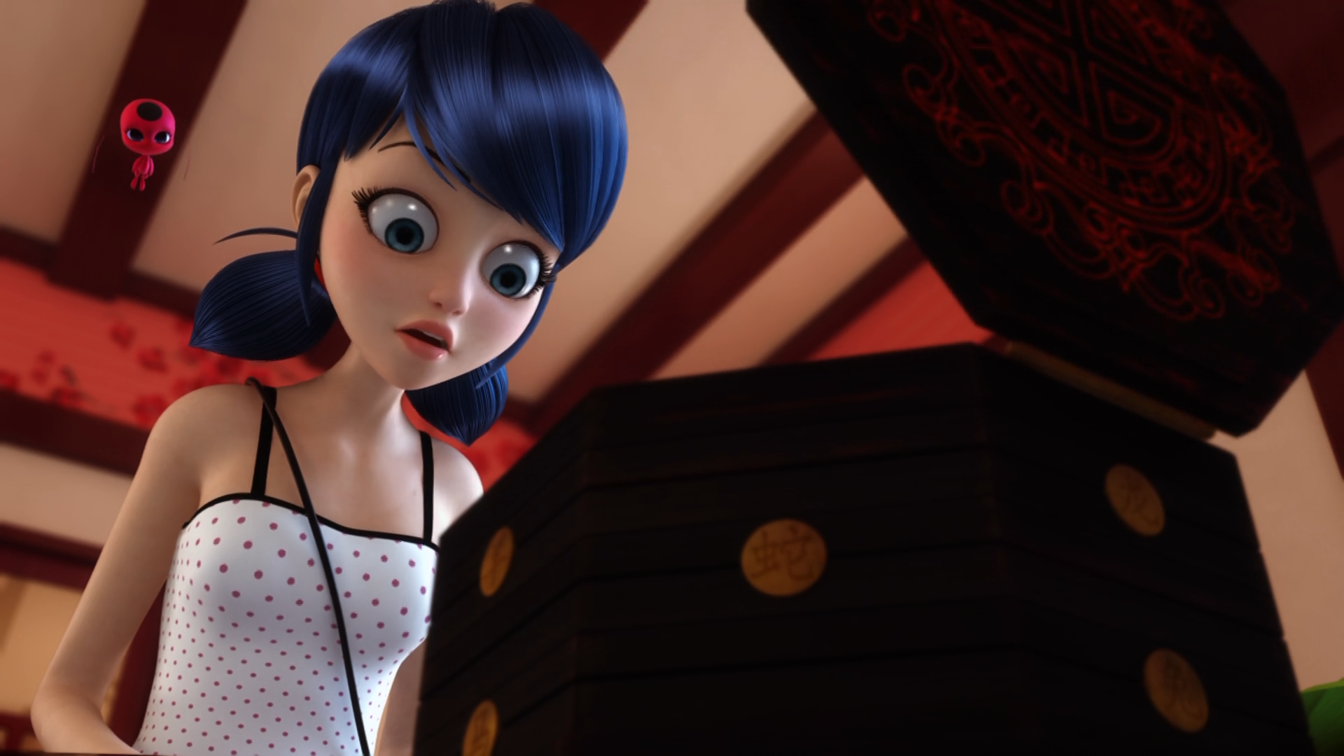

Marinette, pick ______ you can trust to fight alongside you.
a partner
your nose
an ally

Slide 9
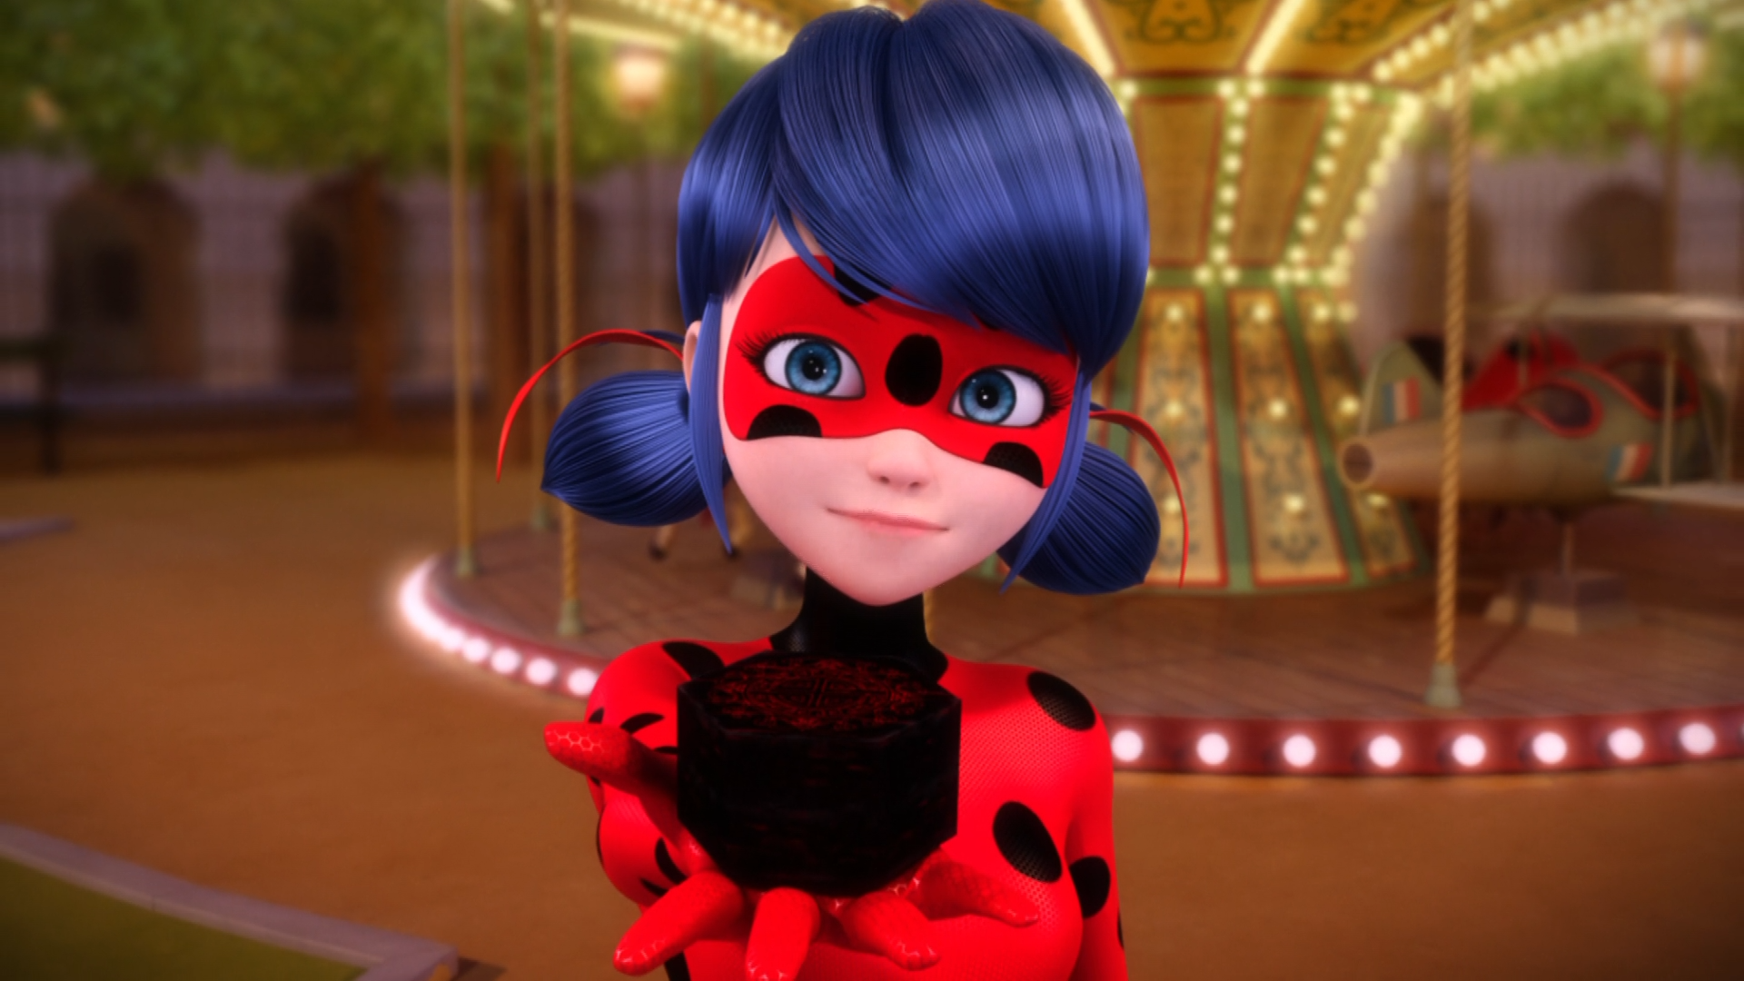
Here is the Miraculous of the ______, which grants the power of illusion.
Fox
Pig
Dog

Slide 10
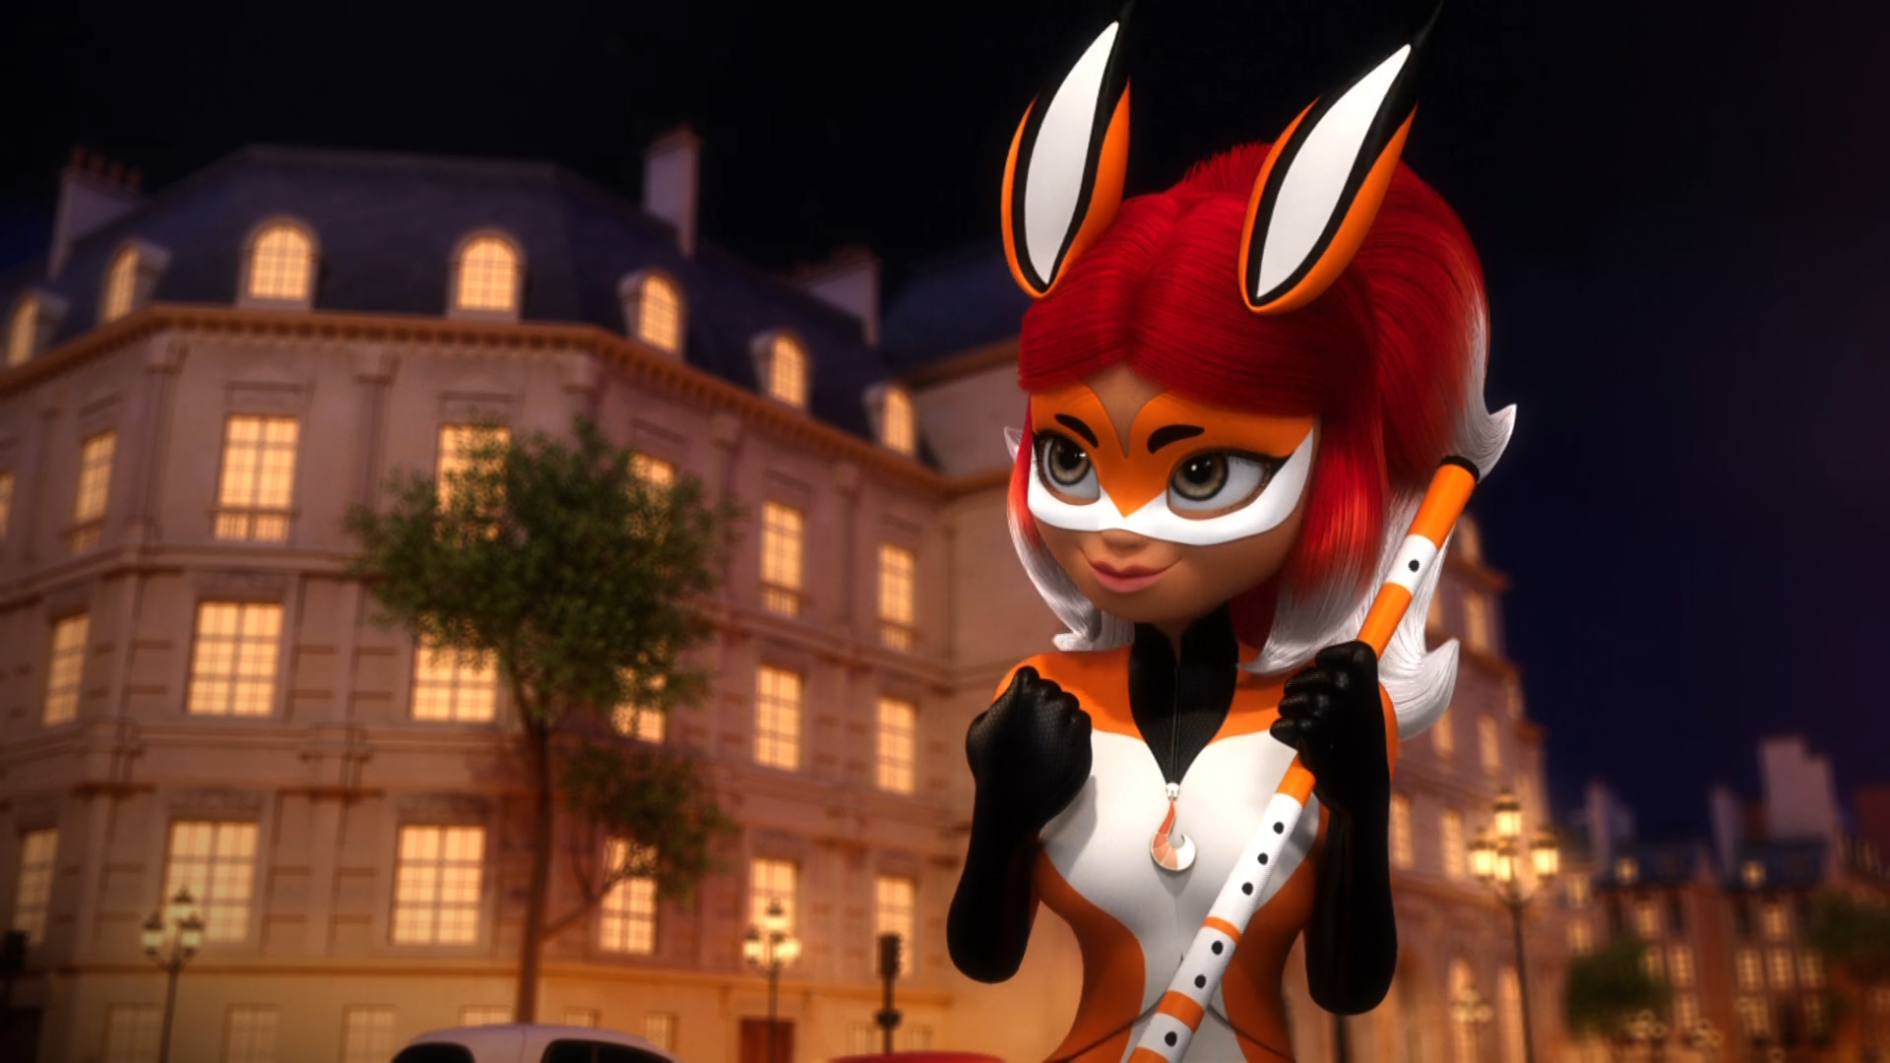
This is so insane! I've got powers and I'm fighting ______!
gremlins
super-villains
Hawk Moth

Slide 11
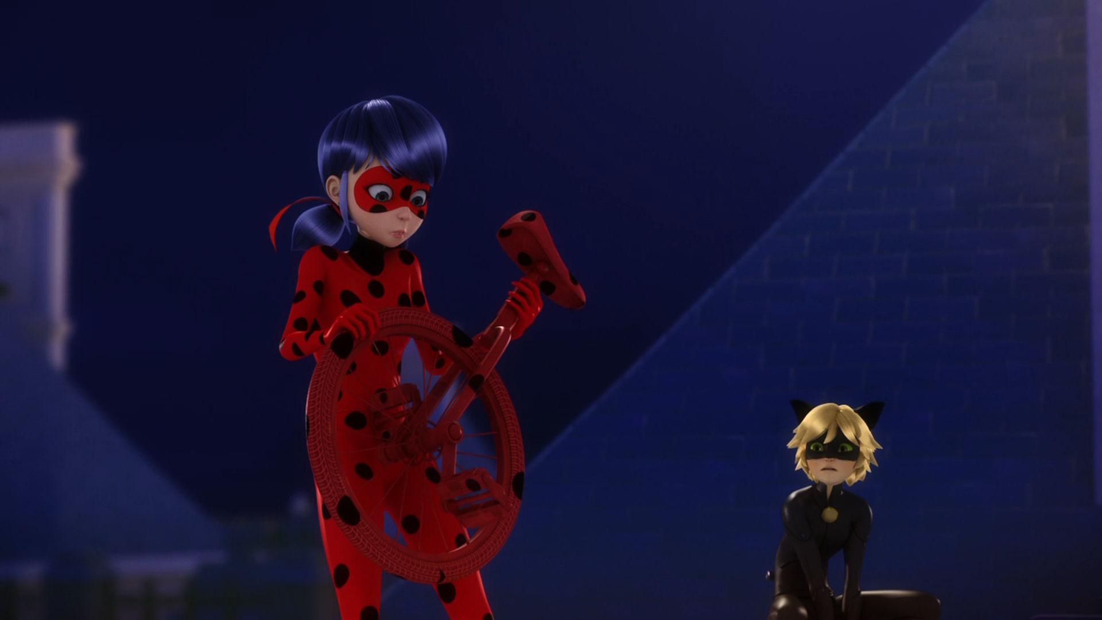
A ______?
wheel
unicycle
bike

Slide 12
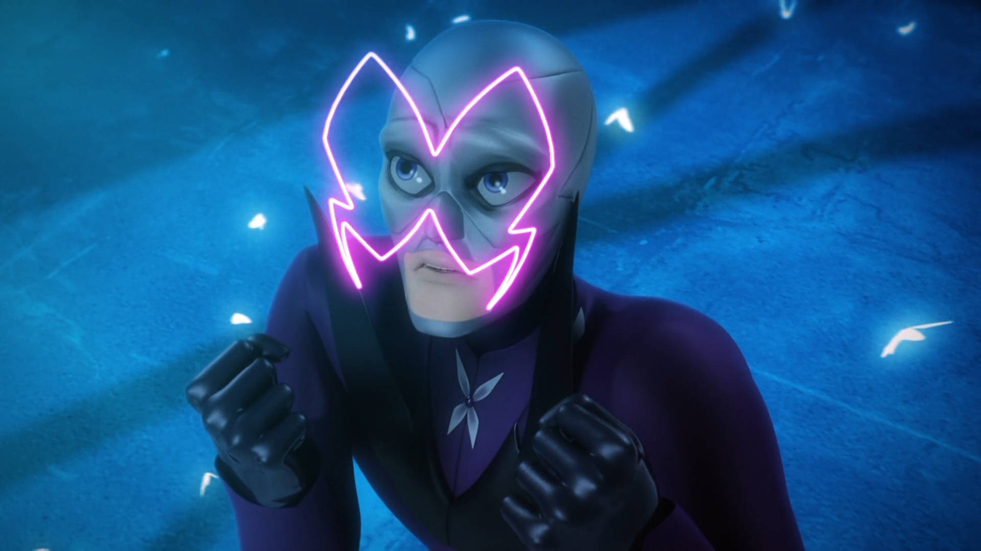
No, wait! Don't go there! Ladybug's trying to ______ you!
trick
trip
trap

Slide 13
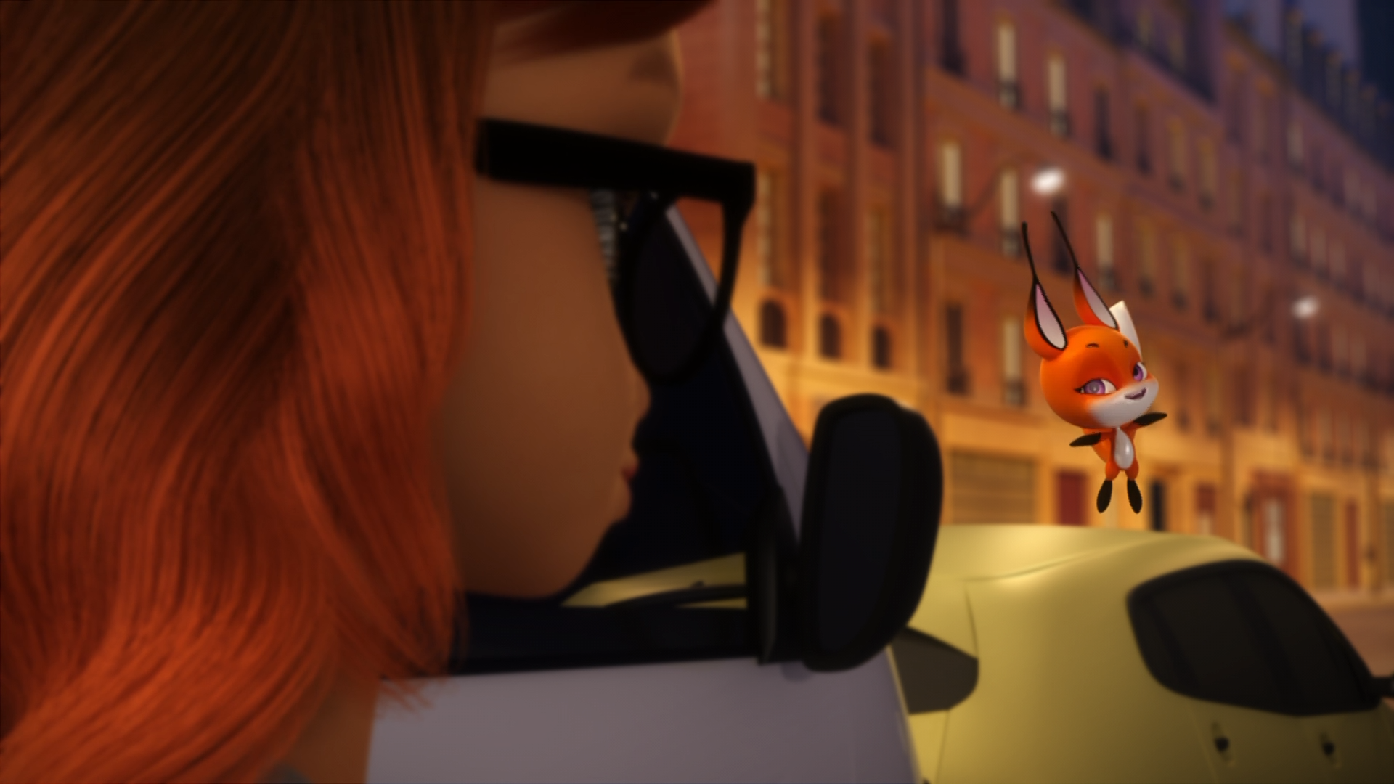
You're strong, ______, but most of all, you're trustworthy.
brave
courageous
kind

Slide 14
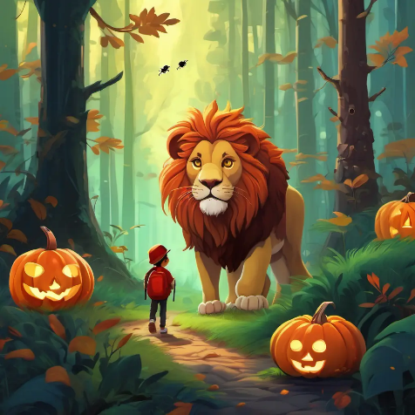
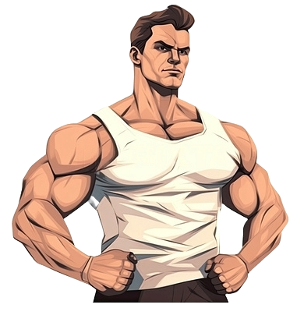
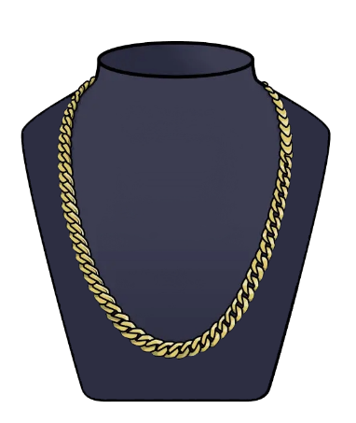
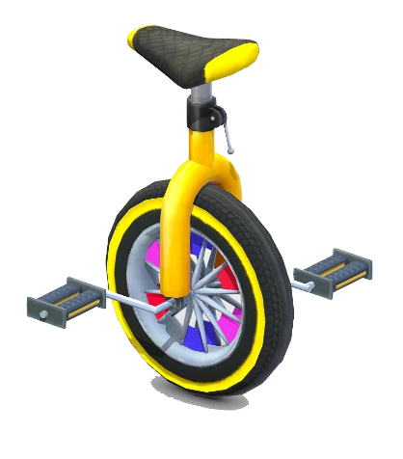
Matching Exercise
unicycle | necklace | brave | strong

Slide 15
Matching Exercise
brave | strong | necklace | unicycle

Slide 16
TRUE OR FALSE
1. Alya's superhero name is Rena Rouge.
2. Alya has a pen.
3. The heroes catch the hats in a bin.
4. Cat Noir takes Marinette home.
5. Alya keeps her Miraculous.

Slide 17
TRUE OR FALSE
1. Alya's superhero name is Rena Rouge. | TRUE
2. Alya has a pen. | FALSE
3. The heroes catch the hats in a bin. | TRUE
4. Cat Noir takes Marinette home. | FALSE
5. Alya keeps her Miraculous. | FALSE

