Slide 1
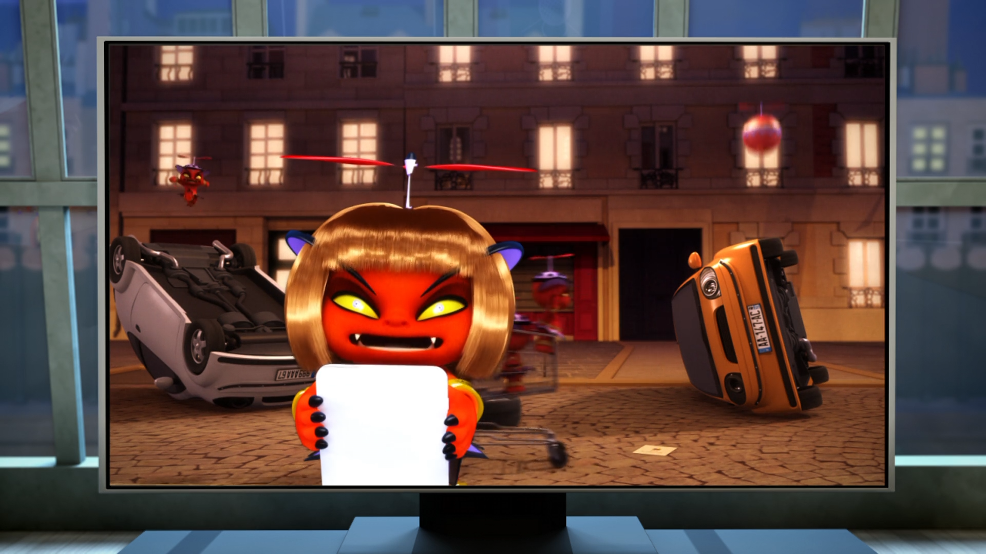
MIRACULOUS LADYBUG: SOPOTIS. PART 1

Slide 2
VOCABULARY
airport - 机场 - eəpɔːt
amusement park - 游乐园 - əˈmjuːzmənt pɑːk
clone - 克隆 - kləʊn
destroy - 摧毁 - dɪˈstrɔɪ
fable - 寓言 - feɪbᵊl
frequency - 频率 - friːkwənsi
identity - 身份 - aɪˈdɛntəti
mischief - 恶作剧 - mɪsʧɪf
thief - 小偷 - θiːf

Slide 3
1. 机场 - airport
2. mɪsʧɪf - mischief
3. 小偷 - theif

Slide 4
1. 机场 - airport
2. mɪsʧɪf - mischief
3. 小偷 - thief

Slide 5
SOPOTIS. PART 1
Alya: Oh, yeah! Ladybug! She's like a high school girl. So to figure out who she really is, all we need to do is to find a girl our age who's always late.
Marinette: Don't you think there's a reason why she keeps her identity a secret?
Alya: What were you saying about her secret identity?

Slide 6
Marinette: Ladybug needs it to protect her family and friends. Otherwise the villains could use them to get to her.
Alya: Well, if I knew who Ladybug really was, I'd keep it a secret. I would even help her! Like say, if you were Ladybug, I'd cover for you - when you needed to transform in school, go fight the "baddies", you know?

Slide 7
Marinette: Oh yeah? Well, if I was Ladybug
I wouldn't even tell you, to protect you from the "baddies", you know?
Alya: You serious? If I was Ladybug, I'd totally tell you! Because I tell my best friend everything.
Marinette: You're right, Alya. You should always tell your best friend everything.

Slide 8
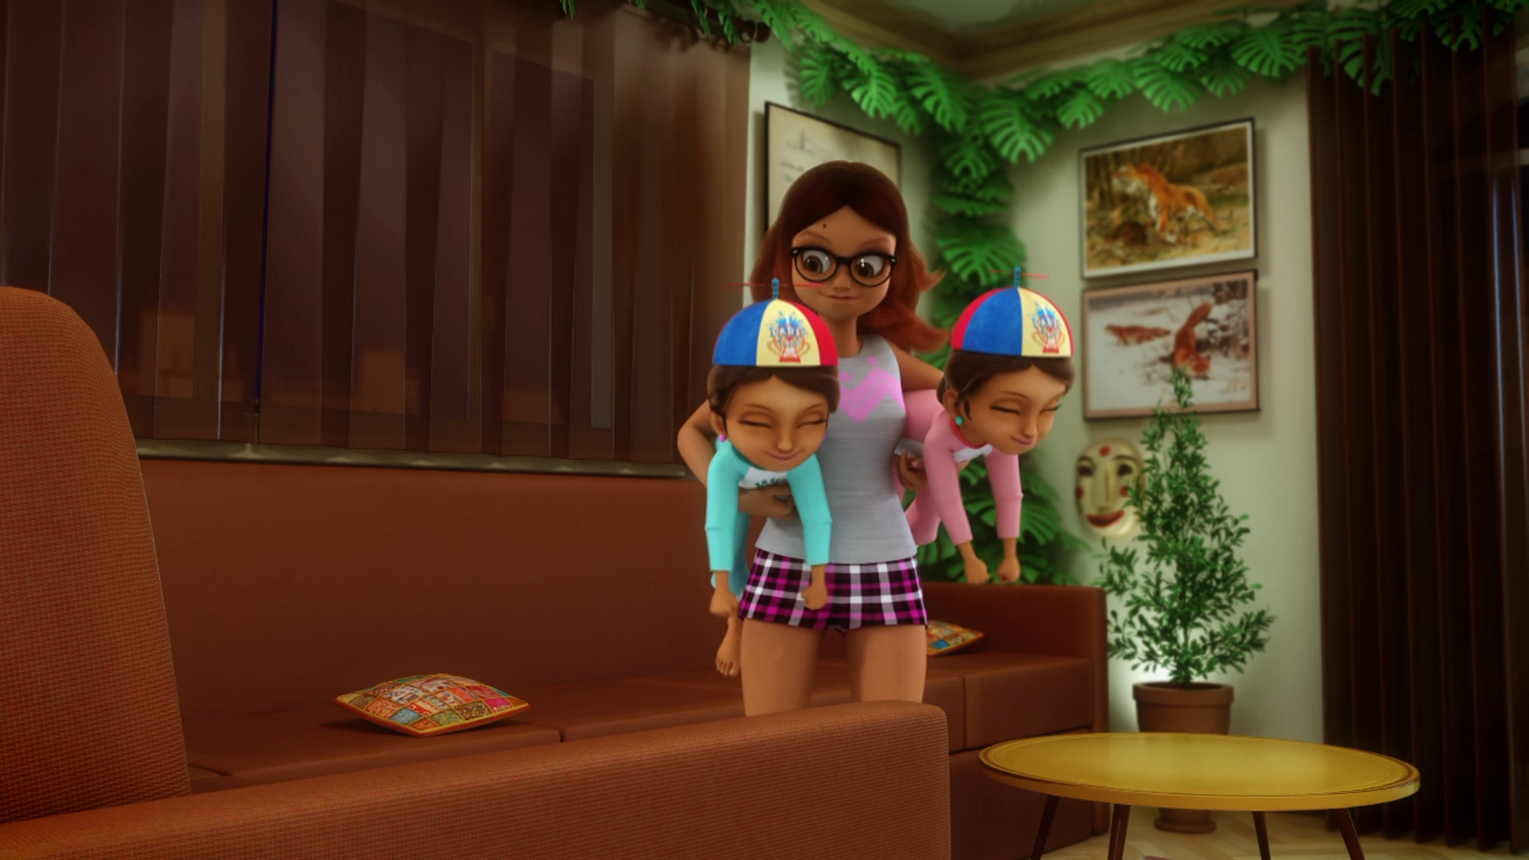

Come on, bedtime, you little ______!
bitches
pigs
monsters

Slide 9
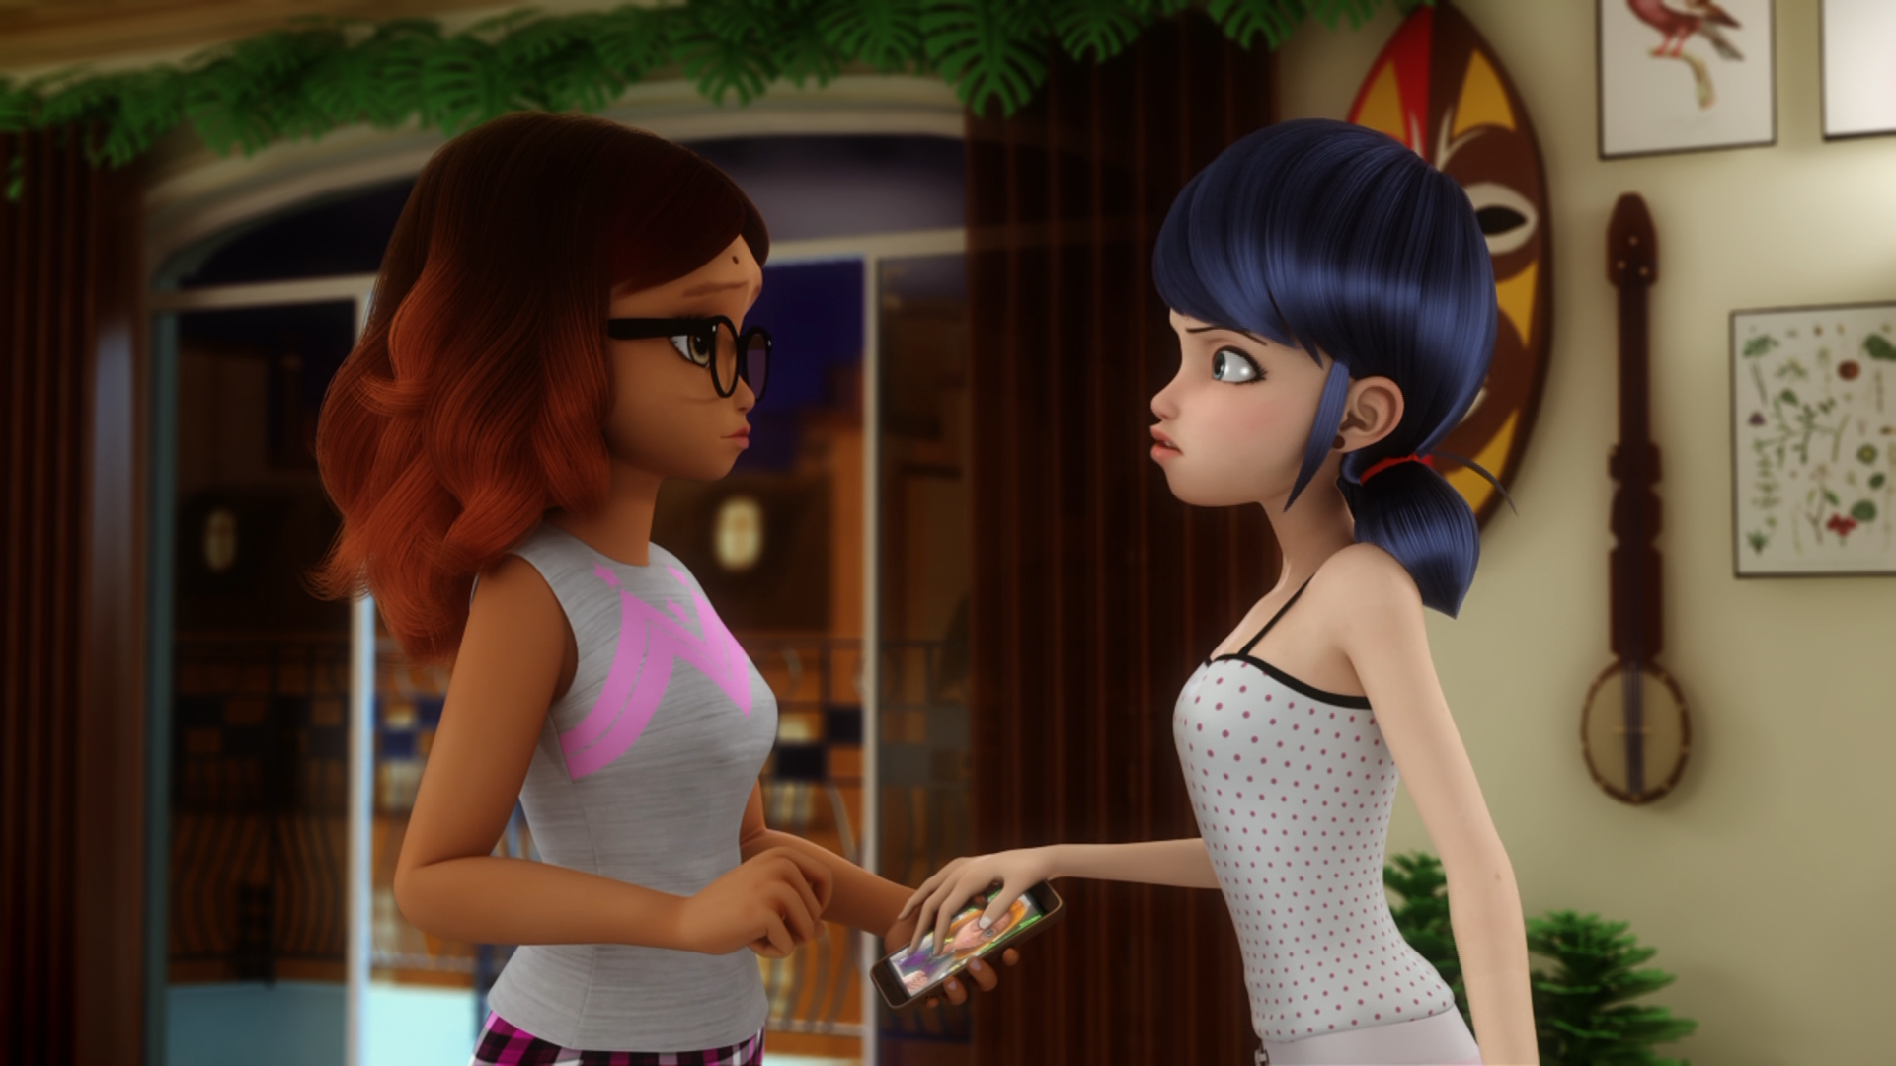
Don't you think there's a reason why she keeps her ______ a secret?
identity
WeChat
name

Slide 10
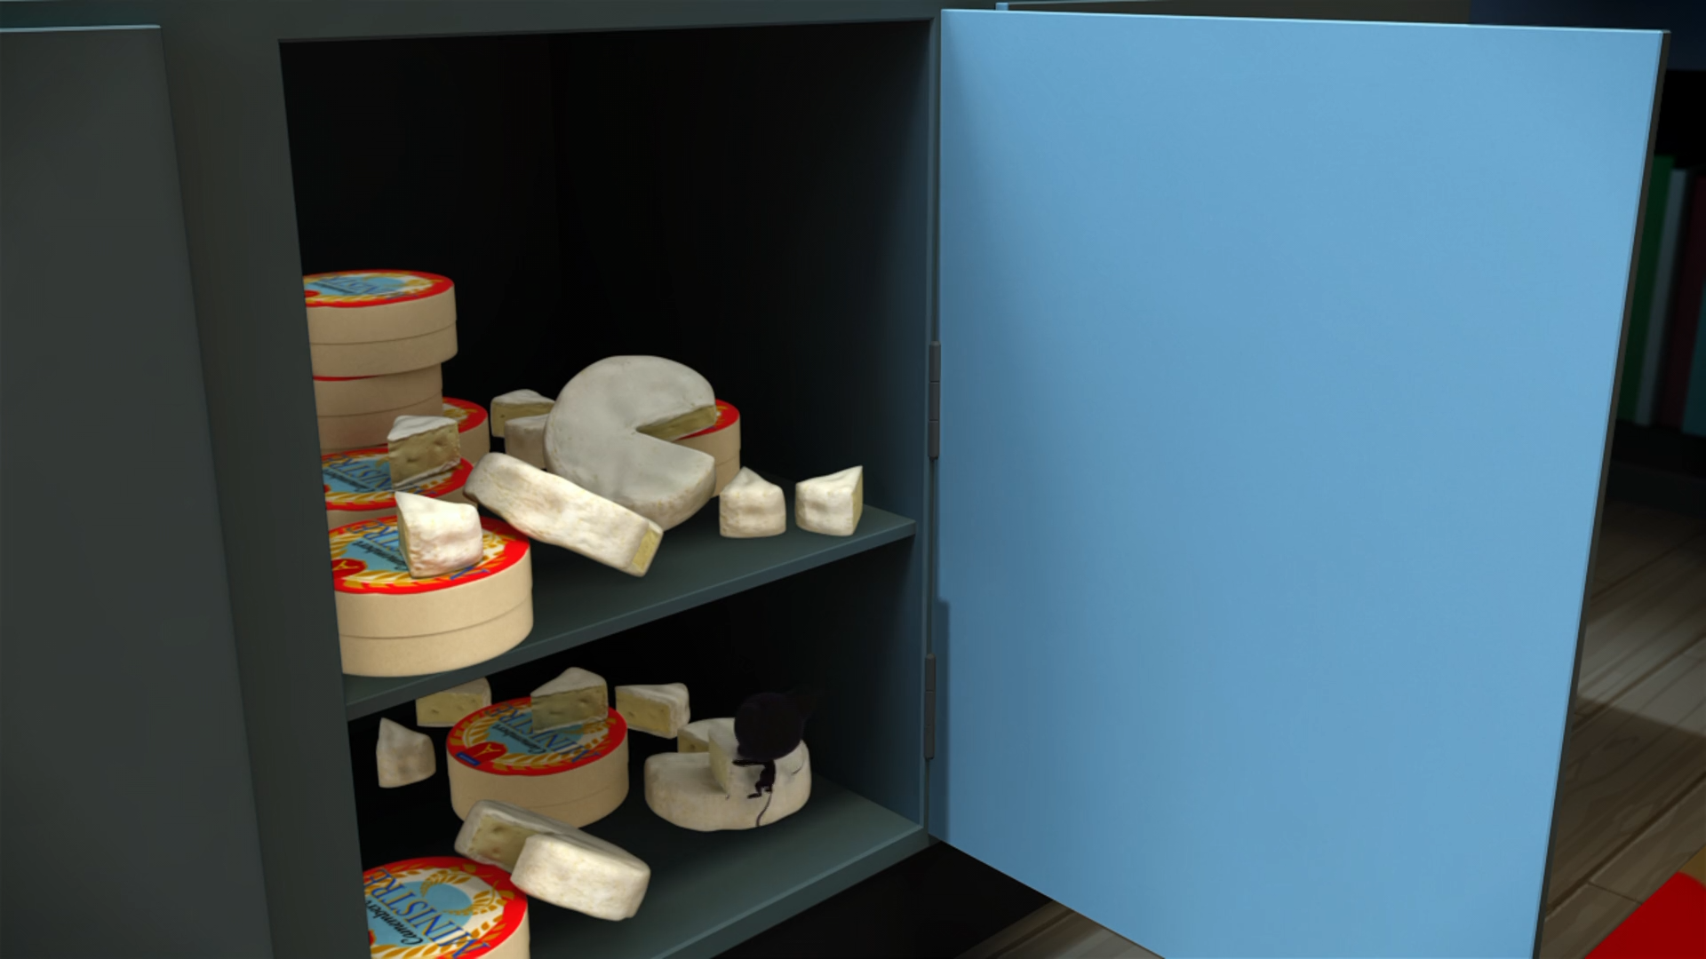
These food thieves are real ______!
naughty
dangerous
small

Slide 11
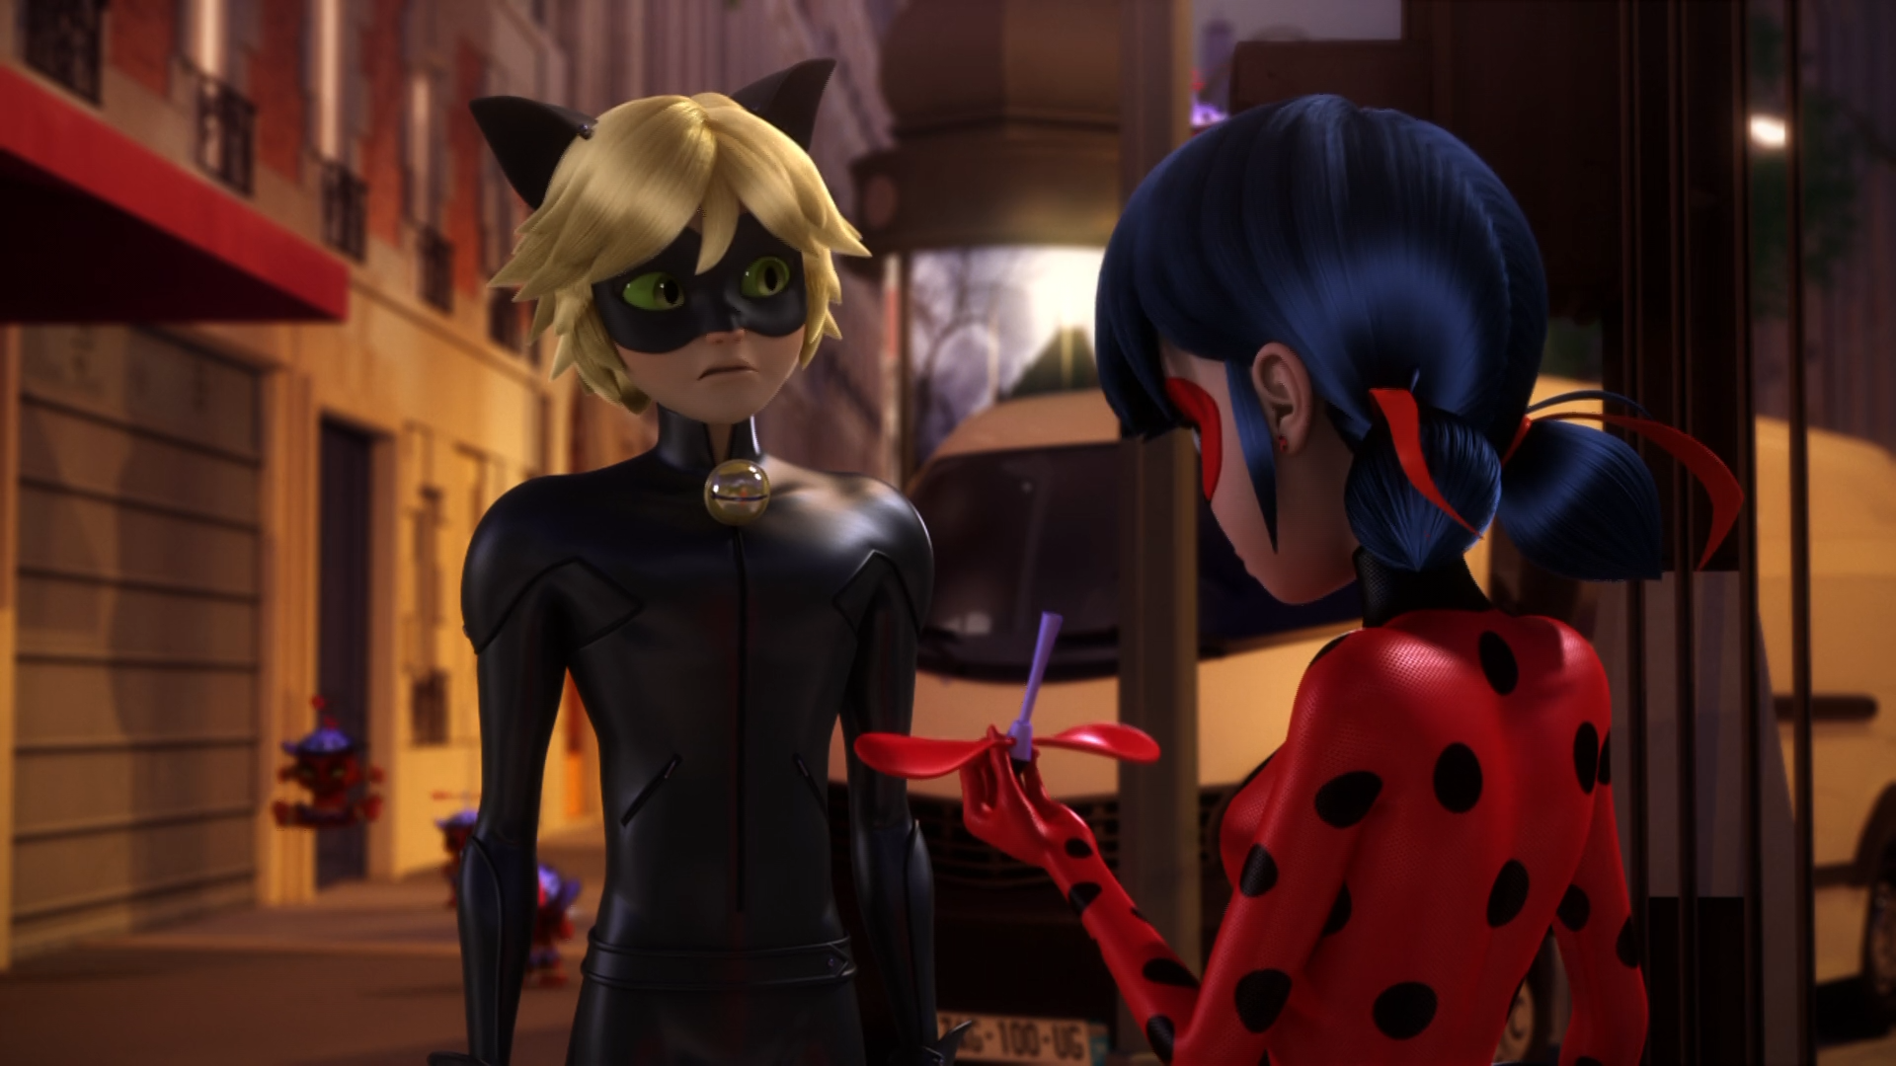
How'd you know to destroy the monster's ______?
cap
hat
head

Slide 12
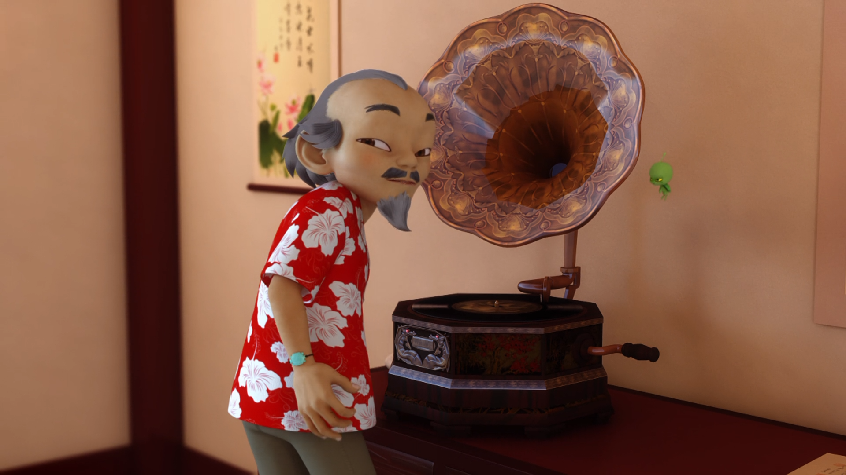
I think it's trying to tell us that you need ______ this time.
Alya
Adrien
help

Slide 13
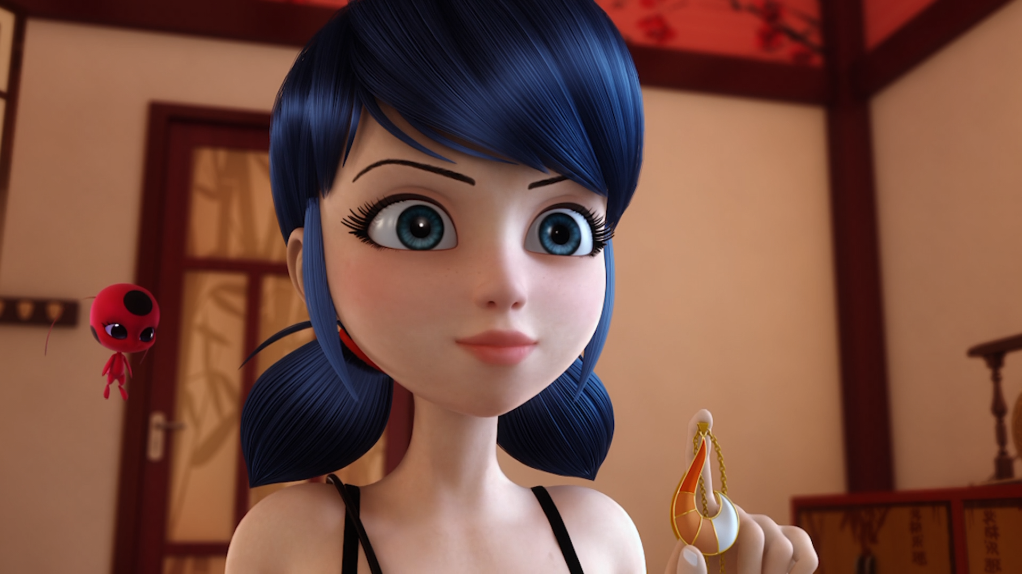
Yes, Master. I know just the right ______!
person
girl
boy

Slide 14

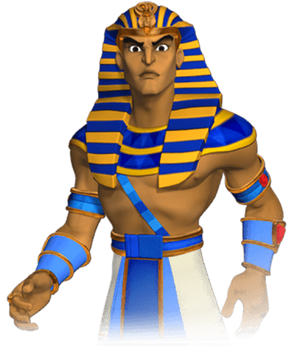
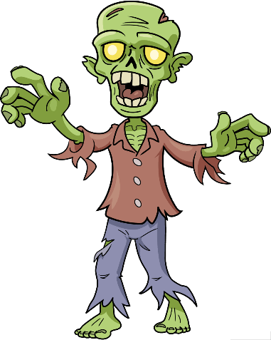
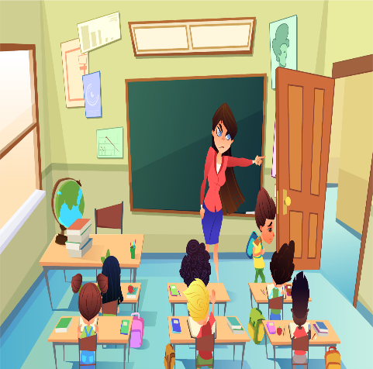
Matching Exercise
strict | teapot | pharaoh | zombie

Slide 15
Matching Exercise
teapot | pharaoh | zombie | strict

Slide 16
TRUE OR FALSE
1. Alya has twin sisters.
2. Alya and Marinette are eating Durian.
3. One of the monsters is reading the news.
4. The Sapotis multiply when they eat.
5. Cat Noir goes to see Master Fu.

Slide 17
TRUE OR FALSE
1. Alya has twin sisters. | TRUE
2. Alya and Marinette are eating Durian. | FALSE
3. One of the monsters is reading the news. | TRUE
4. The Sapotis multiply when they eat. | TRUE
5. Cat Noir goes to see Master Fu. | FALSE

Slide 18
history
1
happiness
2
home
town
3
jobs
4
cakes
5
tech
6
jewellery
7
USA
8
Panda
9
dad
10
candy
11
airport
12
birthdays
13
t-shirts
14
table tennis
15

