Slide 1
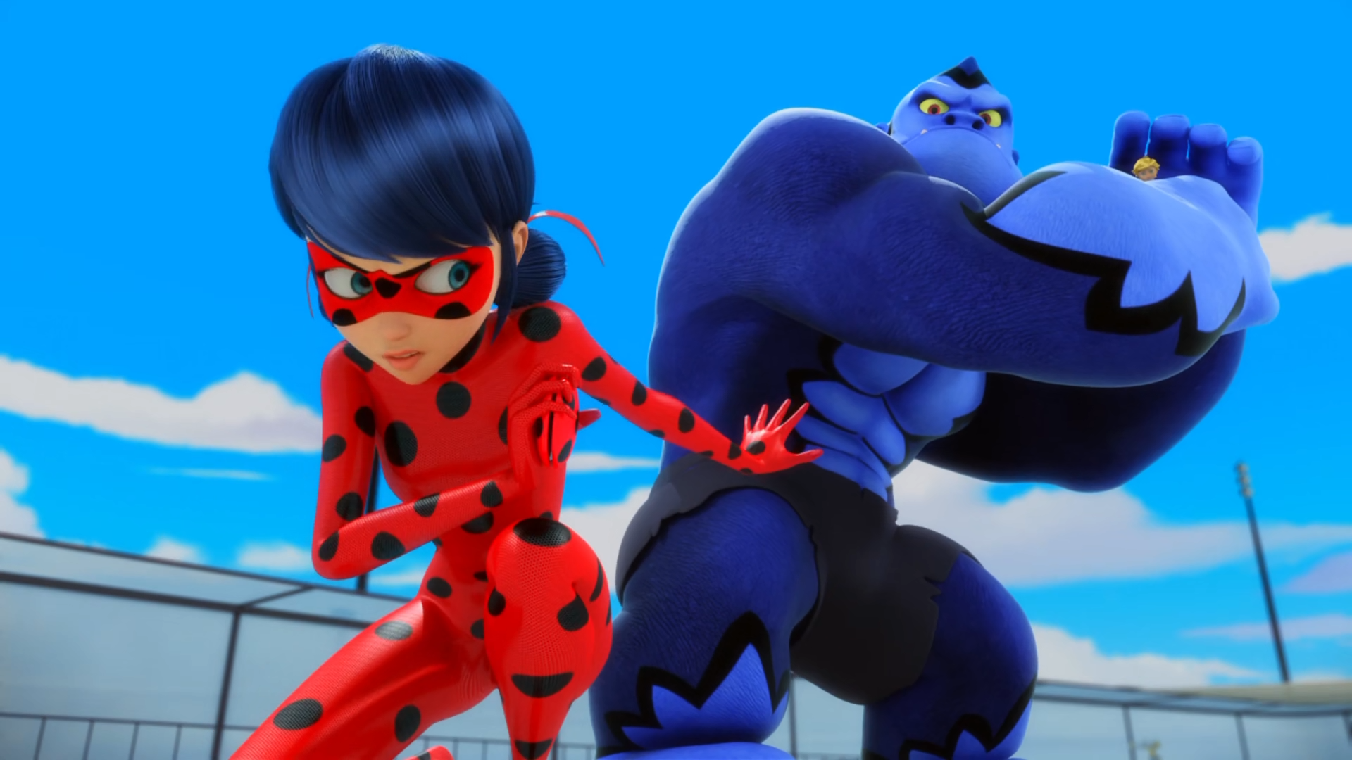
MIRACULOUS LADYBUG: GORIZILLA. PART 2

Slide 2
VOCABULARY
bait - 饵 - beɪt
beast - 兽 - biːst
bodyguard - 保镖 - bɒdɪɡɑːd
maneuver - 演习 - məˈnuːvə
pockets - 口袋 - pɒkɪts
track - 追踪 - træk

Slide 3
1. 保镖
2. 口袋
3. træk

Slide 4
1. 保镖 - bodyguard
2. 口袋 - pockets
3. træk - track

Slide 5
GORIZILLA. PART 2
Adrien: Are you...my bodyguard?!
Wayhem: Let go of Adrien, right now!
Adrien: Stop! I'm the one you wanted. Leave them alone!
Wayhem: Adrien, I'm coming to save you! Marinette: Adrien needs me!
Wayhem: Put Adrien down right now!
Ladybug: Put Adrien down right now!

Slide 6
Ladybug: Jump, Adrien! Quick! You have to trust me!
Adrien: Always! Yeah-ha!
Hawk Moth: No!
Ladybug: No!
Plagg: If you don't transform soon, you might wind up like a gooey pile of cheese!
Adrien: I can't, Plagg! Not in the open like this! I'm sure Ladybug has a plan. I trust her!

Slide 7
Wayhem: Ha ha ha! Now you won't be able to sniff out Adrien, will ya, you big hairy ape! Go ahead, try!
Cat Noir: Why don't you pick on someone your own size? Don't worry, "Adrien", I won't let him touch a hair on your head!
Cat Noir: Missed me! Missed me! Missed me again! That's it, big guy. Come on, just a little more.

Slide 8
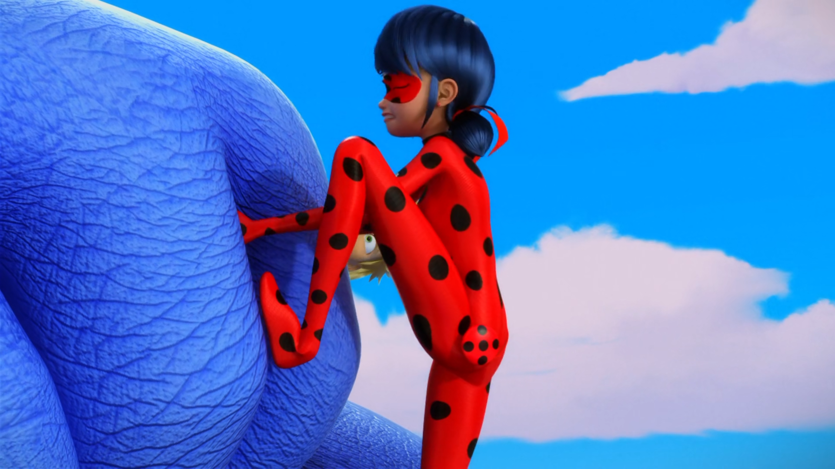

There's no use! He's too ______!
blue
big
strong

Slide 9
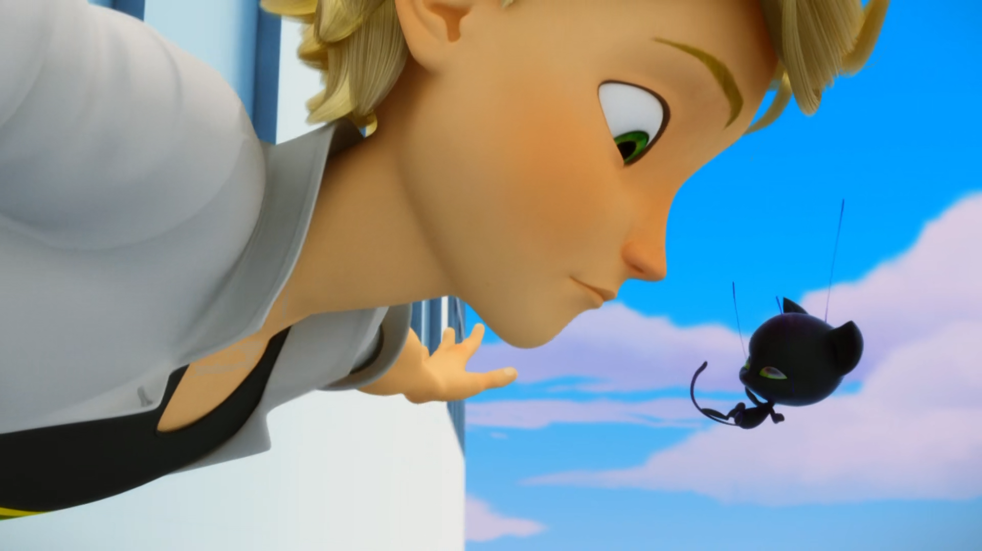
You might wind up like a gooey pile of ______!
Camembert
Crap
Cheese

Slide 10
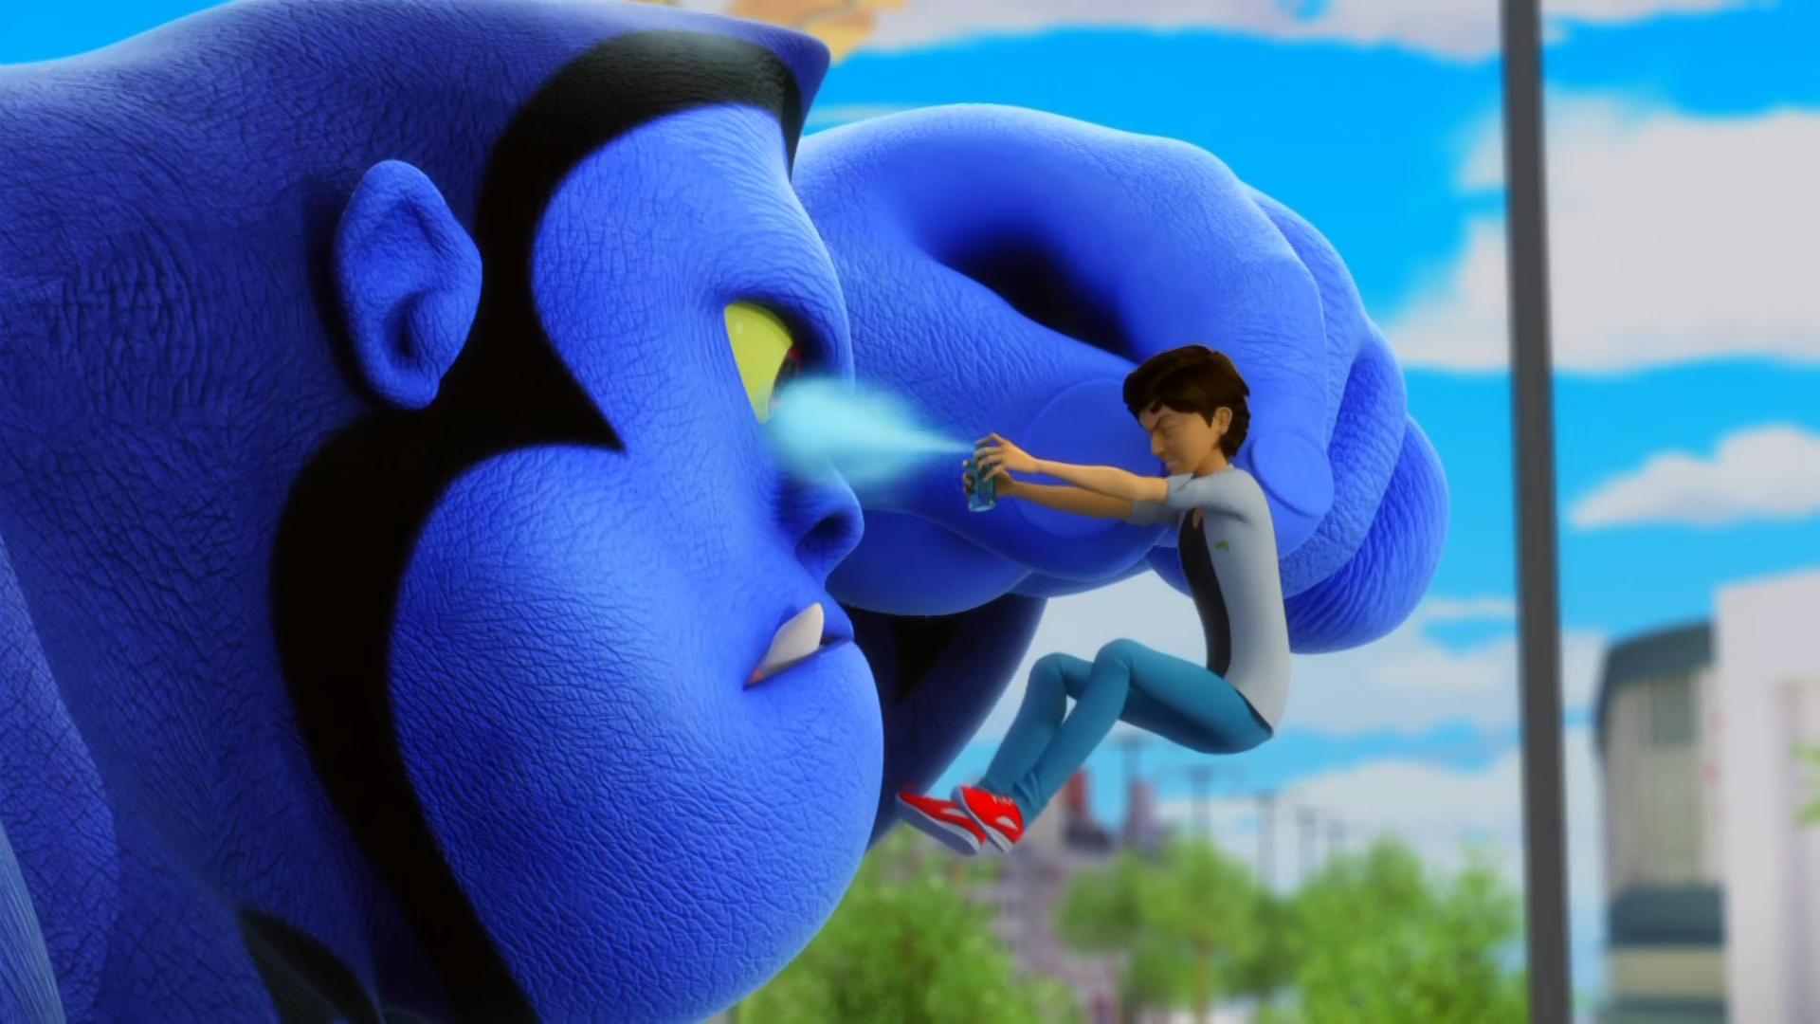
Now you won't be able to sniff out Adrien, will ya, you big hairy ______!
monkey
ape
idiot

Slide 11
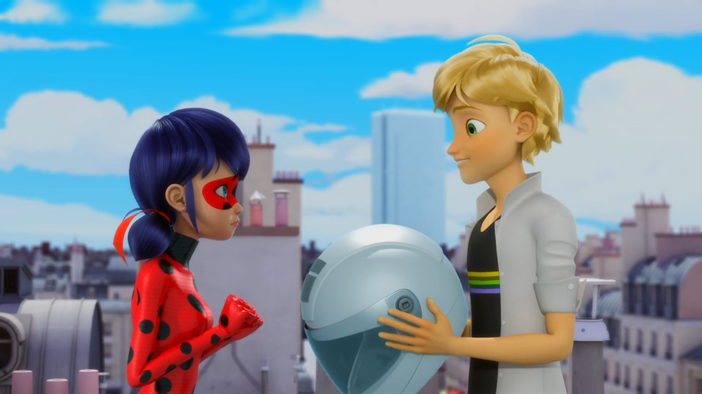
He's my bodyguard. He won't ______ me.
eat
hurt
protect

Slide 12
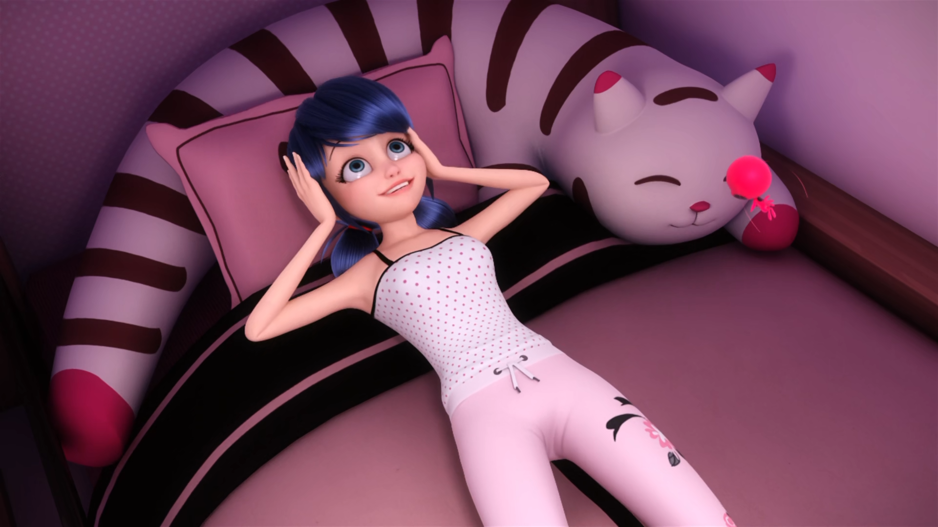
Oh, Tikki! I went to the ______ with Adrien! It's the best day of my life!
toilet
zoo
movies

Slide 13
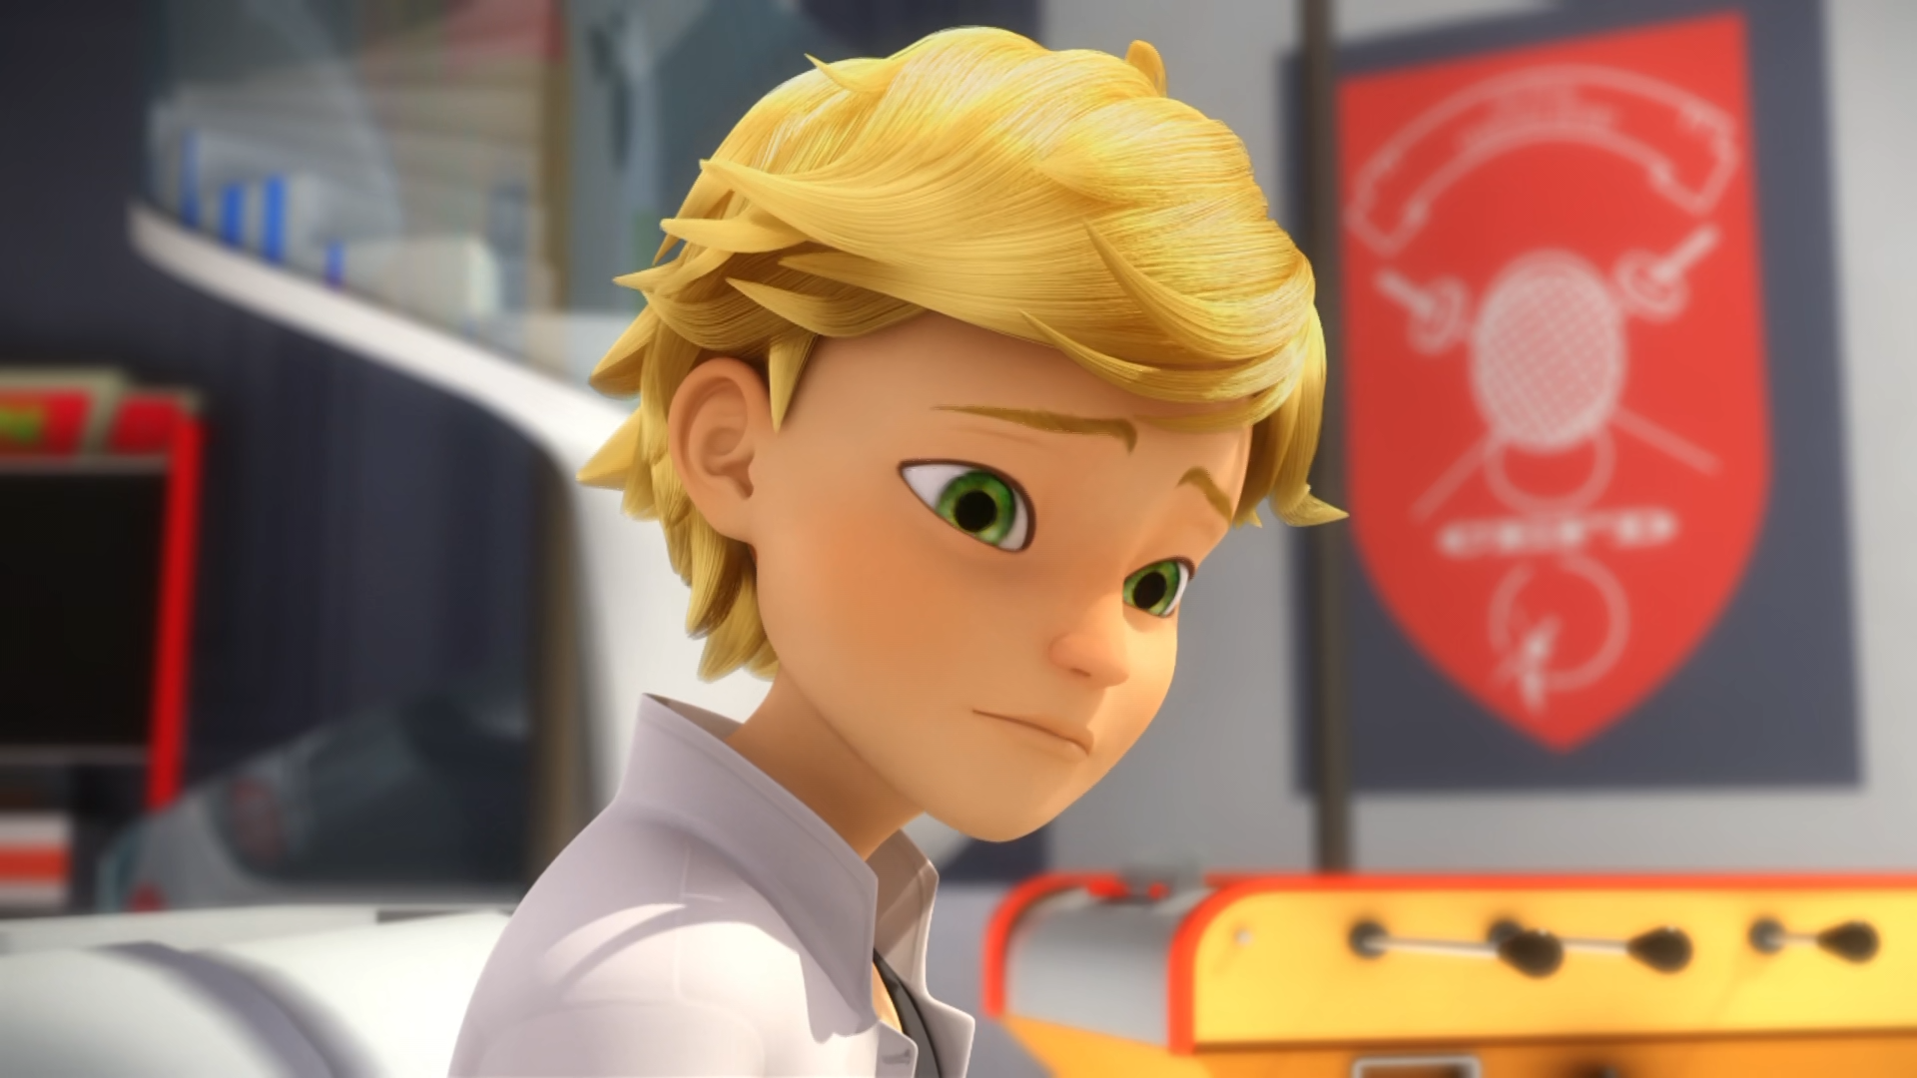
I'm sorry, Father. I tried to talk to you, but you were so ______.
busy
rude
angry

Slide 14
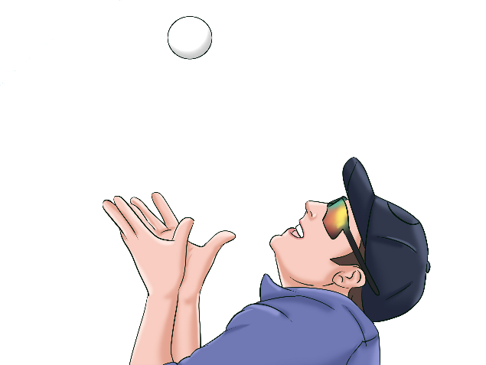
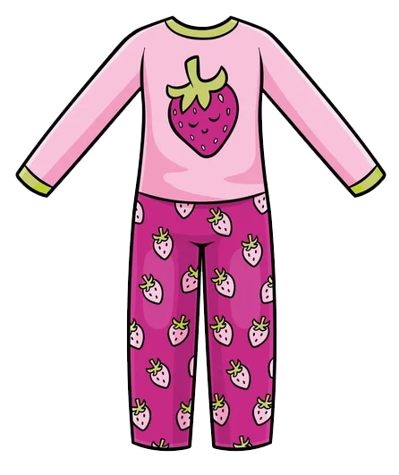


Matching Exercise
helicopter | catch | pyjamas | towels

Slide 15
Matching Exercise
catch | pyjamas | helicopter | towels

Slide 16
TRUE OR FALSE
1. Gorizilla captures Ladybug & Cat Noir.
2. Ladybugs flies an aeroplane into Gorizilla's nose.
3. Hawk Moth thinks Adrien is Cat Noir.
4. Wayhem gets Adrien's e-mail address.
5. Adrien watches a red movie with his dad.

Slide 17
TRUE OR FALSE
1. Gorizilla captures Ladybug & Cat Noir. | TRUE
2. Ladybugs flies an aeroplane into Gorizilla's nose. | FALSE
3. Hawk Moth thinks Adrien is Cat Noir. | TRUE
4. Wayhem gets Adrien's e-mail address. | TRUE
5. Adrien watches a red movie with his dad. | FALSE

Slide 18
Didi
1
the mall
2
grand
parents
3
education
4
breakfast
5
sports
day
6
toys
7
rain
8
BFF
9
mum
10
vegetables
11
K-Pop
12
fruit
13
time
14
basketball
15

