Slide 1
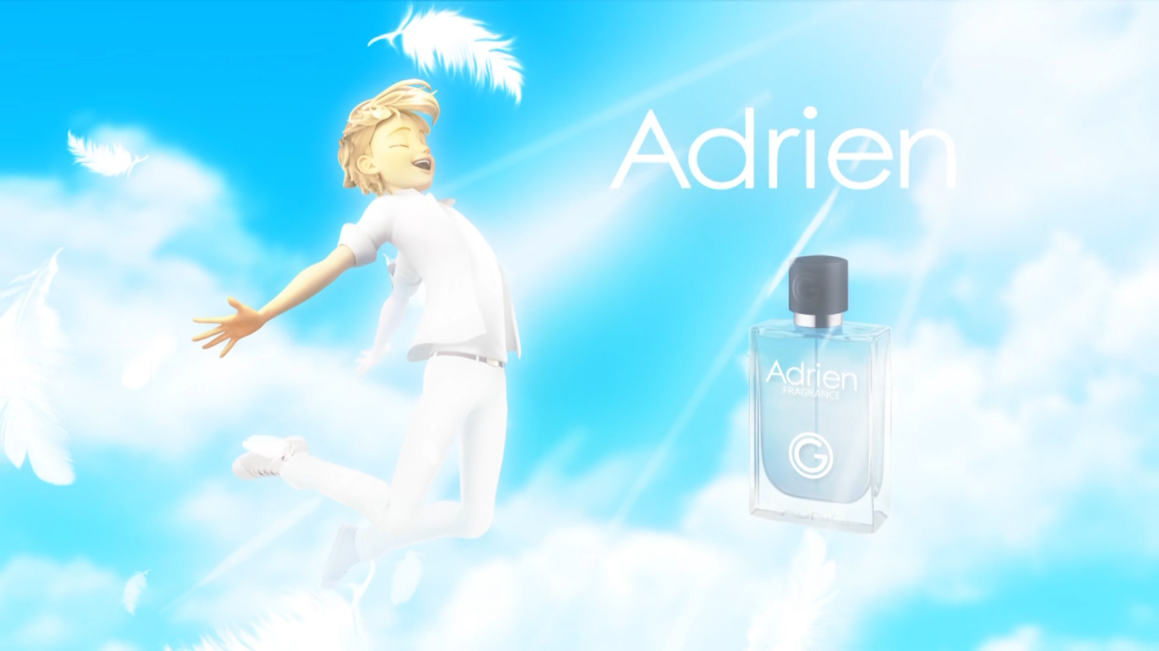
MIRACULOUS LADYBUG: GORIZILLA. PART 1

Slide 2
VOCABULARY
alert - 警报 - əˈlɜːt
autograph - 签名 - ɔːtəɡrɑːf
carefree - 畅快 - keəfriː
cologne - 科隆 - kəˈləʊn
dreamy - 梦幻般的 - driːmi
fragrance - 香味 - freɪɡrᵊns
noticing - 注意到 - nəʊtɪsɪŋ
radiant - 容光焕发的 - reɪdiənt
tracking - 追踪 - trækɪŋ

Slide 3
1. 签名
2. 香味
3. trækɪŋ

Slide 4
1. 签名 - autograph
2. 香味 - fragrance
3. trækɪŋ - tracking

Slide 5
GORIZILLA. PART 1
Girl: It's Adrien from TV!
Firefighter: Can I have an autograph for my daughter?
Wayhem: Adrien? Adrien! Adrien!!
Commercial voice and Marinette: Radiant. Carefree. Dreamy. Adrien...
Alya: Marinette, I've been waiting for you for fifteen minutes! Where are you, girl?

Slide 6
Adrien: Thank you for saving me. People are going crazy over this ad.
Marinette: You starred in an ad? I had no
idea! That's awesome!
Adrien: I don't know about that. In fact it's really quite... embarrassing?
Marinette: Heh! All good now! I'd better get going. Isn't that your bodyguard?

Slide 7
Adrien: I'm so sorry I got you in this crazy mess, Marinette. Plus, now everyone thinks you're my girlfriend!
Marinette: Oh, that's terrible, yeah. I mean no! I mean it's not that terrible, really. Is it? Or...not? Anyway, do you think it's gonna be okay between you and your father?
Adrien: How can anything bad happen... with my Marinette lucky charm?

Slide 8
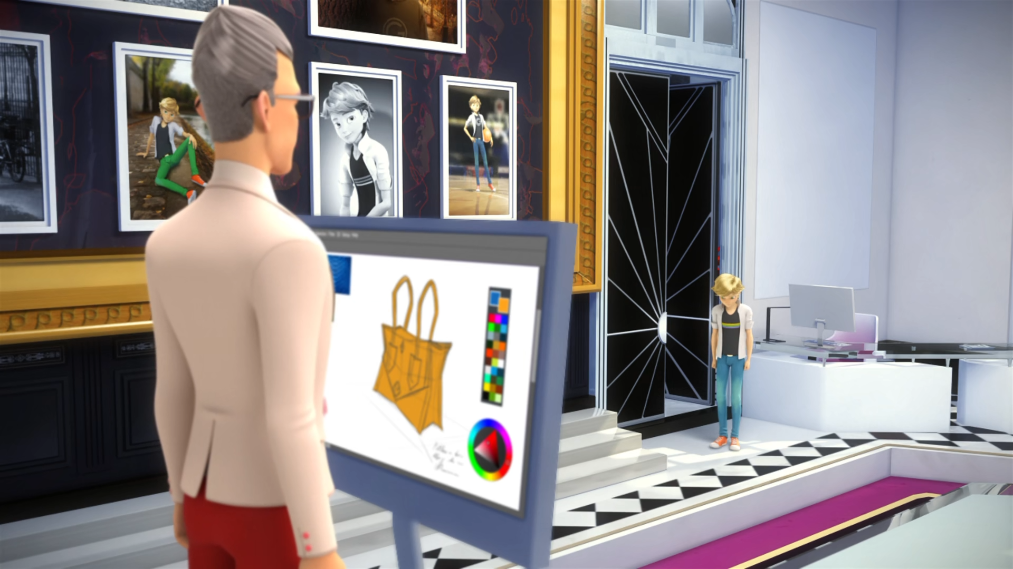

Shouldn't you be practicing your ______?
English
fencing
piano

Slide 9
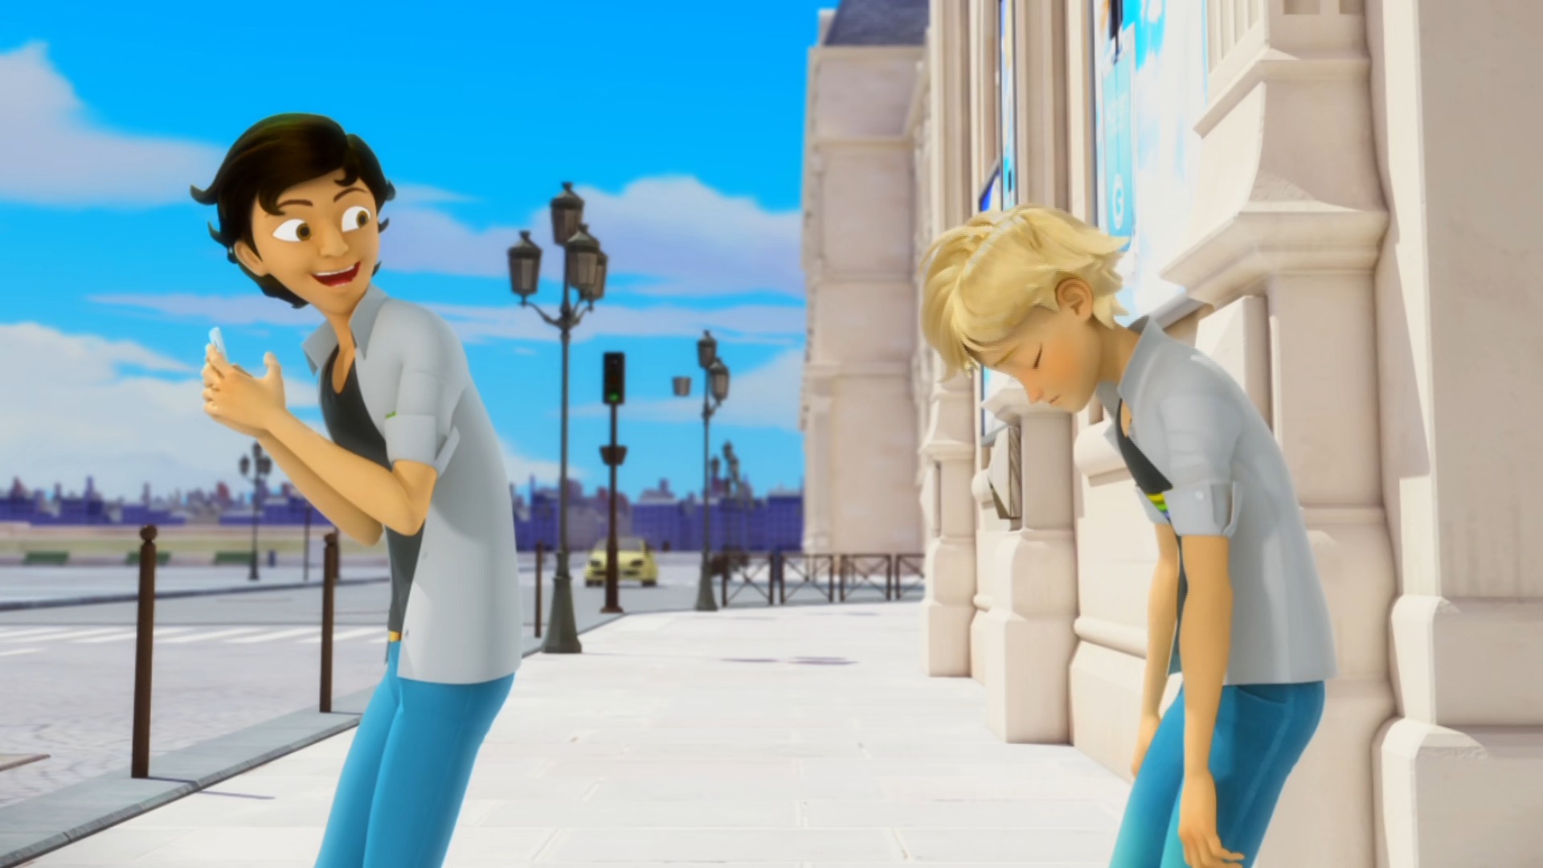
No! Don't post it up on... ______.
the internet
WeChat
Douyin

Slide 10
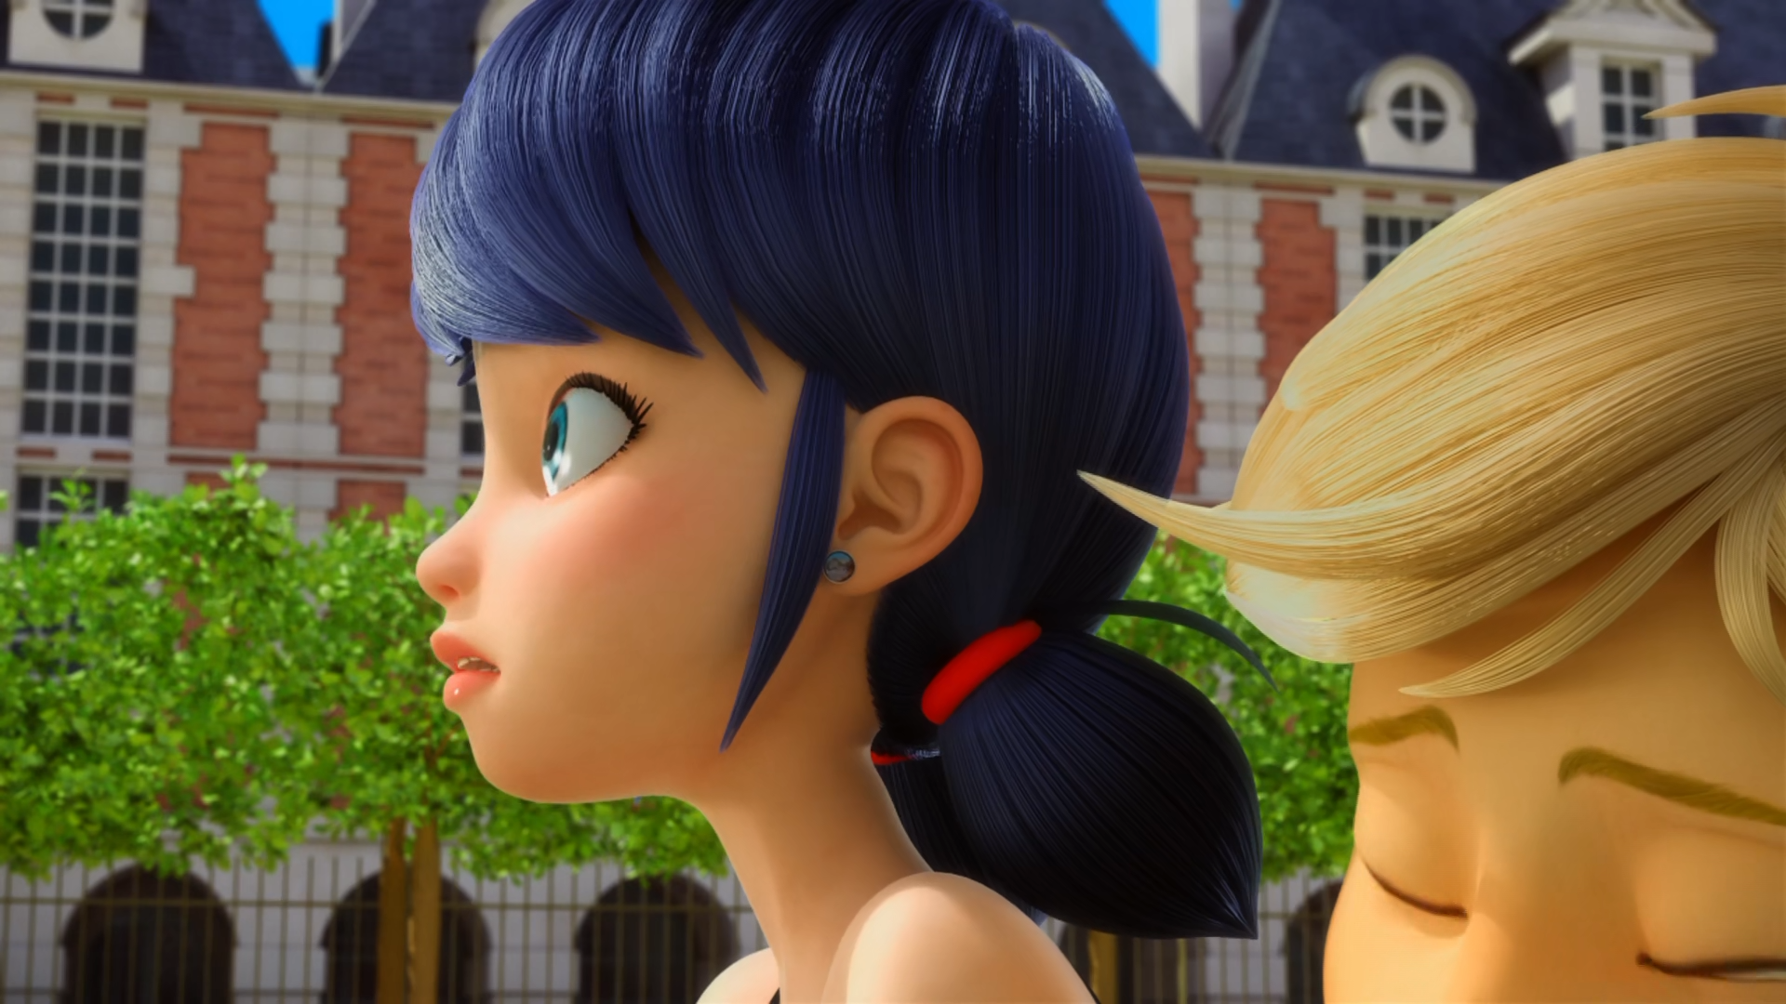
Isn't that your ______?
boyfriend
bodyguard
wife

Slide 11
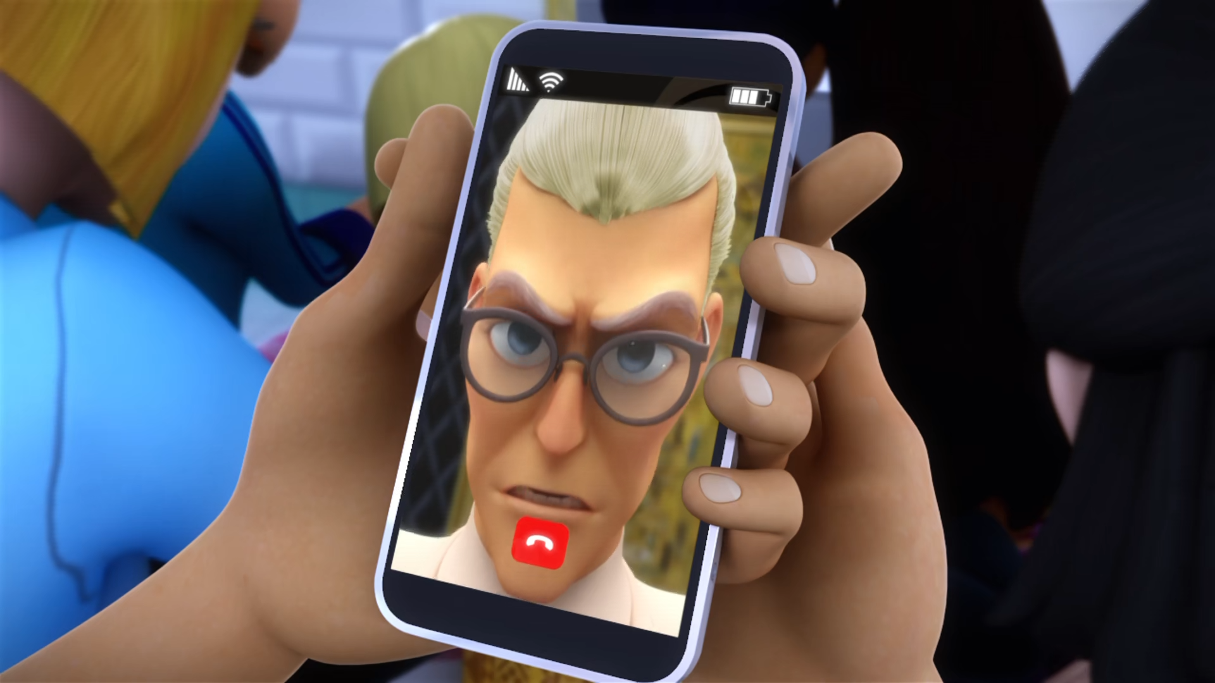
Return that phone this minute or I'll have you ______!
tested
arrested
killed

Slide 12
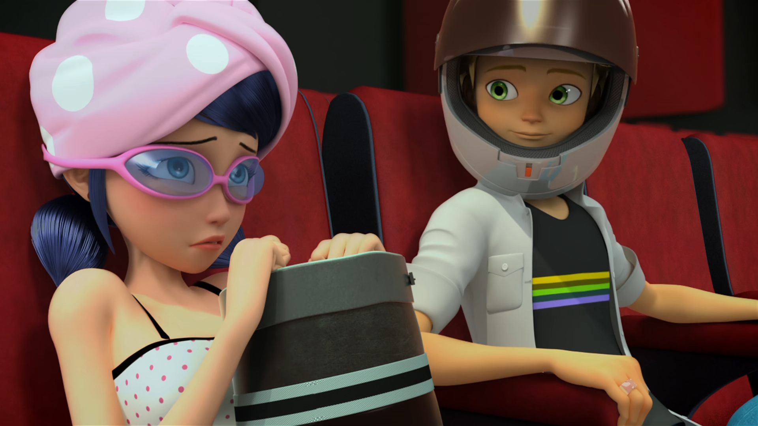
Please don't tell me it's ______ movie!
an action
a superhero
a horror

Slide 13
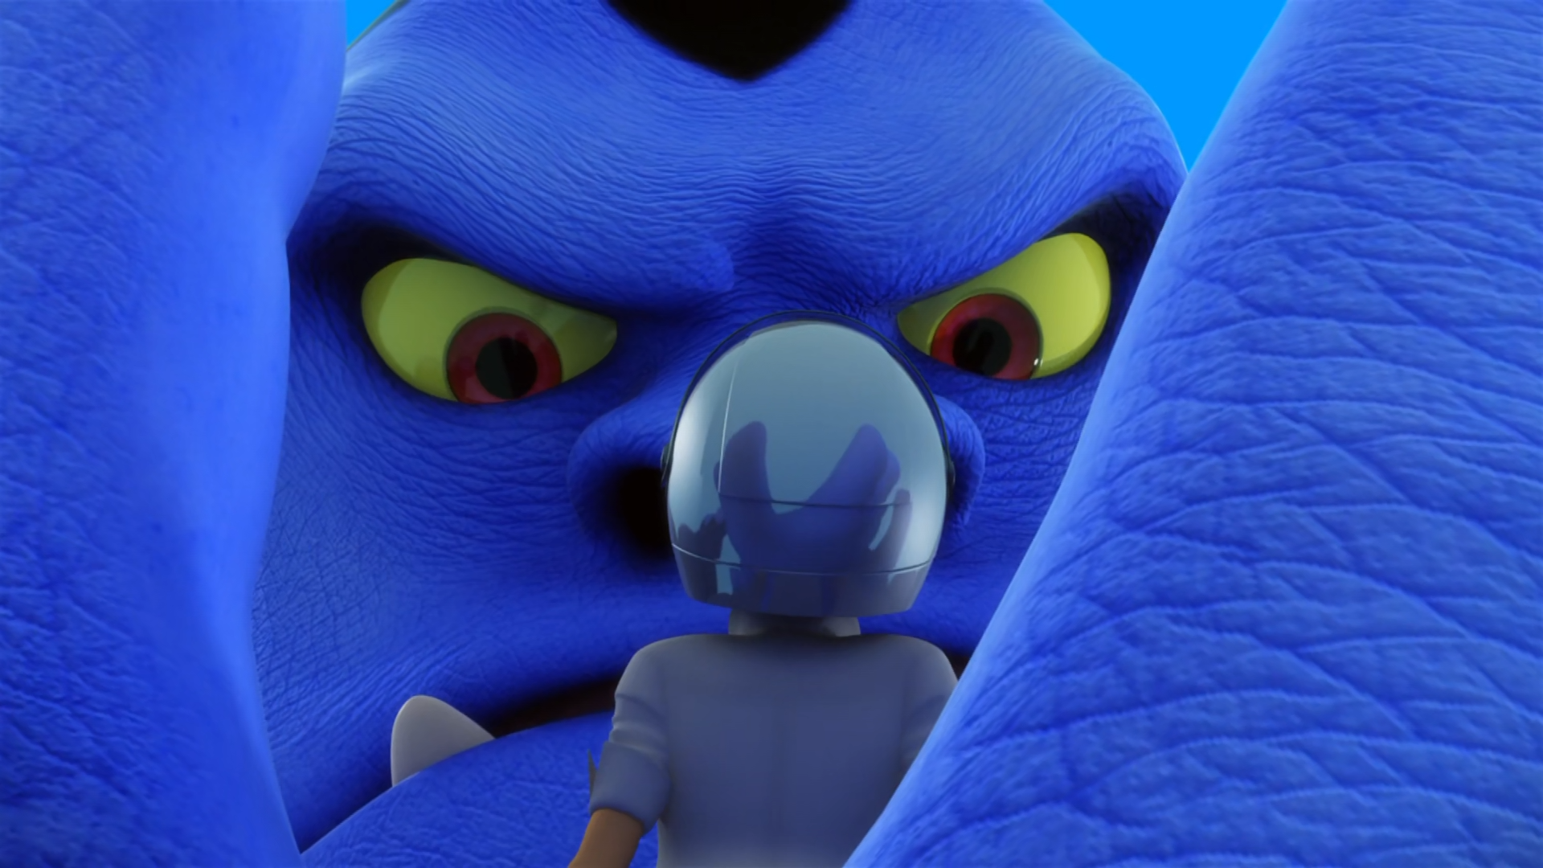
Are you...my ______?
bodyguard
mother
father

Slide 14


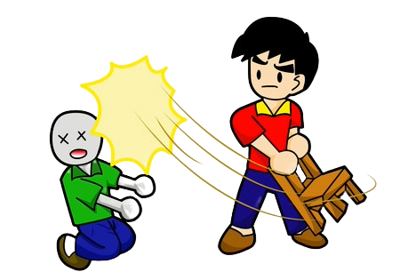

Matching Exercise
embarrass | assault | horror | swimsuit

Slide 15
Matching Exercise
swimsuit | embarrass | assault | horror

Slide 16
TRUE OR FALSE
1. Adrien's father is designing a handbag.
2. Marinette changes her clothes.
3. The bodyguard gets a parking ticket.
4. Marinette and Adrien are hiding in the toilet.
5. Adrien's mum is a movie star.

Slide 17
TRUE OR FALSE
1. Adrien's father is designing a handbag. | TRUE
2. Marinette changes her clothes. | FALSE
3. The bodyguard gets a parking ticket. | TRUE
4. Marinette and Adrien are hiding in the toilet. | FALSE
5. Adrien's mum is a movie star. | TRUE

