Slide 1
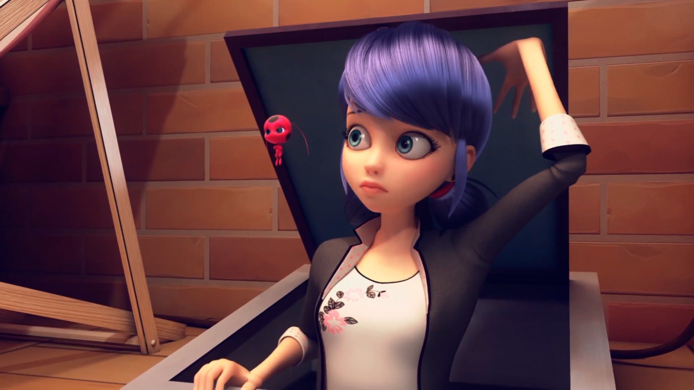
MIRACULOUS LADYBUG: GLACIATOR. PART 2

Slide 2
VOCABULARY
freeze - 冻结 - friːz
frighten - 吓唬 - fraɪtᵊn
glad - 高兴的 - ɡlæd
plan - 计划 - plæn
ruin - 废墟 - ruːɪn
sensitive - 敏感的 - sɛnsɪtɪv
serve - 服务 - sɜːv
taste - 品尝 - teɪst
weird - 诡异的 - wɪəd

Slide 3
1. friːz
2. 计划
3. 品尝

Slide 4
1. friːz - freeze
2. 计划 - plan
3. 品尝 - taste

Slide 5
GLACIATOR. PART 2
Marinette: I'm so sorry.
Cat Noir: Why? It's not your fault.
Marinette: No… Yeah… I mean… What
I mean is I'm very sorry because, um, you prepared all of this and then she didn't show.
Cat Noir: She told me she might not make it but I had my fingers crossed. I really wanted her to come.

Slide 6
Ladybug: That's weird. It looks like he's leaving the couples alone.
Cat Noir: Too bad for us.
Ladybug: You don't understand. We know he doesn't attack couples so we could pretend..
Cat Noir: Pretend?
Ladybug: To be in love!
Cat Noir: Sorry, Ladybug, it's not cool to play with people's feelings.

Slide 7
Ladybug: You're my friend. And I'd never wanna lie to a friend.
Cat Noir: Why do you think it'd be lying?
Ladybug: Because there's this boy I...
Cat Noir: There's a boy? Who is...?
Ladybug: It's.. I can't tell you who it is.
Cat Noir: I get it, Ladybug. Your friendship means everything to me. You can keep the rose. It goes with your costume.

Slide 8
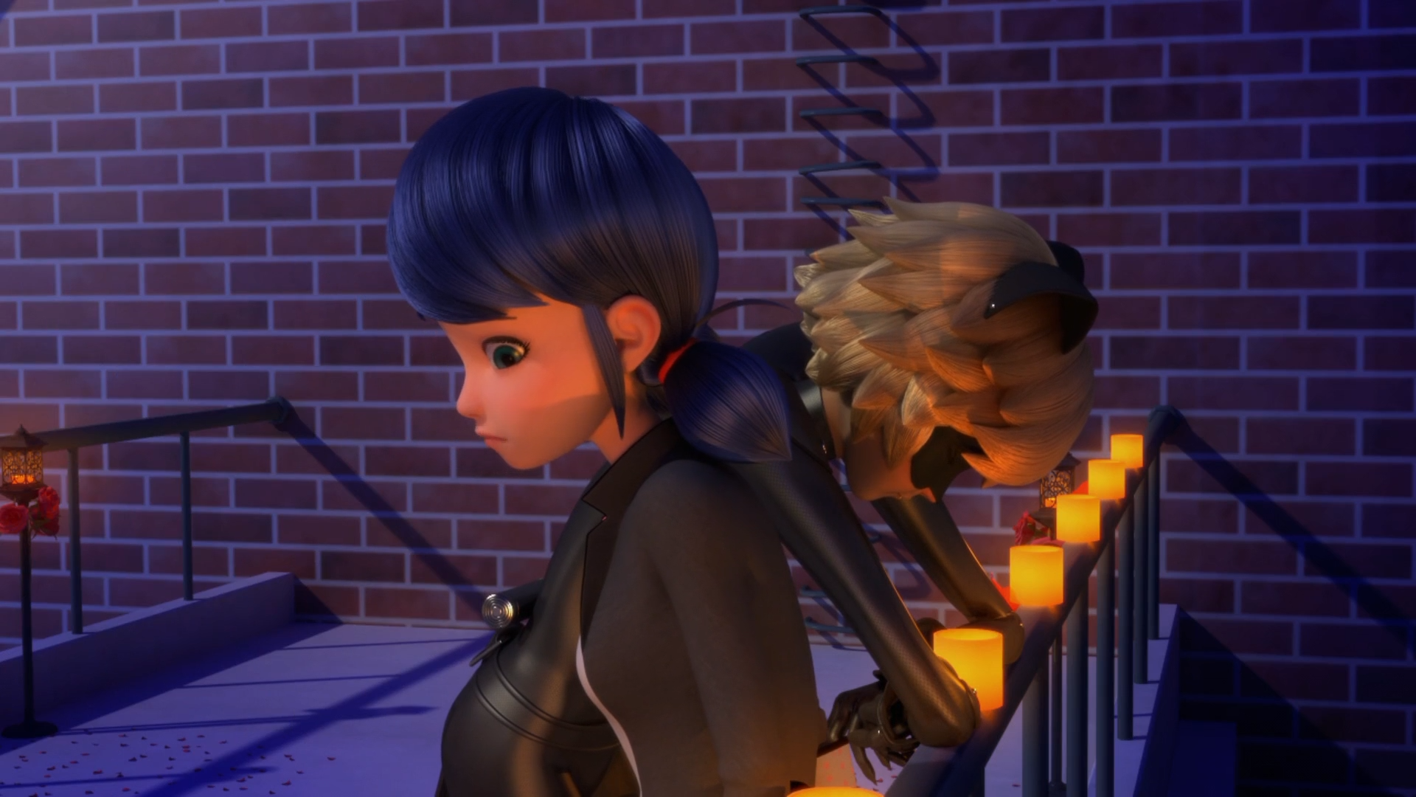

Maybe she had a really good reason for not coming. Like, a ______
date
test
problem

Slide 9
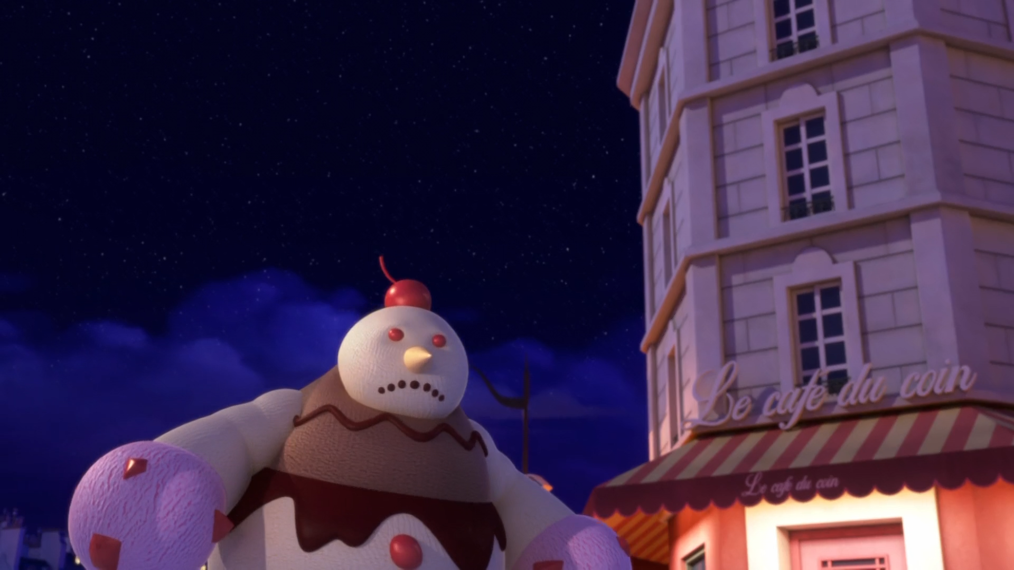
You're looking so sad and surly, but ______ will make it all better.
Glaciator
George
Galactus

Slide 10
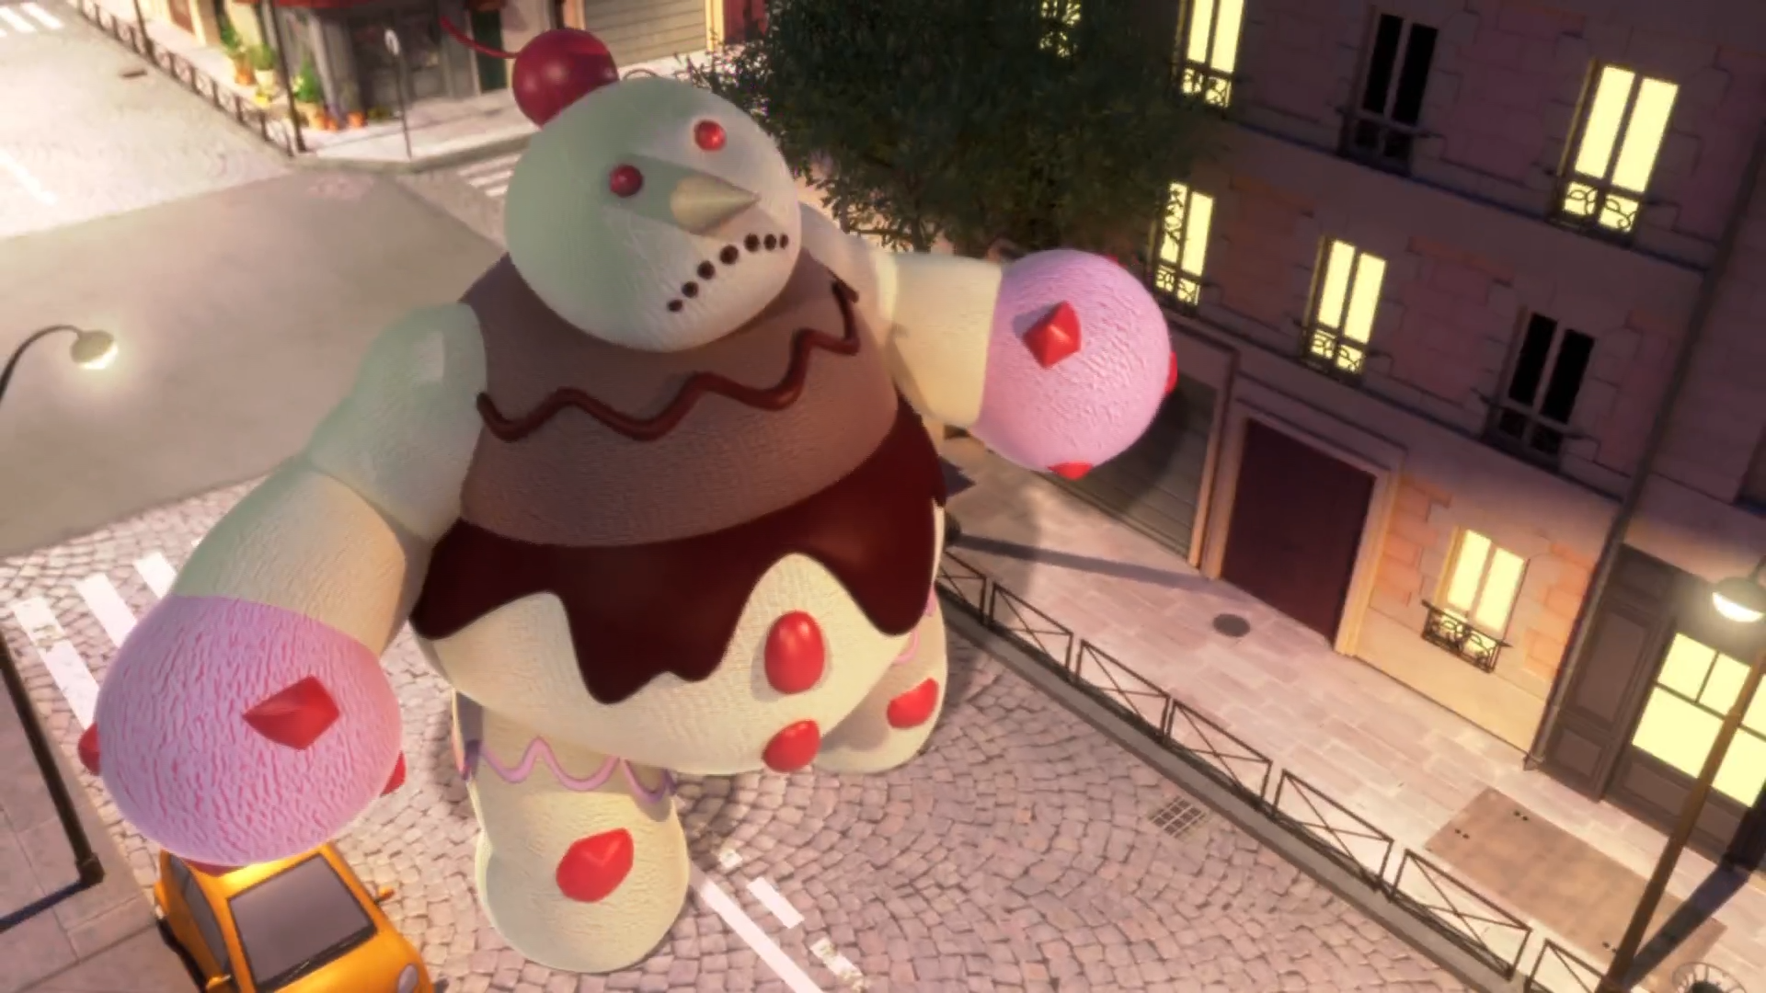
Come out now, or I'll bury ______ in an entire layer of ice-cream!
Dalian
Paris
you

Slide 11
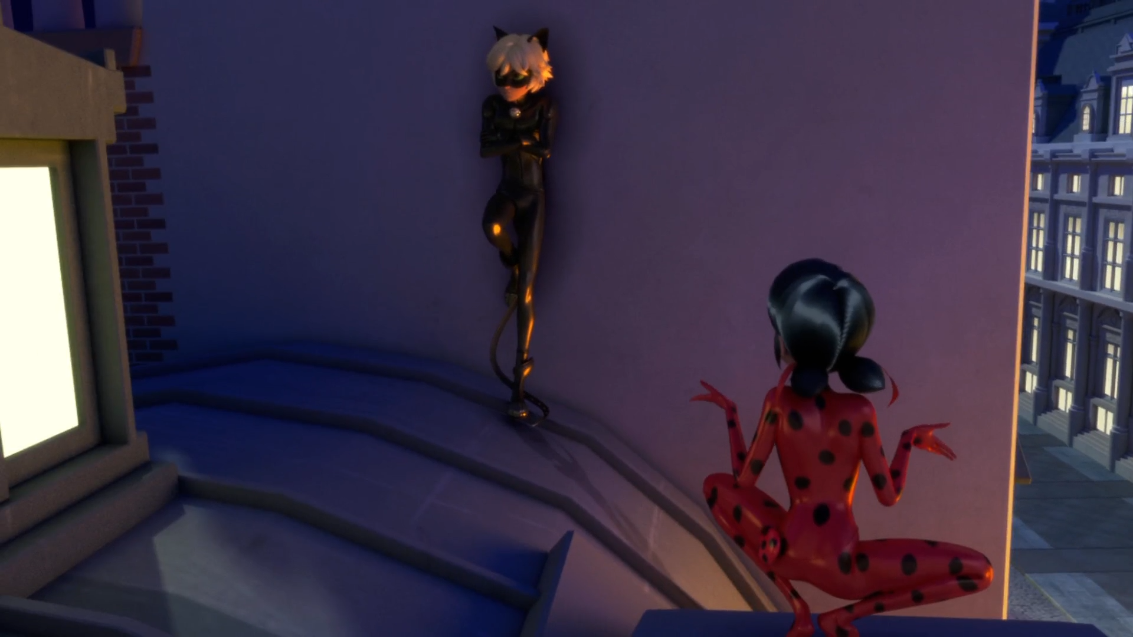
That's weird. It looks like he's leaving the ______ alone.
students
couples
girls

Slide 12
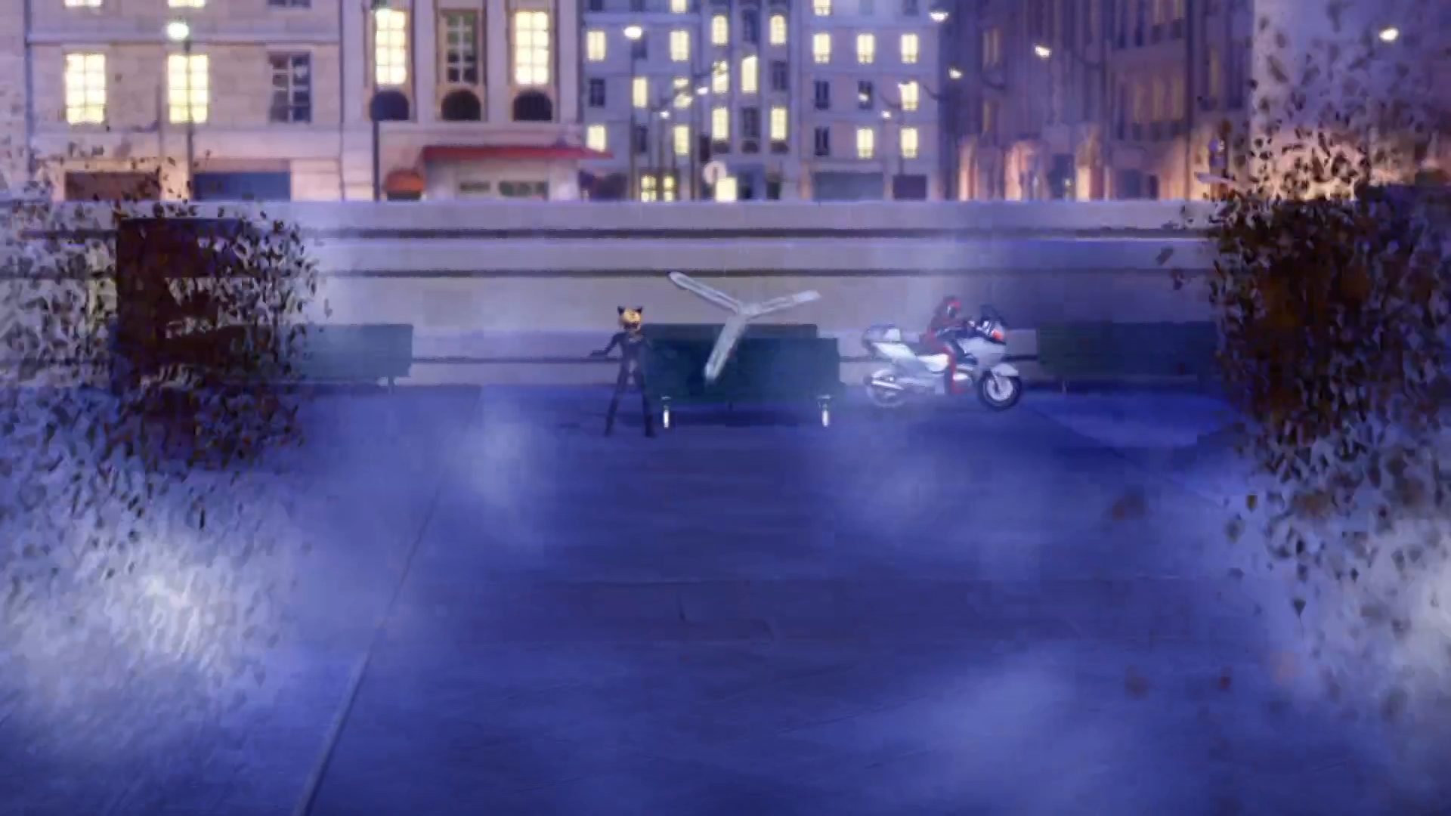
We're gonna make ______!
an airplane
helicopter
propeller

Slide 13
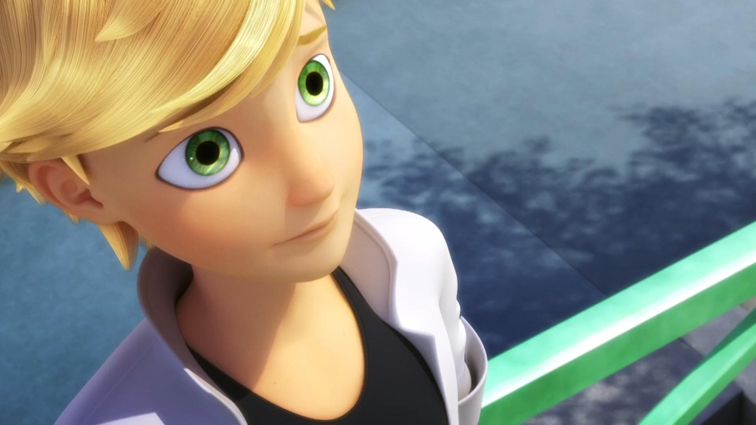
You're spot on, ______! Strawberry with black chocolate chip!
son
boy
dad

Slide 14
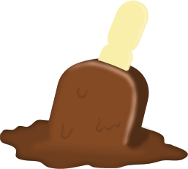

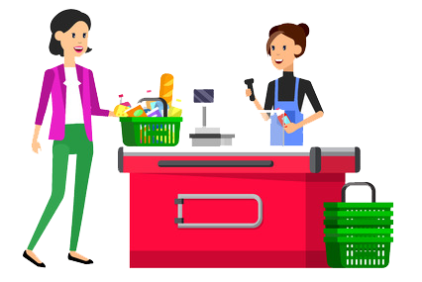
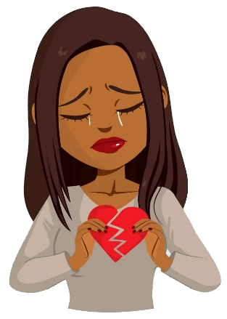
Matching Exercise
customer | heartache | propeller | melt

Slide 15
Matching Exercise
melt | propeller | customer | heartache

Slide 16
TRUE OR FALSE
1. A supervillain once fell in love with Adrien.
2. Cat Noir helps Marinette escape.
3. Glaciator only freezes couples.
4. Cat Noir gives Ladybug a rose.
5. Adrien doesn't eat the ice cream.

Slide 17
TRUE OR FALSE
1. A supervillain once fell in love with Adrien. | FALSE
2. Cat Noir helps Marinette escape. | TRUE
3. Glaciator only freezes couples. | TRUE
4. Cat Noir gives Ladybug a rose. | TRUE
5. Adrien doesn't eat the ice cream. | FALSE

Slide 18
friends
1
marriage
2
the beach
3
KFC
4
news
5
PPTs
6
super-heroes
7
health
8
cats
9
library
10
parents
11
TV
12
dogs
13
stress
14
taobao
15

