Slide 1
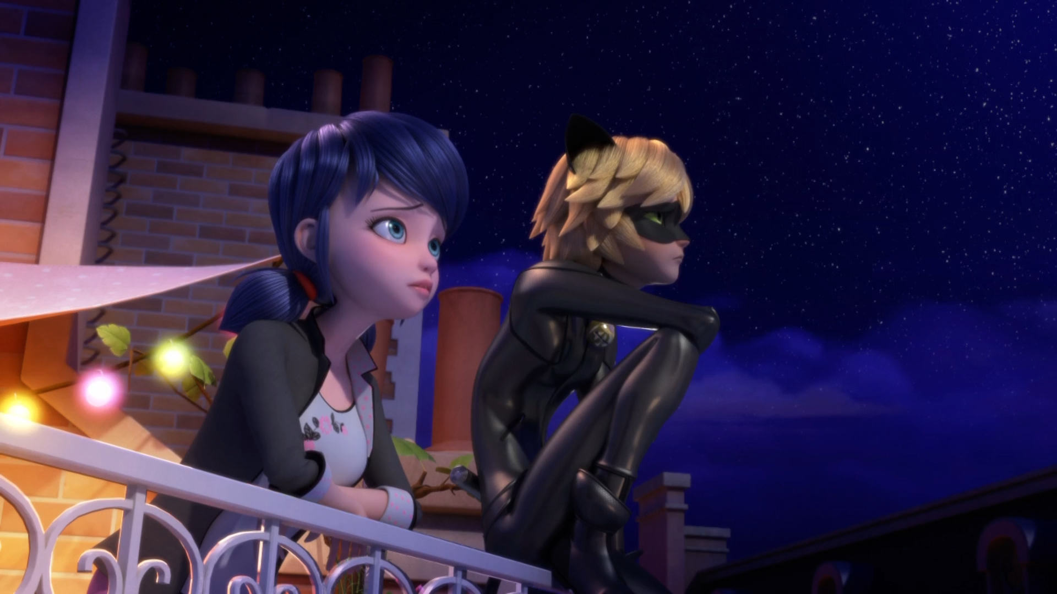
MIRACULOUS LADYBUG: GLACIATOR. PART 1

Slide 2
VOCABULARY
brakes - 刹车 - breɪks
concoction - 混合物 - kənˈkɒkʃᵊn
flavour - 味道 - fleɪvə
lovebirds - 爱情鸟 - lʌvbɜːdz
matchmaker - 媒人 - mæʧˌmeɪkə
materialise - 物化 - məˈtɪərɪəlaɪz
swallow - 吞 - swɒləʊ
sweetheart - 亲爱的 - swiːthɑːt
vanilla - 香草 - vəˈnɪlə

Slide 3
1. 味道
2. 吞
3. swiːthɑːt

Slide 4
1. 味道 - flavour
2. 吞 - swallow
3. swiːthɑːt - sweetheart

Slide 5
GLACIATOR. PART 1
Sabine: That was where your father asked me
Marinette: To marry him.
Sabine: He hid the ring in a scoop of vanilla ice-cream.
Marinette: And you almost swallowed it too!
Sabine: They say that couples who eat
ice-cream at André's will stay in love forever.

Slide 6
Nino: Hey, he's here!
Alya: Let's go!
André: Pistachio, vanilla, and strawberry!
For lovebirds from Italy.
Italian couple: Merci, André!
André: You're welcome, my friends. Enjoy André's ice-cream. May love never end!
Tikki: Why don't you go and get one, too, Marinette?

Slide 7
André: And how about this young miss?
The pretty one who sighs. I have a flavour just for her! It's sure to make her smile!
Marinette: Uh... Me?
André: What's your name, dear?
Marinette: Marinette.
André: Peach pink like his lips and mint like his eyes. Eat this, my dear, and your love will materialize!

Slide 8
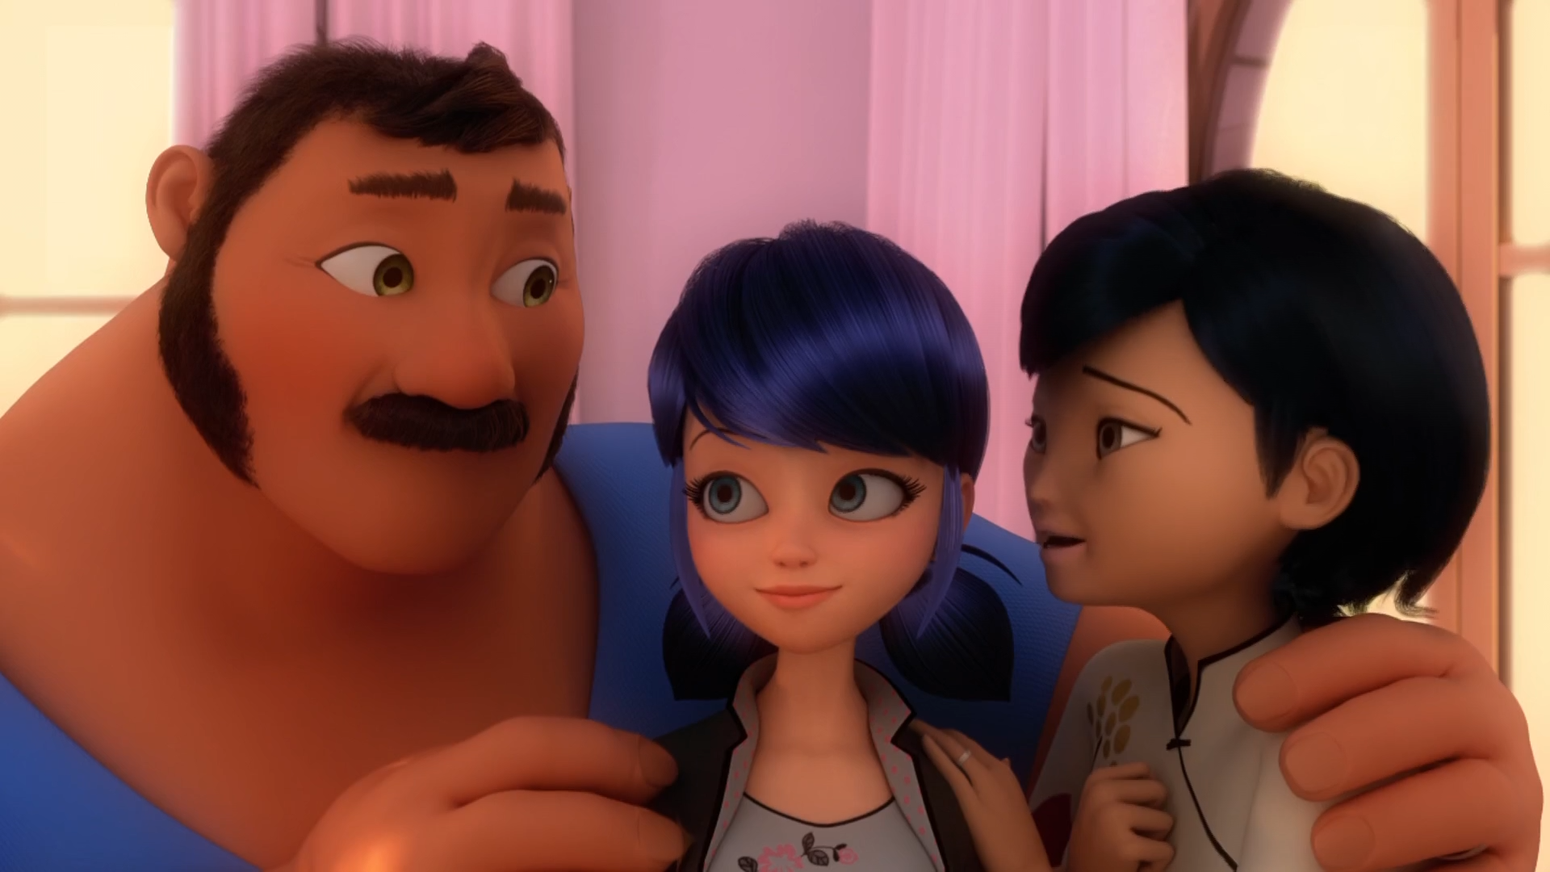

He hid the ring in a scoop of ______ ice cream.
strawberry
chocolate
vanilla

Slide 9
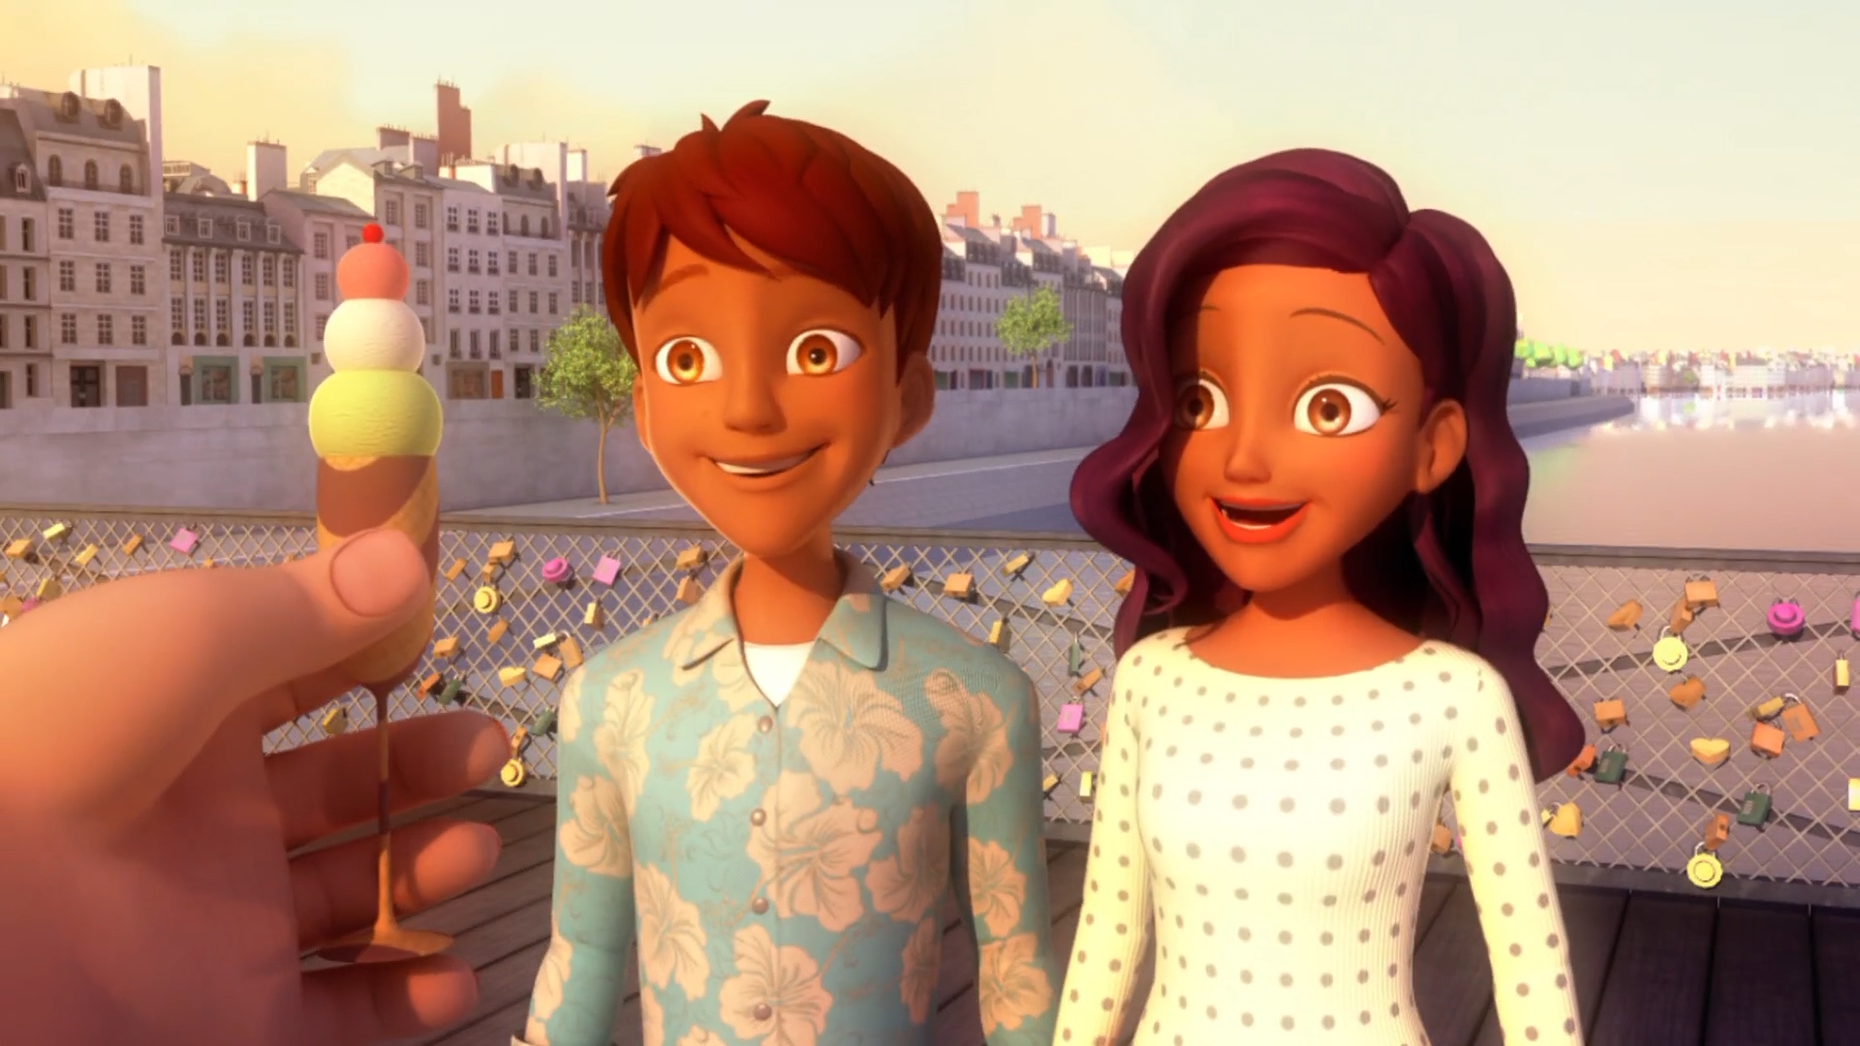
Pistachio, vanilla, and strawberry! For lovebirds from ______.
Italy
DLU
Spain

Slide 10
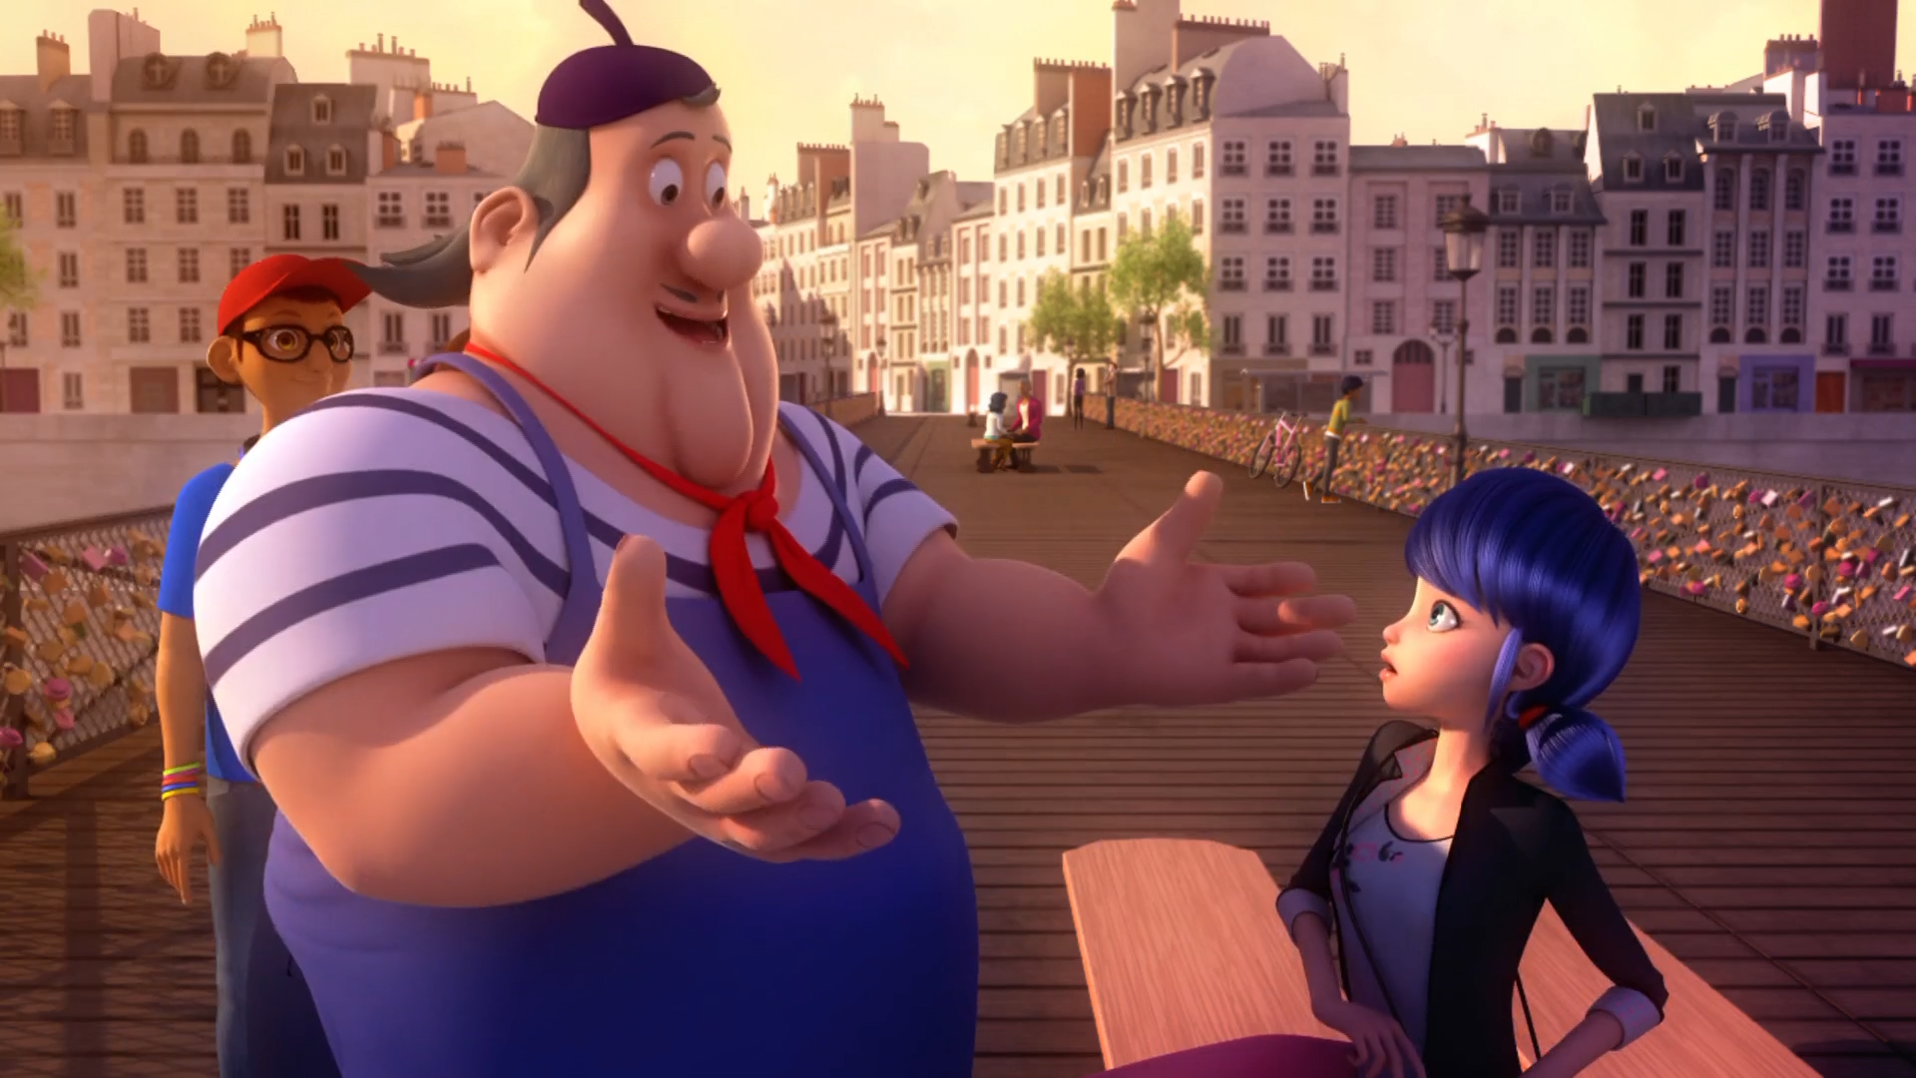
The pretty one who ______. I have a flavour just for her!
smiles
sighs
sings

Slide 11
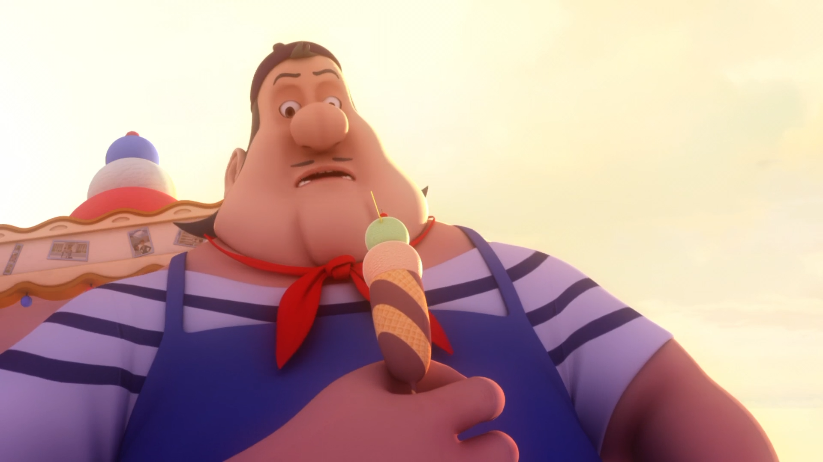
But André's ice-cream always ______ people's hearts.
mends
melts
makes

Slide 12
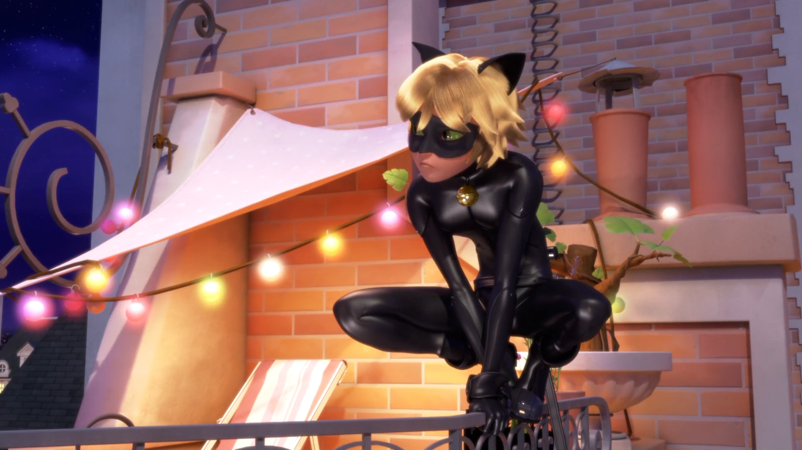
I didn't mean to ______ you.
scare
kill
frighten

Slide 13
What was this special ______?
surprise
ice cream
song

Slide 14
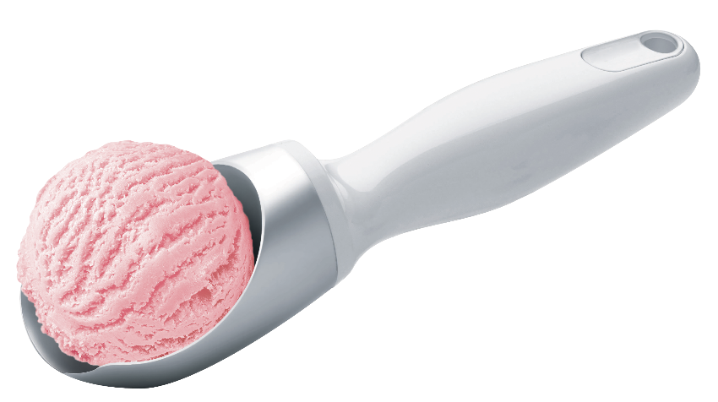
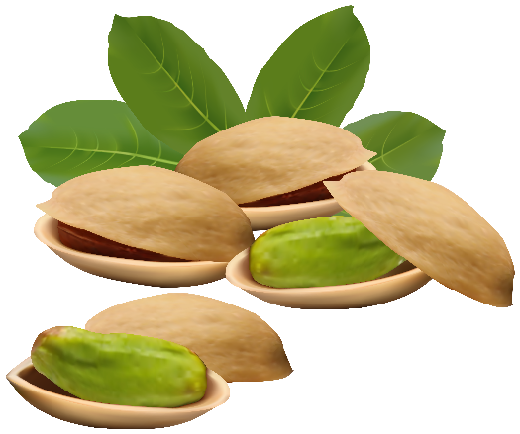
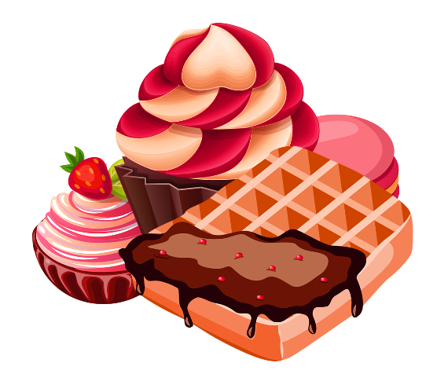
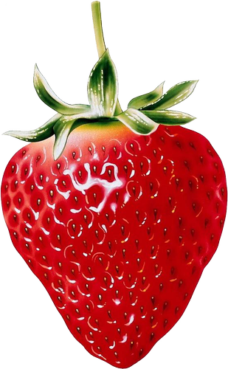
Matching Exercise
dessert | scoop | strawberry | pistachio

Slide 15
Matching Exercise
scoop | pistachio | dessert | strawberry

Slide 16
TRUE OR FALSE
1. Marinette's dad hid his wedding ring in ice cream.
2. It took Ivan and Mylène 3 days to find André's cart.
3. Alya drop's her ice-cream.
4. André is akutamized because of Marinette.
5. Ladybug & Cat Noir have a date.

Slide 17
TRUE OR FALSE
1. Marinette's dad hid his wedding ring in ice cream. | TRUE
2. It took Ivan and Mylène 3 days to find André's cart. | FALSE
3. Alya drop's her ice-cream. | FALSE
4. André is akutamized because of Marinette. | TRUE
5. Ladybug & Cat Noir have a date. | FALSE

