Slide 1
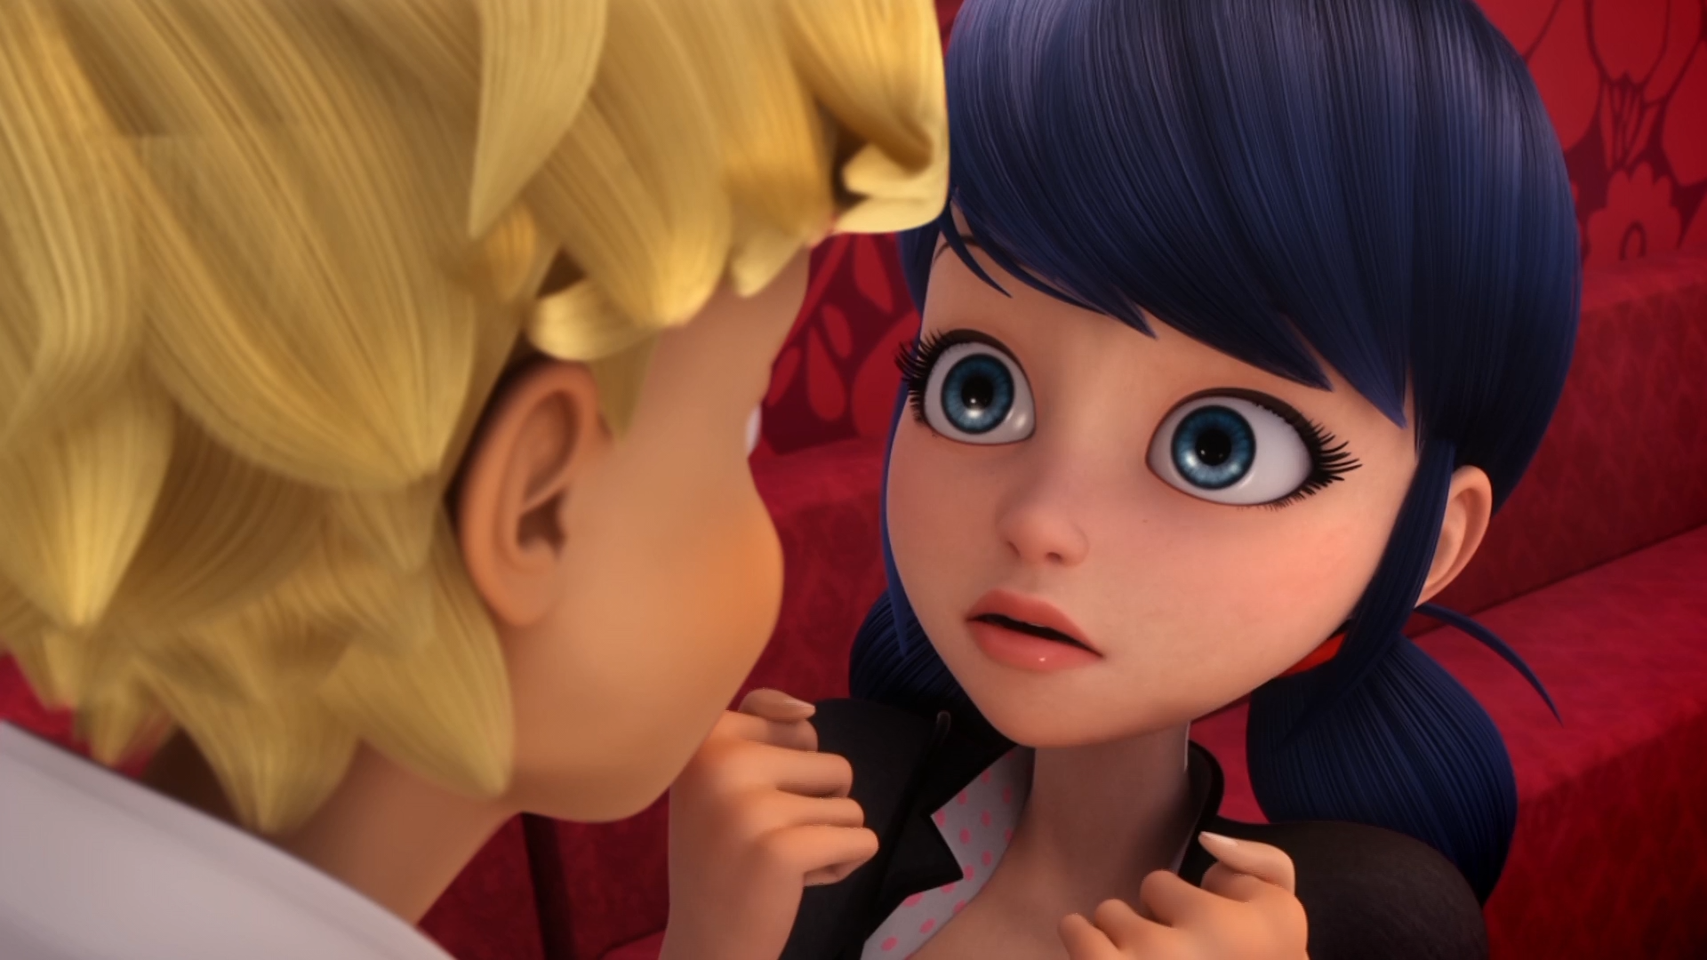
MIRACULOUS LADYBUG: DESPAIR BEAR. PART 2

Slide 2
VOCABULARY
armour - 盔甲 - ɑːmə
cloud - 云 - klaʊd
control - 控制 - kənˈtrəʊl
earrings - 耳环 - ɪərɪŋz
greasy - 腻 - ɡriːzi
lame - 虚弱的 - leɪm
macaroon - 马卡龙 - mækəˈruːn
skin - 皮肤 - skɪn
step - 步 - stɛp

Slide 3
1. 云
2. 皮肤
3. stɛp

Slide 4
1. 云 - cloud
2. 皮肤 - skin
3. stɛp - step

Slide 5
DESPAIR BEAR. PART 2
Chloé: Sabrina? What's gotten into you?
Sabrina: Let me brush your hair! I promise
I won't hurt you!
Chloé: Ahh! Somebody stop her!
Kim: If you touch one hair on Chloé's head, you'll have to answer to me.
Marinette: Uh, I think I had too much orange juice. I gotta go. See ya.

Slide 6
Despair Bear: Naughty, naughty, Ladybug!
Ladybug: Chloé, would you be so kind?
Chloé: Okay, Ladybug!
Despair Bear: No! Stop! What's happening?
Cat Noir: Ladybug? What are you doing?
Ladybug: Oh, nothing. Just saving your skin with the help of our new little sidekick.
Despair Bear: You haven't defeated me, yet!

Slide 7
Ladybug: Thanks for helping me out there. That was really nice of you.
Chloé: I know, wasn't it?
Jean: I must confess. I don't remember anything!
Chloé: Well, basically, you turned evil and
I saved you. In fact, without me, Ladybug and Cat Noir would never have succeeded. I'm even better than you superheroes.

Slide 8
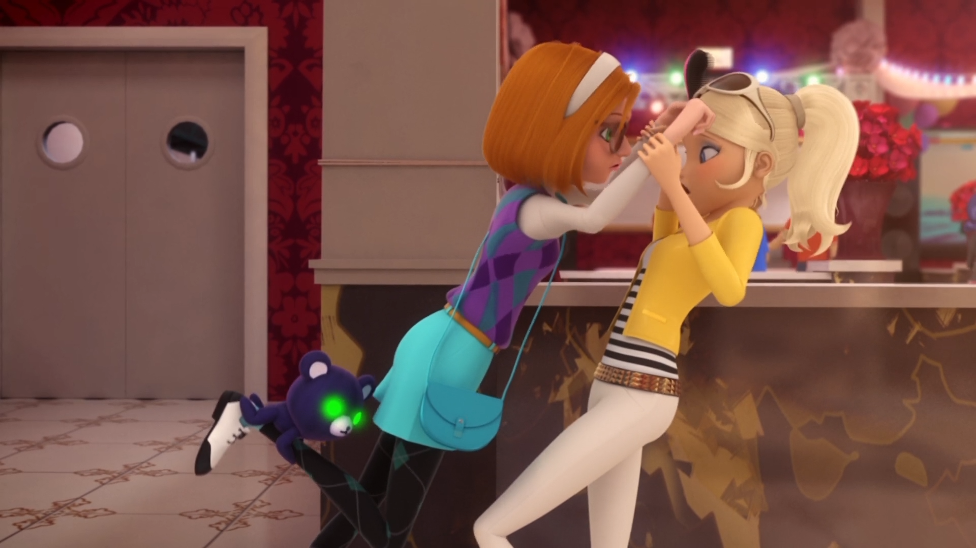

Let me ______ your hair! I promise
I won't hurt you!
style
cut
brush

Slide 9
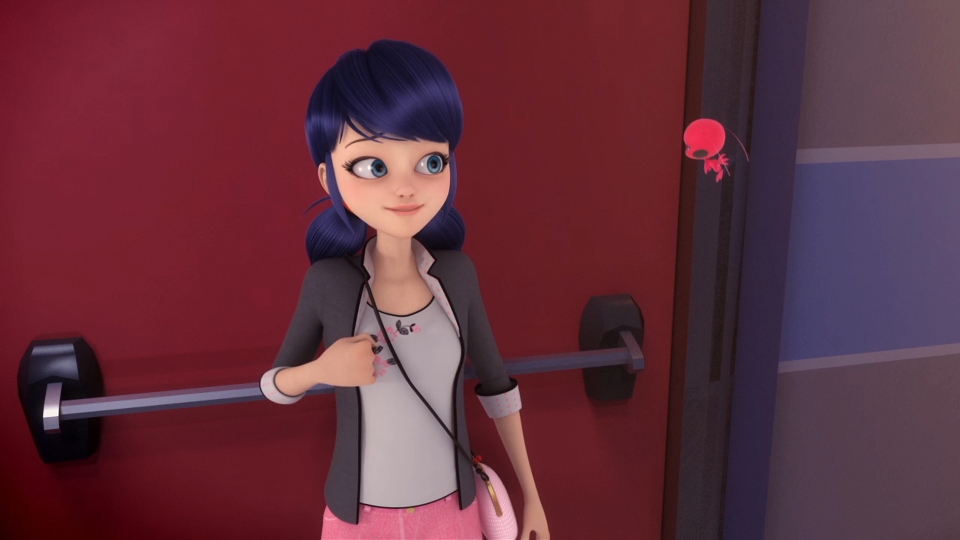
Too bad I had to stop ______ with Adrien.
dancing
sleeping
eating

Slide 10
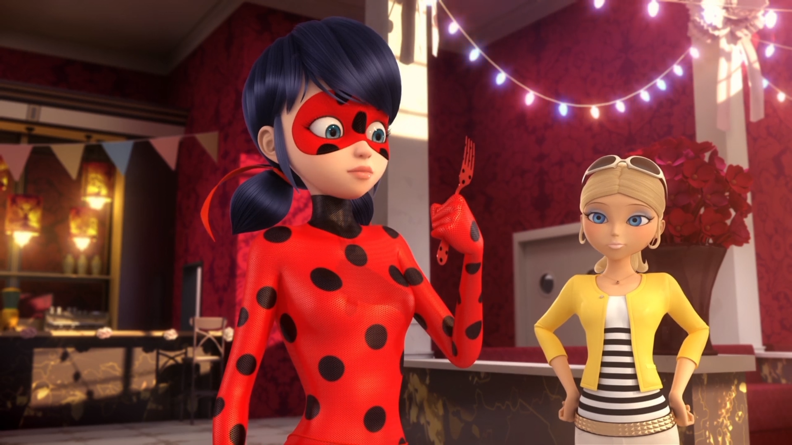
A ______?
a spoon
a fork
a knife

Slide 11
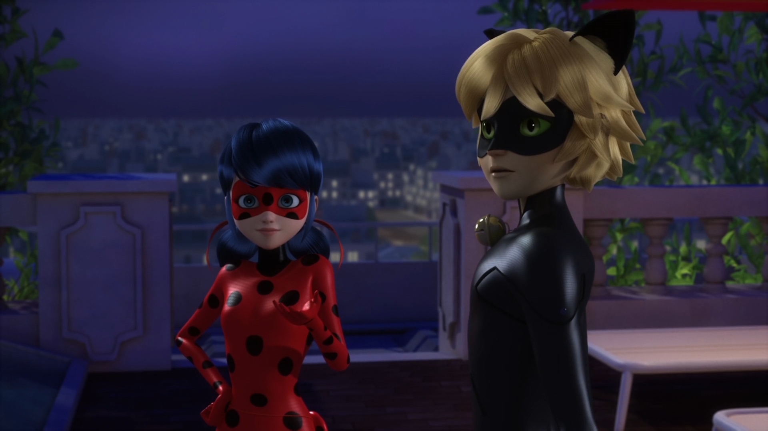
Just saving your ______ with the help of our new little sidekick!
butt
skin
hide

Slide 12
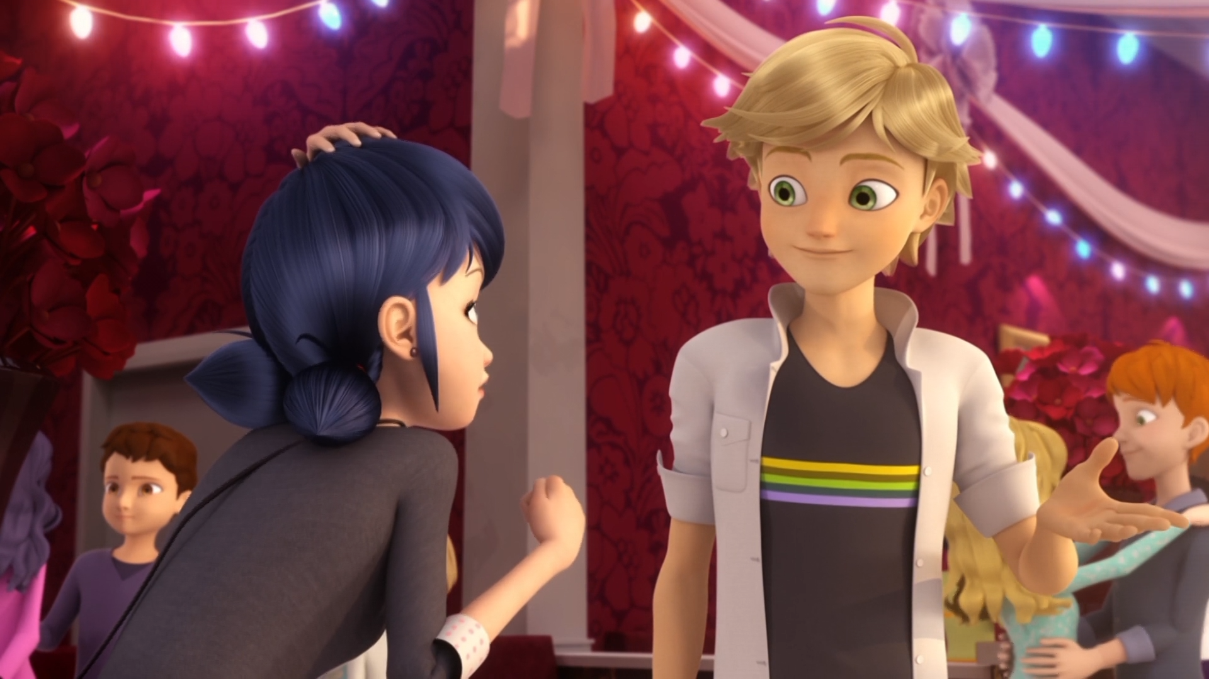
I don't even need a ______.
Miraculous
superpower
costume

Slide 13
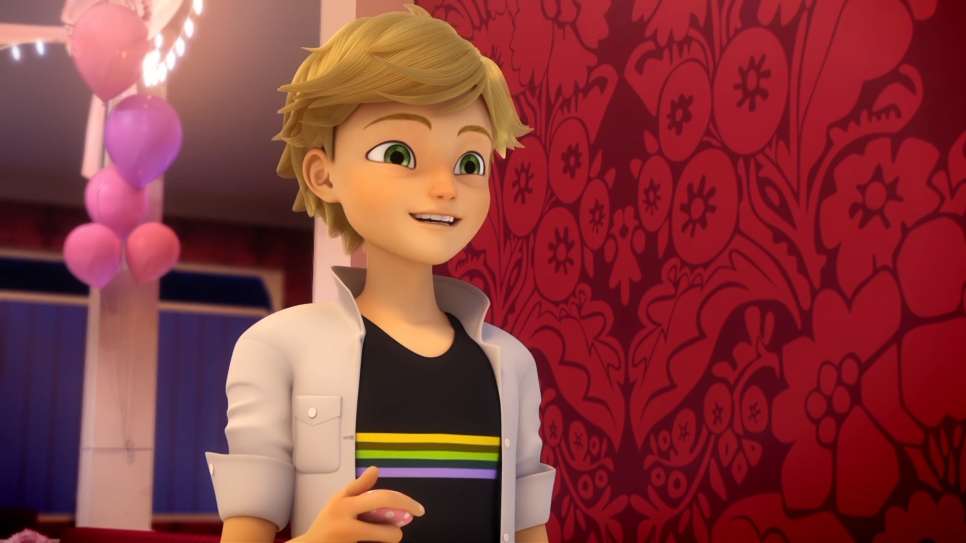
Wow, this is really good. Your baking is good as your ______!
dancing
kissing
eyes

Slide 14
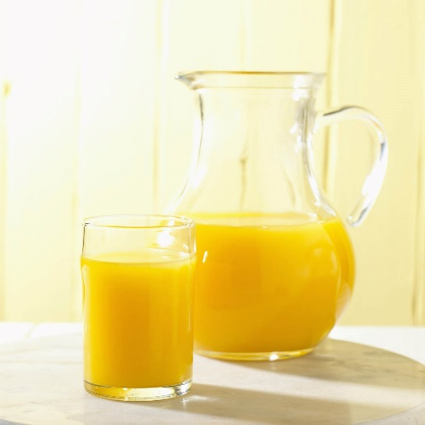
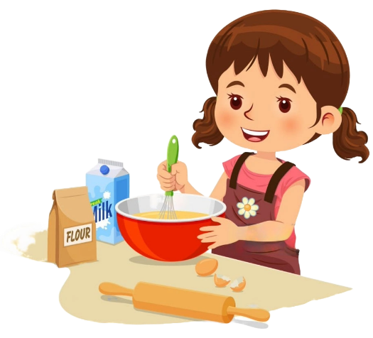

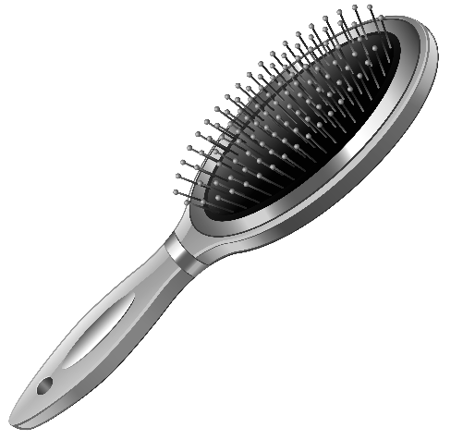
Matching Exercise
costume | brush | baking | orange juice

Slide 15
Matching Exercise
orange juice | baking | costume | brush

Slide 16
TRUE OR FALSE
1. Sabrina brushes Chloé's hair.
2. Marinette dances with Adrien.
3. Chloé saves Marinette from cataclysm.
4. Marinette has a spoon.
5. Adrien likes Marinette's baking.

Slide 17
TRUE OR FALSE
1. Sabrina brushes Chloé's hair. | FALSE
2. Marinette dances with Adrien. | TRUE
3. Chloé saves Marinette from cataclysm. | TRUE
4. Marinette has a spoon. | FALSE
5. Adrien likes Marinette's baking. | TRUE

Slide 18
mobile phones
1
books
2
fashion
3
food
4
A.I.
5
taking
photos
6
Dalian
7
music
8
weather
9
animals
10
jobs
11
sport
12
travel
13
anime
14
Douyin
15

