Slide 1
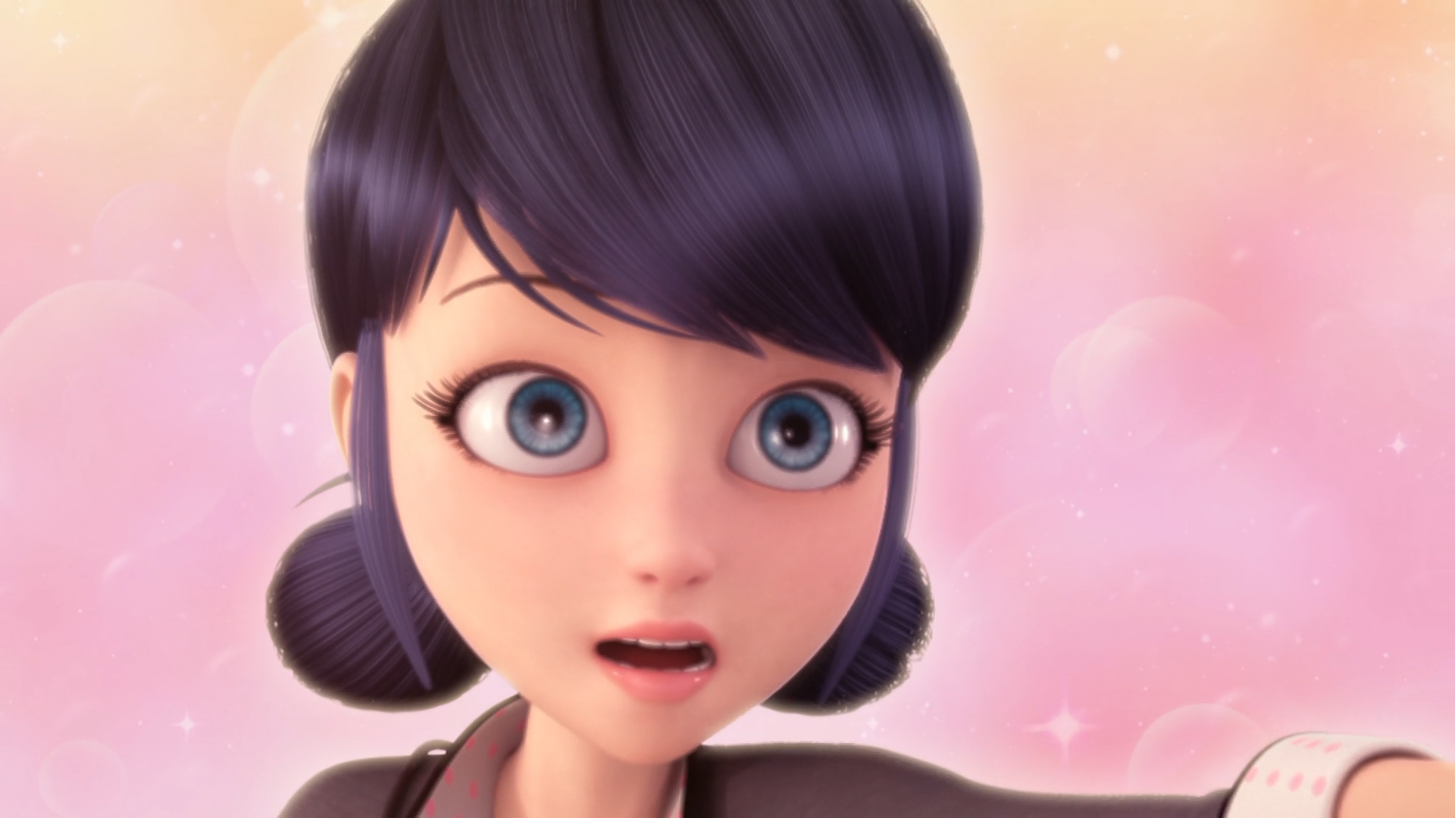
MIRACULOUS LADYBUG: DESPAIR BEAR. PART 1

Slide 2
VOCABULARY
blackmail - 勒索 - blækmeɪl
discover - 发现 - dɪˈskʌvə
false - 错误的 - fɔːls
fire drill - 消防演习 - faɪə drɪl
hacked - 被黑客入侵 - hækt
invite - 邀请 - ɪnˈvaɪt
jewels - 珠宝 - ʤuːᵊlz
servant - 仆人 - sɜːvᵊnt
snob - 势利小人 - snɒb

Slide 3
1. 被黑客入侵
2. 珠宝
3. snɒb

Slide 4
1. 被黑客入侵 - hacked
2. 珠宝 - jewels
3. snɒb - snob

Slide 5
DESPAIR BEAR. PART 1
Tom: Now we need to chill it for half an hour. Marinette?
Marinette: Yes, dad?
Tom: Could you put this in the school cafeteria fridge for me, please?
Marinette: Of course!
Tikki: Mmm, can I get a taste?

Slide 6
Chloé: I saw a student leaving the classroom right before the alarm went off. It must have been her.
Mr. Damocles: Really? Who was it?
Chloé: Let's see if she'll come clean. What do you say, Marinette Dupain-Cheng?
Mr. Damocles: Marinette, do you have something to tell the firefighter captain?

Slide 7
Chloé: Of course it was me who called the fire department. So what?
Adrien: And it doesn't bother you that everyone's being punished because of you?
Chloé: No. Why would it? They all seem to enjoy getting dirty making cookies
Adrien: Chloé, how long have you and I been friends?
Chloé: Since we were adorable little tots.

Slide 8
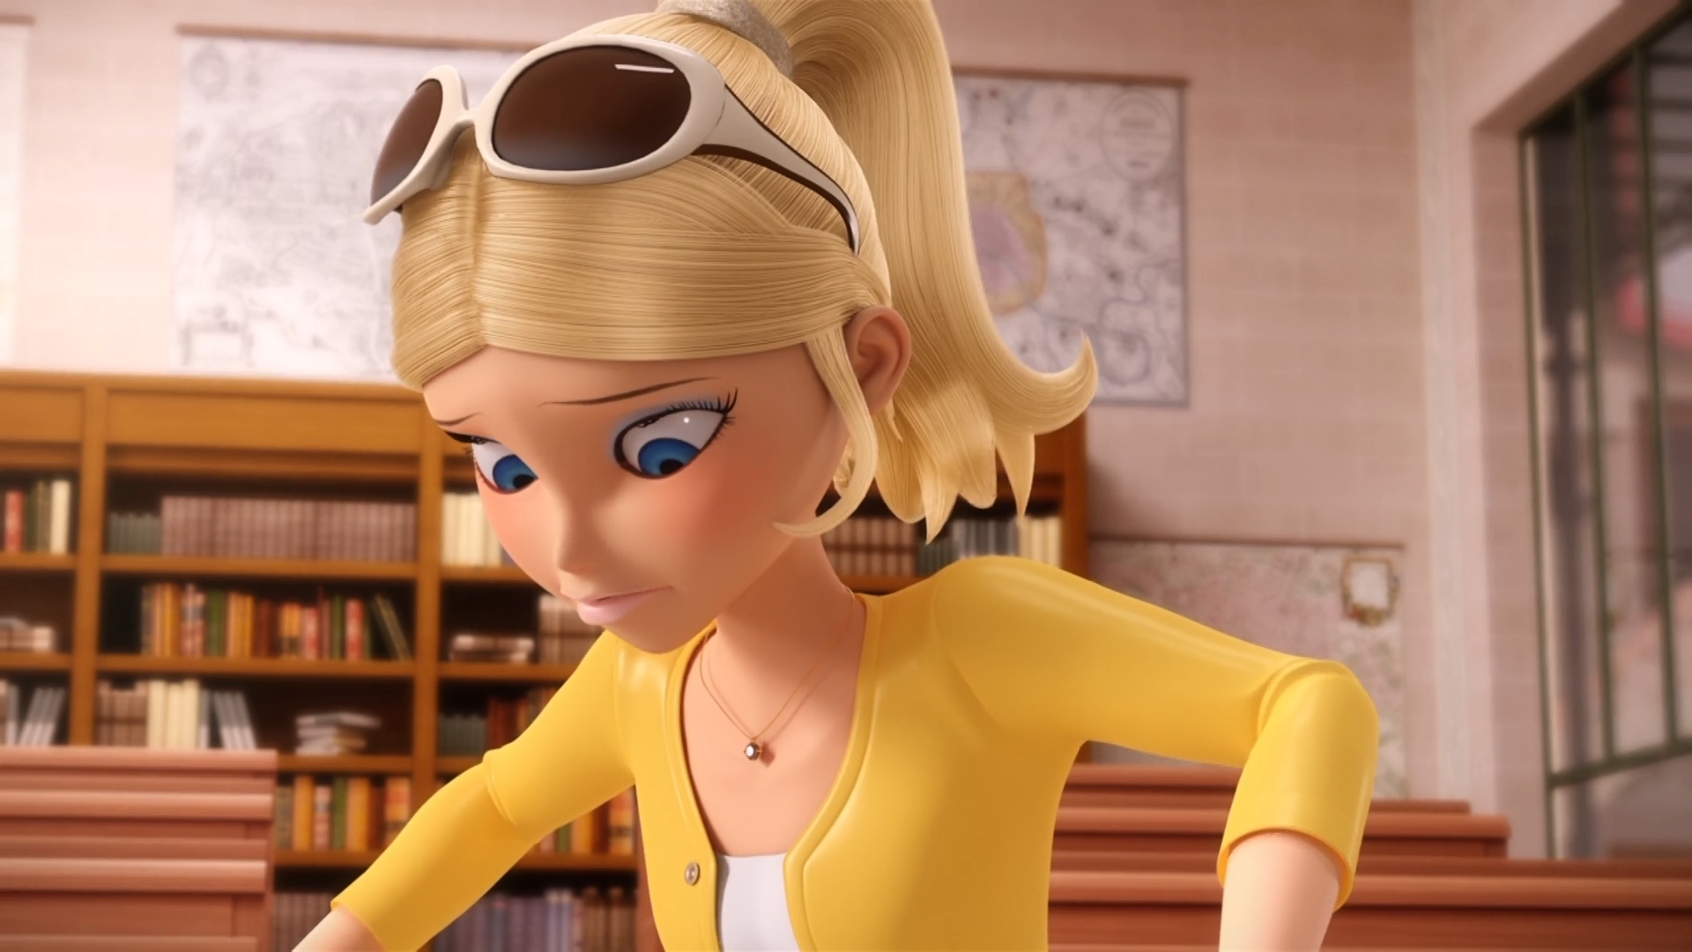

And soil my ______ pants? Who's he kidding?.
Balenciaga
Louis Vuitton
Chanel

Slide 9
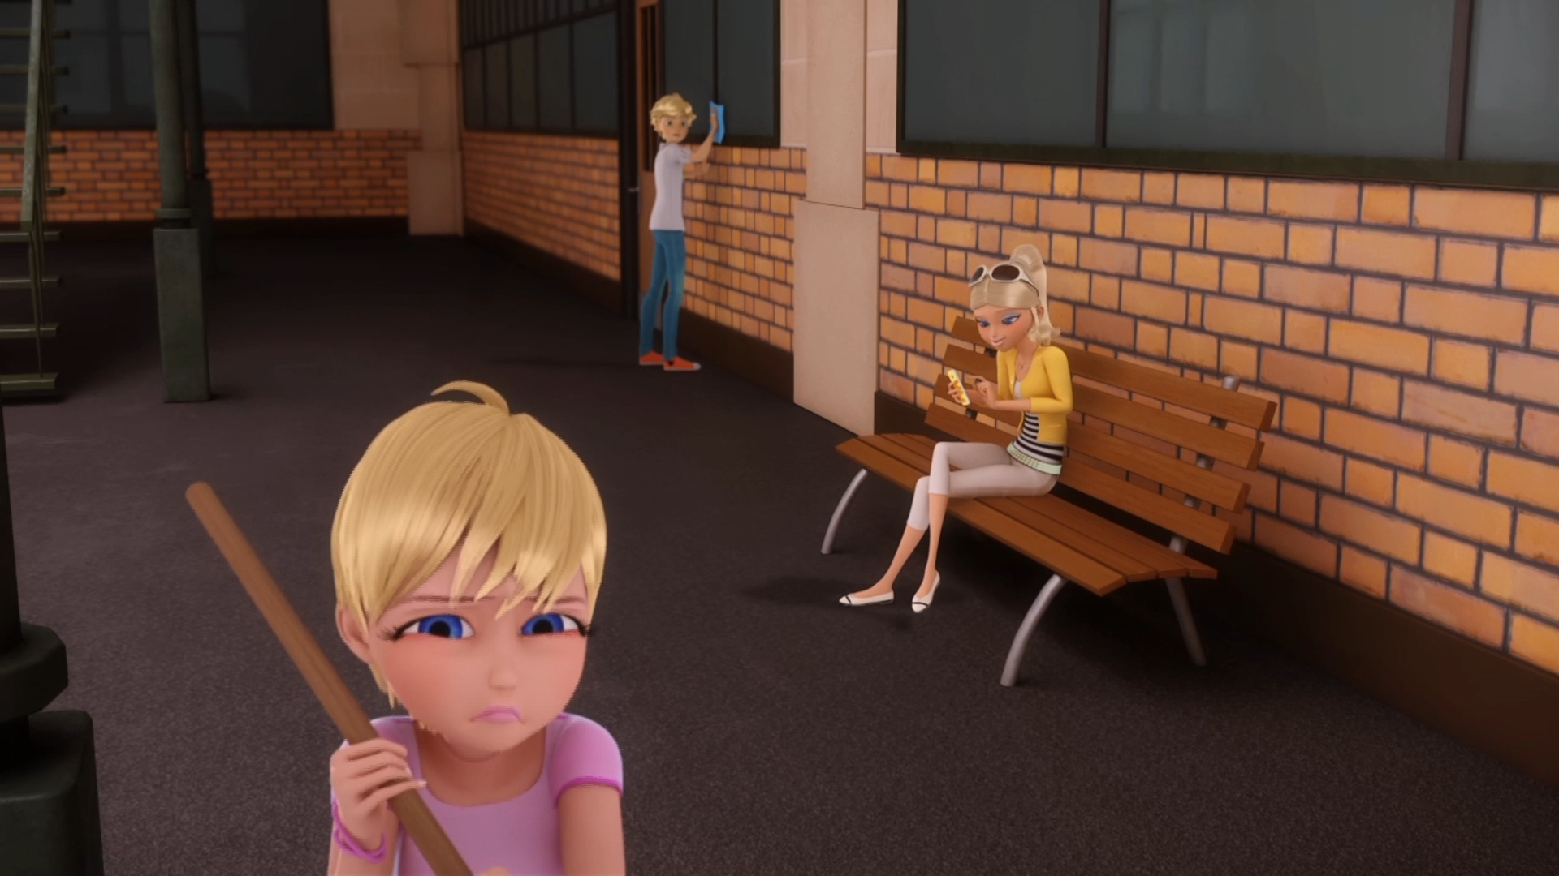
Go ______ somewhere else, Cinderella!
sweep
shave
sleep

Slide 10
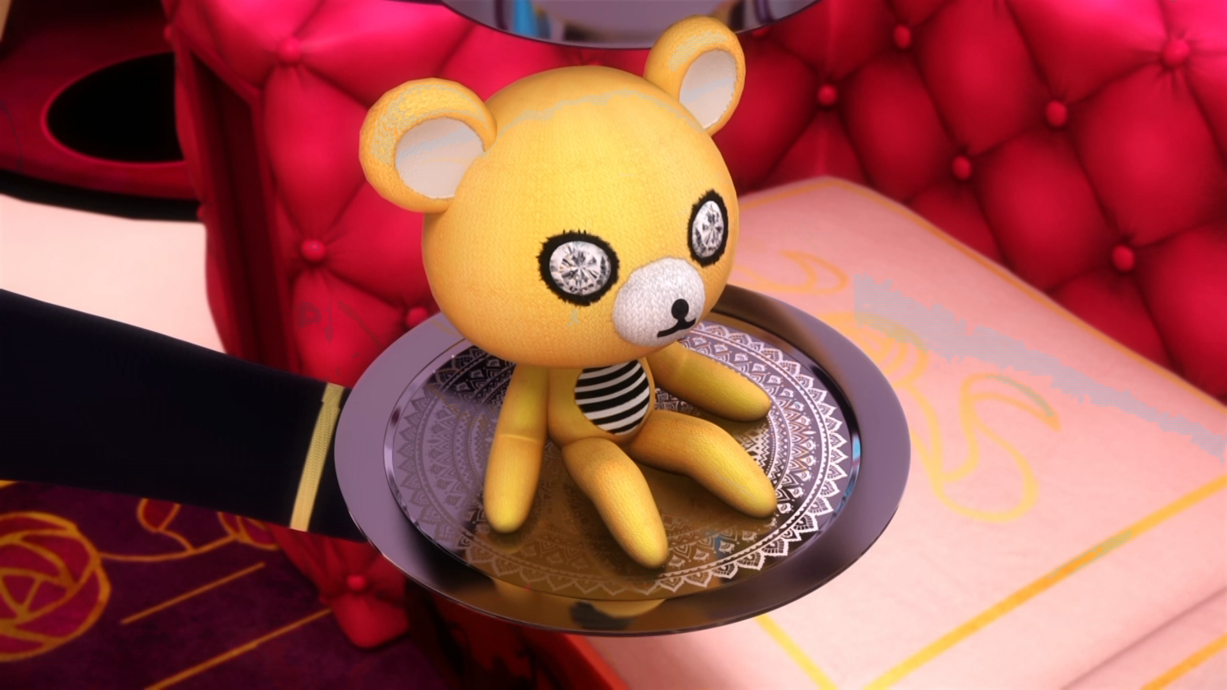
Ah, perhaps Mademoiselle can see comfort with ______?
Mr. Chubby
Mr. Cuddly
Mr. Creepy

Slide 11
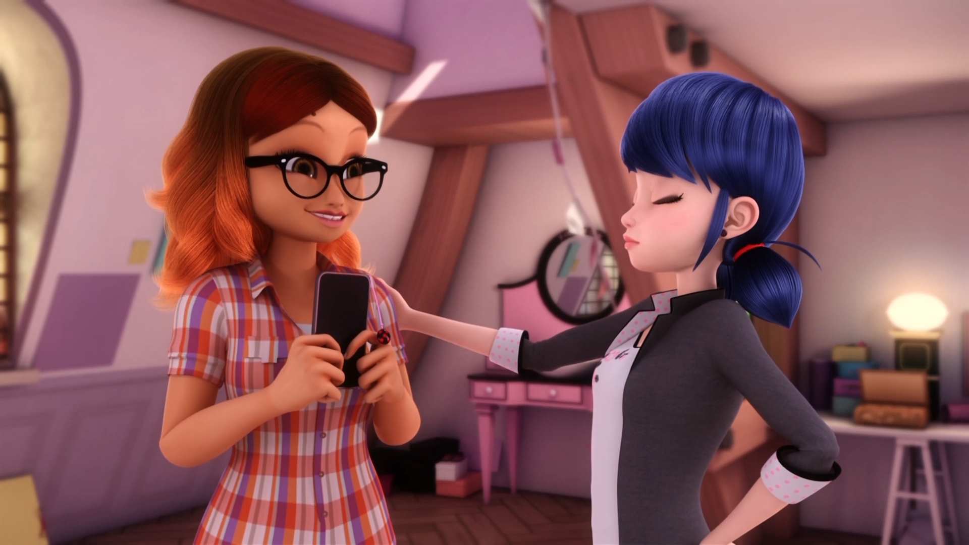
We should totally give Chloé one more ______!
pizza
chance
punch

Slide 12
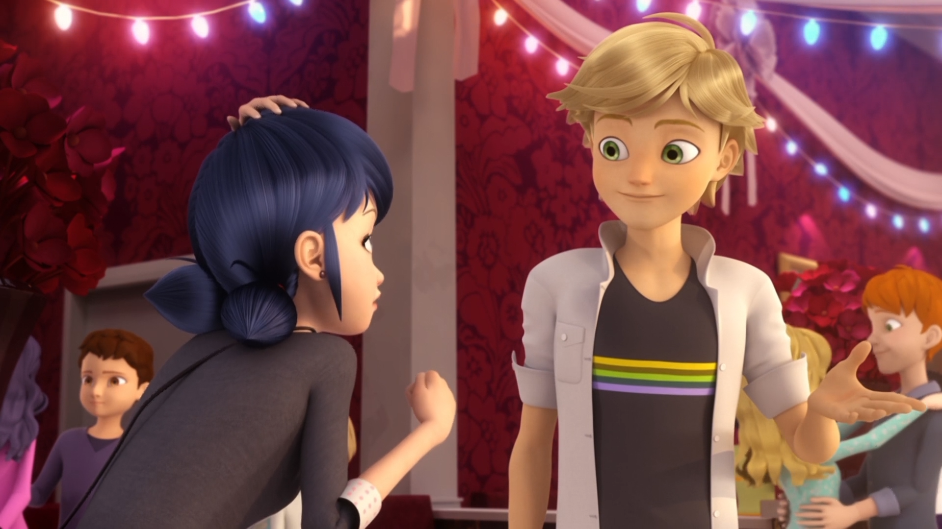
Hey, Marinette. Wanna ______?
kiss
sleep
dance

Slide 13
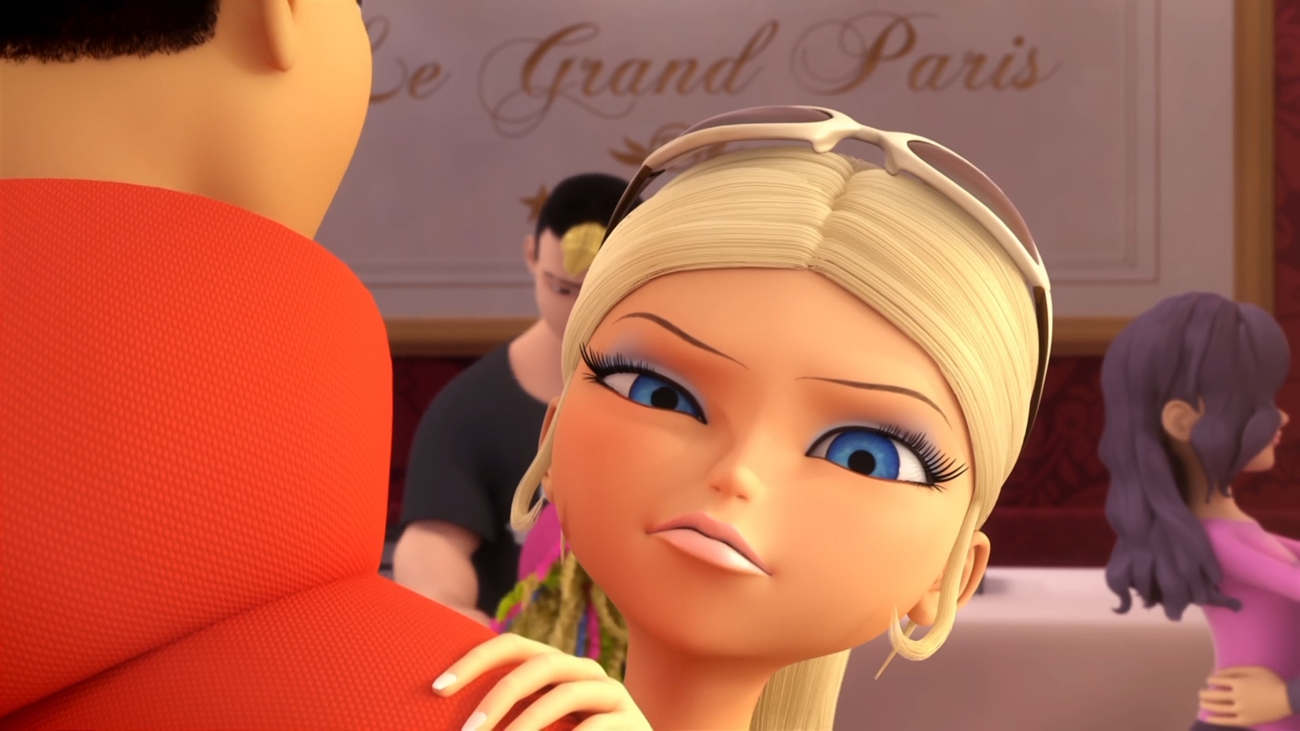
I am ______!
speechless
a bitch
sexy

Slide 14
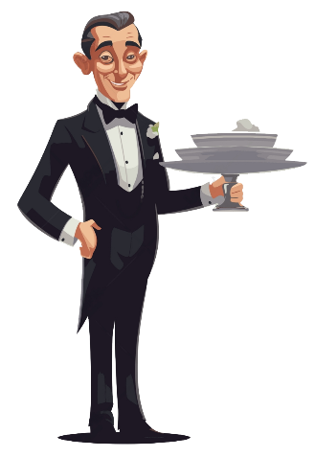

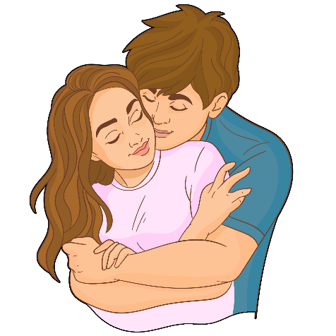
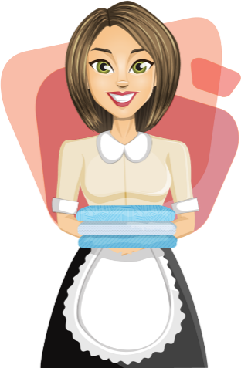
Matching Exercise
maid | cuddle | tot | butler

Slide 15
Matching Exercise
butler | tot | cuddle | maid

Slide 16
TRUE OR FALSE
1. Marinette's dad is a banker.
2. Chloé calls the fire department.
3. Adrien blackmails Chloé.
4. Adrien isn't going to the party.
5. Chloé dances with Kim.

Slide 17
TRUE OR FALSE
1. Marinette's dad is a banker. | FALSE
2. Chloé calls the fire department. | TRUE
3. Adrien blackmails Chloé. | TRUE
4. Adrien isn't going to the party. | FALSE
5. Chloé dances with Kim. | TRUE

