Slide 1
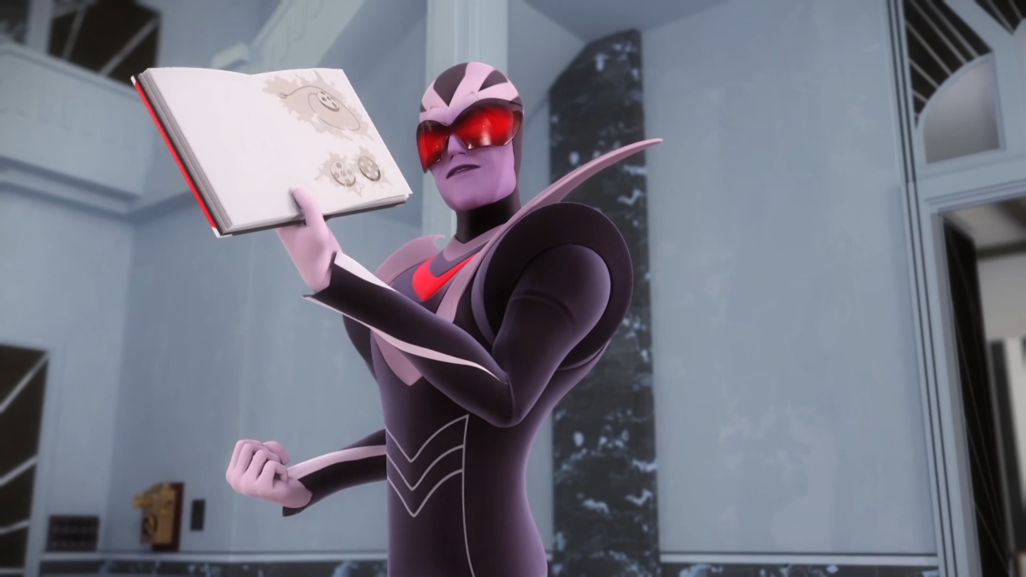
MIRACULOUS LADYBUG: THE COLLECTOR. PART 2

Slide 2
VOCABULARY
admirer - 爱慕者 - ədˈmaɪərə
ammunition - 弹药 - æmjəˈnɪʃᵊn
borrowed - 借来的 - bɒrəʊd
collection - 收藏 - kəˈlɛkʃᵊn
illustration - 插图 - ɪləˈstreɪʃᵊn
immortalize - 永垂不朽 - ɪˈmɔːtəlaɪz
ingenious - 巧妙 - ɪnˈʤiːniəs
invention - 发明 - ɪnˈvɛnʃᵊn
reappeared - 再次出现 - riːəˈpɪəd

Slide 3
1. ədˈmaɪərə
2. 借来的
3. 发明

Slide 4
1. ədˈmaɪərə - admirer
2. 借来的 - borrowed
3. 发明 - invention

Slide 5
THE COLLECTOR. PART 2
Ladybug: You know, the fashion designer?
Cat Noir: You got proof?
Ladybug: I can't tell you.
Cat Noir: So, I'm supposed to just... accept that?
Ladybug: You must trust me on this. But it all makes sense. He is a secretive man and he never leaves his house.

Slide 6
Gabriel: Thank you, thank you, both of you! Adrien...where is my son?
Cat Noir: He...must be hiding?
Ladybug: Cat Noir is right, otherwise your son would have reappeared right here.
Gabriel: Nothing must happen to him.
He's too precious to me.
Ladybug: We're about to transform back. Goodbye.

Slide 7
Master Fu: You were afraid in case the one you love turned out to be Hawk Moth.
Marinette: Wha... Uh, no, uh, how did you know that? I mean, I don't love him at all. Oh, all right, yes, Adrien is amazing. I couldn't stand the thought of him being a supervillain.
Master Fu: You know, Marinette, if we want to be stronger than Hawk Moth, we have to trust each other.

Slide 8
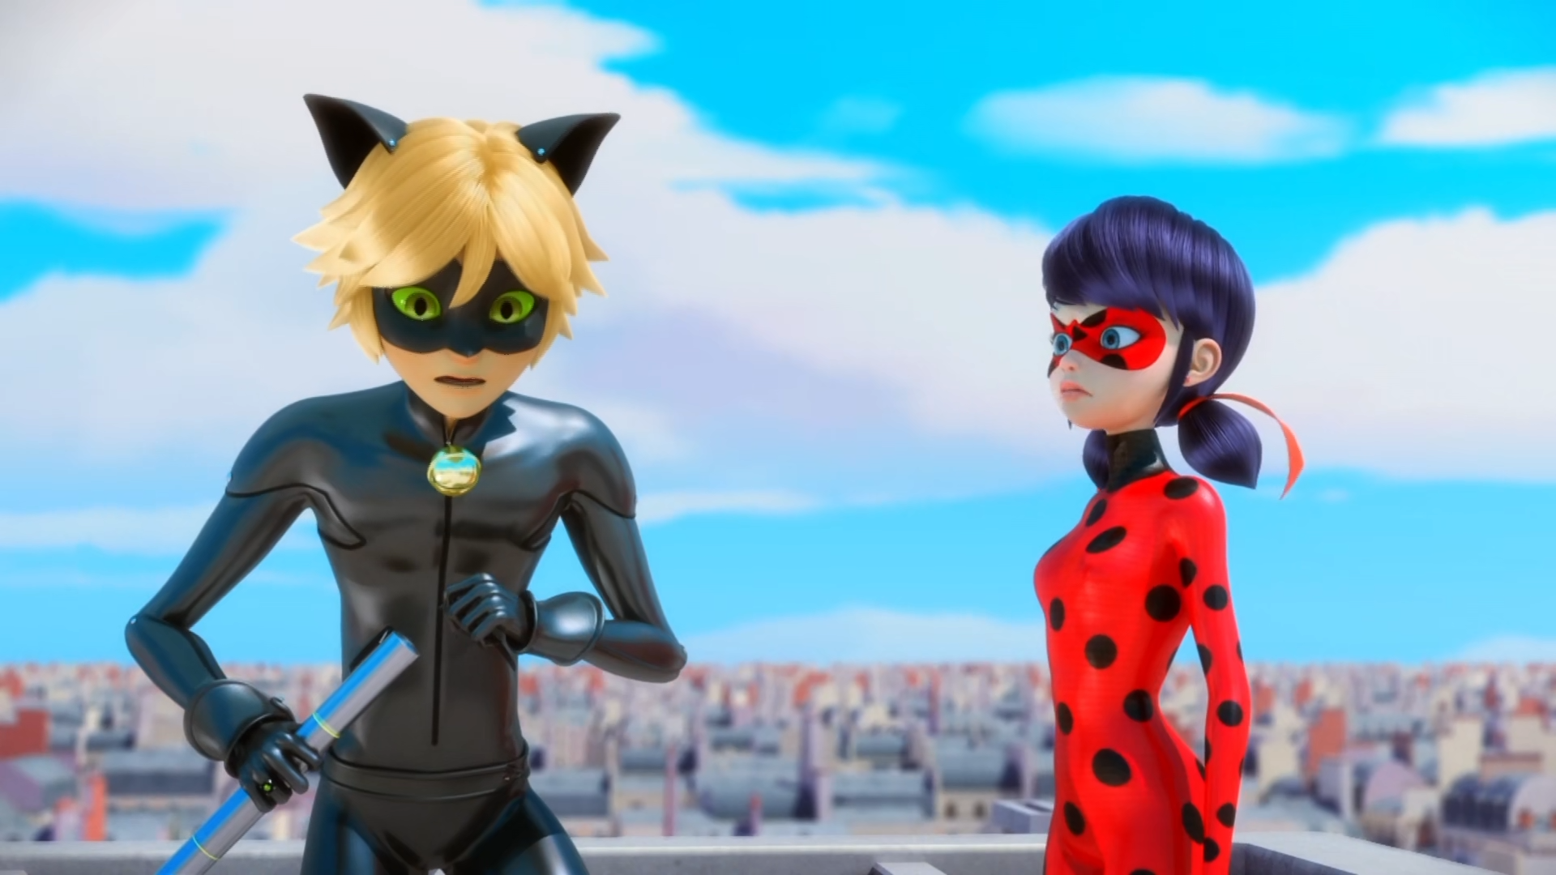

Gabriel Agreste. You know, the ______ designer?
car
kitchen
fashion

Slide 9
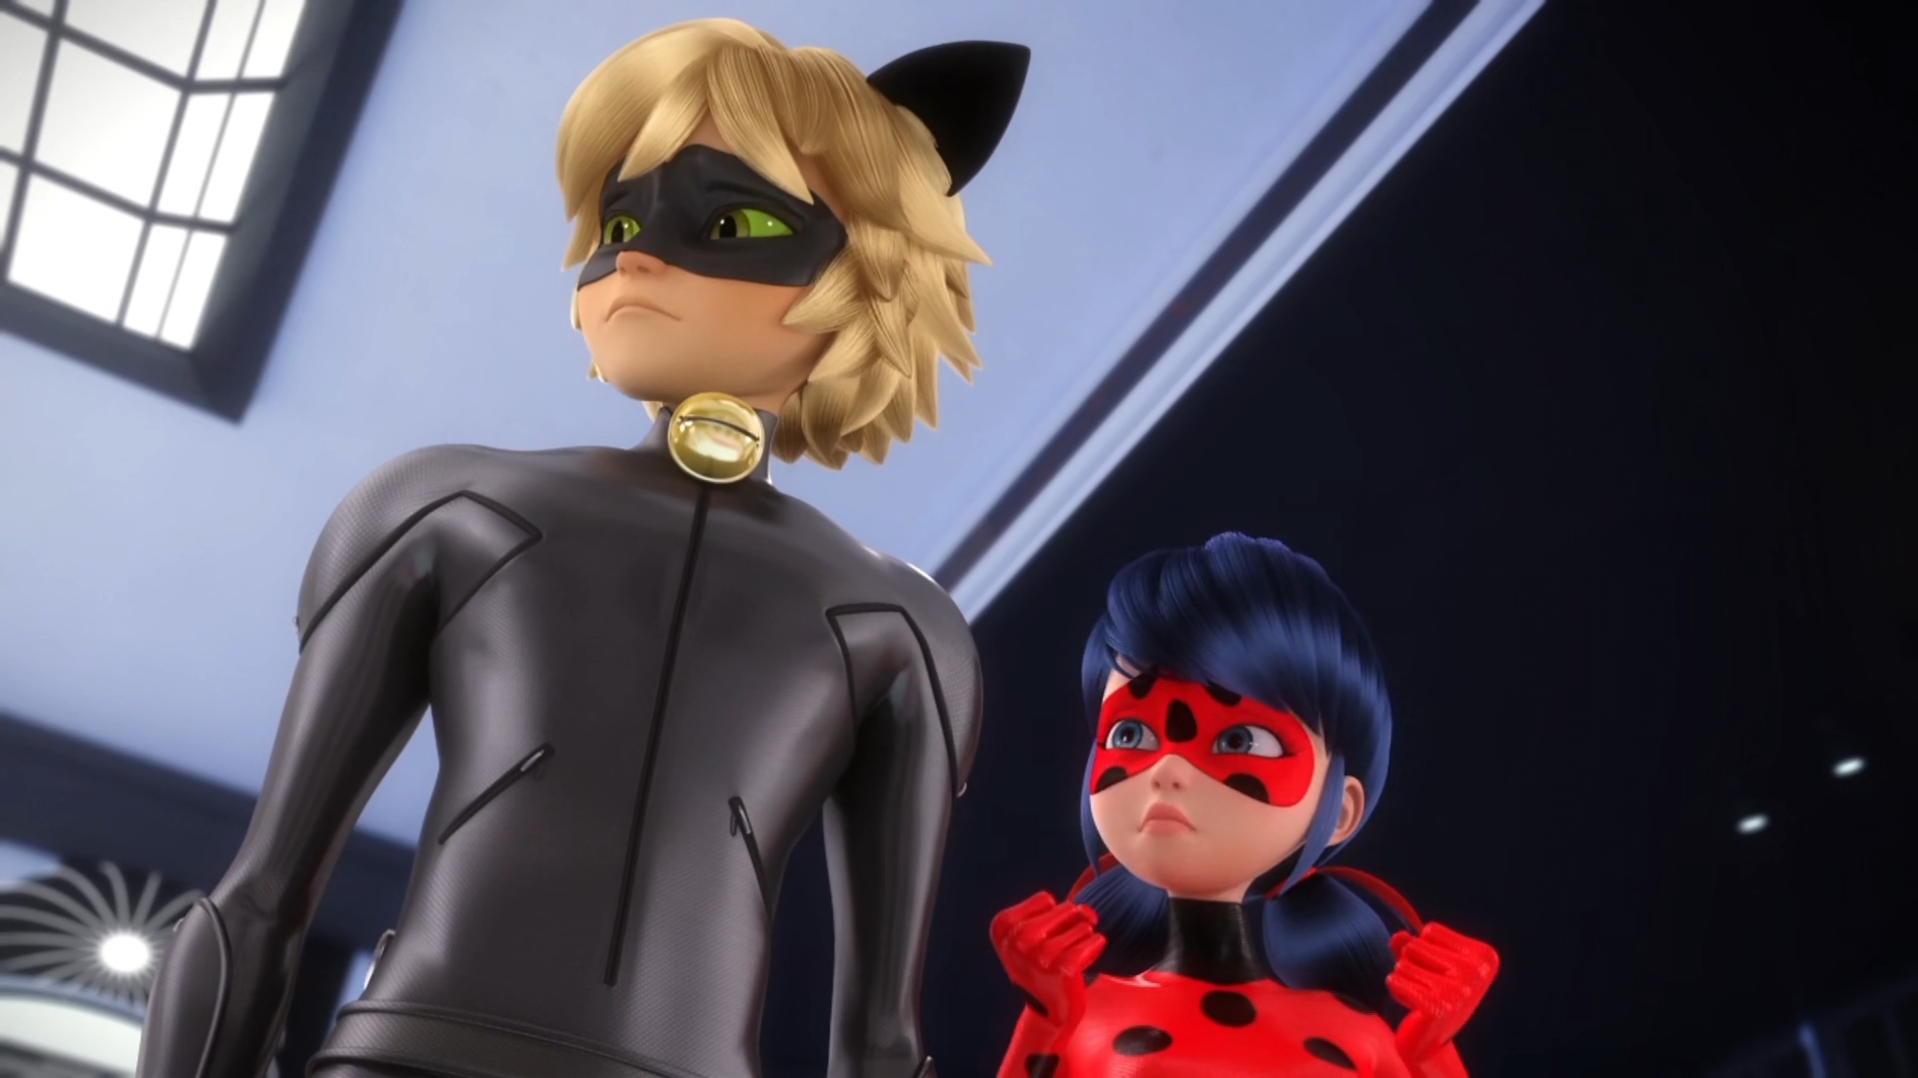
He's got a ______! Let's go check his room.
son
pig
daughter

Slide 10
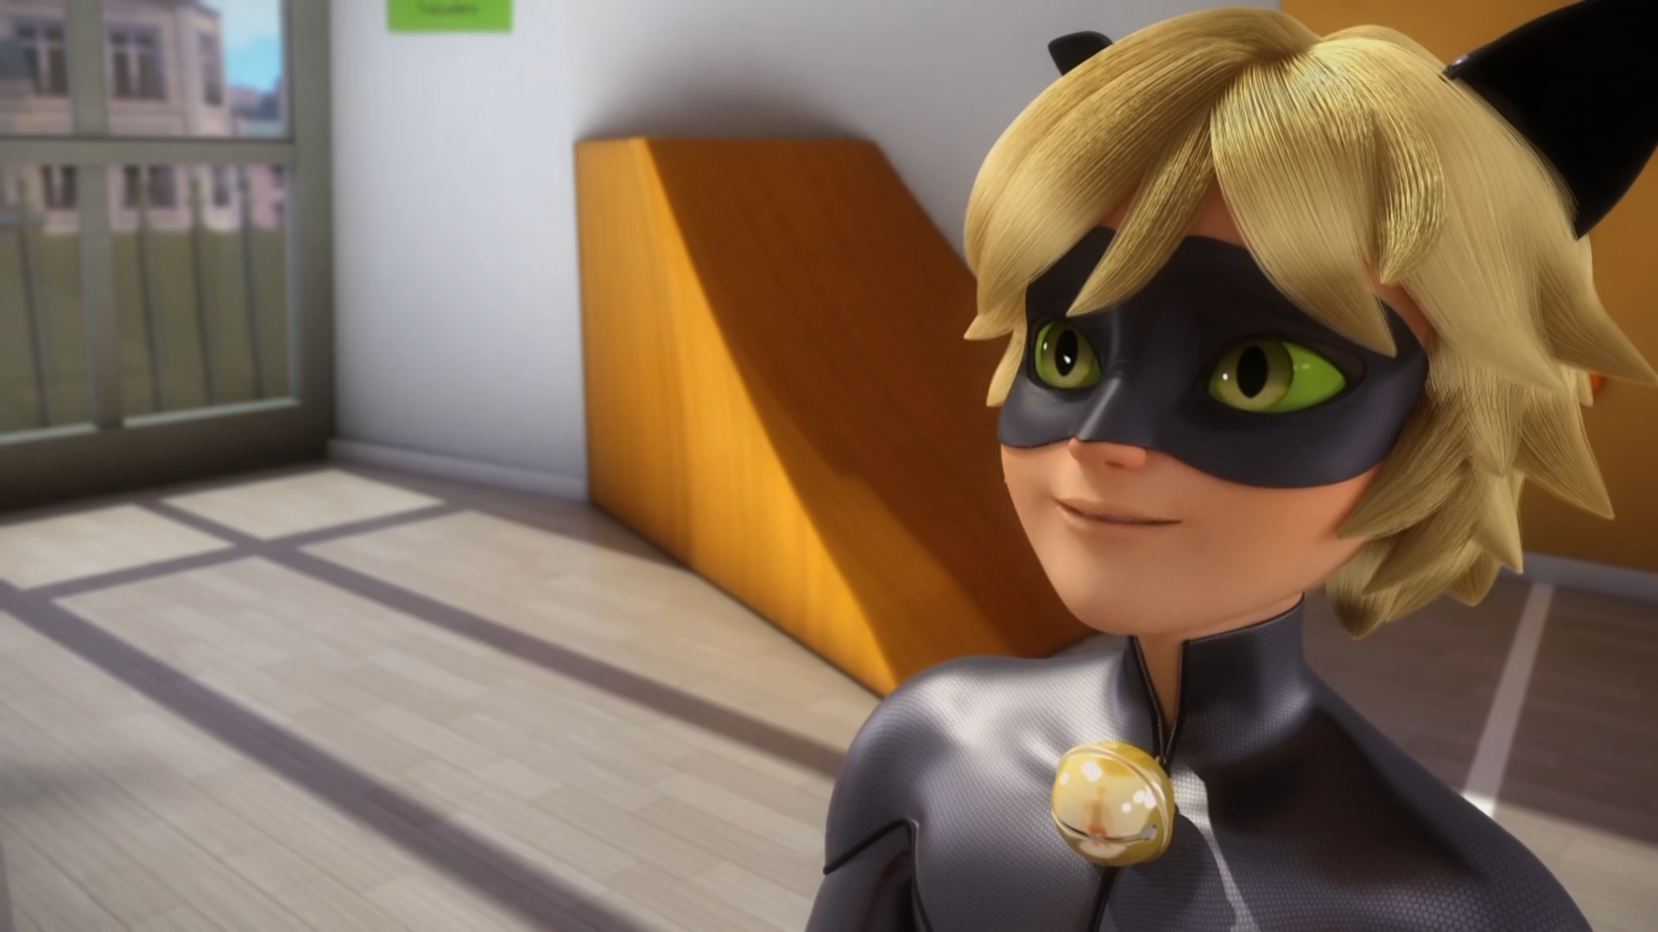
Don't worry yourself, sir. I'm sure your son is safe and ______. him.
round
sound
sleeping

Slide 11
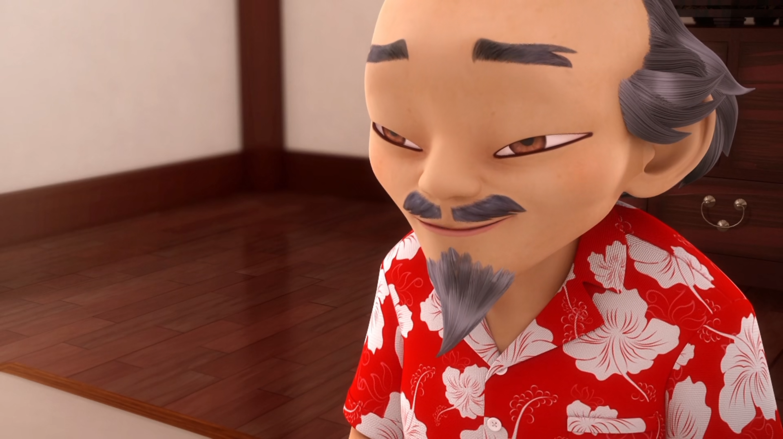
You were ______ in case the one you love turned out to be Hawk Moth.
worried
afraid
stressed

Slide 12
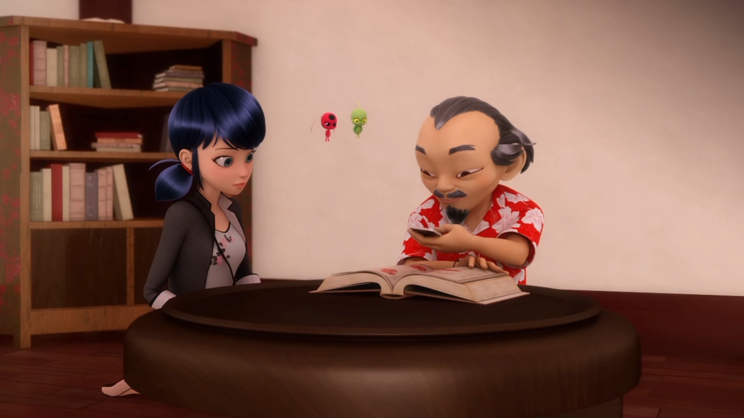
These modern inventions really are ______ incredible. Hmm..
quiet
quit
quite

Slide 13
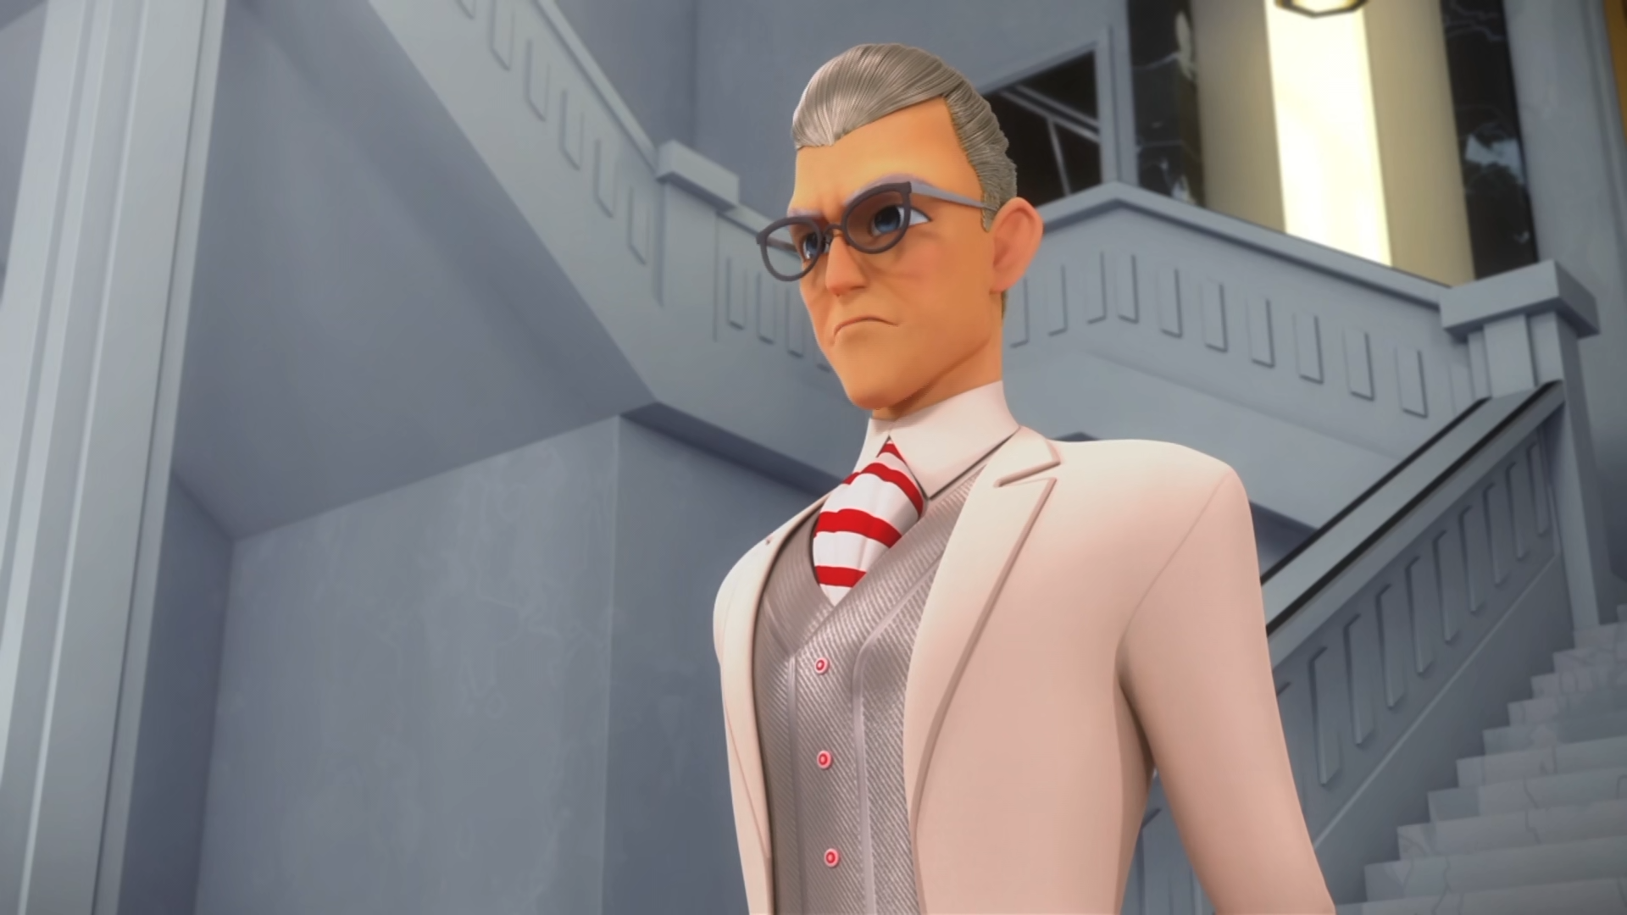
I found it while I was on a trip overseas with my ______.
wife
son
pig

Slide 14

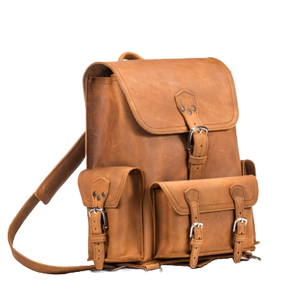

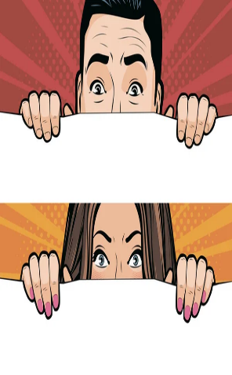
Matching Exercise
backpack | pedal | peek | tantrum

Slide 15
Matching Exercise
pedal | backpack | tantrum | peek

Slide 16
TRUE OR FALSE
1. Marinette thinks Hawk Moth is Adrien's father.
2. The brand's logo is a moth.
3. Master Fu knows Marinette is in love with Adrien.
4. Master Fu takes photos of the book with an ipad.
5. Marinette returns the book.

Slide 17
TRUE OR FALSE
1. Marinette thinks Hawk Moth is Adrien's father. | TRUE
2. The brand's logo is a moth. | FALSE
3. Master Fu knows Marinette is in love with Adrien. | TRUE
4. Master Fu takes photos of the book with an ipad. | FALSE
5. Marinette returns the book. | TRUE

Slide 18
IELTS Speaking Exam. The Environment. Part 2
Describe a place in your country that has changed because of environmental issues. You should say: where it is
and how it has changed

