Slide 1
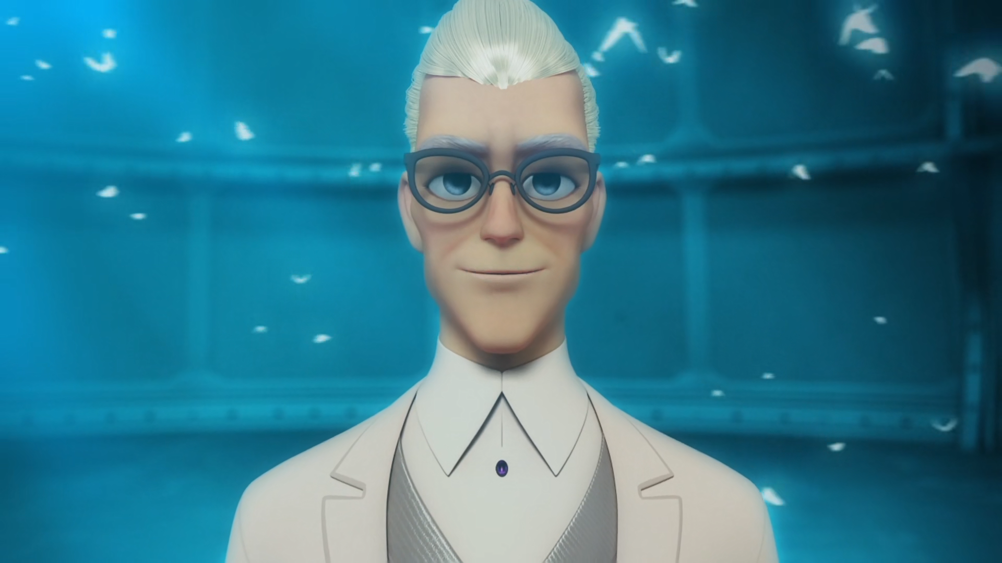
MIRACULOUS LADYBUG: THE COLLECTOR. PART 1

Slide 2
VOCABULARY
belong - 属于 - bɪˈlɒŋ
explanation - 解释 - ɛkspləˈneɪʃᵊn
grounded - 接地气 - ɡraʊndɪd
imprison - 监禁 - ɪmˈprɪzᵊn
inspiration - 灵感 - ɪnspɪˈreɪʃᵊn
investigate - 调查 - ɪnˈvɛstɪɡeɪt
renounce - 放弃 - rɪˈnaʊns
source - 来源 - sɔːs
whiskers - 胡须 - wɪskəz

Slide 3
1. 解释
2. 调查
3. wɪskəz

Slide 4
1. 解释 - explanation
2. 调查 - investigate
3. wɪskəz - whiskers

Slide 5
THE COLLECTOR. PART 1
Marinette: I'm guessing you're not really a vet?
Master Fu: Not really. That was your first day of school, that wasn't a chance meeting either. Marinette, you're always ready to help others. I knew that day, that very moment, that you'd make a fantastic Ladybug!
Marinette: But, who are you?

Slide 6
Adrien: My father's angry because of me; he won't forgive me until I find that book.
Plagg: May I remind you that you're actually grounded?
Adrien: Adrien is, but Cat Noir isn't.
Ladybug: Cat Noir, I think I know who Hawk Moth is. Get your whiskers over here, fast!
Cat Noir: Wow! I guess the Spellbook will have to wait a bit longer.

Slide 7
Marinette: Adrien can't be Hawk Moth! But what if he is? That would mean that I'm crazy in love with a supervillain!
Tikki: Calm down Marinette, I'm sure there's an explanation.
Marinette: I need to get to the bottom of this.
Tikki: Do you know where to find Adrien?
Marinette: I know that boy's schedule by heart.

Slide 8
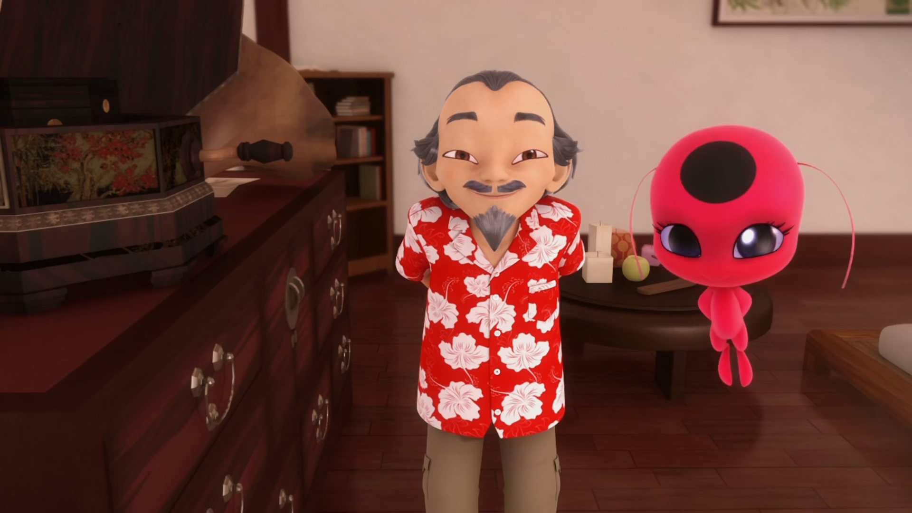

Master Fu is the last known member of the Order of the ______.
Avengers
teachers
guardians

Slide 9
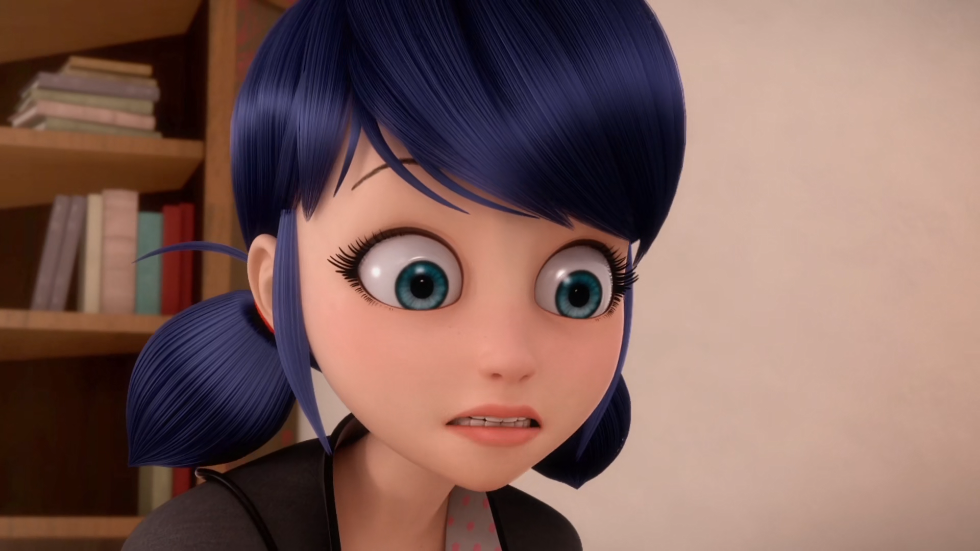
Wait a sec, you mean whoever owned the ______ could be Hawk Moth?
spell book
magic book
dictionary

Slide 10
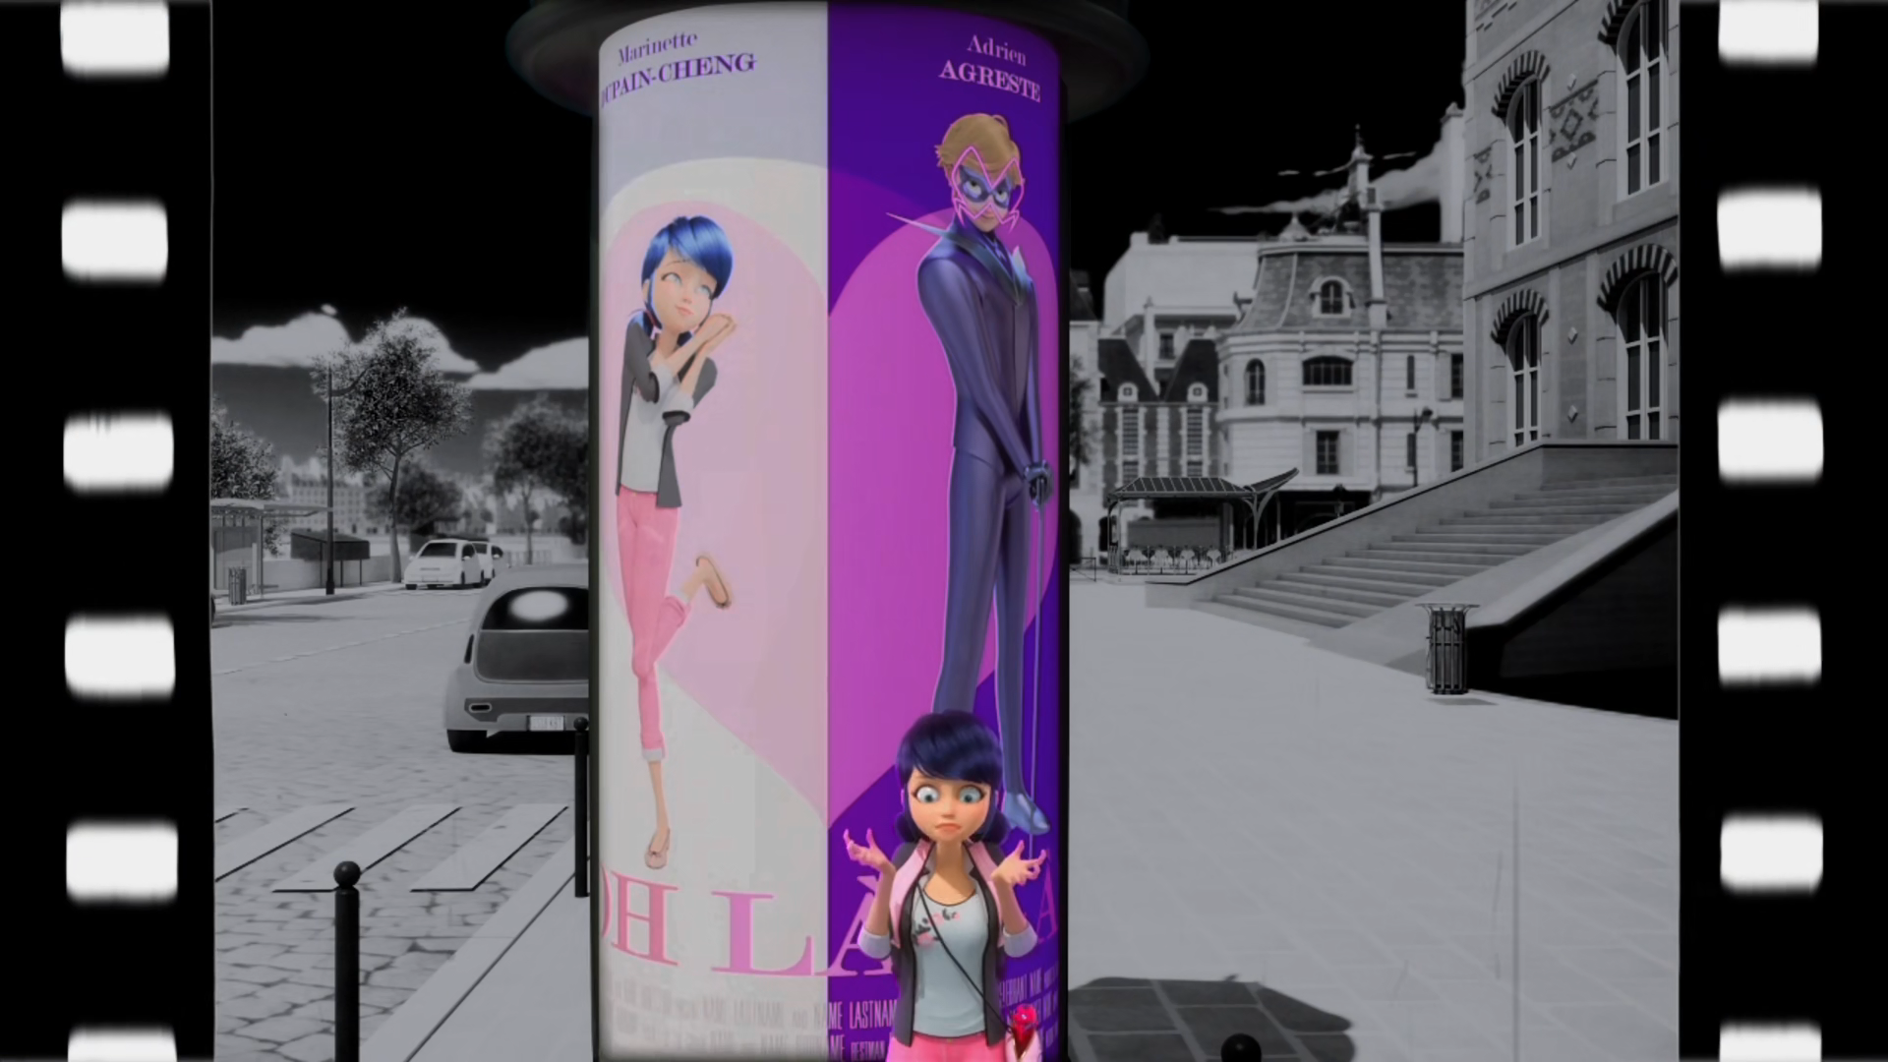
I can't be crazy in love with a supervillain. I'd have to ______ him.
kiss
fight
marry

Slide 11
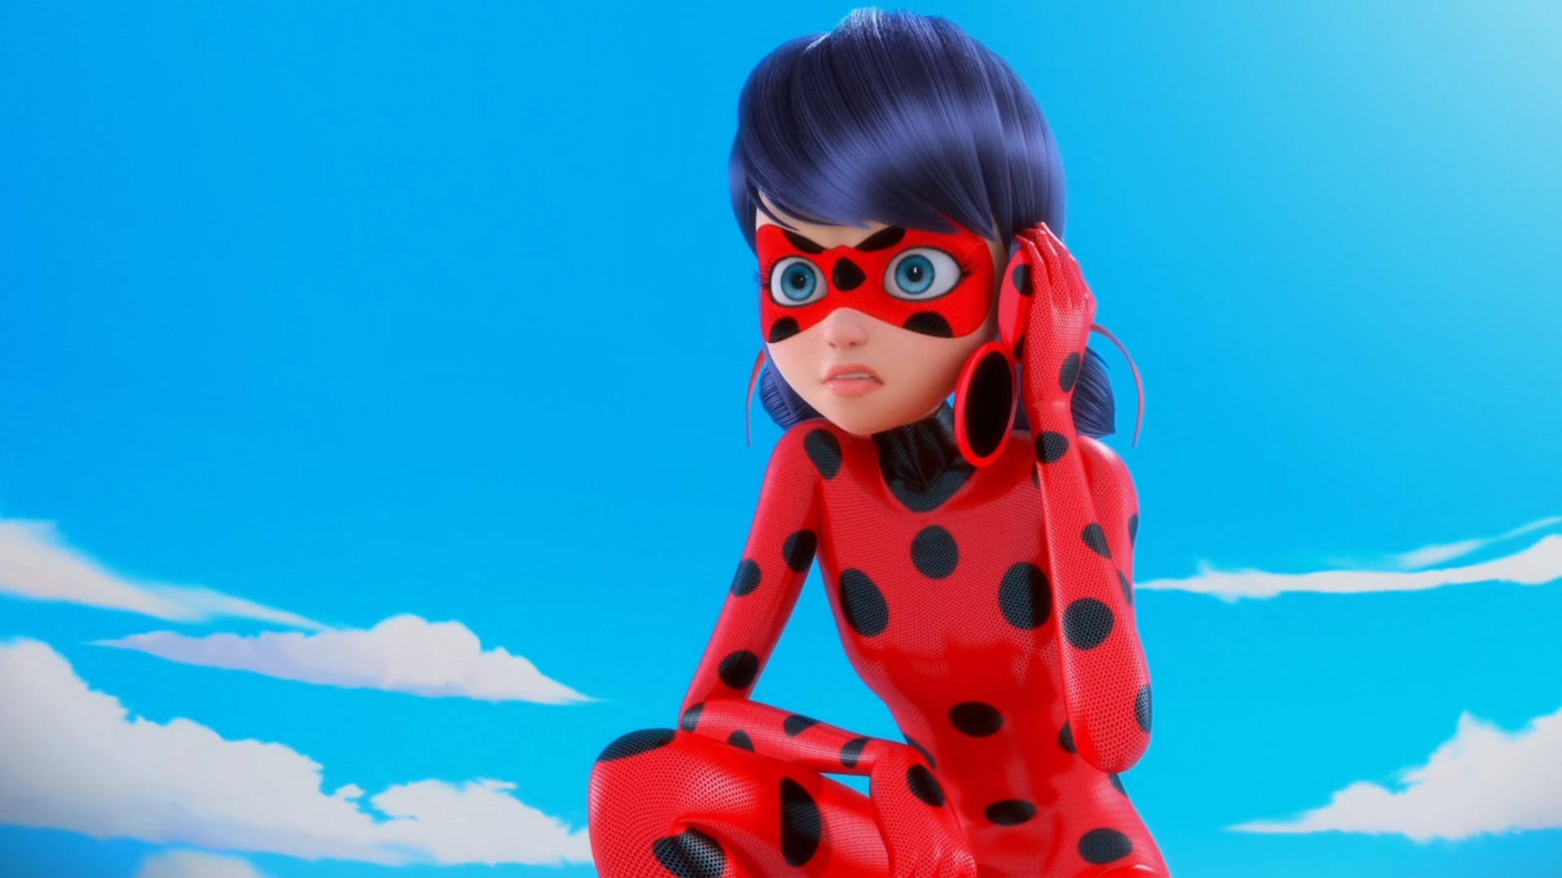
Cat Noir, I think I know who Hawk ______ is.
Month
Moth
Mum

Slide 12
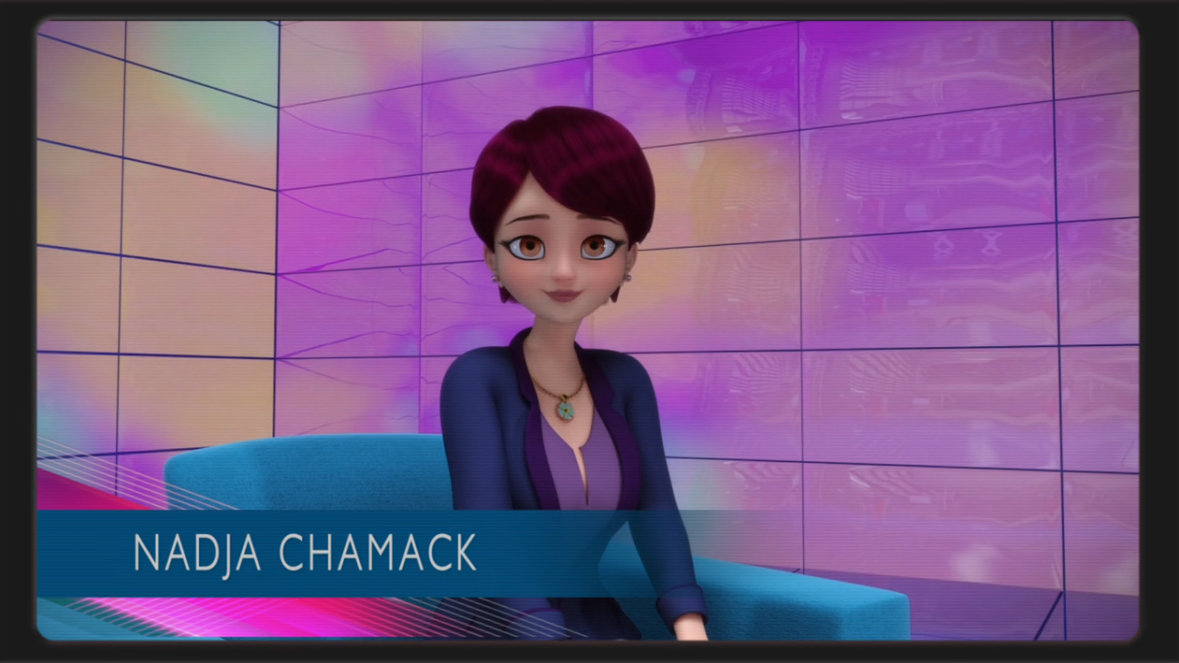
Don't be bemused, it's just ______.
the weather
the sport
the news

Slide 13
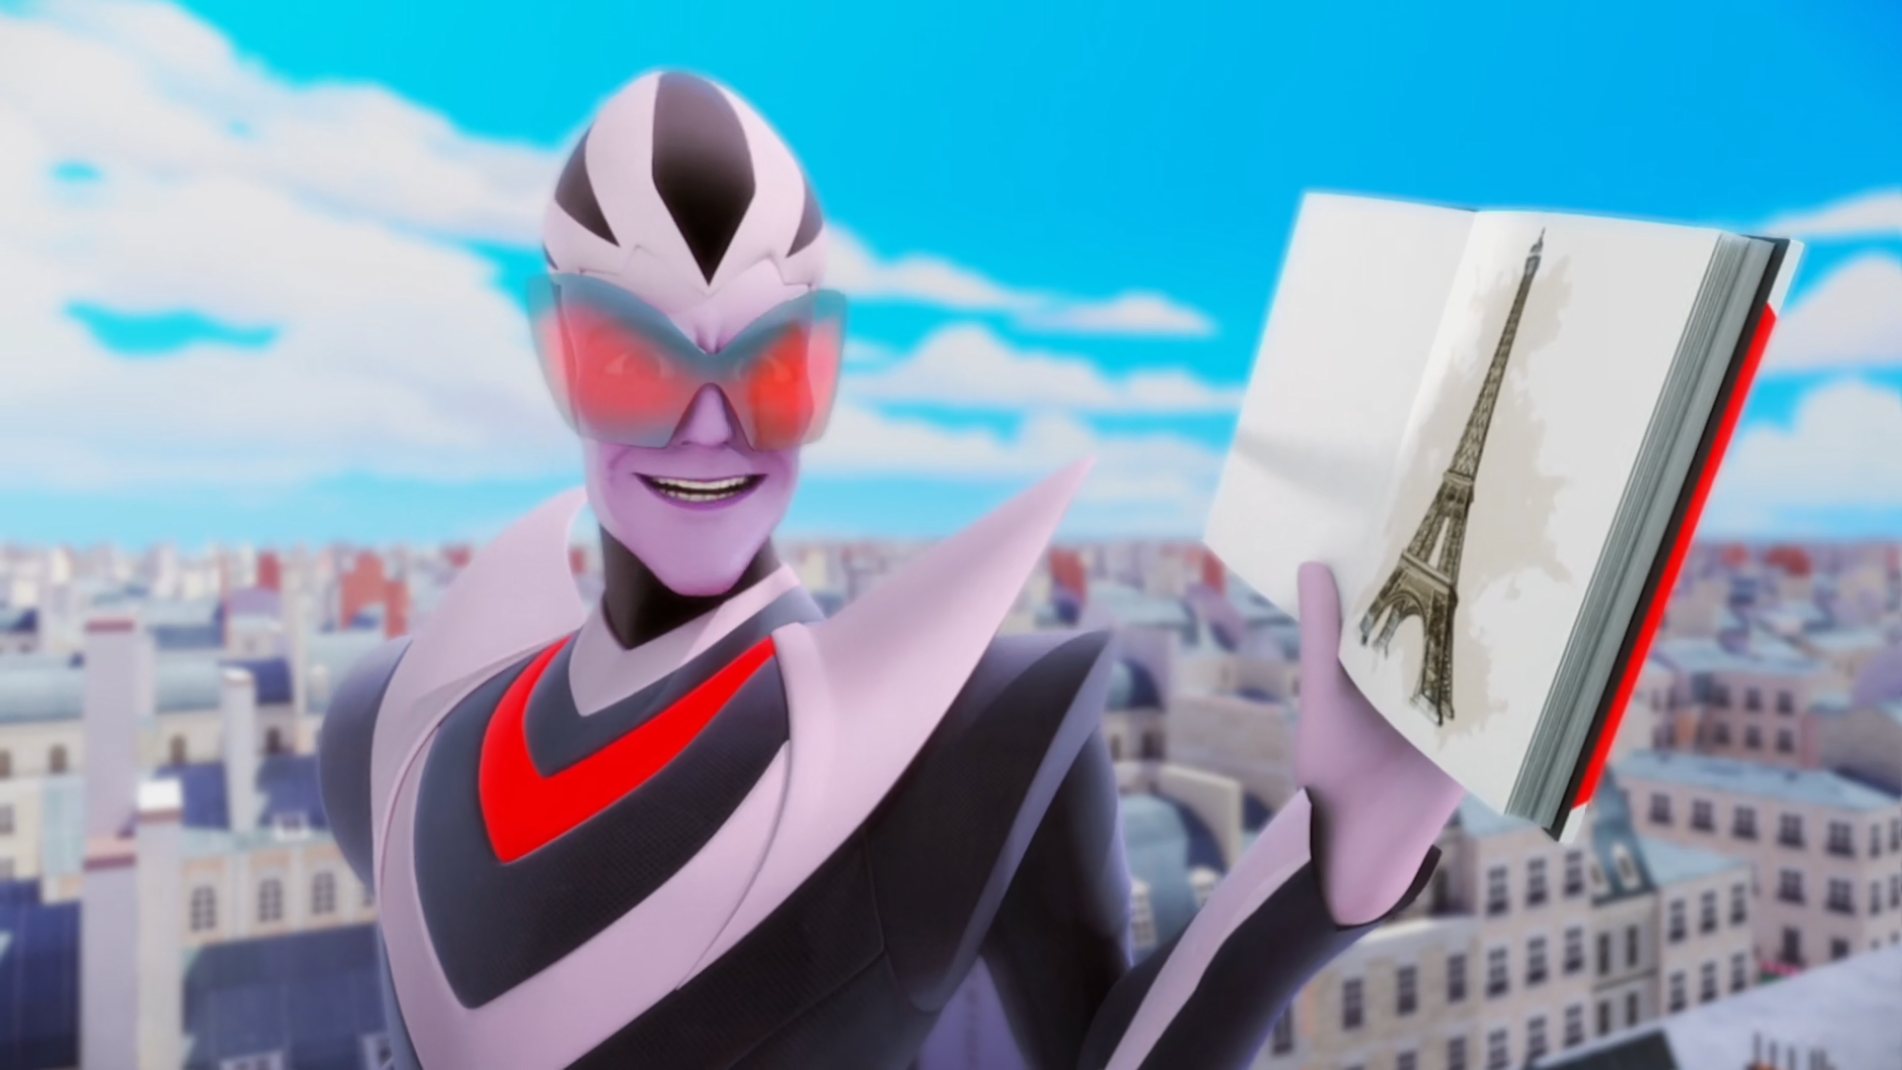
Nothing can inspire me more than ______ Ladybug and Cat Noir.
imprisoning
killing
collecting

Slide 14


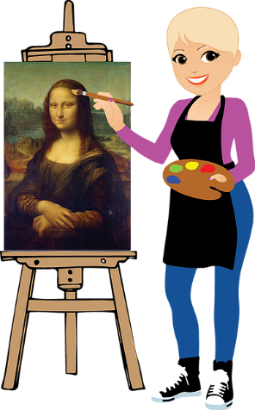

Matching Exercise
bench | portrait | vet | logo

Slide 15
Matching Exercise
vet | logo | bench | portrait

Slide 16
TRUE OR FALSE
1. Marinette has met Master Fu before.
2. Adrien will get his father another book.
3. Marinette is in love with a supervillain.
4. Adrien's father starts smashing up his house.
5. Hawk Moth akumatizes himself.

Slide 17
TRUE OR FALSE
1. Marinette has met Master Fu before. | TRUE
2. Adrien will get his father another book. | FALSE
3. Marinette is in love with a supervillain. | FALSE
4. Adrien's father starts smashing up his house. | TRUE
5. Hawk Moth akumatizes himself. | TRUE

Slide 18


ANAGRAM
R
B
A
E
B
E
A
R

Slide 19
C
H
O
O
G
E
N
T
L
Y
mobile phones, computers, laptops
machines that make things easier
00:00
00:01
00:02
00:03
00:04
00:05
00:06
00:07
00:08
00:09
00:10
00:11
00:12
00:13
00:14
00:15
00:16
00:17
00:18
00:19
00:20
00:21
00:22
00:23
00:24
00:25
00:26
00:27
00:28
00:29
00:30
00:31
00:32
00:33
00:34
00:35
00:36
00:37
00:38
00:39
00:40
00:41
00:42
00:43
00:44
00:45
00:46
00:47
00:48
00:49
00:50
00:51
00:52
00:53
00:54
00:55
00:56
00:56
00:57
00:58
00:59
Hint 1
Hint 2

Slide 20
T
E
C
H
N
O
L
O
G
Y
00:00
Hint 1
Hint 2

Slide 21
A
N
T
O
N
I
O
F
I
R
M
you can use the internet to find this
words and numbers
00:00
00:01
00:02
00:03
00:04
00:05
00:06
00:07
00:08
00:09
00:10
00:11
00:12
00:13
00:14
00:15
00:16
00:17
00:18
00:19
00:20
00:21
00:22
00:23
00:24
00:25
00:26
00:27
00:28
00:29
00:30
00:31
00:32
00:33
00:34
00:35
00:36
00:37
00:38
00:39
00:40
00:41
00:42
00:43
00:44
00:45
00:46
00:47
00:48
00:49
00:50
00:51
00:52
00:53
00:54
00:55
00:56
00:56
00:57
00:58
00:59
Hint 1
Hint 2

Slide 22
I
N
F
O
R
M
A
T
I
O
N
00:00
Hint 1
Hint 2

Slide 23
B
A
R
T
Marinette & Alya call Chloé this
bad boy/girl
00:00
00:01
00:02
00:03
00:04
00:05
00:06
00:07
00:08
00:09
00:10
00:11
00:12
00:13
00:14
00:15
00:16
00:17
00:18
00:19
00:20
00:21
00:22
00:23
00:24
00:25
00:26
00:27
00:28
00:29
00:30
00:31
00:32
00:33
00:34
00:35
00:36
00:37
00:38
00:39
00:40
00:41
00:42
00:43
00:44
00:45
00:46
00:47
00:48
00:49
00:50
00:51
00:52
00:53
00:54
00:55
00:56
00:56
00:57
00:58
00:59
Hint 1
Hint 2

Slide 24
B
R
A
T
00:00
Hint 1
Hint 2

Slide 25
C
O
A
T
I
V
A
N
another word for holiday
travel
00:00
00:01
00:02
00:03
00:04
00:05
00:06
00:07
00:08
00:09
00:10
00:11
00:12
00:13
00:14
00:15
00:16
00:17
00:18
00:19
00:20
00:21
00:22
00:23
00:24
00:25
00:26
00:27
00:28
00:29
00:30
00:31
00:32
00:33
00:34
00:35
00:36
00:37
00:38
00:39
00:40
00:41
00:42
00:43
00:44
00:45
00:46
00:47
00:48
00:49
00:50
00:51
00:52
00:53
00:54
00:55
00:56
00:56
00:57
00:58
00:59
Hint 1
Hint 2

Slide 26
V
A
C
A
T
I
O
N
00:00
Hint 1
Hint 2

