Slide 1
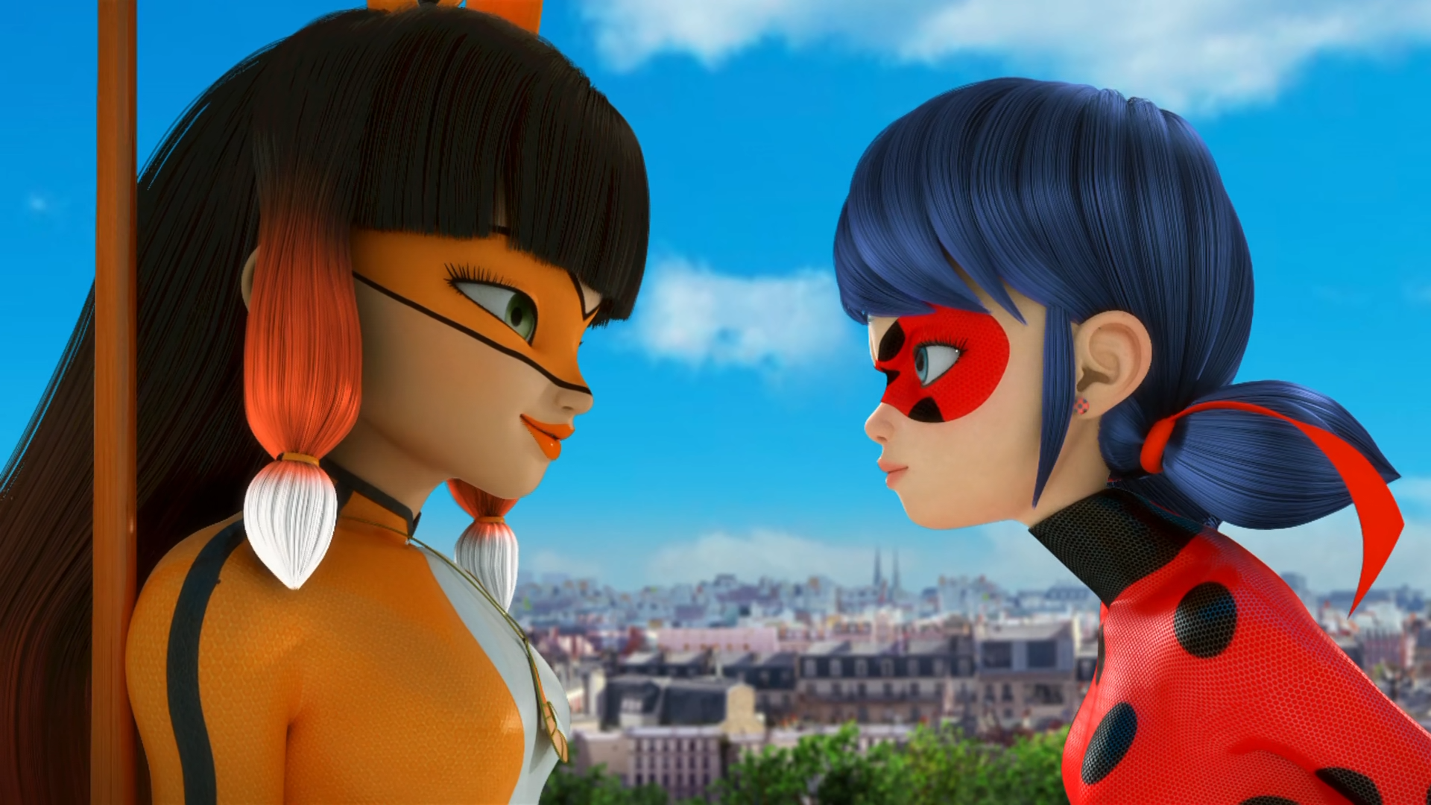
MIRACULOUS LADYBUG: VOLPINA. PART 2

Slide 2
VOCABULARY
code - 代码 - kəʊd
decipher - 解码 - dɪˈsaɪfə
figment - 虚构的 - fɪɡmənt
illusion - 错觉 - ɪˈluːʒᵊn
irresistible - 不可抗拒的 - ɪrɪˈzɪstəbᵊl
meteorite - 陨石 - miːtiəraɪt
partly - 部分地 - pɑːtli
ruined - 毁了 - ruːɪnd
solve - 解决 - sɒlv

Slide 3
1. 代码
2. ɪrɪˈzɪstəbᵊl
3. 毁了

Slide 4
1. 代码 - code
2. ɪrɪˈzɪstəbᵊl - irresistible
3. 毁了 - ruined

Slide 5
VOLPINA. PART 2
Cat Noir: I can't believe it! It's Hawk Moth in the flesh!
Ladybug: He never shows up! Something big is going on. Really big!
Volpina: We can take him down, but it's gonna take all three of us. We better make the most of our individual talents.
Cat Noir: You can count on us.

Slide 6
Volpina: Before I get rid of you, you are going to give me your Miraculous.
Ladybug: Never!
Volpina: Do you really think you've got a choice, Ladybug? You'll give me your Miraculous or the building goes down!
Ladybug: It's an illusion! Just like the meteorite! Just like Hawk Moth! That's your power Volpina, isn't it?! Illusion, lies.

Slide 7
Volpina: See what I mean! She's jealous of me, of you, of us, but this time you aren't going to ruin our date Ladybug.
Adrien: Mmm excuse me, but it wasn't really quite a date, per say. I mean, what I meant was it could've become one right? No need to get bent out of shape!
Ladybug: Excuse us, but I need to have a chat with super liar.

Slide 8
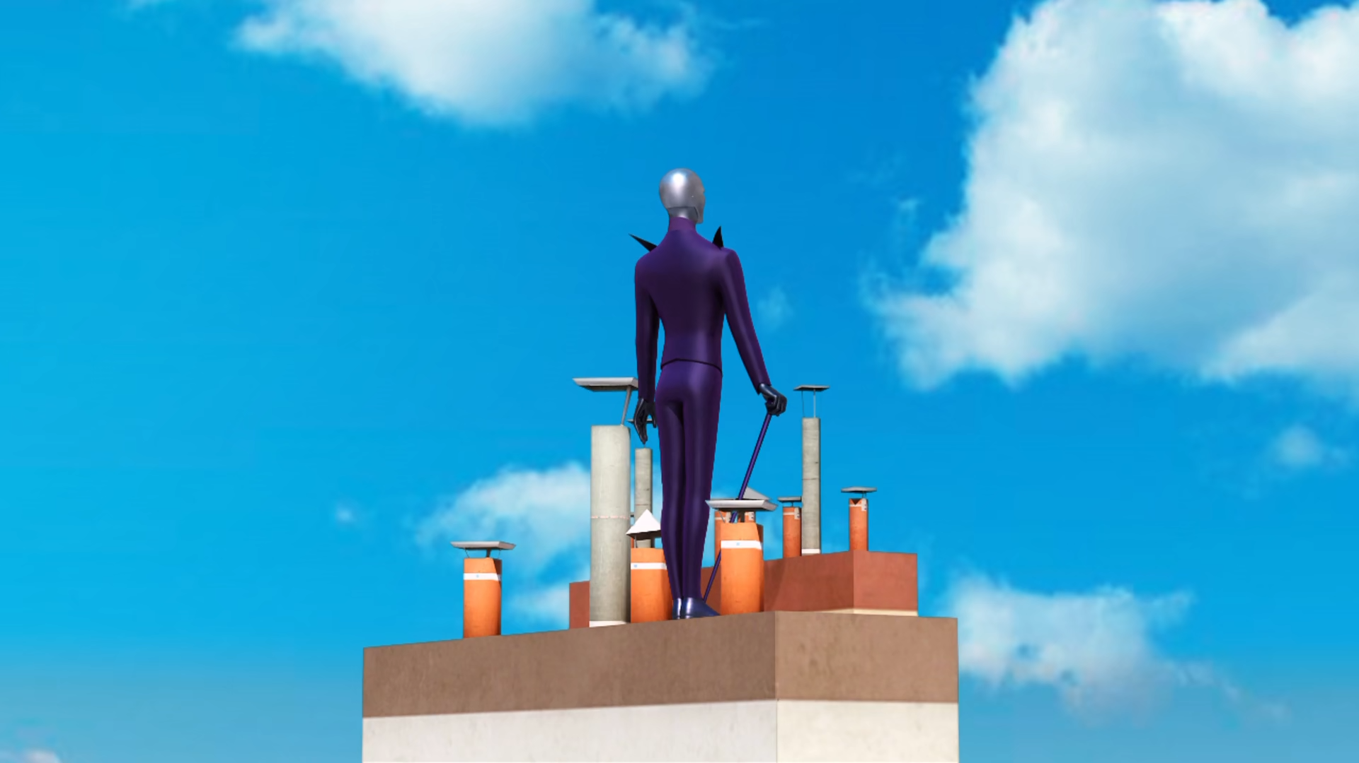

I can't believe it! It's Hawk Moth in the ______!
flash
toilet
flesh

Slide 9
The power of ______ and super strength.
flight
might
sight

Slide 10
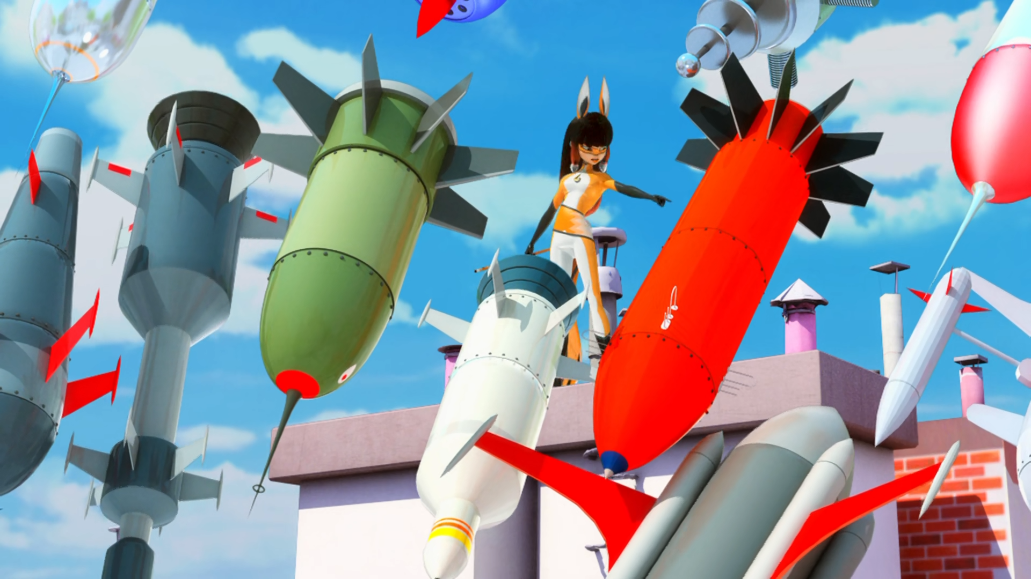
You'll give me your Miraculous or the ______ goes down!
moon
building
sun

Slide 11
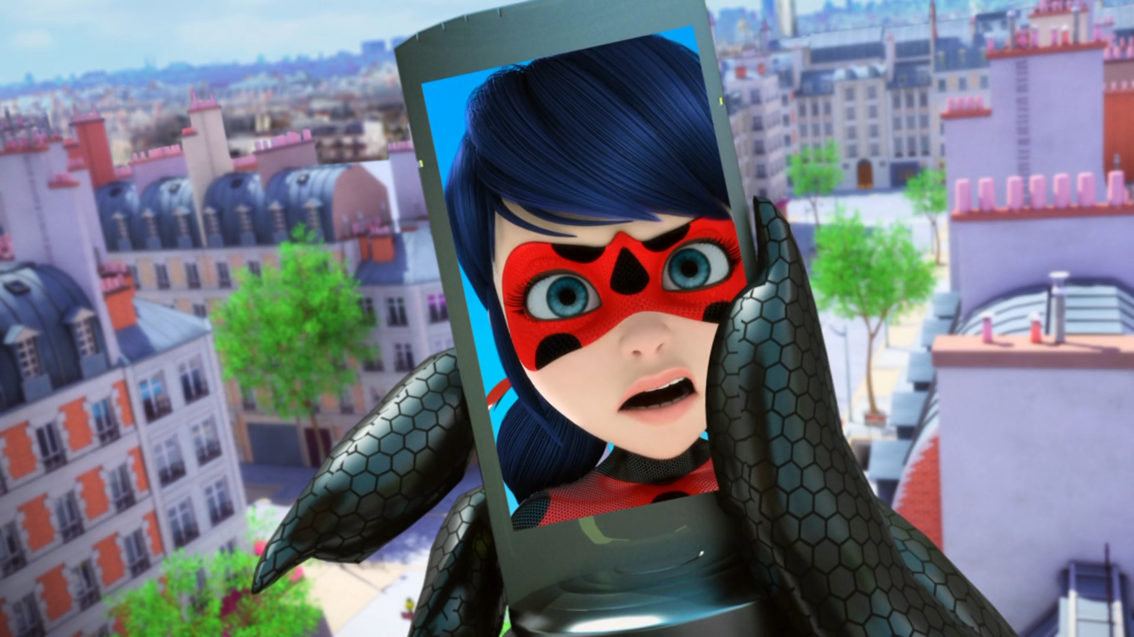
That's Volpina's power. She creates ______.
confusion
illusions
PPTs

Slide 12
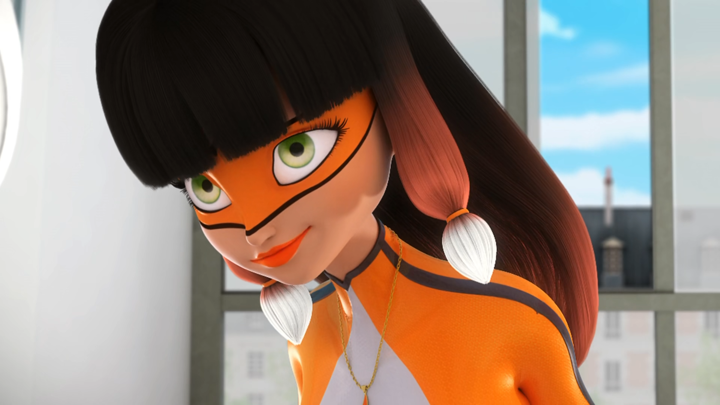
Ladybug's jealous because she's not as ______ as me.
sexy
beautiful
powerful

Slide 13
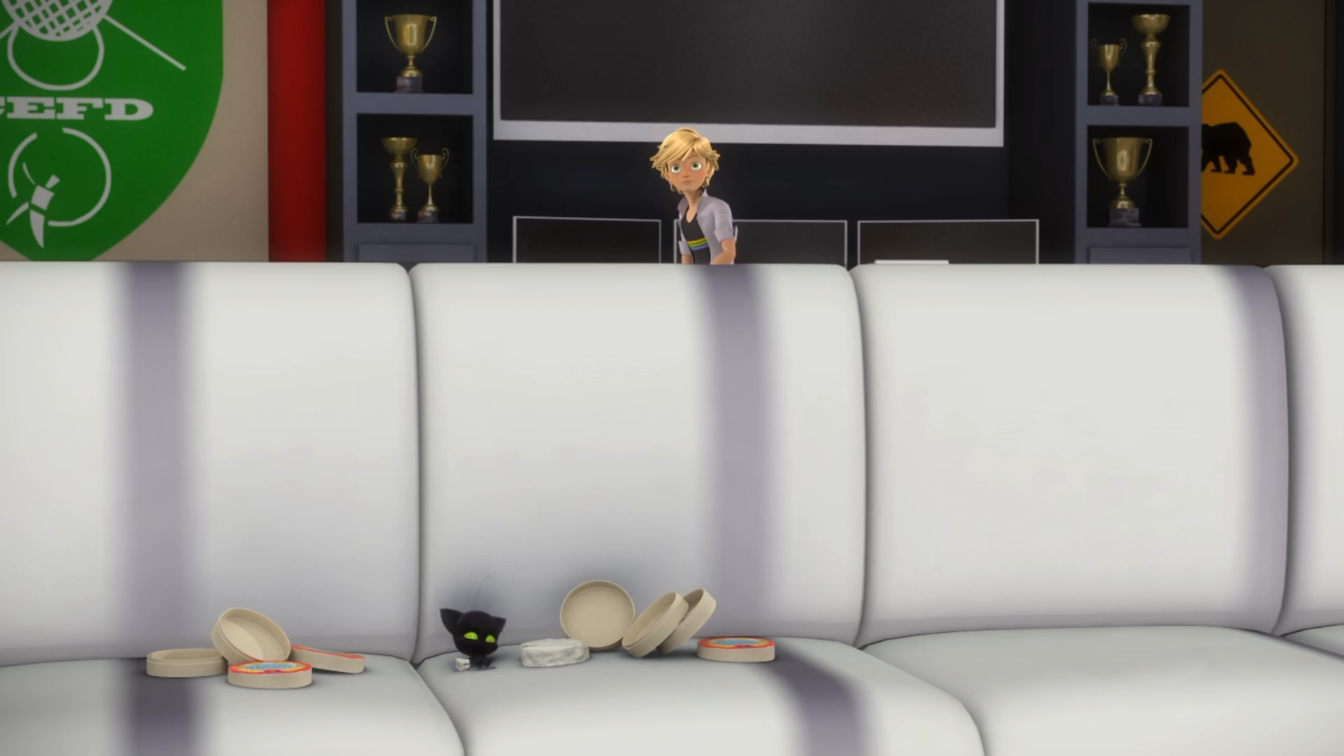
Did you take my father's ______, Plagg?
book
iphone
money

Slide 14



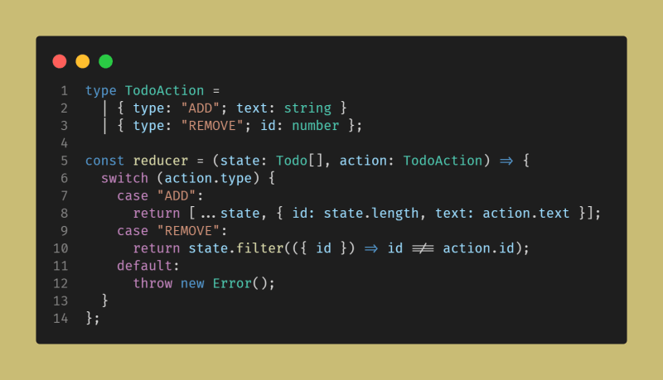
Matching Exercise
meteorite | code | cage | popsicle

Slide 15
Matching Exercise
popsicle | cage | meteor | code

Slide 16
TRUE OR FALSE
1. The Hawk Moth Ladybug & Cat Noir saw wasn't real.
2. Lila is going to Marinette's house.
3. Ladybug is jealous because Lila is more powerful.
4. Volpina is caught in a cage.
5. The book has the secrets of the Miraculous powers.

Slide 17
TRUE OR FALSE
1. The Hawk Moth Ladybug & Cat Noir saw wasn't real. | TRUE
2. Lila is going to Marinette's house. | FALSE
3. Ladybug is jealous because Lila is more powerful. | FALSE
4. Volpina is caught in a cage. | TRUE
5. The book has the secrets of the Miraculous powers. | TRUE

Slide 18


ANAGRAM
R
B
A
E
B
E
A
R

Slide 19
C
H
O
O
G
E
N
T
L
Y
mobile phones, computers, laptops
machines that make things easier
00:00
00:01
00:02
00:03
00:04
00:05
00:06
00:07
00:08
00:09
00:10
00:11
00:12
00:13
00:14
00:15
00:16
00:17
00:18
00:19
00:20
00:21
00:22
00:23
00:24
00:25
00:26
00:27
00:28
00:29
00:30
00:31
00:32
00:33
00:34
00:35
00:36
00:37
00:38
00:39
00:40
00:41
00:42
00:43
00:44
00:45
00:46
00:47
00:48
00:49
00:50
00:51
00:52
00:53
00:54
00:55
00:56
00:56
00:57
00:58
00:59
Hint 1
Hint 2

Slide 20
T
E
C
H
N
O
L
O
G
Y
00:00
Hint 1
Hint 2

Slide 21
A
N
T
O
N
I
O
F
I
R
M
you can use the internet to find this
words and numbers
00:00
00:01
00:02
00:03
00:04
00:05
00:06
00:07
00:08
00:09
00:10
00:11
00:12
00:13
00:14
00:15
00:16
00:17
00:18
00:19
00:20
00:21
00:22
00:23
00:24
00:25
00:26
00:27
00:28
00:29
00:30
00:31
00:32
00:33
00:34
00:35
00:36
00:37
00:38
00:39
00:40
00:41
00:42
00:43
00:44
00:45
00:46
00:47
00:48
00:49
00:50
00:51
00:52
00:53
00:54
00:55
00:56
00:56
00:57
00:58
00:59
Hint 1
Hint 2

Slide 22
I
N
F
O
R
M
A
T
I
O
N
00:00
Hint 1
Hint 2

Slide 23
B
A
R
T
Marinette & Alya call Chloé this
bad boy/girl
00:00
00:01
00:02
00:03
00:04
00:05
00:06
00:07
00:08
00:09
00:10
00:11
00:12
00:13
00:14
00:15
00:16
00:17
00:18
00:19
00:20
00:21
00:22
00:23
00:24
00:25
00:26
00:27
00:28
00:29
00:30
00:31
00:32
00:33
00:34
00:35
00:36
00:37
00:38
00:39
00:40
00:41
00:42
00:43
00:44
00:45
00:46
00:47
00:48
00:49
00:50
00:51
00:52
00:53
00:54
00:55
00:56
00:56
00:57
00:58
00:59
Hint 1
Hint 2

Slide 24
B
R
A
T
00:00
Hint 1
Hint 2

Slide 25
C
O
A
T
I
V
A
N
another word for holiday
travel
00:00
00:01
00:02
00:03
00:04
00:05
00:06
00:07
00:08
00:09
00:10
00:11
00:12
00:13
00:14
00:15
00:16
00:17
00:18
00:19
00:20
00:21
00:22
00:23
00:24
00:25
00:26
00:27
00:28
00:29
00:30
00:31
00:32
00:33
00:34
00:35
00:36
00:37
00:38
00:39
00:40
00:41
00:42
00:43
00:44
00:45
00:46
00:47
00:48
00:49
00:50
00:51
00:52
00:53
00:54
00:55
00:56
00:56
00:57
00:58
00:59
Hint 1
Hint 2

Slide 26
V
A
C
A
T
I
O
N
00:00
Hint 1
Hint 2

