Slide 1
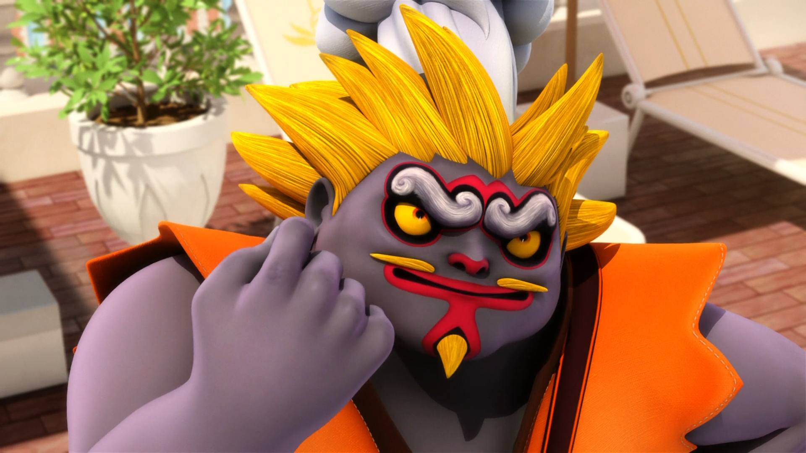
MIRACULOUS LADYBUG: KUNG FOOD. PART 2

Slide 2
VOCABULARY
appetizer - 开胃菜 - æpɪtaɪzə
demonstration - 示范 - dɛmənˈstreɪʃᵊn
foul-smelling - 恶臭的 - faʊl-ˈsmɛlɪŋ
jammed - 卡住了 - ʤæmd
jury - 陪审团 - ʤʊəri
mashed - 捣碎 - mæʃt
minced - 剁碎 - mɪnst
privilege - 特权 - prɪvᵊlɪʤ
sausage - 香肠 - sɒsɪʤ

Slide 3
1. ʤæmd
2. mæʃt
3. 香肠

Slide 4
1. ʤæmd - jammed
2. mæʃt - mashed
3. 香肠 - sausage

Slide 5
KUNG FOOD. PART 2
Kung Food: Brat Soup even more powerful with superhero flavour.
Chloé: I will not eat your soup!
Kung Food: Foolish girl. You are not eating soup, you ARE soup!
Chloé: Someone help! Let me down!
Kung Food: Don't worry, you will be let down soon enough. Hahahaha!

Slide 6
Mayor Bourgeois: Royal hotpot with its giant string of smoked sausages!
Ladybug: Looks like a food fight is coming our way.
Cat Noir: I prefer my sausages with mashed potatoes.
Mayor Bourgeois: Welcome to the world famous Suite 36 of this hotel.

Slide 7
Jagged Stone: Rock n' Roll! I can't wait to get home and write a song about soup!
Cheng Sifu: Thank you, but no longer Celestial Soup. Now called: Marinette Soup.
Marinette: Huh? 谢谢
Cheng Sifu: You're welcome.
Alec: Come over here and stand alongside your uncle, the "World's Greatest Chef"!

Slide 8
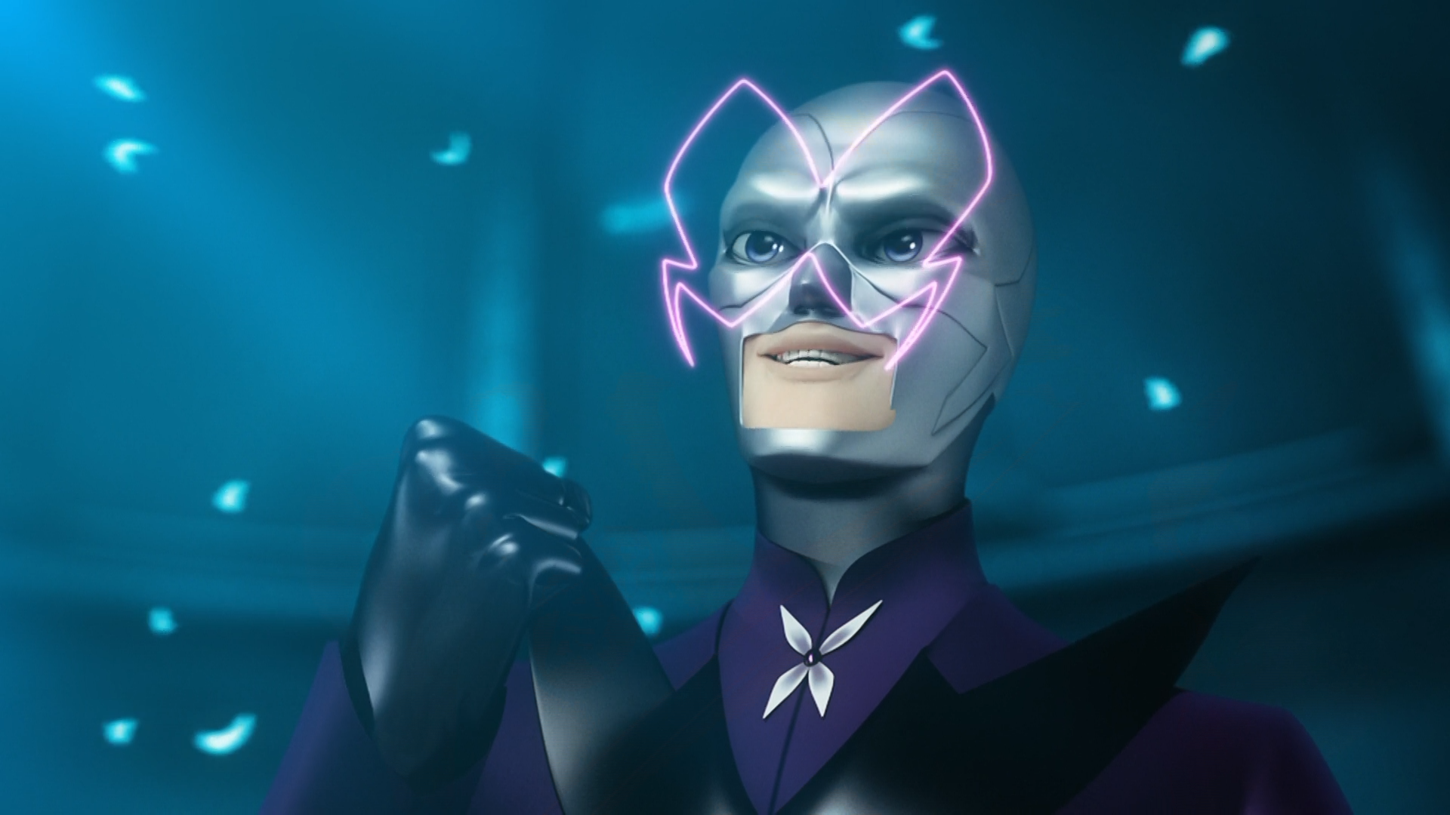
You must add them to your ______.
soup
WeChat
recipe

Slide 9
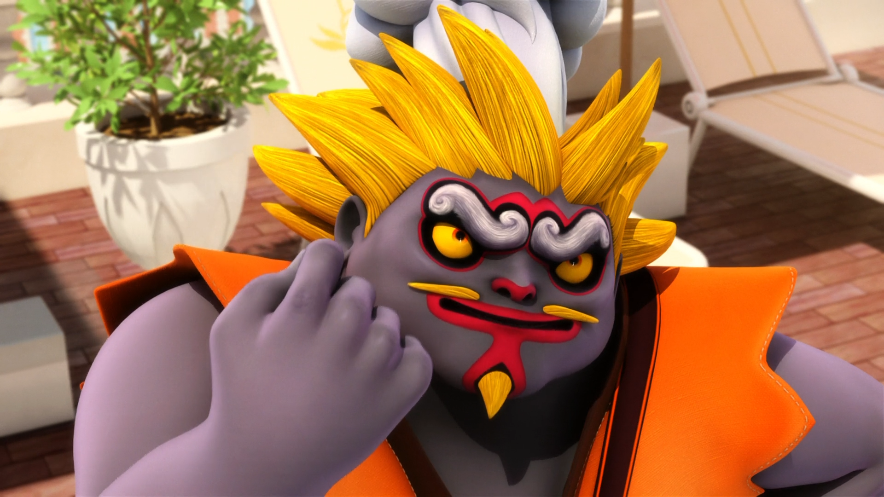
Foolish girl. You are not eating soup, you ARE ______!
soup
bitch
sexy

Slide 10
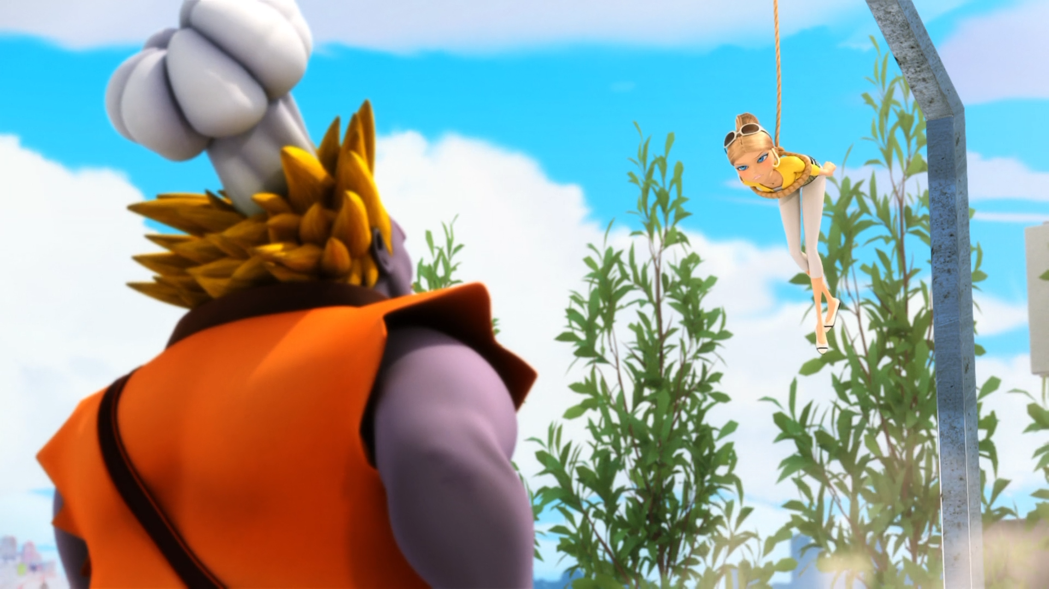
My designer clothes are going to stink of ______!
fish
grease
cheese

Slide 11
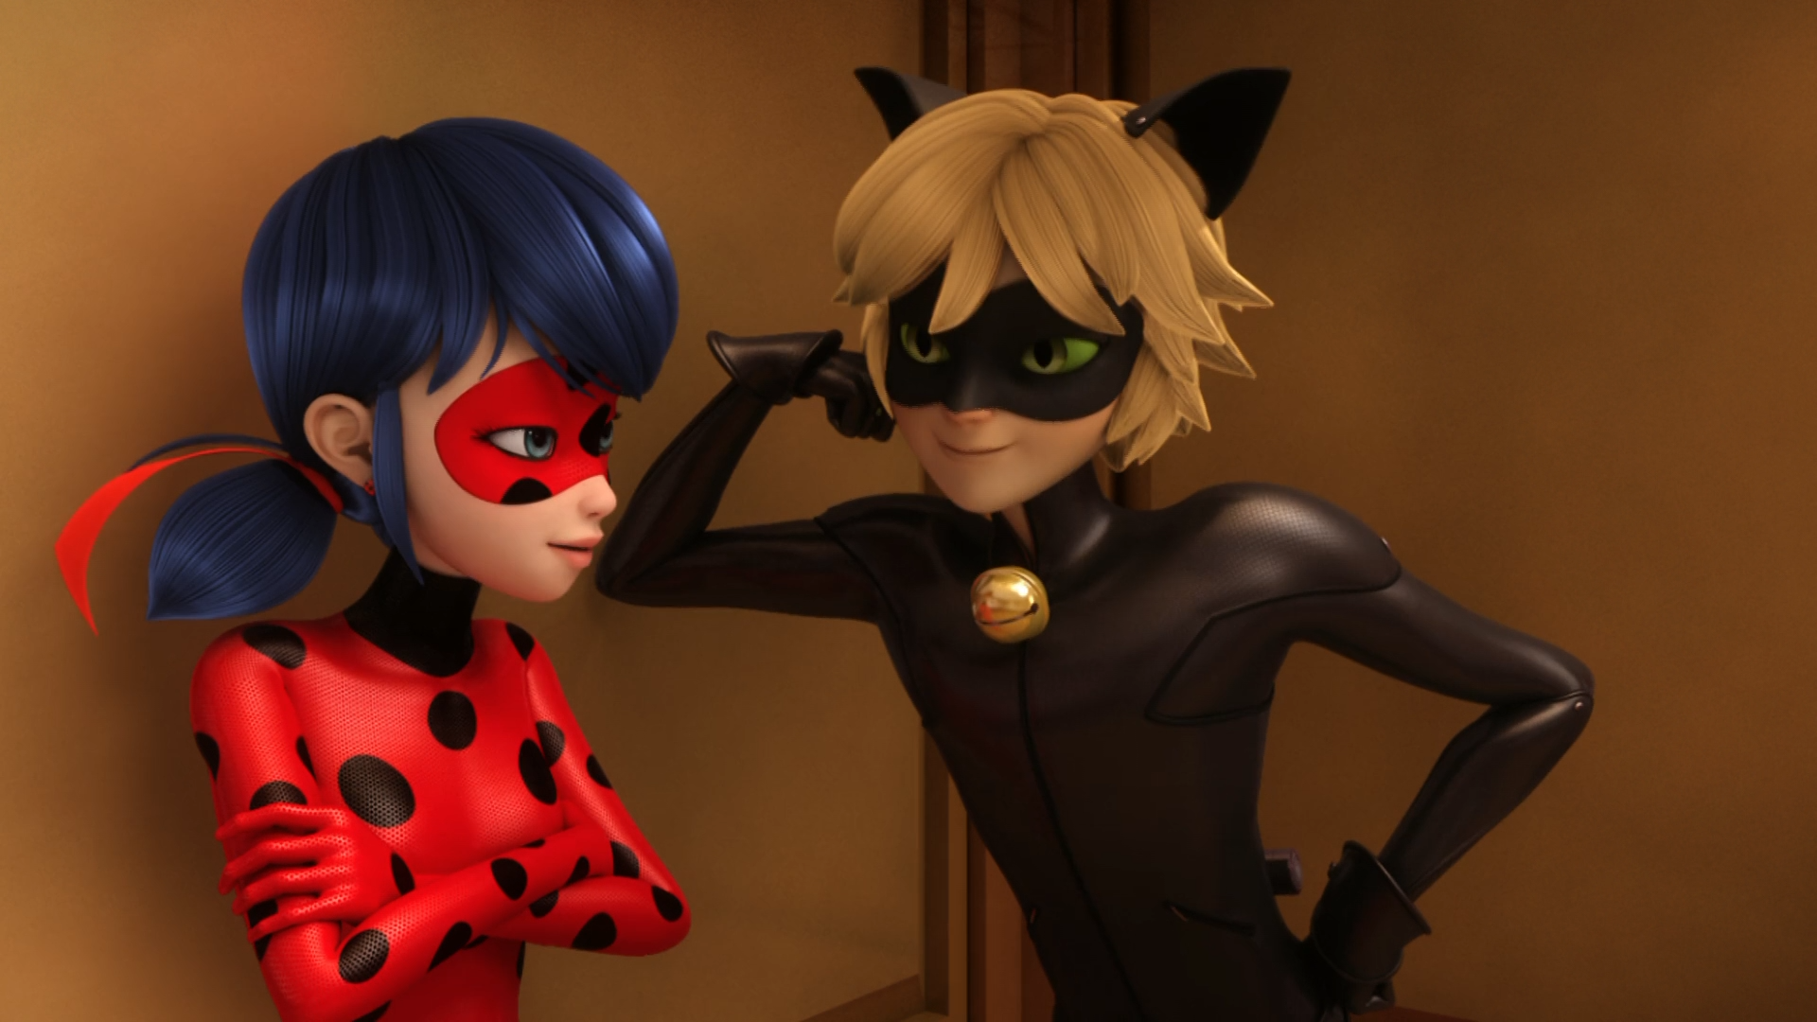
Ladybug, come on. It's just you and me together. We could go ______.
to the hotel
places
KFC

Slide 12
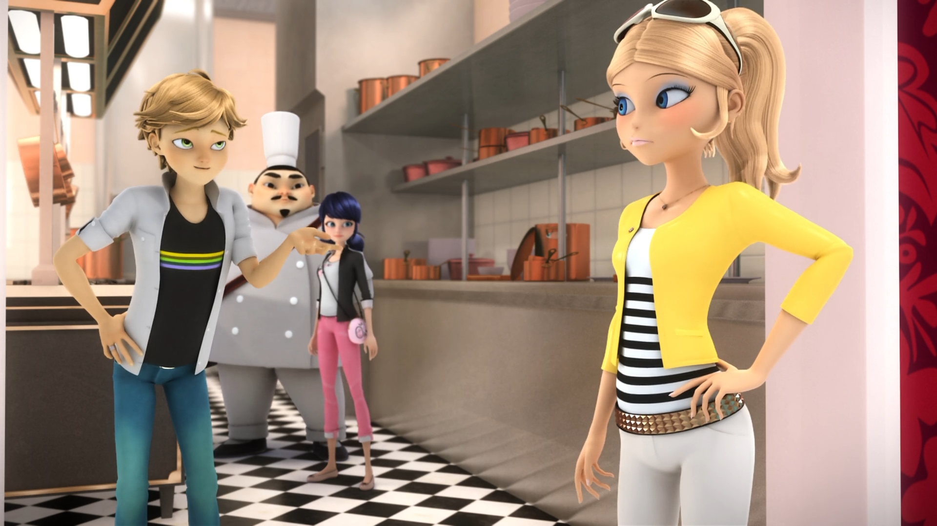
Didn't your father kick you off the ______?
jury
panel
balcony

Slide 13
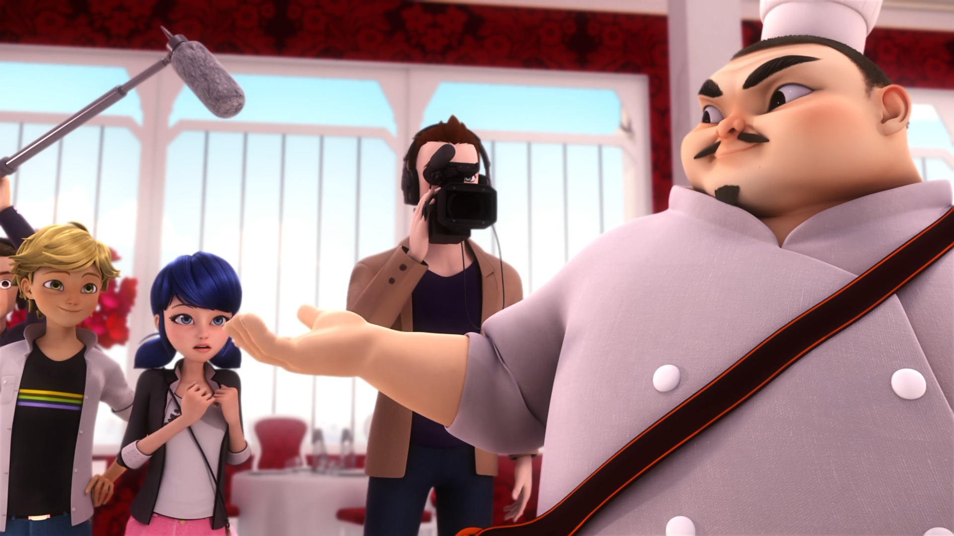
Now called ______ soup.
Ladybug
Dalian
Marinette

Slide 14
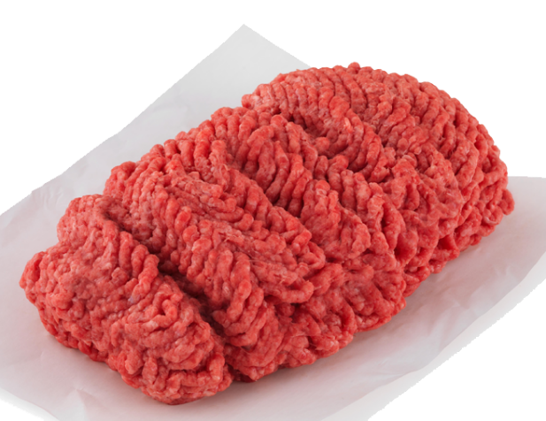
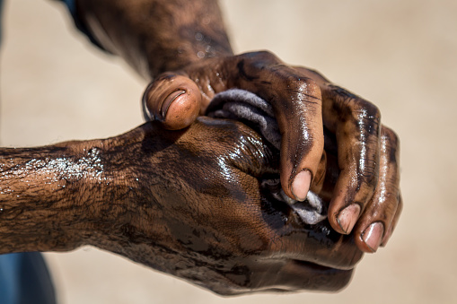

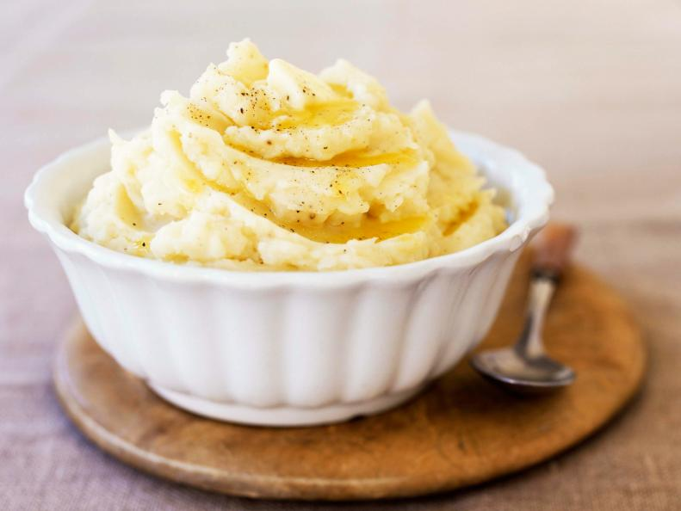
Matching Exercise
sleeve | mashed | minced | greasy

Slide 15
Matching Exercise
greasy | minced | sleeve | mashed

Slide 16
TRUE OR FALSE
1. Chloé is going to be in the soup.
2. Kung Food's soup is going to be greasy.
3. Kung Food has a pizza sword.
4. Celestial Soup is now called Miraculous Soup.
5. Cheng Sifu wins the World's Greatest Chef contest.

Slide 17
TRUE OR FALSE
1. Chloé is going to be in the soup. | TRUE
2. Kung Food's soup is going to be greasy. | FALSE
3. Kung Food has a pizza sword. | TRUE
4. Celestial Soup is now called Miraculous Soup. | FALSE
5. Cheng Sifu wins the World's Greatest Chef contest. | TRUE

