Slide 1
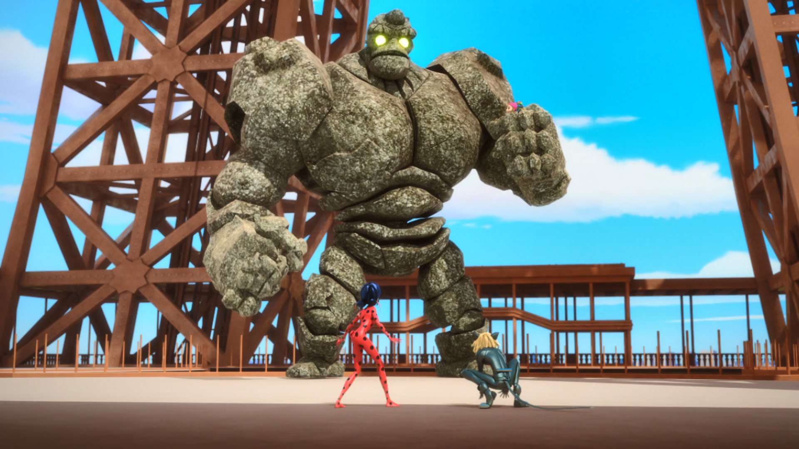
MIRACULOUS LADYBUG: ORIGINS 2. PART 2

Slide 2
VOCABULARY
choice - 选择 - ʧɔɪs
clenched - 攥紧 - klɛnʧt
comedic - 喜剧 - kəˈmidɪk
innocent - 清白的 - ˈɪnəsənt
joker - 小丑 - ʤəʊkə
reverse - 撤销 - rɪˈvɜːs
separate - 分离 - ˈsɛprɪt
surrounded - 包围 - səˈraʊndɪd
timing - 定时 - ˈtaɪmɪŋ

Slide 3
1. 清白的
2. ʤəʊkə
3. 分离

Slide 4
1. 清白的 - innocent
2. ʤəʊkə - joker
3. 分离 - separate

Slide 5
ORIGINS. PART 2
Cat Noir: We're surrounded! What do we do now? We can't attack him.
Ladybug: Yes, but we know where the akuma is.
Cat Noir: In his clenched fist. The one he's holding Mylène with. So…
Ladybug: We don't separate Stoneheart and Mylène, we bring them closer together!

Slide 6
Ladybug: Oh, they're so made for each other. Cat Noir: Like us two.
Ladybug: Uh oh. You see that? Time to split. See you soon, Cat Noir.
Cat Noir: Can't wait, m'lady.
Gabriel: You disobeyed me, Adrien. Take a look at that school.
Adrien: Yes, Father.

Slide 7
Gabriel: You will never, I say, never go back there again…
Adrien: Father, no…
Gabriel: Without your bodyguard. He will drop you off and pick you off every day. Marinette: No, wait.
Chloé: Uhh… You're in the wrong seat. Go on, get lost!

Slide 8
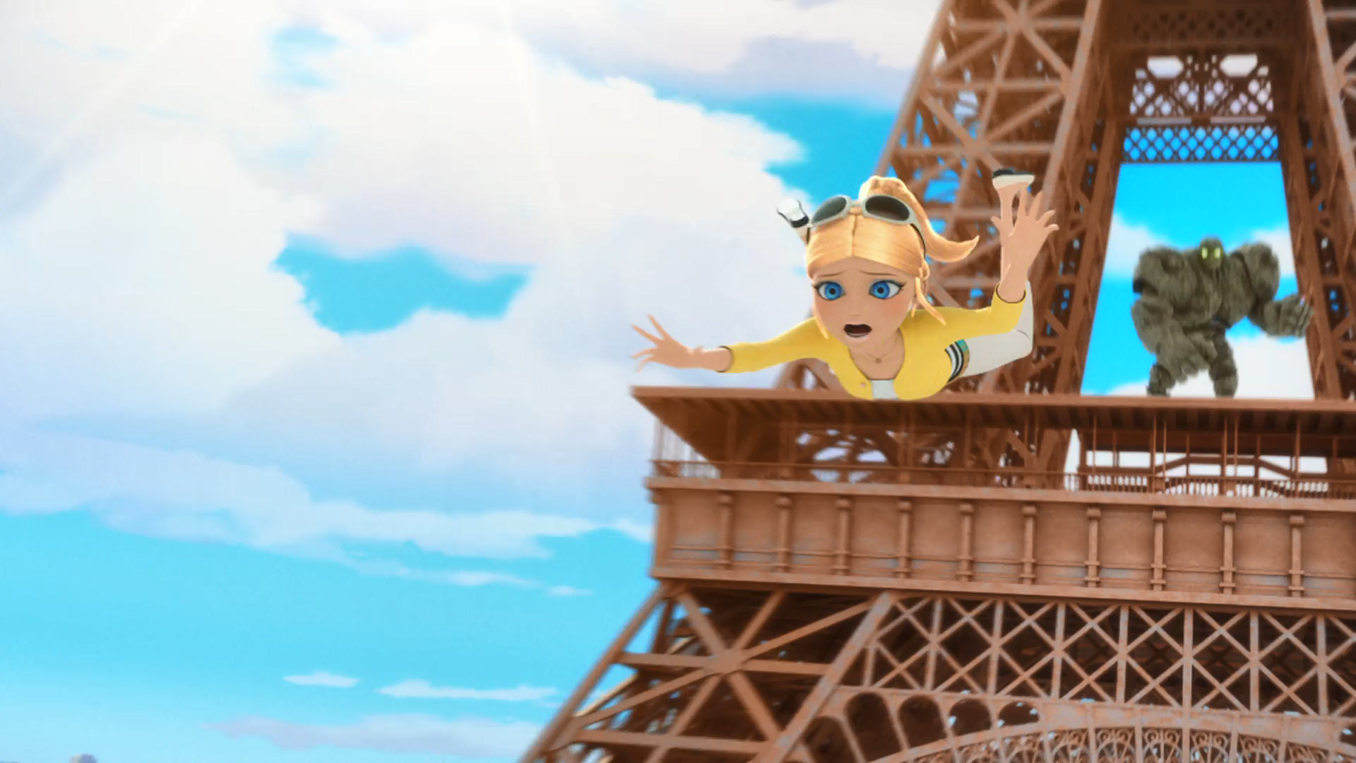
Help! I promise I'll be ______ to everyone, say please and thank you.
good
mean
nice

Slide 9
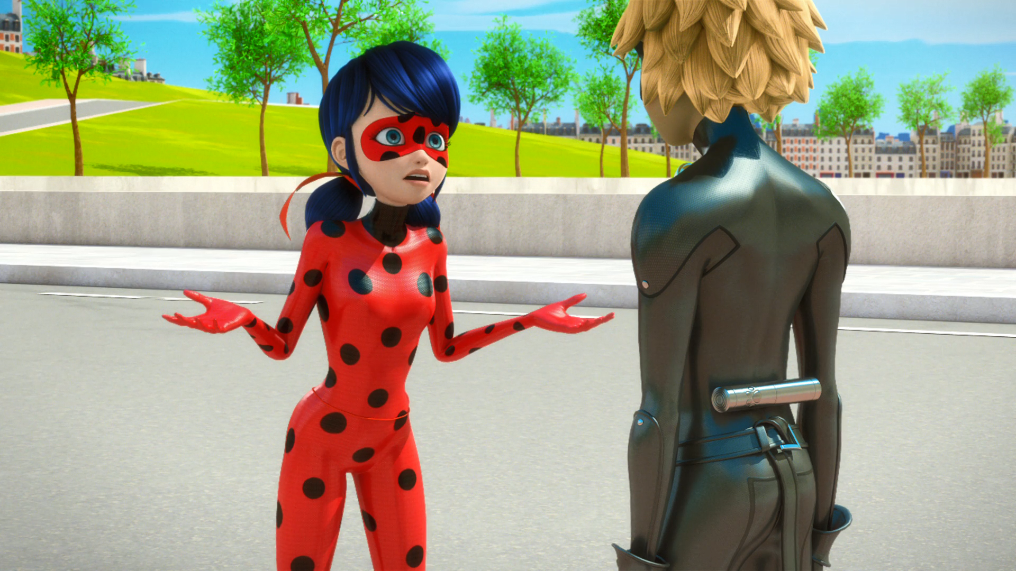
If I had captured Stoneheart's ______ the first time around…
akuma
heart
ring

Slide 10
You'll never take ______ from me! Come to me, my stone beings!
money
Mylène
Chloé

Slide 11
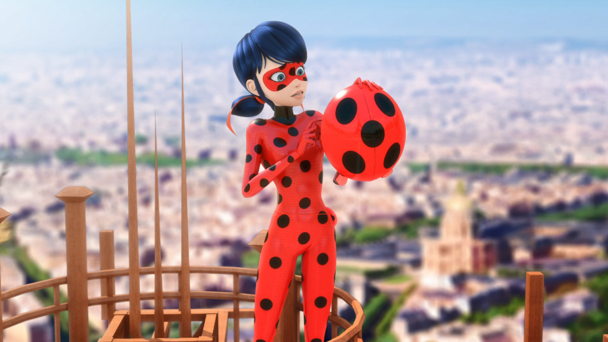
By using our powers! Lucky Charm! A ______?
ladybird
parachute
hat

Slide 12
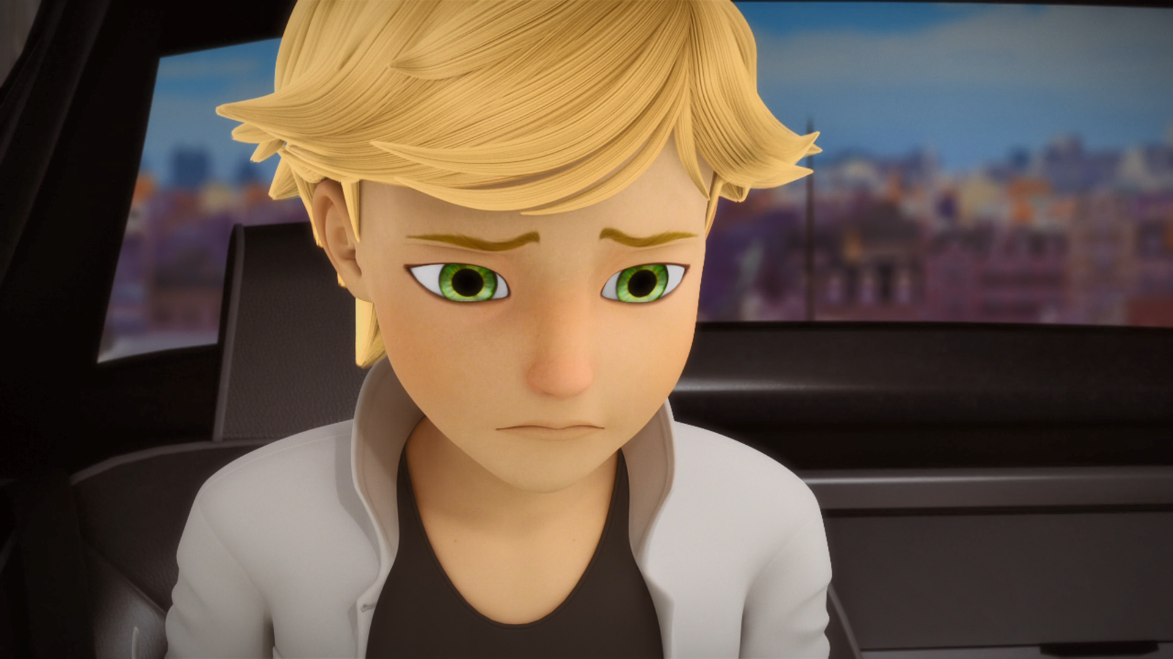
Without your ______. He will drop you off and pick you off every day.
bodyguard
phone
ipad

Slide 13
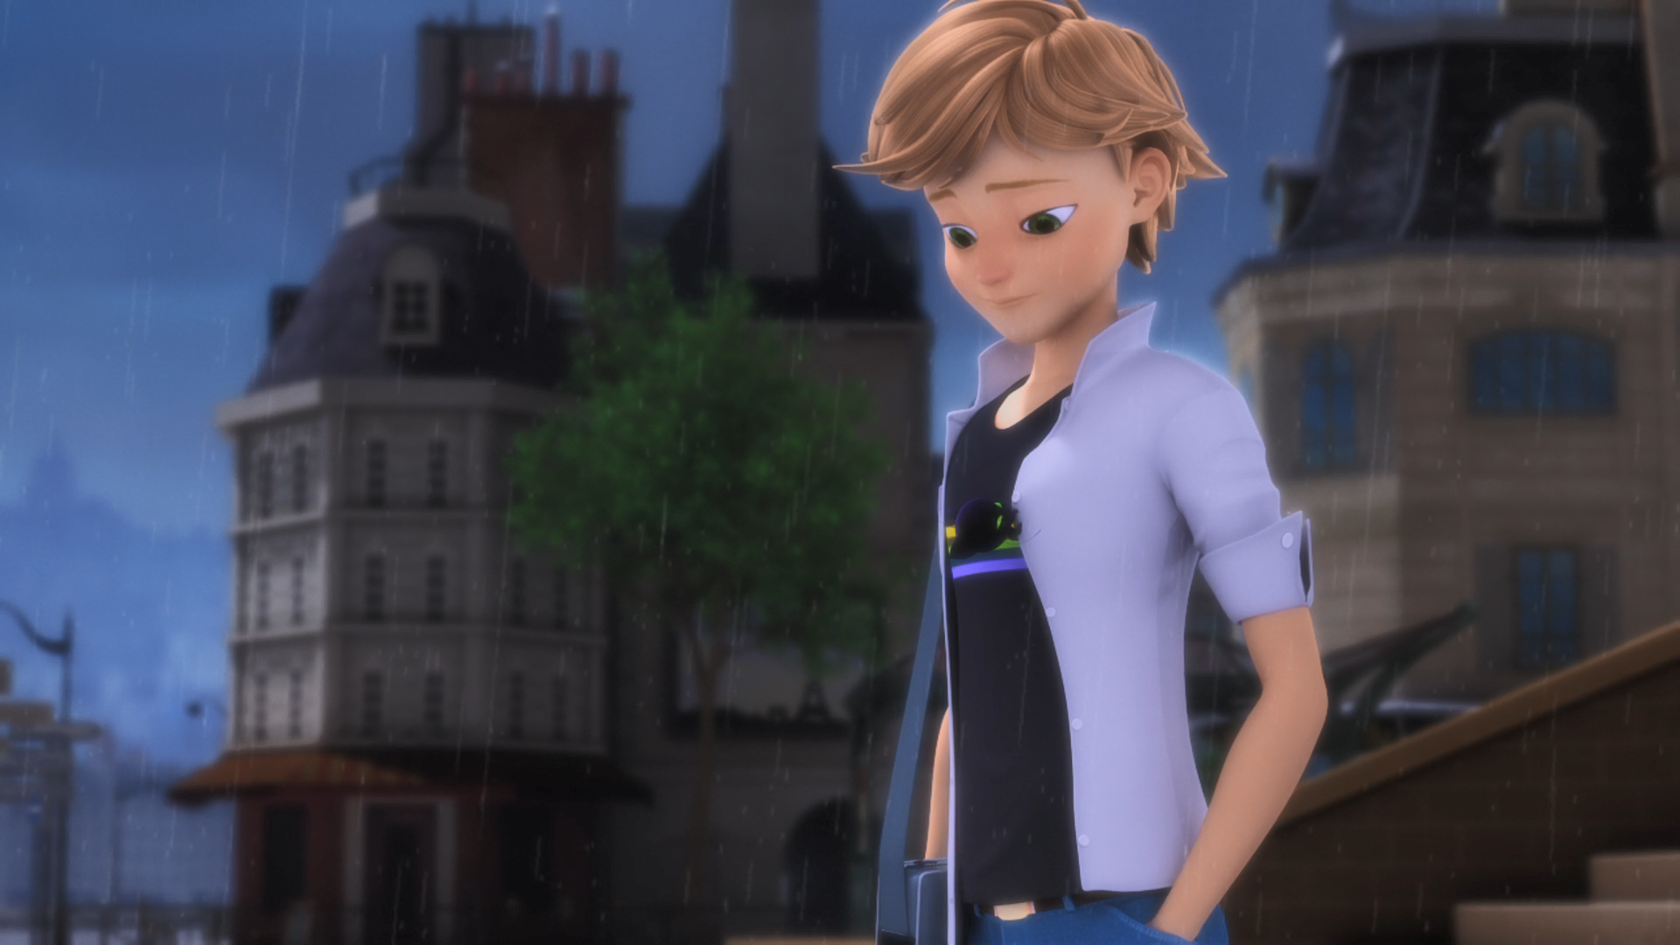
First day of school and we already have two ______.
superheroes
BFFs
lovebirds

Slide 14
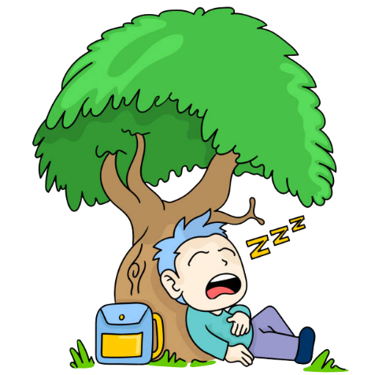
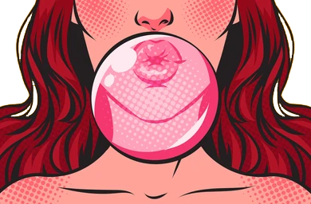
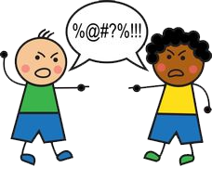

Matching Exercise
chewing gum | swear | earrings | beneath

Slide 15
Matching Exercise
beneath | chewing gum | swear | earrings

Slide 16
TRUE OR FALSE
1. The Mayor wants Mylene's safe return.
2. Hawk Moth talks to the people of London.
3. Adrien can never go to school again.
4. Marinette makes Chloé move.
5. Marinette stammers (结巴者) when she falls in love with Adrien.

Slide 17
TRUE OR FALSE
1. The Mayor wants Mylene's safe return. | FALSE
2. Hawk Moth talks to the people of London. | FALSE
3. Adrien can never go to school again. | FALSE
4. Marinette makes Chloe move. | TRUE
5. Marinette stammers (结巴者) when she falls in love with Adrien. | TRUE

