Slide 1
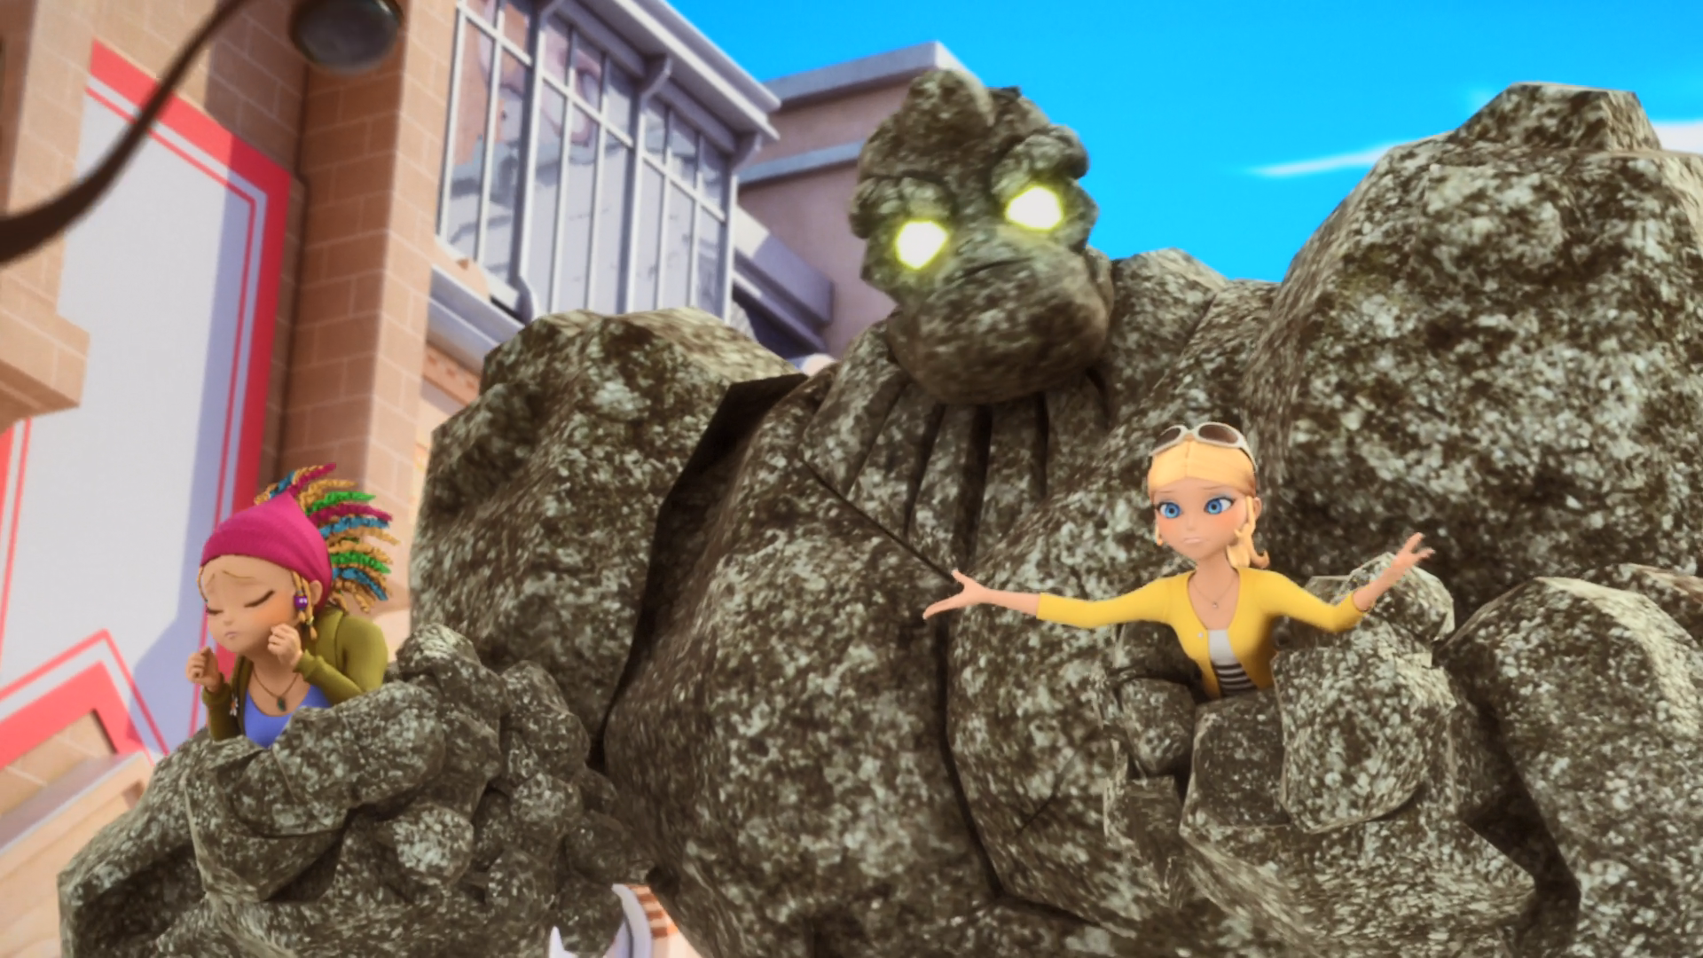
MIRACULOUS LADYBUG: ORIGINS 2. PART 1

Slide 2
VOCABULARY
adjustment - 调整 - əˈʤʌstmənt
attitude - 态度 - ætɪtjuːd
cavalry - 骑兵 - kævəlri
especially - 尤其 - ɪsˈpɛʃəli
handle - 处理 - hændl
negative - 消极的 - nɛgətɪv
protect - 保护 - prəˈtɛkt
positive - 积极的 - pɒzətɪv
strange - 奇怪的 - streɪnʤ

Slide 3
1. əˈʤʌstmənt
2. 态度
3. 奇怪的

Slide 4
1. əˈʤʌstmənt - adjustment
2. 态度 - attitude
3. 奇怪的 - strange

Slide 5
ORIGINS. PART 2
Plagg: You're such a strange kid. Who would want to be at school when he can stay at home all day?
Adrien: You don't get it, Plagg. I've had enough of being shut up at home by my dad.
I want to meet people and make friends!
Go to a normal school like everyone else!

Slide 6
Marinette: Come on, I saw the way you look at her. No! No negative emotions, Ivan.
What I mean is, be positive. I'm sure Mylène has feelings for you too. Go talk to her.
Ivan: I'm no good with words anyway.
Marinette: But… who needs words? You could draw her a picture, send her flowers…
Ivan: I could… write her a song?

Slide 7
Alya: Totally! I'm not scared of anyone! Why?
Marinette: Oh! No reason…
Marinette: Hey! What are you doing?
Adrien: Uhhh… I…
Marinette: Okay. I get it. Good job, you three. Very funny.
Adrien: No, no, I was just trying to take this off!

Slide 8
Marinette: Oh, really? You're friends with Chloé, right?
Adrien: Why do people keep saying that?
Marinette: I know I've seen him somewhere before. Of course! He's the son of my fave fashion designer!
Alya: Daddy's boy, teen supermodel, and Chloé's buddy? Ha! Forget it.

Slide 9
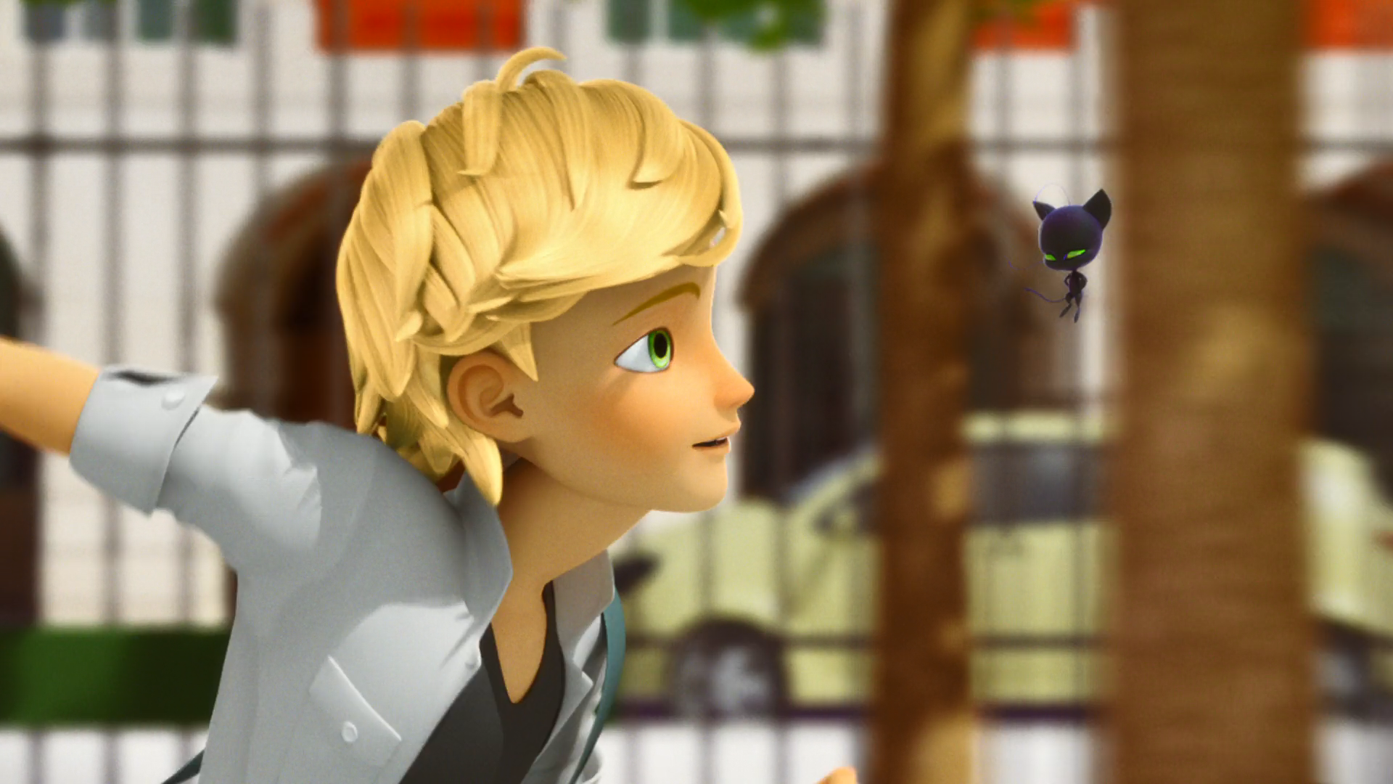
I've had enough of being shut up at ______ by my dad.
school
KFC
home

Slide 10
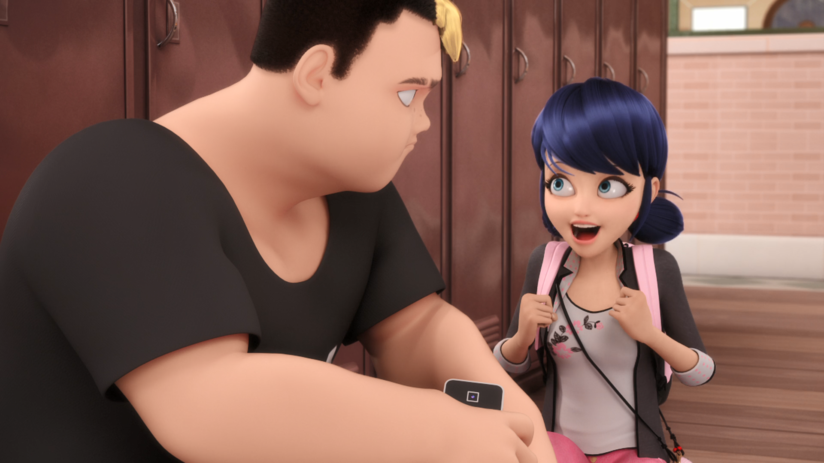
I could… write her ______?
a song
an e-mail
a letter

Slide 11
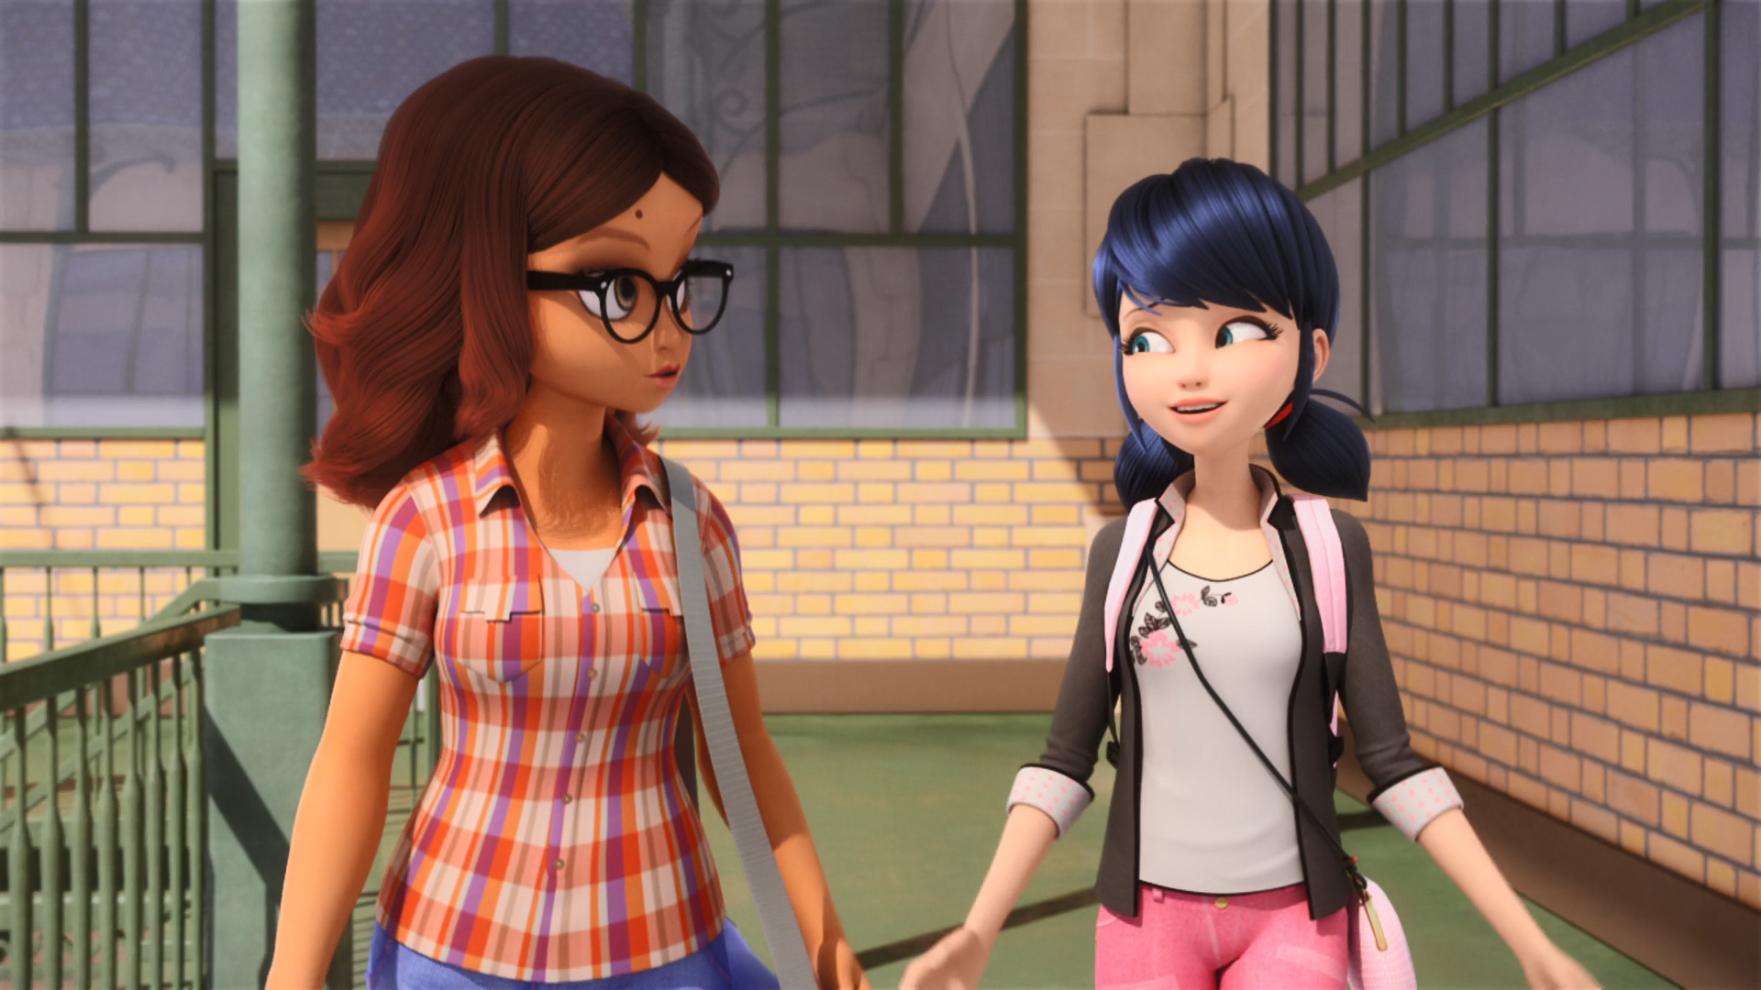
Alya, wouldn't you like to be a ______?
wife
superhero
boy

Slide 12
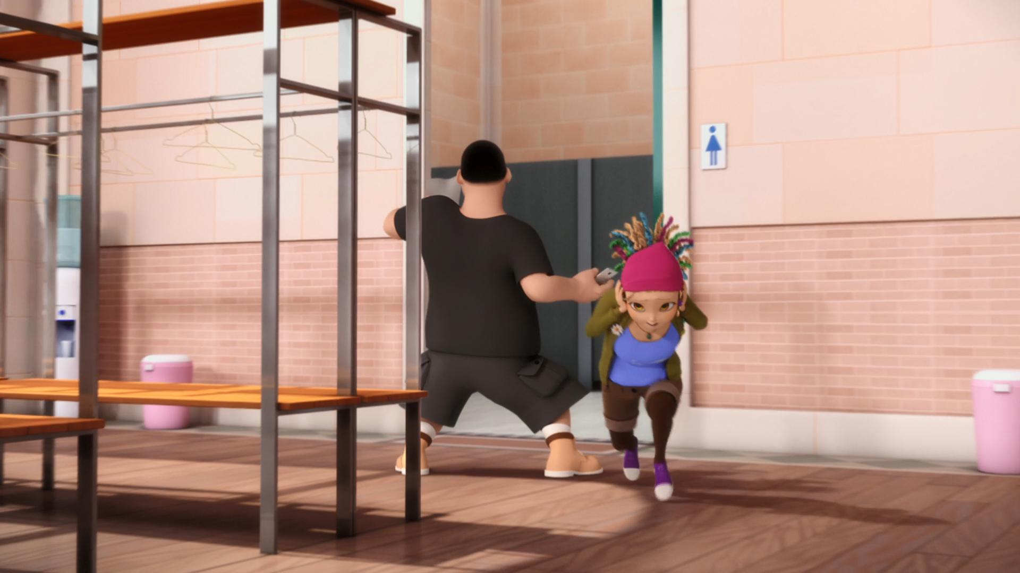
I made this for you. Mylène, be serene, don't be so ______!
fat
mean
sexy

Slide 13
My daddy, the ______, will bring in the police, the army…
mayor
president
king

Slide 14
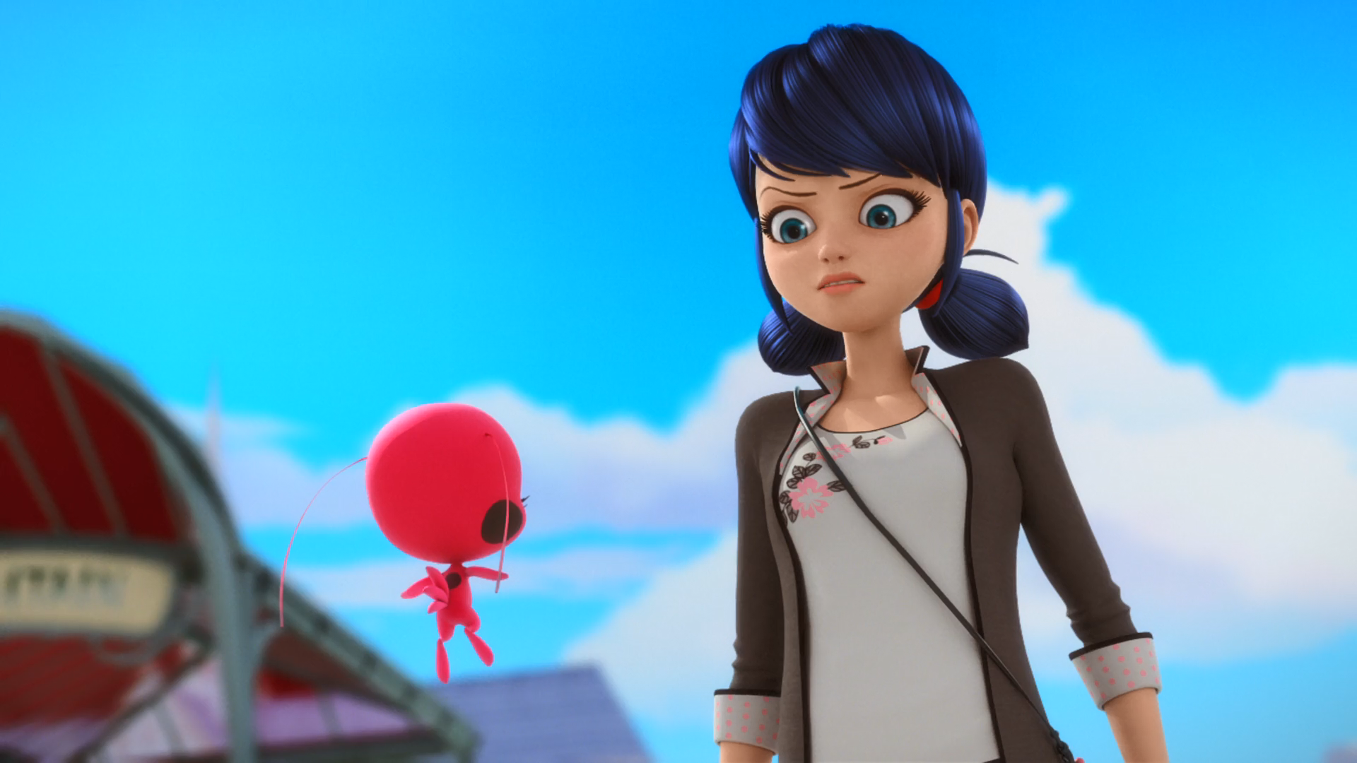
Well, I'm still not sure I'm up for this, but ______ in danger.
Adrien's
Chloe's
Alya's

Slide 15
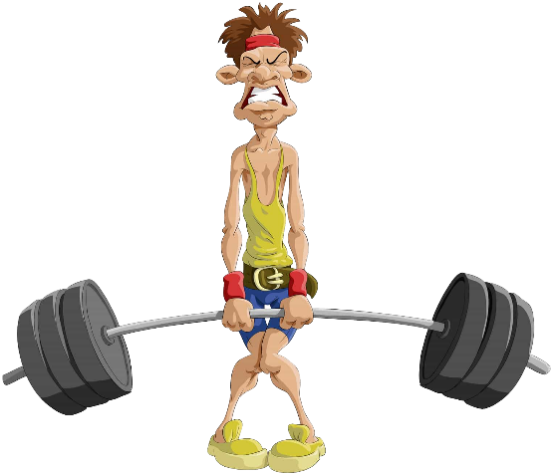


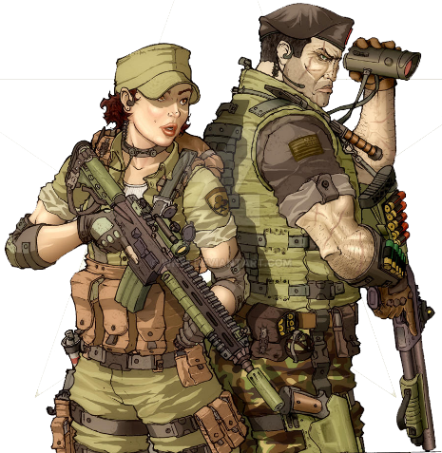
Matching Exercise
army | weak | designer | furious

Slide 16
Matching Exercise
weak | designer | furious | army

Slide 17
TRUE OR FALSE
1. Ivan draws Mylène a picture.
2. Alya wants to be a superhero.
3. Adrien's mother is a fashion designer.
4. Stoneheart kidnaps Mylène and Chloé.
5. Chloé's father is the mayor.

Slide 18
TRUE OR FALSE
1. Ivan draws Mylène a picture. | FALSE
2. Alya wants to be a superhero. | TRUE
3. Adrien's mother is a fashion designer. | FALSE
4. Stoneheart kidnaps Mylène and Chloé. | TRUE
5. Chloé's father is the mayor. | TRUE

