Slide 1
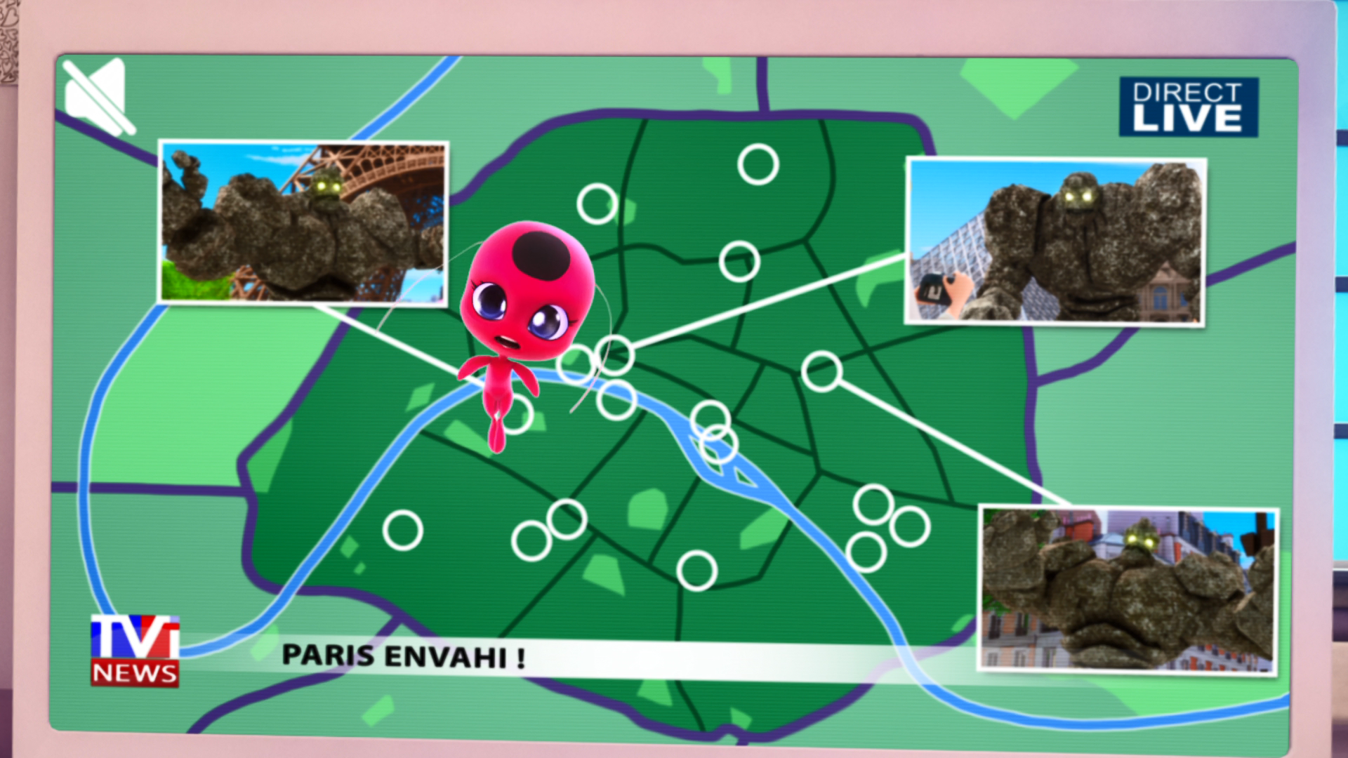
MIRACULOUS LADYBUG: ORIGINS. PART 2

Slide 2
VOCABULARY
apparently - 显然 - əˈpærəntli
awkward - 尴尬的 - ˈɔːkwəd
charm - 魅力 - ʧɑːm
clumsy - 笨拙 - ˈklʌmzi
cruelty - 残酷 - ˈkru(ː)əlti
destruction - 破坏 - dɪsˈtrʌkʃən
possibly - 可能 - ˈpɒsəbli
shameful - 可耻 - ˈʃeɪmfʊl
willing - 愿意的 - ˈwɪlɪŋ

Slide 3
1. ʧɑːm
2. 残酷
3. 可能

Slide 4
1. ʧɑːm - charm
2. 残酷 - cruelty
3. 可能 - possibly

Slide 5
ORIGINS. PART 2
Tikki: Marinette, you are the chosen one!
Marinette: Okay, so all I have to do is break the object where the …
Tikki: It's called an akuma.
Marinette: Got it! Capture it! And what's that charm thing again?
Tikki: The Lucky Charm! It's your secret superpower!

Slide 6
Marinette: Aww... this is all going too fast, Tikki... I... won't be able to pull this off!
Tikki: Trust yourself, Marinette. Just say "Spots on".
Marinette: Spots on? Whoa! What is happening?!
Plagg: Claws out! That's how you transform. Adrien: Got it. Plagg, claws out!

Slide 7
Ladybug: Wait! Haven't you noticed? He gets bigger and stronger with every attack.
We have to do something different.
Cat Noir: Different how?
Ladybug: Uhhh... I don't know.
Cat Noir: Okay then. Let's use our powers. Cataclysm! Apparently I destroy whatever
I touch.

Slide 8
Cat Noir: This girl is awesome. She's crazy awesome.
Ivan: What's going on? What am I doing here?
Cat Noir: You were incredible, miss... uh... Ladybug: We both did it, partner.
Ladybug & Cat Noir: Pound it!

Slide 9
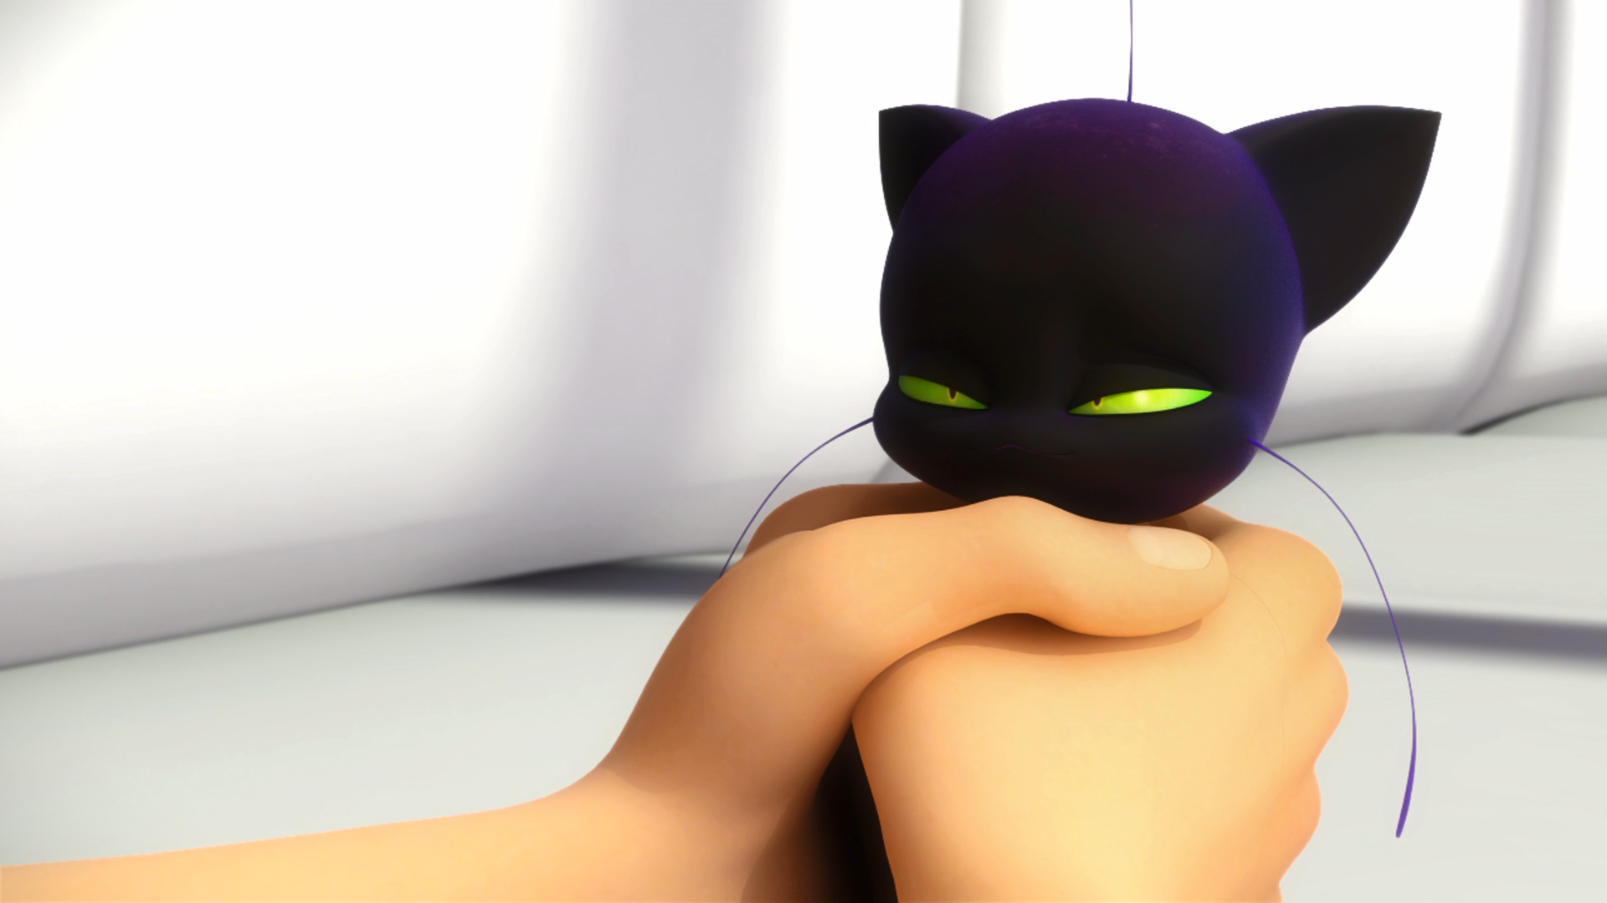
Now, you got anything to eat? I'm ______.
hungry
thirsty
starving

Slide 10
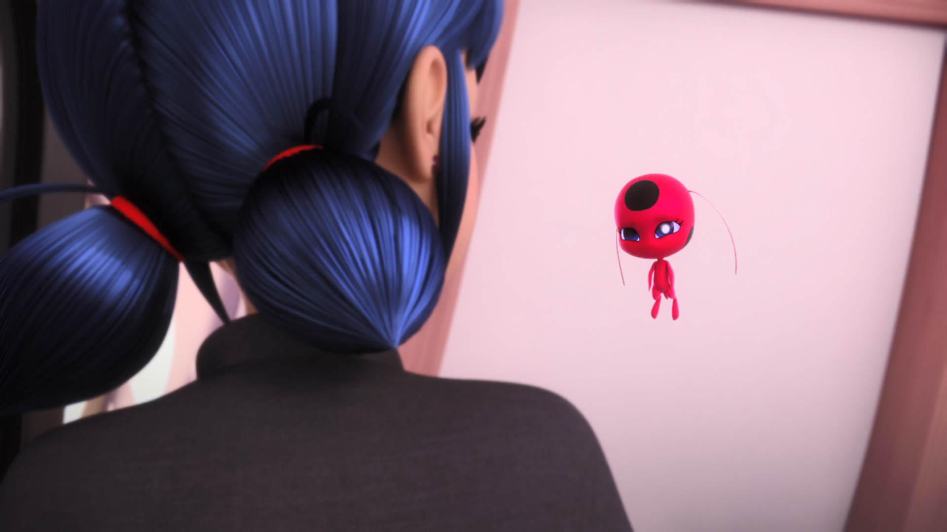
The Lucky ______! It's your secret superpower!
charm
earing
pants

Slide 11
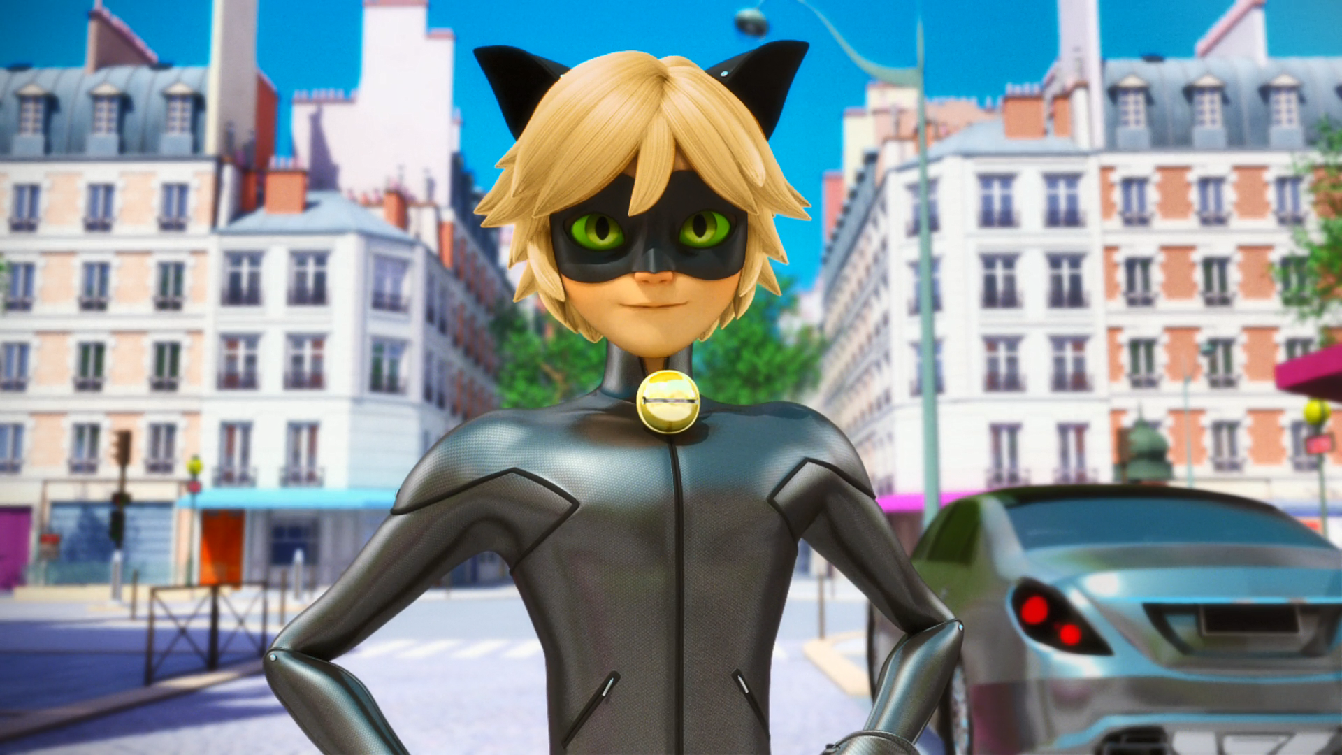
I bet you're the partner my ______ told me about.
grandma
Kwami
doctor

Slide 12
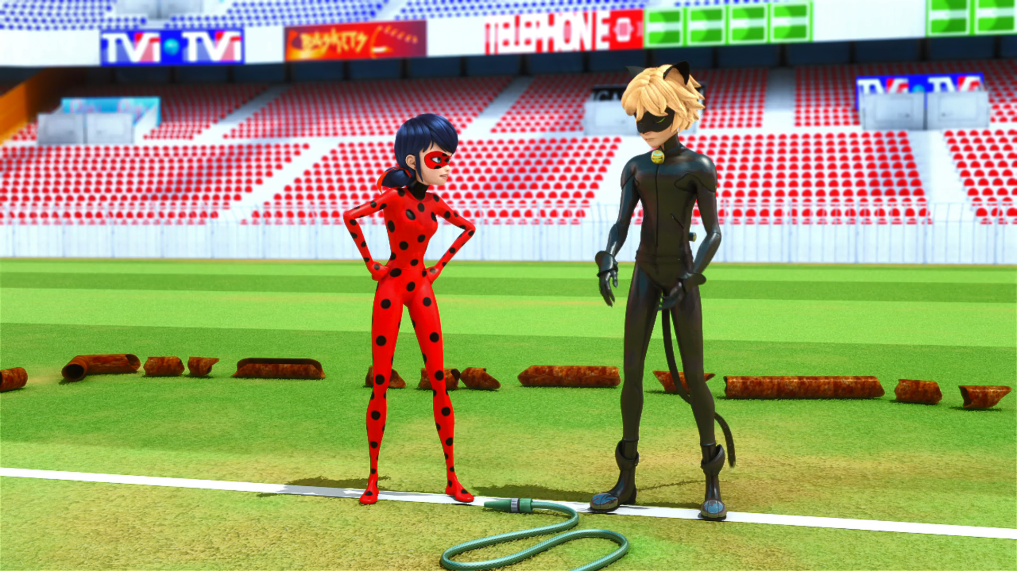
And you only have ______ minutes before you transform back.
three
five
seven

Slide 13
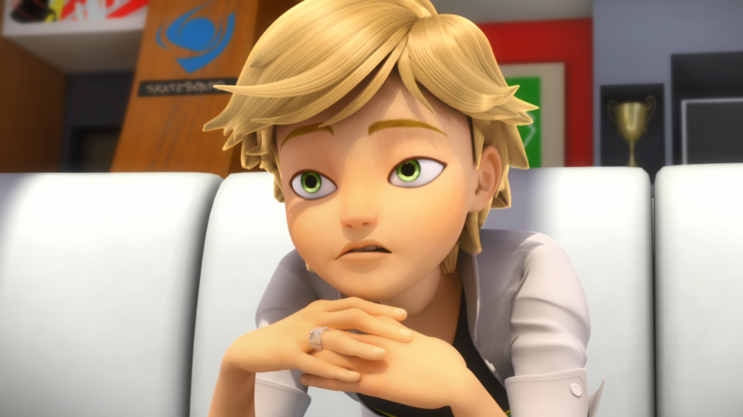
I'm gonna smell like stinky old ______.
cheese
onions
socks

Slide 14
An ______ can multiply, that's why it must be captured.
student
rabbit
akuma

Slide 15
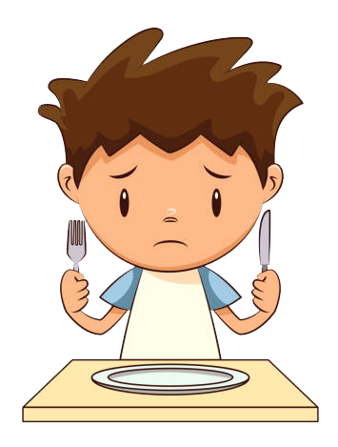



Matching Exercise
capture | secret | starving | explain

Slide 16
Matching Exercise
starving | capture | explain | secret

Slide 17
TRUE OR FALSE
1. Marinette is the chosen one.
2. Stoneheart gets bigger and stronger every time he is attacked.
3. Stoneheart's akuma is in his head.
4. Kim is Stoneheart.
5. Akuma's can multiply.

Slide 18
TRUE OR FALSE
1. Marinette is the chosen one. | TRUE
2. Stoneheart gets bigger and stronger every time he is attacked. | TRUE
3. Stoneheart's akuma is in his head. | FALSE
4. Kim is Stoneheart. | FALSE
5. Akuma's can multiply. | TRUE

