Slide 1
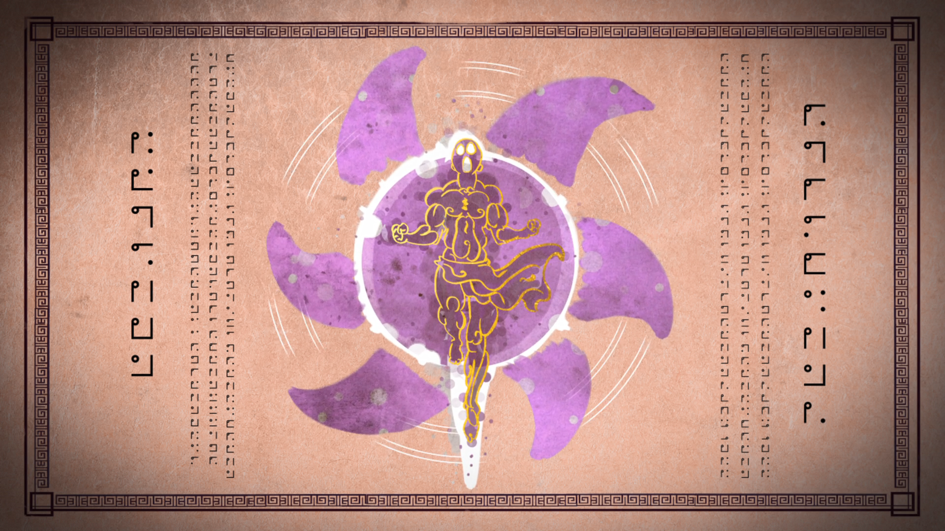
MIRACULOUS LADYBUG: ORIGINS. PART 1

Slide 2
VOCABULARY
brooch - 胸针 - brəʊʧ
centuries - 世纪 - sɛnʧʊriz
created - 创建 - kri(ː)ˈeɪtɪd
devoted - 敬业的 - dɪˈvəʊtɪd
extraordinary - 非凡的 - ɪksˈtrɔːdnri
legend - 传奇 - lɛʤənd
luring - 引诱 - ljʊərɪŋ
negative - 消极的 - nɛgətɪv
obey - 遵守 - əˈbeɪ

Slide 3
1. ɪksˈtrɔːdnri
2. 传奇
3. 遵守

Slide 4
1. ɪksˈtrɔːdnri - extraordinary
2. 传奇 - legend
3. 遵守 - obey

Slide 5
ORIGINS. PART 1
Sabine: You're going to be late for your first day back at school!
Marinette: Got it, Mom! Coming! I bet you anything Chloé will be in my class again.
Sabine: Four years in a row, is that possible?
Marinette: Definitely. Lucky me!
Wang Fu: Mmmh. Delicious! Thank you very much, young lady.

Slide 6
Chloé: So why don't you just go and sit beside that new girl over there?
Alya: Hey! Who elected you Queen of Seats?
Chloé: What are you gonna do, super newbie? Shoot beams at me with your glasses?
Alya: Wouldn't you like to know. Come on.

Slide 7
Adrien: No way... Like the genie in the lamp!
Plagg: I met him once. So he grants wishes. Big deal! I'm way more personable! Plagg. Nice to meet you.
Adrien: No! Don't touch that! Come back here!
Tikki: Listen, Marinette. I know everything may seem a bit strange to you...

Slide 8
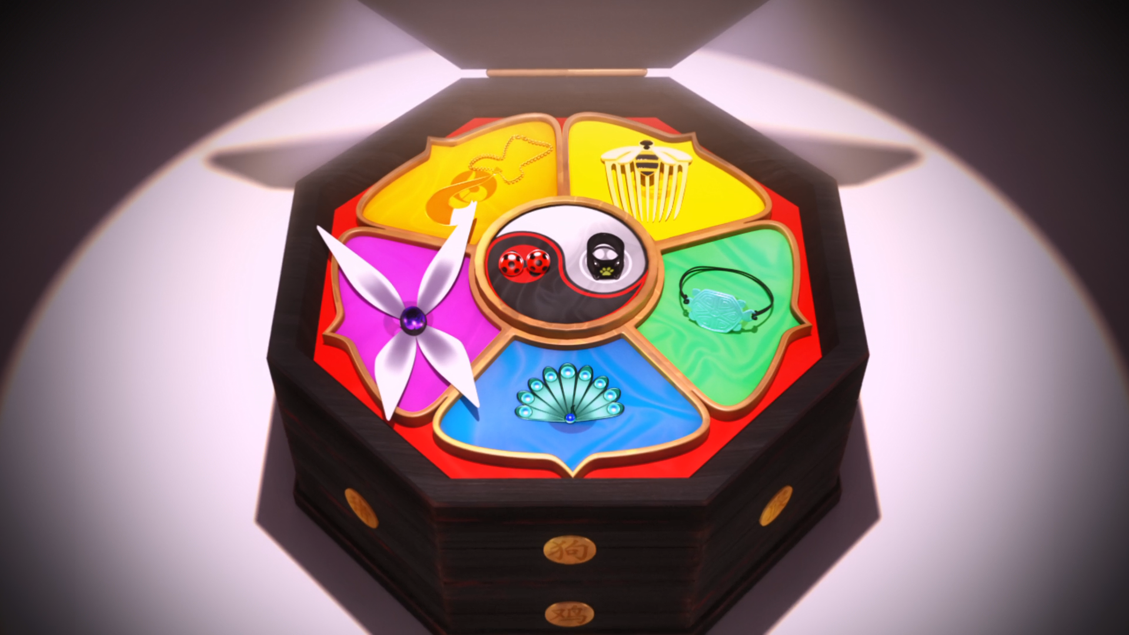
Magic jewels bestowing extraordinary powers, the ______.
Pokémon
Avengers
Miraculous

Slide 9
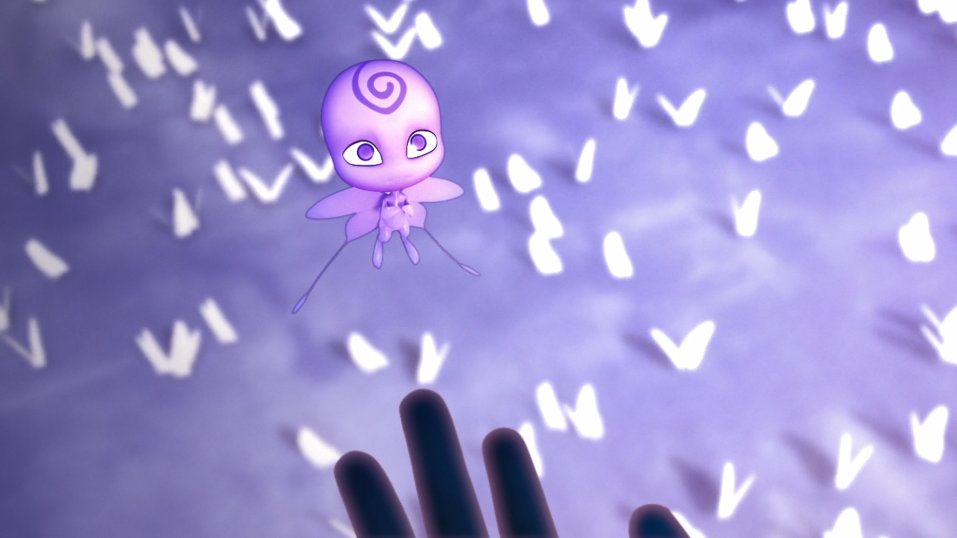
But master, the Miraculous are not meant to be used for ______.
evil
mischief
greed

Slide 10
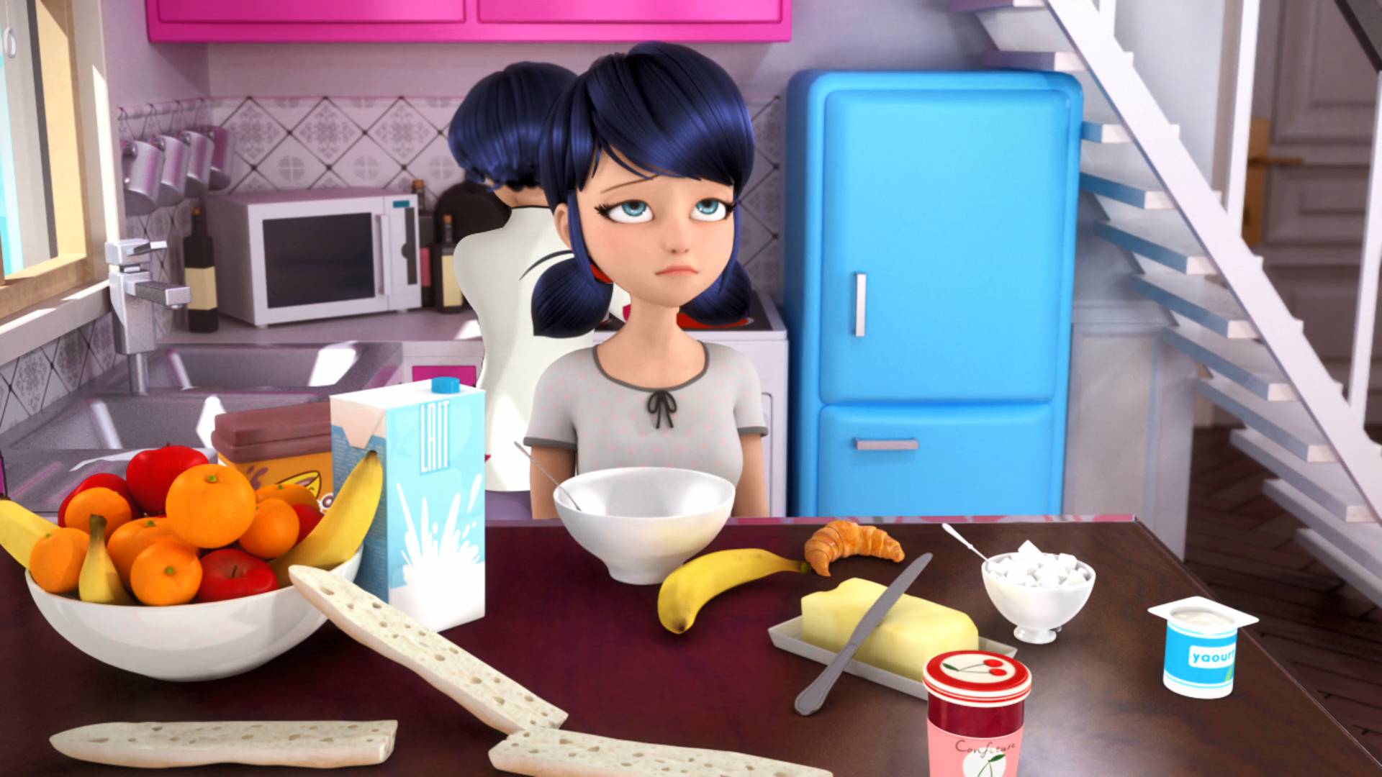
I bet you anything ______ will be in my class again.
Mehdi
Chloé
Trump

Slide 11
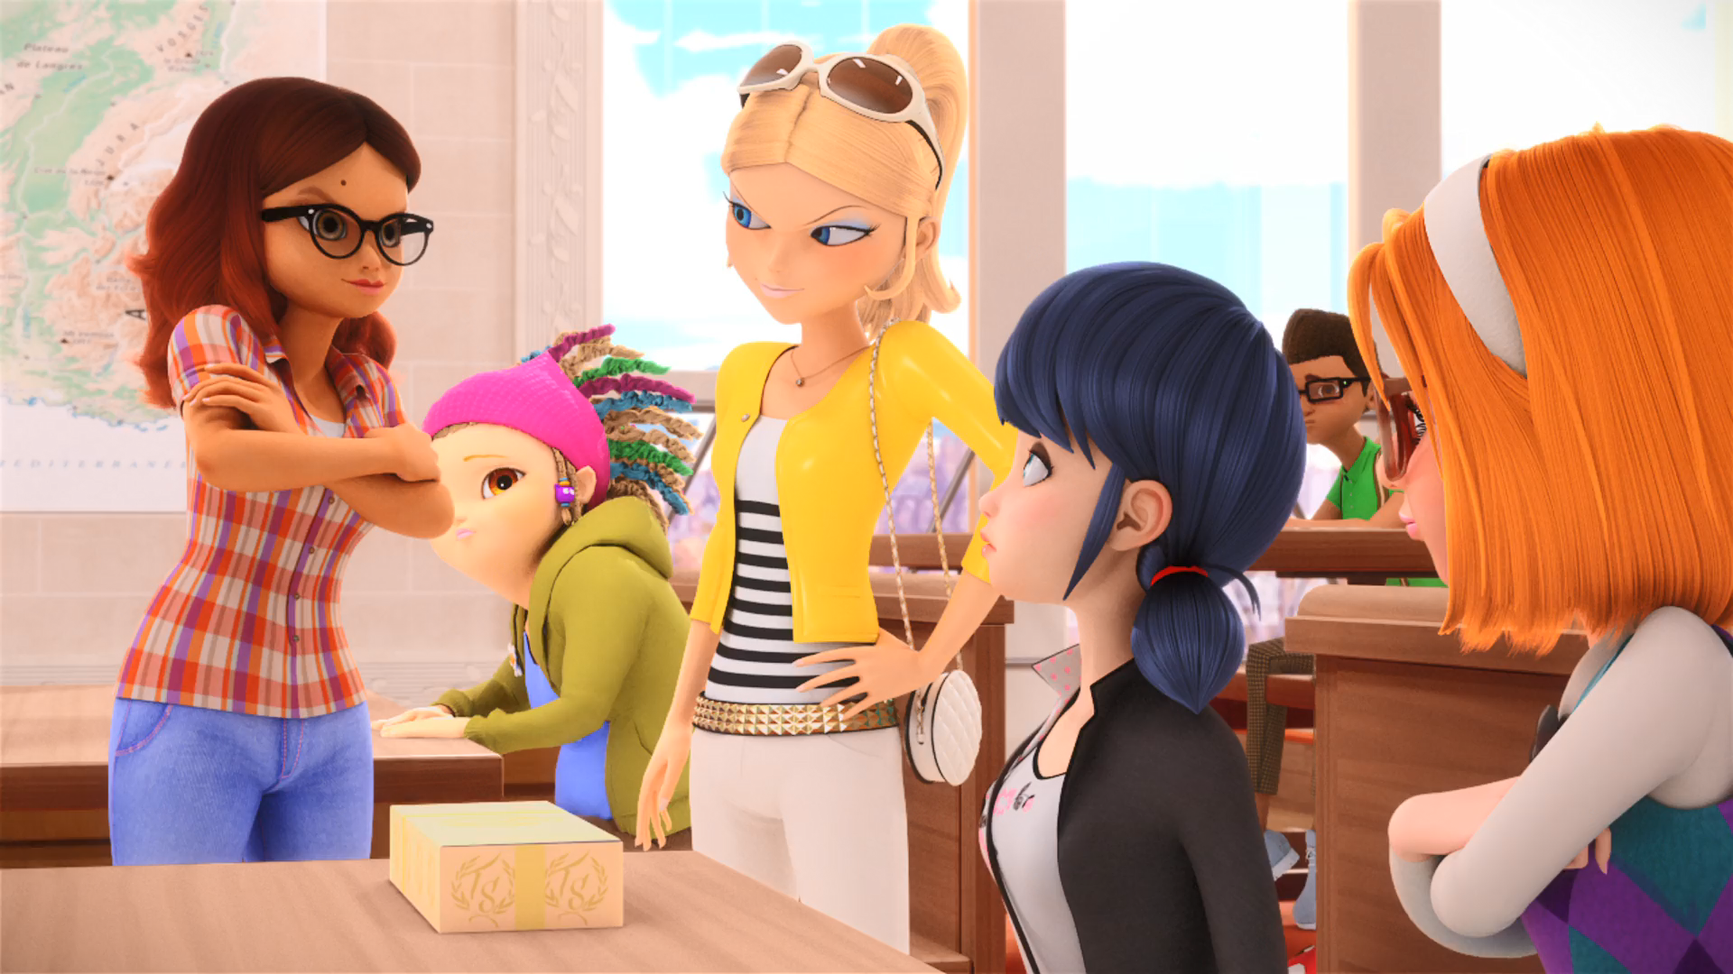
Hey! Who elected you ______ of Seats?
King
Queen
Boss

Slide 12
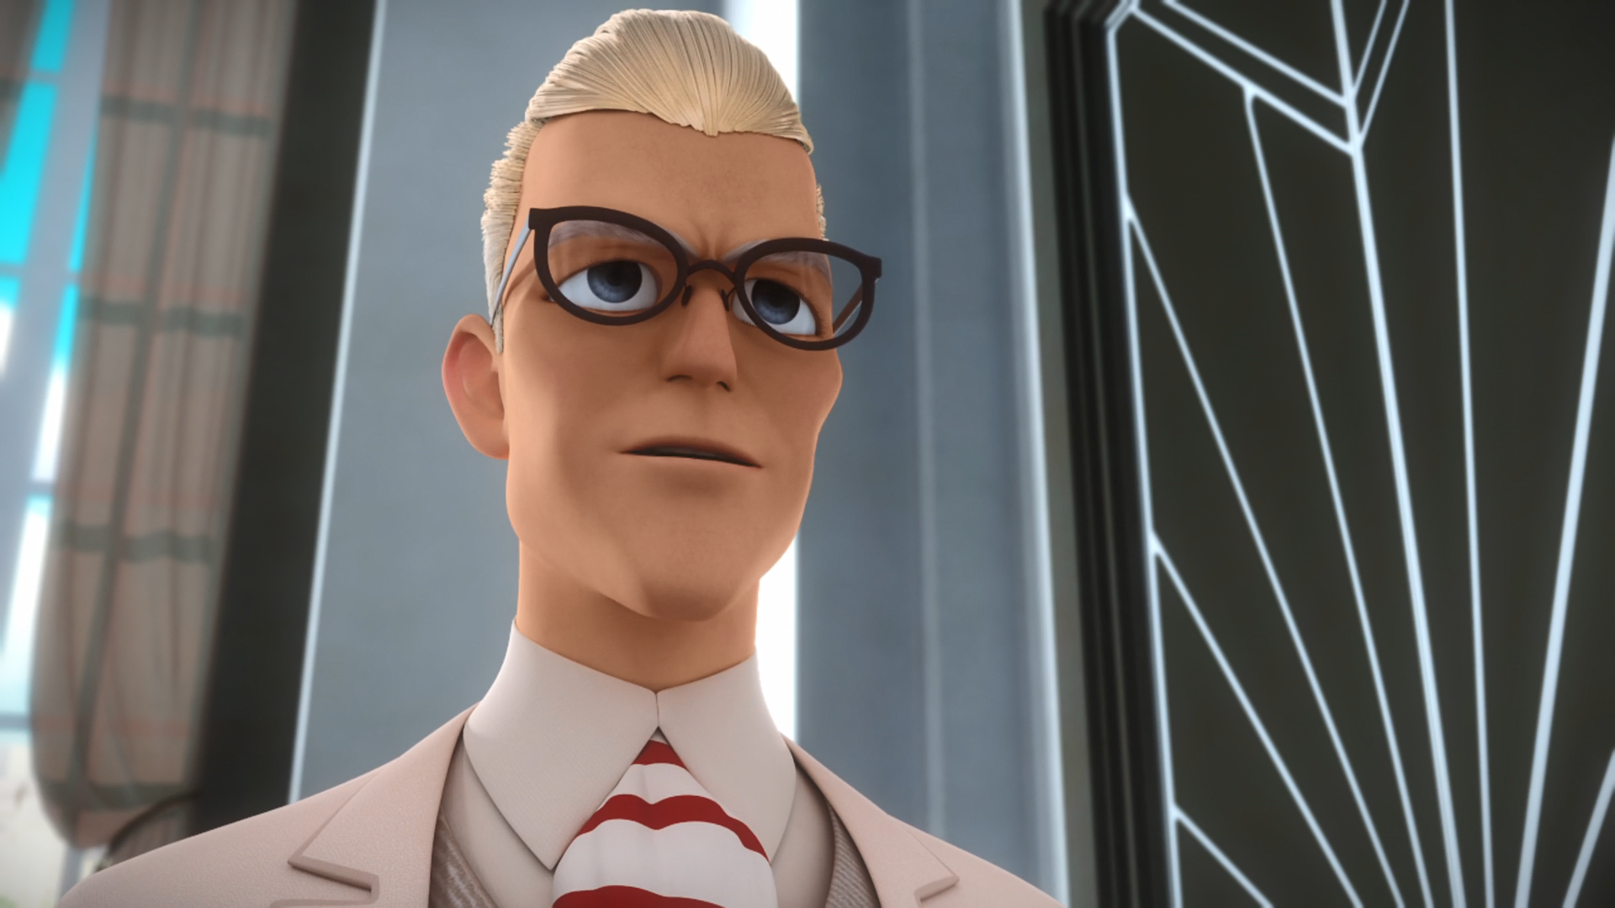
You are NOT going to ______.
I already told you.
KFC
the toilet
Dalian

Slide 13
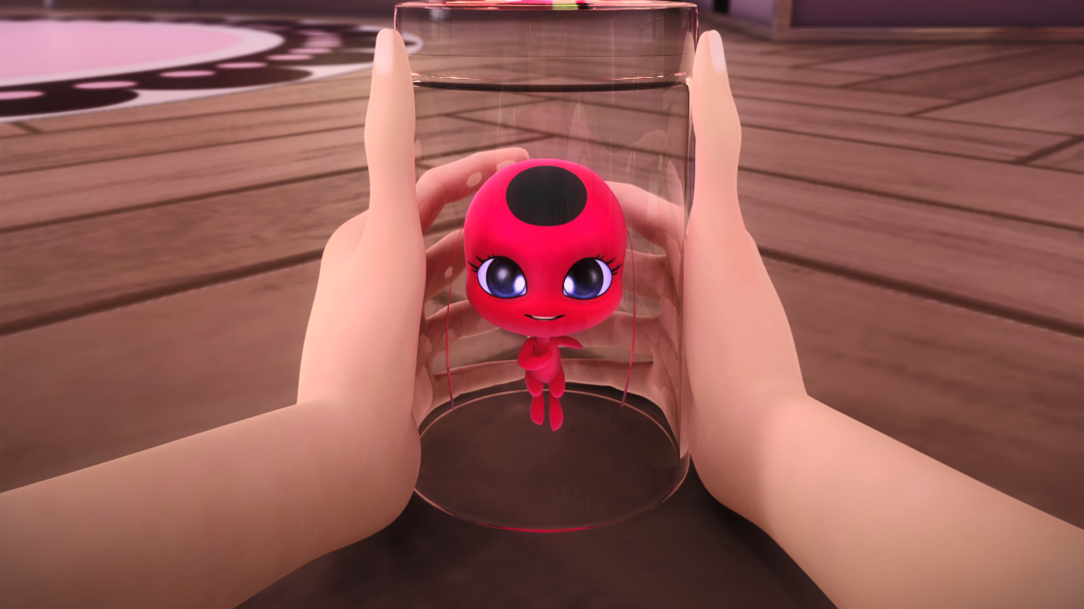
I am a kwami, and my name is ______.
TikTok
Douyin
Tikki

Slide 14
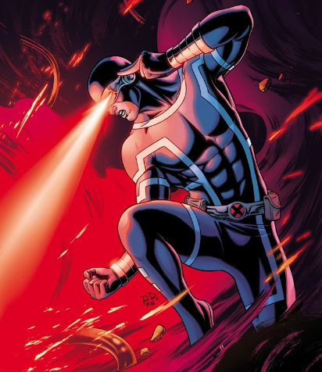



Matching Exercise
alarm | seat | laser beams | elected

Slide 15
Matching Exercise
laser beams | alarm | elected | seat

Slide 16
TRUE OR FALSE
1. The ring of the Black Cat grants the power of destruction.
2. Wang Fu is 296.
3. Chloé has been in Marinette's class for 14 years.
4. Alya is a newbie.
5. Tikki and Plagg are Kwamis.

Slide 17
TRUE OR FALSE
1. The ring of the Black Cat grants the power of destruction. | TRUE
2. Wang Fu is 296. | FALSE
3. Chloé has been in Marinette's class for 14 years. | FALSE
4. Alya is a newbie. | TRUE
5. Tikki and Plagg are Kwamis. | TRUE

