Slide 1
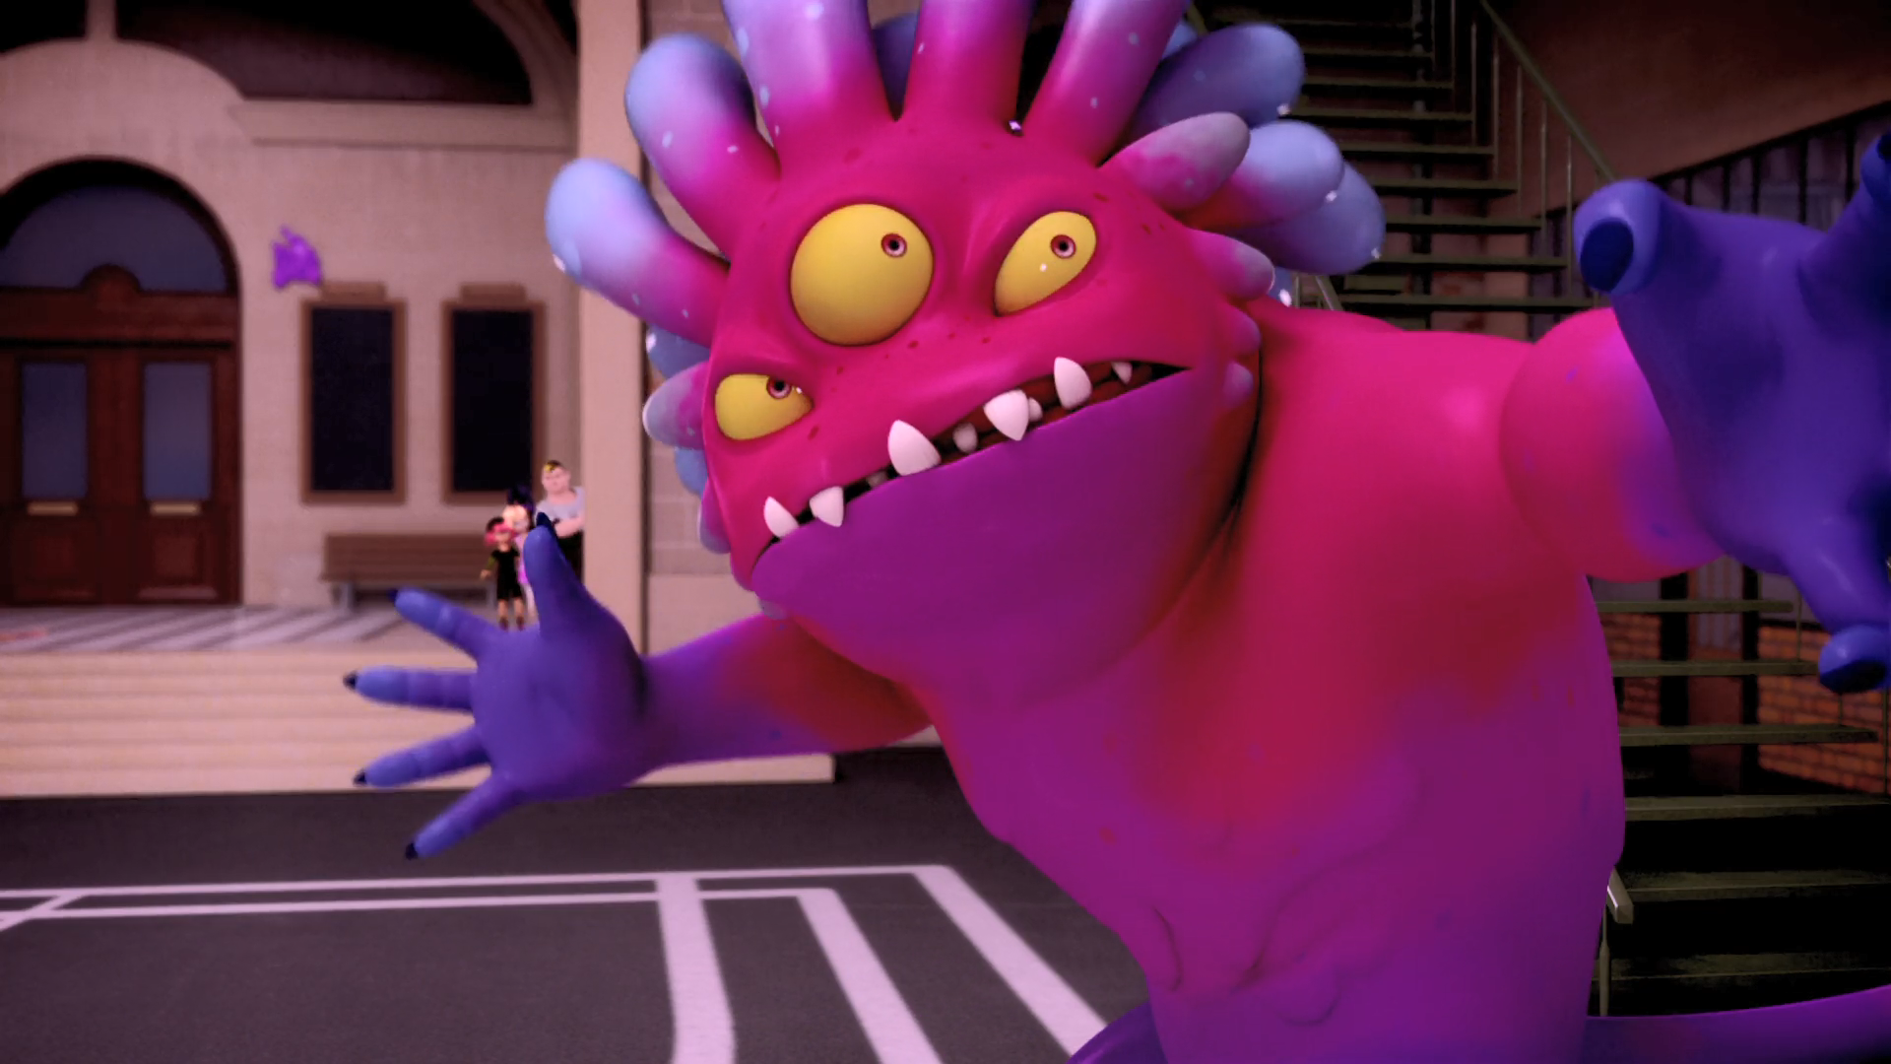
MIRACULOUS LADYBUG: HORRIFICATOR. PART 2

Slide 2
VOCABULARY
barricade - 路障 - bærɪˈkeɪd
control - 控制 - kənˈtrəʊl
director - 导向器 - dɪˈrɛktə
fear - 恐惧 - fɪə
horrible - 可怕 - hɒrəbl
legit - 合法的 - lɪˈʤɪt
mystery - 神秘 - mɪstəri
quite - 相当 - kwaɪt
strength - 力量 - strɛŋθ

Slide 3
1. 恐惧
2. lɪˈʤɪt
3. 力量

Slide 4
1. 恐惧 - fear
2. lɪˈʤɪt - legit
3. 力量 - strength

Slide 5
HORRIFICATOR. PART 2
Alya: Mr. Damocles? Sir?
Rose: Even Principal Damocles is nowhere to be found!
Chloé: We're trapped! I'm going to call Daddy!
Nino: Dudes, you know cellphones never work in horror movies.

Slide 6
Ladybug: The more scared people are of it, the more powerful it gets! By defeating fear, we defeat it!
Cat Noir: Okay, but first we gotta get out of this sticky situation quickly before it dries.
Ladybug: Did you see how it just left Ivan alone?
Cat Noir: Yeah, what's that all about?

Slide 7
Cat Noir: We're too late!
Ladybug: But look! We can track the monster. Chloé: Ladybug, it's me, Chloé!
Ladybug: Don't worry! We'll get you out of there!
Chloé: Well, hurry it up already!
Ladybug: Just try and calm down, we'll find a way to get you out of there!

Slide 8
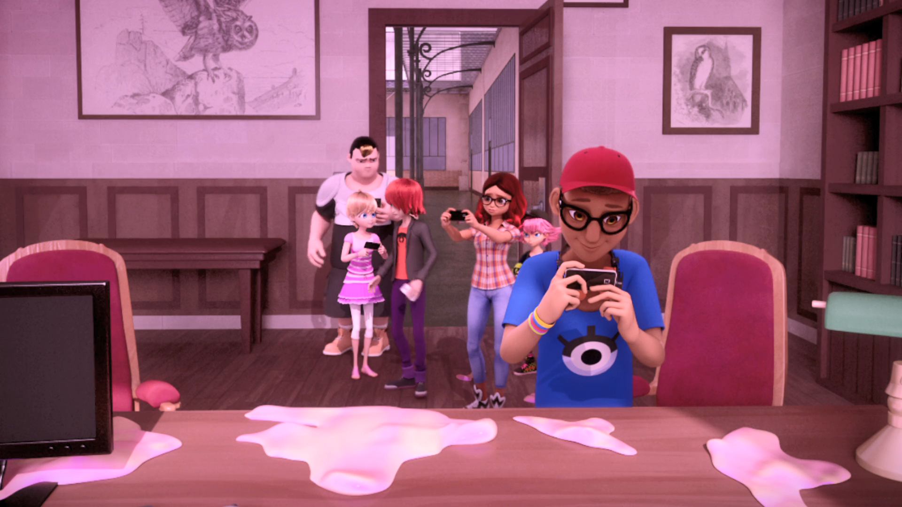
Dudes, you know ______ never work in horror movies.
computers
students
cellphones

Slide 9
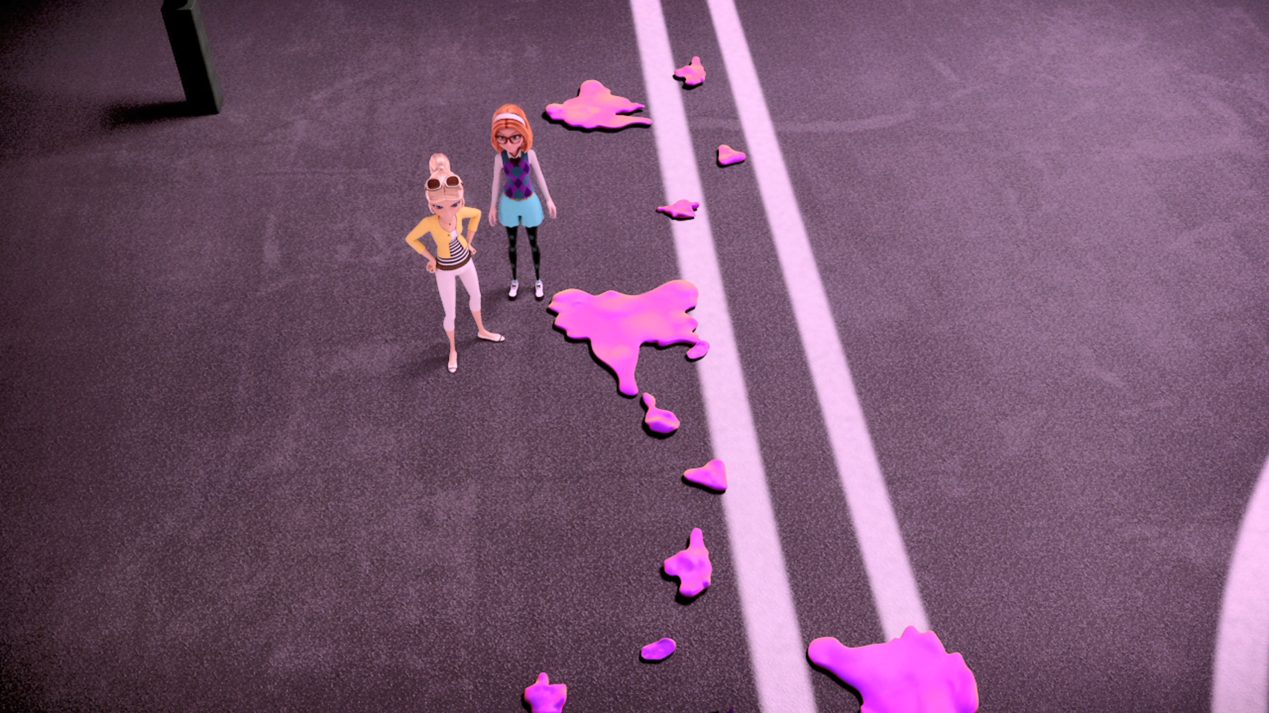
We could just ______ out on our own!
hide
eat
study

Slide 10
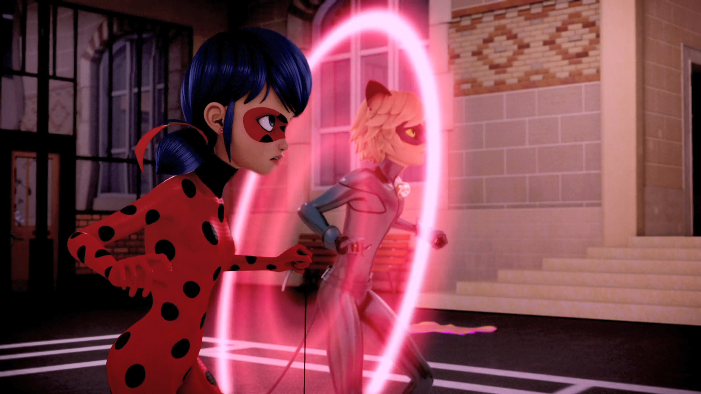
______! It's ______ that gives it its strength!
Love
Fear
Hate

Slide 11
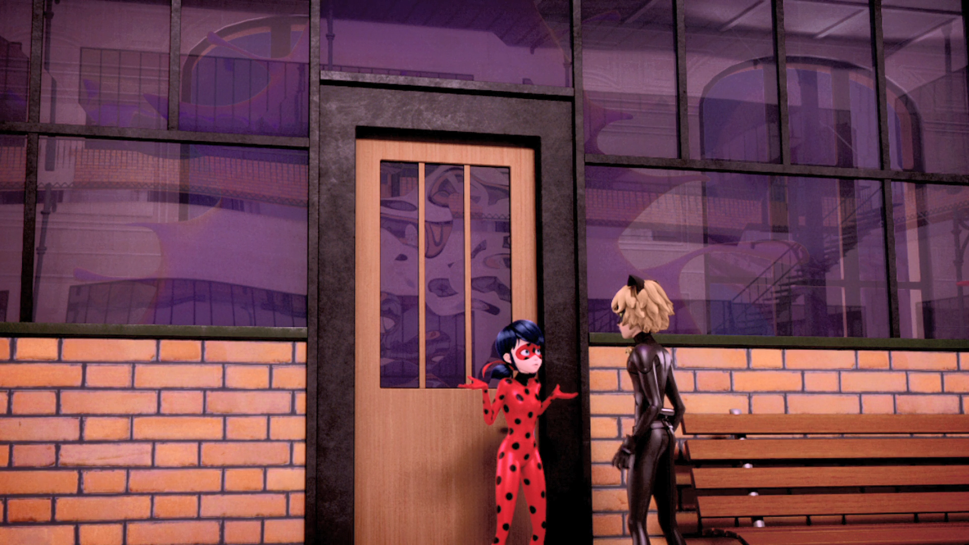
Did you see how it just left ______ alone?
Chloé
Ivan
Max

Slide 12
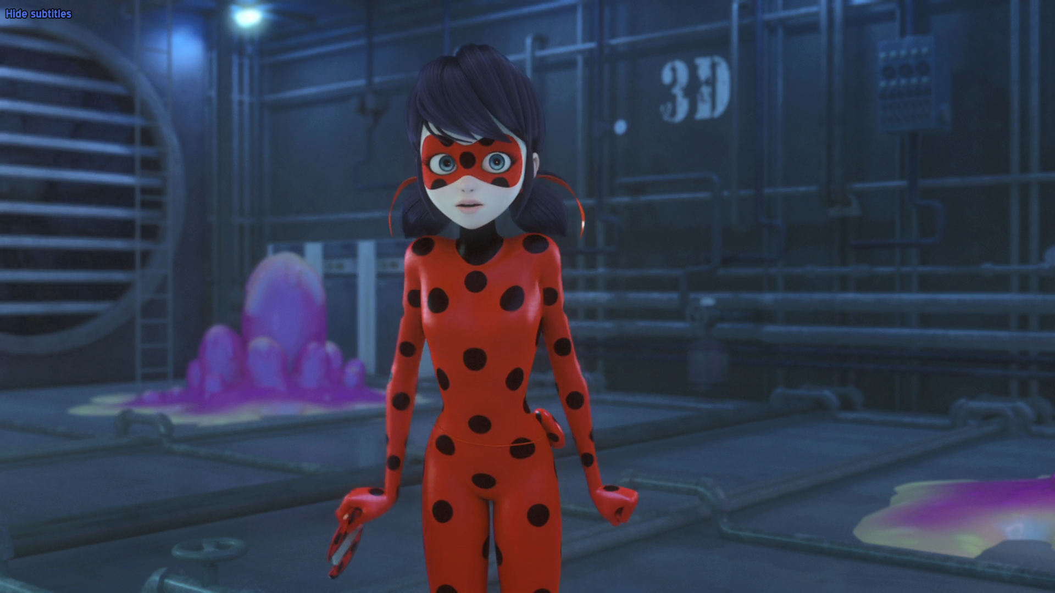
Guitar, music... Mylène's ______!
song
music
tune

Slide 13
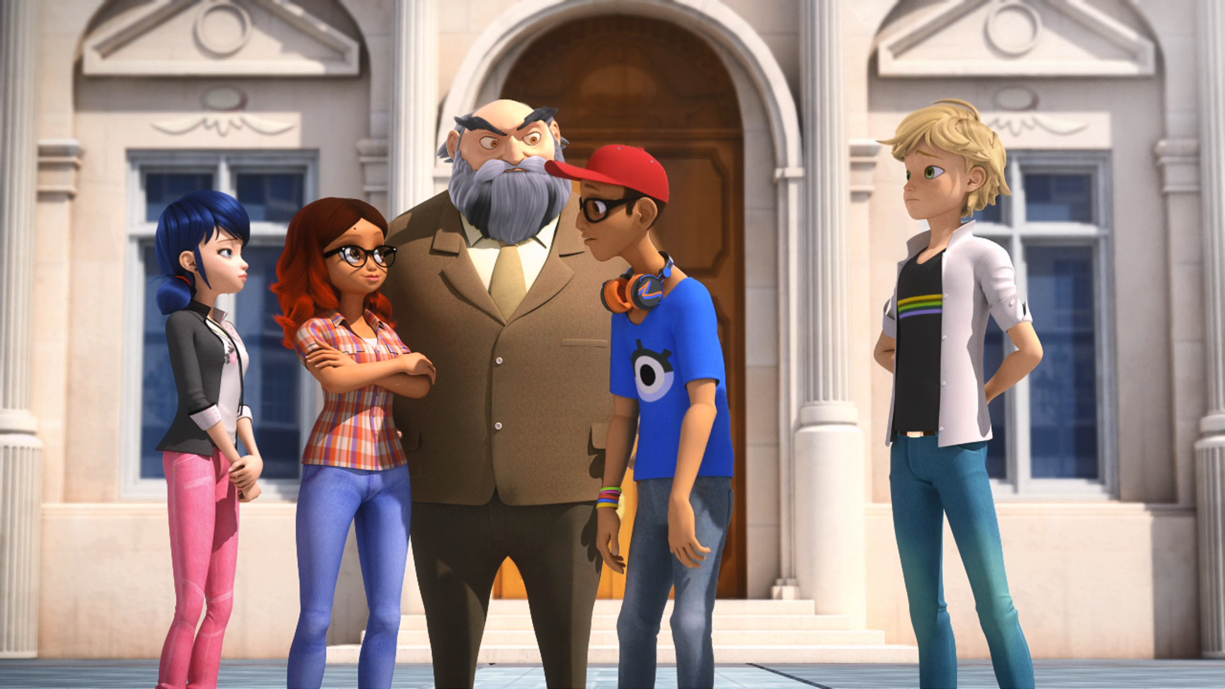
We didn't make the cut! He said the ______ was a horrible replica.
demon
beast
monster

Slide 14
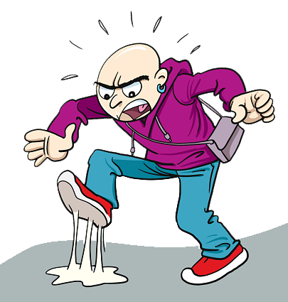

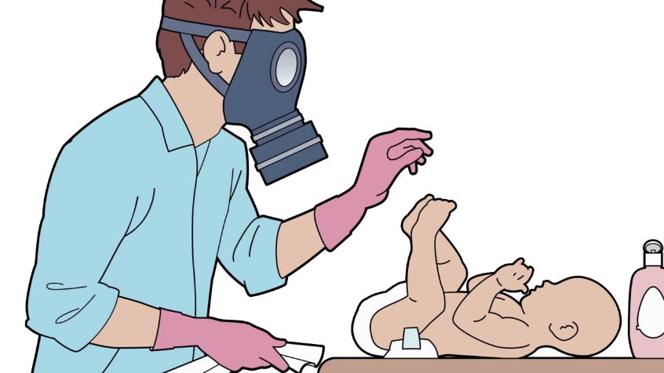

Matching Exercise
guitar | smelly | replica | sticking

Slide 15
Matching Exercise
sticking | replica | smelly | guitar

Slide 16
TRUE OR FALSE
1. Cellphones never work in horror movies.
2. Nino is making a movie.
3. Fear makes the monster weak.
4. The students sing smelly cat.
5. The mayor loves the movie.

Slide 17
TRUE OR FALSE
1. Cellphones never work in horror movies. | TRUE
2. Nino is making a movie. | TRUE
3. Fear makes the monster weak. | FALSE
4. The students sing smelly cat. | FALSE
5. The mayor loves the movie. | FALSE

