Slide 1
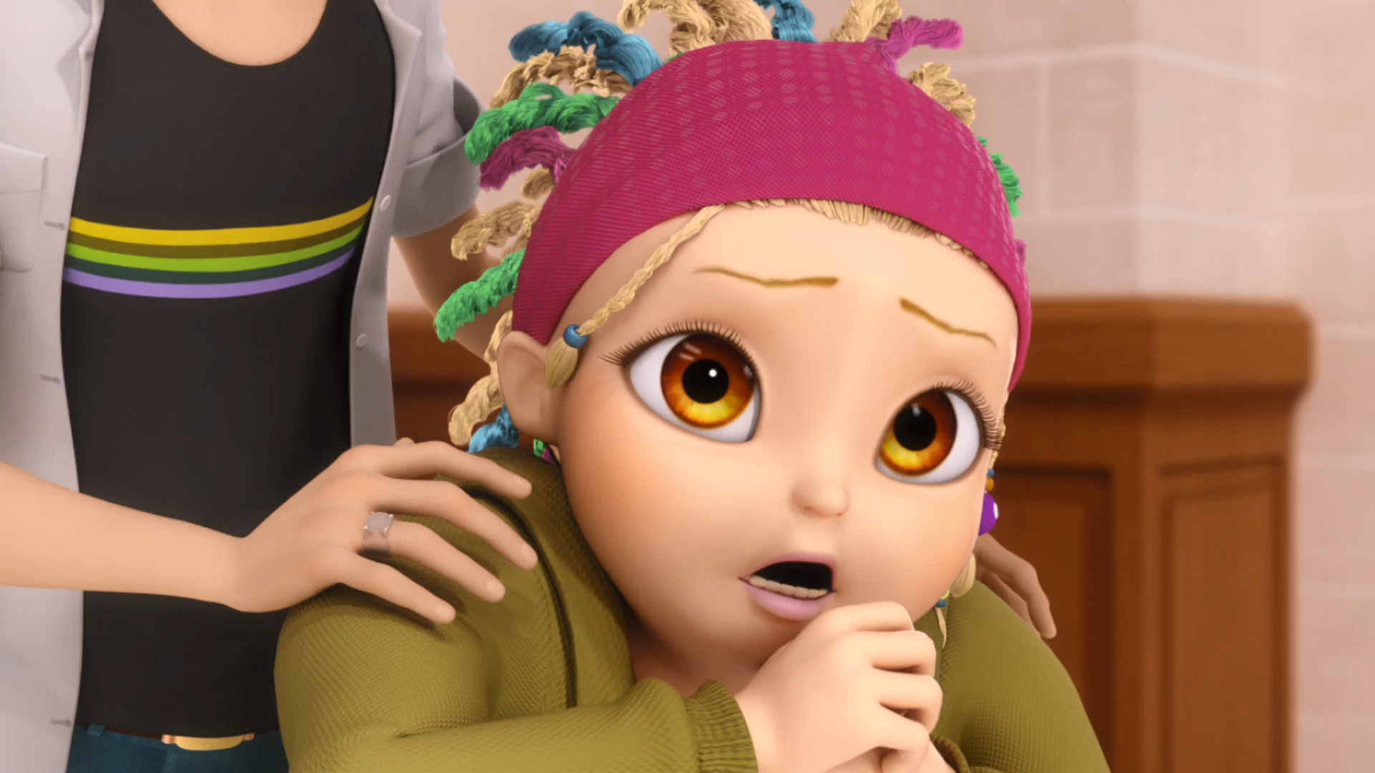
MIRACULOUS LADYBUG: HORRIFICATOR. PART 1

Slide 2
VOCABULARY
actress - 演员 - æktrɪs
breath - 呼吸 - brɛθ
devour - 吞食 - dɪˈvaʊə
judge - 法官 - ʤʌʤ
leading - 领导 - liːdɪŋ
producer - 制片人 - prəˈdjuːsə
pucker - 起皱 - pʌkə
realistic - 实际的 - rɪəˈlɪstɪk
tweak - 调整 - twiːk

Slide 3
1. 演员
2. pʌkə
3. 实际的

Slide 4
1. 演员 - actress
2. pʌkə - pucker
3. 实际的 - realistic

Slide 5
HORRIFICATOR. PART 1
Nino: Mylène! That's like, the tenth take, and we're only on the first scene!
Mylène: I'm... sorry. I'm gonna do better on the next take, I promise.
Rose: Anyone want some tea?
Nino: You're playing a hero from the special forces. You're not supposed to get all freaked out!

Slide 6
Mylène: I know, but... that monster mask he's wearing is so... realistic and scary!
Ivan: Just big old me, Mylène. Nothing to be scared of!
Chloé: You ask me, he doesn't even need a mask!
Nino: Ivan, put the mask back on, you're playing the monster!

Slide 7
Nino: Uh... I wrote it.
Alya: What! You edited my script without even telling me? That's low!
Chloé: Oh, who cares who wrote what? We've got to film this thing, right?
Marinette: Adrien and Chloé kissing cannot happen! No way!

Slide 8
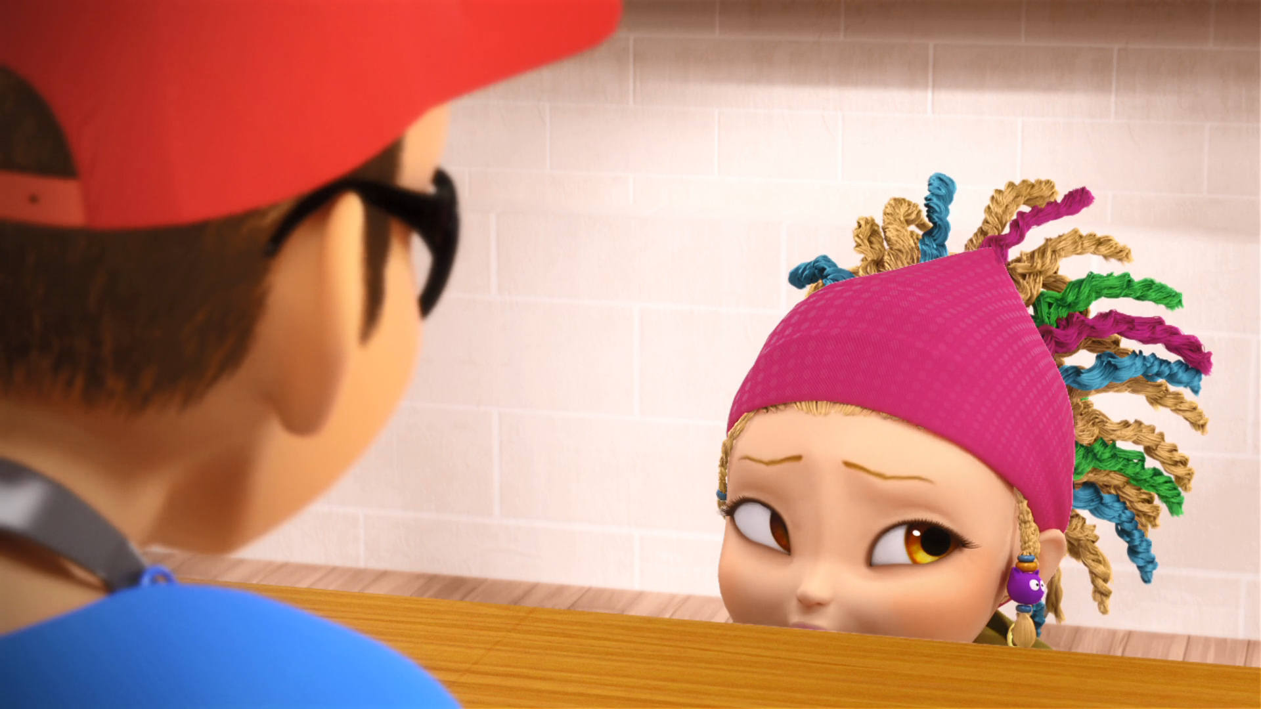
I know, but that ______ mask he's wearing is so realistic and scary!
gimp
Shrek
monster

Slide 9
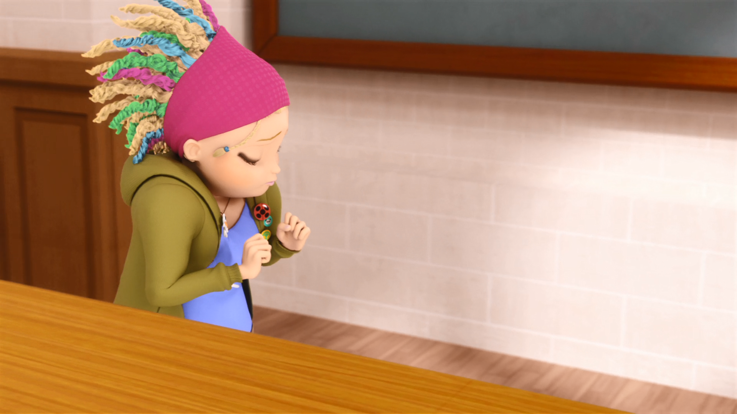
Smelly ______, smelly ______, stinky breath and slimy.
wolf
pig
tramp

Slide 10
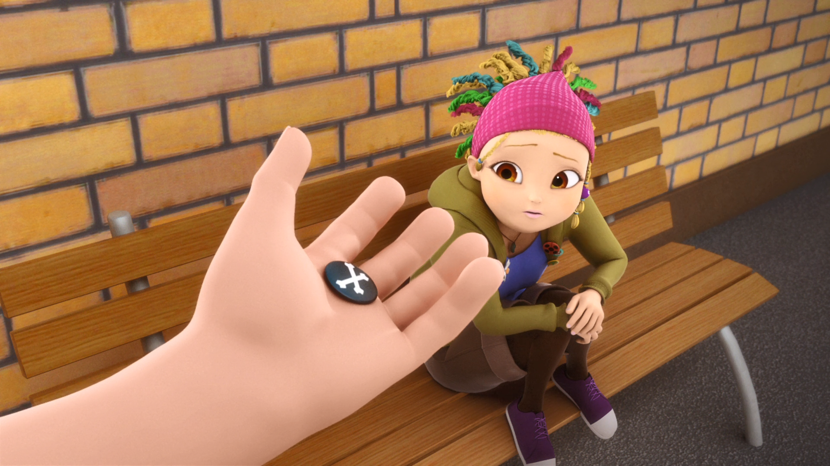
Here. It's from my favourite band, the Zombie Skull ______.
Punchers
Crushers
Lovers

Slide 11
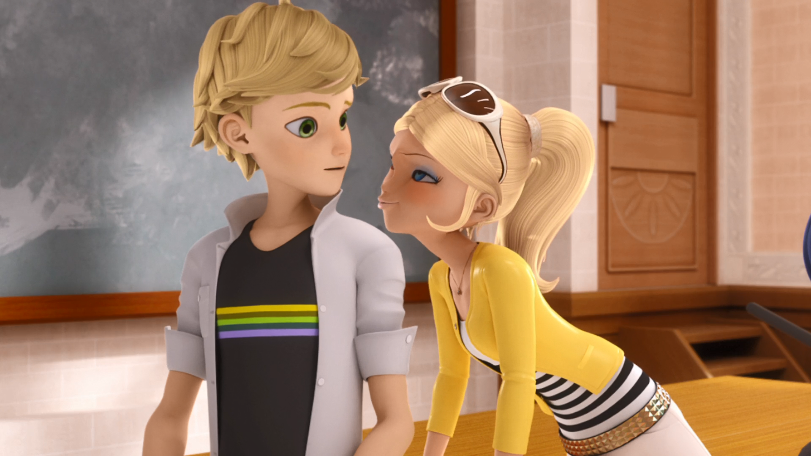
It ends with a kiss between Agent Smith and Officer ______!
Lily
Jones
Frank

Slide 12
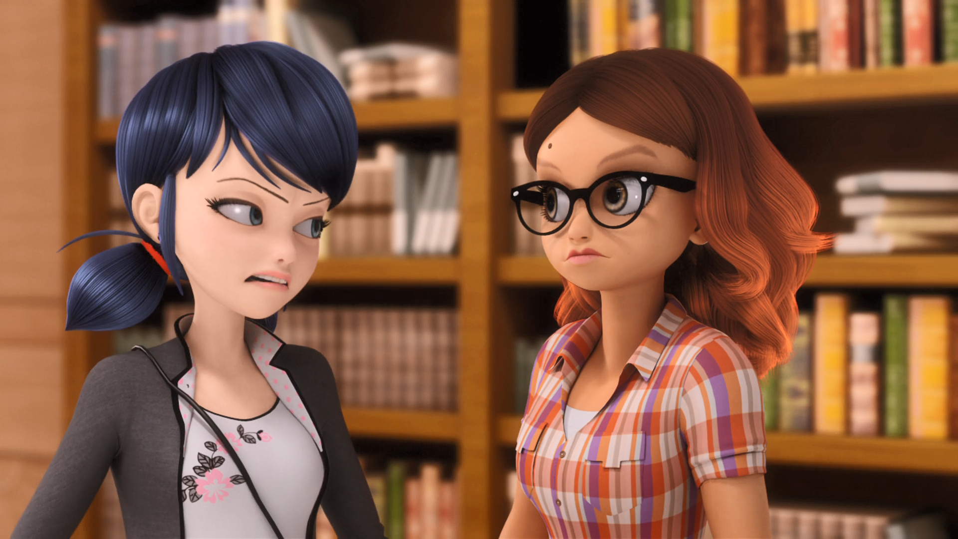
______ and Chloé kissing cannot happen!
Adrien
Alya
Andy

Slide 13
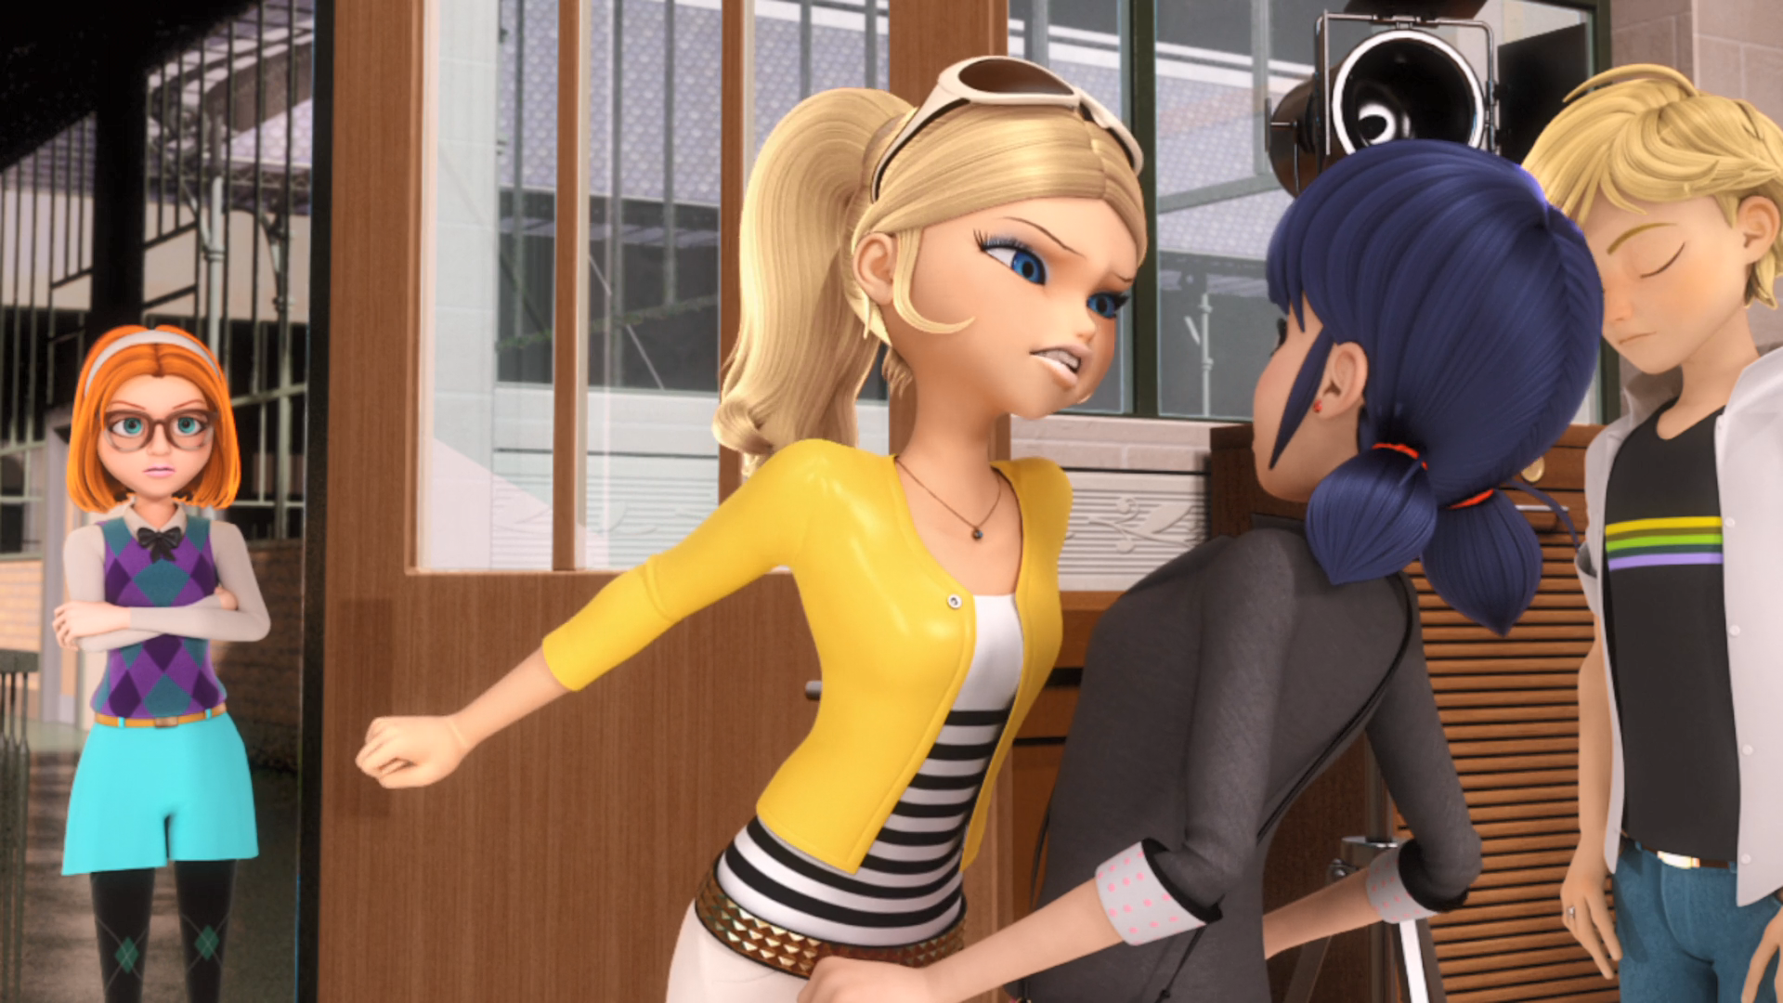
Well, your stupid little ______ won't make it into the festival if I'm not in it.
film
show
movie

Slide 14

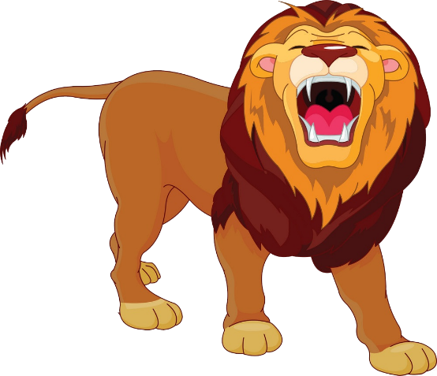

Matching Exercise
pucker | roar | actress | producer

Slide 15
Matching Exercise
producer | pucker | roar | actress

Slide 16
TRUE OR FALSE
1. The students are filming the first scene.
2. Mylene's favourite band are the Zombie Skull Crushers.
3. The first scene ends with Agent Smith and Officer Jones kissing.
4. Chloé wants to be a nurse.
5. Alya wants to kiss Marinette.

Slide 17
TRUE OR FALSE
1. The students are filming the first scene. | TRUE
2. Mylene's favourite band are the Zombie Skull Crushers. | FALSE
3. The first scene ends with Agent Smith and Officer Jones kissing. | TRUE
4. Chloé wants to be a nurse. | TRUE
5. Alya wants to kiss Marinette. | FALSE

