Slide 1
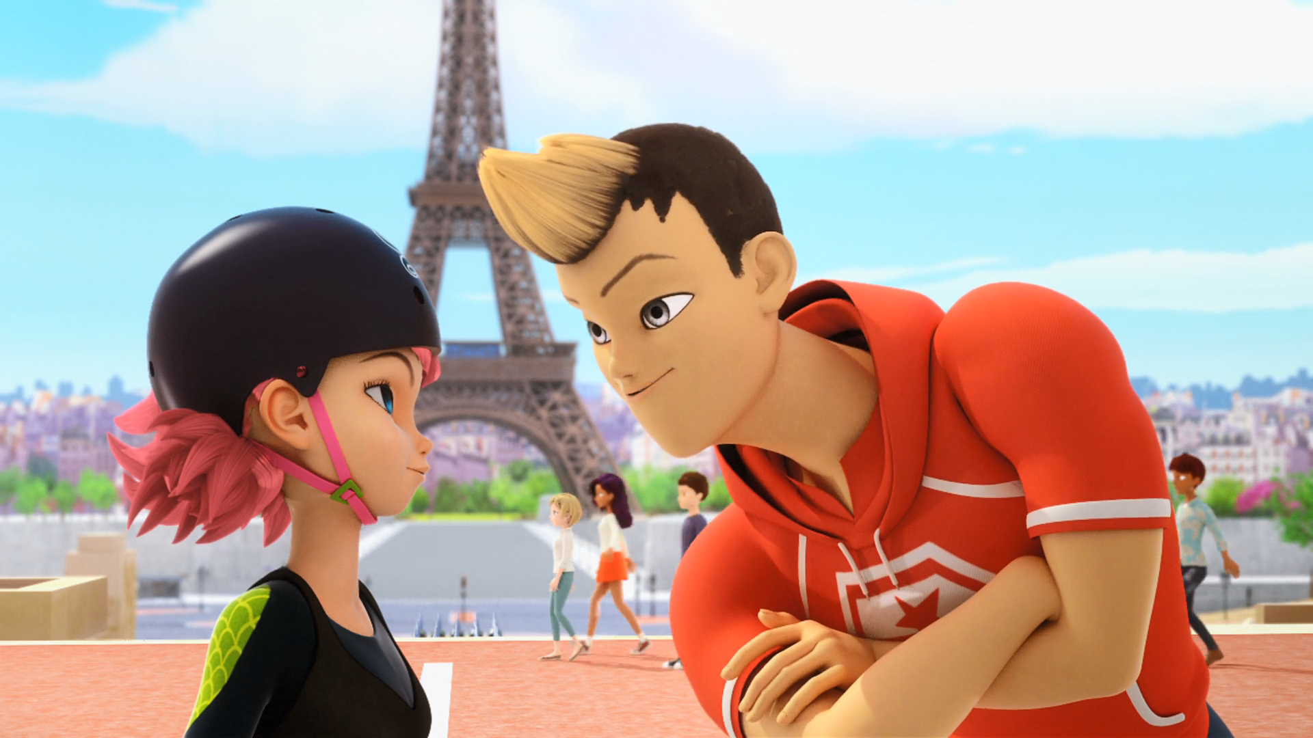
MIRACULOUS LADYBUG: TIMEBREAKER. PART 1

Slide 2
VOCABULARY
ancestor - 祖先 - ænsɪstə
anniversary - 周年纪念日 - ænɪˈvɜːsəri
crooked - 歪 - krʊkt
depend - 依靠 - dɪˈpɛnd
generation - 一代 - ʤɛnəˈreɪʃən
groomed - 修饰过的 - grʊmd
heirloom - 传家宝 - eəluːm
moustache - 胡子 - məsˈtɑːʃ
shave - 刮胡子 - ʃeɪv

Slide 3
TIMEBREAKER. PART 1
Sabine: Well? With or without?
Marinette: Uh, with?
Sabine: You're sure it's not better without?
Marinette: Either way, you look perfect, Mom.
Sabine: You know? It's not every day you celebrate your twentieth wedding anniversary.

Slide 4
Tom: Marinette! Could you come here
a minute, please? Well?
Marinette: Well, what?
Tom: My mustache, I groomed it. Is it too short? Should I shave the whole thing off? Marinette: You look perfect, Dad. Uh, except for one thing.
Tom: Uh? Thanks, sweetheart.

Slide 5
Marinette: No problem Dad! You're going to be late!
Tom: Now don't forget Mrs. Chamack will be coming by to pick up the cake in 30 minutes. I'm depending on you.
Marinette: Yeah, yeah. No sweat, piece of cake. Wow, married twenty years. That's pretty cool, huh Tikki?

Slide 6
Tikki: Time flies when you're having fun.
Marinette: And stands still when you're doing homework.
Alix: Hold on to this for me, will you, Alya?
I don't wanna drop it during the race.
Alya: Hold on girl, I can't! I gotta...
Alix: Guard it with your life. It's a family heirloom!

Slide 7
Alya: But... Marinette, take this. I gotta record the race for my blog!
Max: On your marks, get set... GO!
Marinette: But... she asked you to look after it. I gotta hold up the banner!
Adrien: Need any help?
Marinette: Uh... yup! Thanks. Gotta be careful! Even if you are amazing.

Slide 8
Chloé: If it's Alix's, it's probably worthless.
Marinette: Give it back to Adrien, Chloé.
Alix: Yeah! Hahaha! Ugh! Did you do this?!
Alya: I had to videotape the race so I gave it to Marinette but then she had to hold the banner so she gave it to Adrien, then Chloé snatched it from him and dropped it and, uh, then you skated over it.

Slide 9
Alix: My old man gave me this for my birthday! This watch is totally a family heirloom!
Marinette: It was an accident!
Adrien: We didn't mean any harm, Alix.
Chloé: As if! I totally had nothing to do with this.
Alix: You're all to blame!

Slide 10
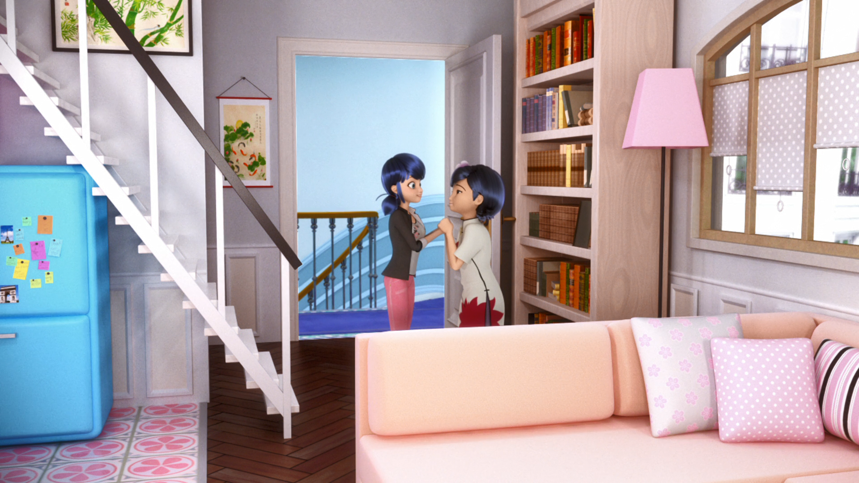
It's not every day you celebrate your twentieth wedding ______.
day
party
anniversary

Slide 11
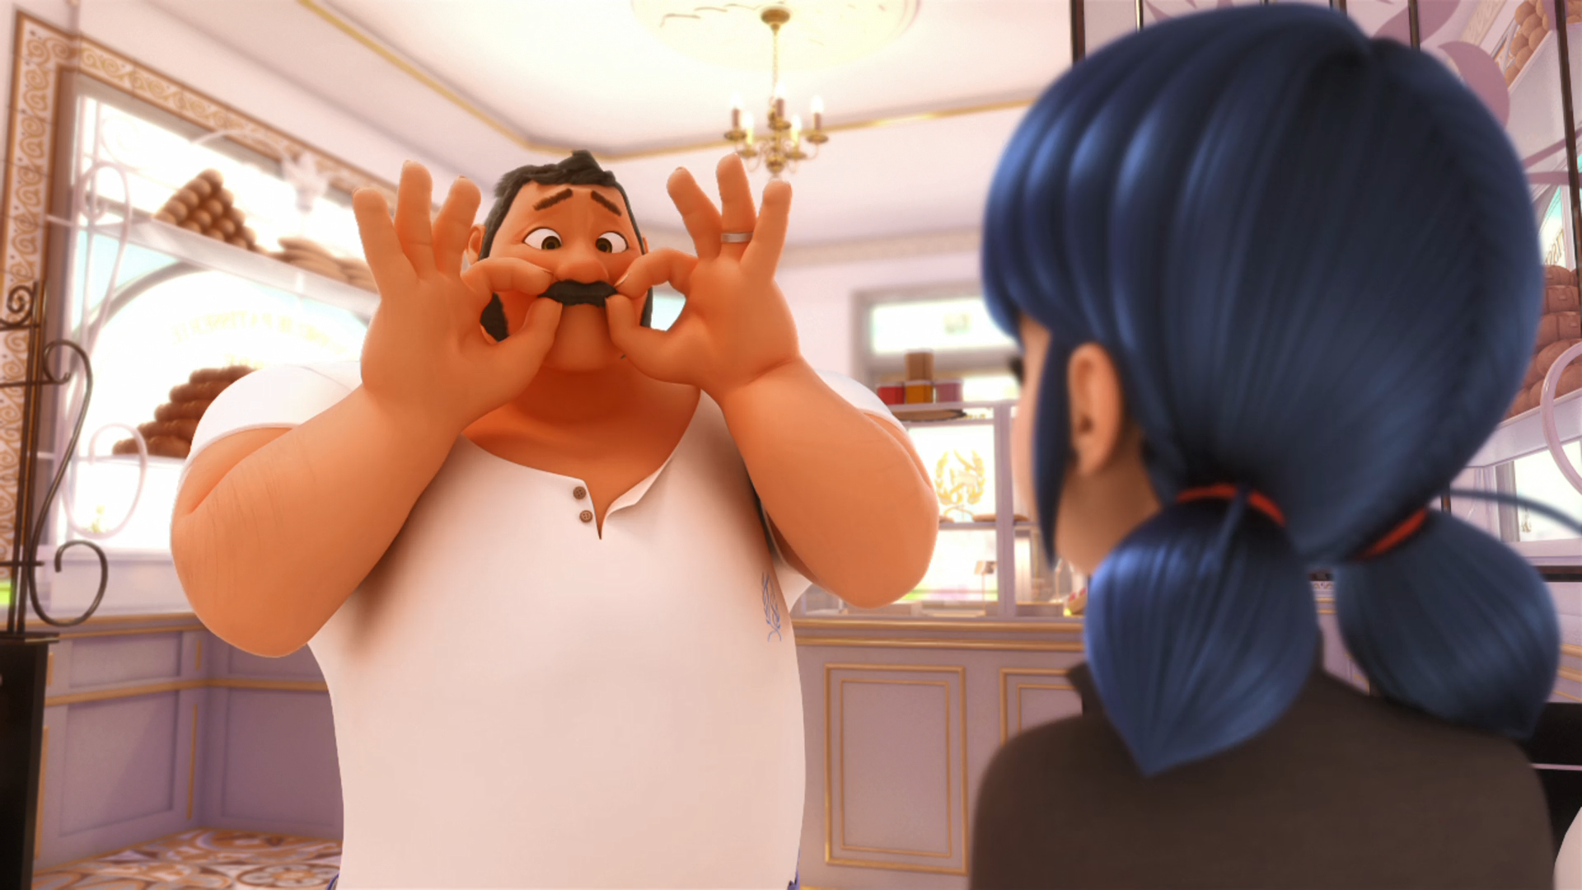
My ______, I groomed it. Is it too short?
mustache
beard
hair

Slide 12
You're no match for me. My ______
is bigger than your thigh.
head
neck
arm

Slide 13
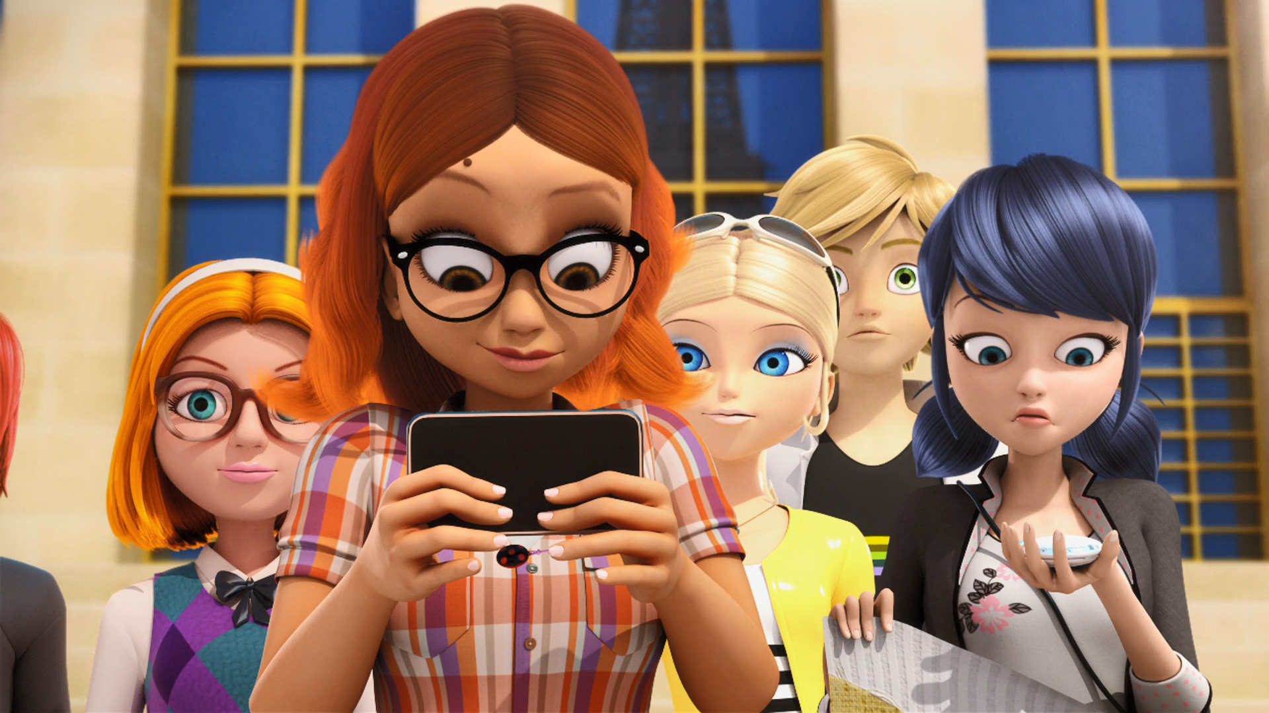
But... Marinette, take this. I gotta record the ______ for my blog!
fight
race
room

Slide 14
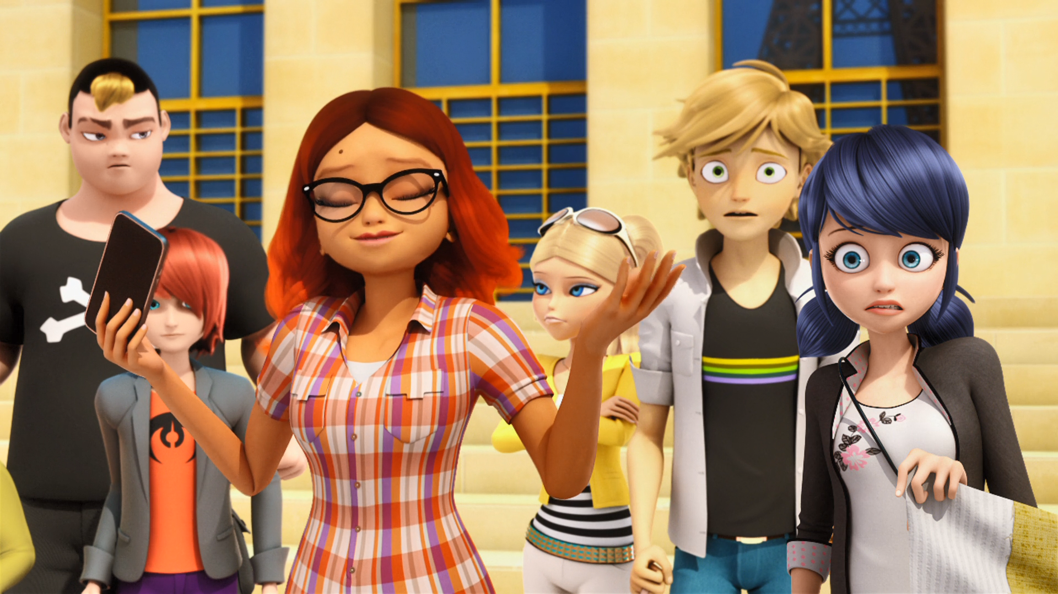
Chloé snatched it from him and ______ it.
dropped
broke
stole

Slide 15
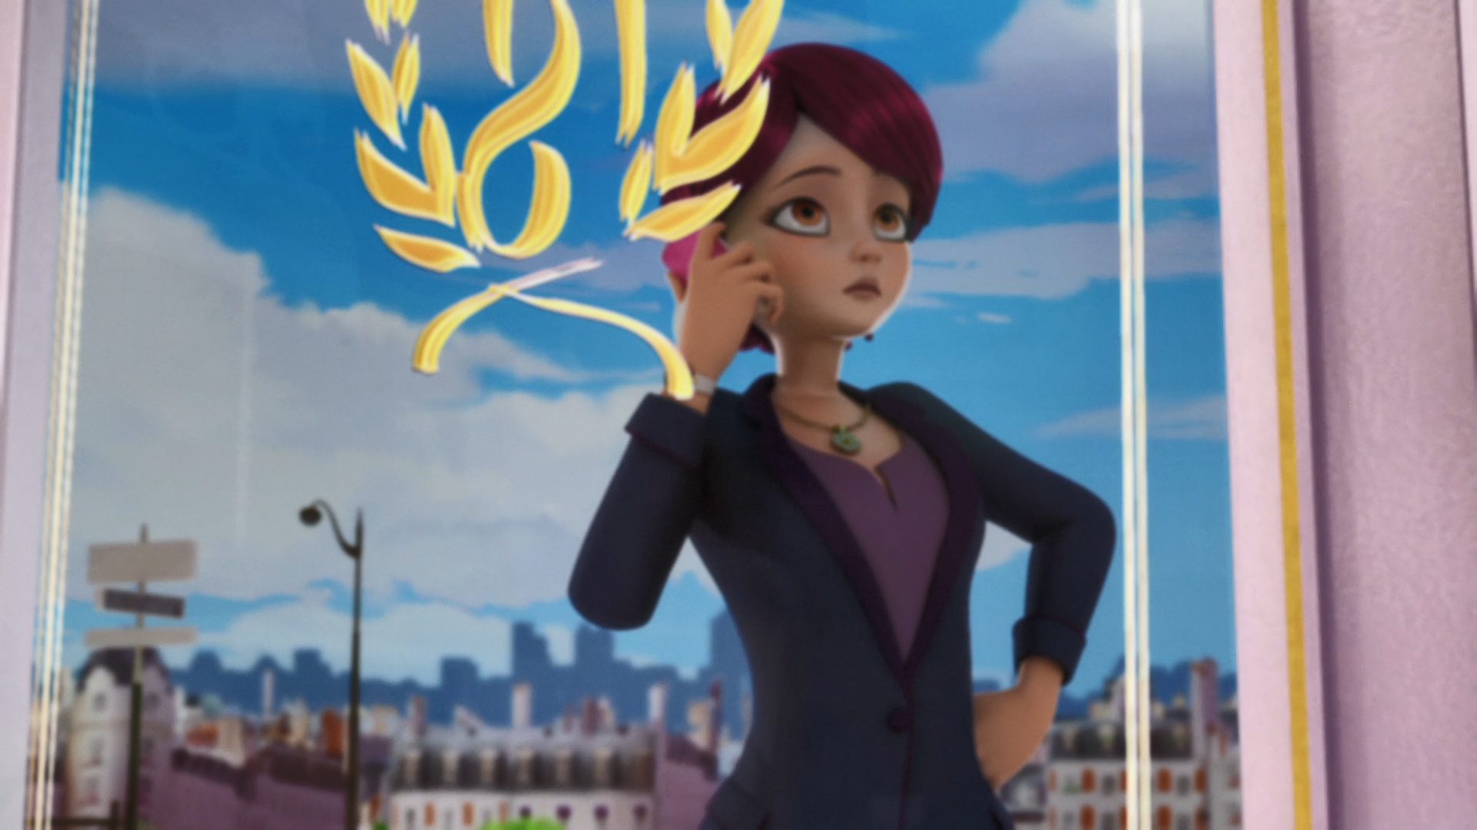
It's closed! And I really need that ______ now!
bread
man
cake

Slide 16
Sabine: Well? With or without?
Marinette: Uh, with?
Sabine: You're sure it's not better without?
Marinette: Either way, you look [1] ____________, Mom.
Sabine: You know? It's not every day you celebrate your twentieth
[2] ____________ anniversary.
Tom: Marinette! Could you come here a minute, please? Well?
Marinette: Well, what?
Tom: My mustache, I groomed it. Is it too short? Should I
[3] ____________ the whole thing off? Maybe it's a little crooked on one.
Marinette: You look perfect, Dad. Uh, [4] ____________ for one thing.

Slide 17
Alix: Did you do this?!
Alya: I had to videotape the [5] ____________ so I gave it to Marinette but then she had to hold the banner so she gave it to Adrien, then Chloé snatched it from him and dropped it and, uh, then you skated over it.
Alix: My old man gave me this for my [6] ____________! This watch is totally a family heirloom!
Marinette: It was an [7] ____________!
Adrien: We didn't mean any harm, Alix.
Chloé: As if! I totally had nothing to do with this.
Alix: You're all to [8] ____________!

Slide 18
Sabine: Well? With or without?
Marinette: Uh, with?
Sabine: You're sure it's not better without?
Marinette: Either way, you look [1] perfect, Mom.
Sabine: You know? It's not every day you celebrate your twentieth
[2] wedding anniversary.
Tom: Marinette! Could you come here a minute, please? Well?
Marinette: Well, what?
Tom: My mustache, I groomed it. Is it too short? Should I
[3] shave the whole thing off? Maybe it's a little crooked on one.
Marinette: You look perfect, Dad. Uh, [4] except for one thing.

Slide 19
Alix: Did you do this?!
Alya: I had to videotape the [5] race so I gave it to Marinette but then she had to hold the banner so she gave it to Adrien, then Chloé snatched it from him and dropped it and, uh, then you skated over it.
Alix: My old man gave me this for my [6] birthday! This watch is totally a family heirloom!
Marinette: It was an [7] accident!
Adrien: We didn't mean any harm, Alix.
Chloé: As if! I totally had nothing to do with this.
Alix: You're all to [8] blame!

Slide 20
QUESTIONS
1. How many years have Marinette's parents been married?
2. When does time stand still?
3. Who dropped the watch?
4. Who needs the Eiffel tower cake?

Slide 21
ANSWERS
1. Marinette's parents have been married for 20 years.
2. Time stands still when doing homework.
3. Chloe dropped the watch.
4. Mrs. Chamack needs the Eiffel tower cake.

Slide 22



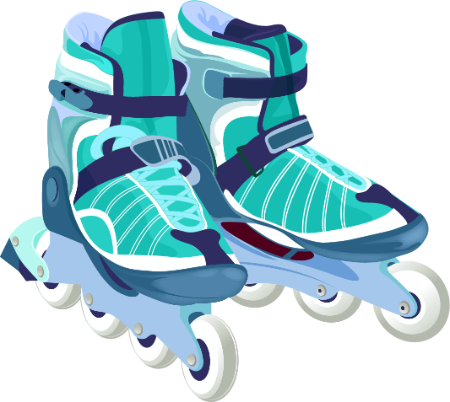
Matching Exercise
rollerblades | neck | thighs | dust

Slide 23
Matching Exercise
neck | thighs | dust | rollerblades

Slide 24
TRUE OR FALSE
1. Mr. Kubdel gives Alix the watch on her 15th birthday.
2. Kim says his neck is bigger than Alix's head.
3. Ali gives her watch to Adrien.
4. Chloe drops the watch.
5. Marinette fixes the watch.

Slide 25
TRUE OR FALSE
1. Mr. Kubdel gives Alix the watch on her 15th birthday. | TRUE
2. Kim says his neck is bigger than Alix's head. | FALSE
3. Alix gives her watch to Adrien. | FALSE
4. Chloe drops the watch. | TRUE
5. Marinette fixes the watch. | FALSE

