Slide 1
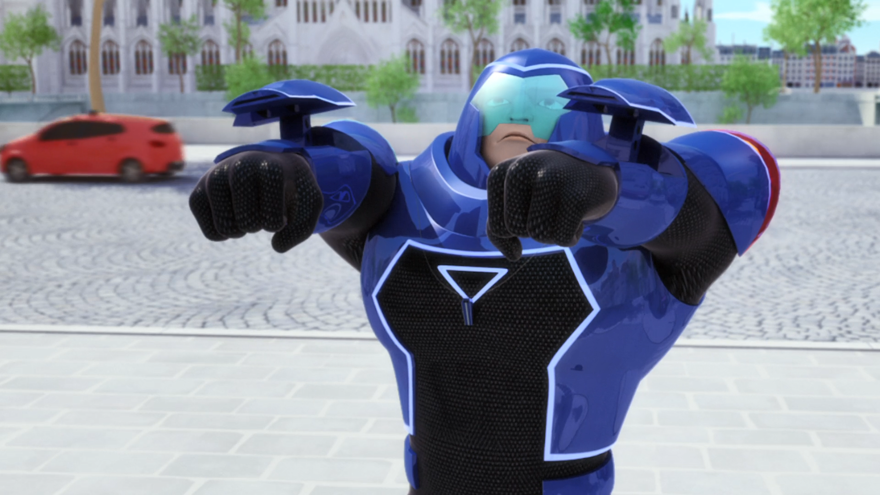
MIRACULOUS LADYBUG: ROGERCOP. PART 2

Slide 2
VOCABULARY
accuse - 告 - əˈkjuːz
authority - 权威 - ɔːˈθɒrɪti
encore - 安可 - ɒŋˈkɔː
evil - 邪恶的 - iːvl
lieutenant - 中尉 - luˈtɛnənt
reach - 抵达 - riːʧ
relinquish - 放弃 - rɪˈlɪŋkwɪʃ
require - 要求 - rɪˈkwaɪə
wrongdoing - 不法行为 - rɒŋˈdu(ː)ɪŋ

Slide 3
1. 邪恶的
2. riːʧ
3. rɒŋˈdu(ː)ɪ

Slide 4
1. 邪恶的 - evil
2. riːʧ - reach
3. rɒŋˈdu(ː)ɪŋ - wrongdoing

Slide 5
ROGERCOP. PART 2
Rogercop: Justice doesn't need an invitation. Mayor, you're under arrest for abuse of power.
Mr. Bourgeois: Look who's talking!
Rogercop: Ladybug. Paris has a new righter of wrong. Your services are no longer required.
Ladybug: I can't let you go around accusing everyone of any little wrongdoing!

Slide 6
Chloé: Hey! Where are you going? Who's going to drive this car?
Cat Noir: Did I ever thank you for the lift? Where'd you get those shoes? I could use a pair like that!
Ladybug: Grab on to me!
Cat Noir: No! Ladybug! What have you done?!

Slide 7
Cat Noir: Ugh! Umm, uh... nice day for a swim! Well, hey. I'm head over heels to
see you, my lady.
Ladybug: There's no point running after him anyway. He's way out of our reach now.
Cat Noir: Well, if it's the mayor he wants...
Ladybug: He'll be heading straight for the
City Hall.

Slide 8
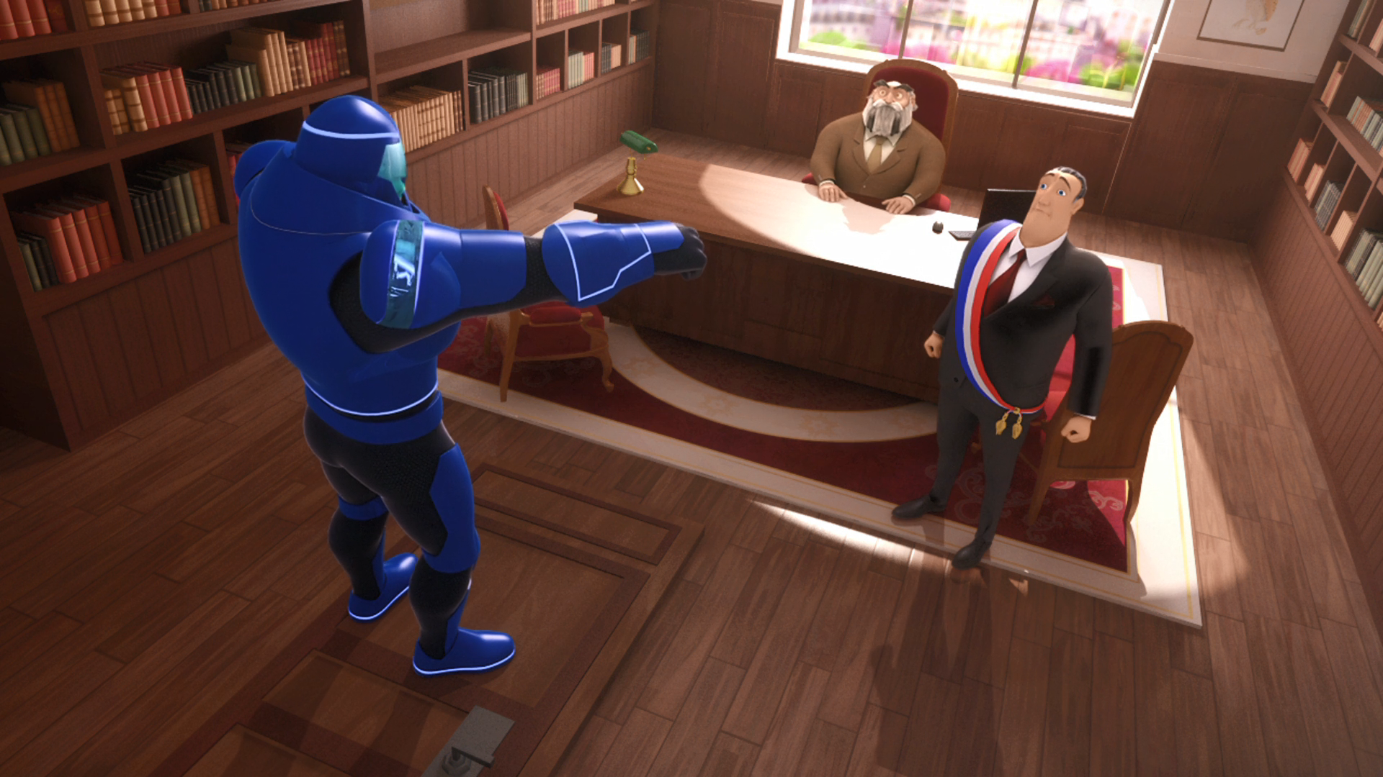
Mayor, you're under arrest for abuse of ______.
Janet
children
power

Slide 9
Justice must prevail in the streets of ______!
Paris
Jinzhou
Dalian

Slide 10
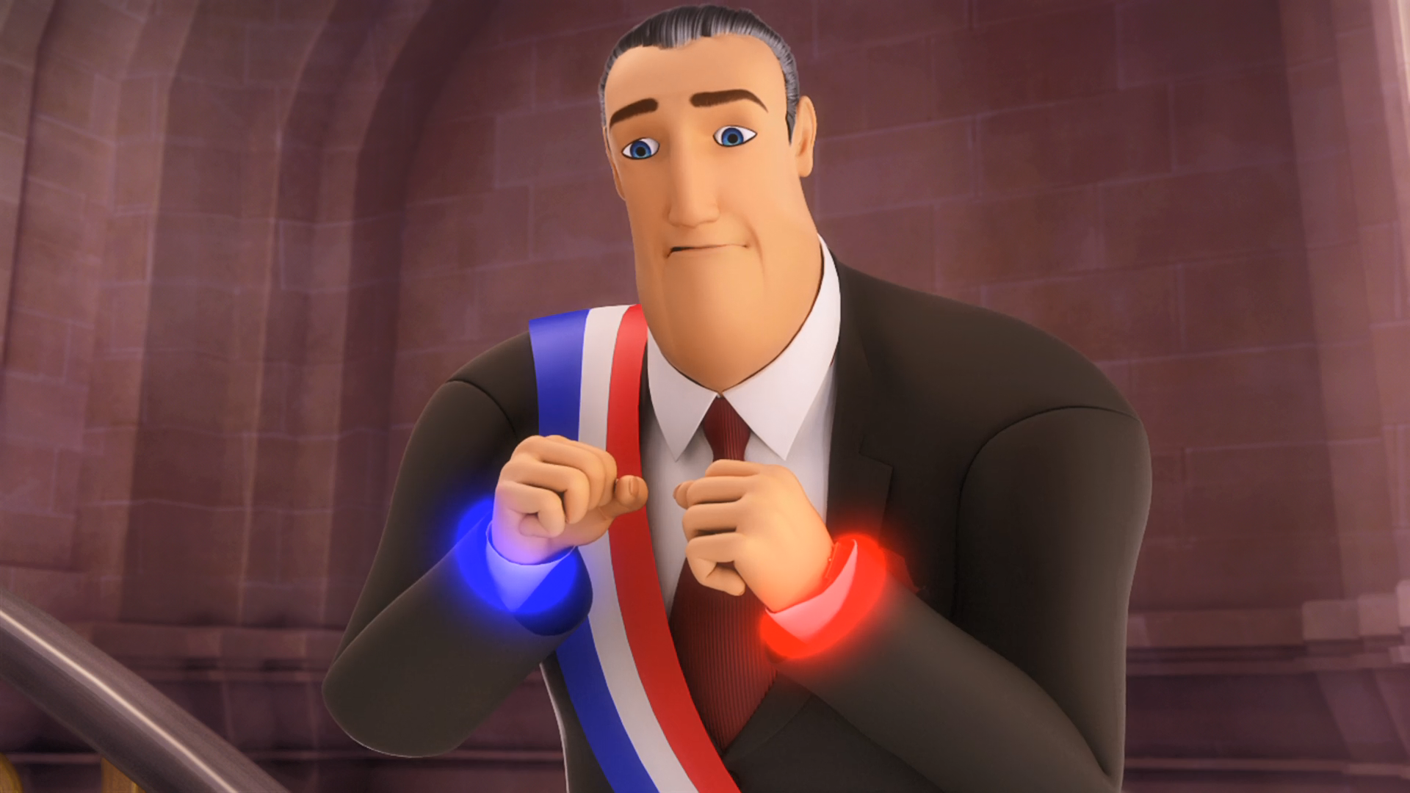
Never! These ______ won't change my mind.
ropes
handcuffs
bracelets

Slide 11
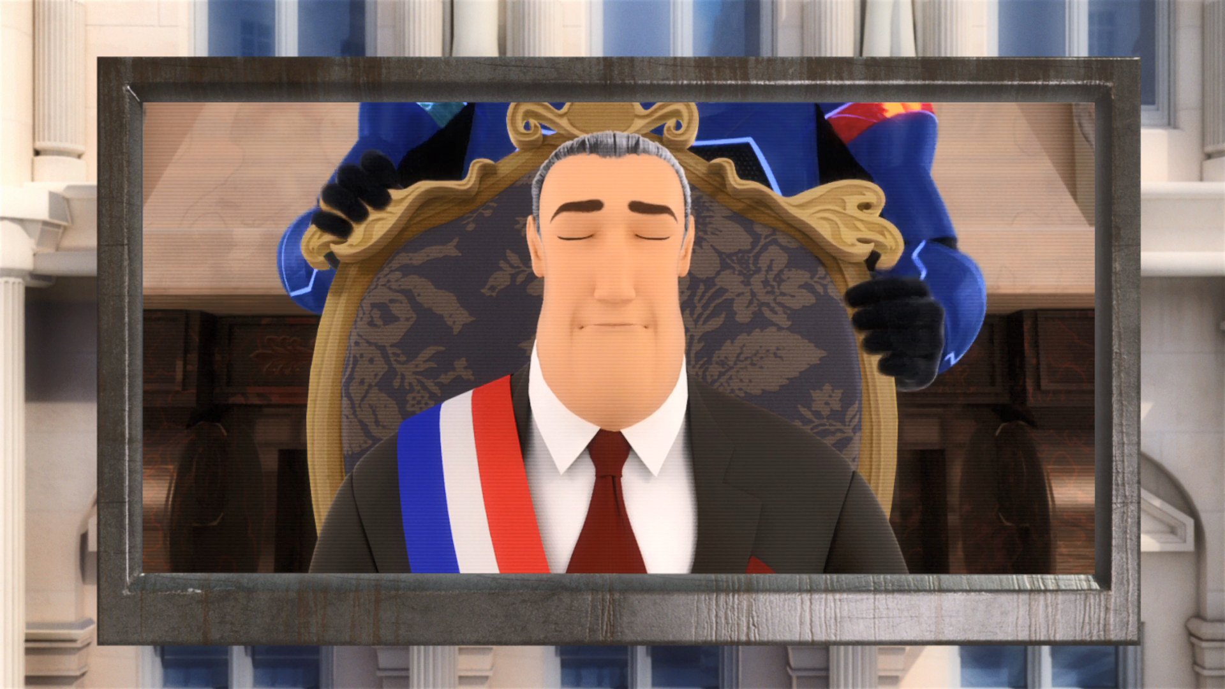
All ______ are ordered to answer at him.
people
citizens
students

Slide 12
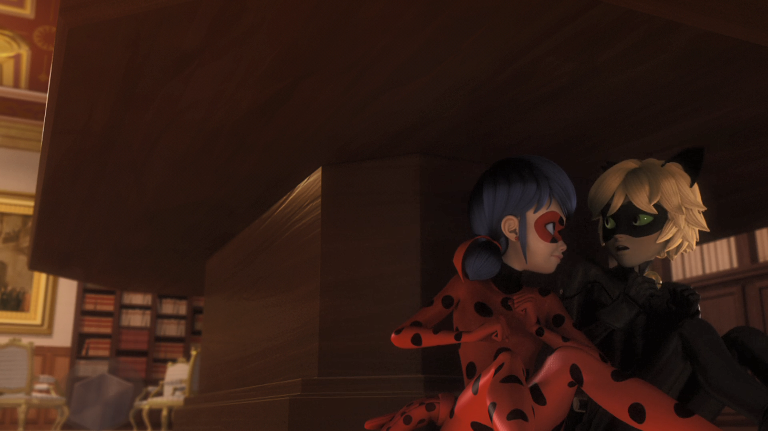
The akuma must be in his ______. We've gotta get to it!
whistle
ass
nose

Slide 13
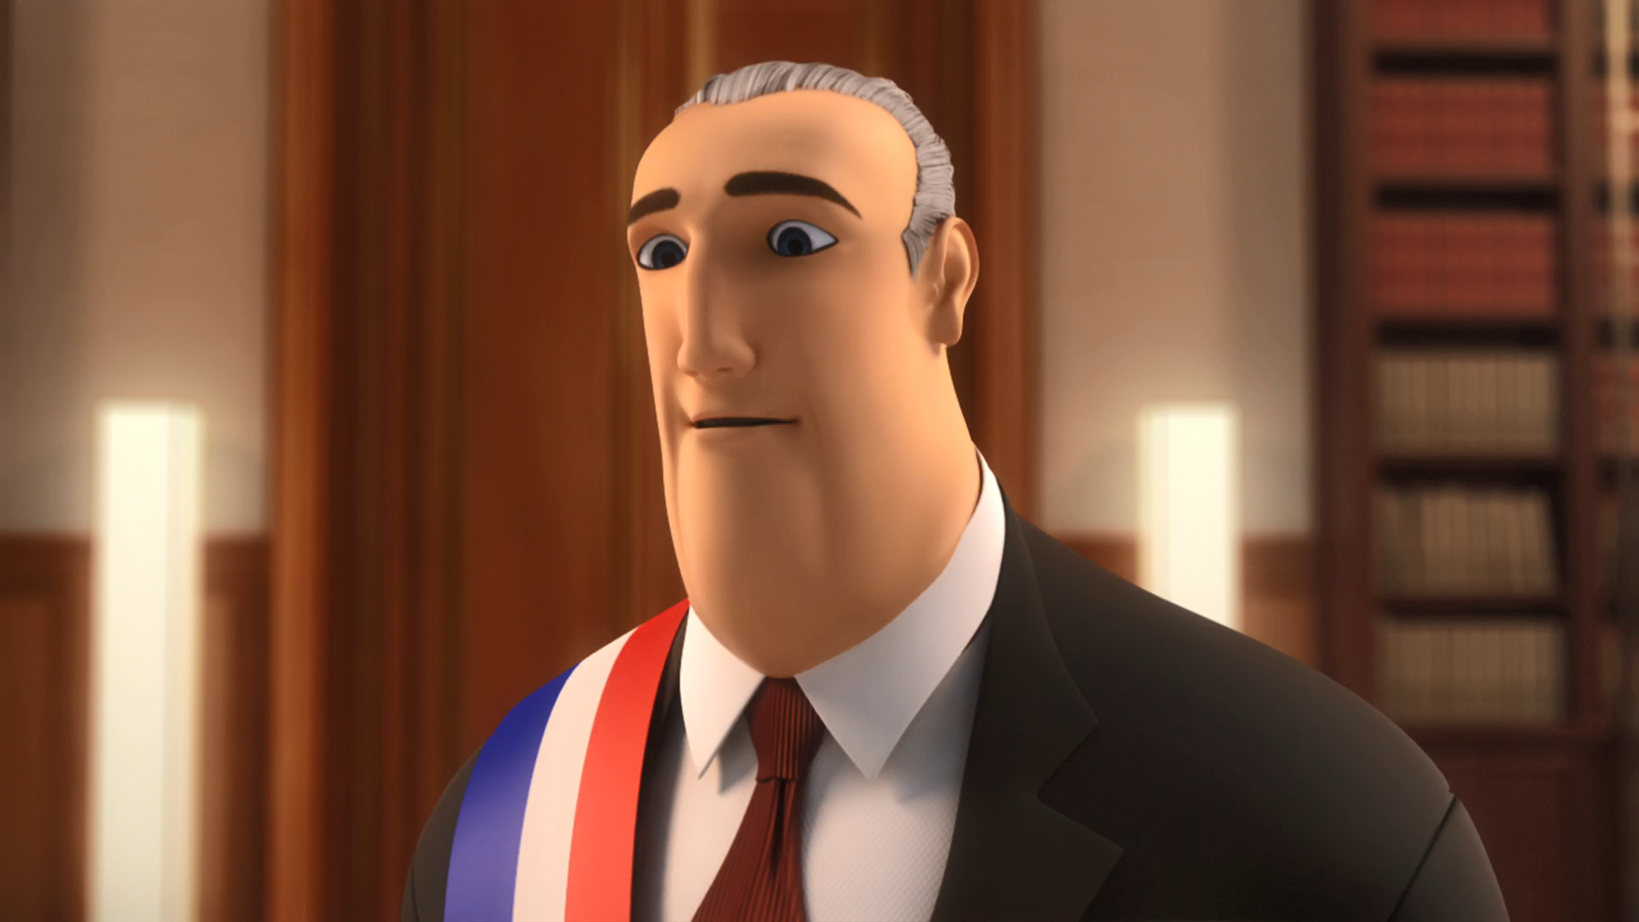
Well, Roger, I do apologize for being so accusatory, and ______ you.
hiring
kissing
firing

Slide 14
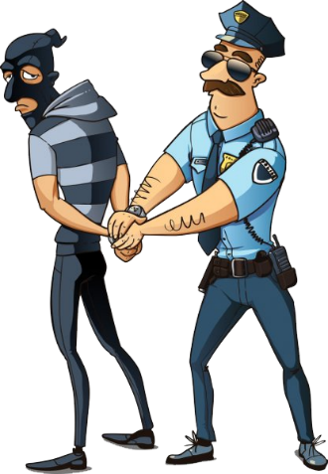
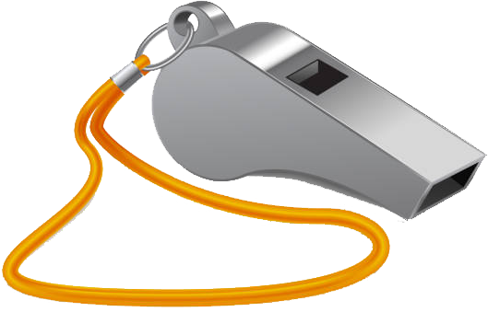


Matching Exercise
lasso | arrest | handcuffs | whistle

Slide 15
Matching Exercise
arrest | whistle | lasso | handcuffs

Slide 16
TRUE OR FALSE
1. Rogercop has a flying car.
2. The mayor puts handcuffs on Rogercop.
3. Rogercop kidnaps Chloe.
4. Rogercop's Akuma is in his whistle.
5. Every citizen is guilty until proven innocent.

Slide 17
TRUE OR FALSE
1. Rogercop has a flying car. | TRUE
2. The mayor puts handcuffs on Rogercop. | FALSE
3. Rogercop kidnaps Chloe. | TRUE
4. Rogercop's Akuma is in his whistle. | TRUE
5. Every citizen is guilty until proven innocent. | FALSE

