Slide 1
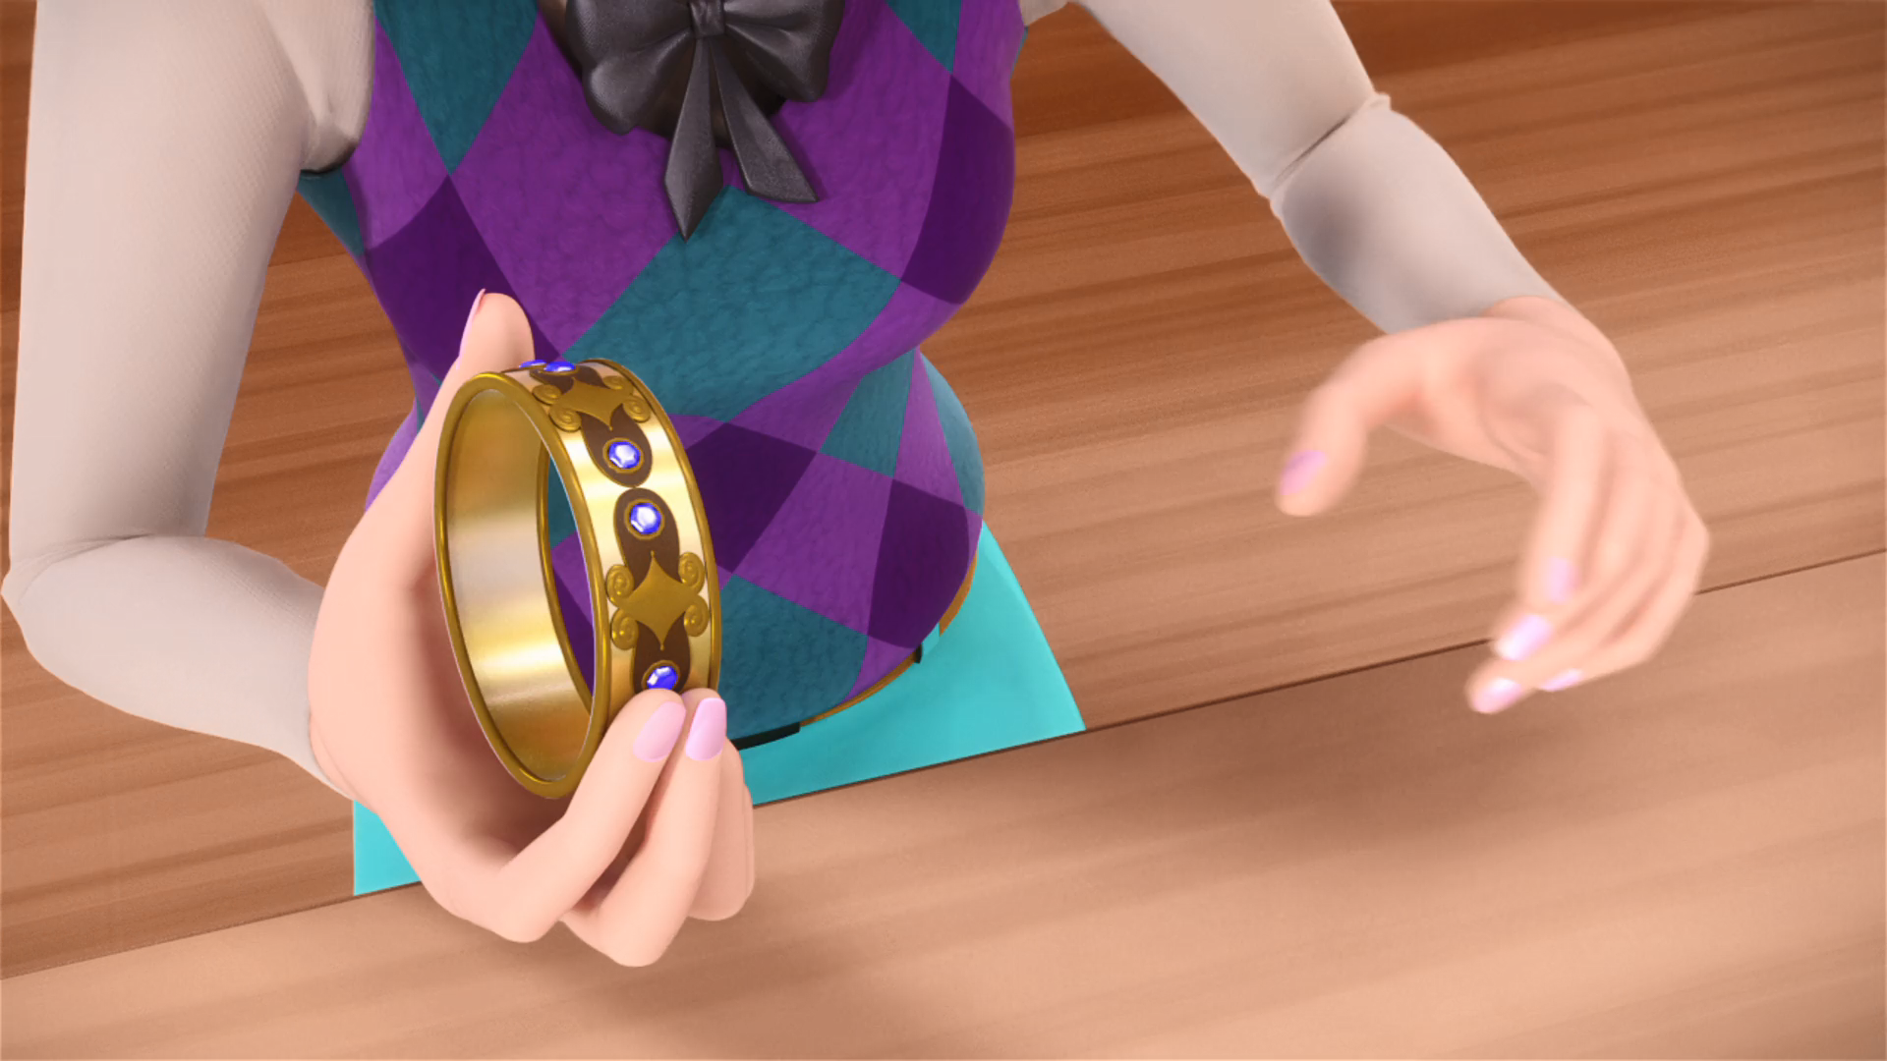
MIRACULOUS LADYBUG: ROGERCOP. PART 1

Slide 2
VOCABULARY
citizen - 公民 - sɪtɪzn
firmly - 牢牢 - fɜːmli
fresh - 新鲜的 - frɛʃ
incompetent - 无能 - ɪnˈkɒmpɪtənt
mayor - 市长 - meə
owned - 拥有 - əʊnd
routine - 常规 - ruːˈtiːn
shiny - 闪亮的 - ʃaɪni
suspect - 怀疑 - sʌspɛkt

Slide 3
1. 新鲜的
2. ɪnˈkɒmpɪtənt
3. 常规
4. ʃaɪni

Slide 4
1. 新鲜的 - fresh
2. ɪnˈkɒmpɪtənt - incompetent
3. 常规 - routine
4. ʃaɪni - shiny

Slide 5
ROGERCOP. PART 1
Marinette: Ready, papa?
Tom: As much as I'll ever be.
Sabine: Happy Career Day, my darlings!
Tom: My day begins at 4 a.m. every morning because the bakery opens at 7.
Adrien: Hi father, it's me. Its Parent's Career Day at school, remember?

Slide 6
Plagg: It is very shiny. I like shiny, hmm!
Chloé: Geez, is there a day when you're not tripping over something?
Miss Bustier: Next on the list is Sabrina's father, a policeman. Officer Roger!
Roger: I've been a police officer for 15 years, and I firmly believe that every citizen is innocent until proven guilty.

Slide 7
Mr. Bourgeois: As mayor of this city, I am your superior!
Roger: But sir, it's against the law! I can't just go...
Mr. Bourgeois: All right. Then you're no longer a police officer!
Roger: Mayor, you can't be serious! Over a missing bracelet?

Slide 8
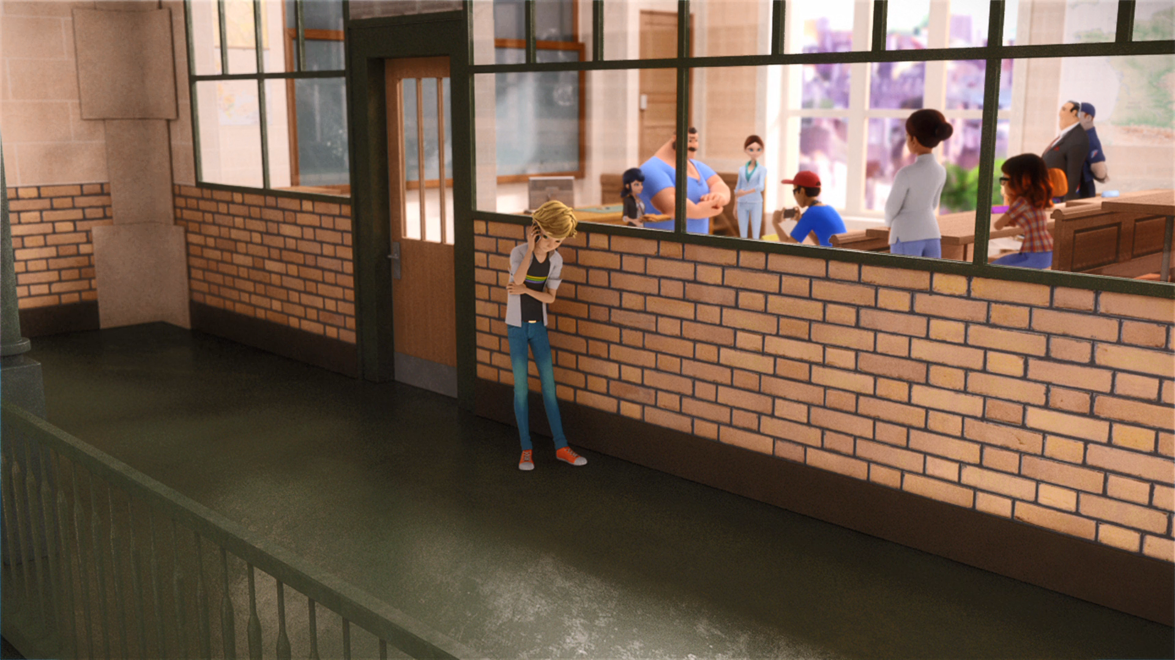
You've reached the ______ of
Gabriel Agreste's office.
house
secretary
voicemail

Slide 9
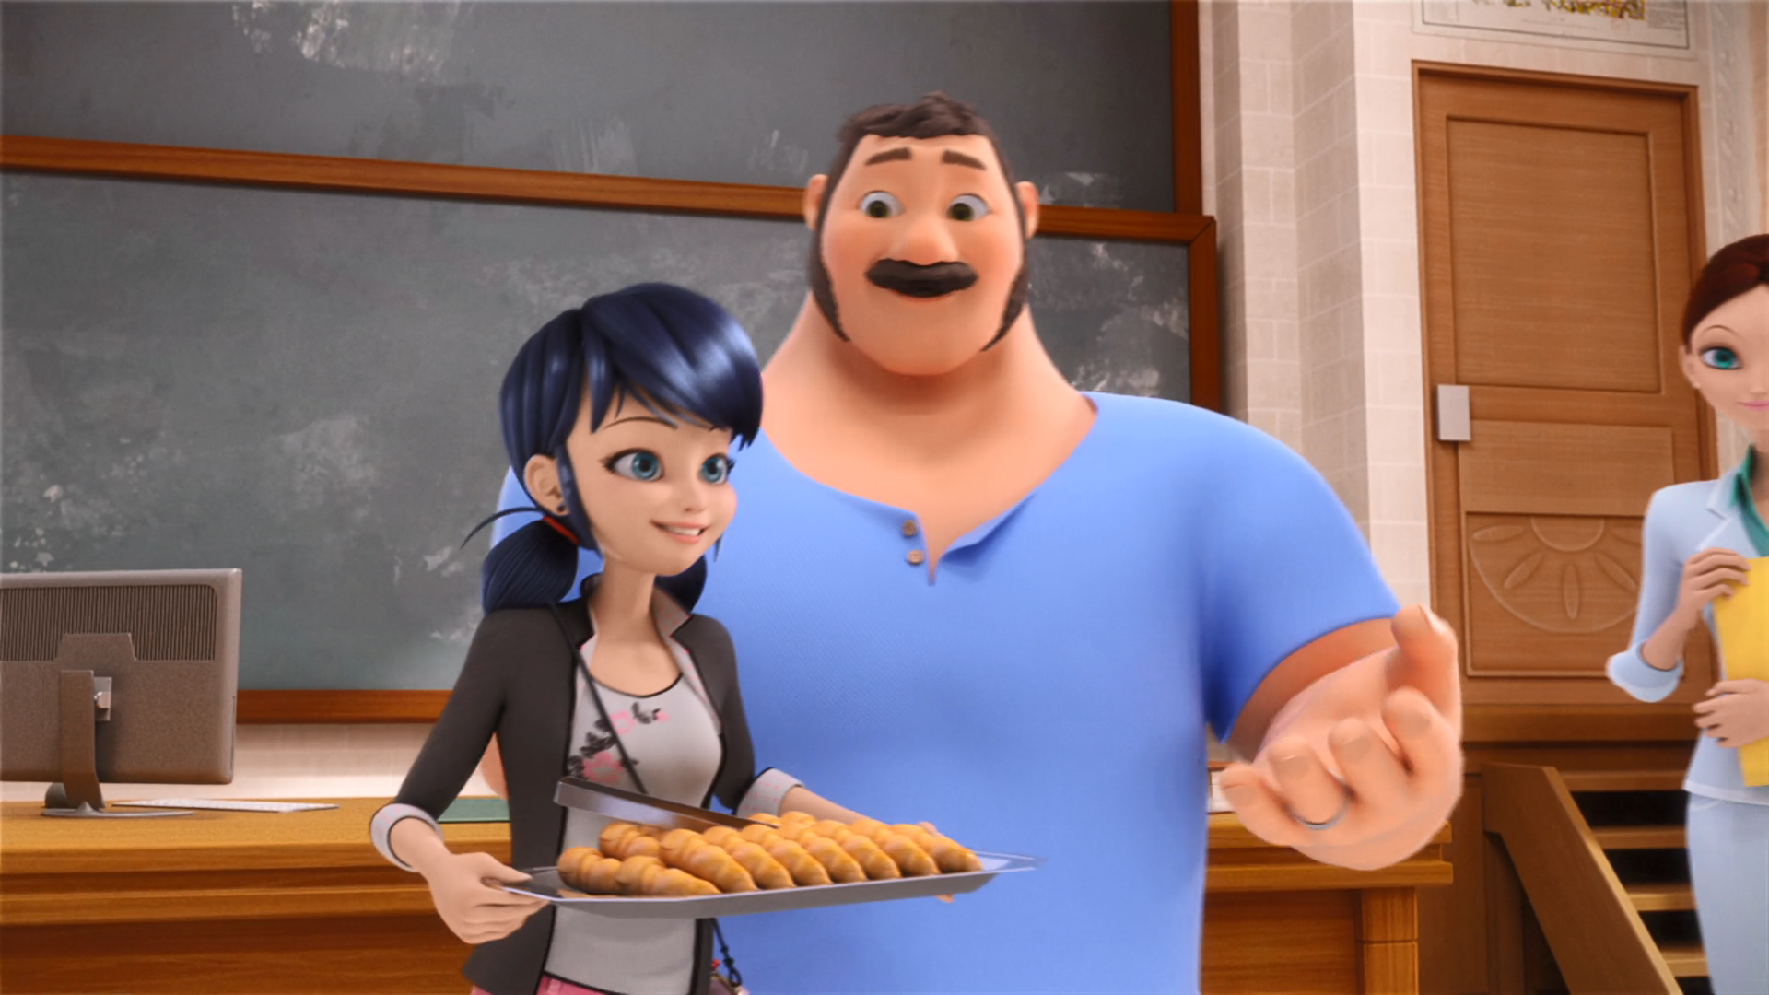
Marinette will come around and pass out some ______.
croissants
bread
donuts

Slide 10
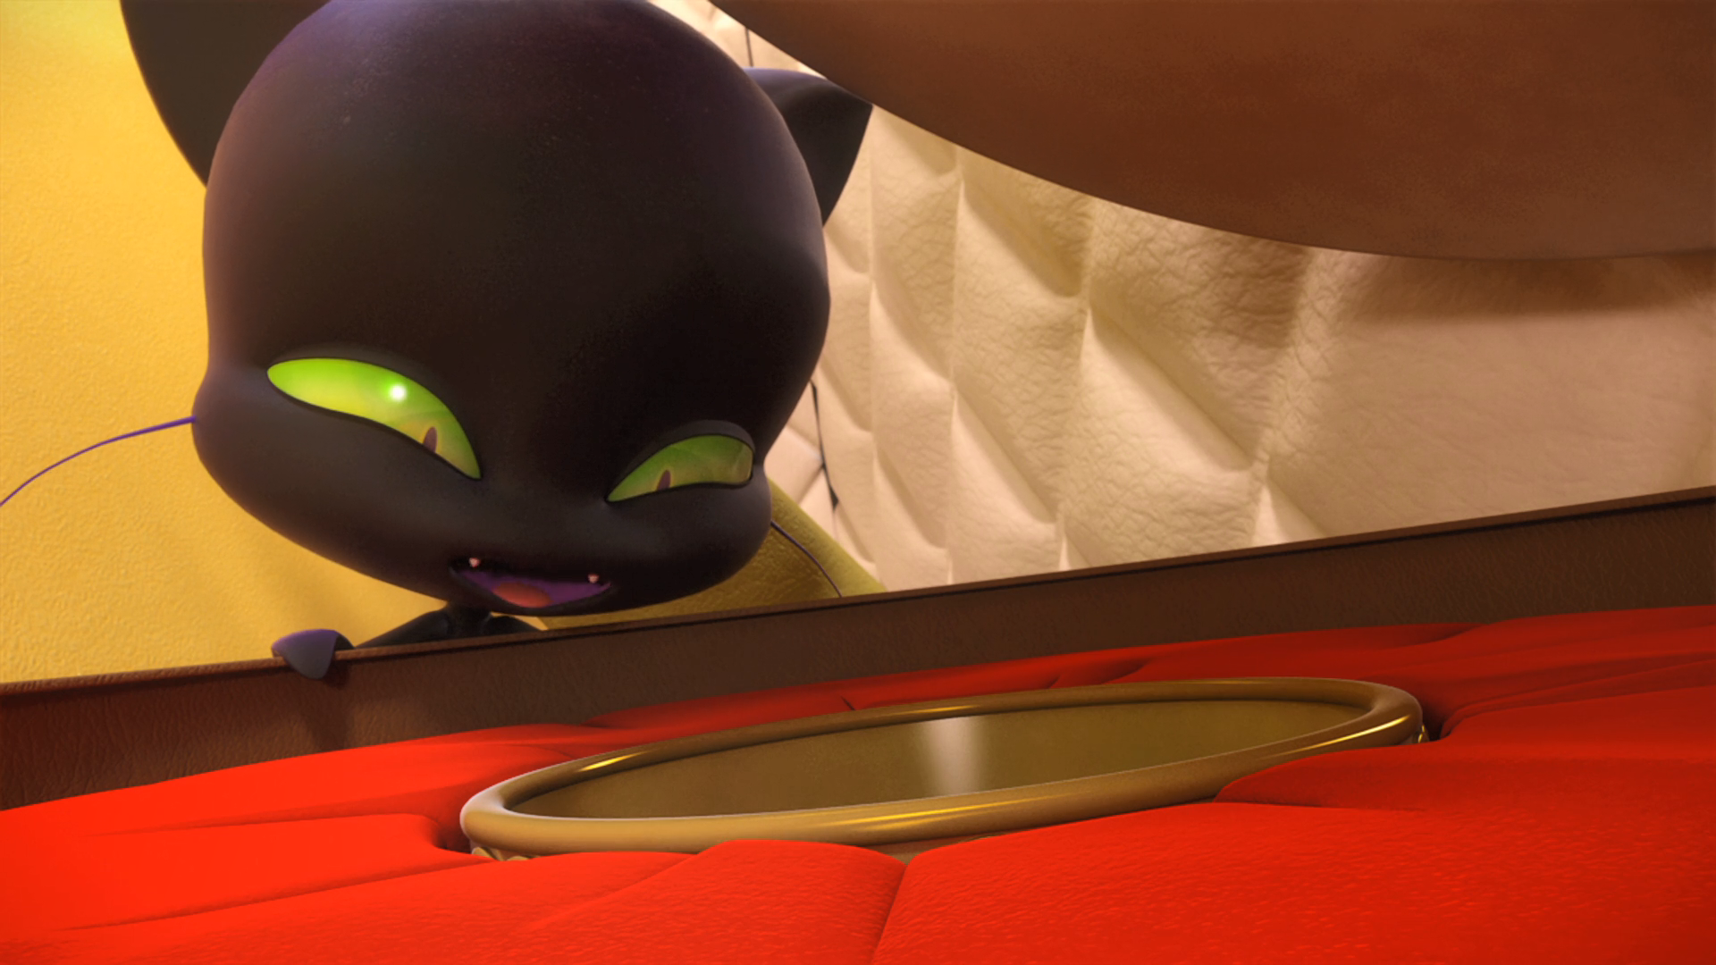
But it is very ______. I like ______.
gold
shiny
expensive

Slide 11
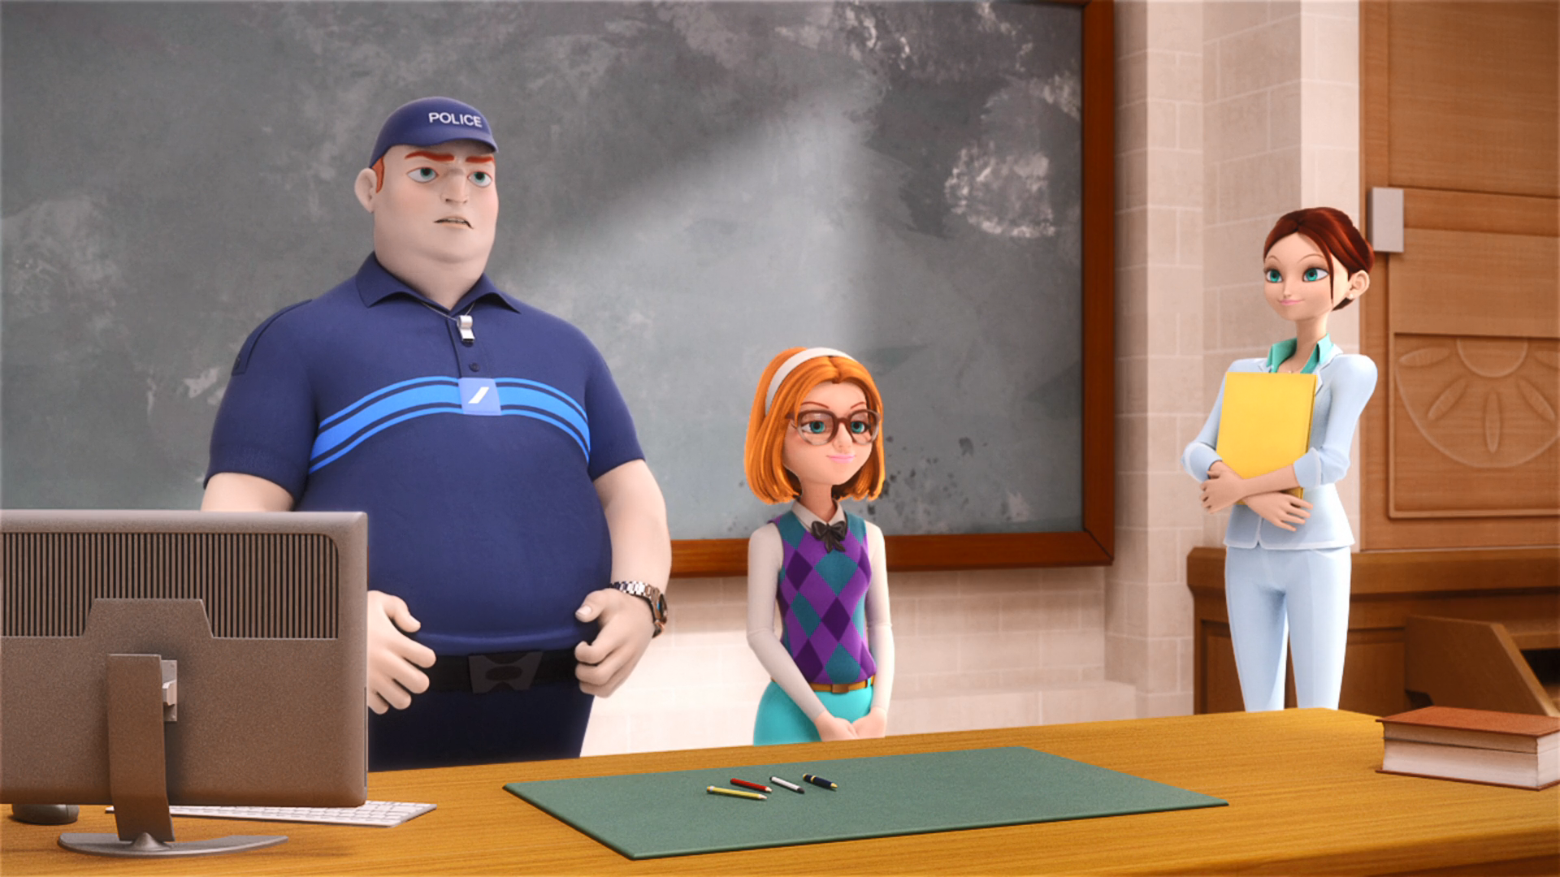
I've been a ______ officer for
15 years.
traffic
police
army

Slide 12
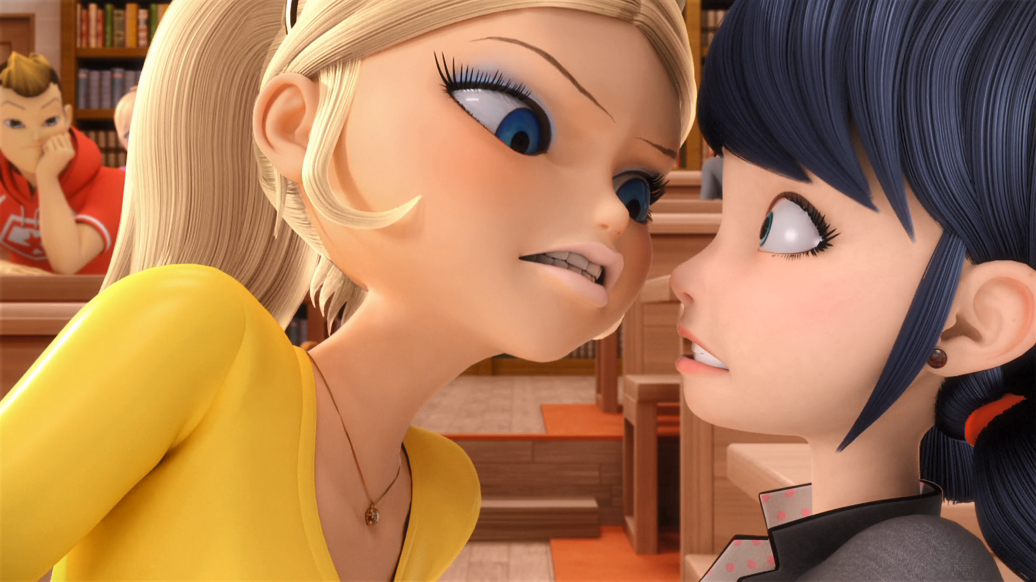
You purposely tripped on my bag so you could steal my ______!
bracelet
phone
lipstick

Slide 13
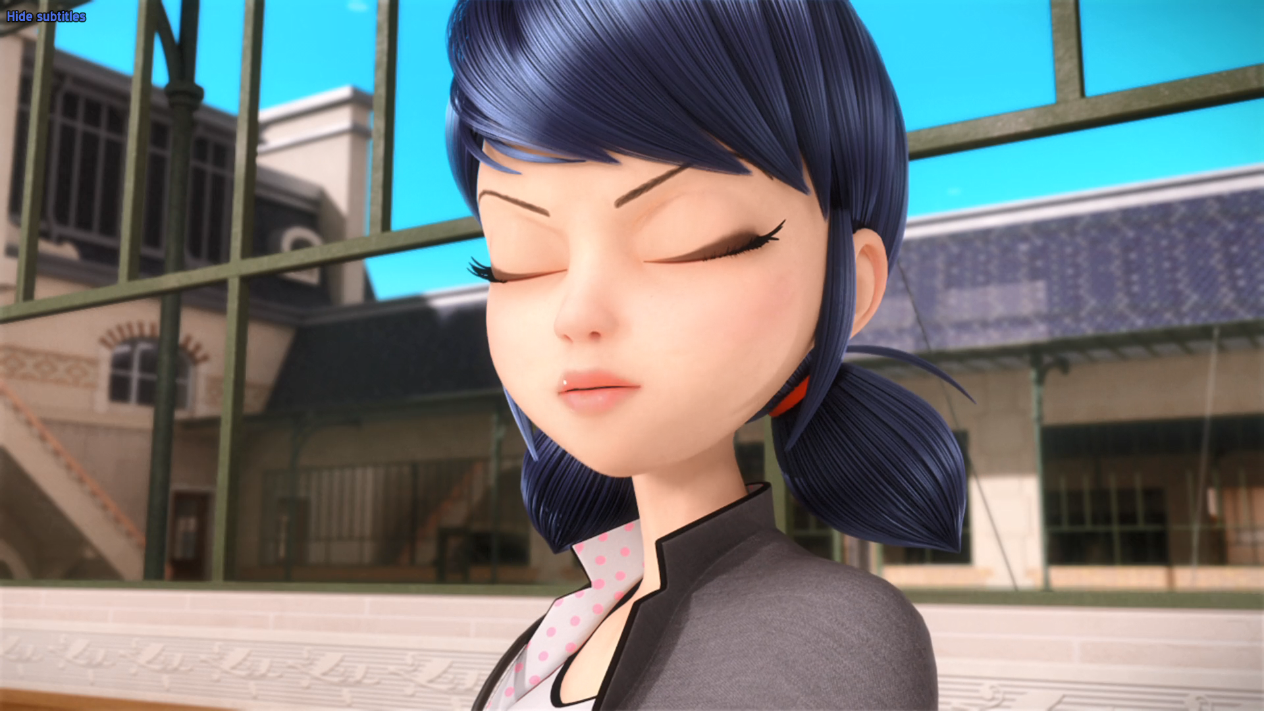
Chloé's the one calling people ______ without any proof.
criminals
pigs
thieves

Slide 14
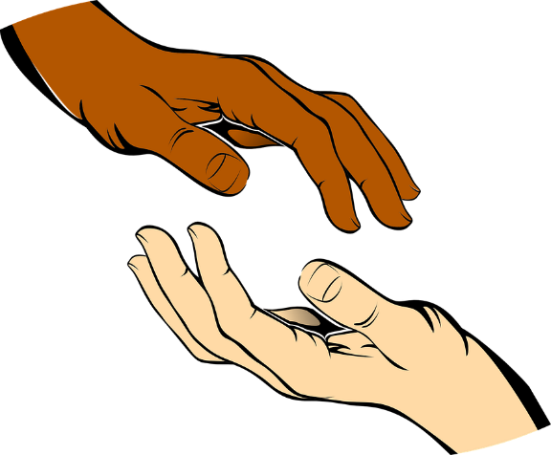


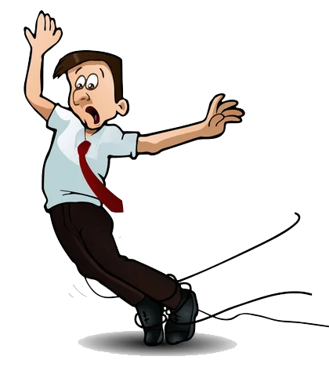
Matching Exercise
bracelet | trip | croissant | touch

Slide 15
Matching Exercise
touch | croissant | bracelet | trip

Slide 16
TRUE OR FALSE
1. The Grand Paris hotel is owned by Chloe's father.
2. Sabrina's father is a policewoman.
3. Plagg stole Chloe's bracelet.
4. Roger searches Chloe.
5. Chloe is a bitch.

Slide 17
TRUE OR FALSE
1. The Grand Paris hotel is owned by Chloe's father. | TRUE
2. Sabrina's father is a policewoman. | FALSE
3. Plagg stole Chloe's bracelet. | TRUE
4. Roger searches Chloe. | FALSE
5. Chloe is a bitch. | TRUE

