Slide 1
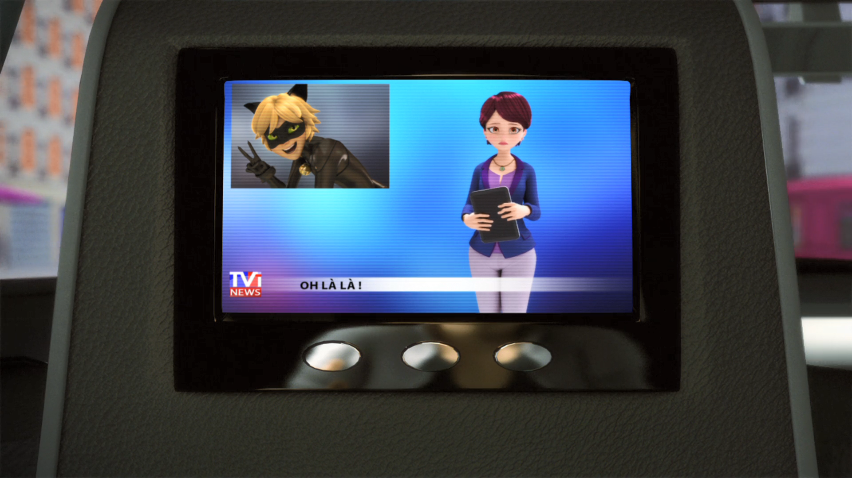
MIRACULOUS LADYBUG: COPYCAT. PART 1

Slide 2
VOCABULARY
adoration - 崇拜 - ædɔːˈreɪʃ(ə)n
astonishing - 惊人 - əsˈtɒnɪʃɪŋ
automated - 自动化 - ɔːtəmeɪtɪd
copycat - 山寨 - kɒpɪkat
improv - 即兴表演 - ɪmprɒv
ridiculous - 荒谬的 - rɪˈdɪkjʊləs
script - 脚本 - skrɪpt
situation - 情况 - sɪtjʊˈeɪʃən
voicemail - 语音信箱 - vɔɪsmeɪl

Slide 3
1. ædɔːˈreɪʃ(ə)n
2. rɪˈdɪkjʊləs
3. 语音信箱

Slide 4
1. ædɔːˈreɪʃ(ə)n - adoration
2. rɪˈdɪkjʊləs - ridiculous
3. 语音信箱 - voicemail

Slide 5
COPYCAT. PART 1
Tikki: How about inviting him to a movie then?
Marinette: Right, Tikki. Can you imagine that conversation?
Tikki: "Hey Adrien, would you like to ..."
Marinette: Exactly. I can't help it. Every time
I see him, I get all clammy and I feel like fainting.

Slide 6
Adrien's voice recorder: Hey, this is Adrien's voicemail. Leave a message.
Marinette: It's gone to voicemail!
Alya: Leave a message! Don't improv!
Marinette: Uhh, hello. Uh, Adrien's voicemail, uh, this is Marinette, who, uh, has a message for you, of course, cause it's, uh, your phone, so, umm... Call me see you later, bye!

Slide 7
Théo: Excuse me, Cat Noir, but Ladybug's not here.
Cat Noir: Don't worry about Ladybug. I'm sure she'll be here any minute.
Théo: It's just that, I wanted to ask her to autograph this photo. She's amazing.
She's so brave and smart, the way she always saves everyone...

Slide 8
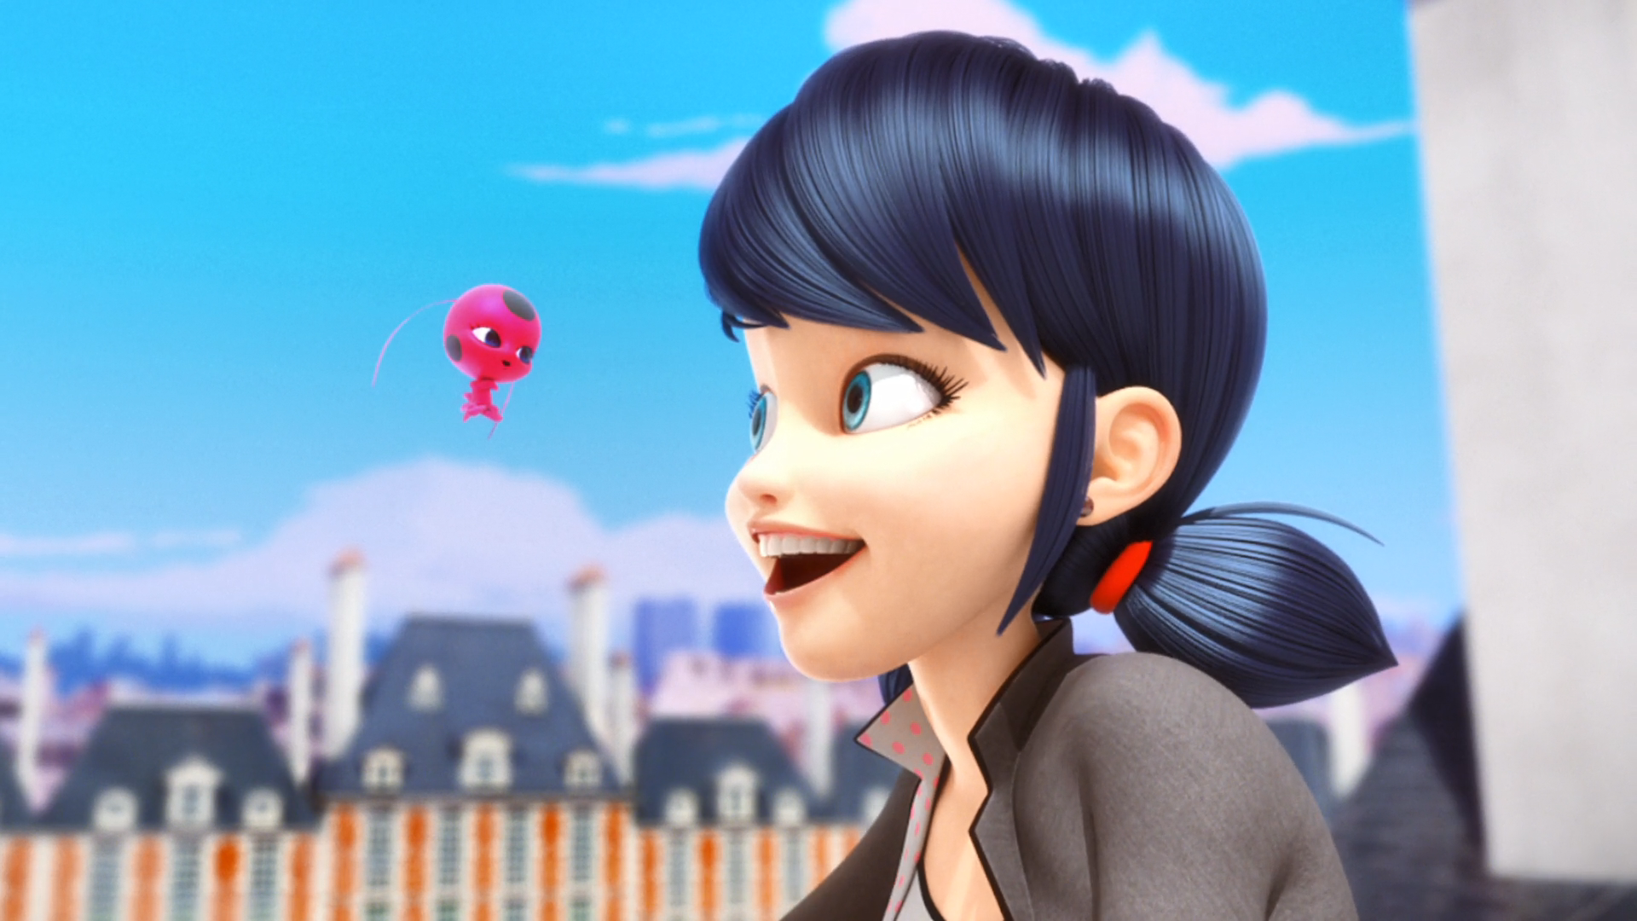
Marinette, it's called a cell phone. You just need his ______.
underpants
banana
number

Slide 9
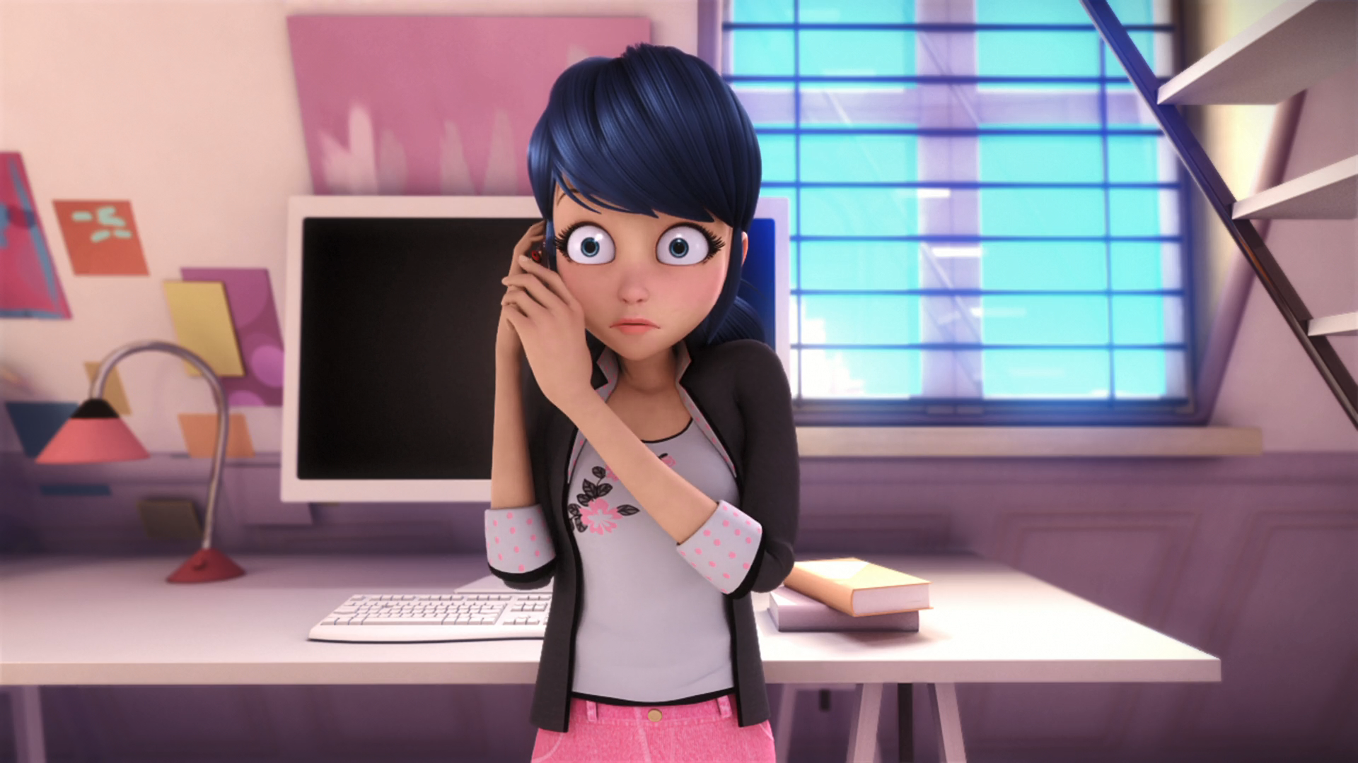
Hey, this is Adrien's ______. Leave a message.
voicemail
grandma
cat

Slide 10
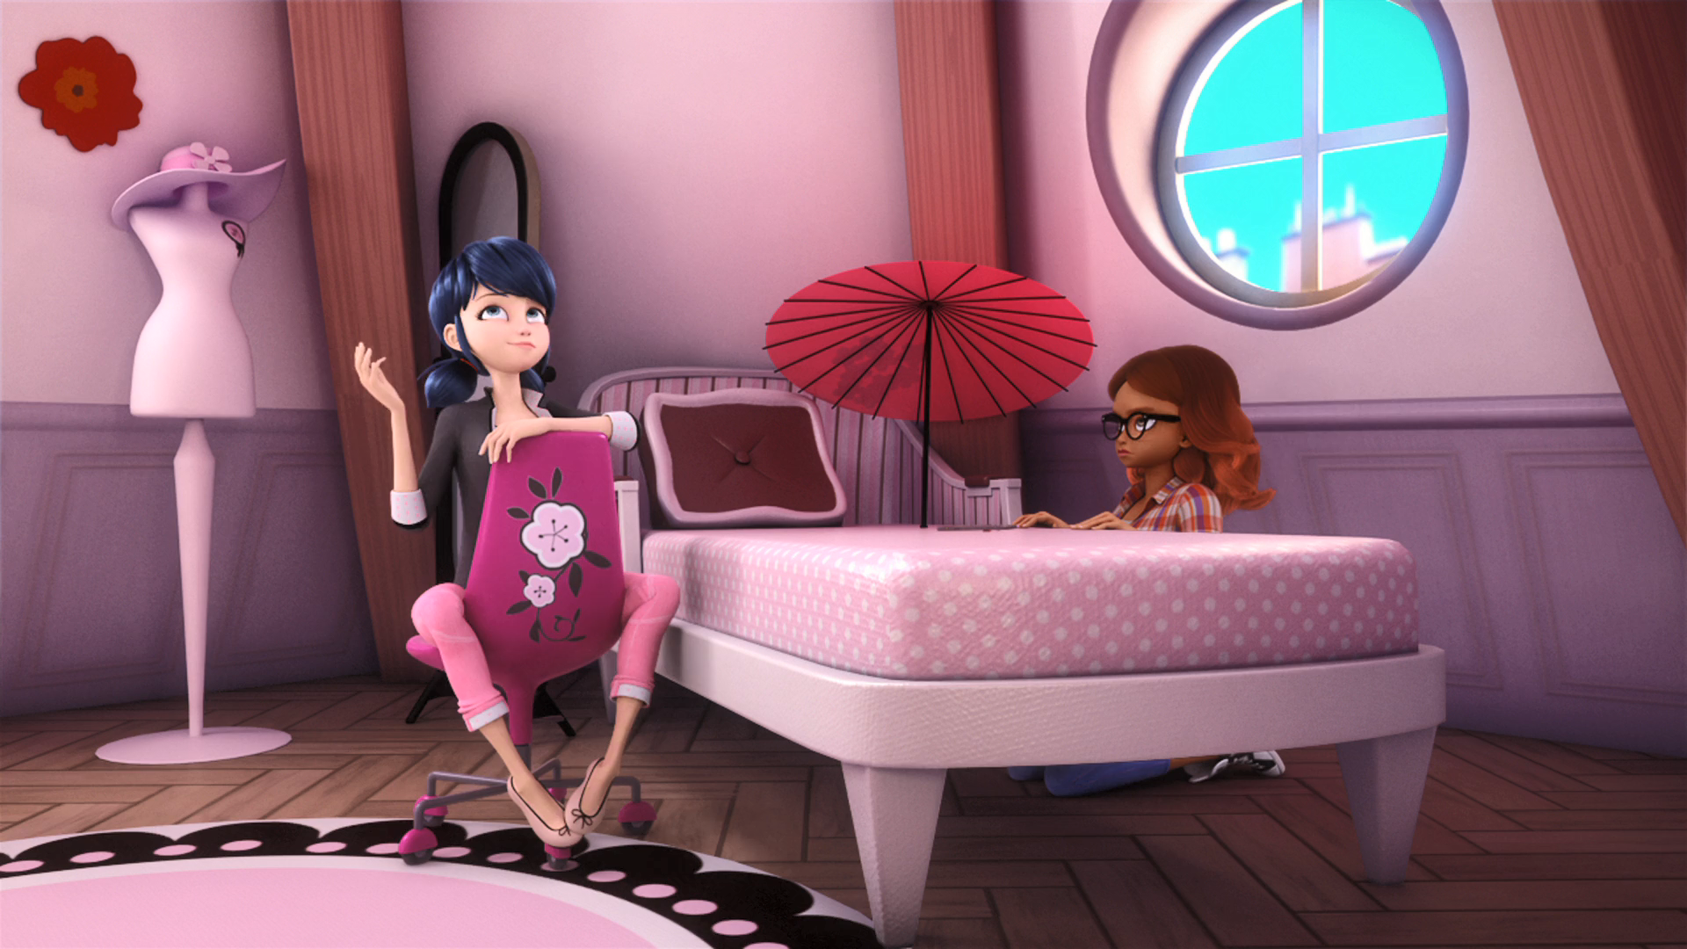
Hey, hot ______, this is Marinette,
I'd ask you on a date to a movie …
body
stuff
mama

Slide 11
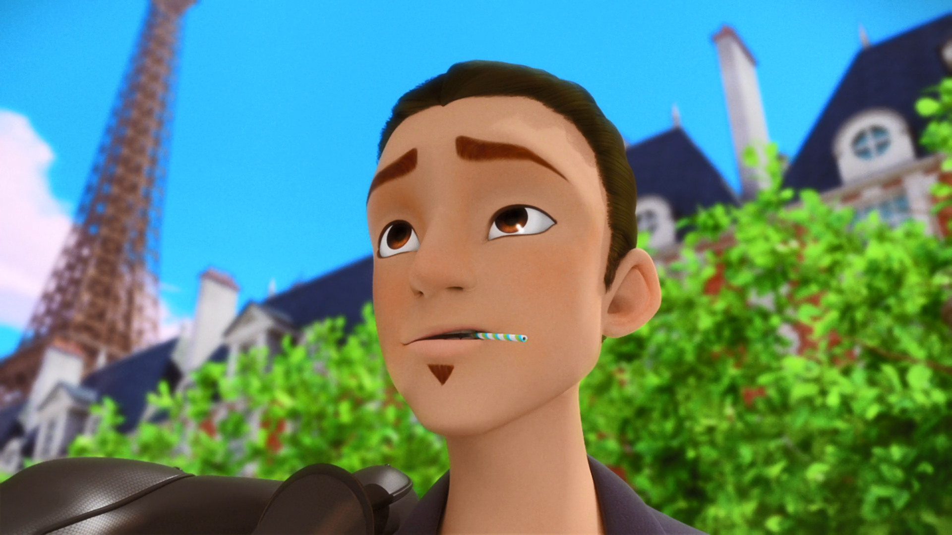
Ladybug didn't show up. I just wanted to express my ______ for her.
love
adoration
hunger

Slide 12
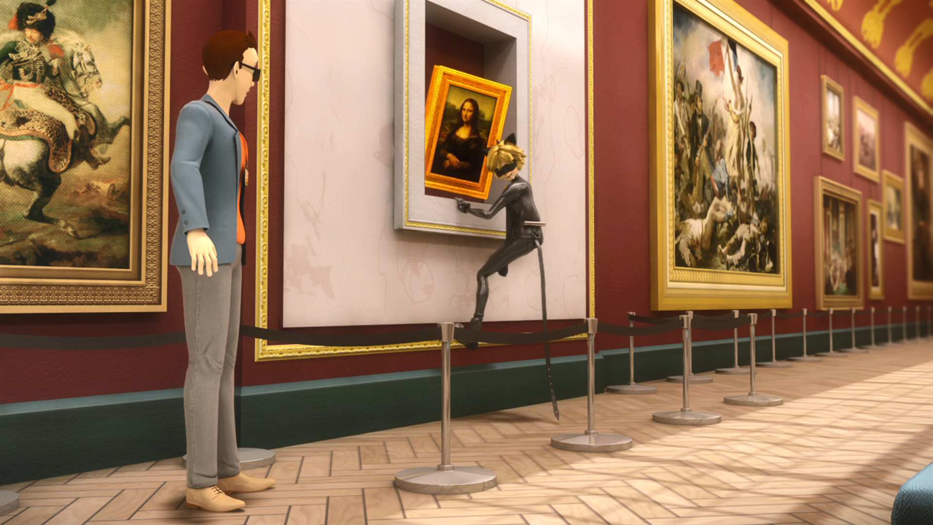
Don't mind me. Just stealing this ______. Go about your business.
painting
iPhone
potato

Slide 13
Amateur video showed that the thief is ______ Noir.
Black
Red
Cat

Slide 14

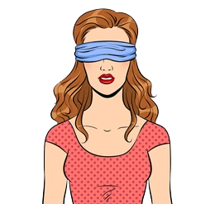
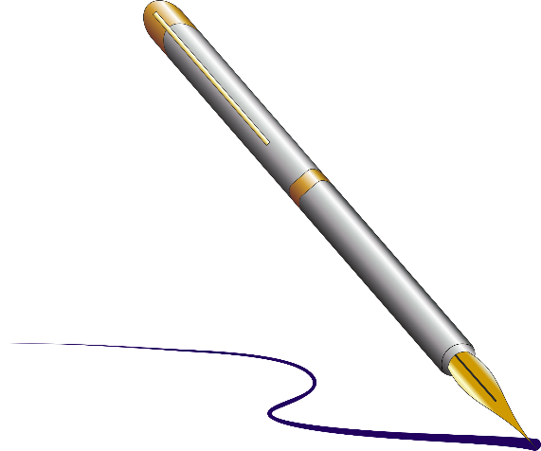

Matching Exercise
fainting | autograph | statue | blindfold

Slide 15
Matching Exercise
statue | blindfold | autograph | fainting

Slide 16
TRUE OR FALSE
1. Tikki says Marinette should call Adrien to talk to him.
2. Alya records a voicemail on Adrien's phone.
3. Ladybug didn't go to the ceremony.
4. Theo is in love with Adrien.
5. Cat Noir steals a painting.

Slide 17
TRUE OR FALSE
1. Tikki says Marinette should call Adrien to talk to him. | TRUE
2. Alya records a voicemail on Adrien's phone. | FALSE
3. Ladybug didn't go to the ceremony. | TRUE
4. Theo is in love with Adrien. | FALSE
5. Cat Noir steals a painting. | FALSE

