Slide 1
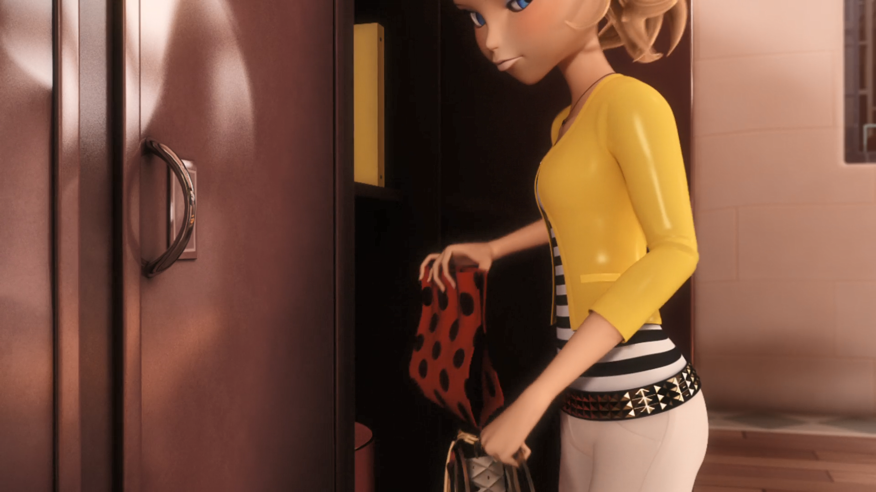
MIRACULOUS LADYBUG: LADY WIFI. PART 1

Slide 2
VOCABULARY
biased - 有偏见的 - baɪəst
conclusions - 结论 - kənˈkluːʒənz
covered - 覆盖 - kʌvəd
destruction - 破坏 - dɪsˈtrʌkʃən
menacing - 来势汹汹 - mɛnəsɪŋ
suspended - 暂停 - səsˈpɛndɪd
unfair - 不公平 - ʌnˈfeə
unjust - 不公正的 - ʌnˈʤʌst
wrongly - 错 - rɒŋli

Slide 3
1. dɪsˈtrʌkʃən
2. 不公平
3. rɒŋli

Slide 4
1. dɪsˈtrʌkʃən - destruction
2. 不公平 - unfair
3. rɒŋli - wrongly

Slide 5
LADY WIFI. PART 1
Alya: Hey, Marinette. Ring me ASAP. We gotta
talk. Nino, wait!
Nino: Yeah?
Alya: Come with me, I need your help!
Nino: So …
Marinette: It's Marinette, leave a message.
Alya: She's not calling me back! Where is that girl?!

Slide 6
Marinette: I missed an entire half day of school AND half day of seeing Adrien!
Sabine: Alya brought your school bag home for you, Marinette.
Marinette: Hey mom...
Sabine: You seem so forgetful these days. Maybe you just need some fresh air and
extra exercise for that growing brain of yours!

Slide 7
Marinette: Sorry... What happened to her?
Nino: The short story? Accused of breaking into Chloé's locker. I mean, Ladybug's locker...
Marinette: WHAT?!?
Miss Bustier: That's it, Marinette! Go to the principal's office!
Adrien: What are you talking about?

Slide 8
Nino: Exactly what I said, bro. Alya says Chloé is Ladybug! She is crazy!
Marinette: Oh, no! Alya! Tikki, time to transform!
Tikki: You're going to have to fight your best friend!
Marinette: Nope! I'm gonna have to save my best friend!

Slide 9
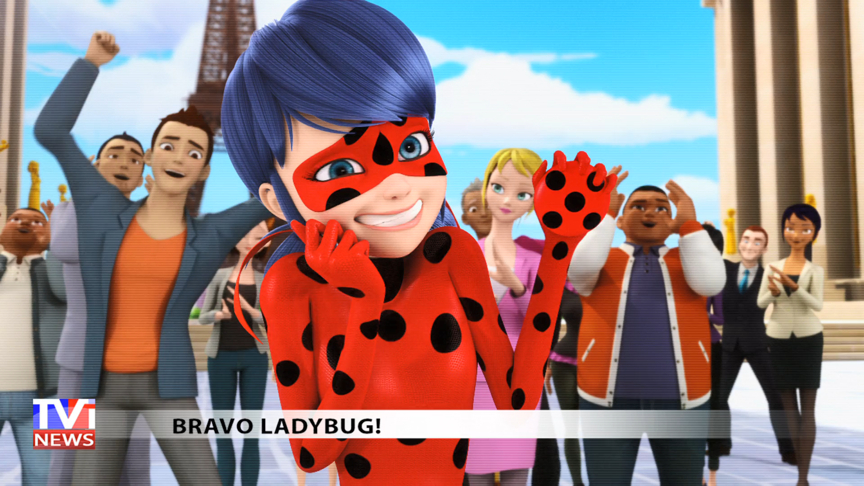
Once again, Ladybug and Cat Noir have saved ______.
Dalian
Chicago
Paris

Slide 10
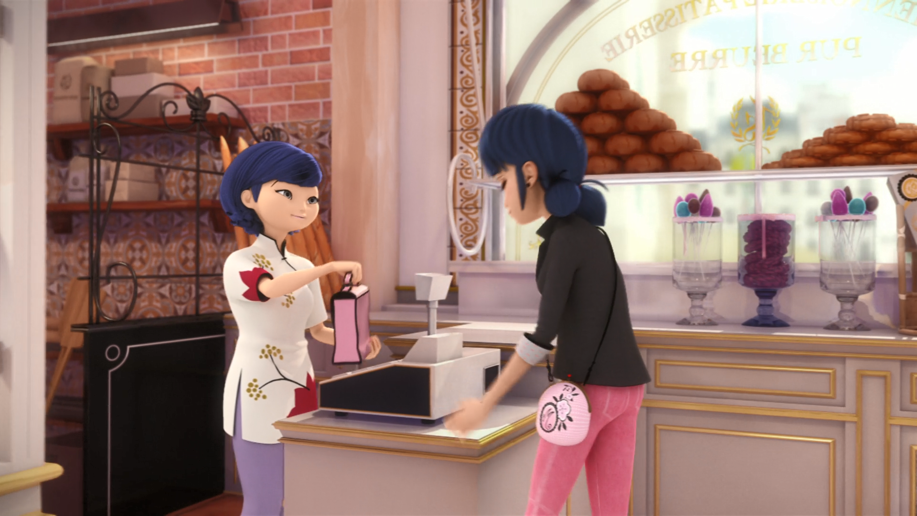
Alya brought your ______ bag home for you, Marinette.
school
shoe
shower

Slide 11
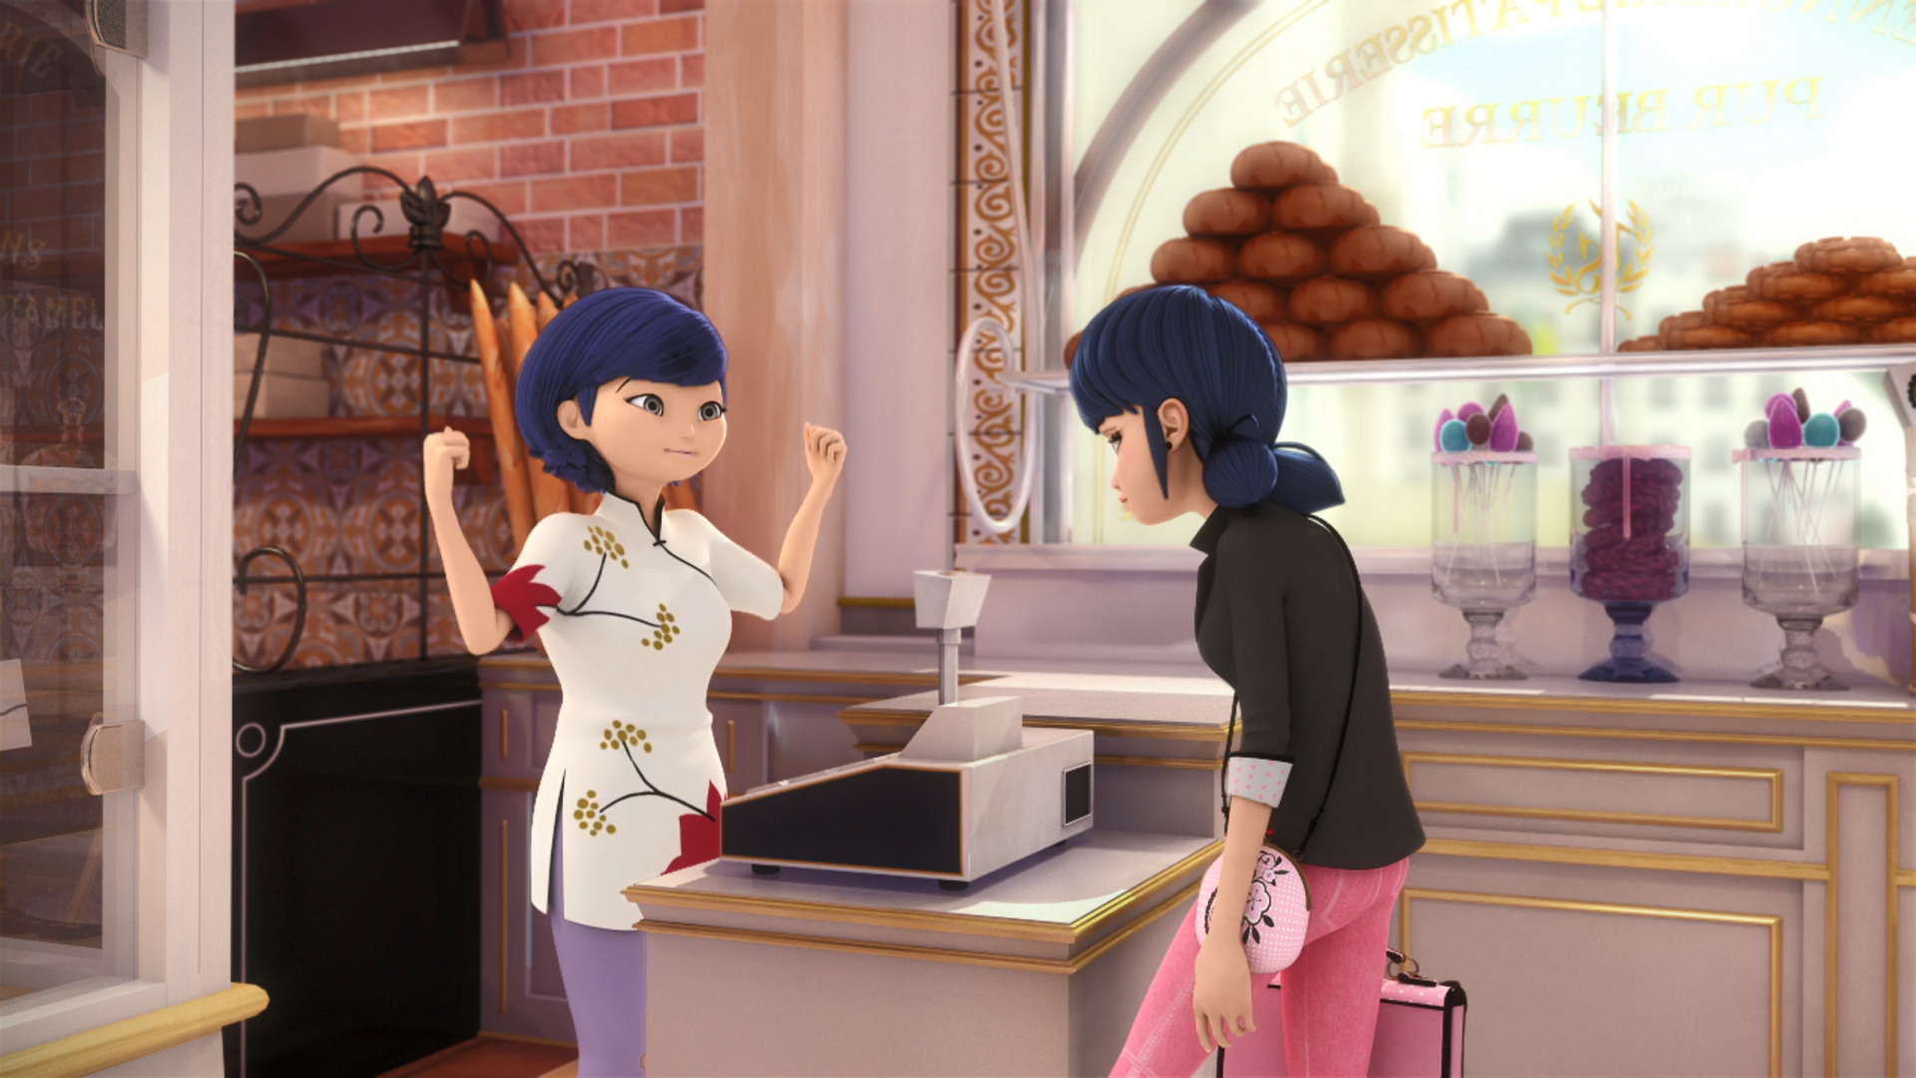
Maybe you just need some fresh air for that growing ______ of yours!
nose
brain
head

Slide 12
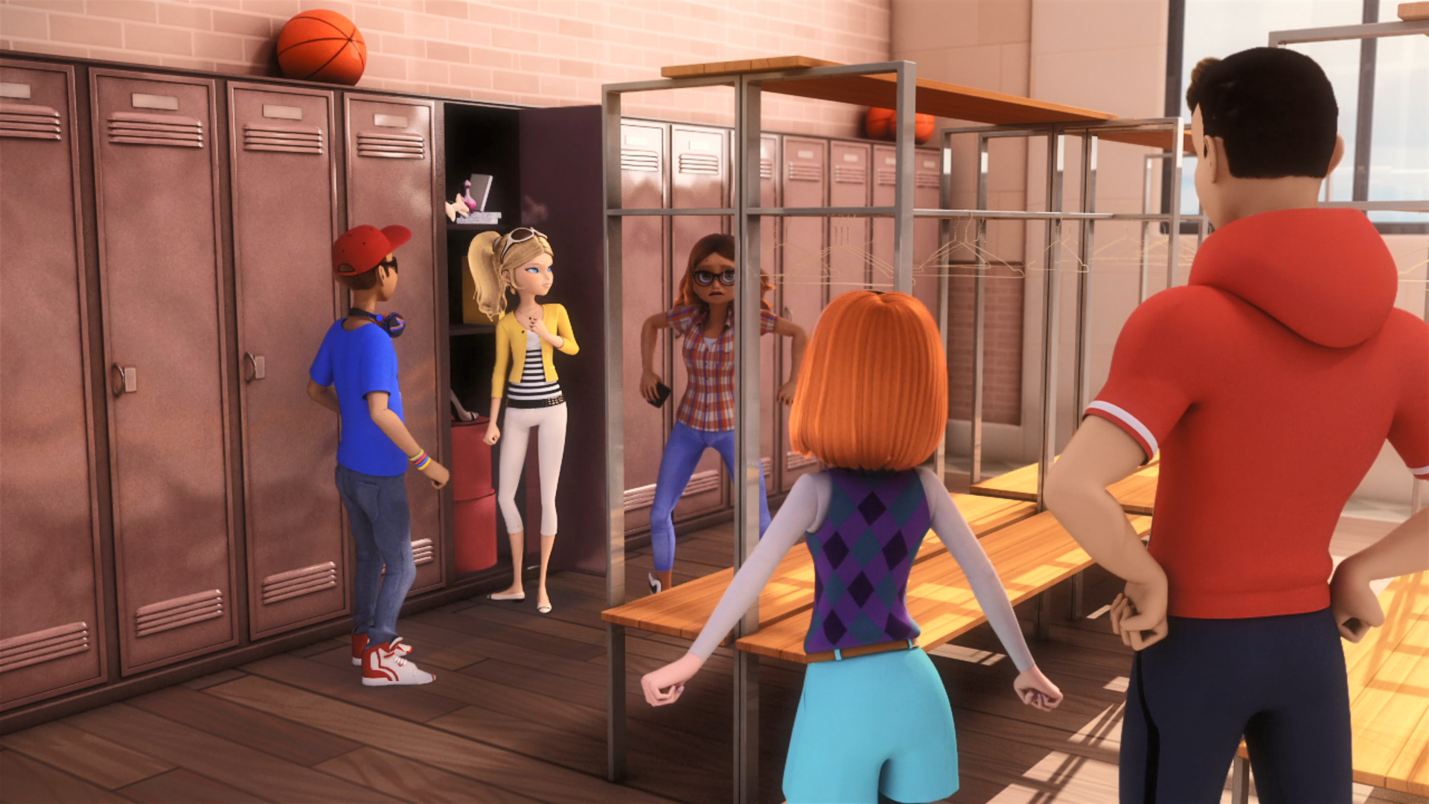
Alya's looking in your ______.
pants
locker
phone

Slide 13
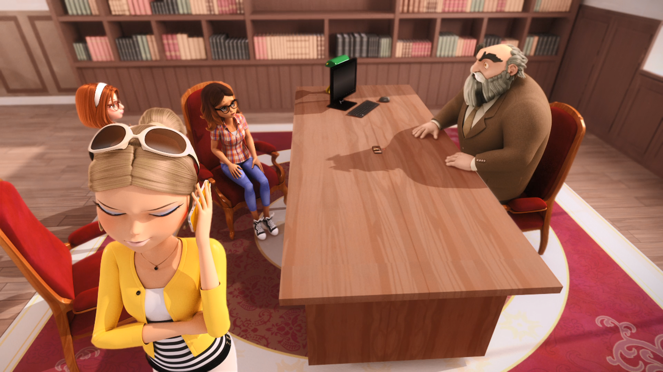
You're ______ for a week, Alya.
suspended
jailed
dead

Slide 14
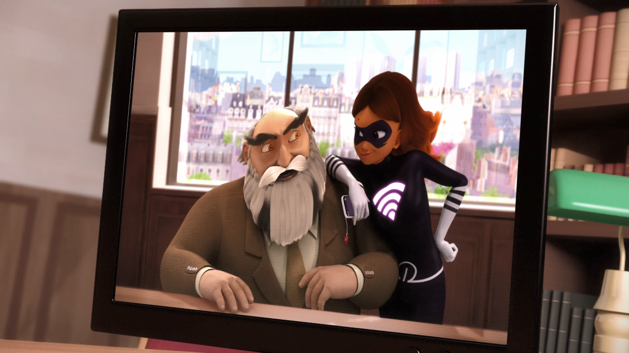
So, Mr. Damocles, is it true you wrongly ______ a student?
kissed
sat on
suspended

Slide 15
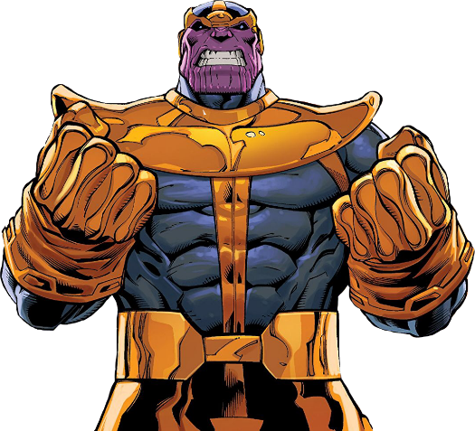
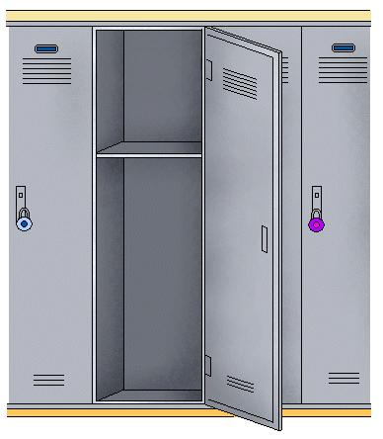


Matching Exercise
principal | mask | villain | locker

Slide 16
Matching Exercise
villain | locker | principal | mask

Slide 17
TRUE OR FALSE
1. Alya thinks Chloe is ladybug.
2. Marinette missed two days of school.
3. Marinette's mother is Chinese.
4. NIno brought Marinette's school bag home.
5. There's no WiFi signal for two hours.

Slide 18
TRUE OR FALSE
1. Alya thinks Chloe is ladybug. | TRUE
2. Marinette missed two days of school. | FALSE
3. Marinette's mother is Chinese. | TRUE
4. NIno brought Marinette's school bag home. | FALSE
5. There's no WiFi signal for two hours. | FALSE

