Slide 1
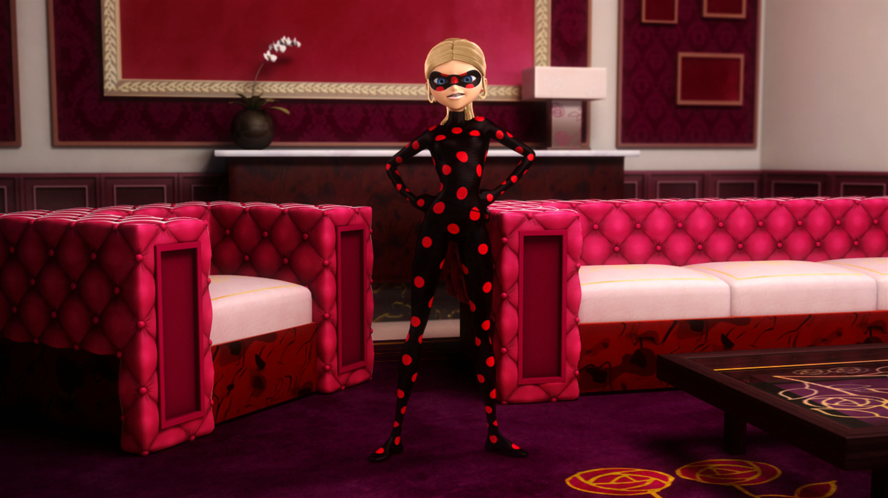
ANTIBUG. PART 2

Slide 2
VOCABULARY
devotion - 奉献 - dɪˈvəʊʃən
earlier - 早些时候 - ˈɜːlɪə
emergency - 紧急情况 - ɪˈmɜːʤənsi
gratitude - 感激 - ˈgrætɪtjuːd
harm - 伤害 - hɑːm
hugest - 最大的 - ˈhjuːʤɪst
judge - 法官 - ˈʤʌʤ
mutual - 相互的 - ˈmjuːtjʊəl
unstoppable - 势不可挡 - ʌnˈstɒpəbl

Slide 3
1. 早些时候
2. 紧急情况
3. hɑːm
4. hjuːʤɪst

Slide 4
1. 早些时候 - earlier
2. 紧急情况 - ɪˈmɜːʤənsi
3. hɑːm - harm
4. hjuːʤɪst - hugest

Slide 5
ANTIBUG. PART 2
Cat Noir: Why didn't you listen to Chloé? She was only trying to help.
Ladybug: First, because that girl put us in danger. And second, she completely lied to us earlier. I was not gonna listen to a liar.
Chloé: You're calling me a liar?! How dare you?! I was your hugest fan, but not anymore!

Slide 6
Antibug: Ha ha ha ha! If it weren't for me, you wouldn't have defeated Vanisher.
And now, I'm going to defeat you!
Ladybug & Cat Noir: Chloé?
Antibug: Wrong, super wrong. I am Antibug!
Ladybug: We've got an emergency here. I'm about to change back.
Cat Noir: Go ahead, I can take care of her.

Slide 7
Tikki: You don't have to do everything yourself. There's no harm in listening to others from time to time.
Marinette: You're right Tikki, but right now we have to go and help Cat Noir. We'll find you something to eat at the hotel.
Tikki: I'm eating as fast as I can!

Slide 8
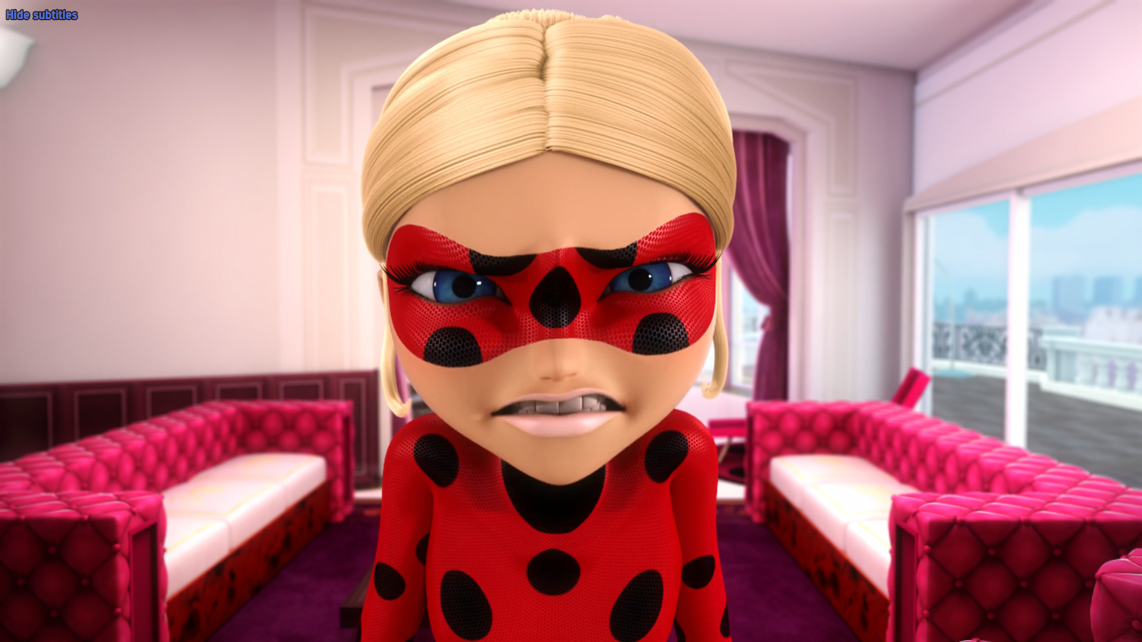
You're calling me a liar?! How dare you?! I was your _____ fan.
biggest
craziest
hugest

Slide 9
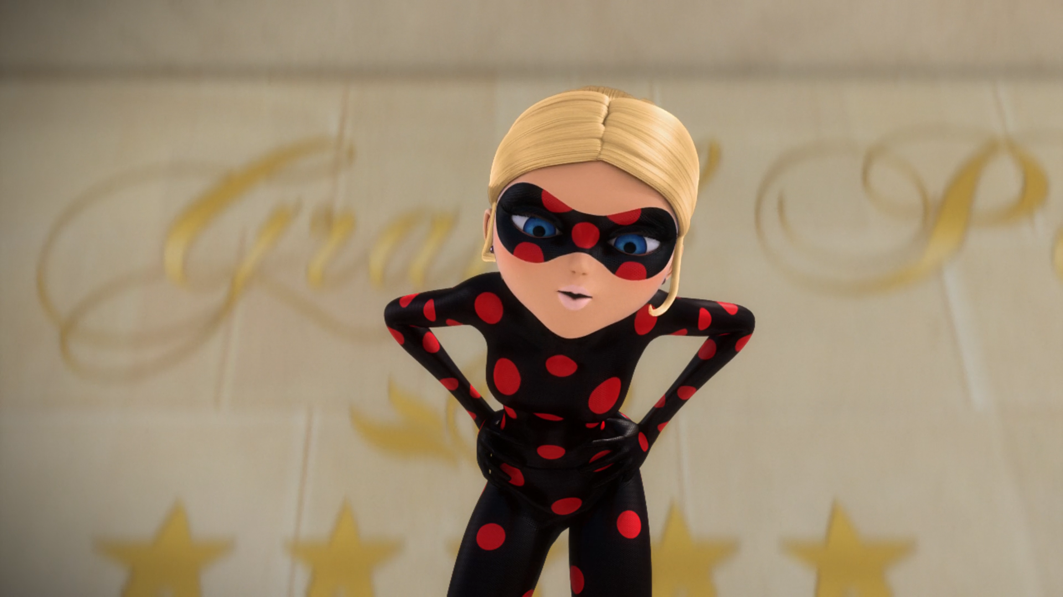
If it weren't for me, you wouldn't have _____ Vanisher.
defeated
killed
beaten

Slide 10
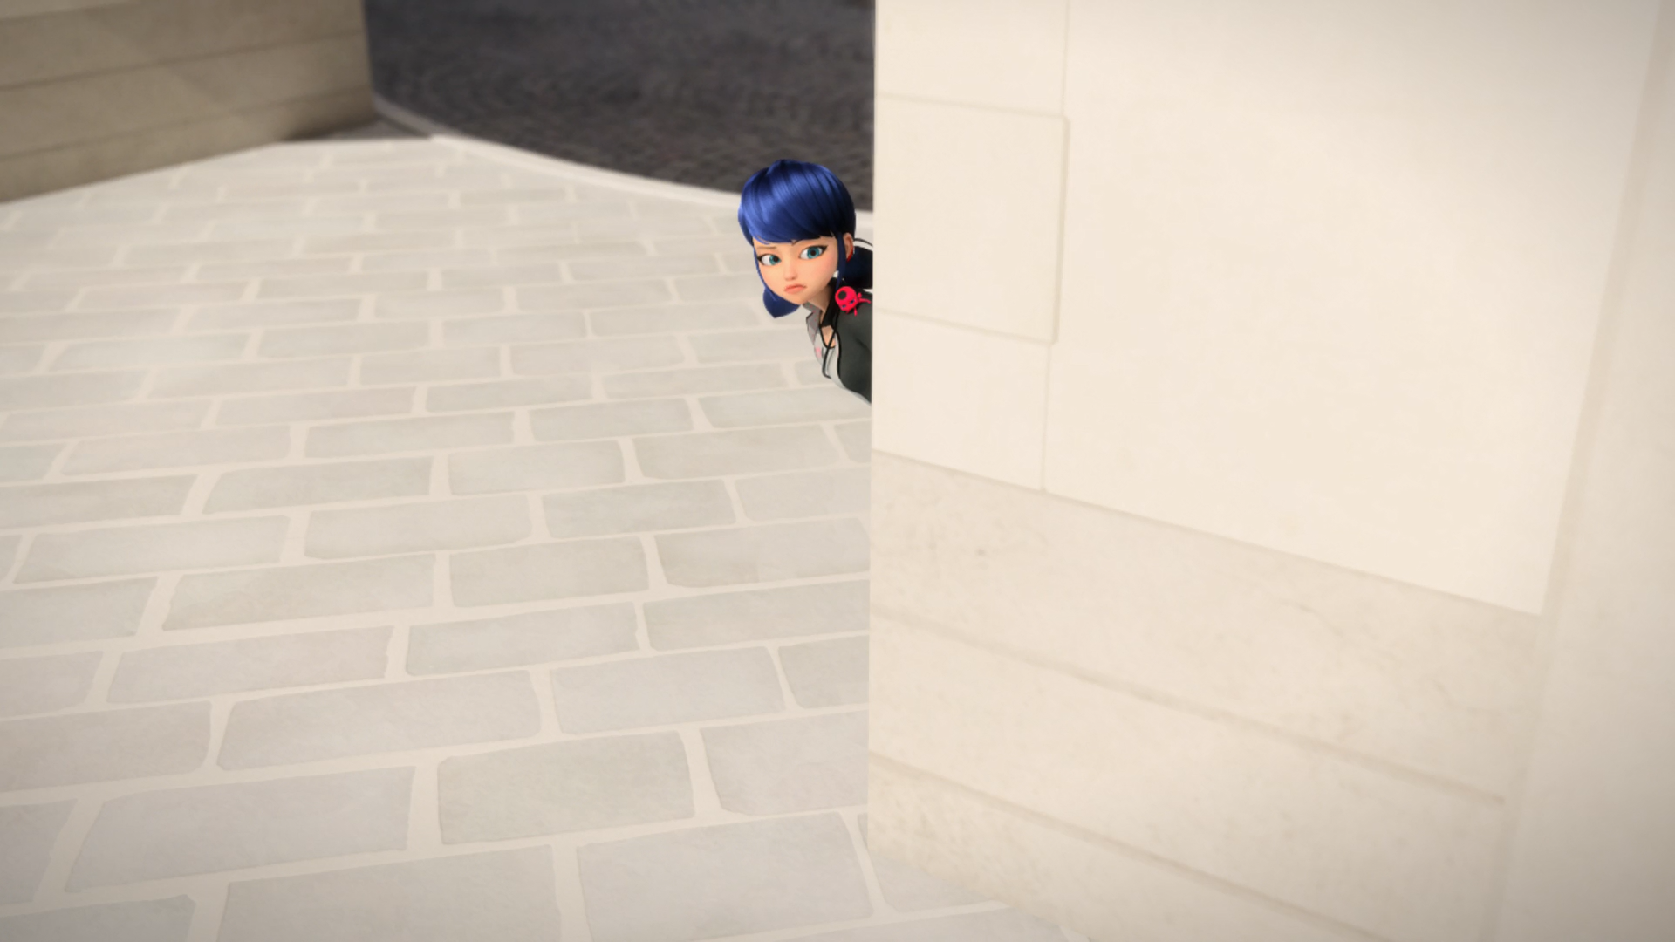
We'll find you something to eat at the ______.
school
hotel
toilet

Slide 11
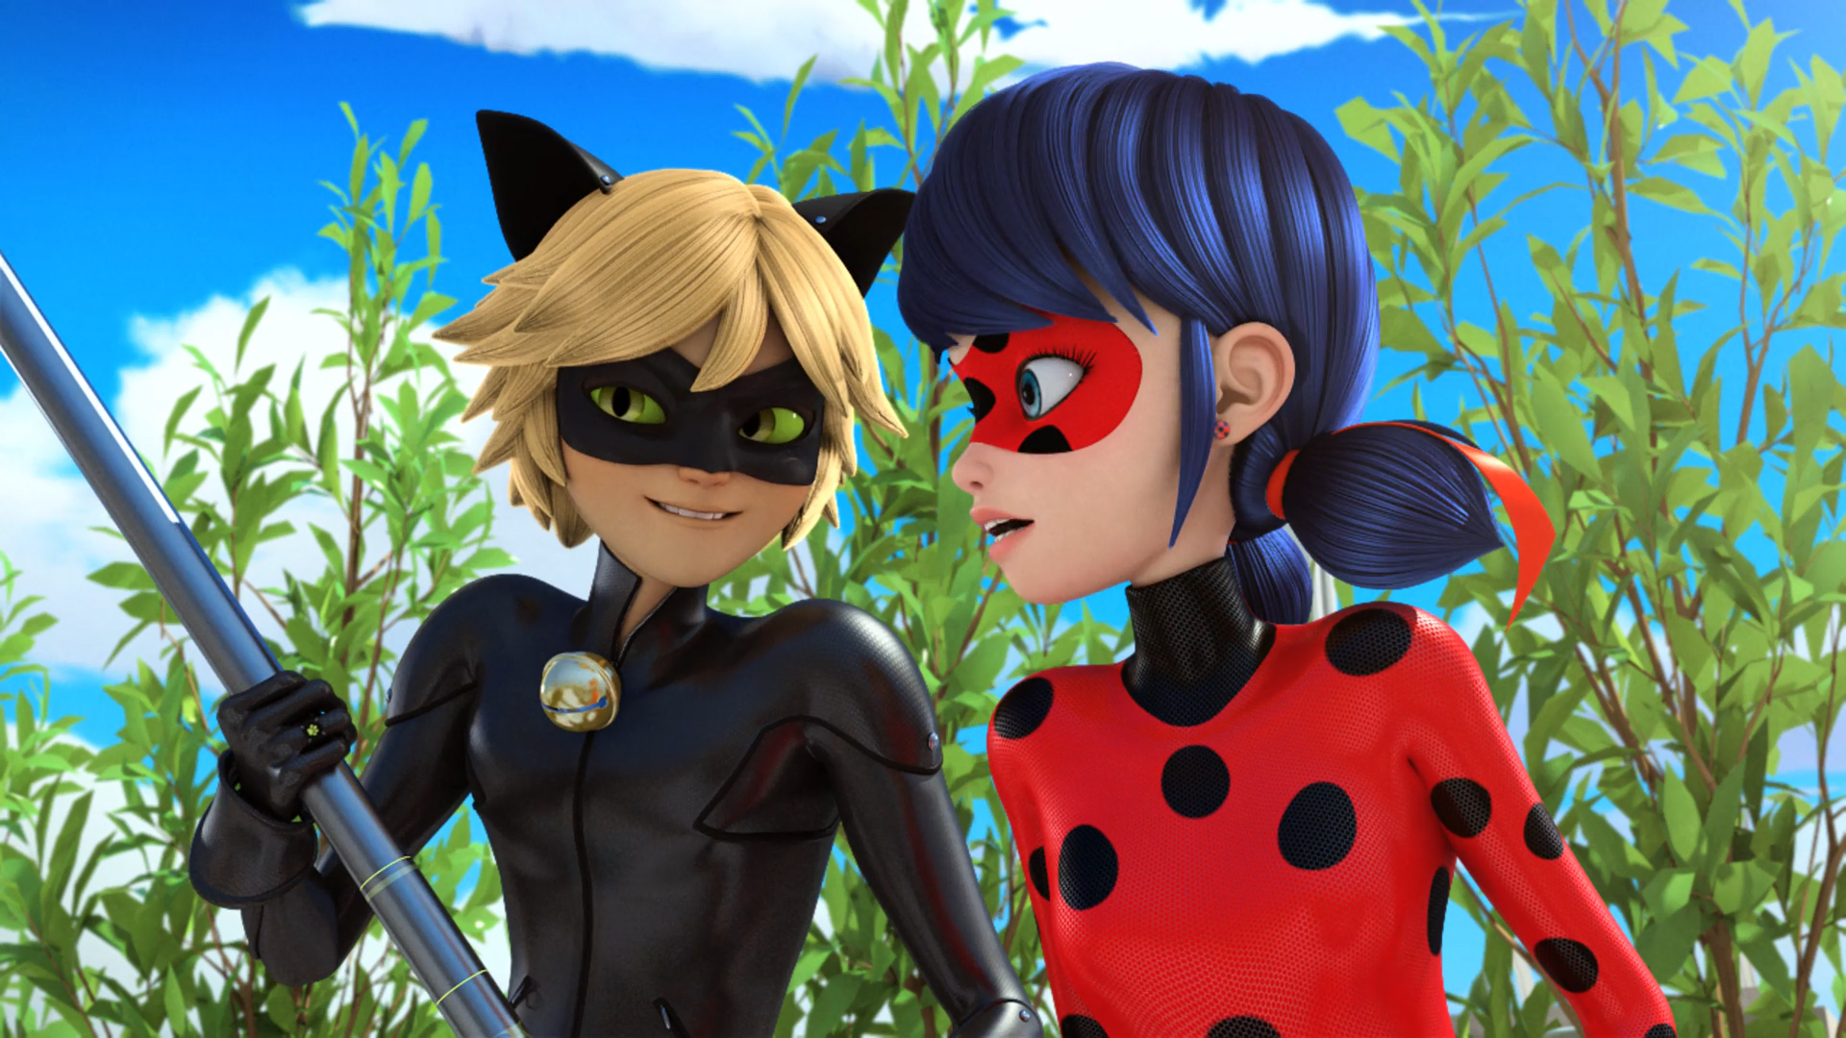
I'm thinking the akuma's in the yo-yo.
I'm thinking it's in her ______.
butt
earrings
pants

Slide 12
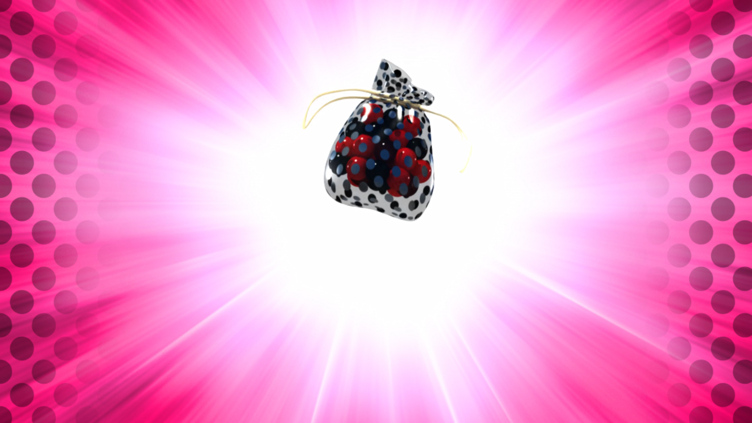
Hahahahaha! What? You're going to defeat me with ______?
balls
toys
marbles

Slide 13
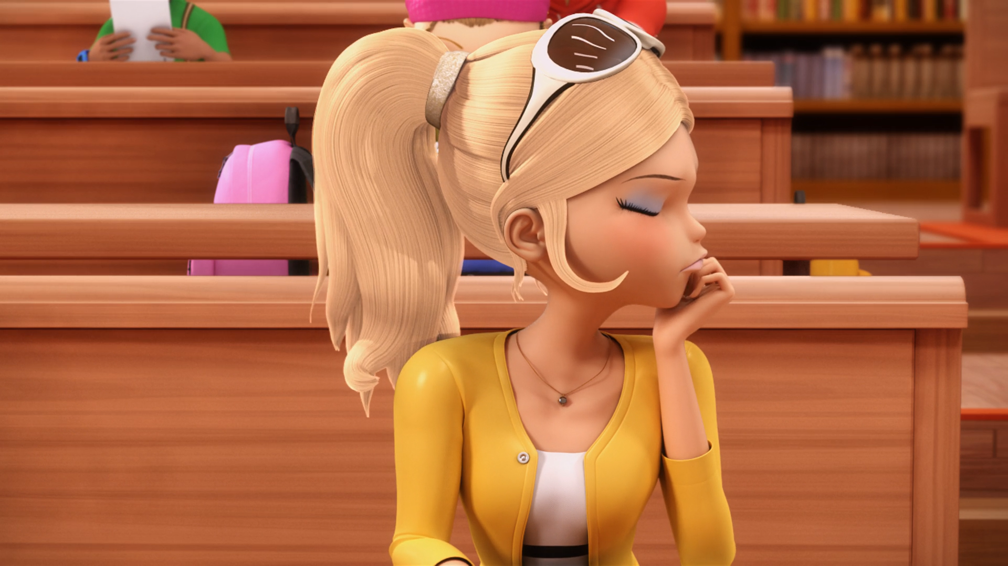
And put it on your ______, it'll make it less horrible.
sweater
head
bag

Slide 14
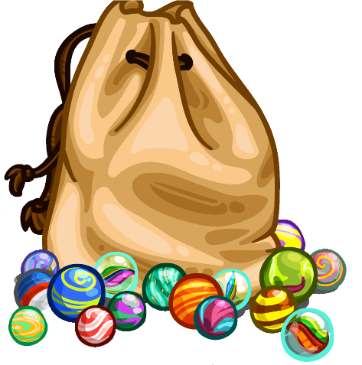
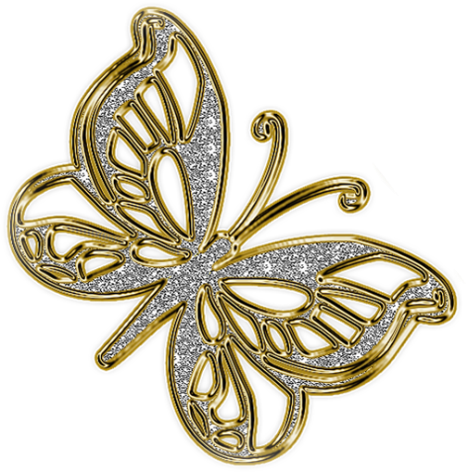
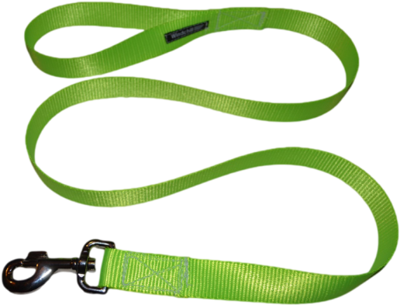

Matching Exercise
marbles | broach | leash | download

Slide 15
Matching Exercise
leash | marbles | download | broach

Slide 16
TRUE OR FALSE
1. Sabrina was Ladybug's biggest fan.
2. Marinette finds food for Tikki at the hotel.
3. Chloé's akuma is in her earrings.
4. Ladybug's lucky charm is a bag of marbles.
5. Chloé gets Sabrina a new sweater.

Slide 17
TRUE OR FALSE
1. Sabrina was Ladybug's biggest fan. | FALSE
2. Marinette finds food for Tikki at the hotel. | TRUE
3. Chloé's akuma is in her earrings. | FALSE
4. Ladybug's lucky charm is a bag of marbles. | TRUE
5. Chloé gets Sabrina a new sweater. | FALSE

Slide 18
IELTS Speaking Exam. Clubs & Societies. Part 2
Describe a time when you learned something new at a club. You should say:
what you learned
and how you learned it.

