Slide 1
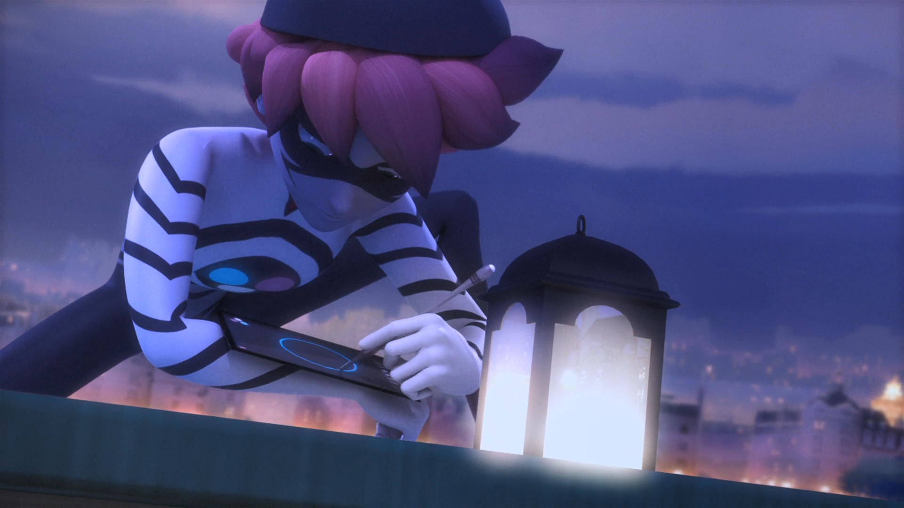
MIRACULOUS LADYBUG: THE EVILLUSTRATOR. PART 2

Slide 2
VOCABULARY
baddie - 坏人 - baddie
duo - 双人组 - djuːəʊ
erased - 抹去 - ɪˈreɪzd
expect - 预计 - ɪksˈpɛkt
gladly - 乐意 - glædli
hurt - 伤害 - hɜːt
invitation - 邀请 - ɪnvɪˈteɪʃən
properly - 适当地 - prɒpəli

Slide 3
1. 抹去
2. hɜːt
3. ɪnvɪˈteɪʃən

Slide 4
1. 抹去 - erased
2. hɜːt - hurt
3. ɪnvɪˈteɪʃən - invitation

Slide 5
EVILLUSTRATOR. PART 2
Sabrina: Great! So, you wanna work on the physics project tonight?
Marinette: Uhhh, I'm so sorry Sabrina, I've got something really important that I have to do.
Sabrina: Something really important? Really? That's fascinating.

Slide 6
Cat Noir: But I am going to need a little help. Care to assist a superhero?
Marinette: What about Ladybug? Aren't you a duo?
Cat Noir: She's busy with something tonight, so...You get to be my Ladybug.
Marinette: Me and Cat Noir? Fighting crime together? Amazing! What do I do?

Slide 7
Marinette: Come on! Seriously? Why is everybody comparing me to Chloé tonight?
Evillustrator: And I'm taking back my promise! Chloé's gonna get a little lesson she'll never forget!
Chloé: Uh? Cat Noir? Is that you? Ahhhh!
Evillustrator: Chloé, where are you? Are you hiding? That is so cute.

Slide 8
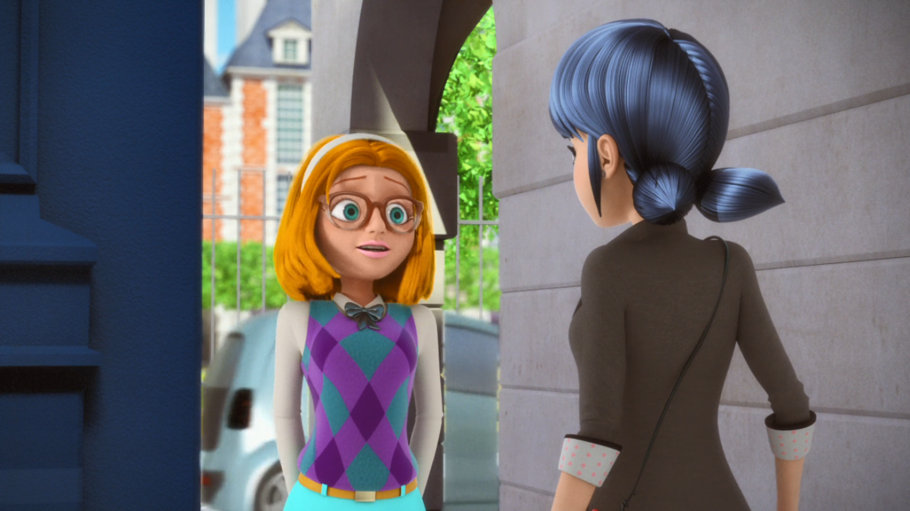
Something really important? Really? That's ______.
fantastic
fabulous
fascinating

Slide 9
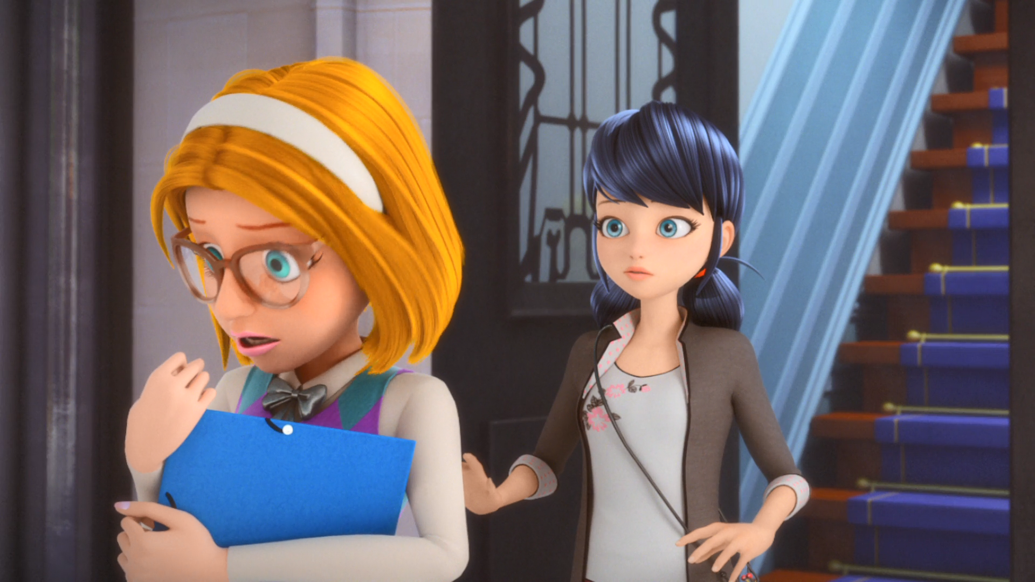
I can't believe I did your ______ homework for you...
geography
Maths
English

Slide 10
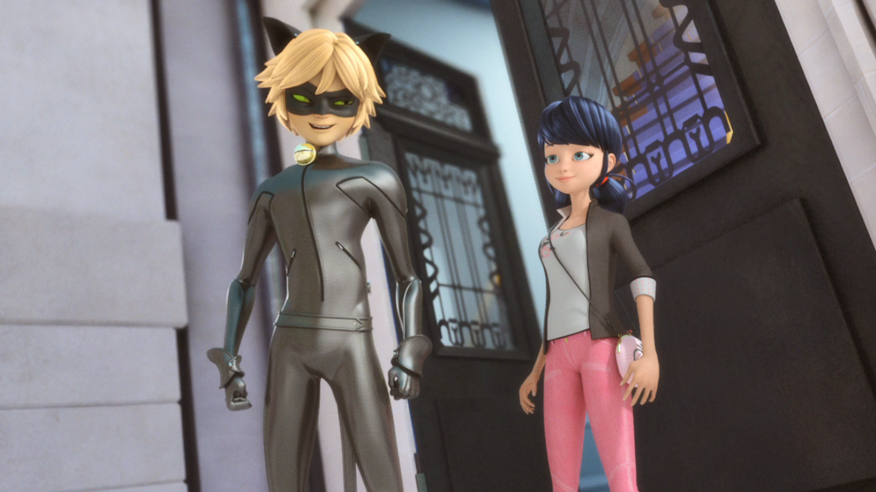
Just get that drawing pencil away from it, ______ lady.
sexy
little
pretty

Slide 11
It's just... I can't draw properly in the ______.
night
dark
toilet

Slide 12
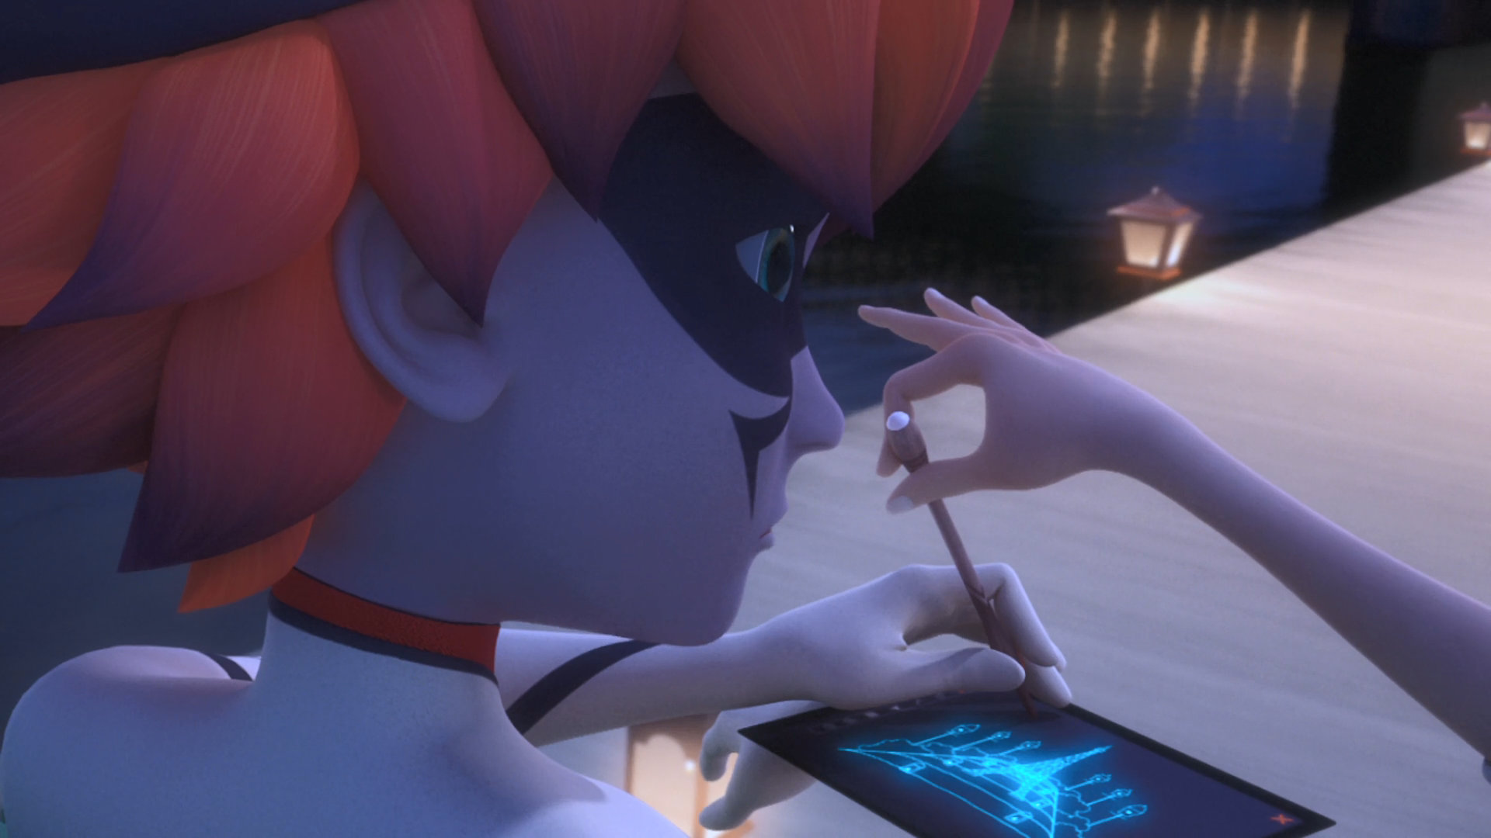
Marinette, give me my ______ back.
I need to draw something, now!
pencil
brain
iPad

Slide 13
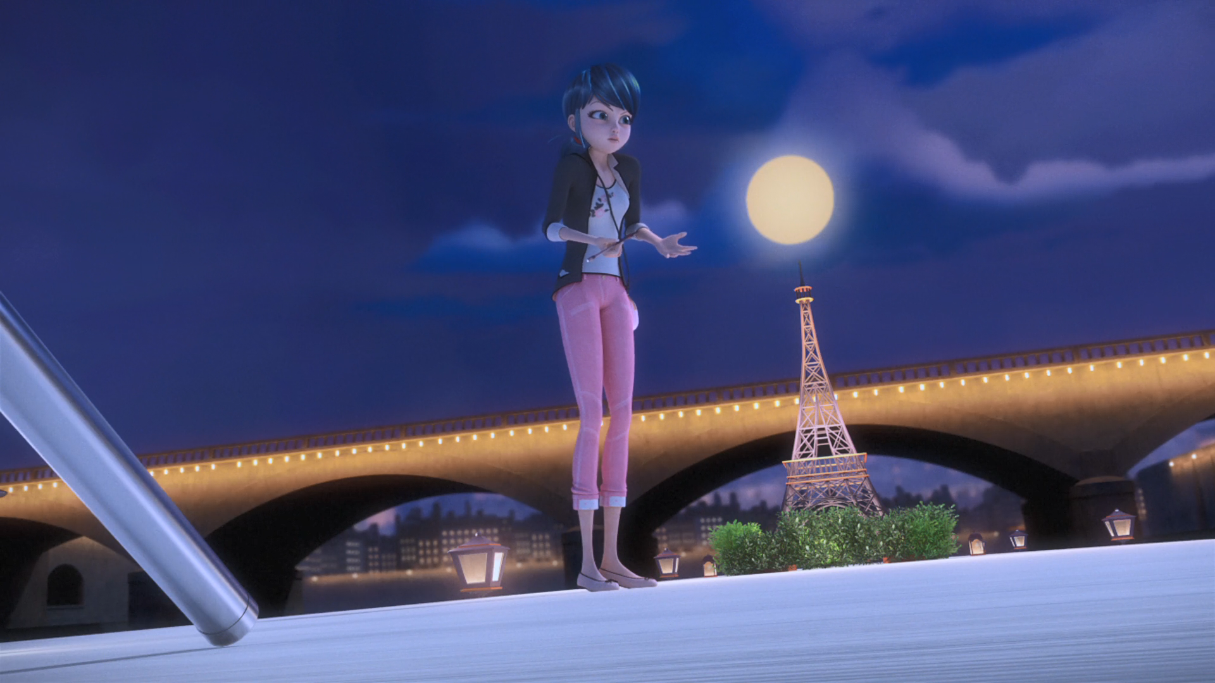
Why is everybody comparing me to ______ tonight?
Olivia
Lisa
Chloe

Slide 14


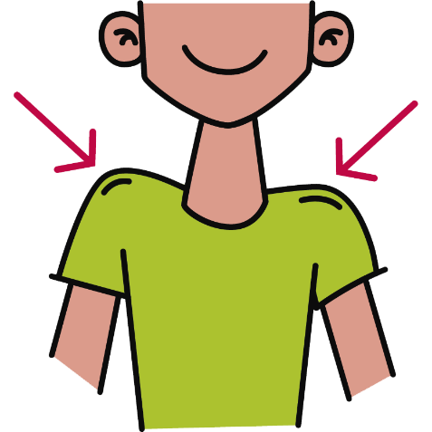
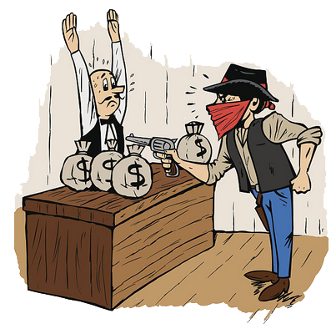
Matching Exercise
bounce | crime | geography | shoulders

Slide 15
Matching Exercise
geography | bounce | shoulders | crime

Slide 16
TRUE OR FALSE
1. Sabrina did Marinette's English homework.
2. It's the Evillustrator's birthday.
3. Evillustrator can't draw during the day.
4. The Evillustrator wears Chloé's Chanel dresses.
5. Marinette said she will never wash her jacket again.

Slide 17
TRUE OR FALSE
1. Sabrina did Marinette's English homework. | FALSE
2. It's the Evillustrator's birthday. | TRUE
3. Evillustrator can't draw during the day. | FALSE
4. The Evillustrator wears Chloé's Chanel dresses. | FALSE
5. Marinette said she will never wash her jacket again. | TRUE

