Slide 1
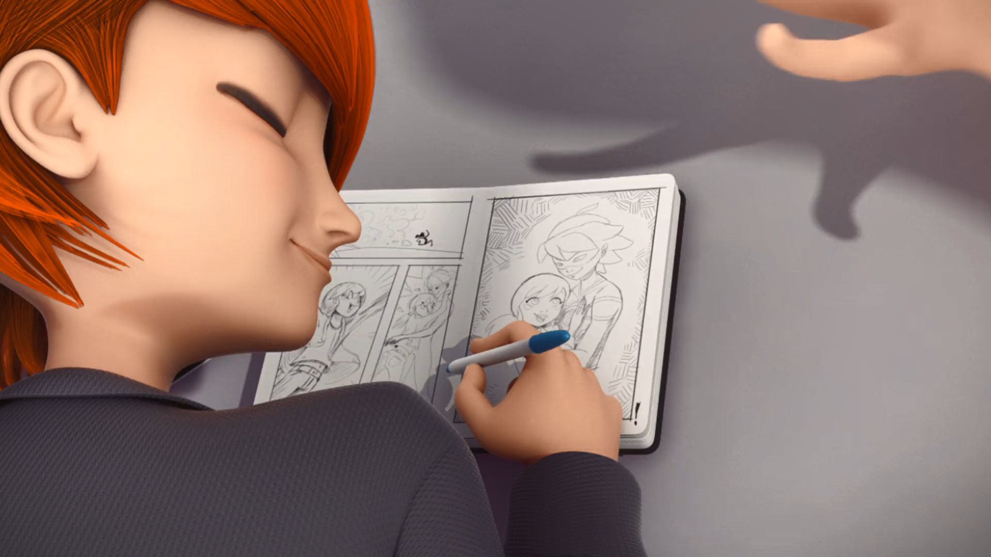
MIRACULOUS LADYBUG: THE EVILLUSTRATOR. PART 1

Slide 2
VOCABULARY
adorable - 可爱的 - əˈdɔːrəbl
artistic - 艺术的 - ɑːˈtɪstɪk
dumb - 愚蠢的 - dʌm
failing - 失败 - feɪlɪŋ
principal - 主要的 - prɪnsəpəl
research - 研究 - rɪˈsɜːʧ
trade - 贸易 - treɪd
unpleasant - 不愉快 - ʌnˈplɛznt
willing - 愿意的 - wɪlɪŋ

Slide 3
1. əˈdɔːrəbl
2. 主要的
3. 研究

Slide 4
1. əˈdɔːrəbl - adorable
2. 主要的 - principal
3. 研究 - research

Slide 5
EVILLUSTRATOR. PART 1
Ms. Mendeleiev: You go march yourself down to the principal's office!
Chloé: Ooh! Look, Sabrina! It's him as a superhero! And look who he's saving!
It's Marinette!
Marinette: Uh...
Chloé: He's so totally crushing on you, Marinette!

Slide 6
Marinette: Well then, why can't you help us with the project?
Sabrina: It's okay, Marinette. You and I will do all the research, and the writing for our project, and then, Chloé can present it! That way it's equal.
Marinette: That's not equal at all! Is that how you two work?!

Slide 7
Marinette: Well, I'd rather have no friends than be friends with you.
Chloé: Whatever. I've got more important things to worry about.
Sabrina: Marinette! I can't believe you stood up to Chloé like that! It was so amazing.
Marinette: Uhh, well...Yeah, what are friends for?

Slide 8
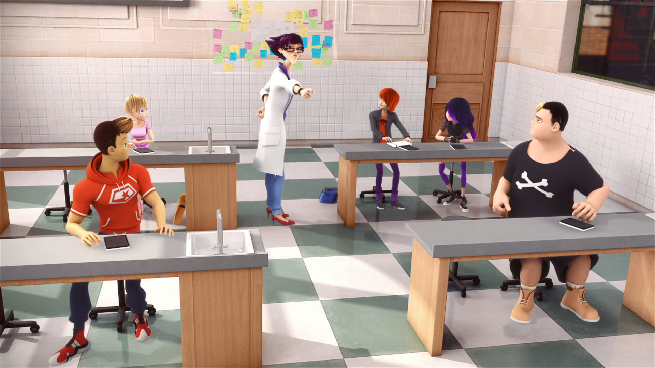
You go march yourself down to the ______ office!
mayor's
teacher's
principal's

Slide 9
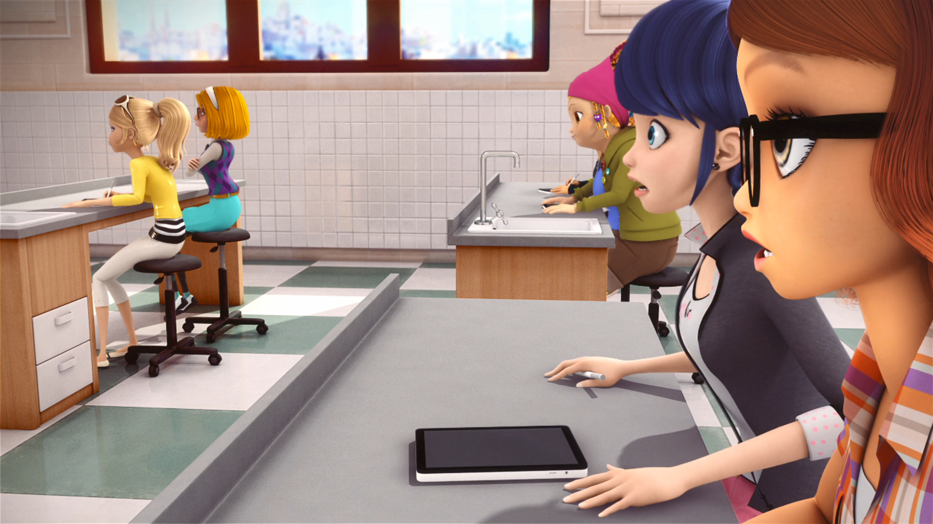
And then, Sabrina, ______ and Marinette.
Chloé
Oliver
Wendy

Slide 10
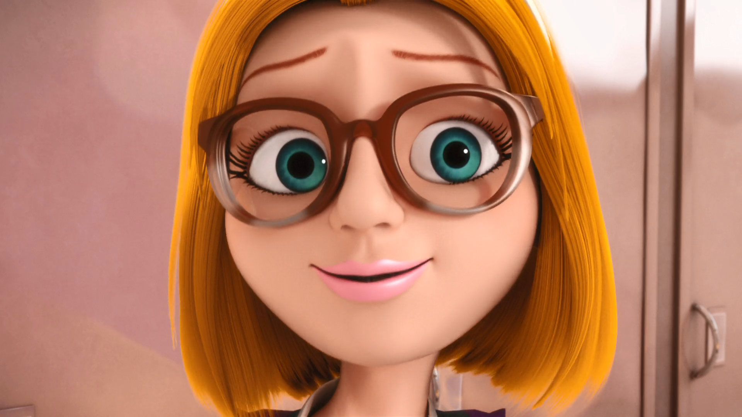
Since grade school, when I started doing Chloé's ______ !
make-up
homework
toilet

Slide 11
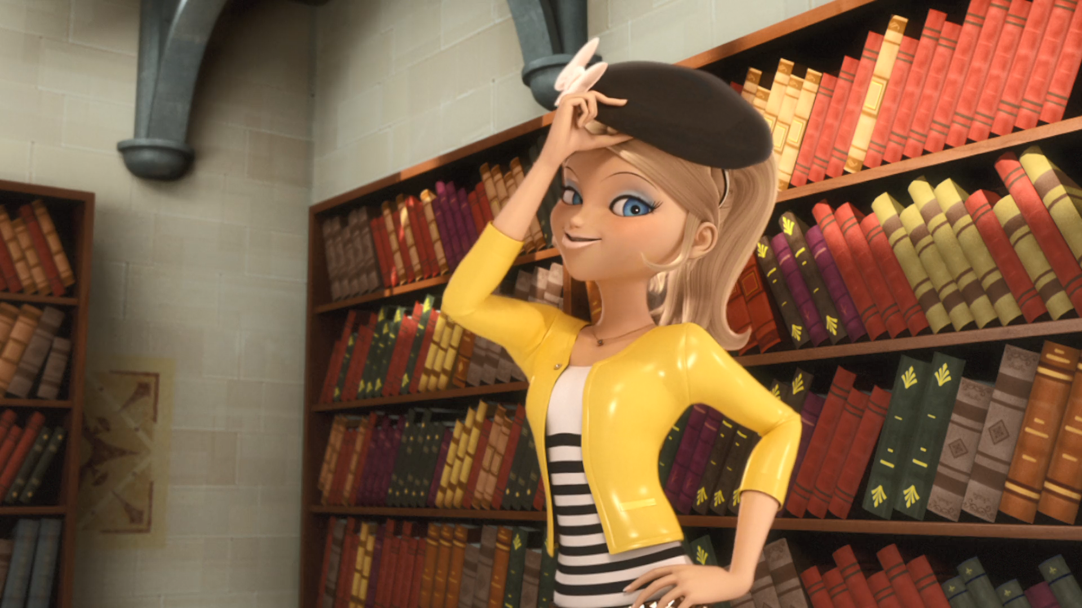
But Marinette didn't buy a super cute ______.
jacket
beret
t-shirt

Slide 12
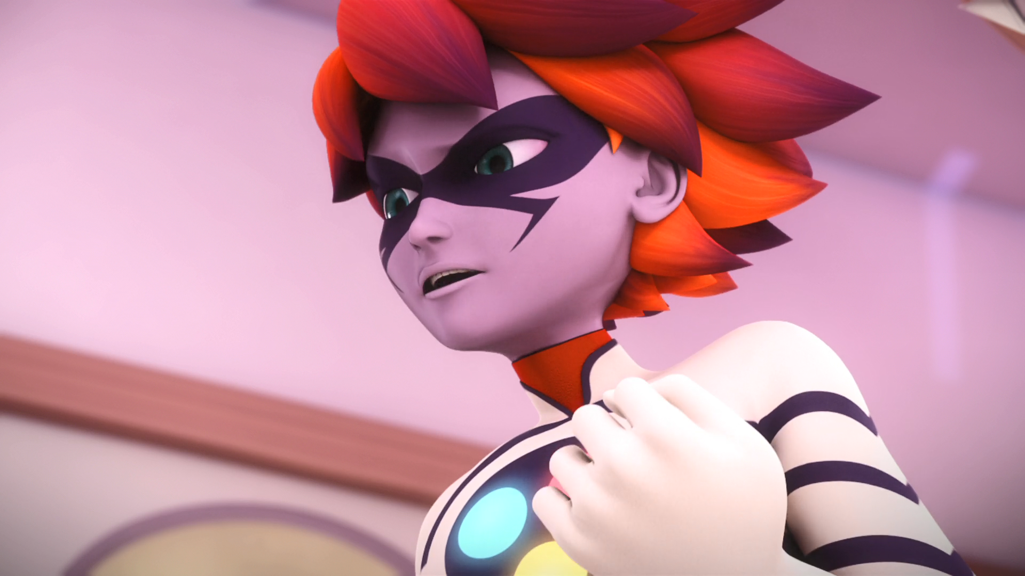
Chloé is ______ and selfish!
cruel
sexy
ugly

Slide 13
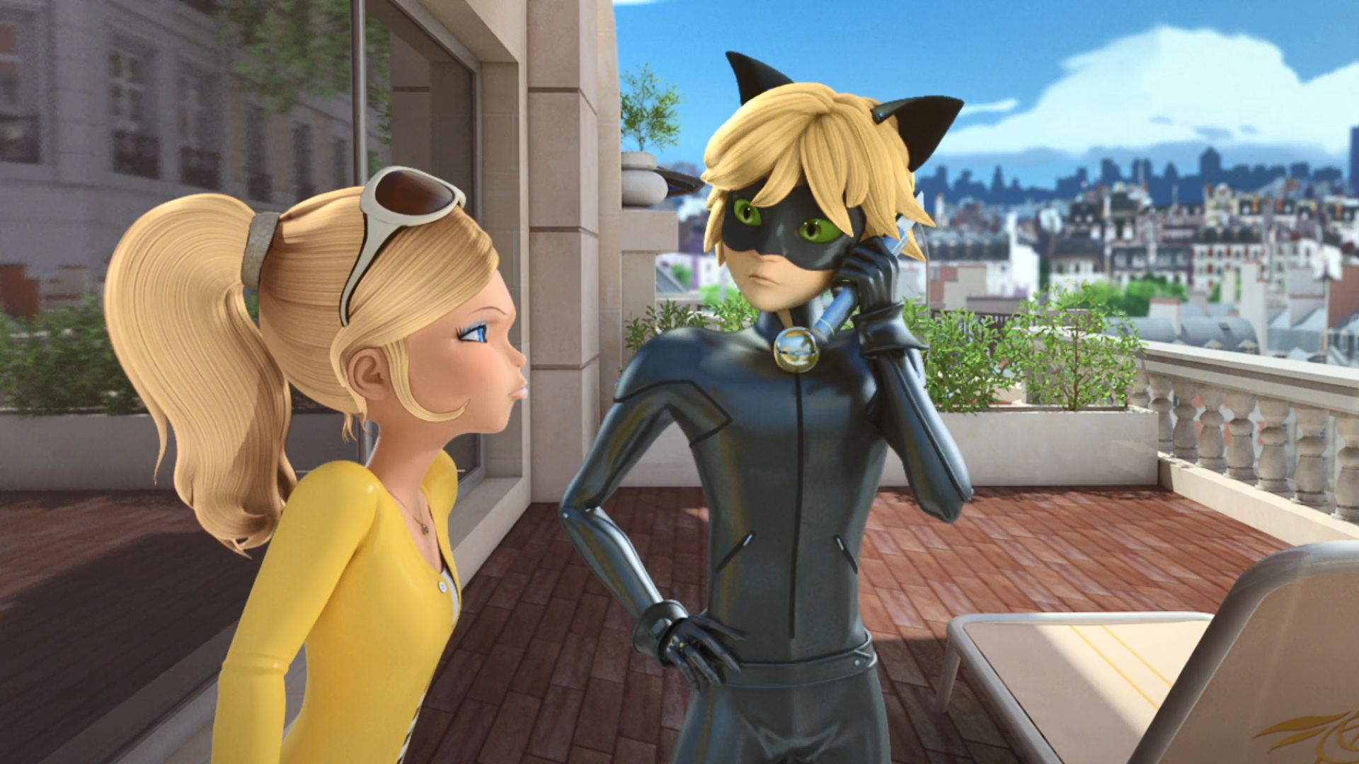
As long as Marinette comes to his ______ party.
wedding
graduation
birthday

Slide 14

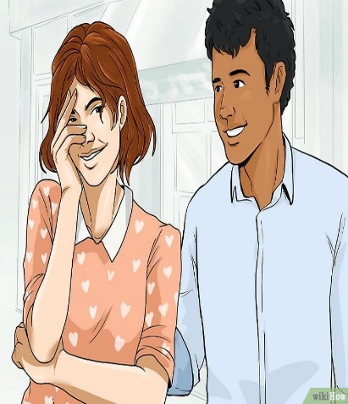


Matching Exercise
crush | science | presentation | trade

Slide 15
Matching Exercise
trade | crush | science | presentation

Slide 16
TRUE OR FALSE
1. Nathaniel is failing science.
2. Sabrina and Alya are in Marinette's group.
3. Chloé bought a hat.
4. Ladybug asks Plagg to protect Marinette.
5. Chloé is a bitch.

Slide 17
TRUE OR FALSE
1. Nathaniel is failing science. | TRUE
2. Sabrina and Alya are in Marinette's group. | FALSE
3. Chloé bought a hat. | TRUE
4. Ladybug asks Plagg to protect Marinette. | FALSE
5. Chloé is a bitch. | TRUE

