Slide 1
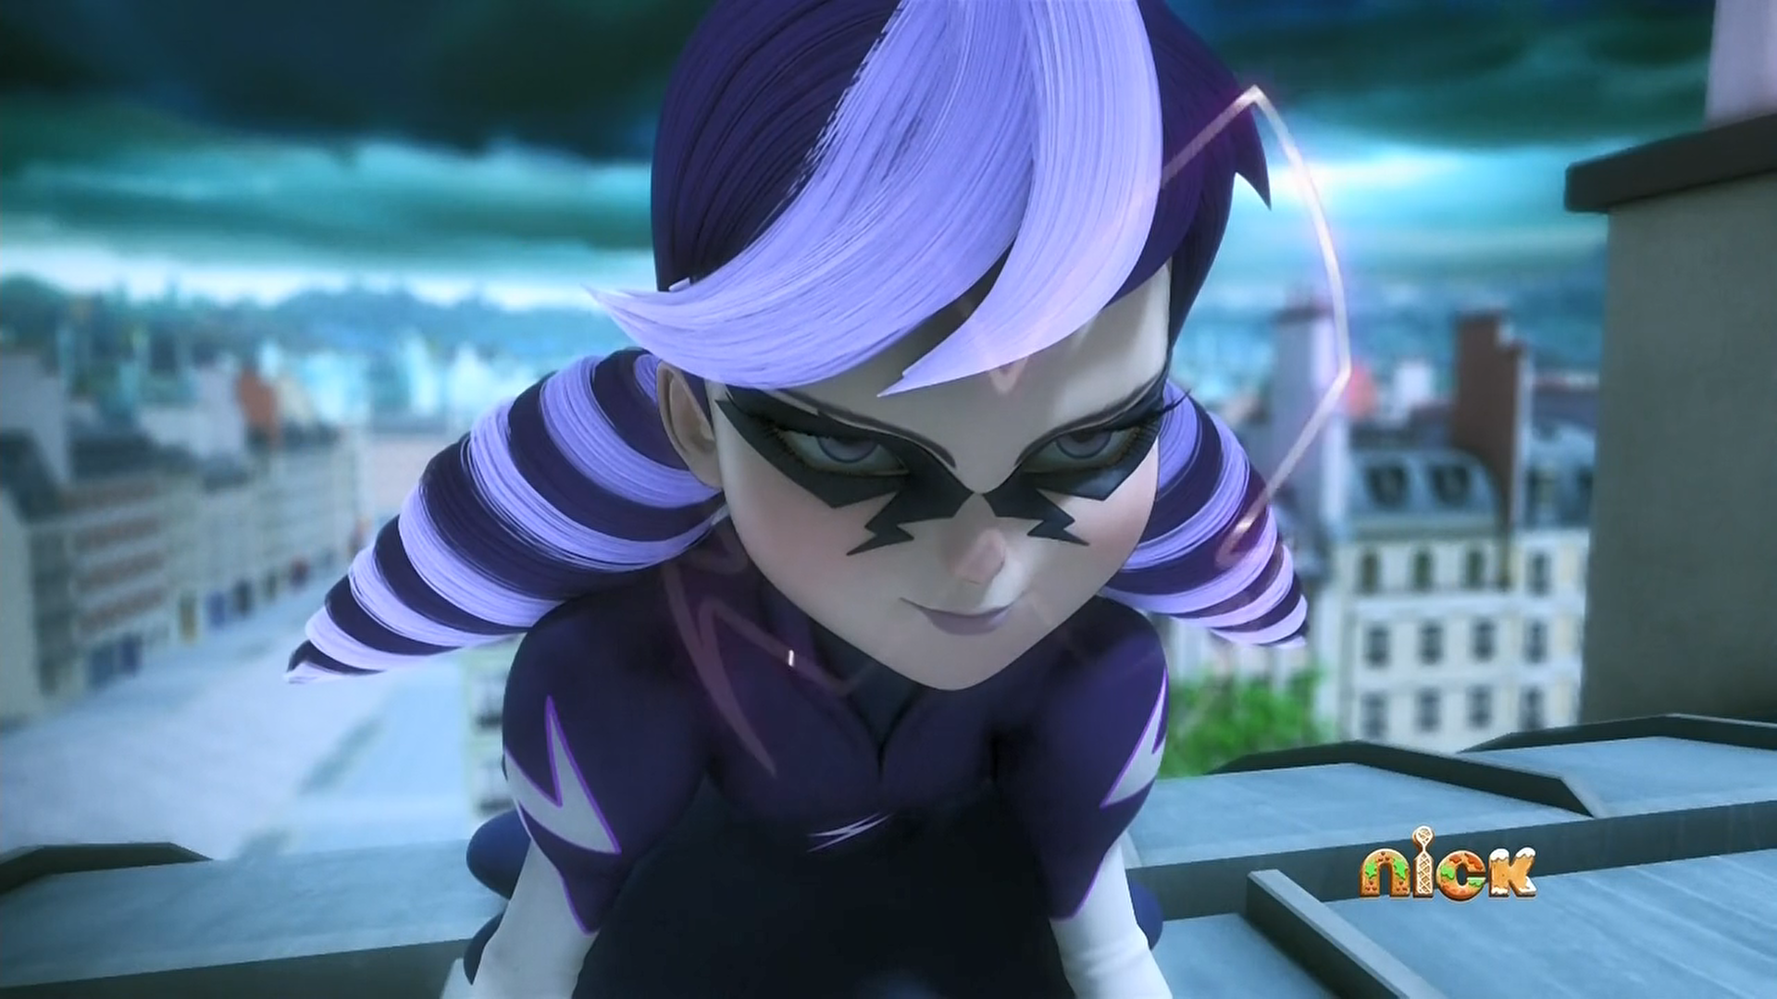
MIRACULOUS LADYBUG: STORMY WEATHER. PART 2

Slide 2
VOCABULARY
butterfly - 蝴蝶 - bʌtəflaɪ
childish - 幼稚 - ʧaɪldɪʃ
cramp - 抽筋 - kræmp
generous - 慷慨的 - ʤɛnərəs
obliterated - 抹杀 - əˈblɪtəreɪtɪd
parasol - 阳伞 - pærəsɒl
quit - 放弃 - kwɪt
temperature - 温度 - tɛmprɪʧə
terrorise - 恐吓 - tɛrəraɪz

Slide 3
1. 蝴蝶
2. 放弃
3. 温度

Slide 4
1. 蝴蝶 - butterfly
2. 放弃 - quit
3. 温度 - temperature

Slide 5
STORMY WEATHER. PART 2
Cat Noir: Listen. I'm feline more generous than usual today. So cool down and we'll call it quits, 'kay?
Cat Noir: Ahhhh! Ugh, oh.
Ladybug: I thought cats always landed on their feet.
Cat Noir: Why thanks, my Ladybug, but I had it covered.

Slide 6
Tikki: Hey, there's the photographer and Adrien waiting for you!
Marinette: You don't think it's too late?
Tikki: Come on, Marinette. You saved Manon, and the whole world for that matter. Have some fun!
Manon: Marinette!
Marinette: Huh?
Manon: I know what your secret is!

Slide 7
Marinette: W-w-what secret?
Manon: Ladybug is your best friend! That's how you both always know what the other one's gonna do!
Marinette: Huhhh... Phew!
Manon: Can I have a lollipop? Can I? Can I? Can I?
Marinette: No, Manon. I have something important to do.

Slide 8
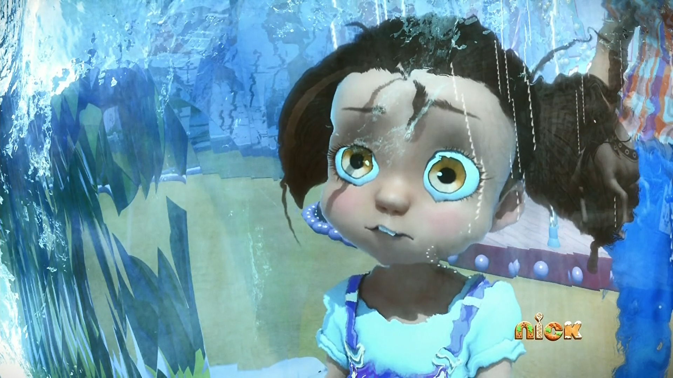
How did you know my ______?
WeChat
address
name

Slide 9
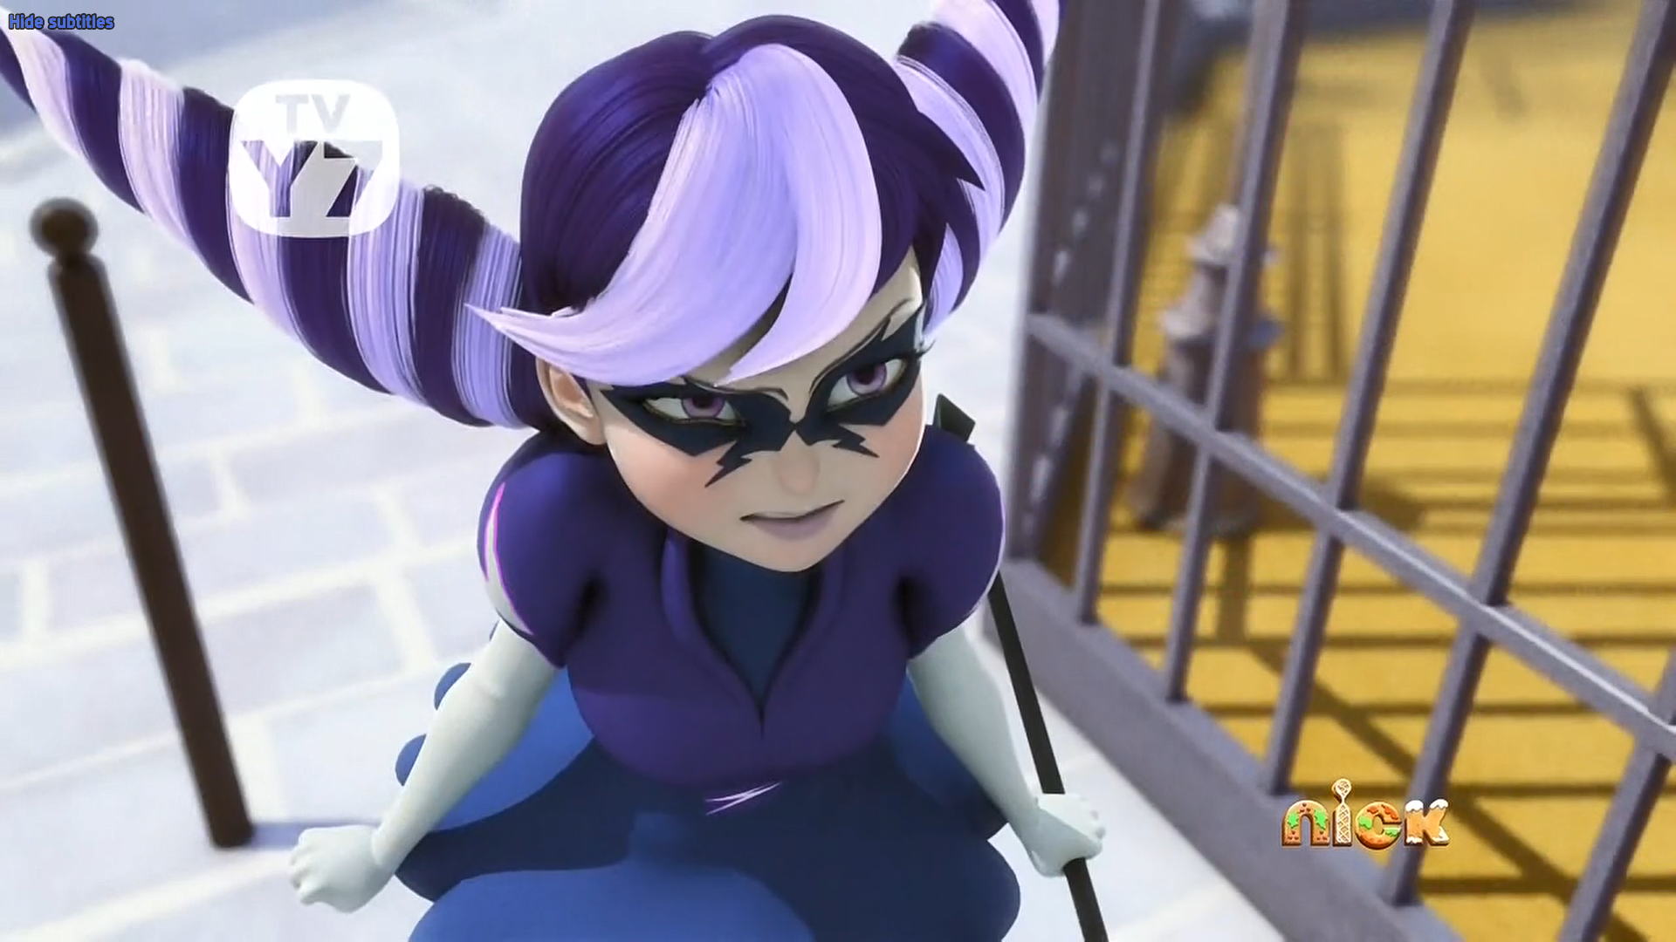
My name is not Ice Queen! It's ______ Weather!
Stormy
Bad
Cold

Slide 10
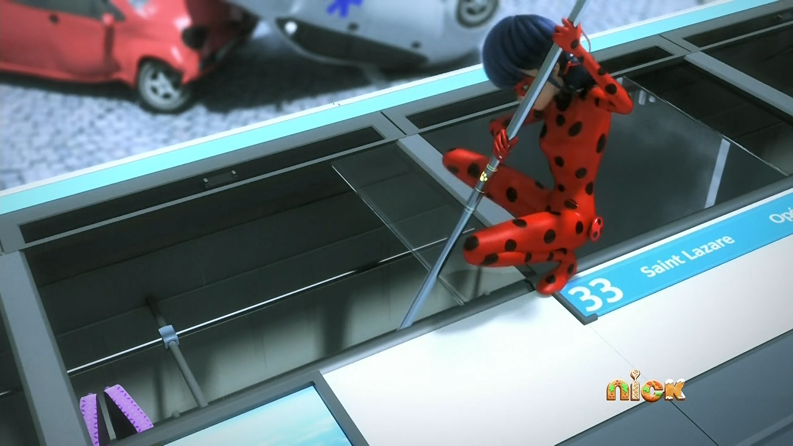
Or she didn't pass her ______ test!
English
driving
Maths

Slide 11
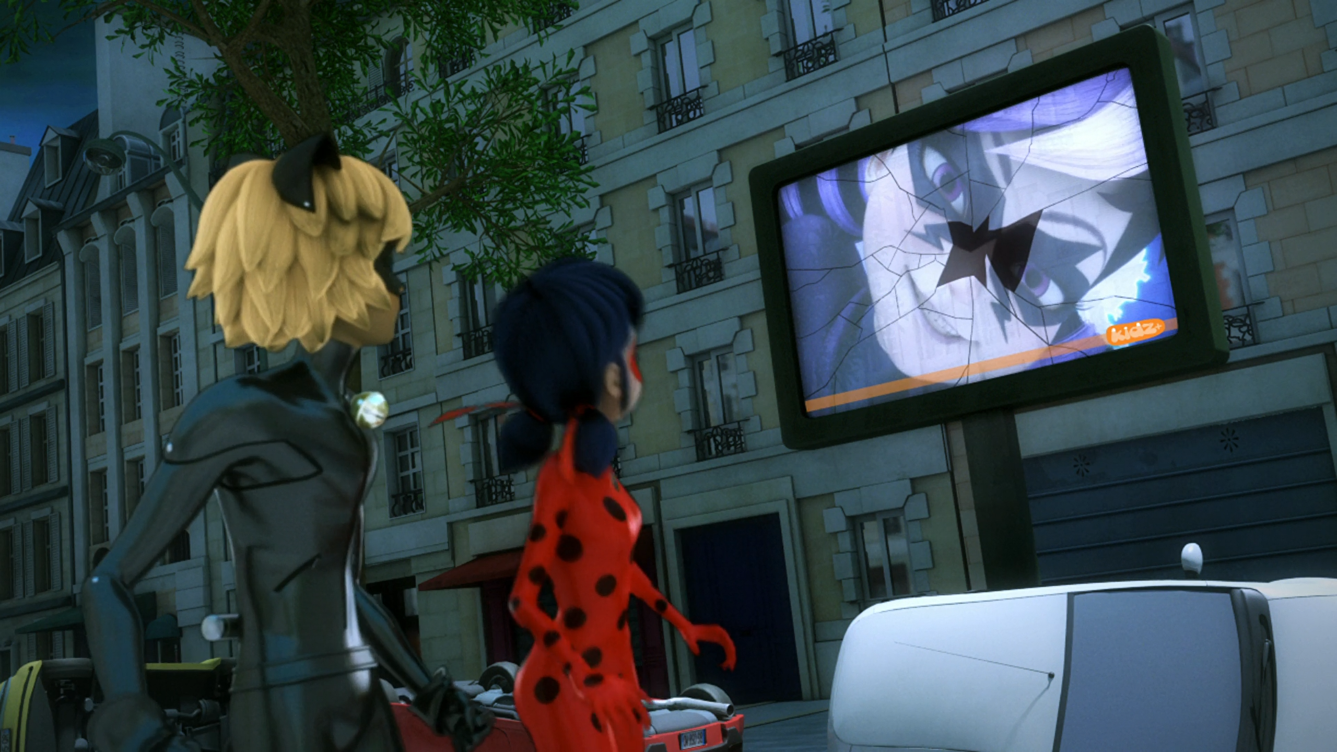
Hello, viewers! Here's the latest forecast for the first day of ______.
winter
summer
autumn

Slide 12
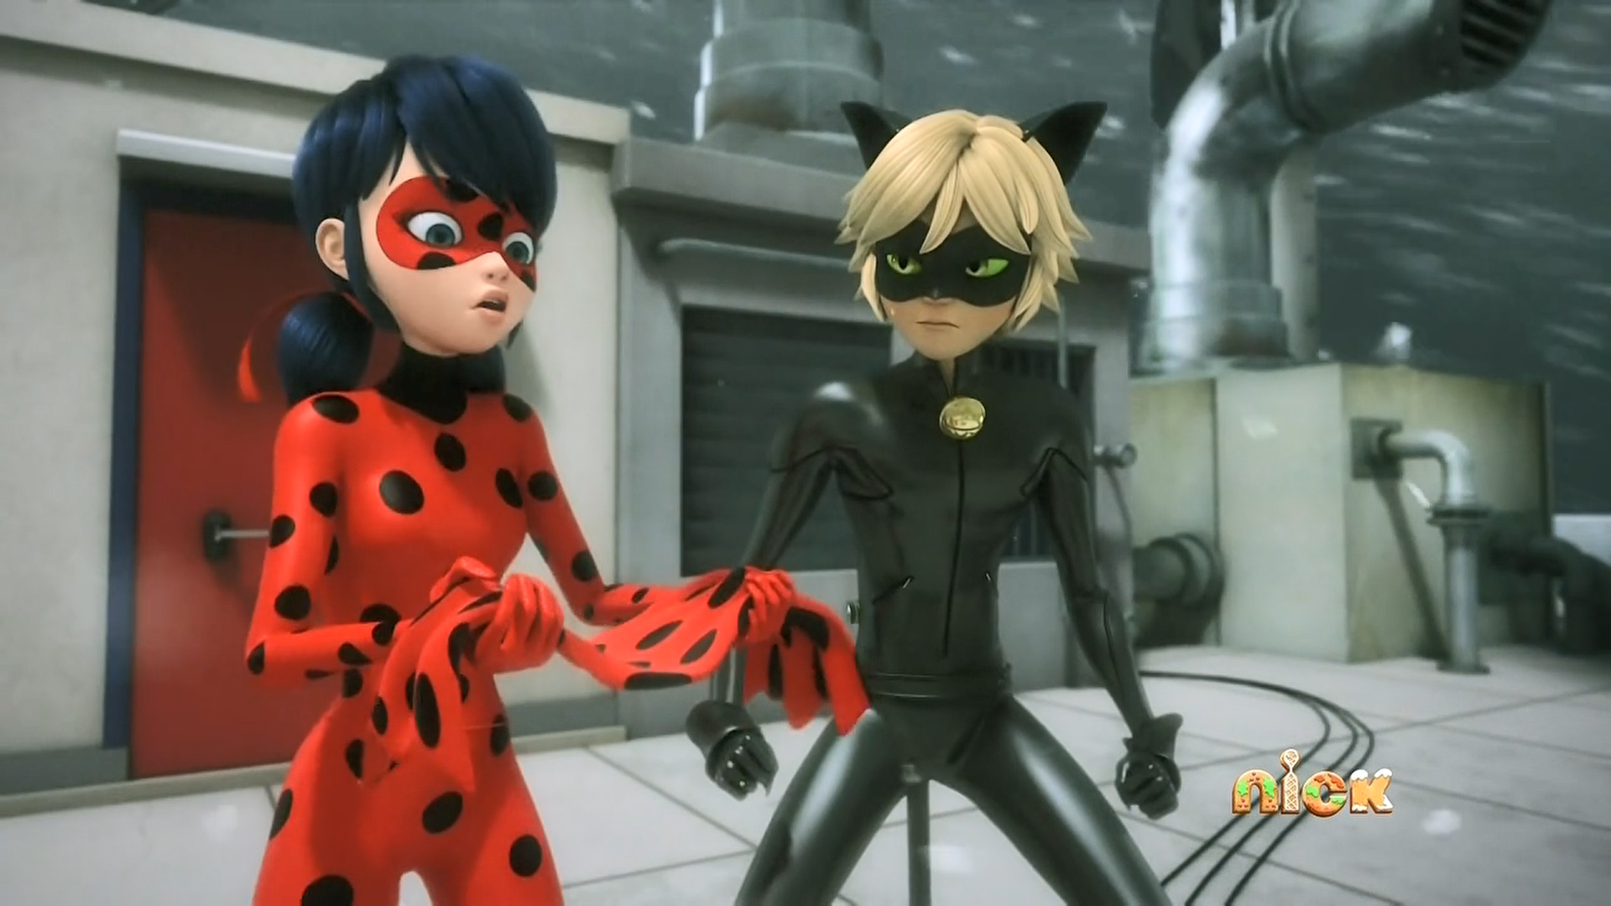
A ______ towel? What am I supposed to do with this?
bath
tea
hand

Slide 13
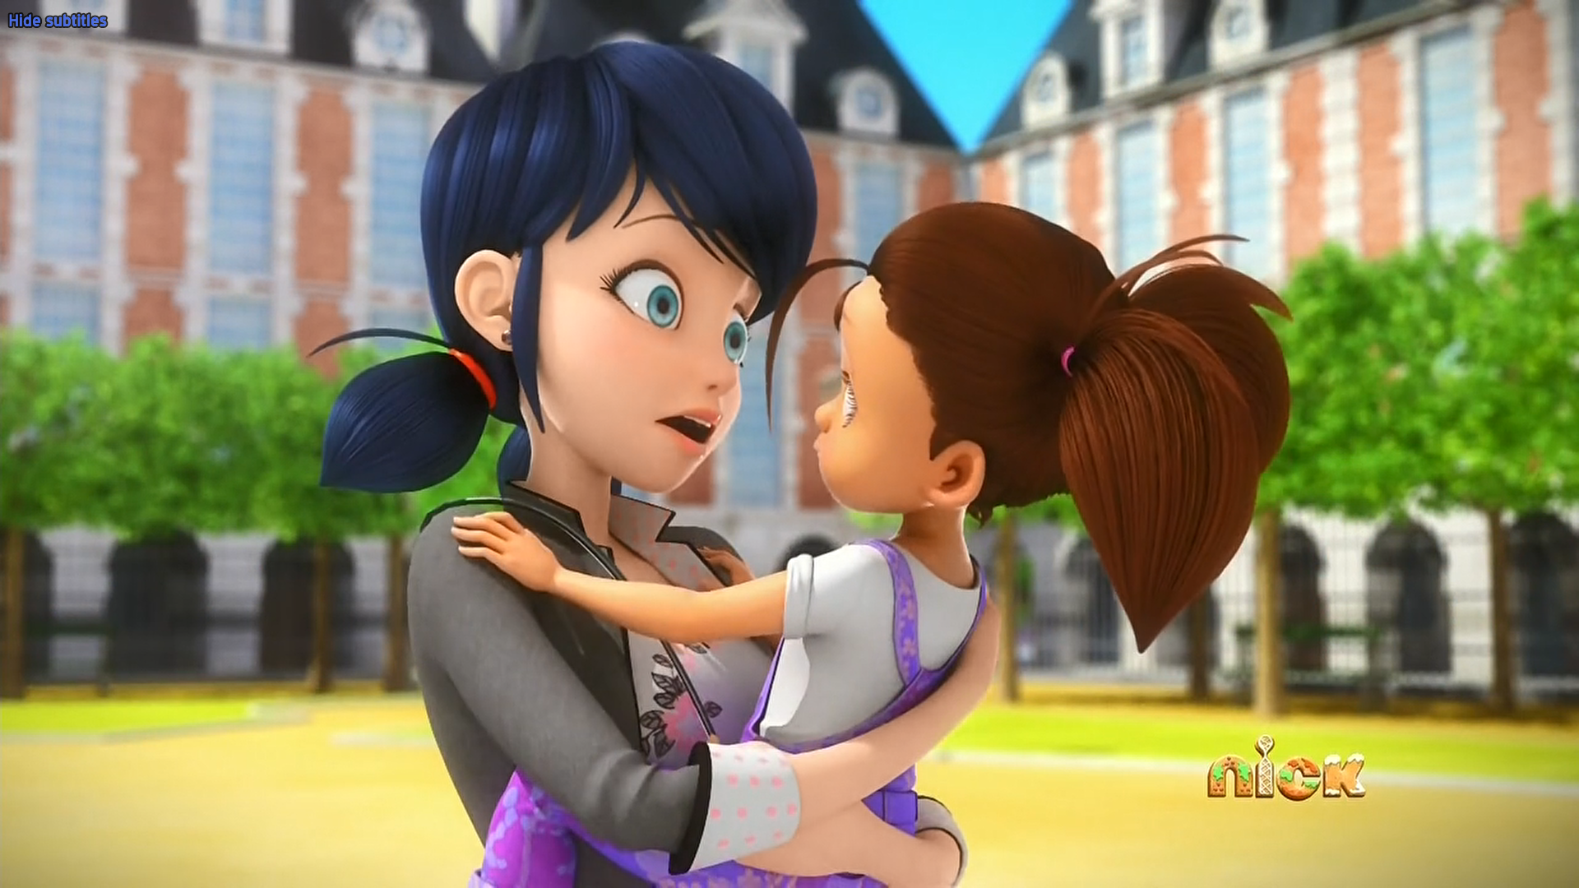
I know what your ______ is.
name
age
secret

Slide 14

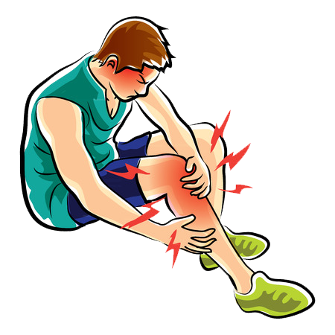

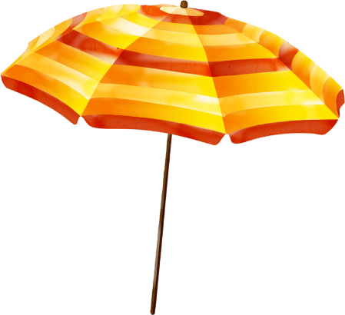
Matching Exercise
butterfly | parasol | cramp | temperature

Slide 15
Matching Exercise
cramp | butterfly | temperature | parasol

Slide 16
TRUE OR FALSE
1. It's the first day of spring.
2. Ladybug and Cat Noir know who Stormy Weather is.
3. Ladybug has a bath towel.
4. Manon wants ice-cream.
5. Manon is in the photoshoot with Adrien.

Slide 17
TRUE OR FALSE
1. It's the first day of spring. | FALSE
2. Ladybug and Cat Noir know who Stormy Weather is. | TRUE
3. Ladybug has a bath towel. | TRUE
4. Manon wants ice-cream. | FALSE
5. Manon is in the photoshoot with Adrien. | TRUE

Slide 18
IELTS Speaking Exam. Noise. Part 1
Do you live in a noisy area?
Would you like to live in a quieter place?
Where are the noisiest places in your country?

