Slide 1
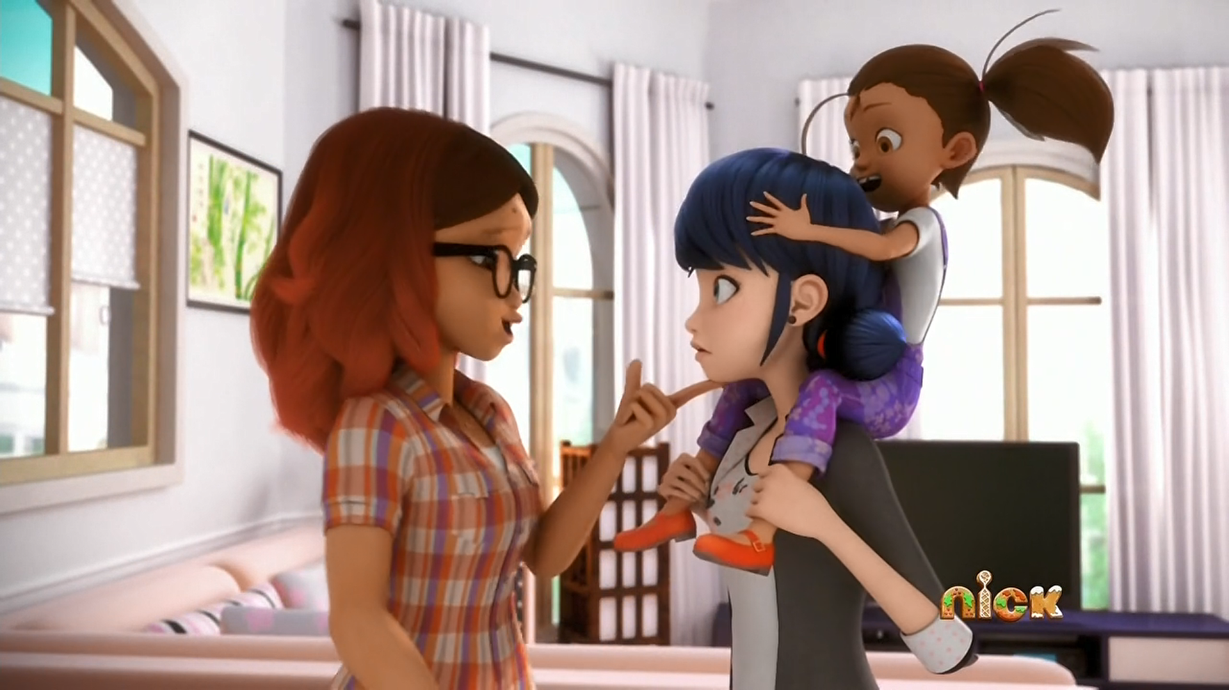
MIRACULOUS LADYBUG: STORMY WEATHER. PART 1

Slide 2
VOCABULARY
disguised - 伪装的 - dɪsˈgaɪzd
favour - 青睐 - feɪvə
freak - 怪物 - friːk
mythical - 神话 - mɪθɪkəl
photoshoot - 照片拍摄 - photoshoot
pushover - 俯卧撑 - pʊʃˌəʊvə
responsible - 负责任的 - rɪsˈpɒnsəbl
stormy - 暴风雨 - stɔːmi
wish - 希望 - wɪʃ

Slide 3
1. 伪装的
2. 照片拍摄
3. 暴风雨
4. 希望

Slide 4
1. 伪装的 - disguised
2. 照片拍摄 - photoshoot
3. 暴风雨 - stormy
4. 希望 - wish

Slide 5
STORMY WEATHER
Marinette: Alya?
Alya: Hey, I got a huge scoop for you. Guess who's on a photoshoot in the park?
Marinette: Now? Adrien is in the park right now?
Alya: As we speak!
Marinette: Oh, gosh! What...what am I gonna say to him?

Slide 6
Marinette: Come on. We're gonna stroll over there real cool as if we just happened to be passing by.
Alya: Then what?
Marinette: Then? I'll invite him out for a fruit smoothie at the end of the photo shoot! Then, we'll get married! Live happily ever after in a beautiful house and have two kids? No, three. And a dog! Maybe a cat?

Slide 7
Manon: I want to go on the merry-go-round!
Marinette: No, no, no, no, not right now,
I gotta get back to Adrien...
Manon: Is that boy your boyfriend?
Marinette: What?! No, I mean, yes? No!
Alya: Go on! What are you waiting for?!
Marinette: But, what about Manon?

Slide 8
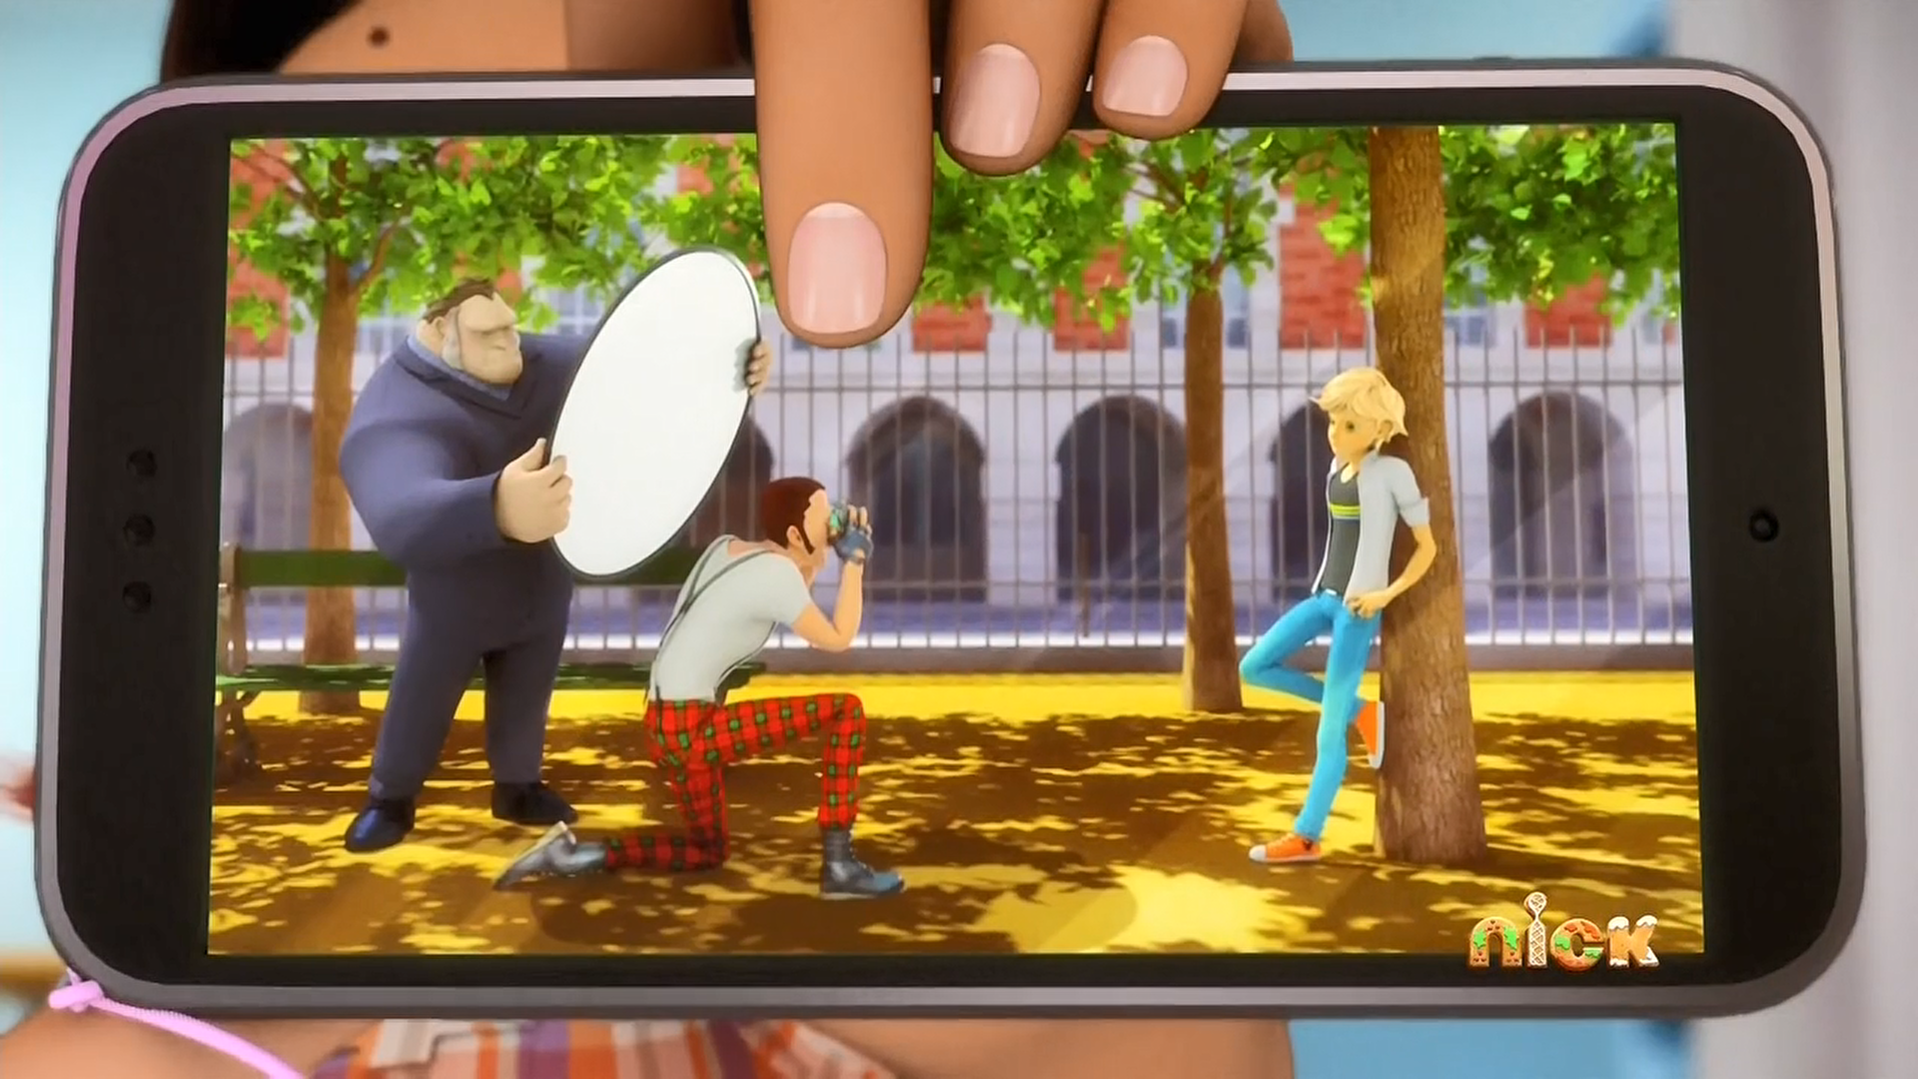
Guess who's on a photoshoot in the ______?
mall
school
park

Slide 9
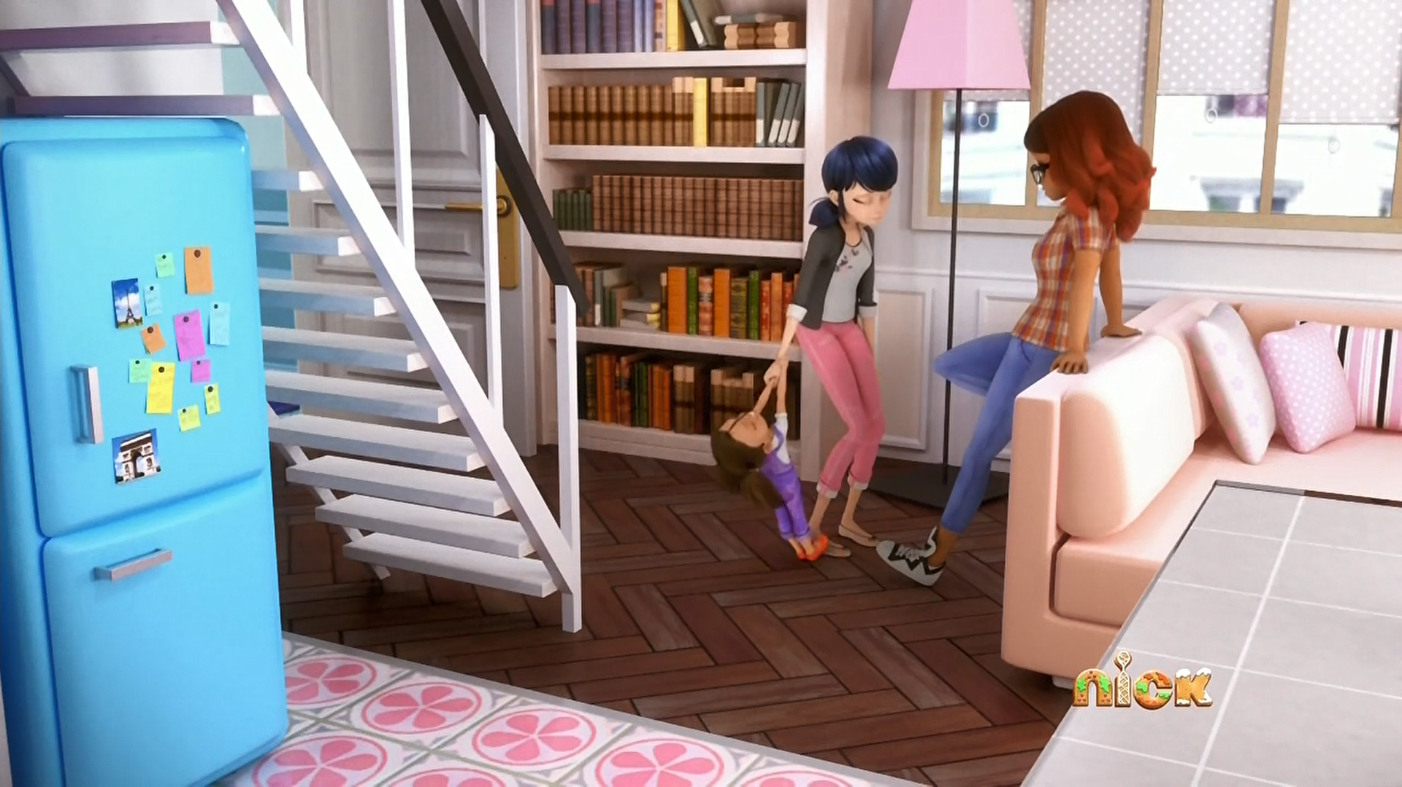
I have to ______ my sisters all the time.
babysit
feed
wash

Slide 10
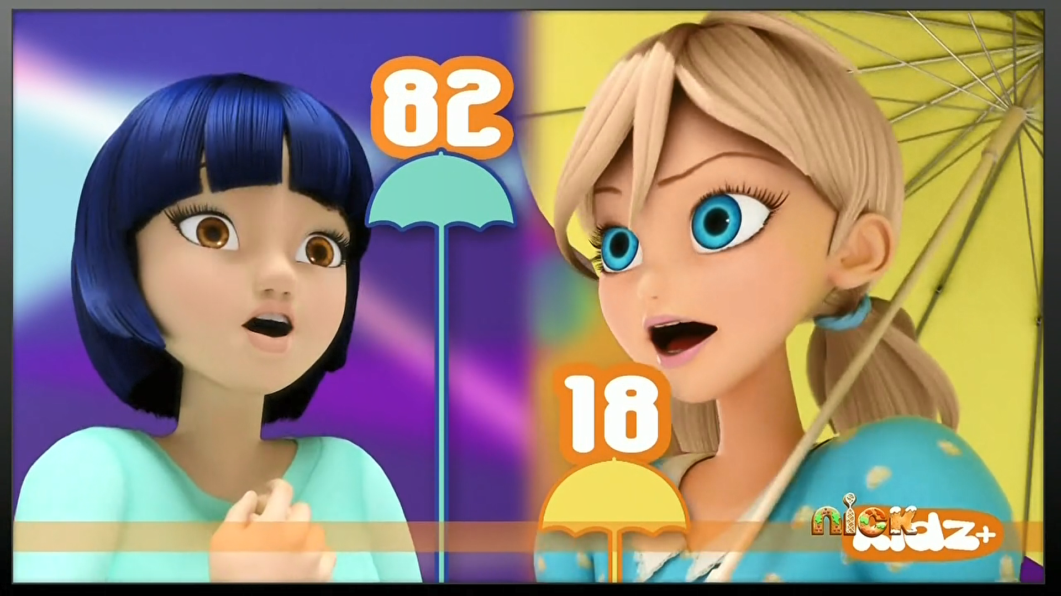
The new KIDZ+ ______ girl is... Mireille!
school
weather
dancing

Slide 11
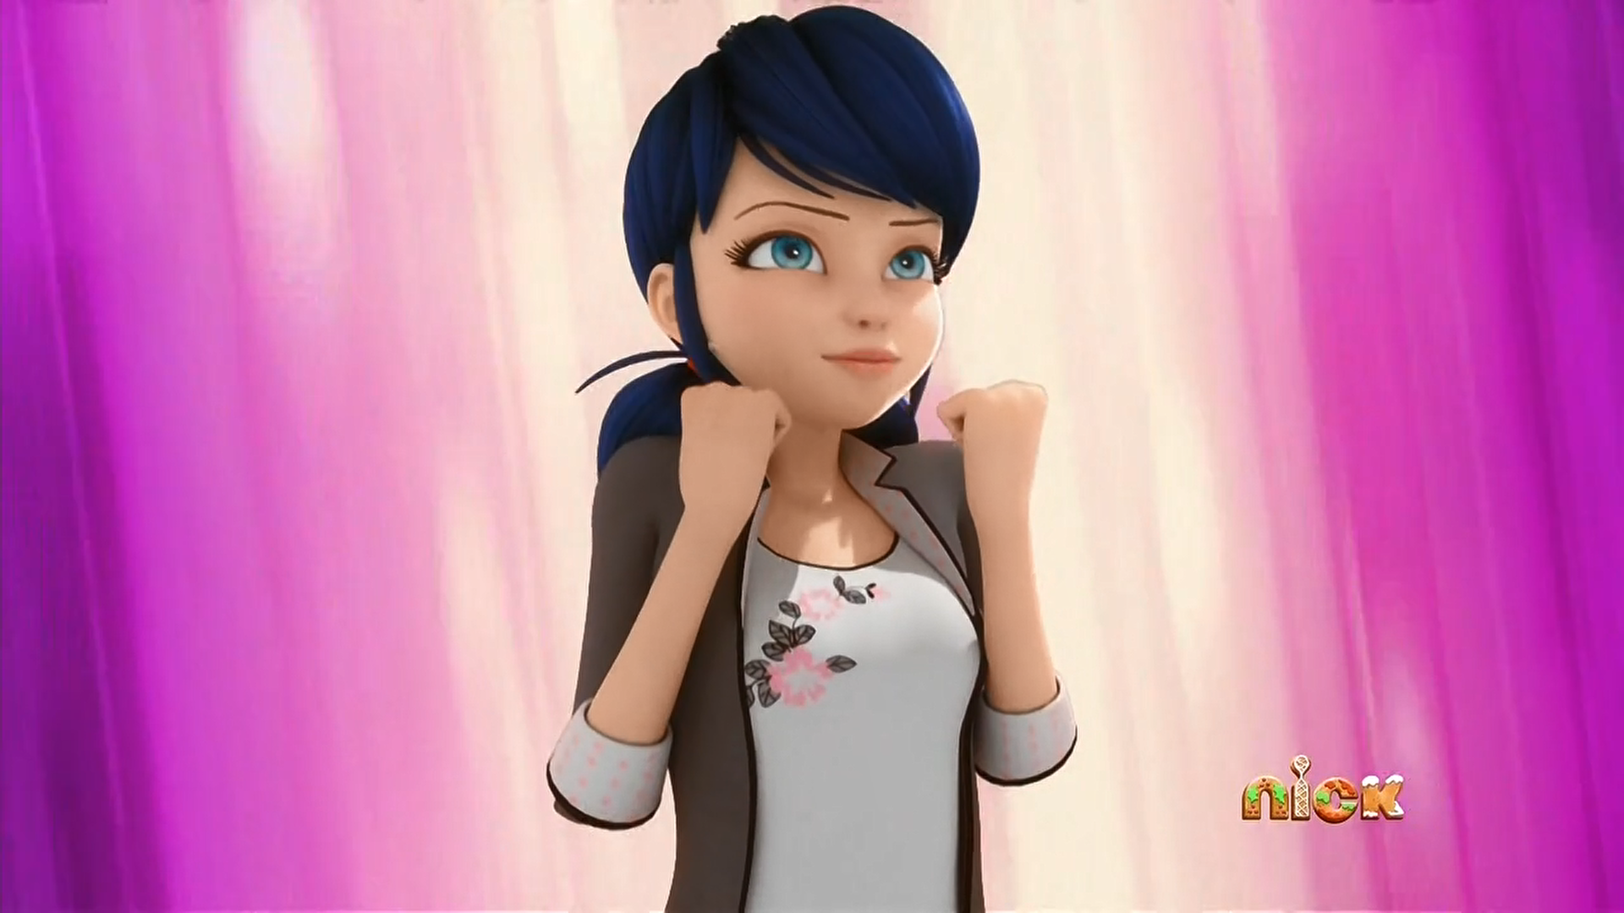
I'll invite him out for a fruit ______ at the end of the photo shoot!
ice cream
smoothie
milkshake

Slide 12
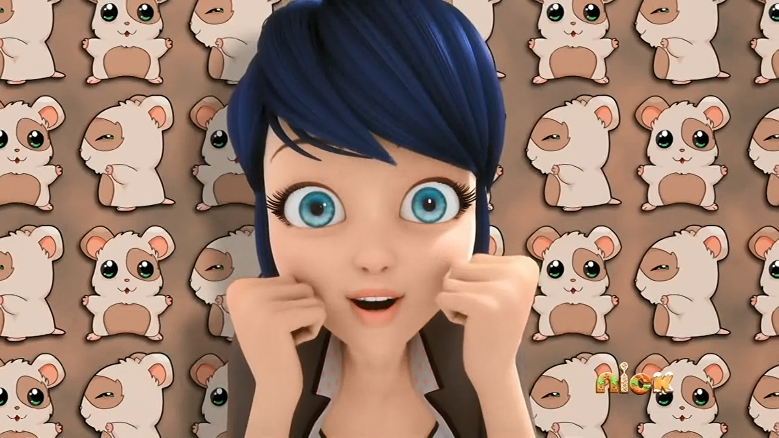
And a dog! Maybe a cat? Nah, forget the cat. A ______!
hamster
mouse
rat

Slide 13
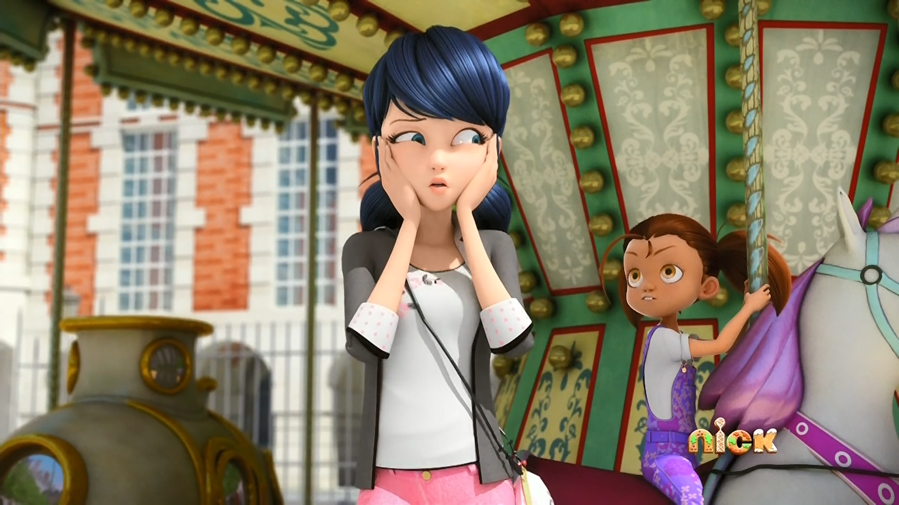
Is that boy your ______?
dad
husband
boyfriend

Slide 14




Matching Exercise
babysitter | unicorn | photoshoot | wish

Slide 15
Matching Exercise
wish | photoshoot | unicorn | babysitter

Slide 16
TRUE OR FALSE
1. Manon is the daughter of Marinette's mother's friend.
2. Aurore won the weather girl contest.
3. Alya wants to invite Adrien to dinner.
4. Marinette wants to marry Adrien.
5. Alya loves hamsters.

Slide 17
TRUE OR FALSE
1. Manon is the daughter of Marinette's mother's friend. | TRUE
2. Aurore won the weather girl contest. | FALSE
3. Alya wants to invite Adrien to dinner. | FALSE
4. Marinette wants to marry Adrien. | TRUE
5. Alya loves hamsters. | FALSE

